Slide 1





Embedded
Systems

Slide 2
Content
What are embedded system
Components
Comparison of Various Software Architecture
Application
Challenges
Embedded Software Development Tools
Application
Future Trends
Conclusion

Slide 3
Hello!
I am Dhruvi Jasani.
My enrollment number is 20020201244.
Today I will explain about Embedded System.

Slide 4
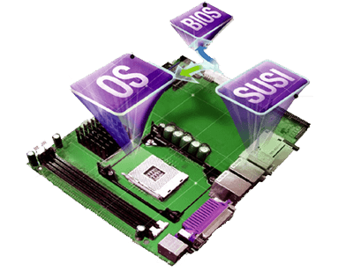
What is Embedded System?
Let’s start with the first set of slides An embedded system is a special purpose computer that is used inside of a device.
A Combination of hardware and software that forms the components of a larger systems.

Slide 5
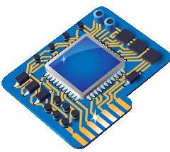
COMPONENTS
Embedded hardware :- It mainly consists of a microcontroller with various peripheral IC’s.
Embedded RTO’S :- All intelligent devices that perform complex functions have an embedded operating system inside.

Slide 6
Device drivers :- The software that acts as a glue between the operating system and the peripheral device is called the device driver.
Communication stacks :- If the embedded device is capable of communicating to the external world, it has a communication software stack running on the top of operating system.
Embedded application :- It performs the predefined function of the embedded device.

Slide 7
COMPARISON OF VARIOUS SOFTWARE ARCHITECTURE
 | PRIORITIES AVAILABLE | WORST RESPONSE TIME FOR TASK CODE | STABILITY OF RESPONSE WHEN THE CODE CHANGES | SIMPLICITY
ROUND ROBIN | None | Execution time for all the task code. | Poor. | Very simple
ROUND ROBIN WITH INTERRUPTS | Interrupts routines in priority order,then the task code in priority order. | Total of execution time for all the task code (plus the execution time for the interrupt routines). | Good for interrupt routines, poor for task code. | Very simple.
FUNCTION QUEUE SCHEDULING | Interrupts routines in priority order,then all the task at same priority. | Execution time for the longest function( plus execution time for the interrupt routines). | Relatively good. | Must deal with data shared between interrupts routines and task code.
REAL TIME OPERATING SYSTEMS | Interrupts routines in priority order. | Zero (plus execution time for routines). | Very good. | More complex.

Slide 8
TOOL CHAIN FOR EMBEDDED SOFTWARE
C & C++ FILES
ASSEMBLY FILES (TARGET ASSEMBLY LANGUAGE)
CROSS COMPILER
CROSS ASSEMBLER
OBJECT FILES (MAYBE ANY FORMAT)
OBJECT FILE (MAYBE ANY FORMAT)
LINKER/ LOCATORS
EXECUTABLE FILE (OF ANY STANDARD FORMAT)
TARGET SYSTEM

Slide 9
Challenges
the challenge is to provide affordable, highly integrated devices meeting stringent requirements for safety, security, reliability, availability and at the same time keeping the cost low.
Precise engineering and design.
Low in cost.
High performance.
Careful selection of chips.
Efficiency.

Slide 10
Application
Automatic teller machines.
Cellular telephone and telephone switches.
Handheld calculators.
Household appliances including washing machine, television sets, microwave ovens, etc.

Slide 11
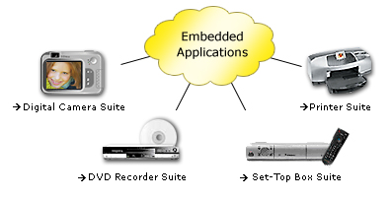

Slide 12
Automatic teller machines.
Cellular telephone and telephone switches.
Handheld calculators.
Household appliances including washing machine, television sets, microwave ovens, etc.
Inertial guidance systems in aircraft and missiles,

Slide 13
Multifunction wristwatches.
Medical equipment.
Programmable digital assistants (PDA’s).
Measurement equipment's like oscilloscopes, logic analyzers and spectrum analyzers.
Programmable logic controllers (PLC’s).

Slide 14
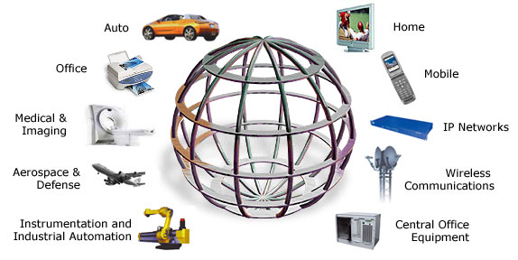
Embedded Global

Slide 15
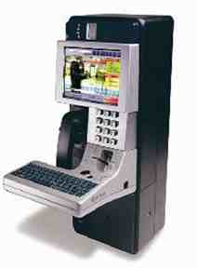
E-millennium
E-millennium is the public communication for the 21st Century. It offers superior multi-pay voice access in combination with powerful, yet user-friendly web applications.
Users can check e-mail, get stock quotes, make on-line purchases, even cruise the Internet, all while talking on the phone.
A built-in Ethernet data port provides the additional option of high-speed web access through a laptop computer.
Extensive testing to meet FCC and CSA telecommunication requirements was required for this device.

Slide 16
Stasia Satellite Ground station
Wavix has developed an inexpensive two-way satellite communication system specifically to support remote data collection and e-mail services.
It is designed as an economical, high-throughput alternative to fill the niche between low-cost, low-throughput systems like Argos, GOES, and Orbcomm, and high-cost, very high-throughput systems like Inmarsat and Intelsat.
Wavix operates its Satellite System in cooperation with Volunteers in Technical Assistance and Satellite non-profit organizations providing health and technology support to people in developing countries.

Slide 17
Future Trends
Adaptive cruise control
Telemedicine
Security
Tele-matics
Bluetooth applications

Slide 18
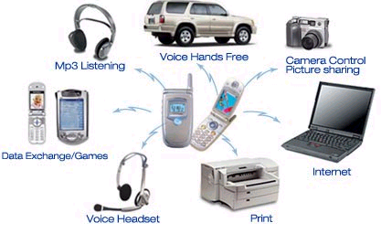
BLUETOOTH AS AN APPLICATION OF EMBEDDED SYSTEM

Slide 19
Conclusion
The world of embedded systems is a dreamer’s paradise with unlimited possibilities.
It make controlling all the systems around just by a simple gesture and the things respond to you as if it was some magic.
As microprocessors are becoming smaller and cheaper, more and more products are becoming ‘smart’ with microprocessors embedded in them.

Slide 20

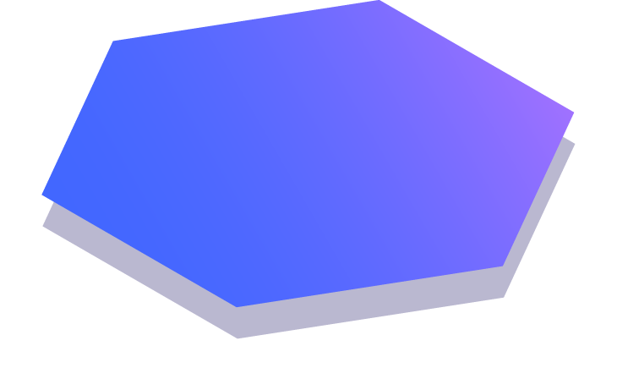
Thanks!

