Slide 1
EMR: Spark

Slide 2
Agenda
Introduction
RDD / Dataframe /Dataset
Architecture
Transformations / Actions
Hands on
Spark JVM memory layout
Optimizations or spark tunning
Troubleshooting
Spark UI

Slide 3
What is Spark?
Apache Spark is a cluster computing framework for large-scale data processing.
Spark does not use MapReduce as an execution engine; instead, it uses its own distributed runtime for executing work on a cluster.
Spark is closely integrated with Hadoop: it can run on YARN and works with Hadoop file formats and storage backends like HDFS.
In memory processing
Keep large working datasets in memory between jobs.
This capability allows Spark to outperform the equivalent MapReduce workflow, where datasets are always loaded from disk.
2 styles of application that benefit greatly from Spark’s processing model are;
Iterative algorithms - a function is applied to a dataset repeatedly until an exit condition is met
Interactive analysis - a user issues a series of ad hoc exploratory queries on a dataset
DAG-based engine
Unlike MapReduce, Spark’s DAG engine can process arbitrary pipelines of operators and translate them into a single job for the user.
Notes:
https://spark.apache.org/

Slide 4
Spark vs MapReduce
In-memory capabilities
Can be upto 100x faster than MR
Developer friendly with multi-language support: Scala, Python, Java & R
SparkSQL for DB developers
Great for streaming data and real-time data processing

Slide 5
RDDs, DataFrames, and Datasets
RDDs
DataFrames
Datasets

Slide 6
RDD: Resilient Distributed Dataset
Distributed collection of immutable elements
Primary data abstraction in Spark
RDD Characteristics
Resilient – Immutable and are self recovered in case of failure
Distributed - Partitioned across many nodes in the cluster
Dataset - Could be textfiles, jsonfiles, DB, parquetfiles, etc.
Cacheable – Persist the data inside RDD in memory (Recommended)
Lazy evaluated - the data inside RDD is not available or transformed until an action is executed that triggers the execution.

Slide 7
Create RDDs Programmatically
There are 3 ways of creating RDDs;
From an in-memory collection of objects (parallelizing a collection)
Using a dataset from external storage (such as HDFS)
Transforming an existing RDD
Example: Parallelized Collections
Here is how to create a parallelized collection holding the numbers 1 to 5:
val data = Array(1, 2, 3, 4, 5)
val distData = sc.parallelize(data)

Slide 8
RDD Operations
Spark provides two categories of operations on RDDs;
Transformations
Apply a function and generate new RDD partitions based on the output
Do NOT have an immediate effect; they are lazy, in the sense that they don’t perform any work until an action is performed on the transformed RDD
e.g.) map, filter, flatMap, groupByKey, repartition, etc.
Actions
Return a result of a function as output to a screen, file, etc.
Have an immediate effect
e.g.) collect, count, take, saveAsTextFile, etc.

Slide 9
When to use RDDs?
You want low-level transformation and actions and control on your dataset;
Your data is unstructured, such as media streams or streams of text;
You want to manipulate your data with functional programming constructs than domain specific expressions;
You don’t care about imposing a schema, such as columnar format, while processing or accessing data attributes by name or column; and
You can forgo some optimization and performance benefits available with DataFrames and Datasets for structured and semi-structured data.
Notes:
https://databricks.com/blog/2016/07/14/a-tale-of-three-apache-spark-apis-rdds-dataframes-and-datasets.html

Slide 10
DataFrame
Like an RDD;
A DataFrame is an immutable distributed collection of data.
Unlike an RDD;
A data is organized into named columns, like a table in a relational database.
Designed to make large data sets processing even easier
DataFrame allows developers to impose a structure onto a distributed collection of data
Higher-level abstraction
It provides following a domain specific language API to manipulate your distributed data.
It makes Spark accessible to a wider audience, beyond specialized data engineers.

Slide 11
Create DataFrames
There are 3 ways of creating DataFrames;
From existing RDD
From Hive table
From Spark data sources
Example:
Here is how to create a dataframe based on the content of a JSON file:
val df = spark.read.json("examples/src/main/resources/people.json")
df.show()
// +----+-------+
// | age| name|
// +----+-------+
// |null|Michael|
// | 30| Andy|
// | 19| Justin|
// +----+-------+
Notes:
https://spark.apache.org/docs/latest/sql-programming-guide.html#creating-dataframes

Slide 12
DataFrame Operations
// Select only the "name" column
df.select("name").show()
// +-------+
// | name|
// +-------+
// |Michael|
// | Andy|
// | Justin|
// +-------+
// Select everybody, but increment the age by 1
df.select($"name", $"age" + 1).show()
// +-------+---------+
// | name|(age + 1)|
// +-------+---------+
// |Michael| null|
// | Andy| 31|
// | Justin| 20|
// +-------+---------+
// Select people older than 21
df.filter($"age" > 21).show()
// +---+----+
// |age|name|
// +---+----+
// | 30|Andy|
// +---+----+
// Count people by age
df.groupBy("age").count().show()
// +----+-----+
// | age|count|
// +----+-----+
// | 19| 1|
// |null| 1|
// | 30| 1|
// +----+-----+
Notes:
https://spark.apache.org/docs/latest/sql-programming-guide.html#creating-dataframes

Slide 13
Dataset
Starting in Spark 2.0, Dataset takes on two distinct APIs characteristics:
A strongly-typed API
An untyped API
Conceptually, consider DataFrame as an alias for a collection of generic objects Dataset[Row], where a Row is a generic untyped JVM object.
Dataset, by contrast, is a collection of strongly-typed JVM objects, dictated by a case class you define in Scala or a class in Java.
Language | Main Abstraction
Scala | Dataset[T] & DataFrame (alias for Dataset[Row])
Java | Dataset[T]
Python | DataFrame
R | DataFrame
Notes:
https://databricks.com/blog/2016/07/14/a-tale-of-three-apache-spark-apis-rdds-dataframes-and-datasets.html

Slide 14
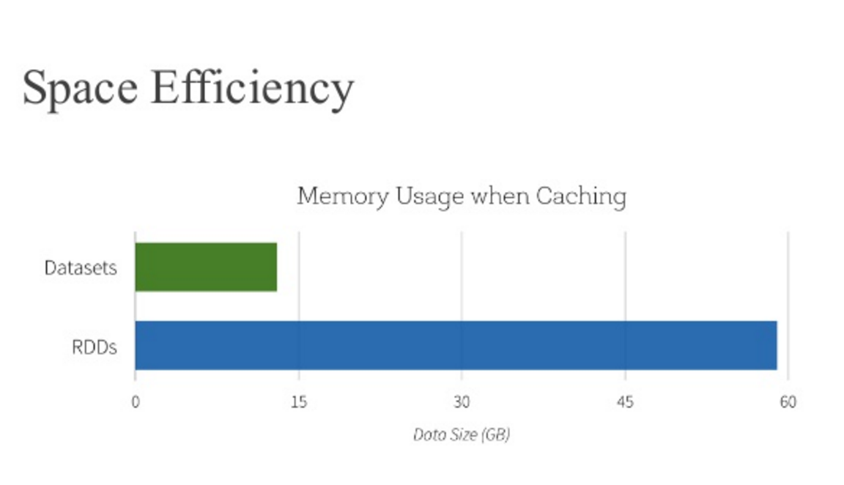
Benefits of Dataset APIs
Static-typing and runtime type-safety
High-level abstraction and custom view into structured and semi-structured data
Ease-of-use of APIs with structure
Performance and Optimization
Notes:
https://databricks.com/blog/2016/07/14/a-tale-of-three-apache-spark-apis-rdds-dataframes-and-datasets.html

Slide 15
Create Datasets
case class Person(name: String, age: Long)
// Encoders are created for case classes
val caseClassDS = Seq(Person("Andy", 32)).toDS()
caseClassDS.show()
// +----+---+
// |name|age|
// +----+---+
// |Andy| 32|
// +----+---+
//SvaD Encoders for most common types are automatically provided by importing spark.implicits._
val primitiveDS = Seq(1, 2, 3).toDS()
primitiveDS.map(_ + 1).collect() // Returns: Array(2, 3, 4)
// DataFrames can be converted to a Dataset by providing a class. Mapping will be done by name
val path = "examples/src/main/resources/people.json"
val peopleDS = spark.read.json(path).as[Person]
peopleDS.show()
// +----+-------+
// | age| name|
// +----+-------+
// |null|Michael|
// | 30| Andy|
// | 19| Justin|
// +----+-------+
Notes:
https://spark.apache.org/docs/latest/sql-programming-guide.html#creating-dataframes

Slide 16
Spark SQL
Spark SQL is a Spark module for structured data processing.
Unlike the basic Spark RDD API, the interfaces provided by Spark SQL provide Spark with more information about the structure of both the data and the computation being performed.
Internally, Spark SQL uses this extra information to perform extra optimizations.
There are several ways to interact with Spark SQL including SQL and the Dataset API.
When computing a result the same execution engine is used, independent of which API/language you are using to express the computation.
This unification means that developers can easily switch back and forth between different APIs based on which provides the most natural way to express a given transformation.
Notes:
https://spark.apache.org/docs/latest/sql-programming-guide.html

Slide 17
Spark REPL Shells
Spark REPL Shell provides an interactive way to learn Spark, explore data, and debug applications.
Available for Scala and Python
REPL: Read Evaluate Print Loop
$ spark-shell
$ pyspark

Slide 18
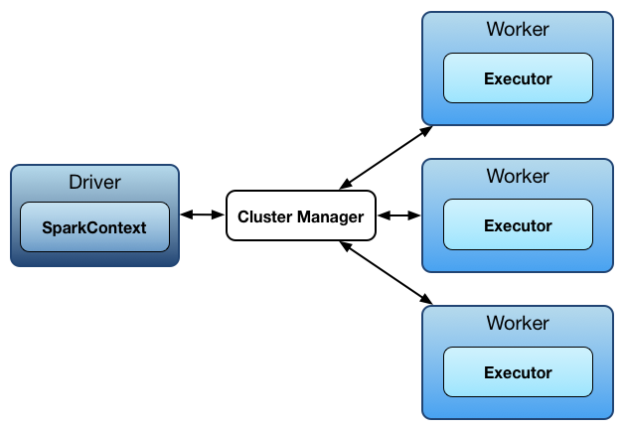

Spark Architecture
Spark uses a master/worker architecture.
There is a driver that talks to a single coordinator called master that manages workers in which executors run.
Notes:
https://jaceklaskowski.gitbooks.io/mastering-apache-spark/spark-architecture.html

Slide 19
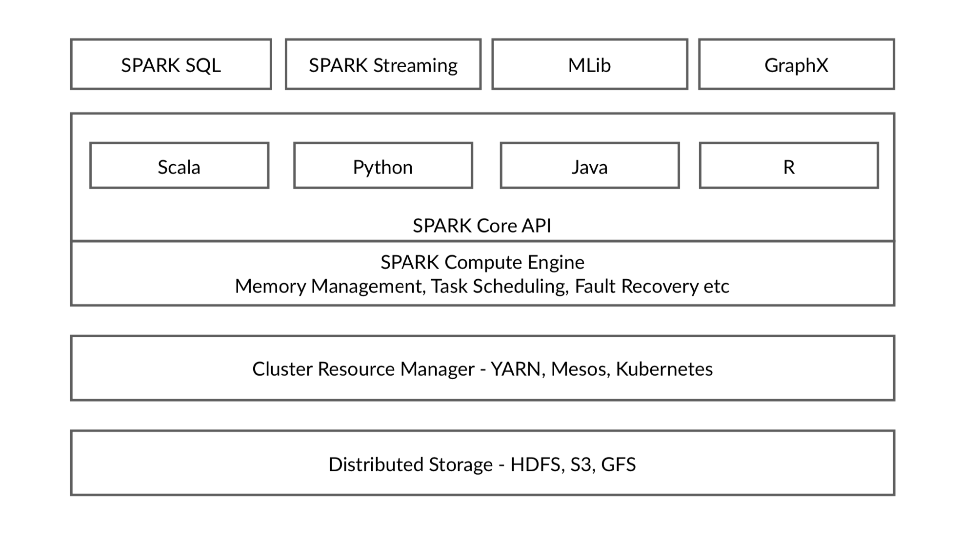

Slide 20
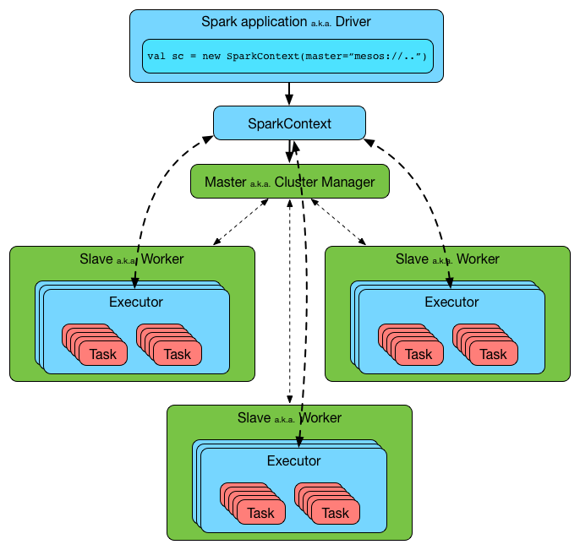
Spark Architecture Details
The driver and the executors run in their own Java processes.
You can run them all on the same (horizontal cluster) or separate machines (vertical cluster) or in a mixed machine configuration.
Notes:
https://jaceklaskowski.gitbooks.io/mastering-apache-spark/spark-architecture.html

Slide 21
Spark Driver
Driver
Contains the main() function
Spark REPLs are Spark driver programs
Creates SparkContext/SparkSession and uses it to access Spark
Manages writing and displaying log files
Driver will be a single point of failure
When running YARN client applications

Slide 22
SparkContext
Driver
Manages the connection to Spark
Contacts YARN ResourceManager to launch Spark Executors
Schedules tasks for Spark Executors
Automatically creates as sc by a REPL at startup
SparkContext

Slide 23
SparkSession
Introduced in Spark 2.0
A new entry point to programming Spark with the Dataset and DataFrame API
SparkConf, SparkContext or SQLContext are encapsulated within the SparkSession.

Slide 24
Spark Executors
Responsible for all application workload processing
The “workers” of a Spark application with SparkContext serving as the “master”
Exist for the life of the application
Interchangeable workspaces
Tasks assigned to a lost executor will be reassigned
Data lost will be recomputed on another executor
Behavior and performance can be controlled programmatically

Slide 25
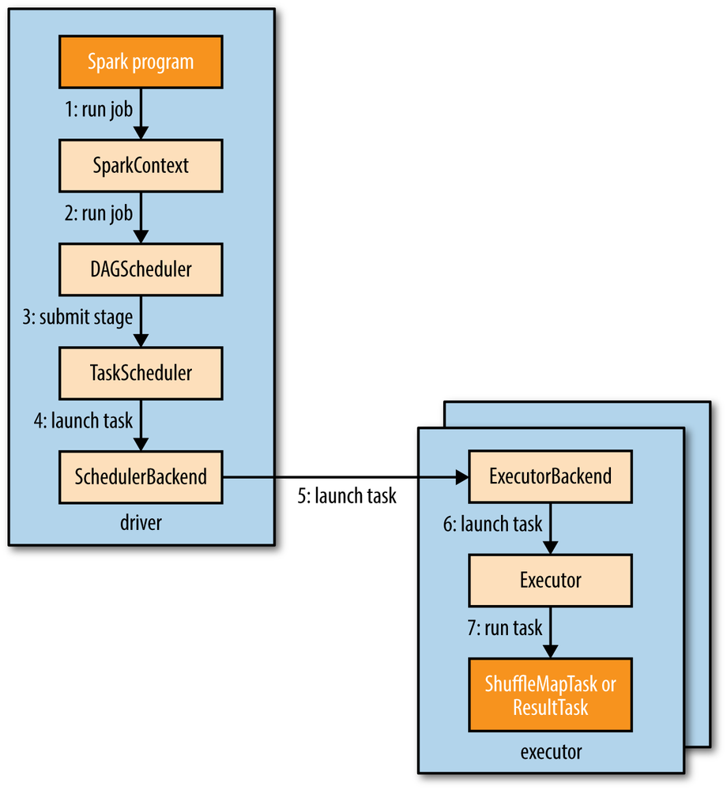
Spark Job Run Details
A Spark job is submitted automatically when an action (such as count()) is performed on an RDD
SparkContext passes the call on to the scheduler that runs as a part of the driver
Once the DAG scheduler has constructed the complete DAG of stages, it submits each stage’s set of tasks to the task scheduler
Assigned tasks are launched through a scheduler backend
Scheduler backend sends a remote launch task message
Executor backend tells the executor to run the task
Executor runs the task

Slide 26
Spark deploy modes in YARN
You can specify whether to deploy your driver on the worker nodes (cluster) or locally as an external client (client) when you launch Spark application.
Client mode
Spark driver is ran locally.
Cluster mode
Spark driver is launched in YARN container.

Slide 27
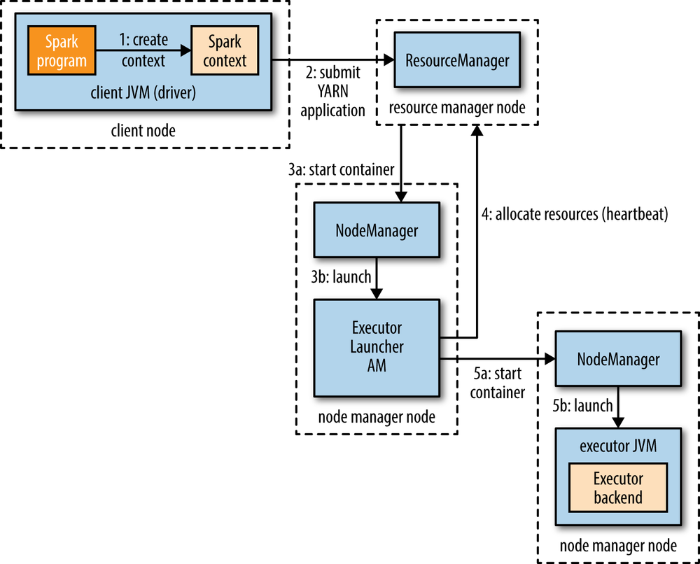

YARN Client mode
The Driver runs in the client process.
The Application Master is only used for requesting resources from YARN.
You can find Spark driver log in stdout of spark-submit command.

Slide 28
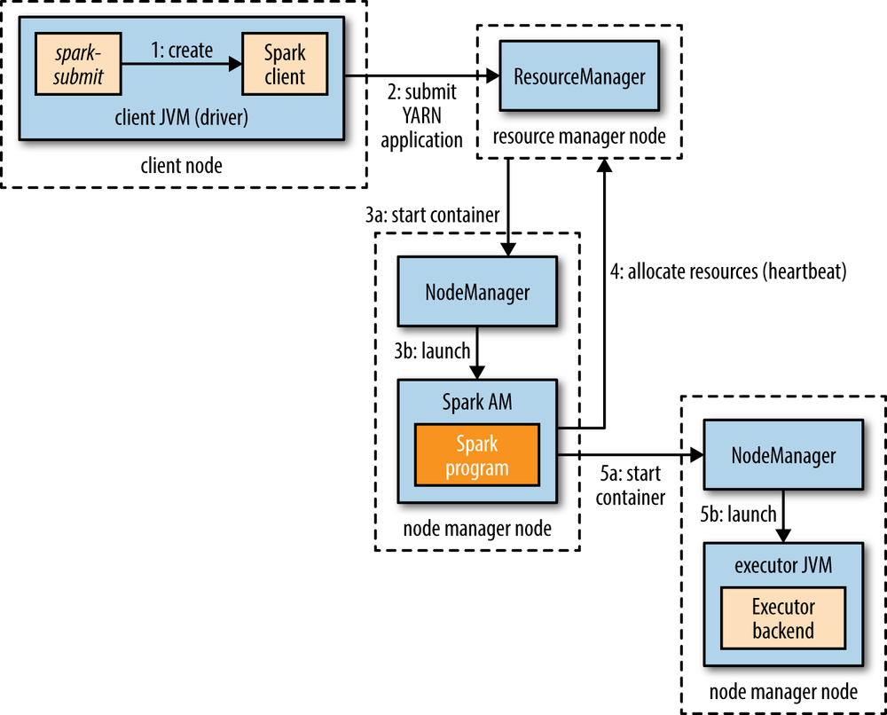
YARN Cluster mode
The Driver runs inside an Application Master process launched in YARN container
You can find Spark driver log in the Yarn container #1.

Slide 29
Client mode vs Cluster mode
When to use client mode
Small cluster
Not so small master node
Single application
When to use cluster mode
Not so small cluster
Multiple applications
Need high availability

Slide 30
Default Spark Setting in EMR
Spark defaults set in EMR:
Setting | Description | Value
spark.executor.memory | Amount of memory to use per executor process | Setting is configured based on the slave instance types in the cluster.
spark.executor.cores | The number of cores to use on each executor | Setting is configured based on the slave instance types in the cluster.
spark.dynamicAllocation.enabled | Whether to use dynamic resource allocation, which scales the number of executors registered with an application up and down based on the workload. | true (emr-4.4.0 or greater)
Notes:
http://docs.aws.amazon.com/emr/latest/ReleaseGuide/emr-spark-configure.html

Slide 31
Maximize Resource Allocation in EMR
Configure executors to utilize the maximum resources possible on each node in a cluster.
There will be 1 executor as large as possible (reserving some room for other processes on the host) on each of the CORE+TASK nodes (or 2 executors total on a 1 or 2-node cluster)
Spark defaults set when maximizeResourceAllocation is enabled:
Setting | Description | Value
spark.default.parallelism | Default number of partitions in RDDs returned by transformations | 2x number of CPU cores available to YARN containers
spark.driver.memory | Amount of memory to use for the driver process | Setting is configured based on the master/slave instance types in the cluster.
spark.executor.memory | Amount of memory to use per executor process | Setting is configured based on the slave instance types in the cluster.
spark.executor.cores | The number of cores to use on each executor | Setting is configured based on the slave instance types in the cluster.
spark.executor.instances | The number of executors | Setting is configured based on the slave instance types in the cluster. Set unless spark.dynamicAllocation.enabled explicitly set to true at the same time.
Notes:
http://docs.aws.amazon.com/emr/latest/ReleaseGuide/emr-spark-configure.html
https://w.amazon.com/index.php/Aws157/Bigtop/Spark/ResourceAllocation

Slide 32
Dynamic Allocation of Executors
Static Allocation of Executors
The number of executors can be configured in following settings;
The command-line flag --num-executors of spark-submit command
spark.executor.instances configuration property
Dynamic Allocation of Executors
Spark on YARN has the ability to scale the number of executors used for a Spark application dynamically.
In releases 4.4.0 or greater, this is the default behavior.
Notes:
https://spark.apache.org/docs/latest/configuration.html#dynamic-allocation

Slide 33
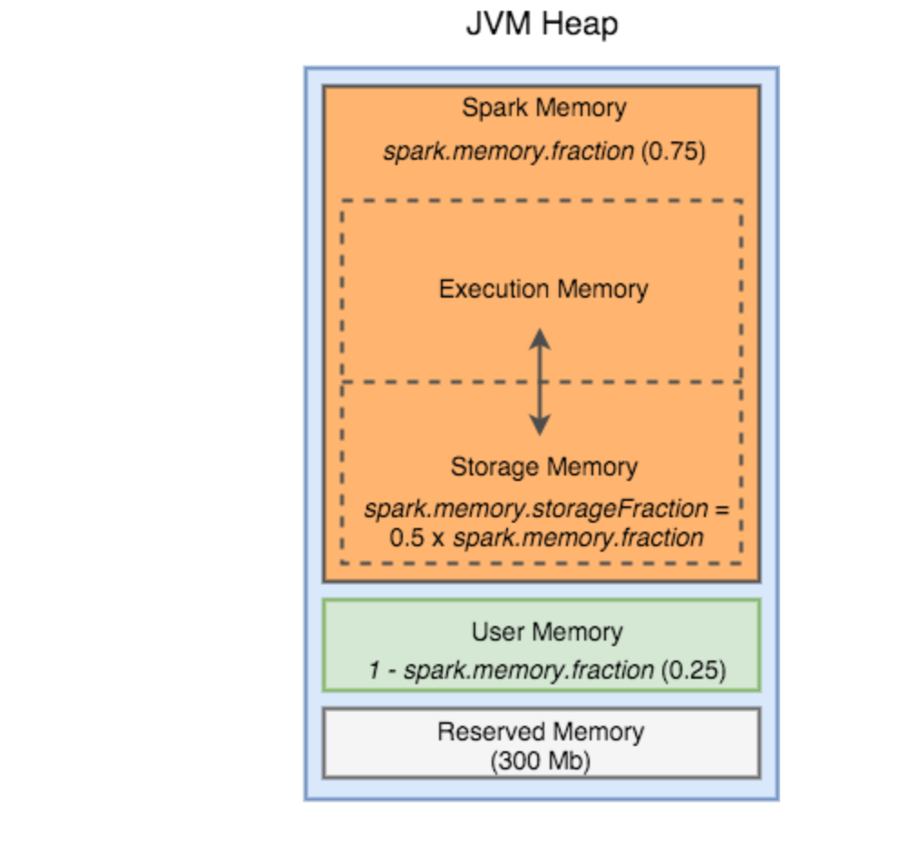
Spark memory model

Slide 34
Spark SQL Optimzer

Slide 35
Spark optimization/Tunning
Determining the number of executors
Large executors vs small executors:
Shuffles
Scale or tunning Driver/Executors/Shufle service.

Slide 36
Troubleshooting
Yarn application logs
Spark UI ( demo )
Df.repartition(1).save()

Slide 37
Thank You
Questions ?

