Slide 1
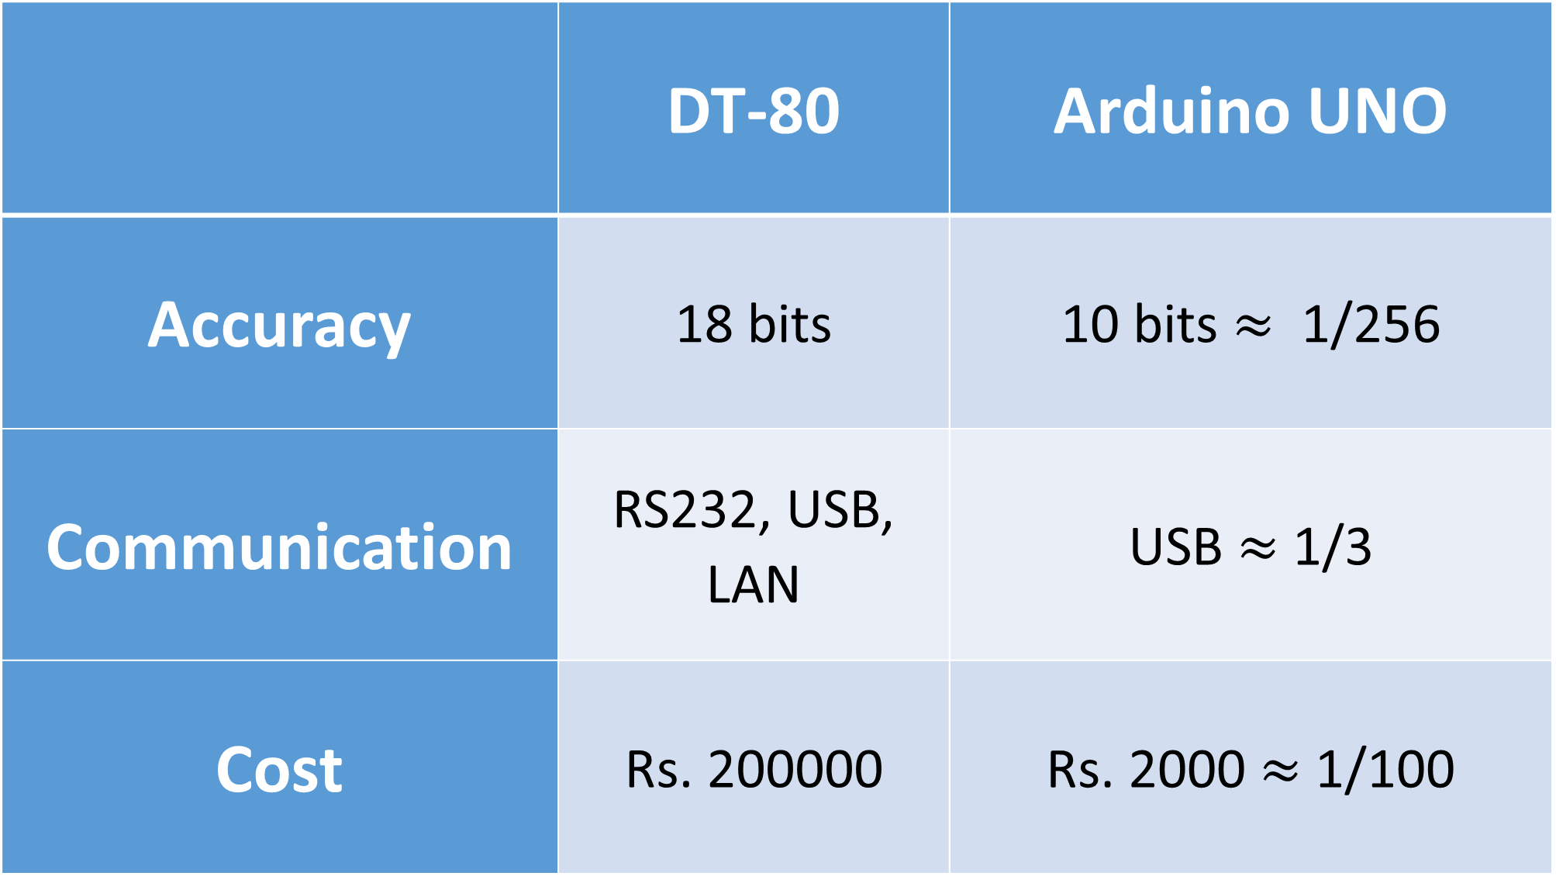
 | DT-80 | Arduino UNO
Accuracy | 18 bits | 10 bits $≈$ 1/256
Communication | RS232, USB, LAN | USB $≈$ 1/3
Cost | Rs. 200000 | Rs. 2000 $≈$ 1/100

Slide 2
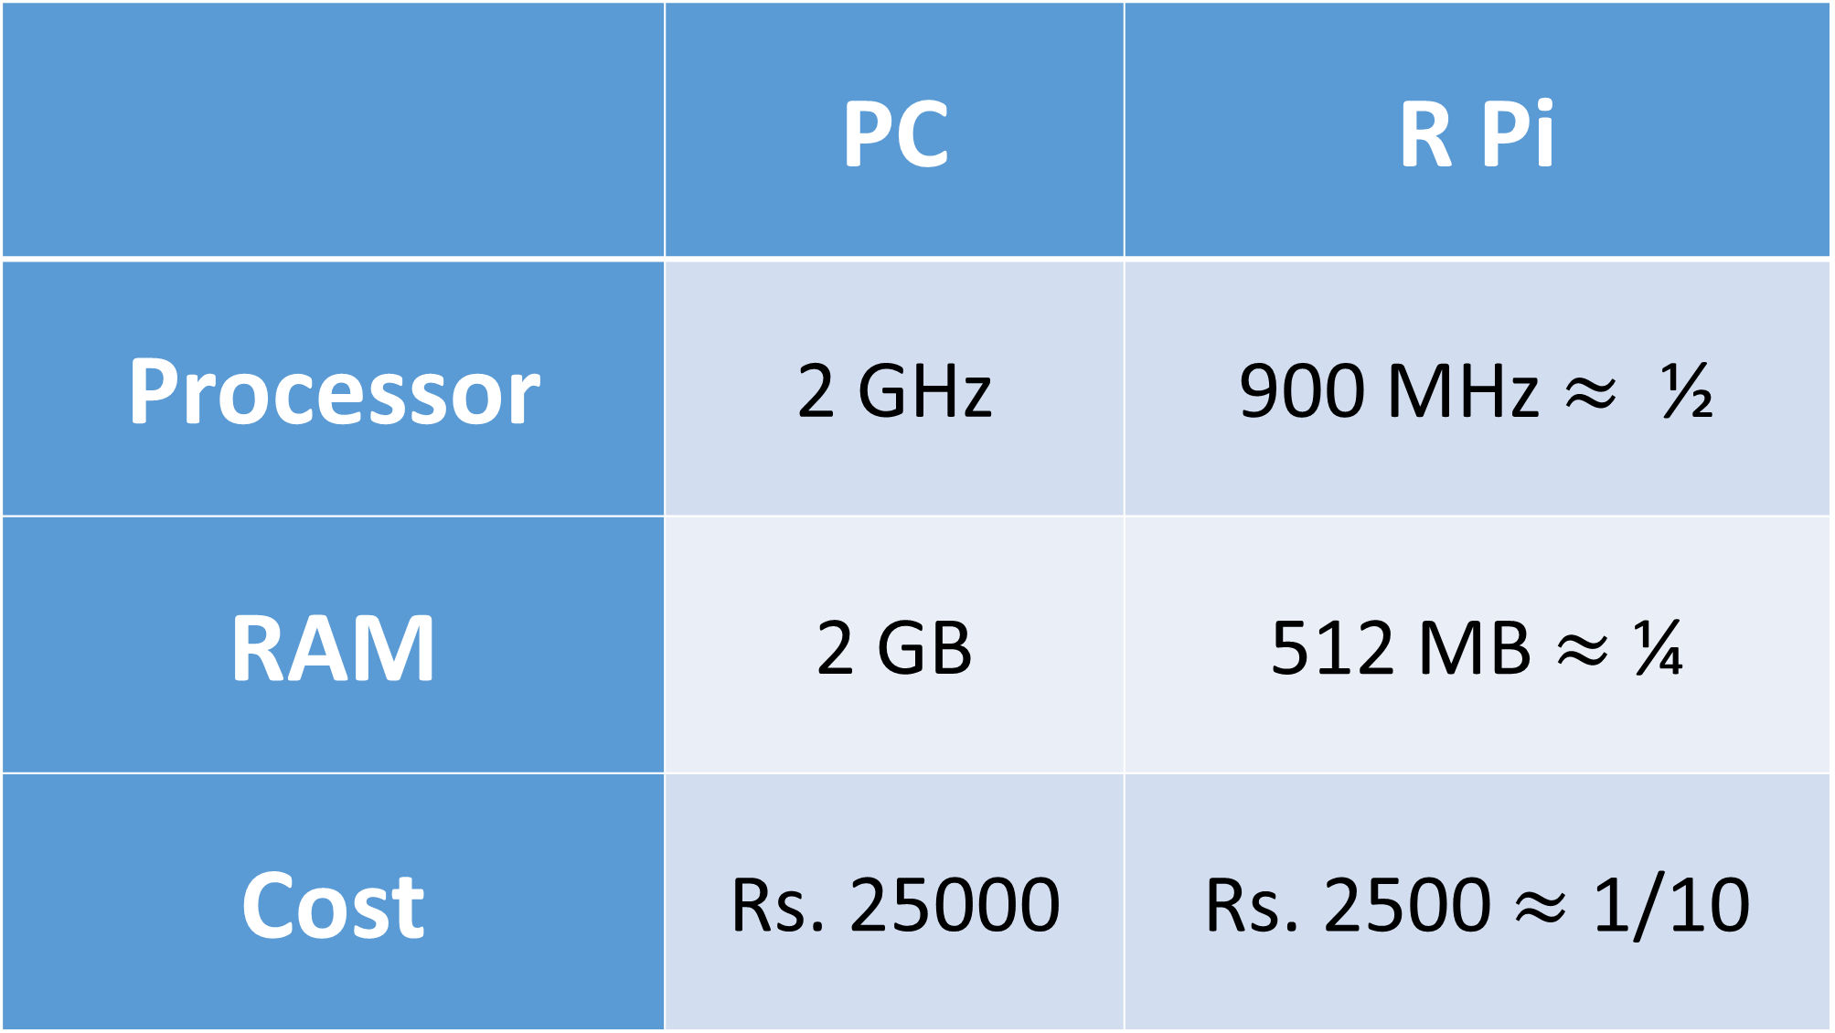
 | PC | R Pi
Processor | 2 GHz | 900 MHz $≈$ ½
RAM | 2 GB | 512 MB $≈$ ¼
Cost | Rs. 25000 | Rs. 2500 $≈$ 1/10

