Slide 1
Chapter 4
PRINCIPLES OF MARKETING
Marketing Research
and
Information Systems

Slide 2

The Importance of Information
Marketing
Environment
Why
Information
Is
Needed
Competition
Customer
Needs
Strategic
Planning
Notes:
The Importance of Information
This CTR relates to the material on p. 99 and provides a context for discussing marketing research and marketing information systems.
Instructor’s Note: This information is extra-textual.
The Importance of Information
A marketing information system is valuable for the information tools it provides in relation to the following areas:
The Marketing Environment. Companies compete in an environment of social, legal, cultural, technological, natural, and competitive forces. Information on each aspect of the environment is crucial to effective market planning.
Discussion Note: You may wish to discuss the role of environmental monitoring or scanning in class. Information gathering can be serendipitous or it can be planned. While not all environmental information needs can be identified in advance, it is possible to approach research and information systems planning with an eye to setting up ways of collecting information in an on-going fashion.
Customer Needs and Wants. If environmental forces cause the company to seek information in a larger context, customer needs and wants focus the attention on the target market. Without information, identifying need and wants is guesswork -- or fortune telling.
Competitors. The actions of competitors cannot go unnoticed by the company. Innovative companies not only identify competitive actions and offerings, they also consume competitors products -- in small quantities of course! For example, to understand the value of a competitors automobile it makes sense to drive it for awhile as a customer would and evaluate it in that fashion.
Strategic Decision Making. Strategy formulation depends upon accurate & timely information most of all.

Slide 3
What is a Marketing
Information System (MIS)?
Consists of people, equipment, and procedures to gather, sort, analyze, evaluate and distribute needed, timely, and accurate information to marketing decision makers.
Function: Assess, Develop and Distribute Information.

Slide 4
The Marketing Information System
Marketing Managers
Distributing
Information
Assessing Information
Needs
Marketing Information System
Information
Analysis
Marketing Environment
Internal
Data
Developing Information
Marketing Decisions and Communications
Marketing
Intelligence
Marketing
Research
Notes:
The Marketing Information System
This CTR corresponds to Figure 4-1 on p. 99 and relates to the material on pp. 99-104.
Discussion Note: The MIS Concept is one of those exciting new areas for marketing careers you may wish to discuss with your students.
Components of the Marketing
Information System
The MIS consists of people, equipment, and procedures to gather, sort, evaluate, and distribute needed, timely, and accurate information to marketing decision makers. Key components and functions include:
Assessing Information Needs. Knowing what is needed or likely to be needed is a key feature of the MIS that underscores the importance of information. Quantity alone is not the answer as too much information can obscure important details. Also, not all desirable information is available. Competitors seldom volunteer information on their results.
Distributing Information. This function requires organizing the MIS in a flexible and responsive manner that allows each user access to the combinations of information they need to make better decisions.
Internal Records. An effective MIS organizes and summaries balance sheets, orders, schedules, shipments, and inventories into trends that can be linked to management decisions on marketing mix changes.
Information Analysis. This function requires that the MIS director anticipate how the information is to be used. For example, if users from all business functions use the MIS on-line for short deadline decisions, then the analytical tools each area needs must be available on demand.
Marketing Intelligence. This function provides the everyday information about environmental variables that managers need as the implement and adjust marketing plans.
Marketing Research. This function links the consumer, customer, and public to the marketer through an exchange of information. Research is often project oriented and discussed in more detail on the following CTR.

Slide 5
Functions of a MIS:
Assessing Information Needs
Conduct Interviews and Determine
What Information is
Desired, Needed, and Feasible to Obtain.
Monitors Environment for Information Managers
Should Have
Examine Cost/ Benefit of Desired
Information

Slide 6
Functions of a MIS:
Developing Information
Obtains Needed Information for Marketing Managers
From the Following Sources
Internal Data
Collection of Information from Data Sources Within the Company
From: Accounting, Sales Force, Marketing, Manufacturing, Sales
Marketing Intelligence
Collection and Analysis of Publicly Available Information about
Competitors and the Marketing Environment
From: Employees, Suppliers, Customers,
Competitors, Marketing Research Companies
Marketing Research
Design, Collection, Analysis, and Reporting of Data about a Situation

Slide 7
Functions of a MIS:
Distributing Information
Information Must be Distributed
to the Right Managers at the Right Time.
Distributes Routine Information for
Decision Making
Distributes Nonroutine
Information for Special
Situations

Slide 8
The Marketing Research
Process
Defining the Problem and the Research Objectives
Developing the Research Plan
Implementing the Research Plan
Interpreting and Reporting the Findings
Notes:
The Research Process
Defining the Problem and Research Objectives. Before researcher can provide managers with information, they must know what kind of problem the manager wishes to solve. Specifying a behaviorally-based information problem clearly is often hard to do. Objectives for research may be exploratory, descriptive, or causal.
Discussion Note: One key is to remind students that people report problem symptoms more often than they identify problems. Objectives for research can only be linked to clear problem definitions.
Developing the Research Plan and Collecting Information. Developing the plan includes the following steps: (1) Determining specific information needs; (2) Surveying secondary information sources; (3) Planning the primary data collection if necessary; (4) Choosing the contact method and sampling procedure appropriate; and (5) Presenting the plan to the client for approval.
Implementing the Plan - Collecting and Analyzing the Data. In implementing the plan care must be taken that all personnel involved in collecting and analyzing data understand clearly the purpose of the research and are adequately trained and experienced to complete it professionally.
Interpreting and Reporting the Findings. Interpreting research findings may involve statistical analyses or not but these tools of analysis should not be confused with the action-oriented information needed by marketing managers. Research is valuable only in its use to make better marketing decisions. Reports of findings should always be in the style and language of how the information will be used by the manager.
The Marketing Research Process
This CTR corresponds to Figure 4-2 on p. 104 and relates to the material on pp. 104-119.
Instructor’s Note: The CTR presents an overview of the research process. Details of each step are presented on subsequent CTR’s.

Slide 9
Marketing Research Process
Step 1. Defining the Problem &
Research Objectives
Exploratory
Research
Gathers preliminary information
that will help define the problem
and suggest hypotheses.
Descriptive
Research
Describes things such as consumers’
attitudes and demographics
or market potential for a product.
Causal
Research
Test hypotheses about cause-
and-effect relationships.
Tests hypotheses about cause-
and-effect relationships.

Slide 10
Marketing Research Process
Step 2. Develop the Research Plan
Determine the Specific Information Needed
Secondary
Primary
Information that has
been previously
collected.
Information collected
for the specific purpose
at hand.
Both Must Be:
Relevant
Accurate
Current
Impartial
Notes:
Secondary Data
Data collected from other sources for other reasons serves as secondary data. Key factors to consider when using secondary information include:
Relevant. Secondary research must fit the needs of the project. It is especially important that categories used previously match the same definitions you are using (like target market). Also, measurement units must be the same.
Teaching Tip: For example, you cannot determine an “average” income from secondary research that reports respondents as having incomes as:
Group 1: $10,000 to $14,999; 10 members
Group 2: $15,000 to $19,999; 20 members
Group 3: $20,000 to $24,999. 7 members
This is categorical, not interval-scaled data. An average cannot be determined.
Accurate. You must be able to determine that the data were reliably collected and reported.
Current. The information must be up-to-date enough for the current project decisions.
Impartial. The information must have been objectively collected and reported.
Discussion Note: Impartiality also refers to ensuring that the researcher had no a priori agenda. For example, the Tobacco Institute continues to fund research projects designed to not find a relationship between cigarette smoking and lung cancer.
This CTR relates to the material on pp. 105-119.
Teaching Tip: Students may not realize research seeks both primary and secondary information for marketing decision making. The need for careful and complete research information requires attention to both kinds of information.

Slide 11
Primary Data Collection Process
Step 1. Research Approaches
Observational Research
Gathering data by observing people,
actions and situations
(Exploratory)
Survey Research
Asking individuals about
attitudes, preferences or
buying behaviors
(Descriptive)
Experimental Research
Using groups of people to
determine cause-and-effect
relationships
(Causal)
Notes:
Primary Data
Decisions on primary information needs include:
Research Approaches. There are three common approaches for gathering primary data.
Observations are linked to actual behaviors but may not help in understanding why people act as they do.
Surveys can help describe reasons for people's behavior and provide the research with flexibility. But surveys can be plagued by problems in completion and demand characteristics from several factors.
Experimental methods help identify cause and effect relationships but controlling for extraneous variables is usually difficult in real world situations.
This CTR relates to information on pp. 109-112.

Slide 12
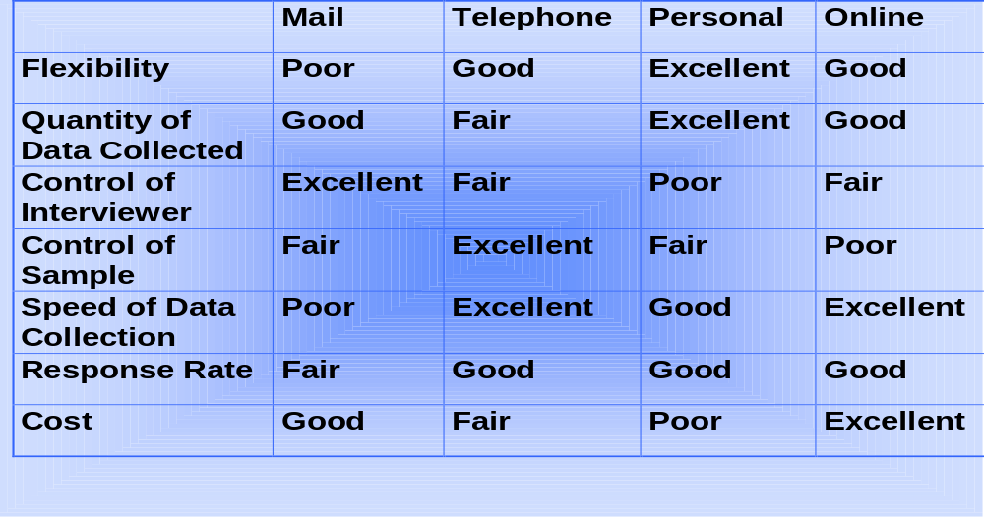
Primary Data Collection Process
Step 2. Contact Methods
Contact Methods
Notes:
Data Collection Methods
Mail Questionnaires. This method provides excellent control over the effects of having an interviewer influencing the respondents answers. Since no interviewer is present, no interpersonal influences are possible. Mail questionnaires may elicit more honest and in-depth information. Discuss with your class the kind of problems that may require this kind of information, such as social marketing issues on health care concerns. Still, lack of ability to distinguish respondents from nonrespondents makes inference to the general population difficult.
Telephone Interviewing. Being able to control the sample and complete the data collection quickly are assets of telephone interviewing. Many marketing contexts, such as person marketing in political campaigns, need almost overnight information on the effectiveness of the latest promotions. Telephone technology can reach diverse geographic markets of interest and can be linked to computers for easy data analysis. Problems with respondent cooperation may becoming increasingly important over time.
Personal Interviewing. Personal interviewing is very flexible and can provide a rich and deep volume of data for the researcher. Also, personal interviewers can follow-up unexpected or unusual responses that other collection methods are not prepared to handle. Using groups in personal interviews can also reveal social influences that may be important in consumer decision making.
Collecting Information
This CTR corresponds to the material in Table 4-3 on p. 112 and relates to the material on pp. 112-114.

Slide 13
Primary Data Collection Process
Step 3. Developing a Sampling Plan
Who is to be
surveyed?
Probability or
Non-probability
sampling?
Sample -
representative
segment of the
population
How should the
sample be
chosen?
How many
should be
surveyed?

Slide 14
Primary Data Collection Process
Step 4. Research Instruments
Research Instruments
Questionnaire
What to ask?
Form of each
  question?
Wording?
Ordering?
Mechanical Devices
People Meters
Grocery Scanners
Galvanometer
Tachistoscope

Slide 15
Marketing Research Process
Step 3. Implementing the Research Plan
Collection
of
Data
Processing of
Data
Research
Plan
Analyzing the
Data

Slide 16
Marketing Research Process
Step 4. Interpreting and Reporting
Findings
Interpret the Findings
Draw Conclusions
Report to Management

