Slide 1



Slide 2

Inefficient use of employee resources
Filling up parking garages inefficiently
Only select garages allow for online reservations
Automating statistics

Slide 3

Professional Website
Create User Account Information
Create reservations online
Valet Assistant Interface
Provides an easy to use interface to quickly collect information and provide notifications to the valet
Apple and Android capabilities
Garage Management System
Assigns lot numbers for maximum occupancy

Slide 4

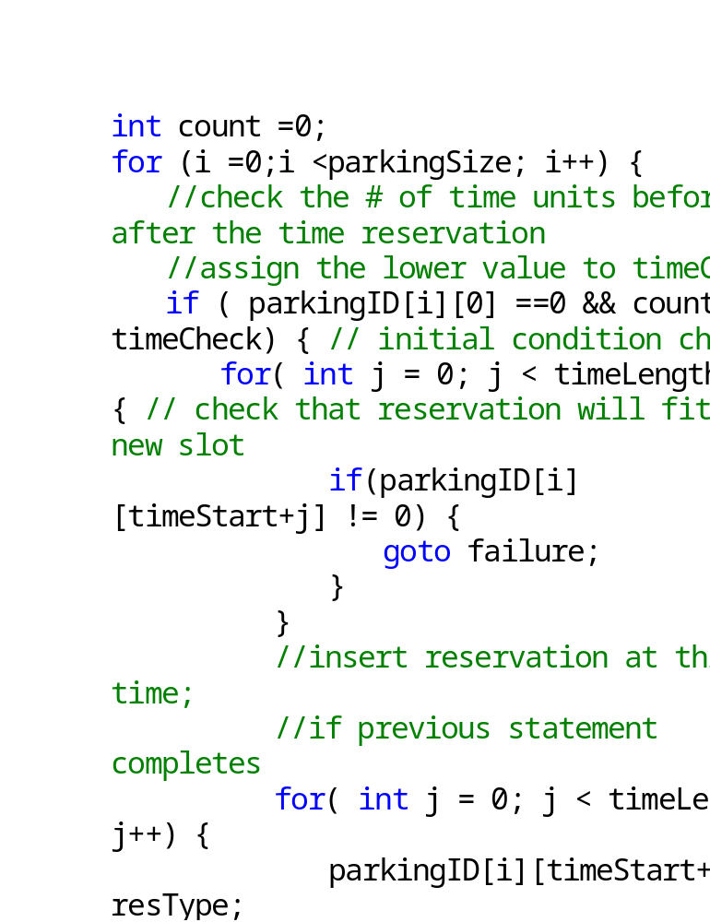
Check space between reservations
Counter to minimize wasted space
Choose optimal reservation to sort

Slide 5

Creating an App for both the customer and the valet
Will reduce customer-employee interaction
Will speed-up the process of parking with a guarantee of no damage done
Creating a Website for customers to reserve spots before hand
Creating an algorithm to optimize ALL THE SPOTS in the parking garage

Slide 6

  Implement a functional map which displays the available spots and the numbe r occupied spots
  Complete implementation of the sorting algorithm
  Have a fully functional reservation system
  Complete Integration Testing
  Have management page (COOKIE implementation)
  More security on website

