Slide 1
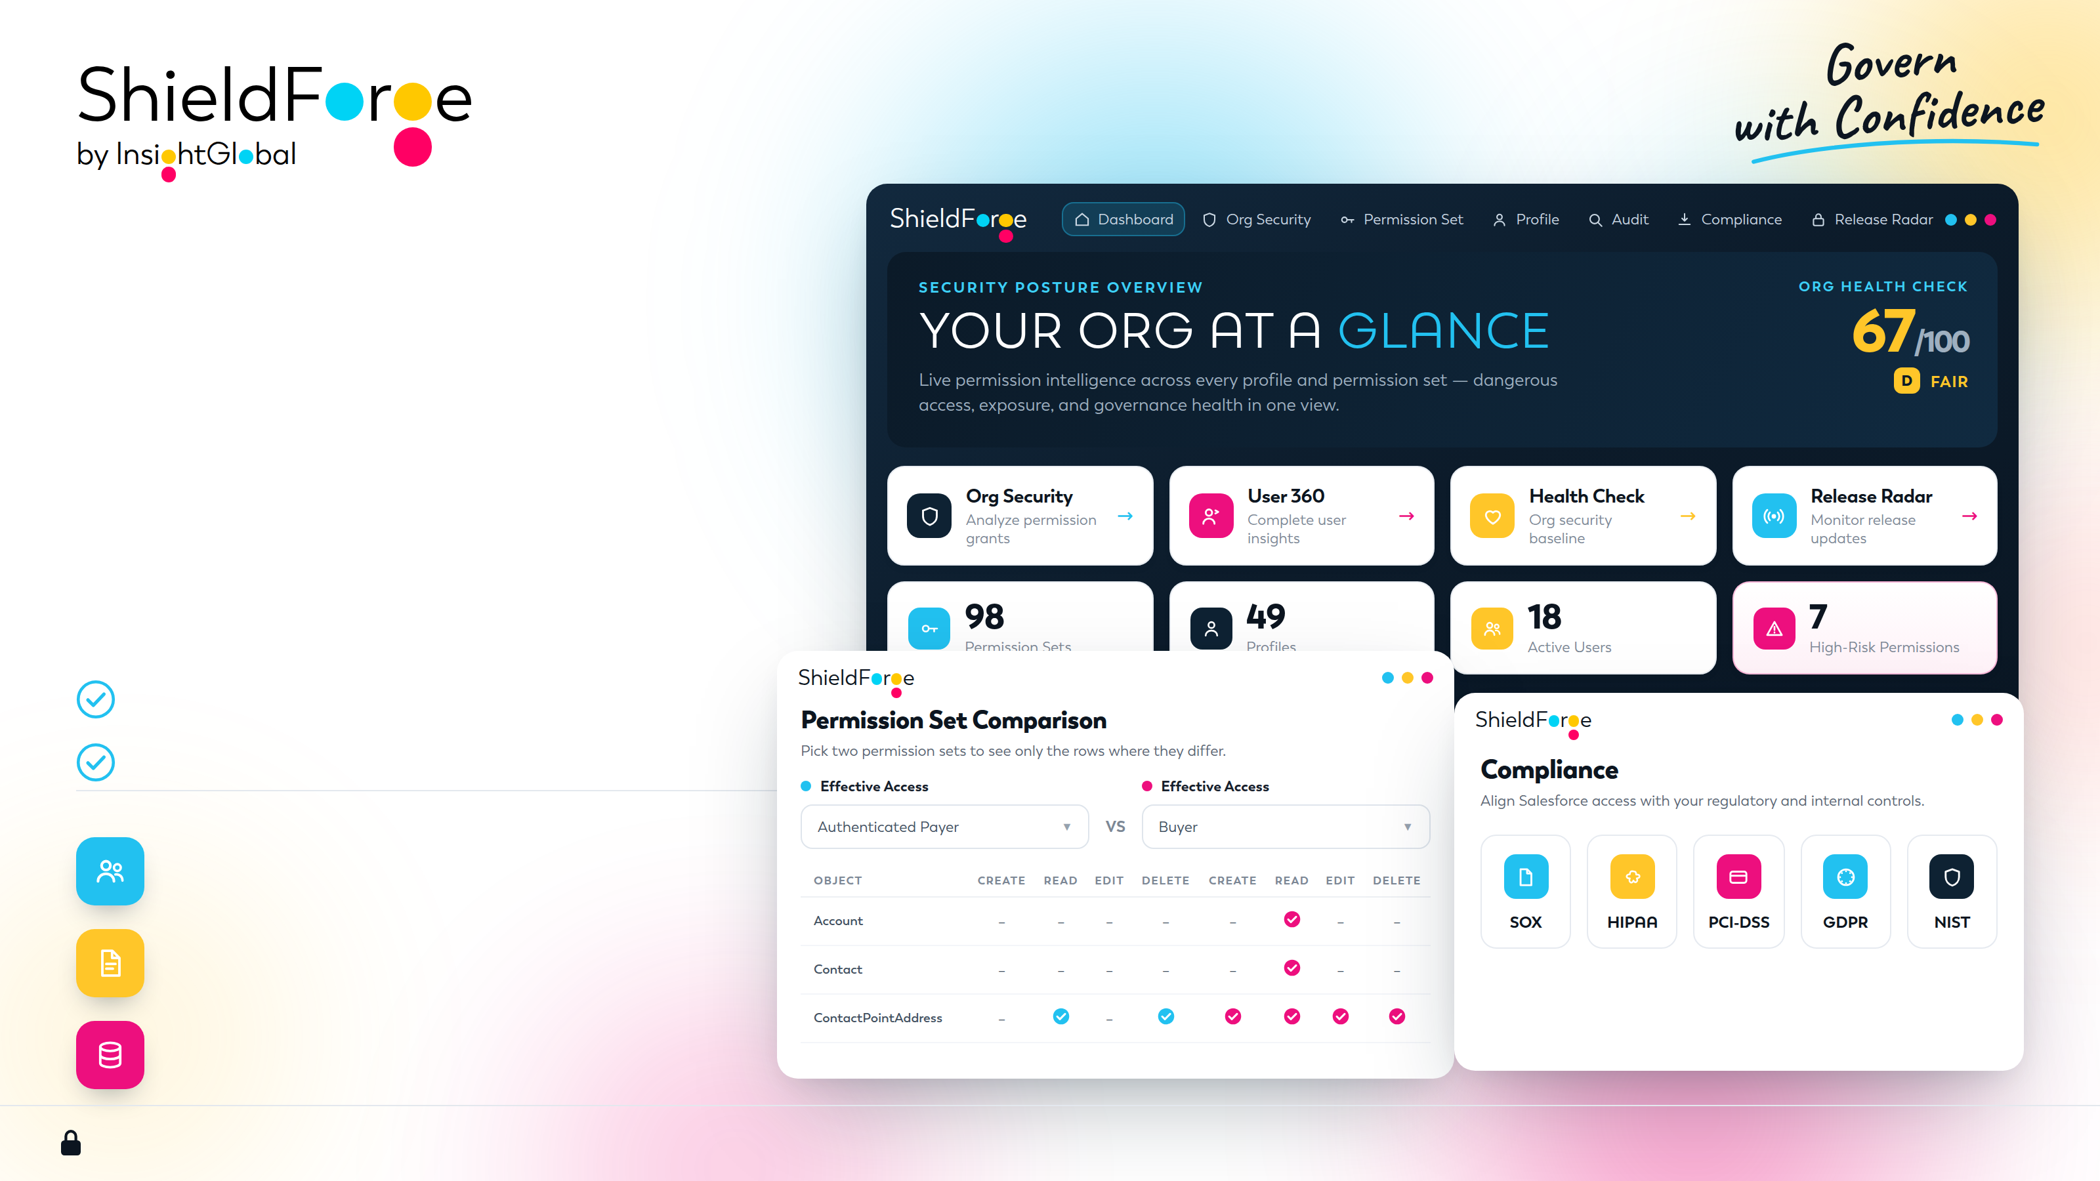
One platform for
Salesforce
governance
Understand user access, assess security risks
and simplify governance within your Salesforce org.
Approved by Salesforce Security Review
Live on AppExchange
Access intelligence
Audit and compliance readiness
Release and storage insights
Illustrative demo view
ShieldForge does not capture, store, or retain customer business data. | Customer data remains within Salesforce.
01

Slide 2
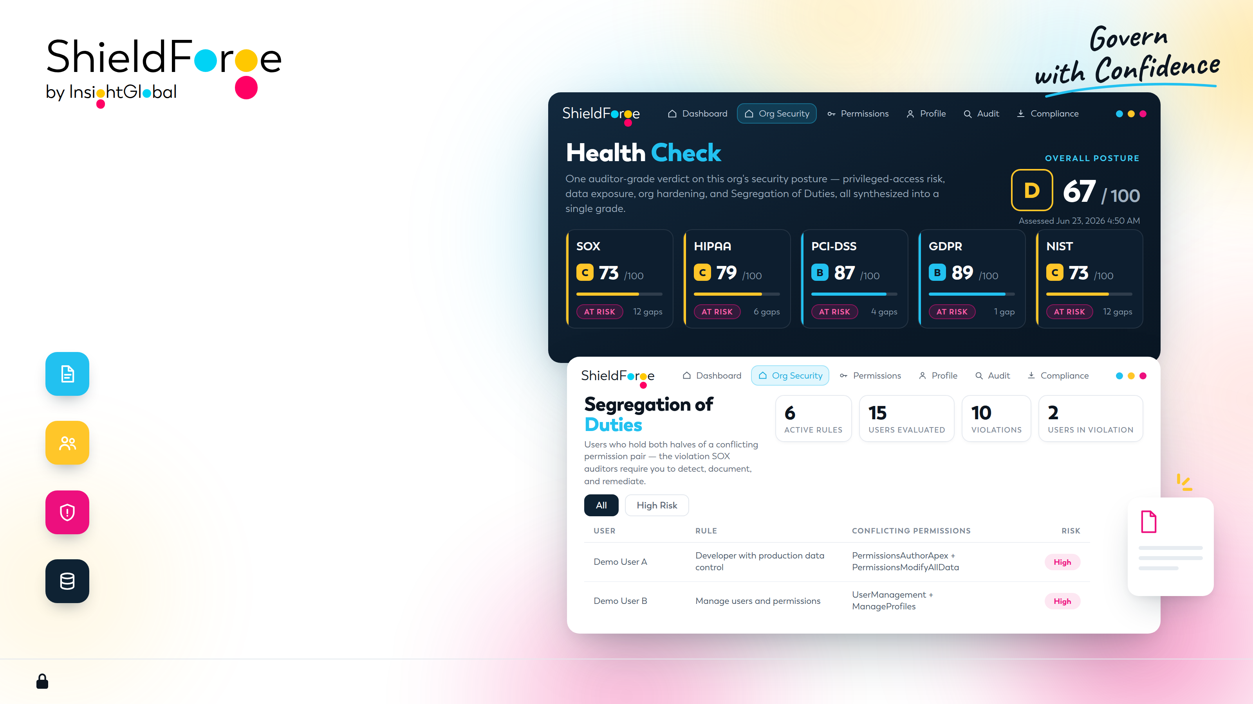
Audit readiness.
Security visibility.
Security posture, compliance findings and
audit evidence in one workspace.
SOX and compliance
Map findings to SOX, HIPAA, PCI-DSS, GDPR and NIST.
Segregation of duties
Identify conflicting permissions and review affected users.
Org Security and Health Check
See posture scores, privileged access and prioritized risks.
Audit evidence
Trace access grants and document reviews with attributable logs.
Illustrative demo view
ShieldForge does not capture, store, or retain customer business data. | Customer data remains within Salesforce.
02

Slide 3
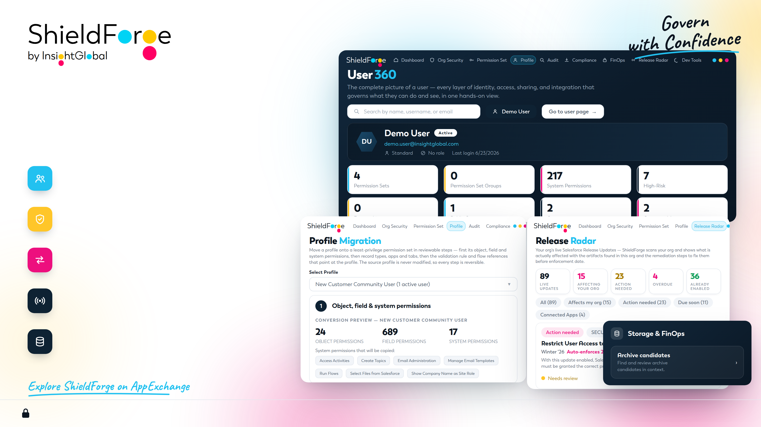
Clearer access.
Simpler administration.
Practical tools for admins, architects and support teams.
User 360 and effective access
See who can do what, why, and how users differ.
Permission intelligence
Analyze and compare permissions. Find and merge duplicates.
Profile migration
Move to permission sets through reviewable steps.
Release Radar and CAB reports
Assess release impact and prepare deployment evidence.
Storage, FinOps and Dev Tools
Find archive candidates and query, import or export in context.
Illustrative demo view
ShieldForge does not capture, store, or retain customer business data. | Customer data remains within Salesforce.
03

