Slide 1
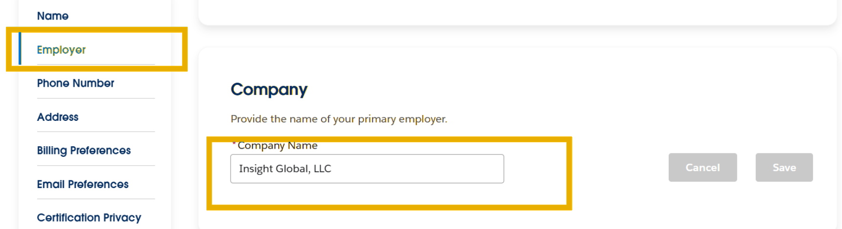
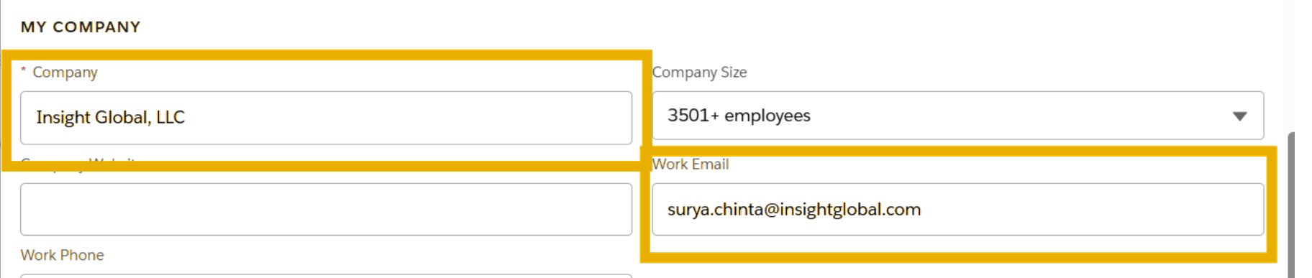
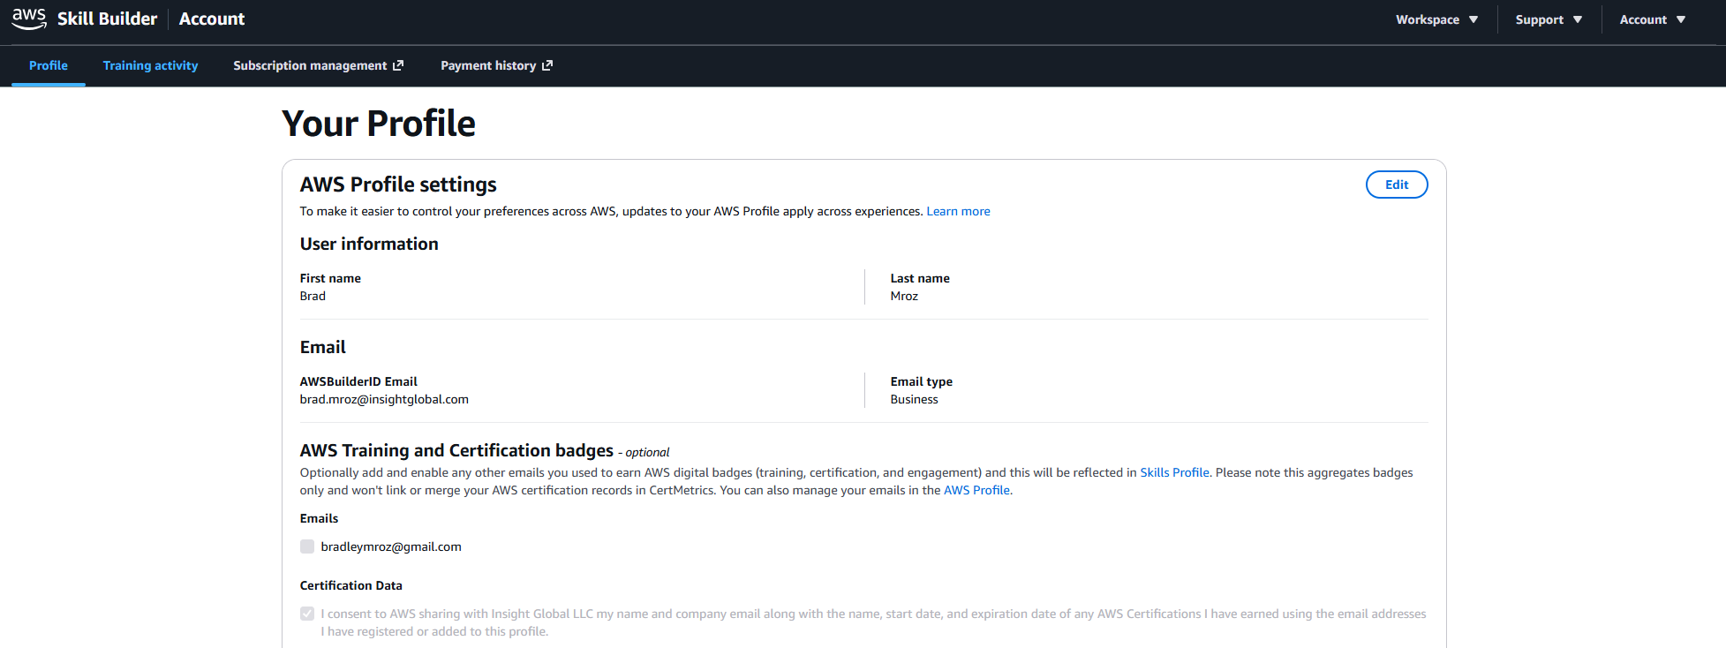
INSIGHT GLOBAL CONSULTING
Salesforce Certification Linking: How-To Guide
🔑 Why This Matters
Linking your Salesforce certifications to Insight Global, LLC ensures they are credited to Insight Global's Salesforce partner record.
More linked certifications strengthen IG's partner standing including tier progression, specializations, and access to Salesforce enablement and funding programs
More certifications strengthen IG's credibility with Salesforce teams, customers, and help us win
🔗 Steps to Link
Pre-req: You must have at least one completed Salesforce certification and access to your Trailhead account.
Sign in to Trailhead Academy (trailhead.salesforce.com) and open your Trailhead Academy Account.
In the Employer section, enter Insight Global, LLC in the Company Name field exactly as shown, then Save.
Sign in to your Trailblazer Profile and open Settings, then edit the Details tile at the bottom of the page.
In the Relationship to Salesforce field, choose Partner.
In My Company, set Company to Insight Global, LLC exactly as shown, and Work Email to your IG email.
Click Save.
  Your certifications then begin counting toward IG's Salesforce partner metrics.
Going forward: register for and complete all future Salesforce training and certifications using your @InsightGlobal.com email address so nothing needs re-linking.

