Slide 1
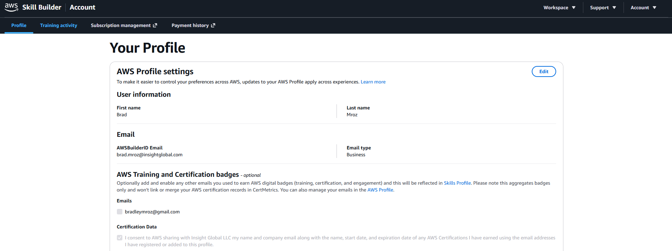
INSIGHT GLOBAL CONSULTING
Certification Linking: How-To Guide
🔑 Why This Matters
Linking your AWS certification to Insight Global's AWS Skill Builder account ensures your certifications contribute to Insight Global’s partnership score.
More linked certifications unlock partner benefits including Migration Acceleration Program (MAP) funding, Partner Opportunity Acceleration (POA) funding, Marketing Development Funds (MDF), Immersion Days, and technical enablement
More certifications strengthen IG's credibility with AWS field teams, customers, and help us win
🔗 Steps to Link
Pre-req: You must have at least one completed AWS certification tied to an email address you can access.
Sign in to AWS Skill Builder (skillbuilder.aws) using your @InsightGlobal.com email via the AWS Builder ID login method. Create an account if you do not have one.
In your Skill Builder profile settings, enter your personal email tied to your existing AWS certification and request a verification code
Enter the code to confirm personal email ownership.
  Your certifications will link to IG's Partner Central account within roughly 5–10 business days and begin counting toward IG's Partner Path skilling metrics
Going forward: register for and complete all future AWS training and certifications using your @InsightGlobal.com email address so nothing needs re-linking.

