Slide 1
HEALTHCARE AI
SOLUTION BLUEPRINTS
Six knowledge-graph blueprints across healthcare and enterprise governance
IGH PRESIDENT BRIEFING · NOVEMBER 2026
Notes:
Purpose: show what our core team can do in healthcare, and give account managers and sales six clear solution blueprints (CareGraph, TherapyGraph, RxGraph, DeviceGraph, ChainGraph, ShieldGraph) to start conversations.
Blueprints, not case studies: all six are proposed solutions at ideation stage: problem, solution, architecture and value. Figures marked 'Pilot target' are agreed with each client; sourced figures are public evidence.

Slide 2
Agenda
HEALTHCARE AI SOLUTION BLUEPRINTS
1
Who we are
6
DeviceGraph · Medical Devices & IoT
2
Universal architecture
7
ChainGraph · Manufacturing & Supply Chain
3
CareGraph · Care Engagement
8
ShieldGraph · Security, Access & Compliance
4
TherapyGraph · Life Sciences
9
How we engage
5
RxGraph · Pharmacy & Drug
Notes:
One universal architecture, then six solution blueprints, one per domain, each in three slides: problem and solution, the blueprint on the universal architecture, value. We close with how we engage and a cheat sheet for sales.

Slide 3



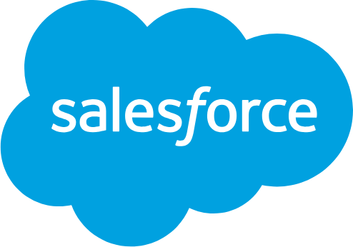

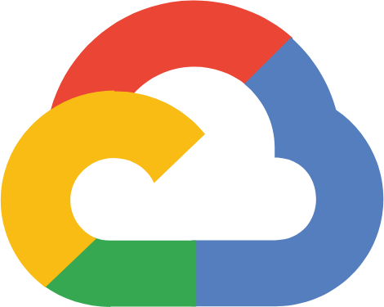

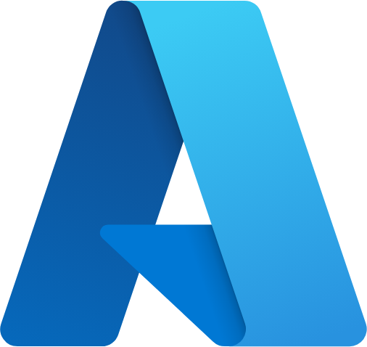


A core team built for any healthcare requirement
HEALTHCARE AI SOLUTION BLUEPRINTS
From strategy to production across AI, data, Salesforce and cloud, with healthcare compliance built in.
Agentic AI & GenAI engineering
Knowledge graph & data engineering
Salesforce for healthcare
Multi-agent workflows, RAG / GraphRAG, evaluation and guardrails, model-agnostic.
Healthcare ontologies (RxNorm, ICD-10, SNOMED, LOINC, NPI, UDI), ETL, vector search.
Health Cloud, Life Sciences Cloud, Marketing Cloud, Data Cloud, Agentforce, MuleSoft.
Multi-cloud delivery
Healthcare compliance & governance
Product & delivery
Google Cloud, AWS and Azure. The same design runs wherever the client already is.
HIPAA, GxP / Part 11, FDA device and safety rules, consent, masking and audit trails.
Ideation workshops, architecture, proof of concept to production, change management.
PROOF POINT
We built a governed agentic delivery platform for a large US health system (Salesforce Health and Marketing Cloud, masked data context, compliance guardian, human approval gates).
Notes:
Key message: one core team covers every layer a healthcare AI program needs, so we can take any requirement from idea to production.
The proof point is our current delivery for a large US health system (client name withheld; use it verbally only if cleared).

Slide 4



























Universal architecture
HEALTHCARE AI SOLUTION BLUEPRINTS · UNIVERSAL ARCHITECTURE
One architecture, six blueprints
Every blueprint uses the same four layers and trust layer, and runs on any cloud. Only the data, the central entity and the agents change.
DATA FOUNDATION
DATA READINESS
INTELLIGENCE CORE
AGENTIC WORKFLOWS
Sources we connect
Matching, masking, codes
The domain model
Agents + where users see it
Clinical systems
FHIR
ICD-10
RxNorm
UDI
Secure access
EHR, claims (FHIR)
Match identities
APIs · MCP tools
CRM & engagement
Salesforce
Salesforce, contact center
Patient
CareGraph
AI agent crew
model-agnostic
Quality & operations
Map to standard codes
QMS, MES, ERP
Identity
ShieldGraph
Therapy
TherapyGraph
Plan the task
Retrieve facts
Devices & IoT
Draft the output
Dashboards
Wearables, connected devices
Central entity
Mask PHI & apply consent
Check the rules
Public reference data
Product lot
ChainGraph
Medication
RxGraph
Hand off to a person
CMS, FDA, NLM, CDC
Documents & content
Device (UDI)
DeviceGraph
Trust layer
Policies, SOPs, labels
Make documents searchable
PHI masking · guardrails in & out · human approval · audit trail
Ask in plain English
Runs on
Google Cloud
AWS
Azure
Salesforce
Any LLM
Notes:
This is the one architecture behind every blueprint. Four layers: data foundation (what we connect), data readiness (match identities, map to standard codes, mask PHI, make documents searchable), intelligence core (a domain model with one central entity: Patient, Therapy, Medication, Device or Product lot), and agentic workflows (an agent crew that plans, retrieves, drafts, checks and hands off to a person, delivering into Salesforce, dashboards and plain-English questions). The trust layer covers everything. Because the architecture is shared, a new blueprint reuses about 80% of the build; only the data, the central entity and the agents change. It runs on Google Cloud, AWS or Azure, with any LLM.

Slide 5











Six blueprints, one architecture
HEALTHCARE AI SOLUTION BLUEPRINTS
Each blueprint is built around one central entity and solves the whole set of problems in its domain.
BLUEPRINT
01
BLUEPRINT
02
BLUEPRINT
03
BLUEPRINT
04
BLUEPRINT
05
BLUEPRINT
06
CareGraph
TherapyGraph
RxGraph
DeviceGraph
ChainGraph
ShieldGraph
CARE ENGAGEMENT
LIFE SCIENCES
PHARMACY & DRUG
MEDICAL DEVICES & IOT
MANUFACTURING & SUPPLY CHAIN
SECURITY, ACCESS & COMPLIANCE
Center: Patient
Center: Therapy
Center: Medication
Center: Device (UDI)
Center: Product lot
Center: Identity
Cohort & gap intelligence
HCP 360 & next-best-action
Medication reconciliation
Remote-monitoring triage
Supplier & material risk
Metadata scanner
Access & SoD analyzer
Journey designer
MLR pre-review
Interaction & PGx safety
Complaint & reportability
Deviation & CAPA copilot
Access navigator
Trial feasibility & sites
Audit score & frameworks
Referral integrity
Benefits & prior auth
Recall & UDI tracing
Batch-record review
Compliance guardian
Patient matching & recruitment
Access review workflow
Adherence & adverse events
Post-market trends
Inspection readiness
Medical-affairs insight
Device cybersecurity
Reports & email digests
Shortage substitution
Shortage early warning
Notes:
The six blueprints at a glance. Pick the blueprint that matches the client in front of you: provider or payer → CareGraph; pharma commercial or clinical → TherapyGraph; pharmacy, PBM or patient hub → RxGraph; MedTech or virtual care → DeviceGraph; manufacturing, CDMO or distribution → ChainGraph; any organization facing SOX / HIPAA audits or access sprawl → ShieldGraph.

Slide 6
CareGraph
HEALTHCARE AI SOLUTION BLUEPRINTS
BLUEPRINT 01
CARE ENGAGEMENT
Every patient journey, connected
Who it's for: Population health, patient access, care coordination, marketing, quality
Notes:
Blueprint 01: CareGraph for Care Engagement. Every patient journey, connected.
Listen for: Care gaps, low screening rates, no-shows, outreach that doesn't convert, network leakage, price questions.
Who to talk to: CMO / CNO, VP Population Health, Patient Access, Marketing.

Slide 7





Care teams can't see, or act on, the whole patient journey
BLUEPRINT 01 · CAREGRAPH · CARE ENGAGEMENT
THE PROBLEM
OUR SOLUTION
CareGraph
Every patient journey, connected
Care gaps, scheduling, referrals, costs and outreach sit in separate systems. Health systems run many campaigns but can't tell why a gap exists, what works for whom, or whether outreach is fair.
One knowledge graph of the patient journey, with agents that find gaps, design outreach and book care, using masked data.
Who feels it: Population health, patient access, care coordination, marketing, quality
Cohort & gap intelligence explains every gap by measure, community and access
PROBLEMS IT SOLVES
Care gaps stay open
One-size-fits-all outreach
Journey designer personalized Marketing Cloud journeys
Screenings and chronic-care follow-ups are missed
Low conversion and high opt-outs
Access navigator right provider, right slot, clear estimate
Hard to get an appointment
Referral leakage
Long queues and abandoned scheduling
Patients leave the network
Referral integrity keeps referrals in network
Cost confusion
Privacy slows everything
Compliance guardian consent, HIPAA and TCPA checked before send
No clear estimates or financial help
Each campaign waits on compliance review
EVIDENCE FROM THE FIELD · WITH SALESFORCE
27%
better patient adherence reported by Salesforce Health Cloud customers
BUILT ON
Source: Salesforce (vendor-reported)
Health Cloud
Marketing Cloud
WHAT WE BRING CareGraph delivers this on Health Cloud, adding the graph, agents and trust layer to scale it across your whole system.
Data Cloud
Agentforce
Tableau
Notes:
PRESIDENT CUT: present this blueprint.
Talk track: Closest to what our core team already delivers for a large US health system. Land the point that agents work on masked aggregates, so marketing, access and population health move fast without touching raw patient data.
Evidence narrative: 27% better patient adherence reported by Salesforce Health Cloud customers (Salesforce (vendor-reported)). What we bring: CareGraph delivers this on Health Cloud, adding the graph, agents and trust layer to scale it across your whole system.

Slide 8
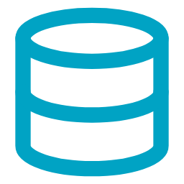

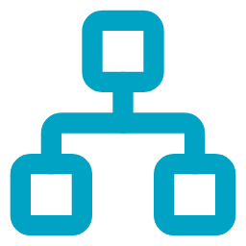














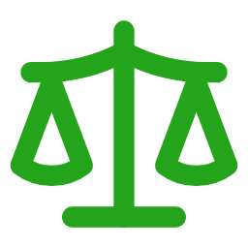

CareGraph
BLUEPRINT 01 · CAREGRAPH · CARE ENGAGEMENT · ON THE UNIVERSAL ARCHITECTURE
Every patient journey, connected
On the universal architecture:
Data Foundation
›
Data Readiness
›
Intelligence Core
›
Agentic Workflows
DATA FOUNDATION
DATA READINESS
INTELLIGENCE CORE
AGENTIC WORKFLOWS
Sources we connect
Matching, masking, codes
The CareGraph model
Agents + where users see it
EHR / FHIR
FHIR
ICD-10
LOINC
NPI
Secure access
Encounters, problems, care gaps
Match patients & providers
APIs · MCP tools
CMS quality measures
Health Cloud console
eCQM specifications
Care gaps
AI agent crew
model-agnostic
CDC PLACES + SDOH
Map to standard codes
Costs
Providers
Community health by census tract
Cohort builder
Gap explainer
NPPES
Consent
Appointments
Journey designer
Marketing Cloud journeys
Provider identity (NPI)
Patient
Mask PHI & apply consent
Access navigator
Price transparency
Compliance guardian
Hospital & payer rate files
Journeys
Referrals
Engagement data
Community (SDOH)
Trust layer
Marketing Cloud, contact center
Make documents searchable
PHI masking · guardrails in & out · human approval · audit trail
Ask CareGraph
Outcomes
Care gaps closed
Personalized outreach
Visits booked
Referrals kept
Fair access
Faster compliant campaigns
Notes:
This is CareGraph on the universal architecture: same four layers, filled with care engagement content. Data foundation: the sources on the left. Data readiness: matching, standard codes, PHI masking and search. Intelligence core: the CareGraph model puts Patient at the center and connects every related entity, so answers are grounded and cited. Agentic workflows: the agent crew works through secure access and delivers into Salesforce, dashboards and plain-English questions. A person approves anything that matters. The outcomes strip is what the client gets.

Slide 9
Close more care gaps, book more visits and keep patients in network, with every send compliant.
BLUEPRINT 01 · CAREGRAPH · CARE ENGAGEMENT · VALUE
VALUE & BENEFITS
20–30%
25–35%
29%
100%
higher care-gap closure rate per campaign
fewer calls per booked appointment
faster case resolution reported with Health Cloud
of outreach checked for consent and PHI before send
Pilot target (validated in pilot)
Pilot target (validated in pilot)
Source: Salesforce (vendor-reported)
Design guarantee
Business
Clinical
IT & data
Compliance
Quality-program revenue, more booked visits, less leakage
Earlier screening and chronic-care follow-up
One governed patient graph reused by every team
Minimum-data access; every send auditable
Notes:
Value: ranges marked Pilot target are targets we agree with the client in the ideation workshop and measure in the pilot; numbers with a source are public evidence.
Discovery questions for account managers:
1. How do you measure care-gap closure today, and which quality programs drive it?
2. What share of appointments are booked online versus by phone?
3. How long does compliance review take for a new campaign?

Slide 10
TherapyGraph
HEALTHCARE AI SOLUTION BLUEPRINTS
BLUEPRINT 02
LIFE SCIENCES
One view of every therapy, from trial to market
Who it's for: Brand and omnichannel teams, Medical Affairs, MLR, Clinical Operations
Notes:
Blueprint 02: TherapyGraph for Life Sciences. One view of every therapy, from trial to market.
Listen for: Launch planning, HCP engagement, slow MLR review, trial enrollment delays, site selection.
Who to talk to: Brand / commercial leads, Medical Affairs, Clinical Operations.

Slide 11





Commercial, medical and clinical teams work from different pictures
BLUEPRINT 02 · THERAPYGRAPH · LIFE SCIENCES
THE PROBLEM
OUR SOLUTION
TherapyGraph
One view of every therapy, from trial to market
HCP data, trial data, publications and approved content live in separate systems. Brands struggle to personalize compliantly, MLR review takes weeks, and trials miss enrollment targets.
One graph of each therapy's world (HCPs, evidence, trials and content) with agents for engagement, review and recruitment.
Who feels it: Brand and omnichannel teams, Medical Affairs, MLR, Clinical Operations
PROBLEMS IT SOLVES
HCP 360 & next-best-action channel, content and timing per HCP
Fragmented HCP view
Slow MLR review
MLR pre-review flags off-label claims before human review
CRM, claims and public data never meet
Every asset waits weeks for approval
Trial feasibility & sites masked patient counts by site and region
Off-label risk
Trial enrollment delays
Claims drift from the approved label
Criteria are free text; screening is manual
Patient matching & recruitment every criterion explained, consent-aware outreach
Site selection by gut feel
Field insights get lost
Not grounded in patient data
MSL notes never reach strategy
Medical-affairs insight summarizes field and literature signals
EVIDENCE FROM THE FIELD · WITH SALESFORCE
Oct 2025
Salesforce Life Sciences Cloud went GA; Pfizer and Fidia named early adopters, Novartis selected it globally
BUILT ON
Source: Salesforce
Life Sciences Cloud
Marketing Cloud
WHAT WE BRING TherapyGraph brings the same Life Sciences Cloud foundation, plus HCP, trial and content intelligence on one graph.
Data Cloud
Agentforce
Notes:
PRESIDENT CUT: present this blueprint.
Talk track: Salesforce Life Sciences Cloud went GA in October 2025 and pharma is rebuilding its commercial stack, so timing is good. TherapyGraph is the one graph that commercial, medical and clinical teams can all use.
Evidence narrative: Oct 2025 Salesforce Life Sciences Cloud went GA; Pfizer and Fidia named early adopters, Novartis selected it globally (Salesforce). What we bring: TherapyGraph brings the same Life Sciences Cloud foundation, plus HCP, trial and content intelligence on one graph.

Slide 12




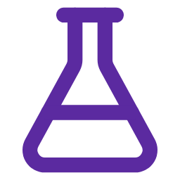






TherapyGraph
BLUEPRINT 02 · THERAPYGRAPH · LIFE SCIENCES · ON THE UNIVERSAL ARCHITECTURE
One view of every therapy, from trial to market
On the universal architecture:
Data Foundation
›
Data Readiness
›
Intelligence Core
›
Agentic Workflows
DATA FOUNDATION
DATA READINESS
INTELLIGENCE CORE
AGENTIC WORKFLOWS
Sources we connect
Matching, masking, codes
The TherapyGraph model
Agents + where users see it
NPPES
NPI
NCT ID
SPL label
MeSH
Secure access
HCP identity (NPI)
Match HCPs across sources (NPI)
APIs · MCP tools
CMS Open Payments
Life Sciences Cloud console
Industry payments to HCPs
HCPs
AI agent crew
model-agnostic
Medicare Part D
Map trials & labels to standard terms
Patient programs
Label & indications
Prescribing by NPI and drug
Pre-call briefing
Next-best-action
ClinicalTrials.gov
Content & claims
Clinical trials
MLR pre-review
Marketing Cloud
Trials, criteria, sites
Therapy
Apply consent & opt-outs
Trial feasibility
DailyMed labels
Patient matcher
Approved indications & claims
Open Payments
Sites & investigators
PubMed
Publications
Trust layer
Publications & authors
Make content & publications searchable
PHI masking · guardrails in & out · human approval · audit trail
Ask TherapyGraph
Outcomes
Richer HCP engagement
Faster MLR approval
On-label content
Faster trial enrollment
Better site selection
Field insight to strategy
Notes:
This is TherapyGraph on the universal architecture: same four layers, filled with life sciences content. Data foundation: the sources on the left. Data readiness: matching, standard codes, PHI masking and search. Intelligence core: the TherapyGraph model puts Therapy at the center and connects every related entity, so answers are grounded and cited. Agentic workflows: the agent crew works through secure access and delivers into Salesforce, dashboards and plain-English questions. A person approves anything that matters. The outcomes strip is what the client gets.

Slide 13
More relevant HCP engagement, faster content approval and trials that enroll on time.
BLUEPRINT 02 · THERAPYGRAPH · LIFE SCIENCES · VALUE
VALUE & BENEFITS
~40%
30–50%
15–25%
$14.67B
less trial screening time with NIH's TrialGPT approach
shorter MLR review cycle per asset
higher HCP engagement rate
in HCP payments in CMS Open Payments (PY2025), linkable by NPI
Pilot target (validated in pilot)
Source: NIH, Nature Communications 2024
Pilot target (validated in pilot)
Source: CMS via IntuitionLabs
Business
Clinical
IT & data
Compliance
Faster launches, rep productivity, shorter trials
Accurate, on-label information; more patients reach trials
One therapy graph shared by commercial, medical and clinical
Sunshine Act and PhRMA Code guardrails built in
Notes:
Value: ranges marked Pilot target are targets we agree with the client in the ideation workshop and measure in the pilot; numbers with a source are public evidence.
Discovery questions for account managers:
1. Are you moving to, or evaluating, Salesforce Life Sciences Cloud?
2. How long does an asset take to get through MLR today?
3. Which studies are behind on enrollment, and how are sites chosen?

Slide 14
RxGraph
HEALTHCARE AI SOLUTION BLUEPRINTS
BLUEPRINT 03
PHARMACY & DRUG
Every medication decision, grounded
Who it's for: Health-system and specialty pharmacy, PBMs, pharma patient-services hubs, drug safety
Notes:
Blueprint 03: RxGraph for Pharmacy & Drug. Every medication decision, grounded.
Listen for: Medication errors, noisy alerts, prior-auth backlogs, CMS-0057-F, adherence, adverse events, shortages.
Who to talk to: Chief Pharmacy Officer, VP Patient Services, Drug Safety.

Slide 15




Medication decisions depend on data scattered across many systems
BLUEPRINT 03 · RXGRAPH · PHARMACY & DRUG
THE PROBLEM
OUR SOLUTION
RxGraph
Every medication decision, grounded
Medication lists are messy, interaction alerts are noisy, prior auth is manual, adherence slips and shortages hit without warning. General-purpose AI models also miss dangerous interactions.
One graph of every medication (ingredients, interactions, coverage, safety and supply) with agents that reconcile, check, authorize and substitute.
Who feels it: Health-system and specialty pharmacy, PBMs, pharma patient-services hubs, drug safety
Medication reconciliation free text to standard codes, discrepancies flagged
PROBLEMS IT SOLVES
Messy medication lists
Missed interactions
Interaction & PGx safety graph lookup first; AI only explains
Reconciled by hand at admission and discharge
Noisy alerts hide real risks
Benefits & prior auth evidence mapped to payer criteria (CMS-0057-F ready)
Prior-auth backlogs
Poor adherence
Packets assembled from charts by hand
Refill gaps go unnoticed
Adherence & adverse events refill nudges and safety-report capture
Missed adverse events
Shortages
Safety reports lost in support calls
Substitutes chosen under pressure
Shortage substitution equivalent options checked against formulary
EVIDENCE FROM THE FIELD · WITH SALESFORCE
27%
faster patient enrollment, and care plans set up 3x faster, after a pharma company launched a Health Cloud patient hub
BUILT ON
Source: Salesforce blog (vendor-reported; company not named)
Health Cloud
Service Cloud
Agentforce
WHAT WE BRING RxGraph brings that hub model to your patients: prior auth, adherence and safety agents on Health Cloud.
EHR (FHIR)
Notes:
PRESIDENT CUT: present this blueprint.
Talk track: Plain chatbots get drug interactions wrong; a graph of trusted drug data plus a pharmacist gate gets them right. The prior-auth deadline in January 2027 makes this urgent for payers, pharmacies and pharma hubs.
Evidence narrative: 27% faster patient enrollment, and care plans set up 3x faster, after a pharma company launched a Health Cloud patient hub (Salesforce blog (vendor-reported; company not named)). What we bring: RxGraph brings that hub model to your patients: prior auth, adherence and safety agents on Health Cloud.

Slide 16













RxGraph
BLUEPRINT 03 · RXGRAPH · PHARMACY & DRUG · ON THE UNIVERSAL ARCHITECTURE
Every medication decision, grounded
On the universal architecture:
Data Foundation
›
Data Readiness
›
Intelligence Core
›
Agentic Workflows
DATA FOUNDATION
DATA READINESS
INTELLIGENCE CORE
AGENTIC WORKFLOWS
Sources we connect
Matching, masking, codes
The RxGraph model
Agents + where users see it
RxNorm
Standards
RxNorm
NDC
ATC
FHIR
Secure access
Drug identity (RxCUI)
Normalize drug names to RxNorm
APIs · MCP tools
DailyMed / openFDA
Pharmacist worklist
Labels, indications, warnings
Ingredients & ATC
AI agent crew
model-agnostic
openFDA FAERS
Link labels, interactions & coverage
NDC & shortages
Interactions
Adverse event reports
Reconciler
Interaction checker
CPIC / PharmGKB
Adverse events
Labels
Prior-auth builder
Health Cloud / EHR
Gene–drug guidance
Medication
Mask PHI & apply consent
Adherence coach
CMS Part D & LCD/NCD
Substitute finder
Formulary & coverage rules
Prior-auth criteria
Pharmaco-genomics
FDA shortages & NDC
Formulary & coverage
Trust layer
Supply status
Make labels & policies searchable
PHI masking · guardrails in & out · human approval · audit trail
Ask RxGraph
Outcomes
Safer medication lists
Interactions caught
Faster prior auth
Better adherence
Adverse events captured
Shortages managed
Notes:
This is RxGraph on the universal architecture: same four layers, filled with pharmacy & drug content. Data foundation: the sources on the left. Data readiness: matching, standard codes, PHI masking and search. Intelligence core: the RxGraph model puts Medication at the center and connects every related entity, so answers are grounded and cited. Agentic workflows: the agent crew works through secure access and delivers into Salesforce, dashboards and plain-English questions. A person approves anything that matters. The outcomes strip is what the client gets.

Slide 17
Safer medication lists, faster access to therapy and fewer surprises from shortages.
BLUEPRINT 03 · RXGRAPH · PHARMACY & DRUG · VALUE
VALUE & BENEFITS
4 of 4
40–60%
15–25%
Jan 2027
AI models tested missed a known interaction, so answers must be grounded
less pharmacist time per reconciliation
higher prior-auth first-pass approval
CMS prior-authorization API deadline (CMS-0057-F)
Pilot target (validated in pilot)
Pilot target (validated in pilot)
Source: CMS
Source: ERCSP 2024
Business
Clinical
IT & data
Compliance
Fewer readmissions, faster time to therapy, less waste
Fewer adverse drug events, continuity during shortages
Standard drug codes and FHIR-ready prior-auth APIs
Pharmacist approves every change; adverse events routed to safety
Notes:
Value: ranges marked Pilot target are targets we agree with the client in the ideation workshop and measure in the pilot; numbers with a source are public evidence.
Discovery questions for account managers:
1. Who does medication reconciliation today, and how long does it take?
2. How many prior auths a month, and what's the first-pass approval rate?
3. How did the last major shortage affect you, and how early did you know?

Slide 18
DeviceGraph
HEALTHCARE AI SOLUTION BLUEPRINTS
BLUEPRINT 04
MEDICAL DEVICES & IOT
Every device, traced from patient to recall
Who it's for: MedTech quality & regulatory, virtual care / RPM programs, biomedical engineering
Notes:
Blueprint 04: DeviceGraph for Medical Devices & IoT. Every device, traced from patient to recall.
Listen for: Remote monitoring programs, alert fatigue, complaint backlogs, FDA / EU MDR reporting, recalls, device security.
Who to talk to: VP Quality / Regulatory, Post-Market Surveillance, Virtual Care, Biomed / CISO.

Slide 19

Device data is everywhere, but nobody sees the whole picture
BLUEPRINT 04 · DEVICEGRAPH · MEDICAL DEVICES & IOT
THE PROBLEM
OUR SOLUTION
DeviceGraph
Every device, traced from patient to recall
Remote-monitoring readings flood care teams, complaints pile up against tight FDA deadlines, recalls are hard to trace to patients, and connected devices carry known vulnerabilities.
One graph that follows every device (UDI) from patient and telemetry to complaints, recalls and vulnerabilities, with agents for triage, reporting and remediation.
Who feels it: MedTech quality & regulatory, virtual care / RPM programs, biomedical engineering
PROBLEMS IT SOLVES
Remote-monitoring triage rules and models decide; AI explains
Alert fatigue
Complaint backlogs
Complaint & reportability intake, IMDRF coding, FDA / EU MDR advice
Too many readings, too few real signals
Manual triage and inconsistent coding
Late FDA reports
Recall traceability
Recall & UDI tracing device to patient in one query
Reportability decided under time pressure
Which patients have the affected device?
Post-market trends early signals from MAUDE and internal data
Device vulnerabilities
RPM billing missed
Known CVEs on connected devices
Data-day and minute rules tracked by hand
Device cybersecurity CVE-to-asset matching and patch plans
EVIDENCE FROM THE FIELD · WITH SALESFORCE
7,000+
Philips call-center and field-service engineers work from one complete customer view on Salesforce Service Cloud
BUILT ON
Source: Salesforce customer story (Philips)
Health Cloud
Service Cloud
MuleSoft
WHAT WE BRING DeviceGraph brings that one-view service model to complaints, recalls and remote monitoring for your devices.
Tableau
Notes:
PRESIDENT CUT: present this blueprint.
Talk track: The IoT story and the device-quality story in one graph. Key design choice: rules and models make the clinical call and people make the reportability call; AI prepares and explains, so it stays safe and auditable.
Evidence narrative: 7,000+ Philips call-center and field-service engineers work from one complete customer view on Salesforce Service Cloud (Salesforce customer story (Philips)). What we bring: DeviceGraph brings that one-view service model to complaints, recalls and remote monitoring for your devices.

Slide 20
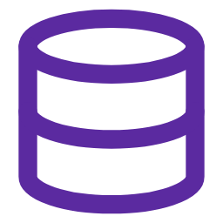

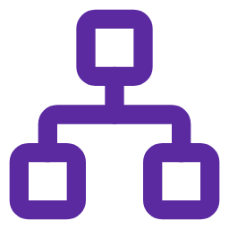


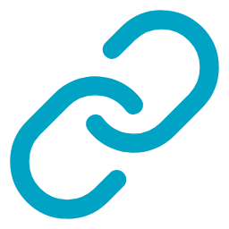





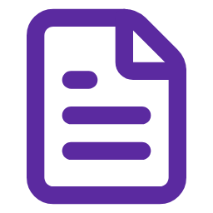





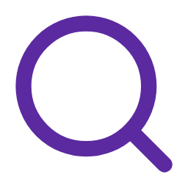

DeviceGraph
BLUEPRINT 04 · DEVICEGRAPH · MEDICAL DEVICES & IOT · ON THE UNIVERSAL ARCHITECTURE
Every device, traced from patient to recall
On the universal architecture:
Data Foundation
›
Data Readiness
›
Intelligence Core
›
Agentic Workflows
DATA FOUNDATION
DATA READINESS
INTELLIGENCE CORE
AGENTIC WORKFLOWS
Sources we connect
Matching, masking, codes
The DeviceGraph model
Agents + where users see it
Device telemetry
Standards
UDI
IMDRF
FHIR
CVE
Secure access
Wearables & home devices (FHIR)
Pair devices to patients (UDI)
APIs · MCP tools
FDA GUDID
Care team console
UDI device identity
Patients
AI agent crew
model-agnostic
FDA MAUDE
Summarize telemetry daily
Vulnera-bilities
Telemetry
Device adverse events
RPM triage
Complaint intake
FDA recalls & 510(k)
510(k) / PMA
Care plans
Reportability advisor
Quality & regulatory
Recalls, clearances, predicates
Device (UDI)
Code events (IMDRF)
Trend detector
CISA ICSMA & NVD
Patch planner
Device vulnerabilities
Recalls
Complaints
Complaints & service
MAUDE events
Trust layer
Service Cloud cases
Make narratives searchable
PHI masking · guardrails in & out · human approval · audit trail
Ask DeviceGraph
Outcomes
Fewer, better alerts
Faster complaint handling
On-time FDA reports
Recalls traced
Devices secured
RPM revenue captured
Notes:
This is DeviceGraph on the universal architecture: same four layers, filled with medical devices & iot content. Data foundation: the sources on the left. Data readiness: matching, standard codes, PHI masking and search. Intelligence core: the DeviceGraph model puts Device (UDI) at the center and connects every related entity, so answers are grounded and cited. Agentic workflows: the agent crew works through secure access and delivers into Salesforce, dashboards and plain-English questions. A person approves anything that matters. The outcomes strip is what the client gets.

Slide 21
Fewer, better alerts, faster complaint handling and devices you can trace and secure.
BLUEPRINT 04 · DEVICEGRAPH · MEDICAL DEVICES & IOT · VALUE
VALUE & BENEFITS
2M+
30–50%
30–40%
40–60%
medical device reports FDA receives each year (MAUDE)
fewer alerts per nurse per day
shorter complaint cycle time
faster fix of critical device vulnerabilities
Source: FDA
Pilot target (validated in pilot)
Pilot target (validated in pilot)
Pilot target (validated in pilot)
Business
Clinical
IT & data
Compliance
Billable virtual care, lower cost of quality, fewer surprise recalls
Earlier intervention and safety issues found sooner
Standards-based device integration (FHIR, UDI)
21 CFR 803, EU MDR vigilance; people make every reportability call
Notes:
Value: ranges marked Pilot target are targets we agree with the client in the ideation workshop and measure in the pilot; numbers with a source are public evidence.
Discovery questions for account managers:
1. How many patients are in remote monitoring, and how many alerts does a nurse handle per day?
2. How many complaints a month, and any late MDRs or FDA observations?
3. Can you trace a recalled device to the patients who have it today?

Slide 22
ChainGraph
HEALTHCARE AI SOLUTION BLUEPRINTS
BLUEPRINT 05
MANUFACTURING & SUPPLY CHAIN
From supplier to patient, end to end
Who it's for: Pharma & biotech manufacturing, CDMOs, quality, supply chain, distributors
Notes:
Blueprint 05: ChainGraph for Manufacturing & Supply Chain. From supplier to patient, end to end.
Listen for: Deviation backlogs, FDA 483s / warning letters, overdue CAPAs, supplier risk, drug shortages.
Who to talk to: VP Quality / QA, Site Heads, Supply Chain, Hospital Pharmacy Directors.

Slide 23


From supplier to patient, the chain is only visible in pieces
BLUEPRINT 05 · CHAINGRAPH · MANUFACTURING & SUPPLY CHAIN
THE PROBLEM
OUR SOLUTION
ChainGraph
From supplier to patient, end to end
Supplier risks are hidden, deviation investigations take weeks, repeat findings lead to FDA 483s, and shortages are discovered too late to plan around.
One graph of the product chain (supplier, material, plant, batch, distribution) with agents for quality, risk and shortage planning.
Who feels it: Pharma & biotech manufacturing, CDMOs, quality, supply chain, distributors
PROBLEMS IT SOLVES
Supplier & material risk single-source and facility risk map
Hidden supplier risk
Slow investigations
Deviation & CAPA copilot similar events, root cause and CAPA drafts
Single-source materials and facilities
Deviations start from a blank page
Repeat deviations
Batch review bottleneck
Batch-record review exceptions flagged before QA release
Root causes never connected; CAPAs overdue
eBMR review delays release
Inspection readiness matches findings to FDA 483 themes
Inspection findings
Late shortage warning
Shortage early warning supply signals and substitution plans
Repeat FDA 483 themes
Stock-outs discovered too late
EVIDENCE FROM THE FIELD · WITH SALESFORCE
90%
cut in average weekly order time at McKesson after moving pharma ordering to Salesforce B2B portals
BUILT ON
Source: Salesforce (vendor-reported)
Quality system (e.g. Veeva Vault QMS)
MES / LIMS / ERP
WHAT WE BRING ChainGraph extends that Salesforce-connected supply chain upstream: suppliers, batches, quality and shortages.
Tableau
Any cloud
Notes:
PRESIDENT CUT: present this blueprint.
Talk track: High value and highly regulated. Lead with control: AI drafts, qualified QA decides, every step sits in the Part 11 audit trail. The supply-chain half uses mostly public data, so a proof of concept is fast.
Evidence narrative: 90% cut in average weekly order time at McKesson after moving pharma ordering to Salesforce B2B portals (Salesforce (vendor-reported)). What we bring: ChainGraph extends that Salesforce-connected supply chain upstream: suppliers, batches, quality and shortages.

Slide 24
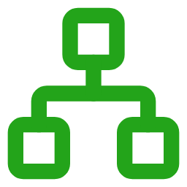






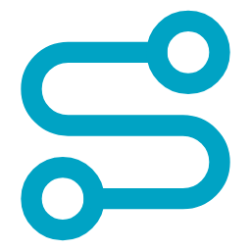


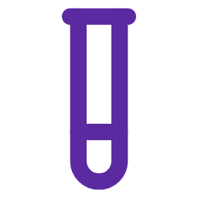

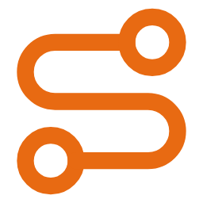



ChainGraph
BLUEPRINT 05 · CHAINGRAPH · MANUFACTURING & SUPPLY CHAIN · ON THE UNIVERSAL ARCHITECTURE
From supplier to patient, end to end
On the universal architecture:
Data Foundation
›
Data Readiness
›
Intelligence Core
›
Agentic Workflows
DATA FOUNDATION
DATA READINESS
INTELLIGENCE CORE
AGENTIC WORKFLOWS
Sources we connect
Matching, masking, codes
The ChainGraph model
Agents + where users see it
ERP & suppliers
NDC
GS1 / DSCSA
GMP
ISO 13485
Secure access
Suppliers, materials, orders
Link supplier → lot → batch
APIs · MCP tools
MES / eBMR & LIMS
Quality workbench
Batches, equipment, tests
Suppliers
AI agent crew
model-agnostic
Quality system (QMS)
Map products & facilities (NDC)
Demand & shortages
Materials & lots
Deviations, CAPAs, changes
Supplier risk
Deviation triage
FDA 483s & letters
Distribution
Plants & equipment
Root-cause drafter
Supply dashboard
Inspection findings
Product lot
Validated, versioned pipelines
CAPA checker
FDA shortages & recalls
Shortage early warning
Market supply signals (NDC)
SOPs & 483s
Batch records
DSCSA / distribution
Deviations & CAPA
Trust layer
Serialization & inventory
Make SOPs & investigations searchable
PHI masking · guardrails in & out · human approval · audit trail
Ask ChainGraph
Outcomes
Supplier risk visible
Faster investigations
Fewer repeat deviations
Faster batch release
Inspection ready
Shortages foreseen
Notes:
This is ChainGraph on the universal architecture: same four layers, filled with manufacturing & supply chain content. Data foundation: the sources on the left. Data readiness: matching, standard codes, PHI masking and search. Intelligence core: the ChainGraph model puts Product lot at the center and connects every related entity, so answers are grounded and cited. Agentic workflows: the agent crew works through secure access and delivers into Salesforce, dashboards and plain-English questions. A person approves anything that matters. The outcomes strip is what the client gets.

Slide 25
Close investigations faster, stop repeat deviations and see shortages coming, with QA always in control.
BLUEPRINT 05 · CHAINGRAPH · MANUFACTURING & SUPPLY CHAIN · VALUE
VALUE & BENEFITS
40%
323
20–30%
25–40%
faster deviation closure reported in industry GenAI case studies
active US drug shortages at the Q1 2024 peak
fewer repeat deviations and overdue CAPAs
earlier warning before a stock-out
Source: ASHP
Pilot target (validated in pilot)
Pilot target (validated in pilot)
Source: McKinsey (vendor-reported)
Business
Clinical
IT & data
Compliance
Right-first-time batches, less lost product, less emergency buying
Consistent quality and continuity of supply for patients
Validated, versioned pipelines (GAMP 5 / CSA)
QA approves every AI draft; Part 11 audit trail
Notes:
Value: ranges marked Pilot target are targets we agree with the client in the ideation workshop and measure in the pilot; numbers with a source are public evidence.
Discovery questions for account managers:
1. How long does an average deviation investigation take to close?
2. Any recent 483 observations on investigations or CAPA?
3. Do you track single-source suppliers and facilities for your key products?

Slide 26
ShieldGraph
HEALTHCARE AI SOLUTION BLUEPRINTS
BLUEPRINT 06
SECURITY, ACCESS & COMPLIANCE
Every system's access, audited in one view
Who it's for: CISO, CIO, Internal Audit, Compliance, system owners (any industry; healthcare leads with HIPAA and SOX)
Notes:
Blueprint 06: ShieldGraph for Security, Access & Compliance. Every system's access, audited in one view.
Listen for: SOX / HIPAA audit prep, access reviews, offboarding gaps, SoD findings, too many admins, multi-system access sprawl.
Who to talk to: CISO, CIO, Internal Audit, Compliance, Salesforce / ERP platform owners.

Slide 27




Access and configuration risk is spread across dozens of systems
BLUEPRINT 06 · SHIELDGRAPH · SECURITY, ACCESS & COMPLIANCE
THE PROBLEM
OUR SOLUTION
ShieldGraph
Every system's access, audited in one view
Who can do what lives in Salesforce, Workday, ERP, ServiceNow and the cloud, each with its own console. Audits are manual and spreadsheet-driven, so excessive access and segregation-of-duties conflicts go unseen until the auditor finds them.
One graph of every identity's access across systems, built from metadata only, with agents that score, flag, review and report.
Who feels it: CISO, CIO, Internal Audit, Compliance, system owners (any industry; healthcare leads with HIPAA and SOX)
Metadata scanner reads roles, permissions and configuration from any system
PROBLEMS IT SOLVES
Excessive access
SoD conflicts
Access & SoD analyzer excessive access and conflicting duties, per person
Users keep permissions they no longer need
One person can create and approve the same transaction
Audit score & frameworks 0–100 posture mapped to HIPAA, SOX, NIST, PCI, GDPR
Manual access reviews
Low audit scores
Quarterly certifications run on spreadsheets
Findings repeat audit after audit
Access review workflow owners certify or revoke with one click
Risky configuration
No single view
Flows, code and connected apps nobody reviews
Every system has its own console and report
Reports & email digests scheduled to inboxes; UI in Salesforce, ServiceNow or AWS
EVIDENCE FROM THE FIELD · OUR SHIELDFORGE
5
compliance frameworks already mapped in ShieldForge (HIPAA, SOX ITGC, NIST 800-53, PCI-DSS, GDPR)
BUILT ON
Source: ShieldForge (Insight Global, in-house)
ShieldForge (Salesforce app)
ServiceNow
AWS
WHAT WE BRING ShieldGraph takes what ShieldForge already does inside Salesforce to Workday, ERP, ServiceNow and the cloud.
Any cloud
Notes:
PRESIDENT CUT: present this blueprint.
Talk track: ShieldForge is our own Salesforce governance product: user audit, permission risk, segregation of duties, compliance scoring and email digests are already built. ShieldGraph takes the same idea to every system the client runs (Workday, ERP, ServiceNow, cloud) using metadata only, and shows the findings in whatever tool they already use.
Evidence narrative: 5 compliance frameworks already mapped in ShieldForge (HIPAA, SOX ITGC, NIST 800-53, PCI-DSS, GDPR) (ShieldForge (Insight Global, in-house)). What we bring: ShieldGraph takes what ShieldForge already does inside Salesforce to Workday, ERP, ServiceNow and the cloud.

Slide 28
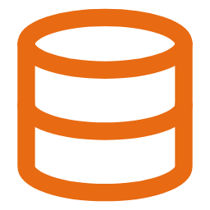
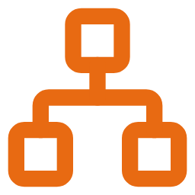












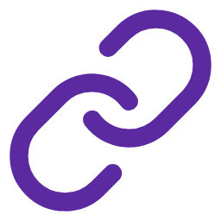



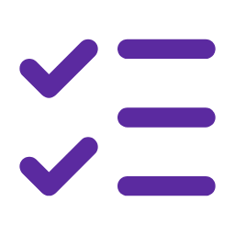

ShieldGraph
BLUEPRINT 06 · SHIELDGRAPH · SECURITY, ACCESS & COMPLIANCE · ON THE UNIVERSAL ARCHITECTURE
Every system's access, audited in one view
On the universal architecture:
Data Foundation
›
Data Readiness
›
Intelligence Core
›
Agentic Workflows
DATA FOUNDATION
DATA READINESS
INTELLIGENCE CORE
AGENTIC WORKFLOWS
Sources we connect
Matching, masking, codes
The ShieldGraph model
Agents + where users see it
Salesforce
SOX ITGC
HIPAA
NIST 800-53
PCI-DSS
Secure access
Profiles, permission sets, flows
Read metadata only (no records)
APIs · MCP tools
Workday
Salesforce (ShieldForge)
Security groups, roles
Users
AI agent crew
model-agnostic
ERP (SAP / Oracle)
Normalize roles & permissions
Reviews & approvals
Roles & profiles
Roles, transaction codes
Metadata scanner
Access analyzer
ServiceNow
Findings
Permissions
SoD checker
ServiceNow / AWS console
ACLs, groups, roles
Identity
Map to control frameworks
Audit scorer
AWS IAM / Azure Entra ID
Report & email writer
Cloud identities, policies
Controls & frameworks
Systems & apps
GRC / ERM
SoD rules
Trust layer
Controls, risks, owners
Resolve people across systems
PHI masking · guardrails in & out · human approval · audit trail
Email digests
Outcomes
Audit score
Access issues found
SoD conflicts flagged
Faster access reviews
Audit-ready reports
Email digests
Notes:
This is ShieldGraph on the universal architecture: same four layers, filled with security, access & compliance content. Data foundation: the sources on the left. Data readiness: matching, standard codes, PHI masking and search. Intelligence core: the ShieldGraph model puts Identity at the center and connects every related entity, so answers are grounded and cited. Agentic workflows: the agent crew works through secure access and delivers into Salesforce, dashboards and plain-English questions. A person approves anything that matters. The outcomes strip is what the client gets.

Slide 29
Pass audits with confidence: every system's access scored, every risk owned, every report on schedule.
BLUEPRINT 06 · SHIELDGRAPH · SECURITY, ACCESS & COMPLIANCE · VALUE
VALUE & BENEFITS
50–70%
30–50%
0–100
100%
less time per access review
fewer excessive-access findings at the next audit
audit posture score per system and overall
metadata only: no patient or business records read
Pilot target (validated in pilot)
Pilot target (validated in pilot)
Source: ShieldForge capability
Design guarantee
Business
Clinical
IT & data
Compliance
Cleaner audits, fewer findings, less audit-prep effort
PHI access limited to the people who need it (HIPAA)
One access graph across every system, no new console
SOX ITGC, HIPAA, NIST, PCI and GDPR evidence on demand
Notes:
Value: ranges marked Pilot target are targets we agree with the client in the ideation workshop and measure in the pilot; numbers with a source are public evidence.
Discovery questions for account managers:
1. How do you run quarterly access reviews today, and how long do they take?
2. Which systems did your last SOX or HIPAA audit flag for access findings?
3. Do you know which users hold conflicting duties across Salesforce, ERP and HR?

Slide 30
How we engage: from idea to production
HEALTHCARE AI SOLUTION BLUEPRINTS
Ideation workshop
Pilot
2 WEEKS
~3 MONTHS
Pick the blueprint and first modules, map data and stakeholders, agree success metrics.
Real users, governed client data, measured against the agreed KPIs.
Proof of concept
Scale
6–8 WEEKS
ONGOING
Working blueprint on public and synthetic data, architecture signed off, sponsor demo.
Add modules and sites, then the next blueprint on the same architecture.
Next step: pick one blueprint and run a 2-week ideation workshop with the client.
Notes:
The ask for account managers: when you hear one of these needs, bring us in for a 2-week ideation workshop. We leave the client with a chosen blueprint and first modules, an architecture, agreed KPIs and a proof-of-concept plan.

Slide 31
Sales cheat sheet: which blueprint to bring
HEALTHCARE AI SOLUTION BLUEPRINTS
Bring
Listen for…
Who to talk to
CareGraph
Care gaps, low screening rates, no-shows, outreach that doesn't convert, network leakage, price questions
CMO / CNO, VP Population Health, Patient Access, Marketing
Care Engagement
TherapyGraph
Launch planning, HCP engagement, slow MLR review, trial enrollment delays, site selection
Brand / commercial leads, Medical Affairs, Clinical Operations
Life Sciences
RxGraph
Medication errors, noisy alerts, prior-auth backlogs, CMS-0057-F, adherence, adverse events, shortages
Chief Pharmacy Officer, VP Patient Services, Drug Safety
Pharmacy & Drug
DeviceGraph
Remote monitoring programs, alert fatigue, complaint backlogs, FDA / EU MDR reporting, recalls, device security
VP Quality / Regulatory, Post-Market Surveillance, Virtual Care, Biomed / CISO
Medical Devices & IoT
ChainGraph
Deviation backlogs, FDA 483s / warning letters, overdue CAPAs, supplier risk, drug shortages
VP Quality / QA, Site Heads, Supply Chain, Hospital Pharmacy Directors
Manufacturing & Supply Chain
ShieldGraph
SOX / HIPAA audit prep, access reviews, offboarding gaps, SoD findings, too many admins, multi-system access sprawl
CISO, CIO, Internal Audit, Compliance, Salesforce / ERP platform owners
Security, Access & Compliance
Notes:
Leave-behind for account managers. If a client mentions anything in 'Listen for', note who said it and bring us in with the matching blueprint.

Slide 32
Notes:
Thank you. Next step: agree which client and which blueprint to take into an ideation workshop first.

