Slide 1
ONE EVENT PLATFORM ON SALESFORCE
Memorial Hermann Health System × Insight Global
CLASSES · EVENTS · CONFERENCES · ENGAGEMENT
OCTOBER 2026
Notes:
Thank Kevin for the detailed answers. Today: how we solve the event registration problem on the Salesforce platform they already own, how we deliver it, and how the registration data can grow engagement and the network.

Slide 2
Agenda
1
What we heard
4
Delivery timeline
2
The solution and design
5
Beyond the event
3
Payments and data security
6
Roadmap and next steps
Notes:
Sections 1 to 4 solve the problem Kevin described. Section 5 is the value we add on top: using registration data to keep people engaged and bring them into the Memorial Hermann network.

Slide 3
What we heard
Area
Today
Where we take it
Classes and events
Sitecore listings open a home-built Experience Cloud site; Chase payments; confirmation up to 24 hours
Keep the site and improve it on one shared event model
Mobile app
People can already register for events in the app
Keep it, connected to the same event model
Conferences
Certain for 1 to 2 multi-day events a year; Authorize.net
Replace with Salesforce conference and session management
Who registers
Consumers, caregivers and providers
One profile per person, matched to Health Cloud
Platform
Health Cloud and Marketing Cloud; Epic not needed
Built on what Memorial Hermann already owns
The ask: replace Certain and run classes and conferences on one Salesforce platform, without rebuilding what already works.
Notes:
Play back Kevin’s answers and what we saw on the site. Class registration already runs on a home-built Experience Cloud site and in the app. The tool they want to replace is Certain. The goal is one platform for both, building on what works.

Slide 4
Build on what already works
No rebuild of today’s class registration. Replace only Certain, then bring every event onto one platform.
KEEP
IMPROVE
REPLACE
ADD LATER
Sitecore class listings
Experience Cloud registration site
Mobile app registration
Health Cloud and Marketing Cloud
Instant confirmation (today up to 24 hours)
Safe payment retries
Live seats and waitlists
Check-in and reporting
One shared event model
Certain, with Salesforce conference and session management
My Agenda portal on Experience Cloud
Authorize.net checkout inside the platform
Certain data migrated
Patient engagement initiatives (PEIs)
App adoption campaigns
AI agents in a controlled harness
Lowest-risk path: what works stays, the one tool you want gone goes, and every event ends up on the same data, payments and reporting.
Notes:
This is the core of our position. We keep the Sitecore listings, the Experience Cloud registration site and the app. We improve classes where today’s experience is weak, such as confirmations that can take up to 24 hours. We replace only Certain. Engagement and AI come later.

Slide 5
01 THE SOLUTION
Conferences first, then classes on the same Salesforce platform

Slide 6
One event platform inside your Salesforce org
1
2
3
Register
Manage
Engage
Your existing front doors
Event app in Salesforce
Marketing Cloud journeys
Sitecore listings and today’s Experience Cloud site
Existing mobile app
“My Agenda” portal for conferences
Classes, series, sessions, speakers
Capacity, waitlists, refunds
QR check-in and reporting
Registrants matched to Health Cloud
Confirmations and reminders
Calendar invites and virtual links
Patient engagement initiatives (PEIs)
CONNECTS TO
Chase
Authorize.net
Sitecore
Zoom / Teams
Health Cloud
Marketing Cloud
Reliable, secure and scalable by design: waiting room and seat holds for busy events, encrypted data, full audit trail.
Notes:
One event platform on the Health Cloud org they already own. Today’s Sitecore listings, Experience Cloud site and mobile app stay the front doors. Salesforce runs classes and conferences on one model, and Marketing Cloud sends every message. Only Certain is retired.

Slide 7
Overall solution design
One flow for conferences and classes on your existing Experience Cloud site and app; replaces Certain
Registrant
Website or app
Registration service
Payment gateway
Salesforce event app
Marketing Cloud
Event staff
REGISTER
Find a class or conference
1
Register and hold a seat
2
Seat held for 10 minutes
3
PAY
Pay on hosted page (free events skip this)
4
Signed webhook, token only
5
Create registration (queued, idempotent)
6
CONFIRM
Registration event
7
Confirmation, QR code, calendar invite, reminders
8
ATTEND
QR check-in at the door
9
ENGAGE
Attendance and interests
10
PEIs: thank you, next class, app, find a doctor
11
GROW
Dashboards, waitlist and demand alerts
12
Add a session in one click
13
Classes and conferences share this flow; conferences add sessions, speakers and My Agenda.
Notes:
This is the whole solution on one page, in the order a registrant experiences it. Register: website or the existing My Memorial Hermann app, with a seat held while they pay. Pay: the gateway hosts the card page; we receive only a token. Confirm: Salesforce records the registration and Marketing Cloud sends confirmation and reminders. Attend: QR check-in. Engage: patient engagement initiatives. Grow: staff see demand and add sessions. It replaces Certain and builds on today’s Experience Cloud site and app.

Slide 8
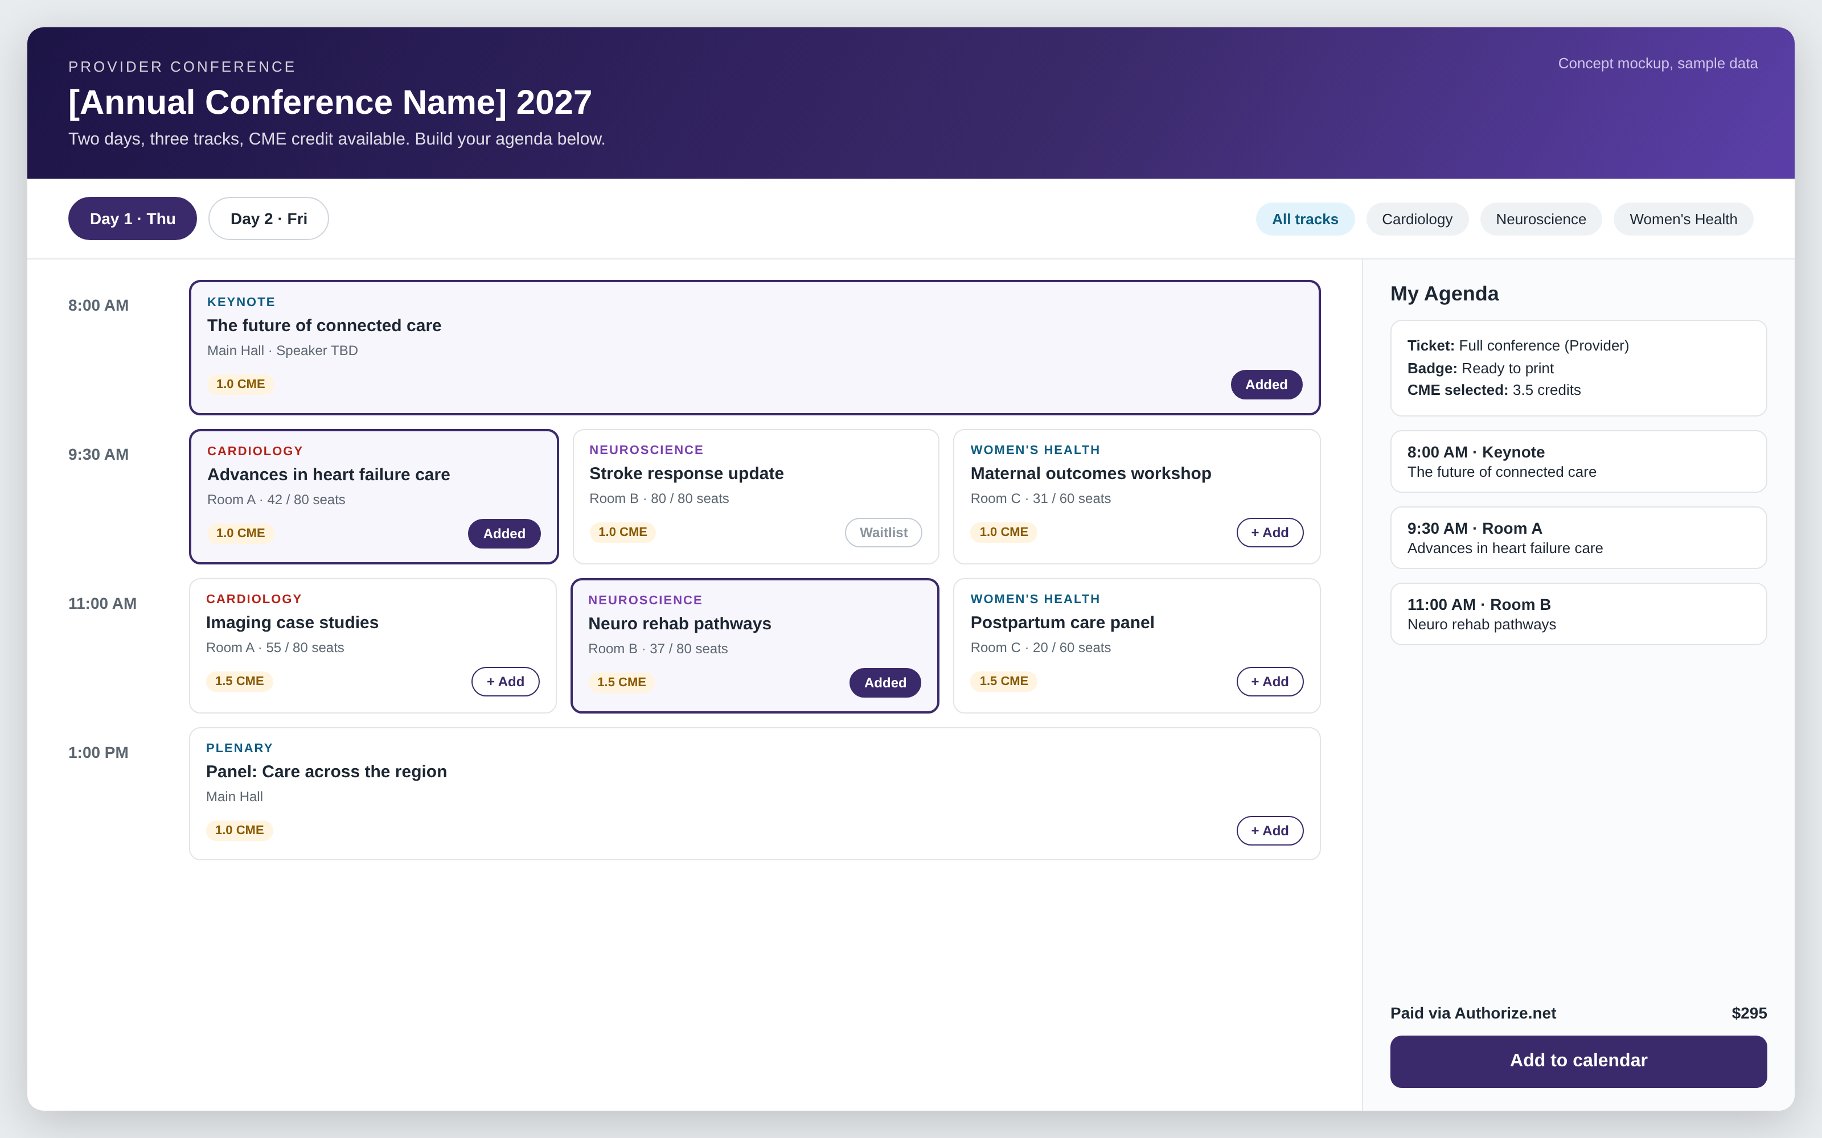
Phase 1: conferences with full session management
Replaces Certain
Multi-day agenda with tracks and rooms
Attendees build their own “My Agenda”
Session capacity and waitlists
Speaker profiles and assignments
Ticket types for providers and guests
Badges and CME credit tracking [to confirm]
Notes:
This is the main ask: replace Certain. Conferences run on the same Salesforce platform as classes, with the attendee portal on their existing Experience Cloud site. CME requirements to be confirmed with Kevin.

Slide 9
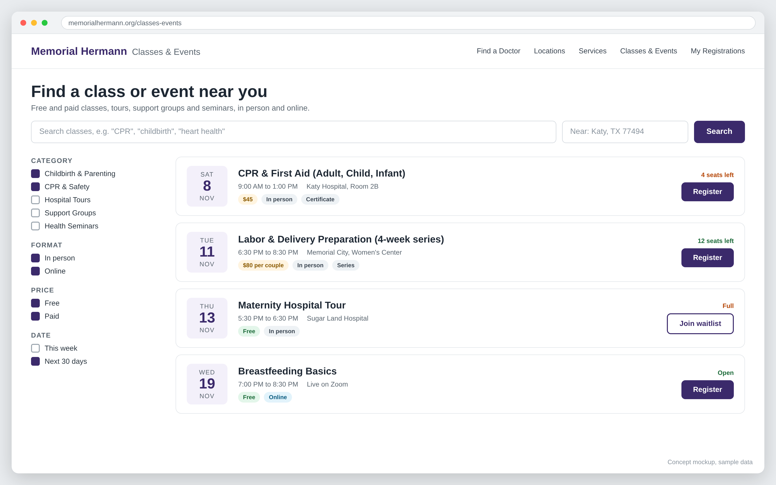
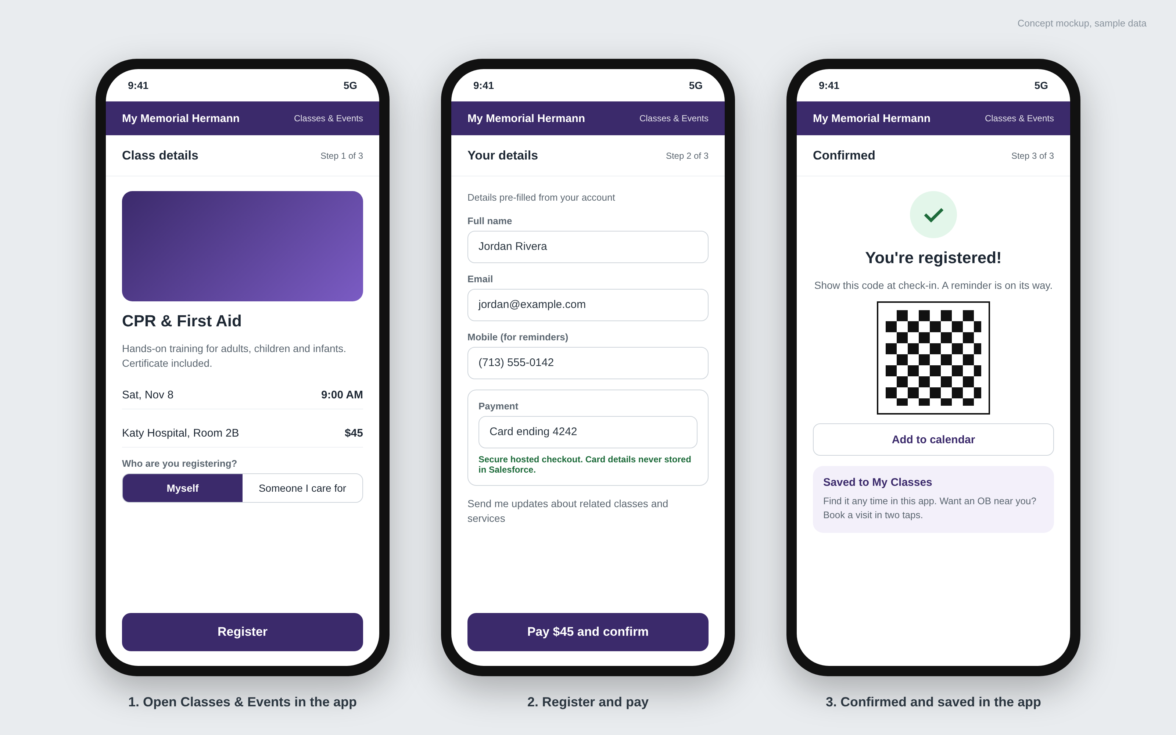
Phase 2: today’s class registration, improved
Website and Experience Cloud site
Existing mobile app
Same listings and registration site, now with live seats, waitlists and instant confirmation.
The app people already register in, connected to the same event model. No new app.
Notes:
Concept screens, sample data. We keep today’s registration site and app and improve them: instant confirmation instead of up to 24 hours, safe payment retries, live seats and waitlists. How the app connects is confirmed with Lucky Rai’s team.

Slide 10
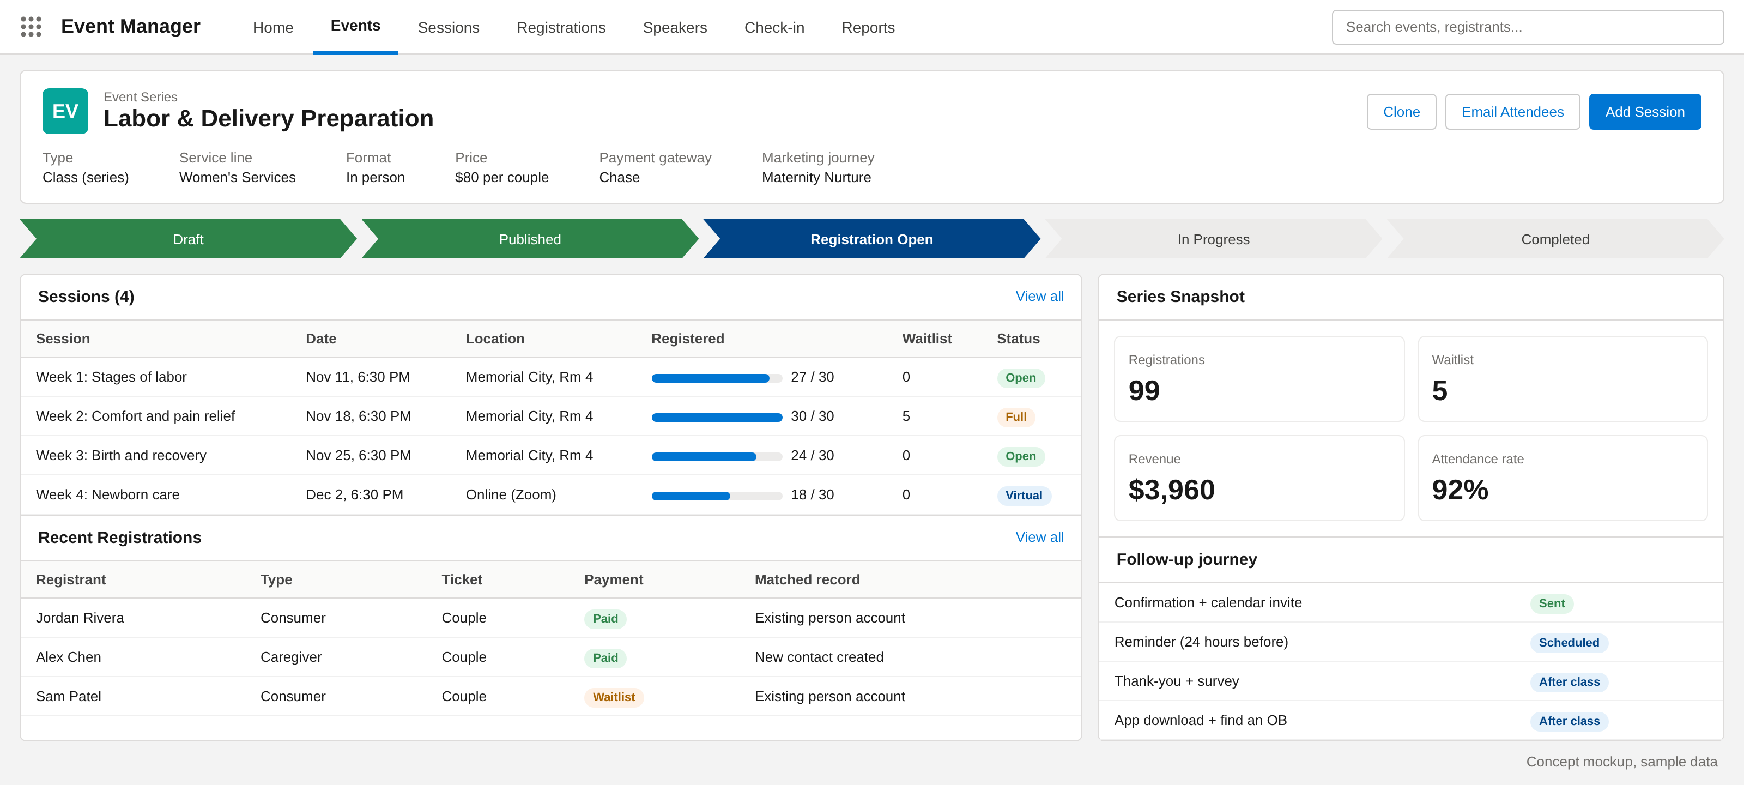
Staff run classes and conferences from one console
What staff can do
Set up a class once and repeat it as a series
Watch capacity and waitlists fill in real time
Match registrants to existing Health Cloud records
Check people in with a QR scan
Email attendees and track revenue
Concept mockup, sample data
Notes:
This is a standard Salesforce Lightning app, so their in-house Salesforce admins can own it after launch.

Slide 11






Every seat filled, no interested person lost
When interest outruns seats: a popular class or a conference opening
1
2
3
4
5
Edge protection
Fair waiting room
Seat hold
Hosted payment
Salesforce
Cached pages, bot defense, rate limits
Admits people in arrival order
10-minute hold; a seat can never be sold twice
Paid = confirmed; unpaid seats return
Queued and retried; never lost
WHERE EVERY CLICK ENDS UP
30
60
All others
Turn overflow into sessions
Demand passes 3× the seats
Staff add a session in one click
Waitlist offered first, then the interest list
Confirmed seats
On the waitlist
On the interest list
Paid, ticketed, QR check-in sent
Freed seats offered by SMS with a 2-hour claim window
Told the moment a new date opens
Reliable: queued, idempotent writes and auto-released holds. Scalable: only admitted traffic reaches Salesforce. Secure: bot defense on every hot event.
Notes:
A popular class can draw far more interest than seats. The platform answers every click within seconds, never oversells, never charges someone who did not get a seat, and keeps everyone who missed out on a waitlist or interest list. When demand passes a threshold, staff add a session in one click and the people waiting get first access. Numbers are an example; caps and thresholds are set per event.

Slide 12
Design detail: registration and seat flow
Registrant
Edge and waiting room
Registration service
Seat inventory
Payment page
Salesforce
Marketing Cloud
Click Register
1
Place in line shown
2
Admit at a safe rate
3
Hold one seat (atomic)
4
If a seat is available
Hold granted, 10 minutes
Your seat is held, pay now
5
6
Pay on hosted page
7
Signed payment webhook
8
Create registration (idempotent, via queue)
9
Registration event
10
Confirmation, QR code, calendar invite
11
If sold out
No seats left
Join waitlist or get notified of new dates
12
13
Waitlist or interest record
14
Unpaid holds expire and return to the pool
Notes:
Step by step for a busy event. The waiting room admits people fairly, seat holds are atomic so a seat is never sold twice, writes to Salesforce are queued and idempotent so nothing is lost or duplicated, and everyone who misses a seat lands on the waitlist or interest list.

Slide 13









Payments and data security by design
Card data never enters our systems
Registrant and patient data, protected in layers
CARD DATA ZONE
Edge
Registrant
TLS 1.2+, web application firewall, bot defense, rate limits
Website, Experience Cloud or app
Card numbers go straight to the payment gateway. PCI scope stays at the simplest level (SAQ A) [to confirm].
Access
SSO with MFA for staff; least-privilege permission sets
Gateway hosted page
Card typed here (Chase or Authorize.net)
Data
Shield Platform Encryption on sensitive fields; field-level security
Signed webhook
OUR SYSTEMS
Monitoring
Token, last 4 digits, approval code
No card number, CVV or expiry stored. Refunds by token. Signed, idempotent webhooks. Daily reconciliation.
Event Monitoring, Field Audit Trail, real-time alerts
Governance
Salesforce payment record
BAA [to confirm], data retention, no tracking pixels, pen tests
Token reference, last 4, amount, status
Class topics are treated as sensitive: signing up for a diabetes class implies a health condition.
Notes:
Two messages. First, card numbers never touch Memorial Hermann or Salesforce systems: the gateway hosts the payment page and returns a token. Second, registrant and patient data is protected in layers from the edge to governance. Shield licensing, BAA coverage and PCI level to be confirmed with Memorial Hermann IT and finance.

Slide 14
Design detail: payment sequence
Registrant (web or app)
Registration service
Gateway hosted page
Salesforce
Gateway choice
Create payment session (amount, reference)
OPTION A
1
Keep both
Session token
Chase for classes, Authorize.net for conferences
2
Open hosted payment page
3
Card details typed into the gateway page
OPTION B
4
Consolidate on one
Approved
One gateway for every event; simpler reconciliation
5
Signed webhook (token, last 4, approval code)
6
After payment
7
Verify signature, idempotency check
Full and partial refunds by token from Salesforce
Automatic receipts
Daily settlement reconciliation
Payment record: token, last 4, amount, status
8
No card number, CVV or expiry is ever stored
Notes:
The card is typed directly into the gateway page; the registration service only creates the session and receives a signed webhook with a token. Salesforce stores the token reference, last 4 digits, amount and status. Gateway choice is Memorial Hermann finance's decision; both are supported.

Slide 15
02 DELIVERY PLAN
Ten sprints: conferences live at week 12, classes improved by week 20

Slide 16
Delivery timeline
Indicative; confirmed after the current-state walkthrough
Weeks 3-12 · Phase 1 live
Week 21+ · Grow
Conferences: sessions, speakers, My Agenda, badges. Certain retired
Patient engagement initiatives, app adoption, AI agents in a controlled harness
Weeks 1-2 · Assess and design
Weeks 13-20 · Phase 2 live
Review today’s Experience Cloud site, the app and Certain; shared event model; payment decision
Classes on the shared model: instant confirmation, waitlists, check-in, reporting
Notes:
Phase 1 replaces Certain around week 12; time it to land before the Certain renewal. Phase 2 brings classes onto the same platform and improves them by week 20, without rebuilding the registration site. Engagement work can start once classes are on the shared model.

Slide 17
Delivery plan: 10 two-week sprints
A working demo and a milestone sign-off with Memorial Hermann at the end of every sprint
Assess and design
Phase 1 · Conferences
Phase 2 · Classes
Sprint-end milestone
SPRINT 1
SPRINT 2
SPRINT 3
SPRINT 4
SPRINT 5
Weeks 1-2
Weeks 3-4
Weeks 5-6
Weeks 7-8
Weeks 9-10
Review today’s Experience Cloud site, app and Certain; design
Shared event model; sessions, tracks, rooms, speakers
My Agenda portal on Experience Cloud; ticket types
Authorize.net checkout; badges; CME [to confirm]
Certain data migration, load test, user testing
Design sign-off
Conference model demo
Attendee portal demo
Pay and badge end to end
Testing sign-off
SPRINT 6
SPRINT 7
SPRINT 8
SPRINT 9
SPRINT 10
Weeks 11-12
Weeks 13-14
Weeks 15-16
Weeks 17-18
Weeks 19-20
Conference go-live and hypercare
Move classes onto the shared model; keep current pages
Instant confirmation, safe payment retries, waitlists
QR check-in, reporting, app connected, PEI journeys
User testing, go-live, knowledge transfer
Phase 1 live, Certain retired
Classes on shared model
Registration improvements demo
User testing starts
Phase 2 live
Notes:
Two-week sprints, each closing with a demo and a milestone Memorial Hermann signs off. Sprint 1 assesses today’s Experience Cloud site, app and Certain. Sprints 2 to 6 deliver conference and session management (live at week 12, Certain retired). Sprints 7 to 10 move classes onto the same platform and improve them (live at week 20). Sprint scope is refined after the current-state walkthrough.

Slide 18




A dedicated five-person delivery pod
Every two-week sprint
LEAD
Scrum Master or Project Manager
Plan
1
Runs sprints, milestones, risks and status
Sprint planning with your product owner
Build and test
Daily stand-ups; QA inside the sprint
QUALITY
QA Engineer
Demo
1
Test plans, automation, load tests, user testing support
Sprint review and milestone sign-off
Improve
Retrospective; adjust the next sprint
BUILD
3
2 Salesforce Developers + 1 Marketing Cloud Developer
FROM MEMORIAL HERMANN
A product owner, plus an Epic and app contact from Lucky Rai’s team
Event app, registration, payments, integrations, journeys and PEIs
5 people · 10 sprints · 20 weeks
Notes:
A small, dedicated pod: one Scrum Master or Project Manager leading delivery, one QA engineer embedded in every sprint, and a build team of two Salesforce developers and one Marketing Cloud developer. Memorial Hermann provides a product owner and an Epic and app contact.

Slide 19
03 BEYOND THE EVENT
Turn every registration into a lasting relationship

Slide 20
Every registration tells you what a person cares about. Use it to bring them back and into the network.
1 profile
4 PEIs
Every registrant, caregiver and provider in one Salesforce record
Patient engagement initiatives after every class
1 tap
Closed loop
App download link at confirmation, check-in and follow-up
From class attended to visit booked, measured end to end
Consent-based: messages go only to people who opt in at registration.
Notes:
This is the upsell. The event platform captures first-party data about what each person is interested in. Marketing Cloud journeys turn that into patient engagement initiatives that lead to app adoption and booked visits.

Slide 21
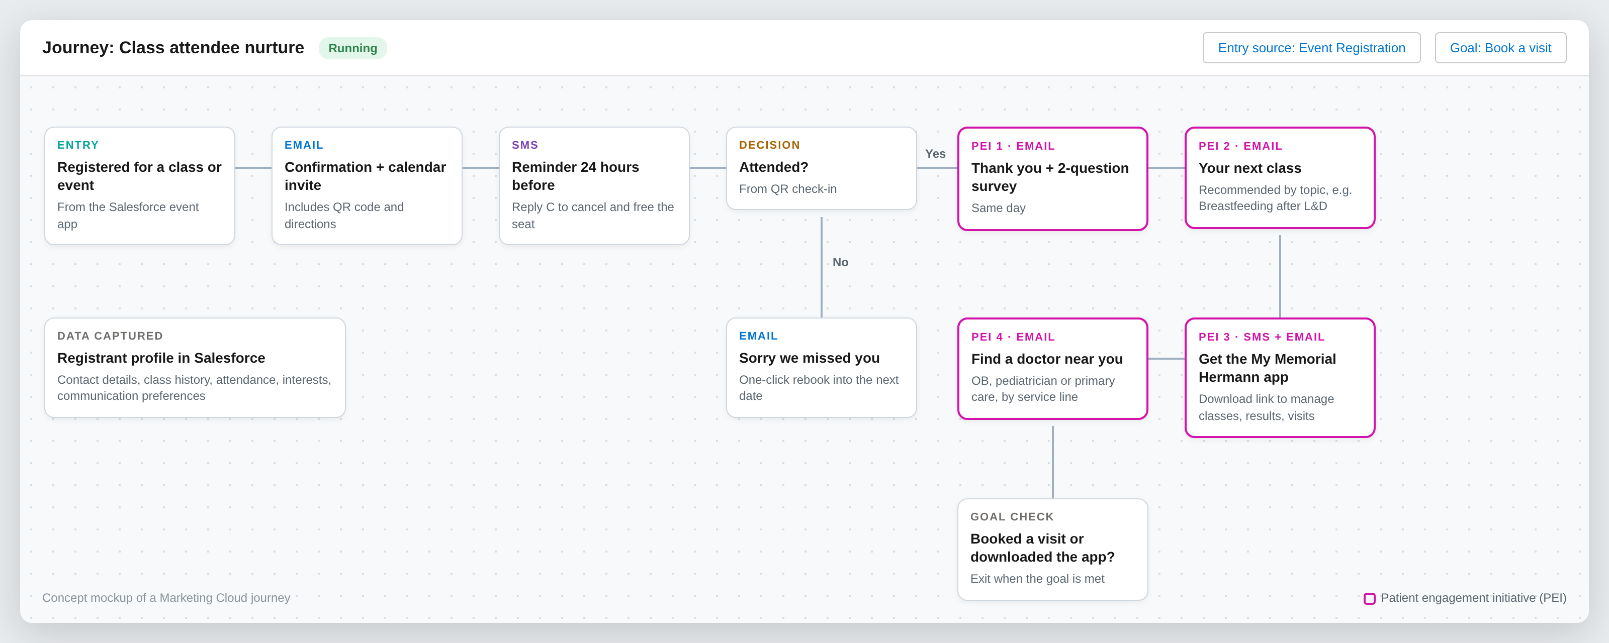
After the class: patient engagement initiatives (PEIs)
Notes:
Every class feeds one Marketing Cloud journey: confirmation, reminder, then four patient engagement initiatives (thank you and survey, next class, app adoption, find a doctor). The journey exits when the person books a visit or downloads the app.

Slide 22
Campaigns built from registration data
After this class
Follow-up PEIs
Network outcome
Labor and delivery prep
Breastfeeding and newborn classes, choose a pediatrician
Delivery at Memorial Hermann, new pediatric patients
Maternity hospital tour
Pre-register for delivery, prenatal class bundle
Delivery booked at Memorial Hermann
CPR and first aid
Heart health seminar, free screening invitation
Primary care and cardiology visits
Support groups and seminars
Education series, specialist-led events
Ongoing specialty care relationships
Provider conference
Next CME events, referral resources
A stronger referral network
Notes:
Examples to show the idea. We would pick two or three service lines with Kevin’s team to start.

Slide 23
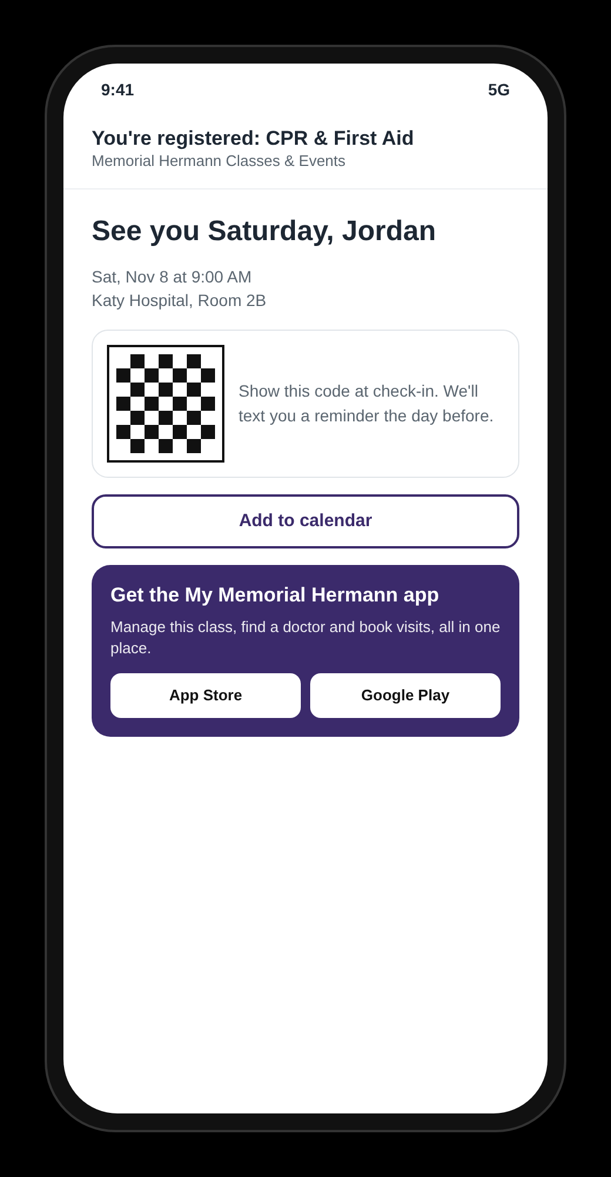
Bring website registrants into the app
1
Confirmation email
App link beside the calendar invite and QR code
2
Check-in
QR at the door and on room signage: scan to download
3
SMS reminder
Manage or cancel your class in the app
4
Post-class PEIs
Find a doctor, book a visit, see results in the app
Tracked links show which classes and service lines drive downloads and booked visits.
Notes:
My Memorial Hermann is their existing Epic-based patient app (scheduling, results, messaging). App users register in the app; people who register on the website get a tracked download link at every touchpoint. No new app is built.

Slide 24
How we will measure success
Conversion
Attendance
Engagement
Visitors who complete a registration
Registrants who show up; fewer no-shows
PEI opens, clicks and survey responses
Baseline set in discovery
Baseline set in discovery
Baseline set in discovery
Downloads
Visits booked
Revenue
App installs from event links
Appointments after a class or event
Paid registrations and conference fees
Baseline set in discovery
Baseline set in discovery
Baseline set in discovery
Notes:
We set baselines during discovery from the current tools, then report these in a Salesforce dashboard.

Slide 25
Roadmap: from registration to relationship
1
2
3
4
Conferences
Classes improved
Engagement
AI agents
Weeks 3-12
Weeks 13-20
From Phase 2 go-live
Week 21+
Sessions and speakers
My Agenda and badges
Certain retired
Shared event model
Instant confirmation, waitlists
Check-in and reporting
PEI journeys by service line
App adoption campaigns
Find-a-doctor nurture
Agents in a controlled harness
Demand and campaign agents
Concierge on web, app and SMS
Phases 1 and 2 solve today’s problem. Phases 3 and 4 grow engagement and the network on the same platform.
Notes:
Future plan. AI agents use Agentforce and are licensed separately; we would scope them after the core platform is live.

Slide 26













Future state: AI agents in a controlled harness
Phase 4, after the core platform is stable. Agentforce and Data Cloud [to confirm].
What the harness controls
Event Ops
Sessions, capacity, reminders
Approved actions only
Guardrails: consent, patient data, spend limits
HARNESS
Staff approve anything sent or published
Insights
Demand
Summarizes feedback and results
Event platform + Marketing Cloud
Spots surges, drafts new dates
Least-privilege identity per agent
Full audit trail of every action
Tested and evaluated before each release
Einstein Trust Layer: masking, zero data retention
Concierge
Campaign
Kill switch for any agent
Registers and answers on web, app, SMS
Builds PEI journeys
AUTONOMY GROWS WITH TRUST
Suggest
Act with approval
Act within limits
Notes:
Future state. Five agents run day-to-day event and campaign work, but only through the harness: approved actions, guardrails on consent and patient data, staff approval for anything that reaches patients or spends money, per-agent identity, a full audit trail, evaluation before release, the Einstein Trust Layer and a kill switch. Autonomy grows as trust is earned.

Slide 27
Investment
Offshore delivery model: fixed scope, five-person pod, 10 sprints
Phase
Sprints
Standard
Partner
STANDARD PROGRAM VALUE
OFFSHORE
Phase 1 · Conferences, replaces Certain
1-6
$350,000
$175,000
$580,000
Phase 2 · Classes on the shared platform
7-10
$230,000
$115,000
Total program
10 sprints
$580,000
$290,000
STRATEGIC PARTNER INVESTMENT
$290,000
Included
Not included
Dedicated five-person offshore pod for 20 weeks
Sprint demos and milestone sign-offs
Testing, load testing, go-live and hypercare
Documentation and handover to your admins
Salesforce licenses (Shield, Agentforce, Data Cloud)
Payment gateway transaction fees
Waiting room subscription
50% partnership credit, applied upfront
You save $290,000 on the full program
Pricing is for an offshore delivery model. Indicative, billed at sprint milestones; final commercials in the statement of work.
Notes:
Pricing is for an offshore delivery model. Standard program value is $580,000. As a strategic partner, Memorial Hermann receives a 50% partnership credit applied upfront, for an investment of $290,000. Billing follows sprint milestones. Licenses and third-party fees are outside this price.

Slide 28
Next steps
1
Walk through today’s Experience Cloud site, the app and Certain
2
Confirm what is not working today and why Certain is being replaced
3
Confirm yearly volumes: classes, conferences, registrants
4
Confirm conference must-haves: sessions, badges, sponsors, CME
5
Agree the payment approach: keep both gateways or consolidate
6
Share the Certain renewal date so Phase 2 lands before it
7
Pick 2 to 3 service lines for the first engagement journeys
Then we return with a scoped plan, team and estimate.
Notes:
Ask Kevin to set up the walkthrough with Lucky Rai’s team. Items 2 to 7 let us firm up the timeline and estimate.

Slide 29
Notes:
Thank you. Open for questions.

