Slide 1
ONE EVENT PLATFORM ON SALESFORCE
Memorial Hermann Health System × Insight Global
CLASSES · EVENTS · CONFERENCES · ENGAGEMENT
OCTOBER 2026
Notes:
Thank Kevin for the detailed answers. Today: how we solve the event registration problem on the Salesforce platform they already own, how we deliver it, and how the registration data can grow engagement and the network.

Slide 2
Agenda
1
What we heard
4
Delivery timeline
2
The solution
5
Beyond the event
3
Payments and integrations
6
Roadmap and next steps
Notes:
Sections 1 to 4 solve the problem Kevin described. Section 5 is the value we add on top: using registration data to keep people engaged and bring them into the Memorial Hermann network.

Slide 3
What we heard
Area
Today
With one platform
Classes and events
Home-built on Salesforce + Sitecore; payments through Chase
One Salesforce event app for every class, tour and seminar
Conferences
Certain for 1 to 2 multi-day events a year; Authorize.net
Same app with sessions, tracks and speakers; Certain retired
Who registers
Consumers, caregivers and providers
One profile per person, matched to Health Cloud
Platform
Health Cloud and Marketing Cloud
Built on what Memorial Hermann already owns
Epic
Not needed for this use case
Lucky Rai’s team if an integration is ever required
Goal: one platform for simple classes (free or paid, in person or online) and multi-day conferences with session management.
Notes:
Play back Kevin’s answers so he can correct anything. Two systems and two payment gateways today; the goal is one platform.

Slide 4
01 THE SOLUTION
One Salesforce event app for classes, events and conferences

Slide 5
An event app inside your Salesforce org
1
2
3
Register
Manage
Engage
Website and mobile
Event app in Salesforce
Marketing Cloud journeys
Class listings and sign-up on Sitecore pages
Mobile-friendly checkout
“My Agenda” portal for conferences
Classes, series, sessions, speakers
Capacity, waitlists, refunds
QR check-in and reporting
Registrants matched to Health Cloud
Confirmations and reminders
Calendar invites and virtual links
Post-event interactions (PEIs)
CONNECTS TO
Chase
Authorize.net
Sitecore
Zoom / Teams
Health Cloud
Marketing Cloud
Notes:
One app on the Health Cloud org they already own. Sitecore stays the public front door, Salesforce runs events, Marketing Cloud sends every message. This retires both the home-built class tool and Certain.

Slide 6
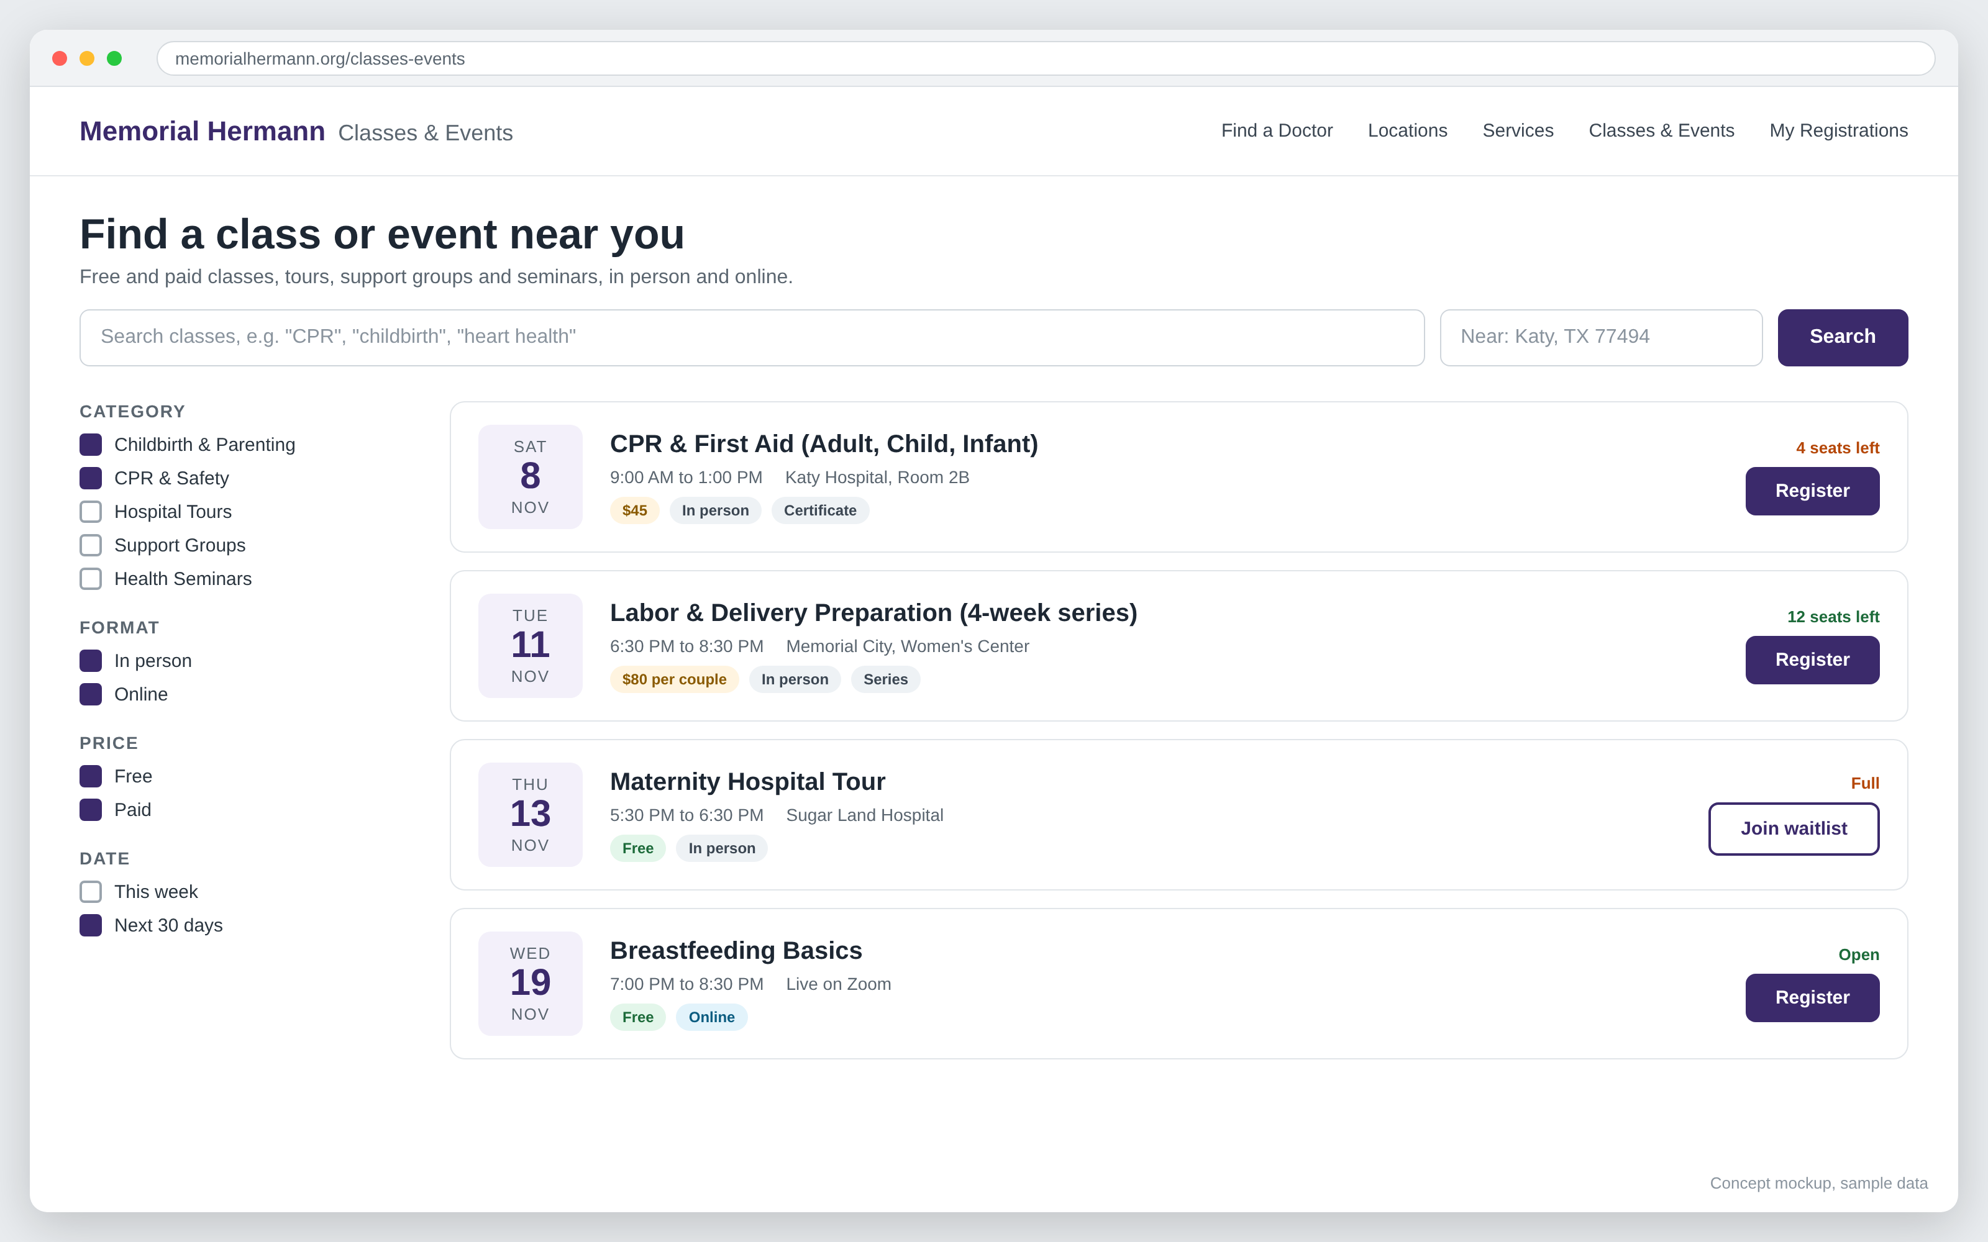
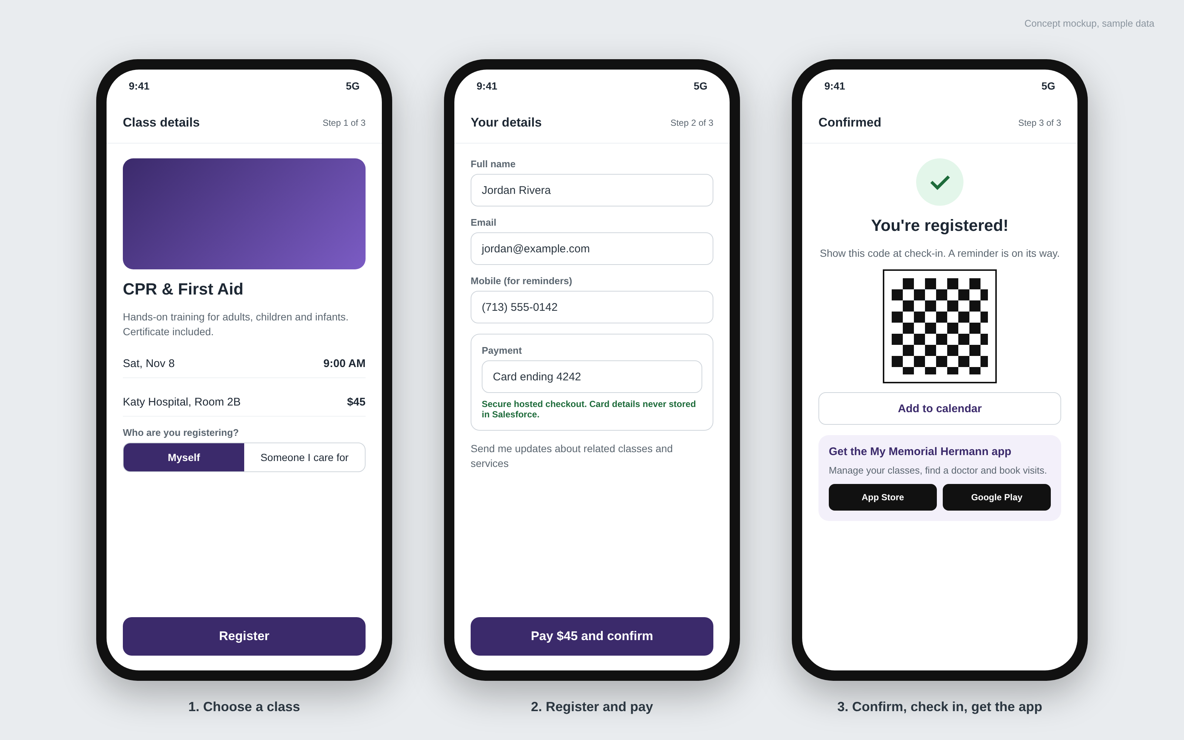
Consumers find, register and pay in minutes
Website
Mobile
Search by topic, location, date, format and price. Seats left and waitlists update live.
Register yourself or someone you care for, pay securely, get a QR code and the app link.
Notes:
Concept screens, sample data. The same experience works on desktop and phone, and can sit inside the existing Sitecore site.

Slide 7
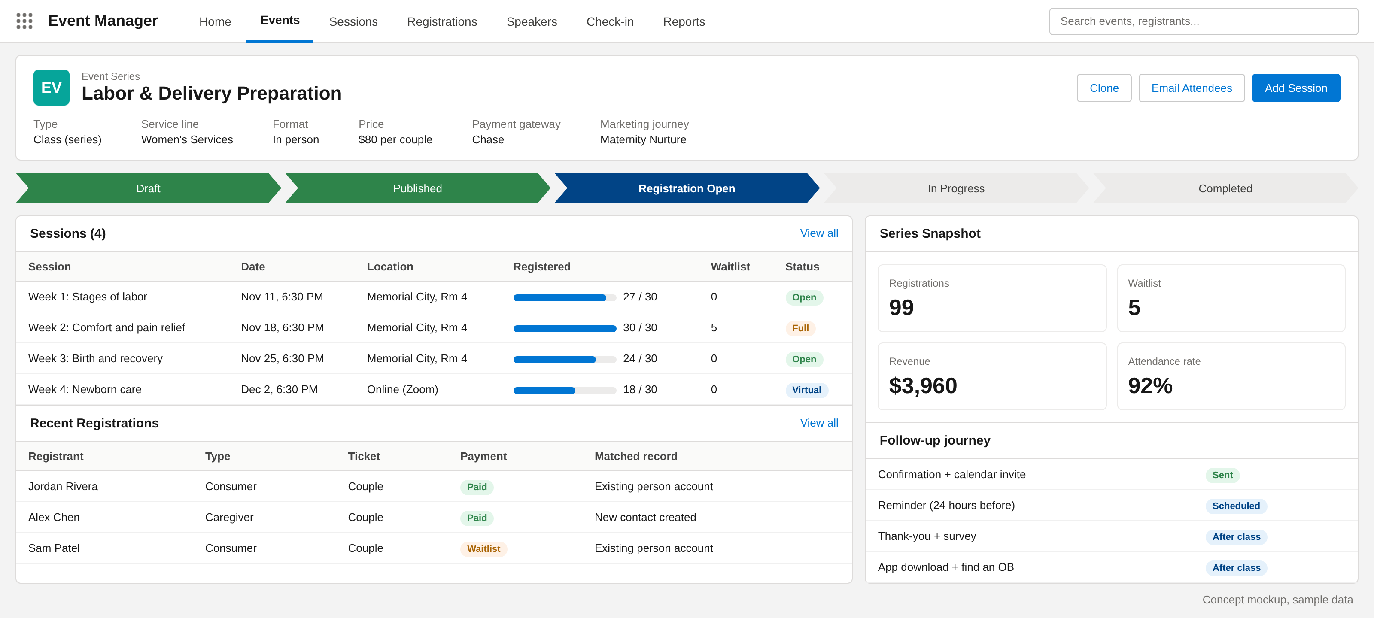
Staff run every class from one Salesforce console
What staff can do
Set up a class once and repeat it as a series
Watch capacity and waitlists fill in real time
Match registrants to existing Health Cloud records
Check people in with a QR scan
Email attendees and track revenue
Concept mockup, sample data
Notes:
This is a standard Salesforce Lightning app, so their in-house Salesforce admins can own it after launch.

Slide 8
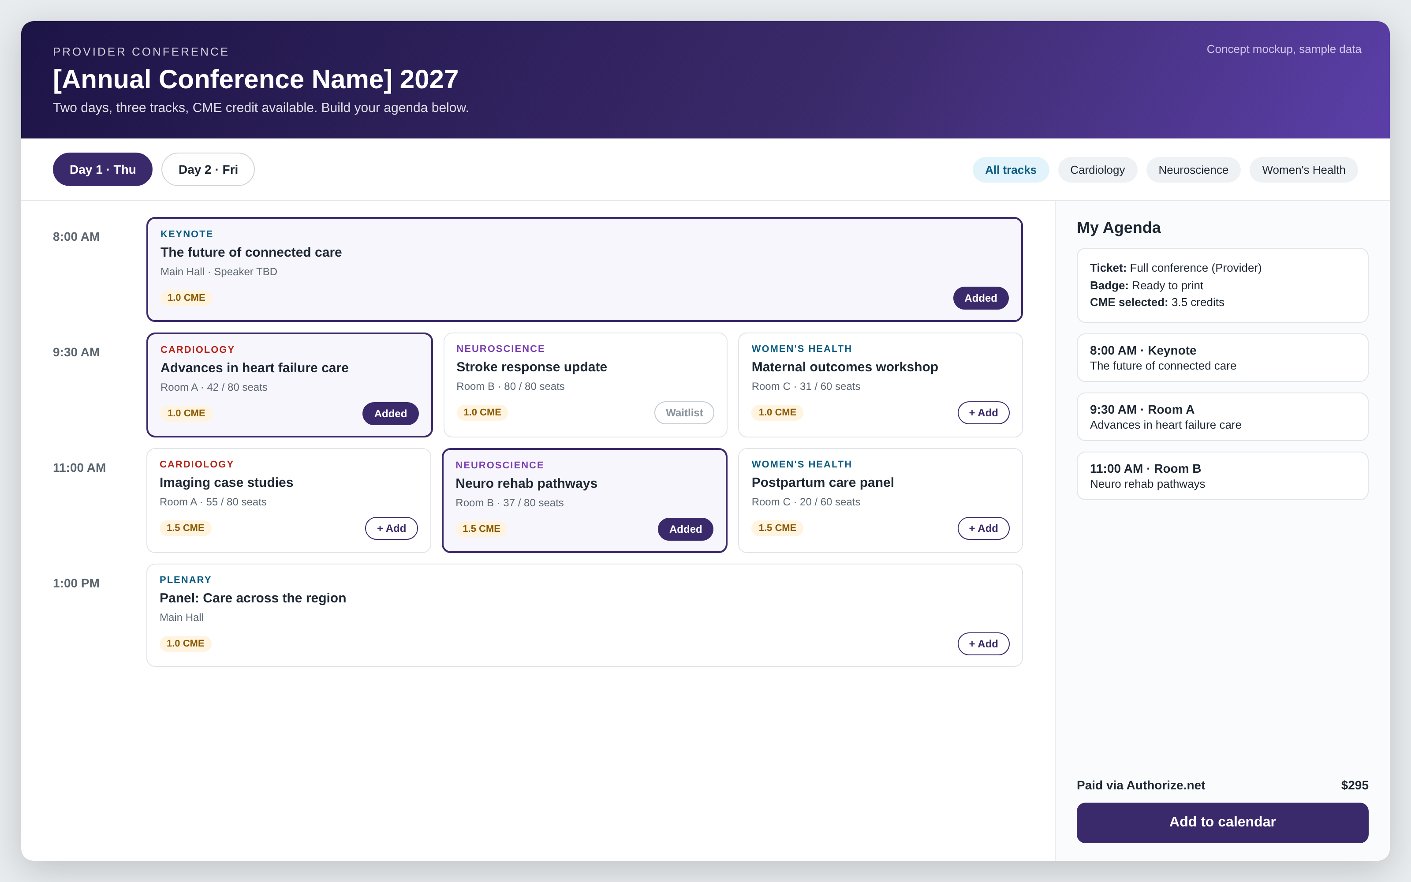
Conferences with full session management
Replaces Certain
Multi-day agenda with tracks and rooms
Attendees build their own “My Agenda”
Session capacity and waitlists
Speaker profiles and assignments
Ticket types for providers and guests
Badges and CME credit tracking [to confirm]
Notes:
Conferences use the same app and data as classes, so attendees, payments and reporting stay in one place. CME requirements to be confirmed with Kevin.

Slide 9
Payments and integrations
Registrant checks out
Hosted payment page
Chase or Authorize.net
Payment record in Salesforce
Receipts, refunds, reconciliation
What’s included
OPTION A
OPTION B
Card details stay on the gateway’s hosted page, never in Salesforce (smaller PCI scope)
Free, paid, discount codes and per-couple pricing
Full and partial refunds from Salesforce
Automatic receipts and a daily reconciliation report
Keep both gateways
Consolidate on one
Chase for classes, Authorize.net for conferences. No change for finance.
One gateway for every event. Simpler reconciliation and support.
Decision for Memorial Hermann finance; both options are supported.
Notes:
Today Chase handles Salesforce-based classes and Authorize.net handles Certain events. We support either path. Hosted checkout keeps card data out of Salesforce.

Slide 10
02 DELIVERY PLAN
Two phases, about 24 weeks to both platforms live

Slide 11
Delivery timeline
Indicative; confirmed after the current-state walkthrough
Weeks 4-14 · Phase 1 live
Week 25+ · Grow
Classes and events: registration, payments, journeys, check-in. Home-built tool retired
Engagement journeys, app downloads, AI assistant and recommendations
Weeks 1-3 · Discover and design
Weeks 15-24 · Phase 2 live
Walkthrough of the current build, requirements, data model, payment decision
Conferences: sessions, speakers, My Agenda, badges. Certain retired
Notes:
Phase 1 replaces the home-built class registration around week 14. Phase 2 replaces Certain around week 24; time it to land before the Certain renewal. Engagement work can start as soon as Phase 1 is live.

Slide 12
What each phase delivers
Phase 1 · Classes and events
Phase 2 · Conferences and sessions
Scope
Event catalog, recurring classes, capacity and waitlists
Multi-day agenda, tracks, rooms and session capacity
Registration
Consumers and caregivers, family sign-up
Providers and guests, ticket types, My Agenda
Payments
Chase hosted checkout, refunds, receipts
Authorize.net or one consolidated gateway
Engagement
Confirmation and reminder journeys, QR check-in
Speaker and attendee communications, badges, CME [to confirm]
Data
Registrants matched to Health Cloud records
Certain history migrated
Retires
Home-built class registration
Certain
Notes:
Same team and same app across both phases, so Phase 2 builds on Phase 1 rather than starting over.

Slide 13
03 BEYOND THE EVENT
Turn every registration into a lasting relationship

Slide 14
Every registration tells you what a person cares about. Use it to bring them back and into the network.
1 profile
4 PEIs
Every registrant, caregiver and provider in one Salesforce record
Automated post-event interactions after every class
1 tap
Closed loop
App download link at confirmation, check-in and follow-up
From class attended to visit booked, measured end to end
Consent-based: messages go only to people who opt in at registration.
Notes:
This is the upsell. The event platform captures first-party data about what each person is interested in. Marketing Cloud journeys turn that into post-event interactions that lead to app downloads and booked visits.

Slide 15
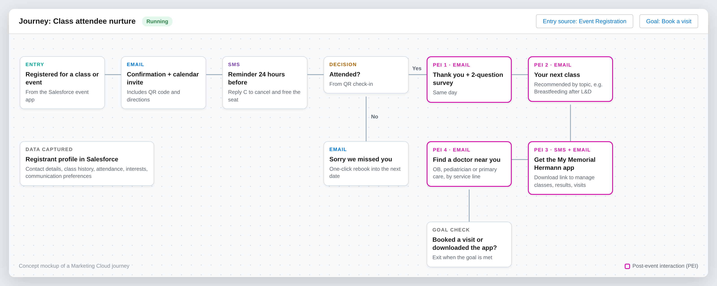
After the class: post-event interactions (PEIs)
Notes:
Every class feeds one Marketing Cloud journey: confirmation, reminder, then four PEIs (thank you and survey, next class, app download, find a doctor). The journey exits when the person books a visit or downloads the app.

Slide 16
Campaigns built from registration data
After this class
Follow-up PEIs
Network outcome
Labor and delivery prep
Breastfeeding and newborn classes, choose a pediatrician
Delivery at Memorial Hermann, new pediatric patients
Maternity hospital tour
Pre-register for delivery, prenatal class bundle
Delivery booked at Memorial Hermann
CPR and first aid
Heart health seminar, free screening invitation
Primary care and cardiology visits
Support groups and seminars
Education series, specialist-led events
Ongoing specialty care relationships
Provider conference
Next CME events, referral resources
A stronger referral network
Notes:
Examples to show the idea. We would pick two or three service lines with Kevin’s team to start.

Slide 17
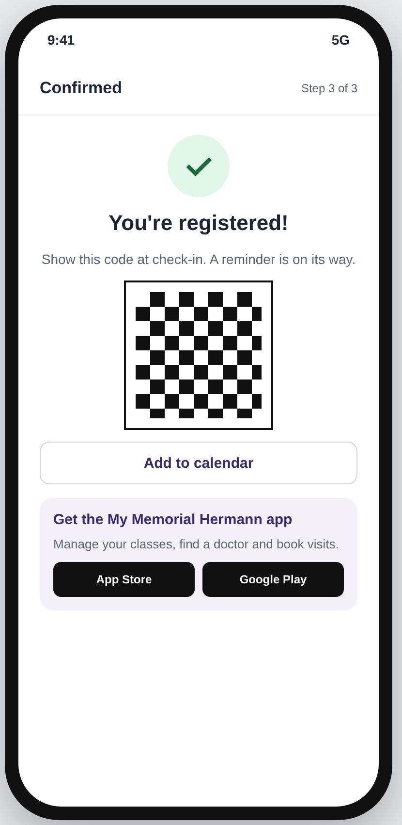
Drive My Memorial Hermann app downloads
1
Confirmation email
App link beside the calendar invite and QR code
2
Check-in
QR at the door and on room signage: scan to download
3
SMS reminder
Manage or cancel your class in the app
4
Post-class PEIs
Find a doctor, book a visit, see results in the app
Tracked links show which classes and service lines drive downloads and booked visits.
Notes:
My Memorial Hermann is their Epic-based patient app (scheduling, results, messaging). Every touchpoint in the event journey carries a tracked download link.

Slide 18
How we will measure success
Conversion
Attendance
Engagement
Visitors who complete a registration
Registrants who show up; fewer no-shows
PEI opens, clicks and survey responses
Baseline set in discovery
Baseline set in discovery
Baseline set in discovery
Downloads
Visits booked
Revenue
App installs from event links
Appointments after a class or event
Paid registrations and conference fees
Baseline set in discovery
Baseline set in discovery
Baseline set in discovery
Notes:
We set baselines during discovery from the current tools, then report these in a Salesforce dashboard.

Slide 19
Roadmap: from registration to relationship
1
2
3
4
Classes and events
Conferences
Engagement
Intelligence
Weeks 1-14
Weeks 15-24
From Phase 1 go-live
Week 25+
Registration and payments
Marketing Cloud reminders
QR check-in and reporting
Sessions and speakers
My Agenda and badges
Certain retired
PEI journeys by service line
App download campaigns
Find-a-doctor nurture
AI registration assistant (Agentforce)
Session and class recommendations
Class-to-visit attribution
Phases 1 and 2 solve today’s problem. Phases 3 and 4 grow engagement and the network on the same platform.
Notes:
Future plan. AI features use Agentforce and are licensed separately; we would scope them after the core platform is live.

Slide 20
Next steps
1
Walk through the current class solution with Lucky Rai’s team
2
Confirm yearly volumes: classes, conferences, registrants
3
Confirm conference must-haves: sessions, badges, sponsors, CME
4
Agree the payment approach: keep both gateways or consolidate
5
Share the Certain renewal date so Phase 2 lands before it
6
Pick 2 to 3 service lines for the first engagement journeys
Then we return with a scoped plan, team and estimate.
Notes:
Ask Kevin to set up the walkthrough with Lucky Rai’s team. Items 2 to 6 let us firm up the timeline and estimate.

Slide 21
Notes:
Thank you. Open for questions.

