Slide 1
ONE EVENT PLATFORM ON SALESFORCE
Memorial Hermann Health System × Insight Global
CLASSES · EVENTS · CONFERENCES · ENGAGEMENT
OCTOBER 2026
Notes:
Thank Kevin for the detailed answers. Today: how we solve the event registration problem on the Salesforce platform they already own, how we deliver it, and how the registration data can grow engagement and the network.

Slide 2
Agenda
1
Business opportunity
4
Delivery timeline
2
The solution and design
5
Beyond the event
3
Payments and data security
6
Roadmap and next steps

Slide 3
Business Opportunity
Area
Today
With one platform
Classes and events
Home-built on Salesforce + Sitecore; payments through Chase
One Salesforce event app for every class, tour and seminar
Conferences
Certain for 1 to 2 multi-day events a year; Authorize.net
Same app with sessions, tracks and speakers; Certain retired
Who registers
Consumers, caregivers and providers
One profile per person, matched to Health Cloud
Platform
Health Cloud and Marketing Cloud
Built on what Memorial Hermann already owns
Epic
Not needed for this use case
Lucky Rai’s team if an integration is ever required
Goal: one platform for simple classes (free or paid, in person or online) and multi-day conferences with session management.

Slide 4
01 THE SOLUTION
One Salesforce event app for classes, events and conferences

Slide 5
An event app inside your Salesforce org
1
2
3
Register
Manage
Engage
Website and My MH app
Event app in Salesforce
Marketing Cloud journeys
Sign-up on Sitecore pages and inside the existing My Memorial Hermann app
Secure hosted checkout
“My Agenda” portal for conferences
Classes, series, sessions, speakers
Capacity, waitlists, refunds
QR check-in and reporting
Registrants matched to Health Cloud
Confirmations and reminders
Calendar invites and virtual links
Patient engagement initiatives (PEIs)
CONNECTS TO
Chase
Authorize.net
Sitecore
Zoom / Teams
Health Cloud
Marketing Cloud
Reliable, secure and scalable by design: waiting room and seat holds for busy events, encrypted data, full audit trail.

Slide 6
Overall solution design
One flow from sign-up to follow-up for classes and conferences, replacing the home-built class tool and Certain
Registrant
Website or My MH app
Registration service
Payment gateway
Salesforce event app
Marketing Cloud
Event staff
REGISTER
Find a class or conference
1
Register and hold a seat
2
Seat held for 10 minutes
3
PAY
Pay on hosted page (free events skip this)
4
Signed webhook, token only
5
Create registration (queued, idempotent)
6
CONFIRM
Registration event
7
Confirmation, QR code, calendar invite, reminders
8
ATTEND
QR check-in at the door
9
ENGAGE
Attendance and interests
10
PEIs: thank you, next class, app, find a doctor
11
GROW
Dashboards, waitlist and demand alerts
12
Add a session in one click
13
Conferences follow the same flow, adding sessions, speakers and My Agenda.
Notes:
This is the whole solution on one page, in the order a registrant experiences it. Register: website or the existing My Memorial Hermann app, with a seat held while they pay. Pay: the gateway hosts the card page; we receive only a token. Confirm: Salesforce records the registration and Marketing Cloud sends confirmation and reminders. Attend: QR check-in. Engage: patient engagement initiatives. Grow: staff see demand and add sessions. It replaces both the home-built class tool and Certain.

Slide 7
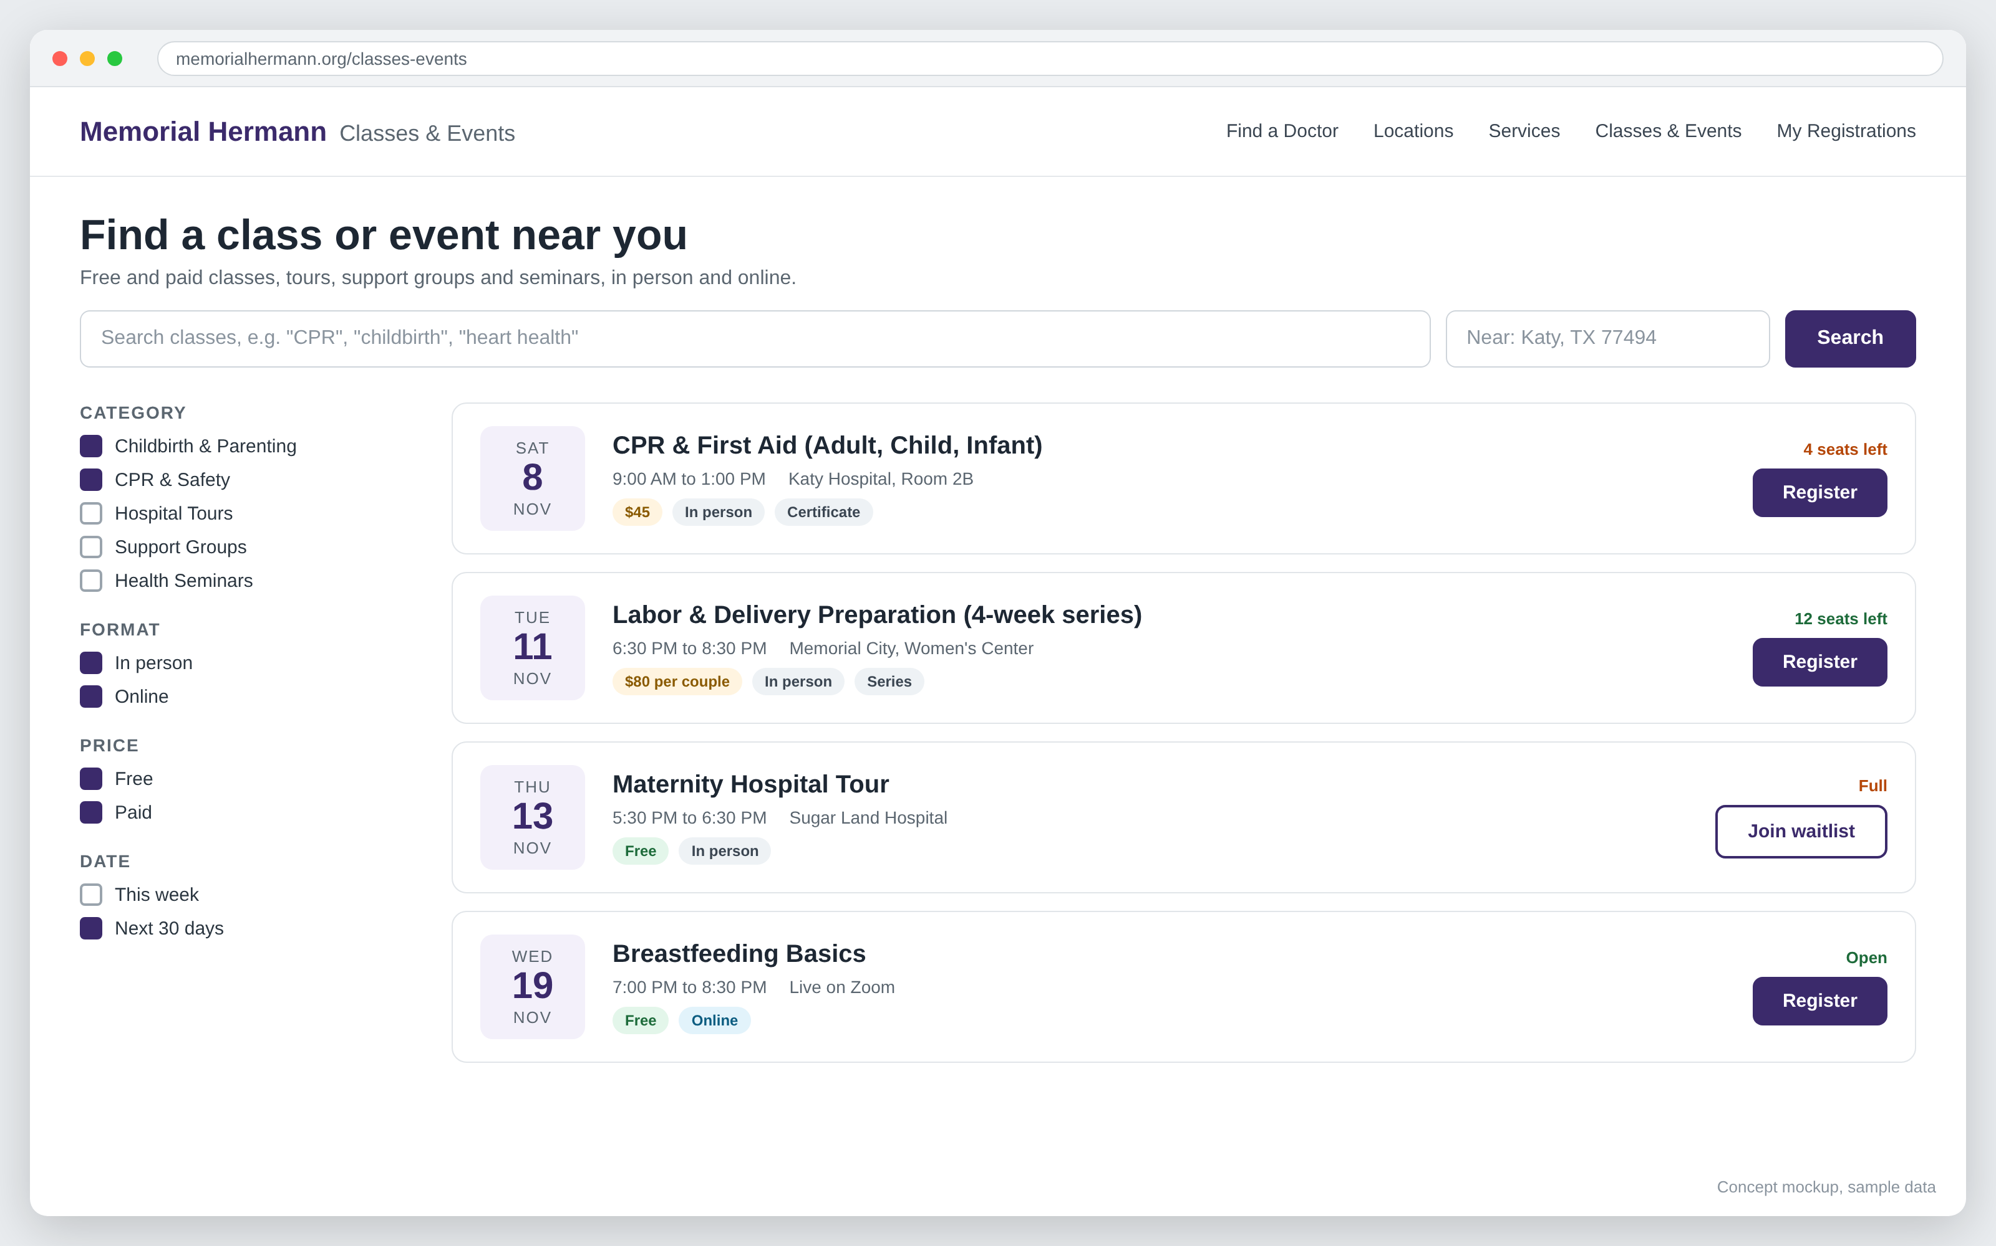
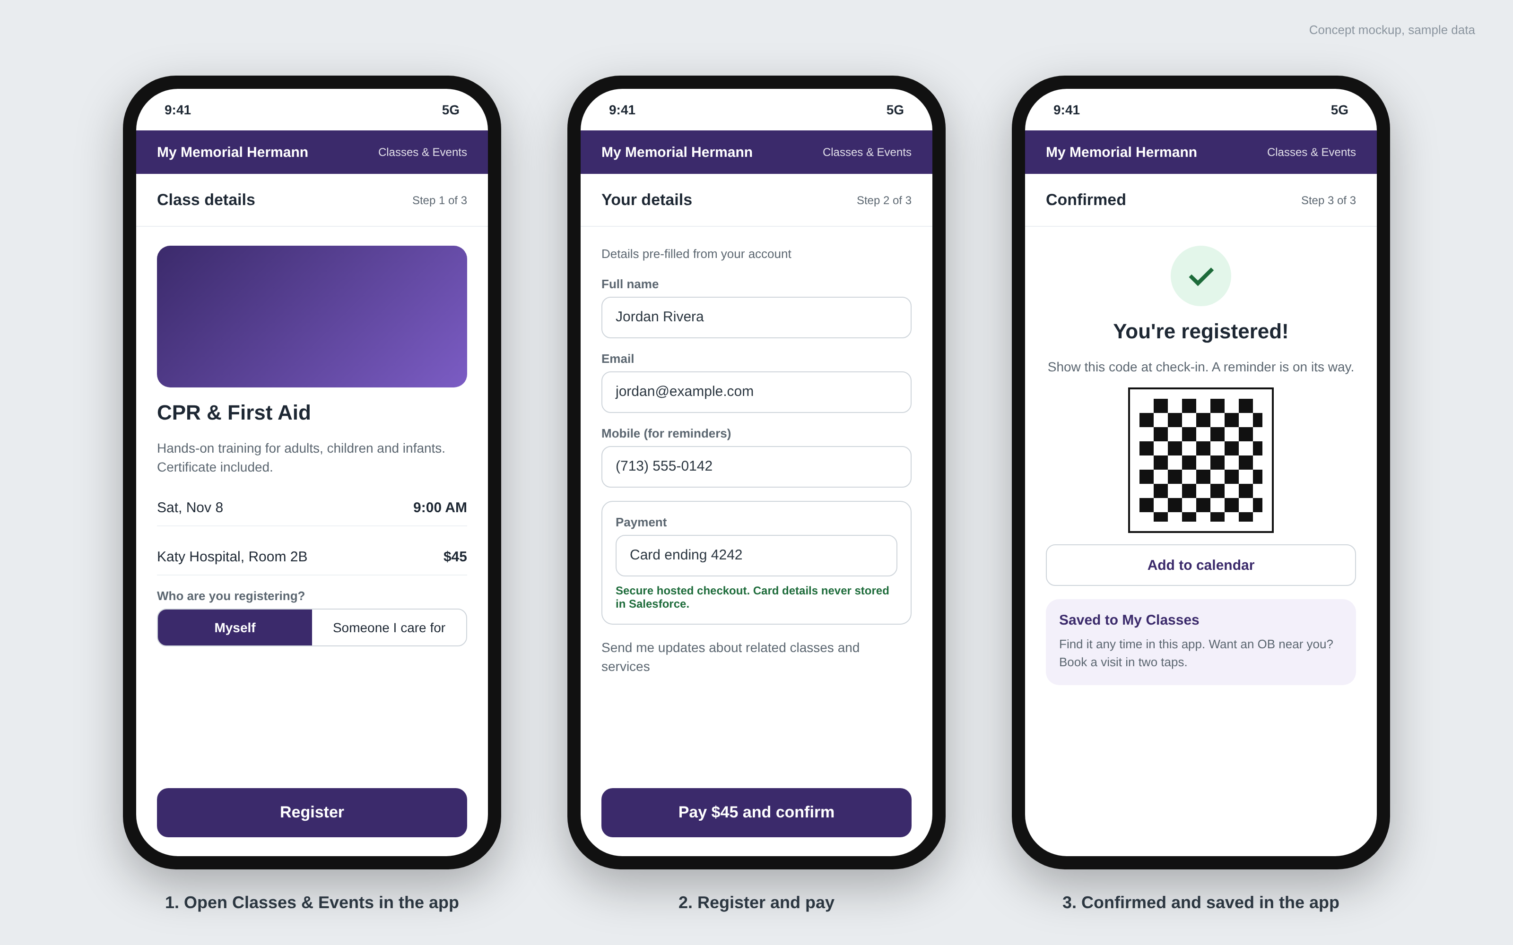
One registration flow for website and app
Website
Existing My Memorial Hermann app
Search by topic, location, date, format and price. Seats left and waitlists update live.
A Classes & Events entry in the app people already use. No new app to download [Epic setup to confirm].
Notes:
Concept screens, sample data. One registration flow serves the Sitecore website and the existing My Memorial Hermann app (Epic MyChart), so nothing is built twice. How it appears in the app (menu link or SMART on FHIR launch) is confirmed with Lucky Rai’s team.

Slide 8
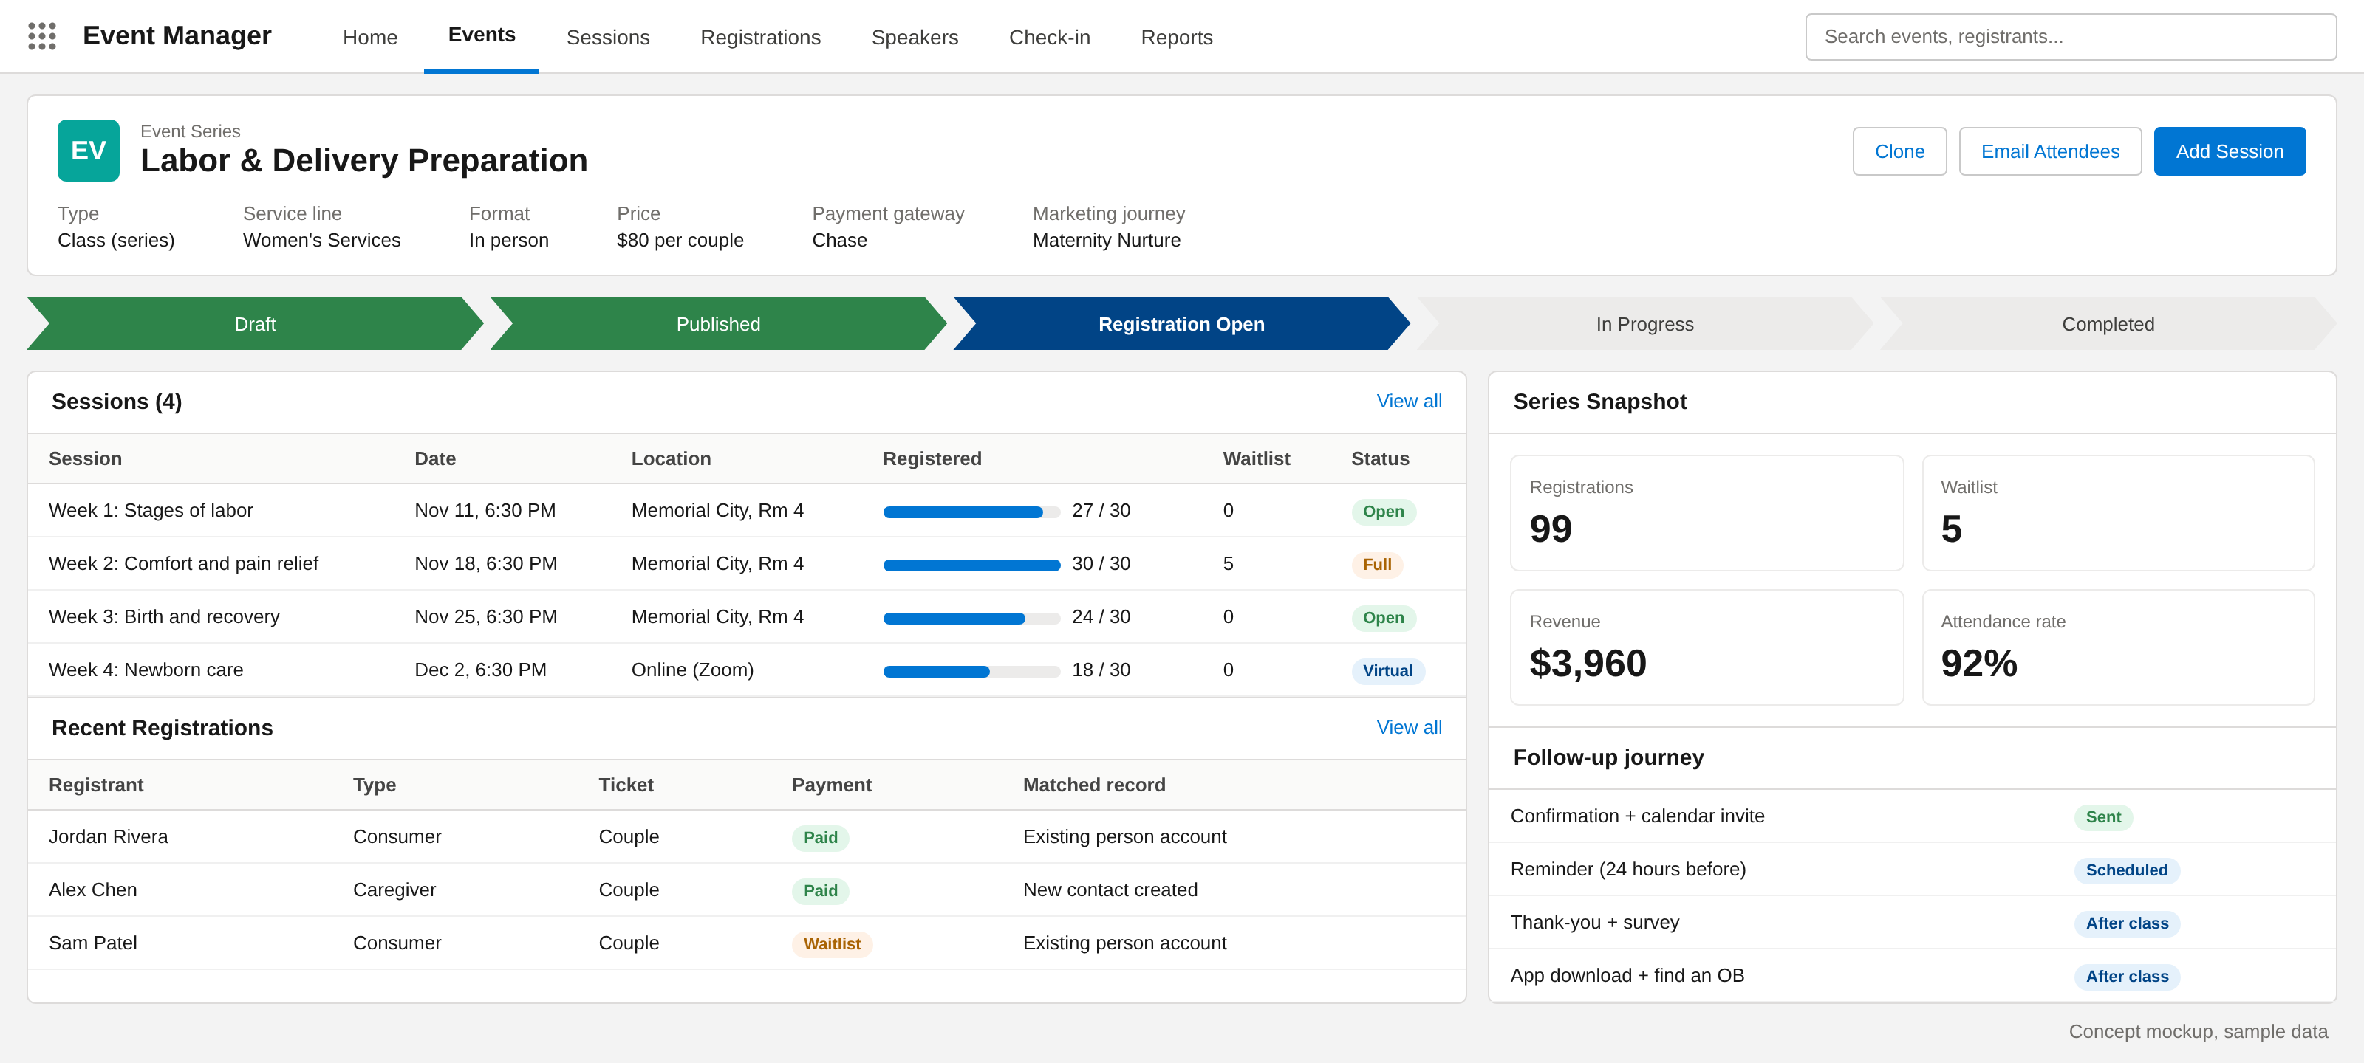
Staff run every class from one Salesforce console
What staff can do
Set up a class once and repeat it as a series
Watch capacity and waitlists fill in real time
Match registrants to existing Health Cloud records
Check people in with a QR scan
Email attendees and track revenue
Concept mockup, sample data
Notes:
This is a standard Salesforce Lightning app, so their in-house Salesforce admins can own it after launch.

Slide 9
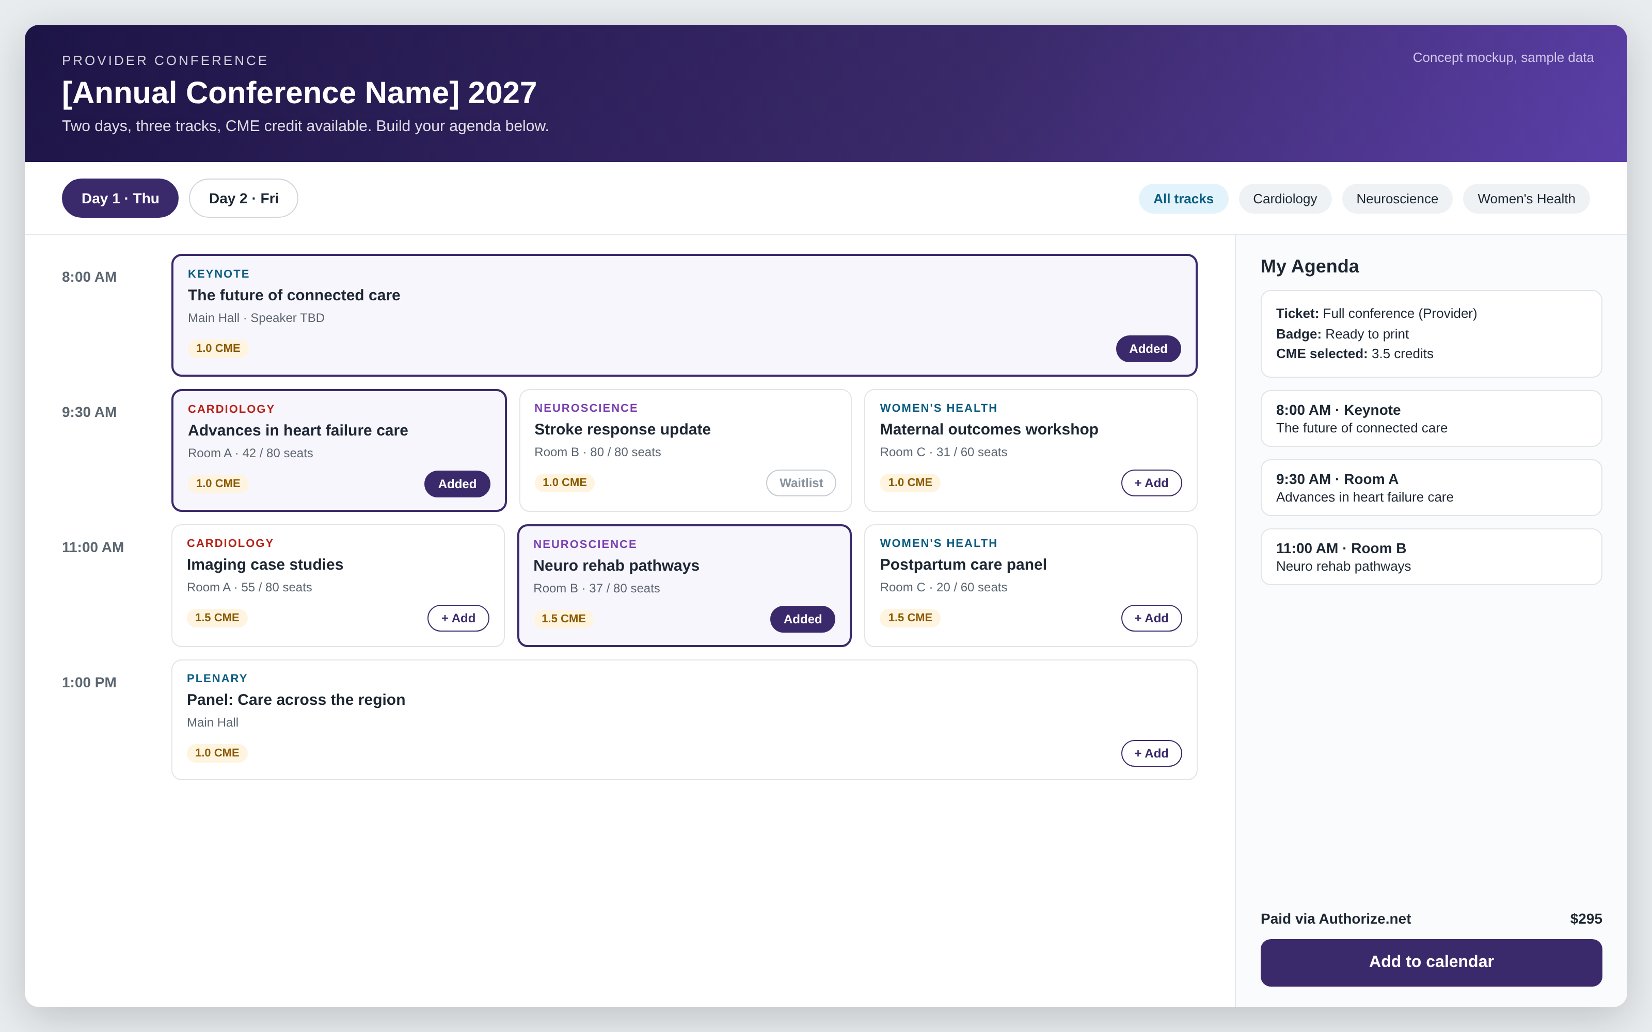
Conferences with full session management
Replaces Certain
Multi-day agenda with tracks and rooms
Attendees build their own “My Agenda”
Session capacity and waitlists
Speaker profiles and assignments
Ticket types for providers and guests
Badges and CME credit tracking [to confirm]
Notes:
Conferences use the same app and data as classes, so attendees, payments and reporting stay in one place. CME requirements to be confirmed with Kevin.

Slide 10




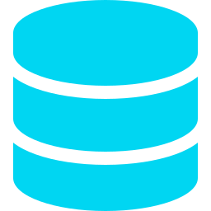

Every seat filled, no interested person lost
Example: 100,000 people click Register for a class with 30 seats
1
2
3
4
5
Edge protection
Fair waiting room
Seat hold
Hosted payment
Salesforce
Cached pages, bot defense, rate limits
Admits people in arrival order
10-minute hold; a seat can never be sold twice
Paid = confirmed; unpaid seats return
Queued and retried; never lost
WHERE EVERY CLICK ENDS UP
30
60
All others
Turn overflow into sessions
Demand passes 3× the seats
Staff add a session in one click
Waitlist offered first, then the interest list
Confirmed seats
On the waitlist
On the interest list
Paid, ticketed, QR check-in sent
Freed seats offered by SMS with a 2-hour claim window
Told the moment a new date opens
Reliable: queued, idempotent writes and auto-released holds. Scalable: only admitted traffic reaches Salesforce. Secure: bot defense on every hot event.
Notes:
A popular class can draw far more interest than seats. The platform answers every click within seconds, never oversells, never charges someone who did not get a seat, and keeps everyone who missed out on a waitlist or interest list. When demand passes a threshold, staff add a session in one click and the people waiting get first access. Numbers are an example; caps and thresholds are set per event.

Slide 11
Design detail: registration and seat flow
Registrant
Edge and waiting room
Registration service
Seat inventory
Payment page
Salesforce
Marketing Cloud
Click Register
1
Place in line shown
2
Admit at a safe rate
3
Hold one seat (atomic)
4
If a seat is available
Hold granted, 10 minutes
Your seat is held, pay now
5
6
Pay on hosted page
7
Signed payment webhook
8
Create registration (idempotent, via queue)
9
Registration event
10
Confirmation, QR code, calendar invite
11
If sold out
No seats left
Join waitlist or get notified of new dates
12
13
Waitlist or interest record
14
Unpaid holds expire and return to the pool
Notes:
Step by step for a busy event. The waiting room admits people fairly, seat holds are atomic so a seat is never sold twice, writes to Salesforce are queued and idempotent so nothing is lost or duplicated, and everyone who misses a seat lands on the waitlist or interest list.

Slide 12









Payments and data security by design
Card data never enters our systems
Registrant and patient data, protected in layers
CARD DATA ZONE
Edge
Registrant
TLS 1.2+, web application firewall, bot defense, rate limits
Website or My Memorial Hermann app
Card numbers go straight to the payment gateway. PCI scope stays at the simplest level (SAQ A) [to confirm].
Access
SSO with MFA for staff; least-privilege permission sets
Gateway hosted page
Card typed here (Chase or Authorize.net)
Data
Shield Platform Encryption on sensitive fields; field-level security
Signed webhook
OUR SYSTEMS
Monitoring
Token, last 4 digits, approval code
No card number, CVV or expiry stored. Refunds by token. Signed, idempotent webhooks. Daily reconciliation.
Event Monitoring, Field Audit Trail, real-time alerts
Governance
Salesforce payment record
BAA [to confirm], data retention, no tracking pixels, pen tests
Token reference, last 4, amount, status
Class topics are treated as sensitive: signing up for a diabetes class implies a health condition.
Notes:
Two messages. First, card numbers never touch Memorial Hermann or Salesforce systems: the gateway hosts the payment page and returns a token. Second, registrant and patient data is protected in layers from the edge to governance. Shield licensing, BAA coverage and PCI level to be confirmed with Memorial Hermann IT and finance.

Slide 13
Design detail: payment sequence
Registrant (web or app)
Registration service
Gateway hosted page
Salesforce
Gateway choice
Create payment session (amount, reference)
OPTION A
1
Keep both
Session token
Chase for classes, Authorize.net for conferences
2
Open hosted payment page
3
Card details typed into the gateway page
OPTION B
4
Consolidate on one
Approved
One gateway for every event; simpler reconciliation
5
Signed webhook (token, last 4, approval code)
6
After payment
7
Verify signature, idempotency check
Full and partial refunds by token from Salesforce
Automatic receipts
Daily settlement reconciliation
Payment record: token, last 4, amount, status
8
No card number, CVV or expiry is ever stored
Notes:
The card is typed directly into the gateway page; the registration service only creates the session and receives a signed webhook with a token. Salesforce stores the token reference, last 4 digits, amount and status. Gateway choice is Memorial Hermann finance's decision; both are supported.

Slide 14
02 DELIVERY PLAN
Two phases, about 24 weeks to both platforms live

Slide 15
Delivery timeline
Indicative; confirmed after the current-state walkthrough
Weeks 4-14 · Phase 1 live
Week 25+ · Grow
Classes and events: registration, payments, journeys, check-in. Home-built tool retired
Patient engagement initiatives, app adoption, AI agents in a controlled harness
Weeks 1-3 · Discover and design
Weeks 15-24 · Phase 2 live
Walkthrough of the current build, requirements, data model, payment decision
Conferences: sessions, speakers, My Agenda, badges. Certain retired
Notes:
Phase 1 replaces the home-built class registration around week 14. Phase 2 replaces Certain around week 24; time it to land before the Certain renewal. Engagement work can start as soon as Phase 1 is live.

Slide 16
Delivery plan: 12 two-week sprints
A working demo and a milestone sign-off with Memorial Hermann at the end of every sprint
Discover and design
Phase 1 · Classes and events
Phase 2 · Conferences and engagement
Sprint-end milestone
SPRINT 1
SPRINT 2
SPRINT 3
SPRINT 4
SPRINT 5
SPRINT 6
Weeks 1-2
Weeks 3-4
Weeks 5-6
Weeks 7-8
Weeks 9-10
Weeks 11-12
Walkthrough, requirements, data model
Environments, CI/CD, security baseline, backlog
Event catalog and class listings on Sitecore
Registration, seat holds, waitlist
Chase checkout, refunds, confirmation journeys
QR check-in, reporting, My MH app entry, load test
Design sign-off
Architecture approved
Classes browsable in test
Registration demo
Pay and confirm end to end
User testing starts
SPRINT 7
SPRINT 8
SPRINT 9
SPRINT 10
SPRINT 11
SPRINT 12
Weeks 13-14
Weeks 15-16
Weeks 17-18
Weeks 19-20
Weeks 21-22
Weeks 23-24
User testing, move upcoming classes, go-live
Sessions, tracks, rooms and speakers
My Agenda portal, ticket types, Authorize.net
Badges, CME [to confirm], PEI journeys
Certain data migration, load test, user testing
Go-live, hypercare, knowledge transfer
Phase 1 live
Conference build demo
Attendee portal demo
Engagement journeys pilot
Testing sign-off
Phase 2 live, Certain retired
Notes:
Two-week sprints, each closing with a demo and a milestone Memorial Hermann signs off. Sprints 1 and 2 cover discovery and design, sprints 3 to 7 deliver classes and events (live at week 14), and sprints 8 to 12 deliver conferences and the first engagement journeys (live at week 24, Certain retired). Sprint scope is refined after the current-state walkthrough.

Slide 17




A dedicated five-person delivery pod
Every two-week sprint
LEAD
Scrum Master or Project Manager
Plan
1
Runs sprints, milestones, risks and status
Sprint planning with your product owner
Build and test
Daily stand-ups; QA inside the sprint
QUALITY
QA Engineer
Demo
1
Test plans, automation, load tests, user testing support
Sprint review and milestone sign-off
Improve
Retrospective; adjust the next sprint
BUILD
3
2 Salesforce Developers + 1 Marketing Cloud Developer
FROM MEMORIAL HERMANN
A product owner, plus an Epic and app contact from Lucky Rai’s team
Event app, registration, payments, integrations, journeys and PEIs
5 people · 12 sprints · 24 weeks
Notes:
A small, dedicated pod: one Scrum Master or Project Manager leading delivery, one QA engineer embedded in every sprint, and a build team of two Salesforce developers and one Marketing Cloud developer. Memorial Hermann provides a product owner and an Epic and app contact.

Slide 18
What each phase delivers
Phase 1 · Classes and events
Phase 2 · Conferences and sessions
Scope
Event catalog, recurring classes, capacity and waitlists
Multi-day agenda, tracks, rooms and session capacity
Registration
Consumers and caregivers, family sign-up
Providers and guests, ticket types, My Agenda
Payments
Chase hosted checkout, refunds, receipts
Authorize.net or one consolidated gateway
Engagement
Confirmation and reminder journeys, QR check-in
Speaker and attendee communications, badges, CME [to confirm]
Data
Registrants matched to Health Cloud records
Certain history migrated
Built in
Waiting room, seat holds, encryption, monitoring
Load test before each conference opens
Retires
Home-built class registration
Certain
Notes:
Same team and same app across both phases, so Phase 2 builds on Phase 1 rather than starting over.

Slide 19
03 BEYOND THE EVENT
Turn every registration into a lasting relationship

Slide 20
1 profile
4 PEIs
Every registrant, caregiver and provider in one Salesforce record
Patient engagement initiatives after every class
Every registration tells you what a person cares about. Use it to bring them back and into the network.
1 tap
Closed loop
App download link at confirmation, check-in and follow-up
From class attended to visit booked, measured end to end
Consent-based: messages go only to people who opt in at registration.
Notes:
This is the upsell. The event platform captures first-party data about what each person is interested in. Marketing Cloud journeys turn that into patient engagement initiatives that lead to app adoption and booked visits.

Slide 21
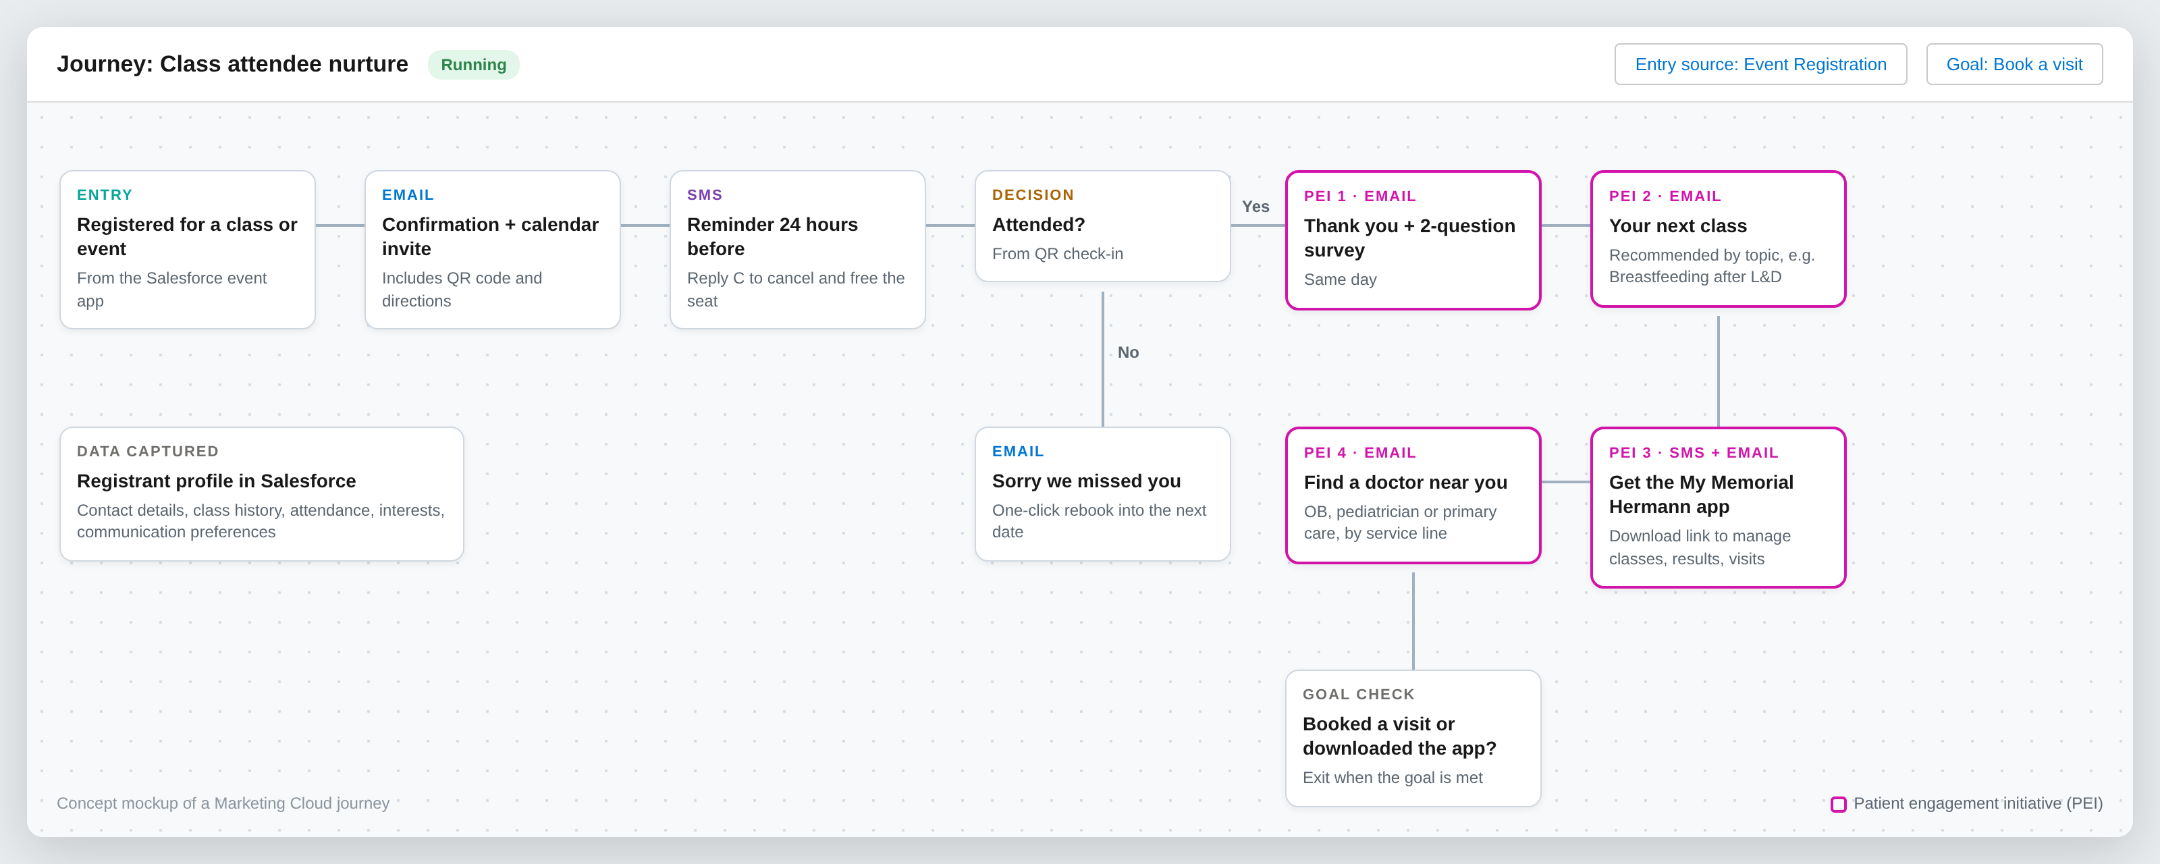
After the class: patient engagement initiatives (PEIs)
Notes:
Every class feeds one Marketing Cloud journey: confirmation, reminder, then four patient engagement initiatives (thank you and survey, next class, app adoption, find a doctor). The journey exits when the person books a visit or downloads the app.

Slide 22
Campaigns built from registration data
After this class
Follow-up PEIs
Network outcome
Labor and delivery prep
Breastfeeding and newborn classes, choose a pediatrician
Delivery at Memorial Hermann, new pediatric patients
Maternity hospital tour
Pre-register for delivery, prenatal class bundle
Delivery booked at Memorial Hermann
CPR and first aid
Heart health seminar, free screening invitation
Primary care and cardiology visits
Support groups and seminars
Education series, specialist-led events
Ongoing specialty care relationships
Provider conference
Next CME events, referral resources
A stronger referral network
Notes:
Examples to show the idea. We would pick two or three service lines with Kevin’s team to start.

Slide 23
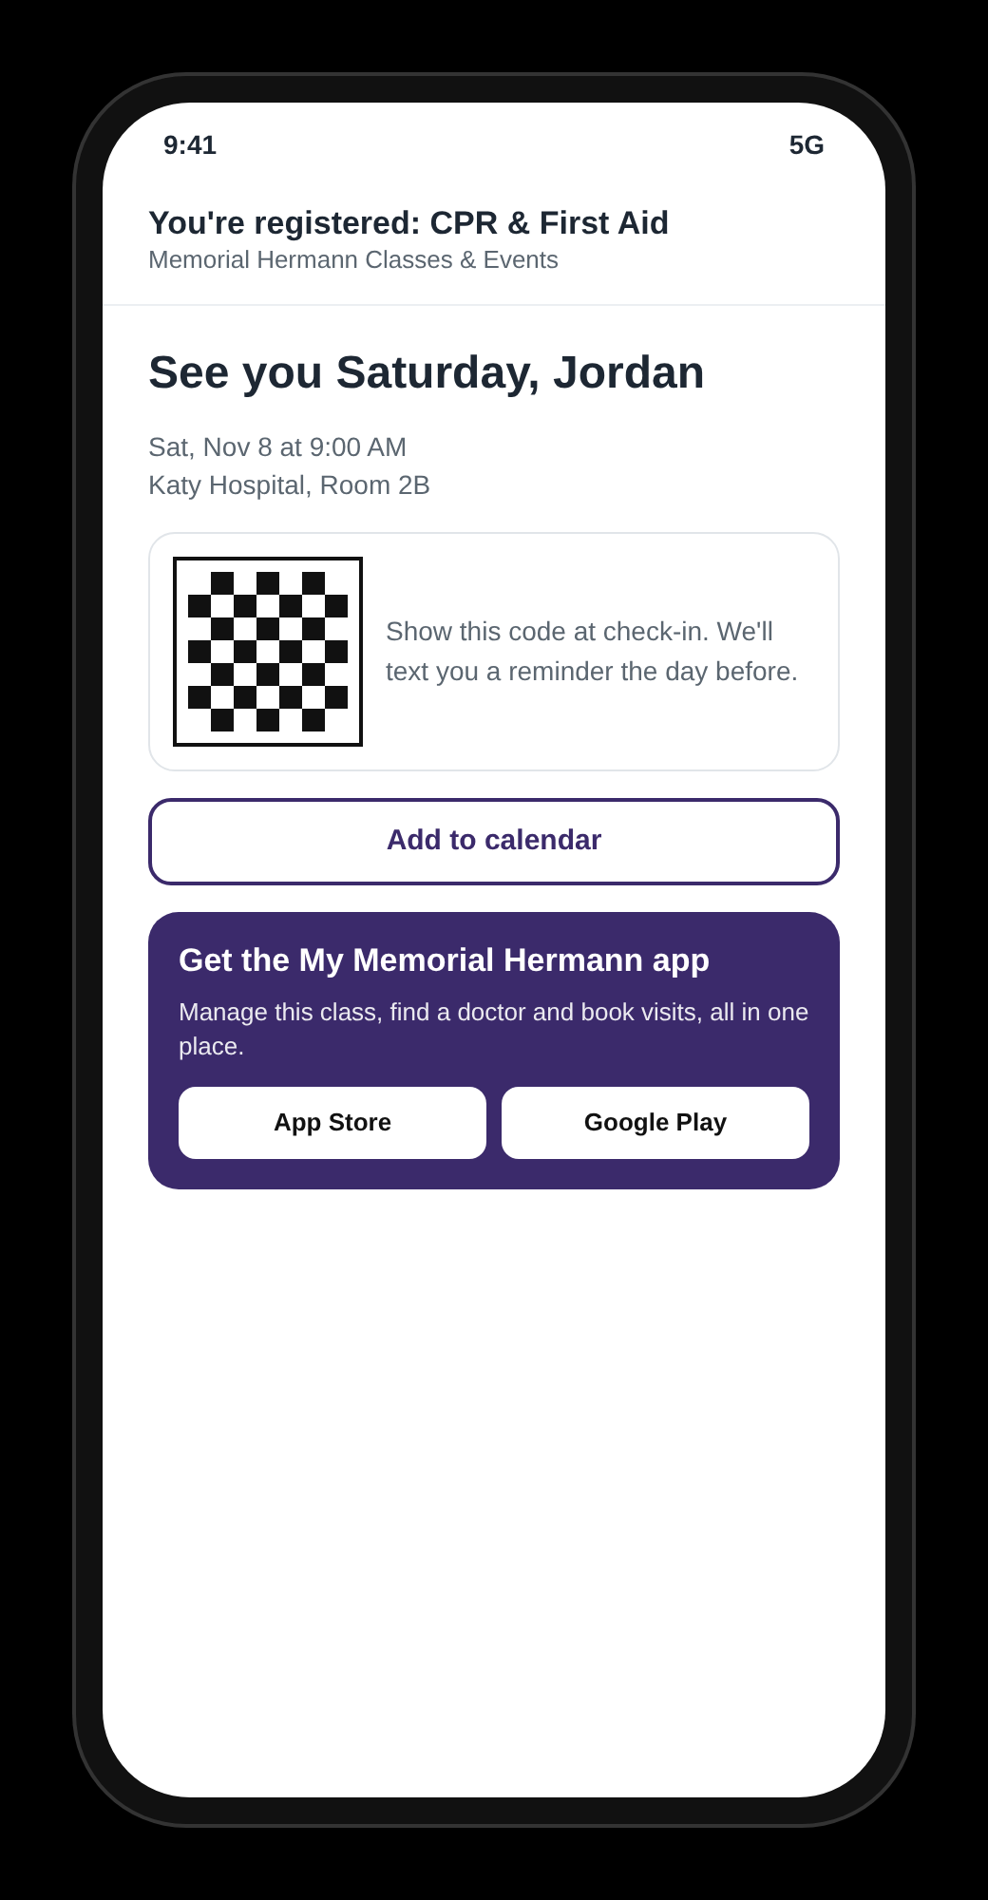
Bring website registrants into the app
1
Confirmation email
App link beside the calendar invite and QR code
2
Check-in
QR at the door and on room signage: scan to download
3
SMS reminder
Manage or cancel your class in the app
4
Post-class PEIs
Find a doctor, book a visit, see results in the app
Tracked links show which classes and service lines drive downloads and booked visits.
Notes:
My Memorial Hermann is their existing Epic-based patient app (scheduling, results, messaging). App users register in the app; people who register on the website get a tracked download link at every touchpoint. No new app is built.

Slide 24
How we will measure success
Conversion
Attendance
Engagement
Visitors who complete a registration
Registrants who show up; fewer no-shows
PEI opens, clicks and survey responses
Baseline set in discovery
Baseline set in discovery
Baseline set in discovery
Downloads
Visits booked
Revenue
App installs from event links
Appointments after a class or event
Paid registrations and conference fees
Baseline set in discovery
Baseline set in discovery
Baseline set in discovery
Notes:
We set baselines during discovery from the current tools, then report these in a Salesforce dashboard.

Slide 25
Roadmap: from registration to relationship
1
2
3
4
Classes and events
Conferences
Engagement
AI agents
Weeks 1-14
Weeks 15-24
From Phase 1 go-live
Week 25+
Registration and payments
Marketing Cloud reminders
QR check-in and reporting
Sessions and speakers
My Agenda and badges
Certain retired
PEI journeys by service line
App download campaigns
Find-a-doctor nurture
Agents in a controlled harness
Demand and campaign agents
Concierge on web, app and SMS
Phases 1 and 2 solve today’s problem. Phases 3 and 4 grow engagement and the network on the same platform.
Notes:
Future plan. AI agents use Agentforce and are licensed separately; we would scope them after the core platform is live.

Slide 26













Future state: AI agents in a controlled harness
Phase 4, after the core platform is stable. Agentforce and Data Cloud [to confirm].
What the harness controls
Event Ops
Sessions, capacity, reminders
Approved actions only
Guardrails: consent, patient data, spend limits
HARNESS
Staff approve anything sent or published
Insights
Demand
Summarizes feedback and results
Event platform + Marketing Cloud
Spots surges, drafts new dates
Least-privilege identity per agent
Full audit trail of every action
Tested and evaluated before each release
Einstein Trust Layer: masking, zero data retention
Concierge
Campaign
Kill switch for any agent
Registers and answers on web, app, SMS
Builds PEI journeys
AUTONOMY GROWS WITH TRUST
Suggest
Act with approval
Act within limits

Slide 27
Investment
Offshore delivery model: fixed scope, five-person pod, 12 sprints
Phase
Sprints
Standard
Partner
STANDARD PROGRAM VALUE
OFFSHORE
Phase 1 · Classes and events
1-7
$410,000
$205,000
$700,000
Phase 2 · Conferences and engagement
8-12
$290,000
$145,000
Total program
12 sprints
$700,000
$350,000
STRATEGIC PARTNER INVESTMENT
$350,000
Included
Not included
Dedicated five-person offshore pod for 24 weeks
Sprint demos and milestone sign-offs
Testing, load testing, go-live and hypercare
Documentation and handover to your admins
Salesforce licenses
Payment gateway transaction fees
Waiting room subscription
50% partnership credit, applied upfront
You save $350,000 on the full program
Pricing is for an offshore delivery model. Indicative, billed at sprint milestones; final commercials in the statement of work.
Notes:
Pricing is for an offshore delivery model. Standard program value is $700,000. As a strategic partner, Memorial Hermann receives a 50% partnership credit applied upfront, for an investment of $350,000. Billing follows sprint milestones. Licenses and third-party fees are outside this price.

Slide 28
Next steps
1
Walk through the current class solution with Lucky Rai’s team
2
Confirm how registration opens inside the My Memorial Hermann app
3
Confirm yearly volumes: classes, conferences, registrants
4
Confirm conference must-haves: sessions, badges, sponsors, CME
5
Agree the payment approach: keep both gateways or consolidate
6
Share the Certain renewal date so Phase 2 lands before it
7
Pick 2 to 3 service lines for the first engagement journeys
Then we return with a scoped plan, team and estimate.
Notes:
Ask Kevin to set up the walkthrough with Lucky Rai’s team. Items 2 to 7 let us firm up the timeline and estimate.

Slide 29
Notes:
Thank you. Open for questions.

