Slide 1
ONE EVENT PLATFORM ON SALESFORCE
Memorial Hermann Health System × Insight Global
CLASSES · EVENTS · CONFERENCES · ENGAGEMENT
OCTOBER 2026
Notes:
Thank Kevin for the detailed answers. Today: how we solve the event registration problem on the Salesforce platform they already own, how we deliver it, and how the registration data can grow engagement and the network.

Slide 2
Agenda
1
Business opportunity
4
Delivery timeline
2
The solution and design
5
Beyond the event
3
Payments and data security
6
Roadmap and next steps

Slide 3
Business opportunity
PRIMARY ASK
1 to 2 multi-day conferences a year, with session management, for providers, caregivers and consumers. Authorize.net today, moving to Chase.
Replace Certain with conference and session management on Salesforce
Also: run classes on the same platform, building on today’s registration instead of rebuilding it.
Area
Today
Where we take it
Conferences
Certain for multi-day events; Authorize.net payments
Replace with Salesforce conference and session management, paid through Chase
Classes and events
Sitecore listings open a home-built Experience Cloud site; Chase payments; confirmation up to 24 hours
Keep the site and improve it on one shared event model
Mobile app
People can already register for events in the app
Keep it, connected to the same event model
Platform
Health Cloud and Marketing Cloud; Epic not needed
Built on what Memorial Hermann already owns

Slide 4
Build on what already works
No rebuild of today’s class registration. Replace only Certain, then bring every event onto one platform.
KEEP
IMPROVE
REPLACE
ADD LATER
Sitecore class listings
Experience Cloud registration site
Mobile app registration
Chase payments, now for conferences too
Health Cloud and Marketing Cloud
Instant confirmation (today up to 24 hours)
Safe payment retries
Live seats and waitlists
Check-in and reporting
One shared event model
Certain, with Salesforce conference and session management
My Agenda portal on Experience Cloud
Authorize.net, by reusing today’s Chase checkout
Certain data migrated
Patient engagement initiatives (PEIs)
App adoption campaigns
AI agents in a controlled harness
Lowest-risk path: what works stays, the one tool you want gone goes, and every event ends up on the same data, payments and reporting.
Notes:
This is the core of our position. We keep the Sitecore listings, the Experience Cloud registration site and the app. We improve classes where today’s experience is weak, such as confirmations that can take up to 24 hours. We replace only Certain. Engagement and AI come later.

Slide 5
01 THE SOLUTION
Conferences first, then classes on the same Salesforce platform

Slide 6
One event platform inside your Salesforce org
1
2
3
Register
Manage
Engage
Your existing front doors
Event app in Salesforce
Marketing Cloud journeys
Sitecore listings and today’s Experience Cloud site
Existing mobile app
“My Agenda” portal for conferences
Classes, series, sessions, speakers
Capacity, waitlists, refunds
QR check-in and reporting
Registrants matched to Health Cloud
Confirmations and reminders
Calendar invites and virtual links
Patient engagement initiatives (PEIs)
CONNECTS TO
Chase
Experience Cloud
Sitecore
Zoom / Teams
Health Cloud
Marketing Cloud
Reliable, secure and scalable by design: waiting room and seat holds for busy events, encrypted data, full audit trail.

Slide 7
Overall solution design
One flow for conferences and classes on your existing Experience Cloud site and app; replaces Certain
Registrant
Website or app
Registration service
Chase payment page
Salesforce event app
Marketing Cloud
Event staff
REGISTER
Find a class or conference
1
Register and hold a seat
2
Seat held for 10 minutes
3
PAY
Pay on hosted page (free events skip this)
4
Signed webhook, token only
5
Create registration (queued, idempotent)
6
CONFIRM
Registration event
7
Confirmation, QR code, calendar invite, reminders
8
ATTEND
QR check-in at the door
9
ENGAGE
Attendance and interests
10
PEIs: thank you, next class, app, find a doctor
11
GROW
Dashboards, waitlist and demand alerts
12
Add a session in one click
13
Classes and conferences share this flow; conferences add sessions, speakers and My Agenda.
Notes:
This is the whole solution on one page, in the order a registrant experiences it. Register: website or the existing My Memorial Hermann app, with a seat held while they pay. Pay: the gateway hosts the card page; we receive only a token. Confirm: Salesforce records the registration and Marketing Cloud sends confirmation and reminders. Attend: QR check-in. Engage: patient engagement initiatives. Grow: staff see demand and add sessions. It replaces Certain and builds on today’s Experience Cloud site and app.

Slide 8
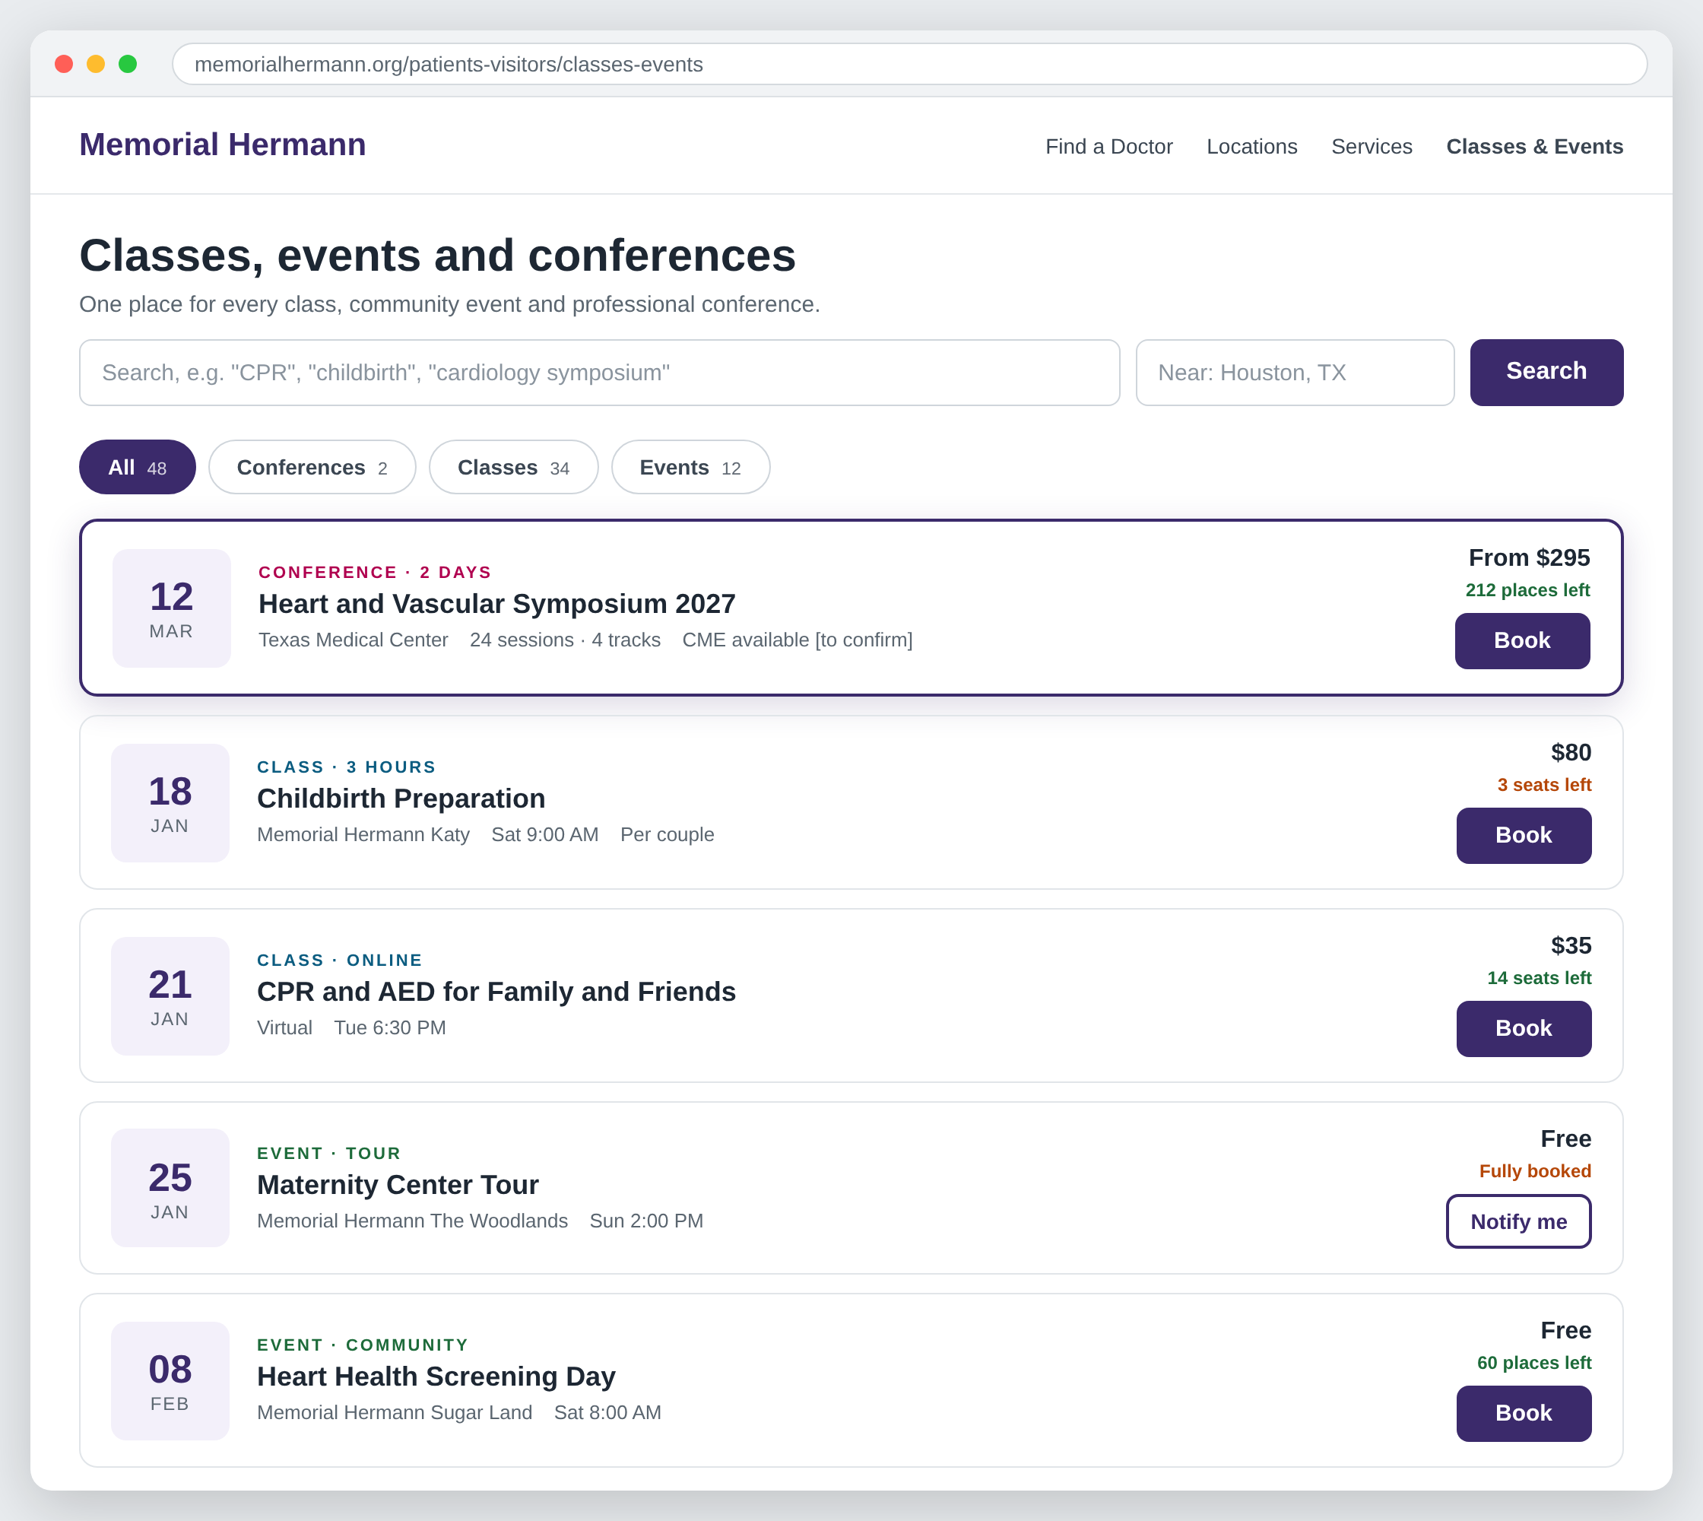
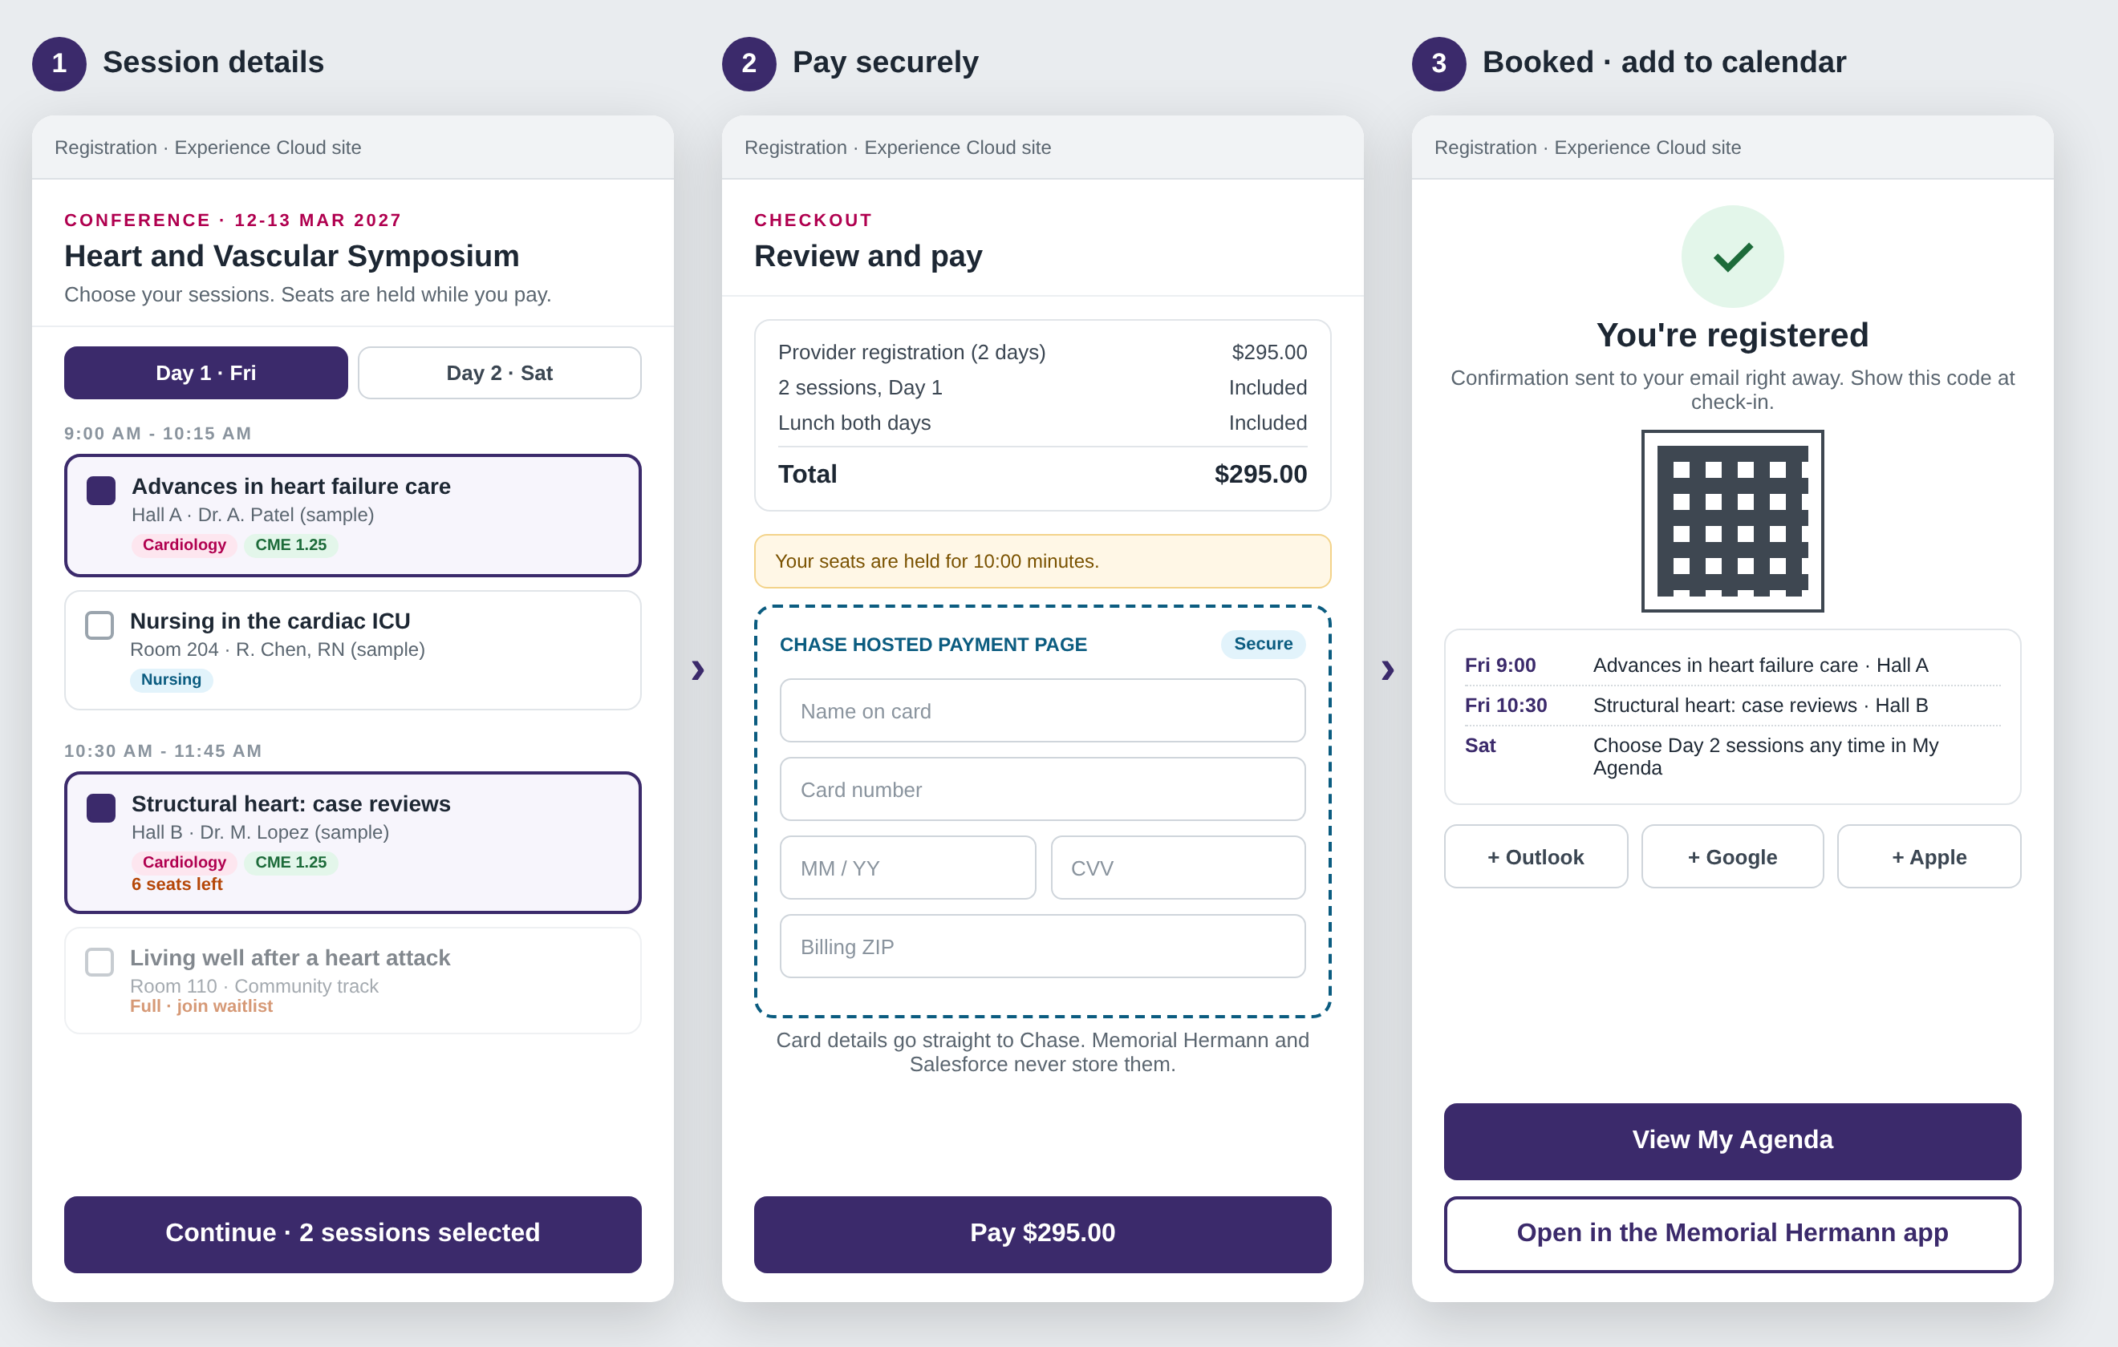
Registrant view: find it, book it, pay, add to calendar
1
Sitecore page: conferences, classes and events
2
Click Book on a conference: session details, pay, add to calendar
Concept mockup, sample data. Listings stay on Sitecore; booking runs on the existing Experience Cloud site and app; payment on Chase’s hosted page.
Notes:
One listing for conferences, classes and events, on the Sitecore page people already use. Book on a conference opens the registration site: pick sessions by day (seats are held while paying), pay on Chase’s hosted page, then get an instant confirmation with a QR code for check-in and add-to-calendar links. Classes and events use the same flow without the session step.

Slide 9
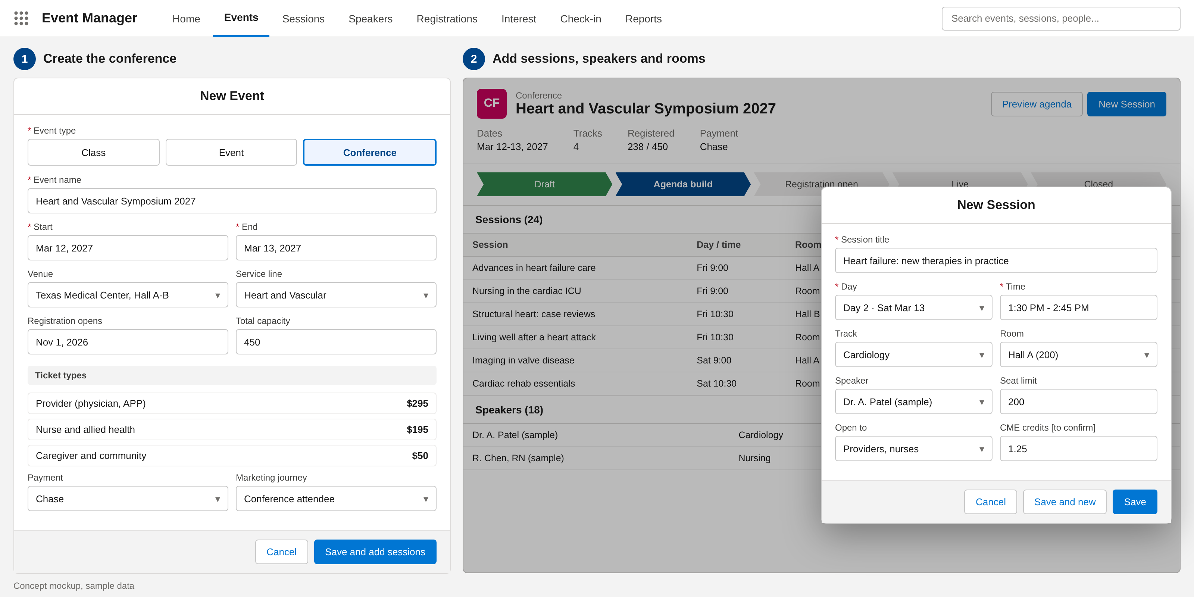
Staff view: set up a conference and its sessions
How organizers work
One form for every event
Pick class, event or conference; dates, venue, capacity
Ticket types per audience
Provider, nurse, caregiver and community prices
Sessions in minutes
Day, time, room, track, speaker, seat limit, CME [to confirm]
Payment and journey
Chase checkout and a Marketing Cloud journey set per event
Publish
The agenda appears on the website and app
Concept mockup, sample data. A standard Salesforce Lightning app, so Memorial Hermann’s admins can own it after launch.
Notes:
Organizers create a class, event or conference from one form, add ticket types, then build the agenda session by session: day, time, room, track, speaker and seat limit. Payment (Chase) and the Marketing Cloud journey are set per event. Publishing puts the agenda on the website and app. This replaces the conference setup done in Certain today.

Slide 10
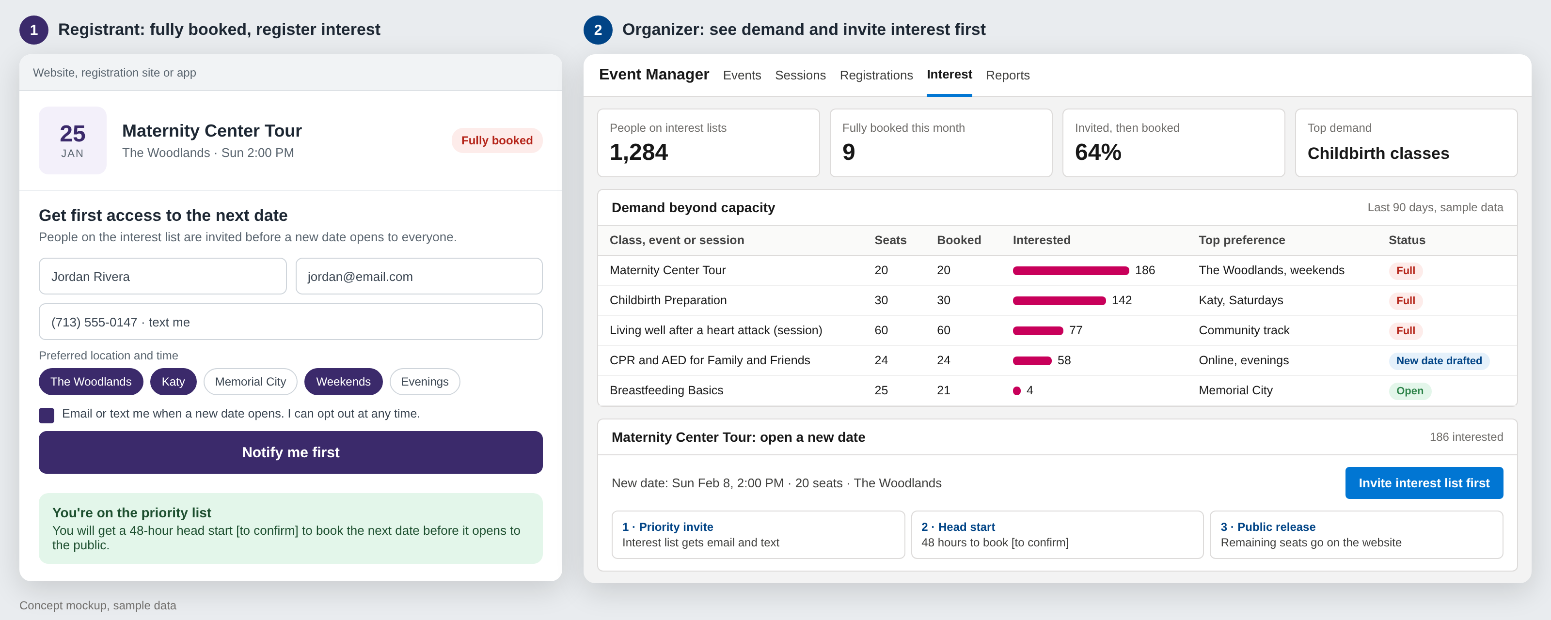
Fully booked? Capture interest and invite them first
Concept mockup, sample data. Works for classes, events and conference sessions. Head-start window [to confirm].
Notes:
When a class, event or session is full, people register interest with their preferred location and time, and consent to be contacted. Organizers see demand beyond capacity by event, location and time, which tells them where to add dates. When a new date opens, the interest list is invited first with a head start before seats go public. The length of the head start is Memorial Hermann’s choice.

Slide 11






Every seat filled, no interested person lost
When interest outruns seats: a popular class or a conference opening
1
2
3
4
5
Edge protection
Fair waiting room
Seat hold
Hosted payment
Salesforce
Cached pages, bot defense, rate limits
Admits people in arrival order
10-minute hold; a seat can never be sold twice
Paid = confirmed; unpaid seats return
Queued and retried; never lost
WHERE EVERY CLICK ENDS UP
30
60
All others
Turn overflow into sessions
Demand passes 3× the seats
Staff add a session in one click
Waitlist offered first, then the interest list
Confirmed seats
On the waitlist
On the interest list
Paid, ticketed, QR check-in sent
Freed seats offered by SMS with a 2-hour claim window
Told the moment a new date opens
Reliable: queued, idempotent writes and auto-released holds. Scalable: only admitted traffic reaches Salesforce. Secure: bot defense on every hot event.
Notes:
A popular class can draw far more interest than seats. The platform answers every click within seconds, never oversells, never charges someone who did not get a seat, and keeps everyone who missed out on a waitlist or interest list. When demand passes a threshold, staff add a session in one click and the people waiting get first access. Numbers are an example; caps and thresholds are set per event.

Slide 12
Design detail: registration and seat flow
Registrant
Edge and waiting room
Registration service
Seat inventory
Payment page
Salesforce
Marketing Cloud
Click Register
1
Place in line shown
2
Admit at a safe rate
3
Hold one seat (atomic)
4
If a seat is available
Hold granted, 10 minutes
Your seat is held, pay now
5
6
Pay on hosted page
7
Signed payment webhook
8
Create registration (idempotent, via queue)
9
Registration event
10
Confirmation, QR code, calendar invite
11
If sold out
No seats left
Join waitlist or get notified of new dates
12
13
Waitlist or interest record
14
Unpaid holds expire and return to the pool
Notes:
Step by step for a busy event. The waiting room admits people fairly, seat holds are atomic so a seat is never sold twice, writes to Salesforce are queued and idempotent so nothing is lost or duplicated, and everyone who misses a seat lands on the waitlist or interest list.

Slide 13









Payments and data security by design
Card data never enters our systems
Registrant and patient data, protected in layers
CARD DATA ZONE
Edge
Registrant
TLS 1.2+, web application firewall, bot defense, rate limits
Website, Experience Cloud or app
Card numbers go straight to the payment gateway. PCI scope stays at the simplest level (SAQ A) [to confirm].
Access
SSO with MFA for staff; least-privilege permission sets
Chase hosted page
Card typed here (Chase, as for classes today)
Data
Shield Platform Encryption on sensitive fields; field-level security
Signed webhook
OUR SYSTEMS
Monitoring
Token, last 4 digits, approval code
No card number, CVV or expiry stored. Refunds by token. Signed, idempotent webhooks. Daily reconciliation.
Event Monitoring, Field Audit Trail, real-time alerts
Governance
Salesforce payment record
BAA [to confirm], data retention, no tracking pixels, pen tests
Token reference, last 4, amount, status
Class topics are treated as sensitive: signing up for a diabetes class implies a health condition.
Notes:
Two messages. First, card numbers never touch Memorial Hermann or Salesforce systems: the gateway hosts the payment page and returns a token. Second, registrant and patient data is protected in layers from the edge to governance. Shield licensing, BAA coverage and PCI level to be confirmed with Memorial Hermann IT and finance.

Slide 14
Design detail: payment sequence
Registrant (web or app)
Registration service
Chase hosted page
Salesforce
One gateway: Chase
Create payment session (amount, reference)
RECOMMENDED
1
Chase for every event
Session token
Reuse today’s class integration; Authorize.net retires with Certain
2
Open hosted payment page
3
Card details typed into the Chase page
TO CONFIRM
4
Finance sign-off
Approved
Chase merchant setup for conference fees [to confirm]
5
Signed webhook (token, last 4, approval code)
6
After payment
7
Verify signature, idempotency check
Full and partial refunds by token from Salesforce
Automatic receipts
Daily settlement reconciliation
Payment record: token, last 4, amount, status
8
No card number, CVV or expiry is ever stored
Notes:
The card is typed directly into the gateway page; the registration service only creates the session and receives a signed webhook with a token. Salesforce stores the token reference, last 4 digits, amount and status. Chase already takes class payments in Salesforce, so conferences reuse that integration and Authorize.net retires with Certain: one gateway, one reconciliation. Merchant setup for conference fees to confirm with Memorial Hermann finance.

Slide 15
02 DELIVERY PLAN
Ten sprints: conferences live at week 12, classes improved by week 20

Slide 16
Delivery timeline
Indicative; confirmed after the current-state walkthrough
Weeks 3-12 · Phase 1 live
Week 21+ · Grow
Conferences: sessions, speakers, My Agenda, badges. Certain data moved and Certain retired
Patient engagement initiatives, app adoption, AI agents in a controlled harness
Weeks 1-2 · Assess and design
Certain transition
Weeks 13-20 · Phase 2 live
Review today’s Experience Cloud site, the app and Certain; shared event model; payment decision
Weeks 7-12: export, map, two trial loads, cutover
Classes on the shared model: instant confirmation, waitlists, check-in, reporting
Notes:
Phase 1 replaces Certain around week 12, with a six-week Certain to Salesforce data transition in weeks 7 to 12; time it to land before the Certain renewal. Phase 2 brings classes onto the same platform and improves them by week 20, without rebuilding the registration site. Engagement work can start once classes are on the shared model.

Slide 17
What each phase delivers
Phase 1 · Conferences (replaces Certain)
Phase 2 · Classes on the shared platform
Scope
Multi-day agenda, tracks, rooms and session capacity
Today’s classes moved onto the shared event model
Registration
Providers and guests, ticket types, My Agenda on Experience Cloud
Existing Experience Cloud site and app, now with instant confirmation
Payments
Chase checkout, reusing today’s class integration
Chase checkout with safe payment retries and refunds
Engagement
Speaker and attendee communications, badges, CME [to confirm]
Reminder journeys, waitlists, QR check-in
Data
Certain data moved in a six-week transition (weeks 7-12)
Class history kept; registrants matched to Health Cloud
Built in
Load test before each conference opens
Live seats, waitlists, encryption, monitoring
Retires
Certain
Nothing retired; today’s registration is improved
Notes:
Same team and same platform across both phases, so Phase 2 builds on Phase 1 rather than starting over.

Slide 18
Certain to Salesforce transition
Six weeks (weeks 7 to 12) alongside Phase 1. Certain stays live until Memorial Hermann signs off the cutover.
1 · WEEKS 7-8
2 · WEEKS 7-8
3 · WEEKS 9-10
4 · WEEKS 11-12
5 · WEEK 12+
Inventory and export
Map and cleanse
Trial loads
Cutover
Retire Certain
Certain exports or API pull; data owners named; history window agreed
Fields mapped to the Salesforce event model; duplicates removed; attendees matched
Two rehearsal loads in a sandbox; counts and payment totals reconciled; your team checks samples
Short registration freeze, final delta load, conferences go live on Salesforce
Read-only until the contract ends; full archive export kept
Data
How it moves
Safeguards
Upcoming conferences, open registrations
Loaded and live in Salesforce at cutover
Reconciliation report signed off before cutover
Rollback ready: Certain stays live until sign-off
Cutover outside open conference registration [to confirm]
Open Authorize.net refunds finished in Authorize.net
Delivered by the same five-person pod
Past events, sessions, speakers, attendees
Loaded for the agreed history window
Attendance and CME records
Loaded and kept for retention needs [to confirm]
Payment history
Summary only (amount, status, reference); card data never moves
Older history
Archive export, available on request
Notes:
Data migration from Certain is planned as its own six-week workstream inside Phase 1 (weeks 7 to 12), so conferences go live on Salesforce with their data. Export and mapping start once the event model is built; two trial loads are reconciled before the final load. How many years of history to bring across is Memorial Hermann’s decision, agreed in discovery; older history can stay in an archive export. Card data is never migrated: payment history moves as a summary, and open Authorize.net refunds finish in Authorize.net.

Slide 19
Delivery plan: 10 two-week sprints
A working demo and a milestone sign-off with Memorial Hermann at the end of every sprint
Assess and design
Phase 1 · Conferences
Phase 2 · Classes
Certain transition
Sprint-end milestone
SPRINT 1
SPRINT 2
SPRINT 3
SPRINT 4
SPRINT 5
Weeks 1-2
Weeks 3-4
Weeks 5-6
Weeks 7-8
Weeks 9-10
Review today’s Experience Cloud site, app and Certain; design
Shared event model; sessions, tracks, rooms, speakers
My Agenda portal on Experience Cloud; ticket types
Chase checkout for conferences; badges; CME [to confirm]
Load test, user testing, conference reporting
Design sign-off
Conference model demo
Attendee portal demo
Pay and badge end to end
Testing sign-off
CERTAIN TRANSITION · Weeks 7-10: export, map, trial loads
SPRINT 6
SPRINT 7
SPRINT 8
SPRINT 9
SPRINT 10
Weeks 11-12
Weeks 13-14
Weeks 15-16
Weeks 17-18
Weeks 19-20
Final data load, conference go-live, hypercare
Move classes onto the shared model; keep current pages
Instant confirmation, safe payment retries, waitlists
QR check-in, reporting, app connected, PEI journeys
User testing, go-live, knowledge transfer
Phase 1 live, Certain retired
Classes on shared model
Registration improvements demo
User testing starts
Phase 2 live
Weeks 11-12: cutover
Notes:
Two-week sprints, each closing with a demo and a milestone Memorial Hermann signs off. Sprint 1 assesses today’s Experience Cloud site, app and Certain. Sprints 2 to 6 deliver conference and session management (live at week 12, Certain retired), with the six-week Certain to Salesforce data transition running in weeks 7 to 12. Sprints 7 to 10 move classes onto the same platform and improve them (live at week 20). Sprint scope is refined after the current-state walkthrough.

Slide 20




A dedicated five-person delivery pod
Every two-week sprint
LEAD
Scrum Master or Project Manager
Plan
1
Runs sprints, milestones, risks and status
Sprint planning with your product owner
Build and test
Daily stand-ups; QA inside the sprint
QUALITY
QA Engineer
Demo
1
Test plans, automation, load tests, user testing support
Sprint review and milestone sign-off
Improve
Retrospective; adjust the next sprint
BUILD
3
2 Salesforce Developers + 1 Marketing Cloud Developer
FROM MEMORIAL HERMANN
A product owner, plus an Epic and app contact from Lucky Rai’s team
Event app, registration, payments, integrations, journeys and PEIs
5 people · 10 sprints · 20 weeks
Notes:
A small, dedicated pod: one Scrum Master or Project Manager leading delivery, one QA engineer embedded in every sprint, and a build team of two Salesforce developers and one Marketing Cloud developer. Memorial Hermann provides a product owner and an Epic and app contact.

Slide 21
03 BEYOND THE EVENT
Turn every registration into a lasting relationship

Slide 22
1 profile
4 PEIs
Every registrant, caregiver and provider in one Salesforce record
Patient engagement initiatives after every class
Every registration tells you what a person cares about. Use it to bring them back and into the network.
1 tap
Closed loop
App download link at confirmation, check-in and follow-up
From class attended to visit booked, measured end to end
Consent-based: messages go only to people who opt in at registration.
Notes:
This is the upsell. The event platform captures first-party data about what each person is interested in. Marketing Cloud journeys turn that into patient engagement initiatives that lead to app adoption and booked visits.

Slide 23
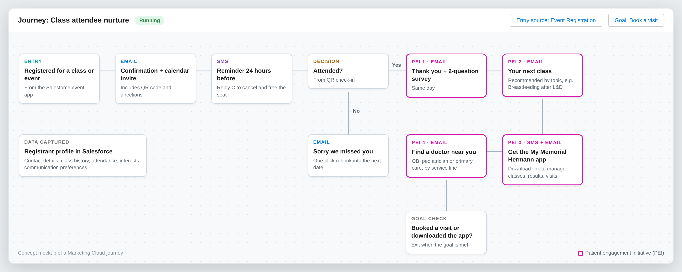
After the class: patient engagement initiatives (PEIs)
Notes:
Every class feeds one Marketing Cloud journey: confirmation, reminder, then four patient engagement initiatives (thank you and survey, next class, app adoption, find a doctor). The journey exits when the person books a visit or downloads the app.

Slide 24
Campaigns built from registration data
After this class
Follow-up PEIs
Network outcome
Labor and delivery prep
Breastfeeding and newborn classes, choose a pediatrician
Delivery at Memorial Hermann, new pediatric patients
Maternity hospital tour
Pre-register for delivery, prenatal class bundle
Delivery booked at Memorial Hermann
CPR and first aid
Heart health seminar, free screening invitation
Primary care and cardiology visits
Support groups and seminars
Education series, specialist-led events
Ongoing specialty care relationships
Provider conference
Next CME events, referral resources
A stronger referral network
Notes:
Examples to show the idea. We would pick two or three service lines with Kevin’s team to start.

Slide 25
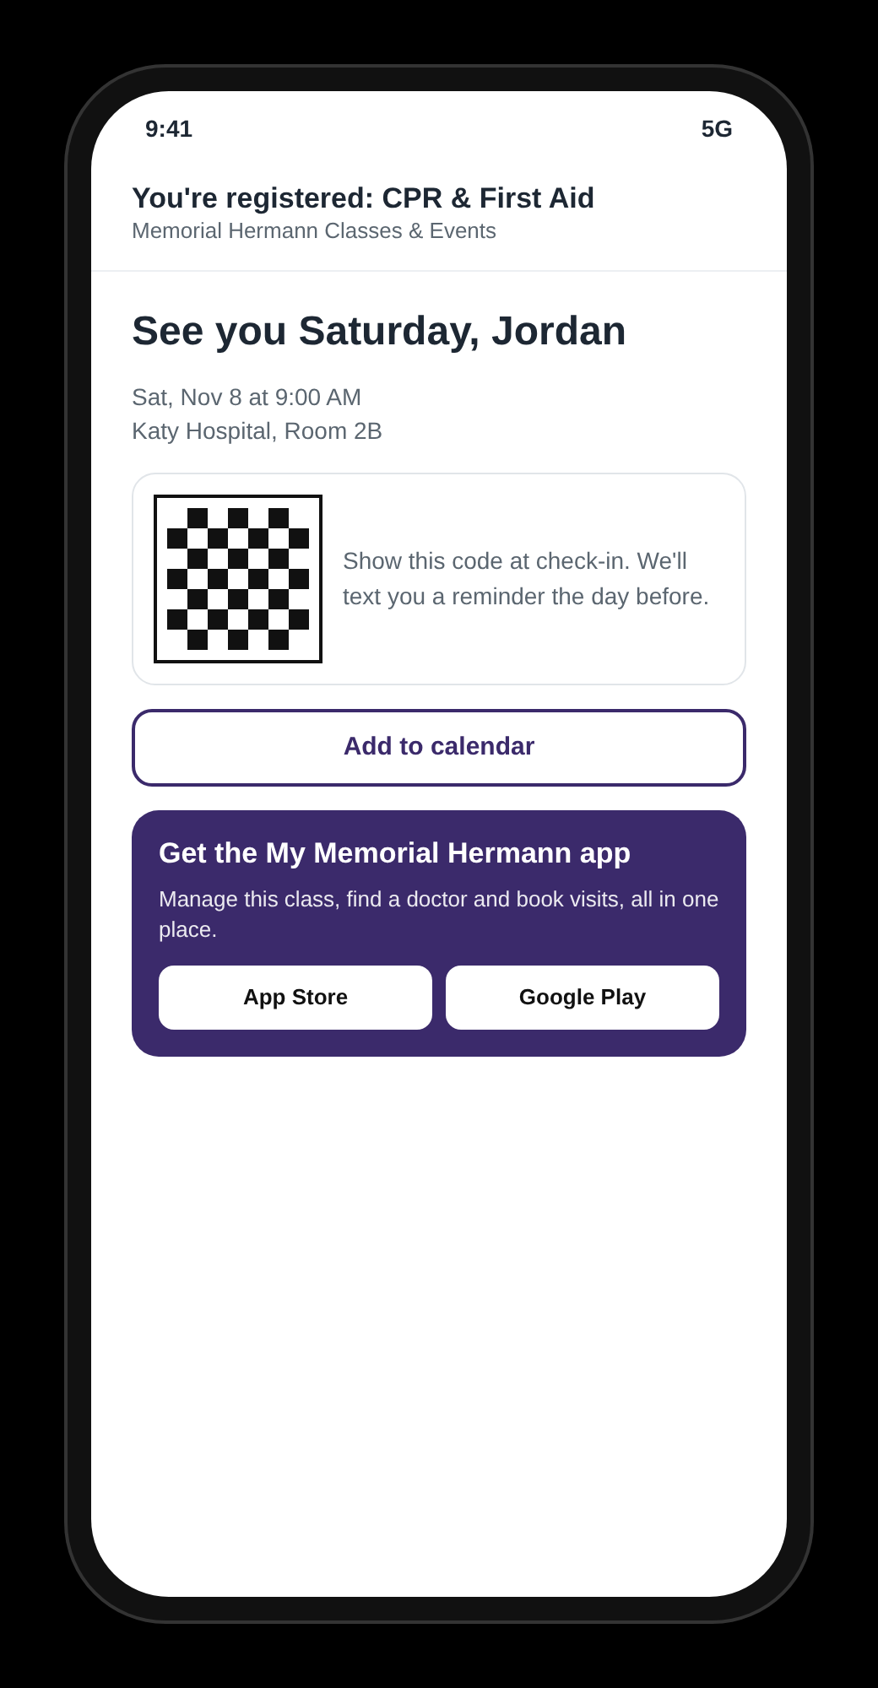
Bring website registrants into the app
1
Confirmation email
App link beside the calendar invite and QR code
2
Check-in
QR at the door and on room signage: scan to download
3
SMS reminder
Manage or cancel your class in the app
4
Post-class PEIs
Find a doctor, book a visit, see results in the app
Tracked links show which classes and service lines drive downloads and booked visits.
Notes:
My Memorial Hermann is their existing Epic-based patient app (scheduling, results, messaging). App users register in the app; people who register on the website get a tracked download link at every touchpoint. No new app is built.

Slide 26
How we will measure success
Conversion
Attendance
Engagement
Visitors who complete a registration
Registrants who show up; fewer no-shows
PEI opens, clicks and survey responses
Baseline set in discovery
Baseline set in discovery
Baseline set in discovery
Downloads
Visits booked
Revenue
App installs from event links
Appointments after a class or event
Paid registrations and conference fees
Baseline set in discovery
Baseline set in discovery
Baseline set in discovery
Notes:
We set baselines during discovery from the current tools, then report these in a Salesforce dashboard.

Slide 27
Roadmap: from registration to relationship
1
2
3
4
Conferences
Classes improved
Engagement
AI agents
Weeks 3-12
Weeks 13-20
From Phase 2 go-live
Week 21+
Sessions and speakers
My Agenda and badges
Certain retired
Shared event model
Instant confirmation, waitlists
Check-in and reporting
PEI journeys by service line
App adoption campaigns
Find-a-doctor nurture
Agents in a controlled harness
Demand and campaign agents
Concierge on web, app and SMS
Phases 1 and 2 solve today’s problem. Phases 3 and 4 grow engagement and the network on the same platform.
Notes:
Future plan. AI agents use Agentforce and are licensed separately; we would scope them after the core platform is live.

Slide 28













Future state: AI agents in a controlled harness
Phase 4, after the core platform is stable. Agentforce and Data Cloud [to confirm].
What the harness controls
Event Ops
Sessions, capacity, reminders
Approved actions only
Guardrails: consent, patient data, spend limits
HARNESS
Staff approve anything sent or published
Insights
Demand
Summarizes feedback and results
Event platform + Marketing Cloud
Spots surges, drafts new dates
Least-privilege identity per agent
Full audit trail of every action
Tested and evaluated before each release
Einstein Trust Layer: masking, zero data retention
Concierge
Campaign
Kill switch for any agent
Registers and answers on web, app, SMS
Builds PEI journeys
AUTONOMY GROWS WITH TRUST
Suggest
Act with approval
Act within limits

Slide 29
Investment
Offshore delivery model: fixed scope, five-person pod, 10 sprints
Phase
Sprints
Standard
Partner
STANDARD PROGRAM VALUE
OFFSHORE
Phase 1 · Conferences, replaces Certain
1-6
$350,000
$175,000
$580,000
Phase 2 · Classes on the shared platform
7-10
$230,000
$115,000
Total program
10 sprints
$580,000
$290,000
STRATEGIC PARTNER INVESTMENT
$290,000
Included
Not included
Dedicated five-person offshore pod for 20 weeks
Sprint demos and milestone sign-offs
Testing, load testing, go-live and hypercare
Documentation and handover to your admins
Salesforce licenses
Payment gateway transaction fees
Waiting room subscription
50% partnership credit, applied upfront
You save $290,000 on the full program
Pricing is for an offshore delivery model. Indicative, billed at sprint milestones; final commercials in the statement of work.
Notes:
Pricing is for an offshore delivery model. Standard program value is $580,000. As a strategic partner, Memorial Hermann receives a 50% partnership credit applied upfront, for an investment of $290,000. Billing follows sprint milestones. Licenses and third-party fees are outside this price.

Slide 30
Next steps
1
Walk through today’s Experience Cloud site, the app and Certain
2
Confirm what is not working today and why Certain is being replaced
3
Confirm yearly volumes: classes, conferences, registrants
4
Confirm conference must-haves: sessions, badges, sponsors, CME
5
Confirm Chase for conference payments with finance
6
Share the Certain renewal date so Phase 2 lands before it
7
Pick 2 to 3 service lines for the first engagement journeys
Then we return with a scoped plan, team and estimate.
Notes:
Ask Kevin to set up the walkthrough with Lucky Rai’s team. Items 2 to 7 let us firm up the timeline and estimate.

Slide 31
Notes:
Thank you. Open for questions.

