Slide 1

G2M Case Study
Virtual Internship
25-10-2021

Slide 2
1. Business Problem
A go-to-market strategy is an action plan which determines how a company is going to reach their target audience and achieve a competitive advantage. Go-to-market strategy will play a huge role in early investment rounds. The main purpose of this analysis is to understand the market before investing in a Cab firm and to select the best company to invest.

Slide 3
2. Hypothesis
Does the profit change over time? How?
How does the percentage of profitable trips change by the city?
How does average profit change by holidays?
Is there any seasonality of demand changing?
How the demand varies with age?
How about the loyalty of customers
Is there any fluctuations of payment methods with age, city and the time?

Slide 4
3. Data Exploration
This data analysis has been mainly divided into four parts, as follows.
Data Understanding
Data Preparation
Exploratory data analysis
Profit Analysis
Demand Analysis
Client Analysis
Decision Making

Slide 5

Data Sets
Cab_Data.csv
City.csv
Customer_ID.csv
master_df.csv
No of Features: 15
Total Data Points: 359392
Timeframe: 31/01/2016 -31/12/2018
Transaction_ID.csv
Us-holiday-dates.csv

Slide 6
4. Assumptions
According to the graphs, there are outliers in the Price Charged feature. But since we do not have enough information on the components that made the Price Charged, it is not appropriate to treat it as an outlier.
There are outliers in the Price_Charged feature. But since we do not have enough information on the components that made the Price_Charged, it is not appropriate to treat it as an outlier.
When calculating the Profit per ride, all other factors were considered as constants and only Price_Charged and Cost_of_Trip features were used to calculate the profit.
Users feature of city dataset is treated as all the cab users in the city. (including Yellow and Pink cab)

Slide 7
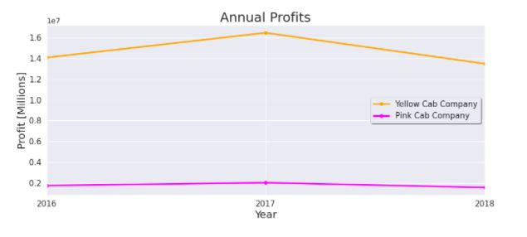
Profit Analysis
5. Profit Analysis
Annual Profits
Figure 1

Slide 8
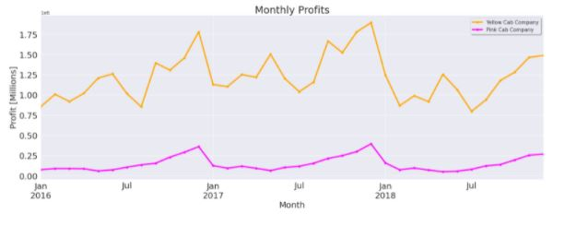
Profit Analysis
Monthly profits
Yellow Cab Company's earnings are more stable with fluctuations of 23.08% while Pink Cab Company's earnings vary with fluctuations of 61.22%.
Figure 2

Slide 9
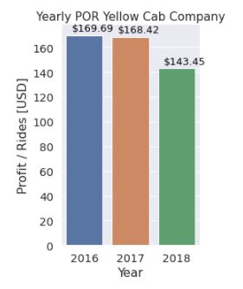
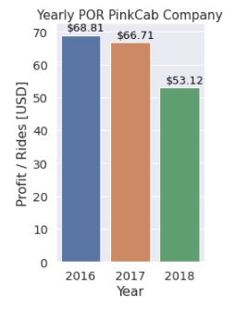
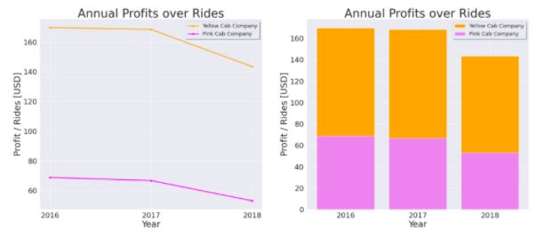
Annual average profits over rides
Profit per ride decreases over time in both companies.
Figure 3
Figure 4
Figure 5

Slide 10
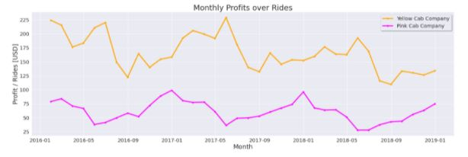
Monthly average profits over rides
Figure 6

Slide 11
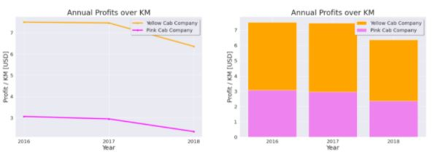
Annual average profits over Km
Profit per Km decreases over time in both companies.
Figure 7

Slide 12
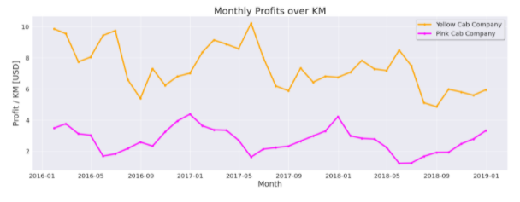
Monthly average profits over Km
Profit per Kilometer in Yellow cab company is higher than Pink cab company for each and every month.
Figure 8

Slide 13
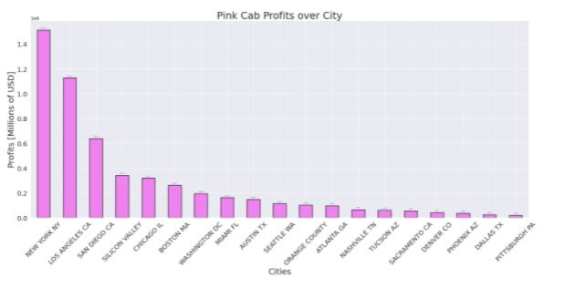
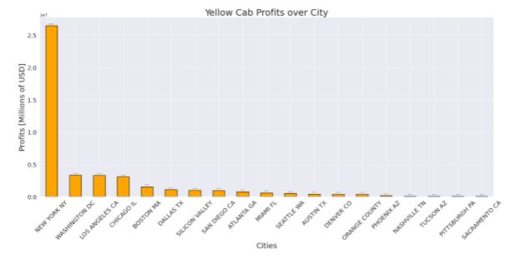
Profits over City
In this analysis New York city has been removed from both cab companies to get a better sight of the profits over the other cities.
Yellow Cab has greater market share in every City.
Figure 9

Slide 14
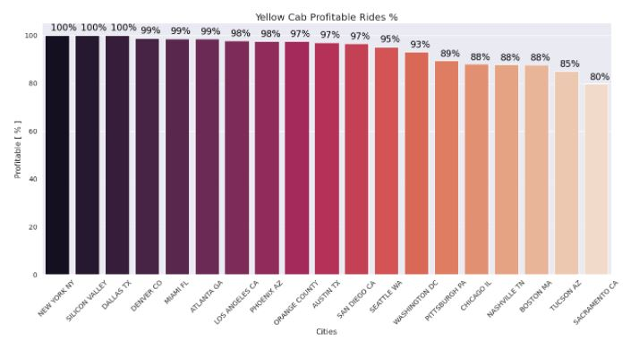
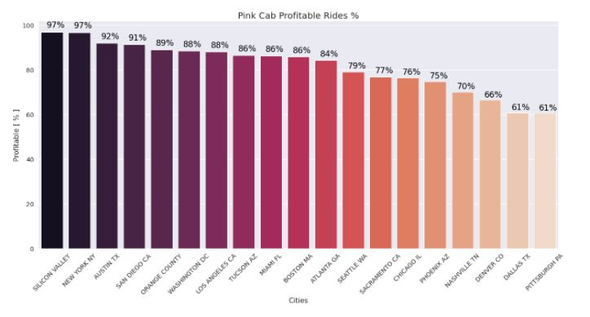
Profit (City wise)
Assumption: if the profitability percentage of rides per city is higher than 80%, it will perform well. Then, we can say that: profitability percentage of rides change by cities and Yellow Cab has a high performance according to the analysis.
Figure 10
Figure 11

Slide 15
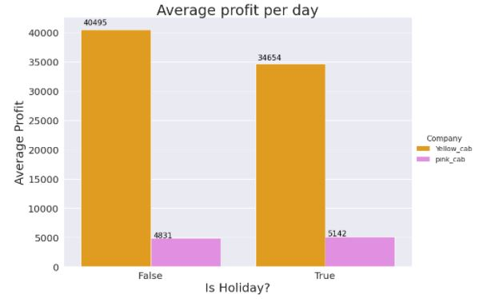
Average profit per day
Yellow cab company: the average profit per holiday is less than the average profit per normal day. Pink cab company: the average profit per holiday is greater than the average profit per normal day.
Figure 12

Slide 16
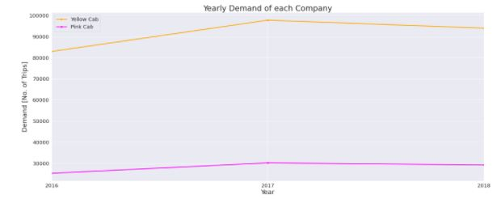
6. Demand analysis
Annual Demand
Yearly demand of Yellow cab company is maintained nearly 4 times greater than the demand of Pink cab company.
Figure 13

Slide 17
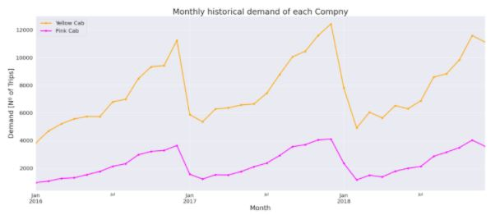
Monthly Demand
There is a seasonality of demand changing throughout every year. The highest demand is in December.
Figure 14

Slide 18
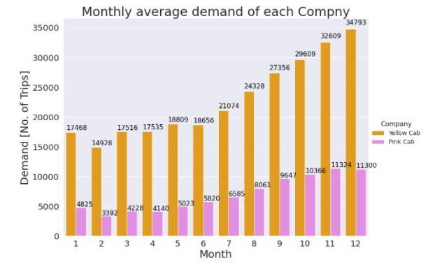
Monthly Demand
The highest demand is in December.
Figure 15

Slide 19
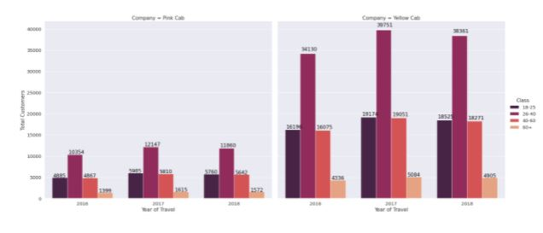
Demand Age Wise
Each year both companies have more customers in the age class of 20-40 years.
Figure 16

Slide 20
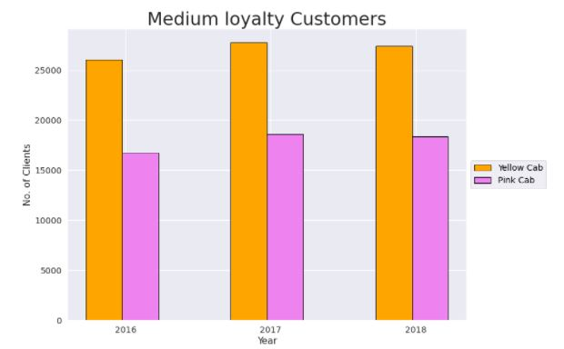
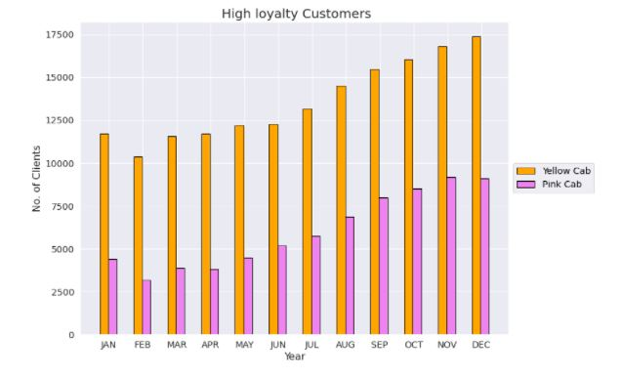
7. Client Analysis
Loyalty Rates
To analyze the Loyalty rates, Let's define 2 classes:
1. Medium loyalty Customers: Customers who took more than 10 rides yearly. 2. High loyalty Customers: Customers who took more than 10 rides monthly.
Figure 17
Figure 18

Slide 21
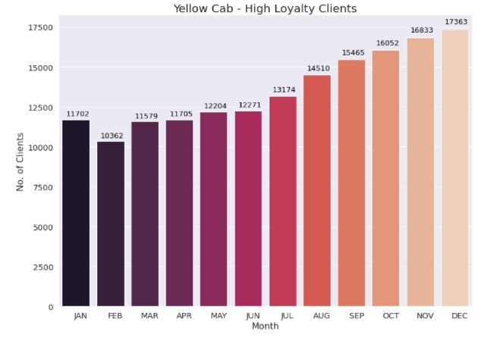
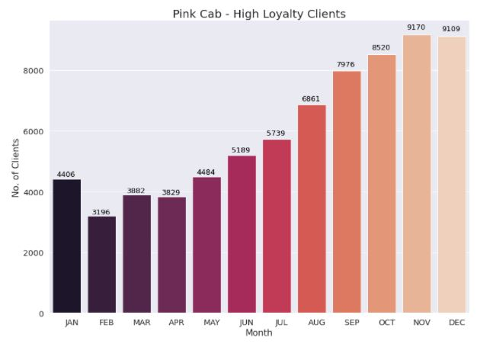
High loyalty customers
Yellow Cab Company is doing better in both classes of Loyalty Rates.
Figure 19
Figure 20

Slide 22
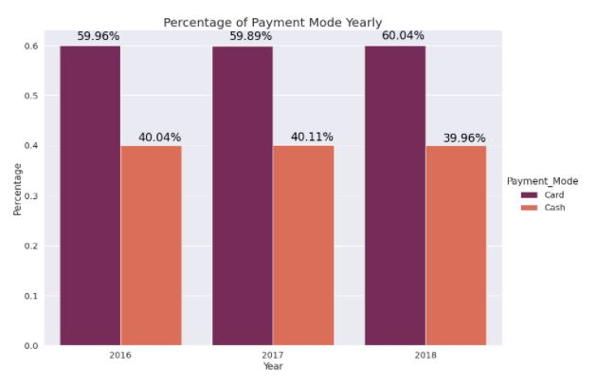
Payment mode
Minimal deviations in the payment method are observed over time.
Figure 21

Slide 23
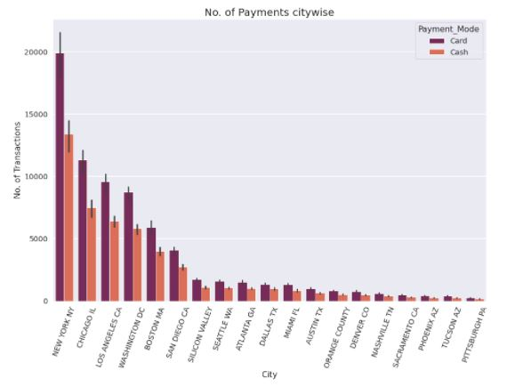
Payment mode – City wise
Minimal deviations of the payment method are observed in each city.
Figure 22

Slide 24
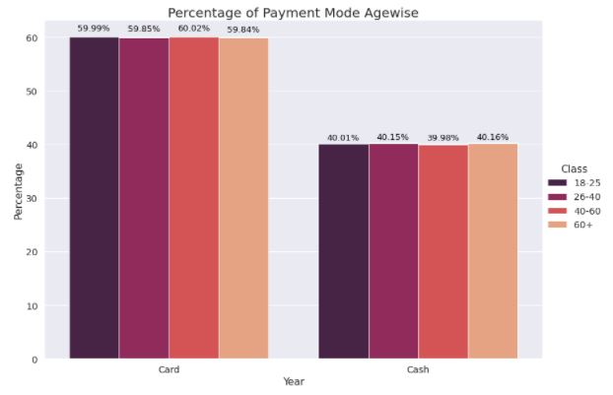
Payment mode – Age wise
Minimal deviations of the payment method are observed with respect to the age of the clients.
Figure 23

Slide 25
8. Recommendation
Profit Analysis
Yellow cab company has higher profits than Pink cab company over time.
Yellow cab company has fewer monthly fluctuations than a pink cab company.
Profit per ride of Yellow cab company is higher than profit per ride of Pink cab company, over three years.
Yellow Cab has greater market share in every City.
Pink cab company have gained higher profit per holiday than a normal day.
Demand Analysis
Yellow Cab has demand more than Pink Cab Company.
Both companies has the same distribution of demand age wise.
There is a seasonality of demand changing throughout the year in both cab companies.

Slide 26
Recommendation
Client Analysis
Both companies present the same distribution of Payment Mode over time, city wise and age wise.
Considering overall analysis, we can conclude that Yellow cab company is better than the Pink cab company for investing

Slide 27
References
[1] https://www.kaggle.com/ignaciosolorzano/data-analysis-for-cab-investment/notebook

Slide 28
Thank You!

