Slide 1
Deep Inverse Q-learning with Constraints
Gabriel Kalweit, Maria Huegle, Moritz Wehrling and Joschka Boedecker. NeurIPS 2020
Presented by: Chinthaka Jayaweera

Slide 2
Contents
Introduction
Related work
Methodology and algorithms
The experiment
Results
Discussion

Slide 3
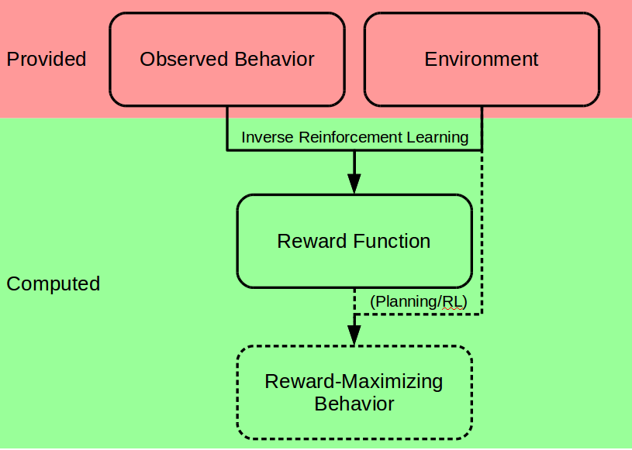
1. Introduction
1.1 Inverse Reinforcement Learning

Slide 4
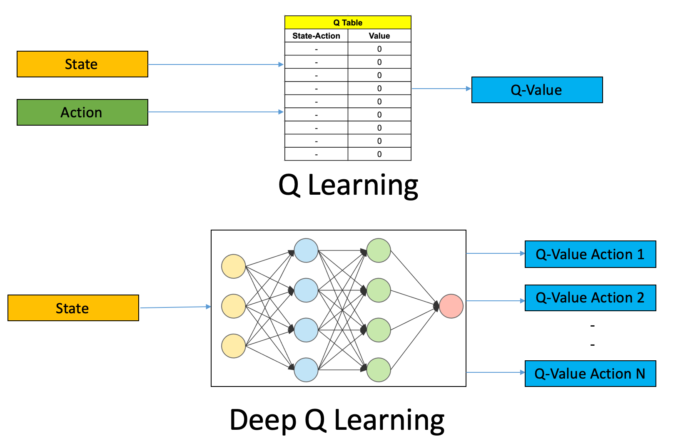
1. Introduction
1.2 Q-Learning

Slide 5
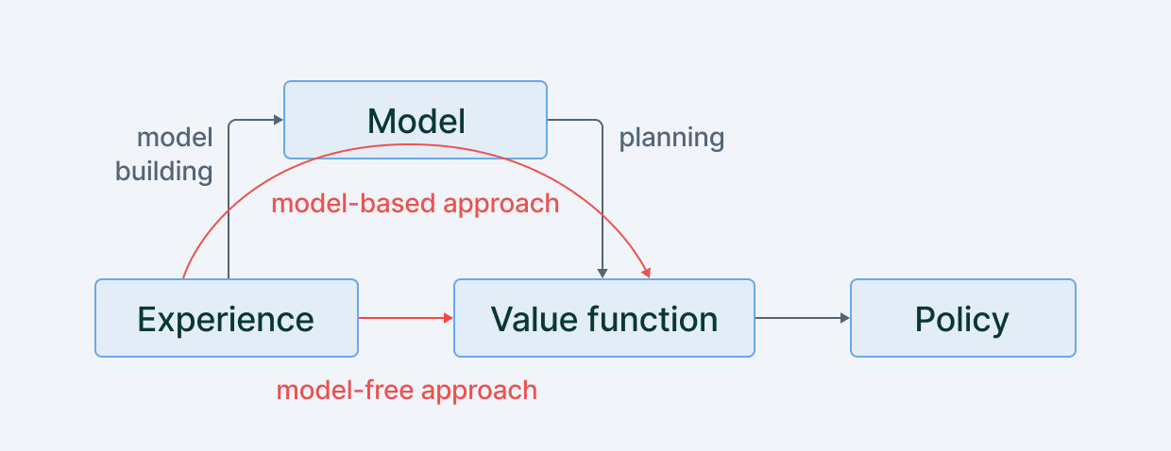
1. Introduction
1.3 Model-based vs Model-free RL algorithms

Slide 6
1. Introduction
The idea behind the Inverse Q-learning is to learn the reward function and use Q-learning to find the optimal policy
Common Inverse RL methods are using complex and time-consuming calculations to find the reward function
In the paper, they have purposed a new set of algorithms that only needs to solve the MDP for the demonstrated behavior once to recover the expert policy.
Their method, called Inverse Action-value Iteration (IAVI), can accurately recover an external agent's reward function using simple analytical calculations
They also provide a sampling-based variant that doesn't require a model of the environment.
They evaluate the algorithms on the Objectworld benchmark and show a significant speedup compared to existing methods.
They also apply the Deep Constrained Inverse Q-learning algorithm to the task of learning autonomous lane-changes in a simulator and achieving competent driving after training on 30 minutes of demonstrations.

Slide 7
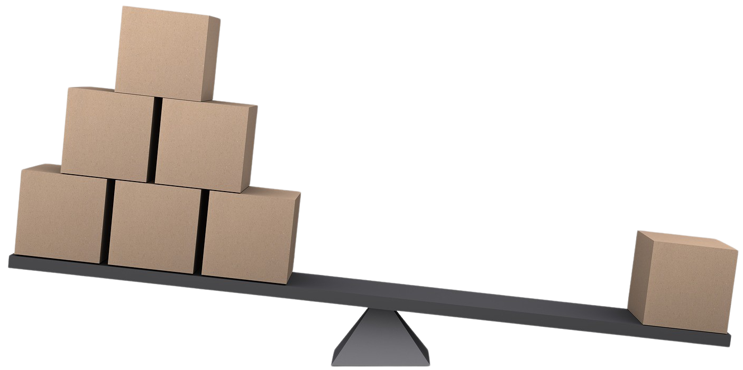
2. Related work
Previous Work
Previous research has used Linear IRL [22, 1] and Large-Margin Q-Learning [24] to solve this problem
And Maximum Entropy Inverse Reinforcement Learning (MaxEnt IRL [30]) is another popular approach that addresses the ambiguity of possible reward functions and induced policies by keeping the distribution over actions non-committed
However, MaxEnt IRL requires the MDP underlying the demonstrations to be solved multiple times, making it computationally expensive.
This work
In this work, the authors propose a novel class of IRL algorithms based on Inverse Action-value Iteration (IAVI)
which uses a probabilistic formulation and assumes a policy that only maximizes entropy locally at each step.
This approach allows them to avoid the computationally expensive inner loop of MaxEnt IRL.

Slide 8
3. Methodology and algorithms
3.1 Purposed algorithms
Inverse Action value iteration – Model-based
Tabular Inverse Q-learning – Model-free
Deep Inverse Q-learning – Model-based
Tabular Constrained Inverse Q-learning – Model-free
Fixed Batch Deep Constrained Inverse Q-learning – Model-free
We will only implement 1st and, the 2nd algorithm in this Assignment

Slide 9
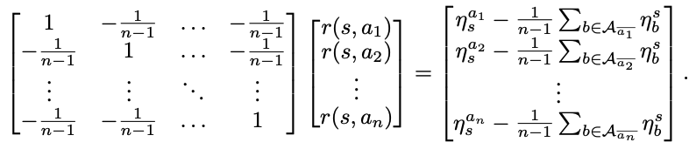

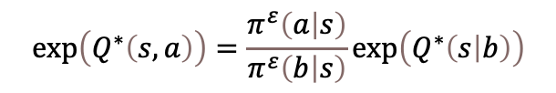
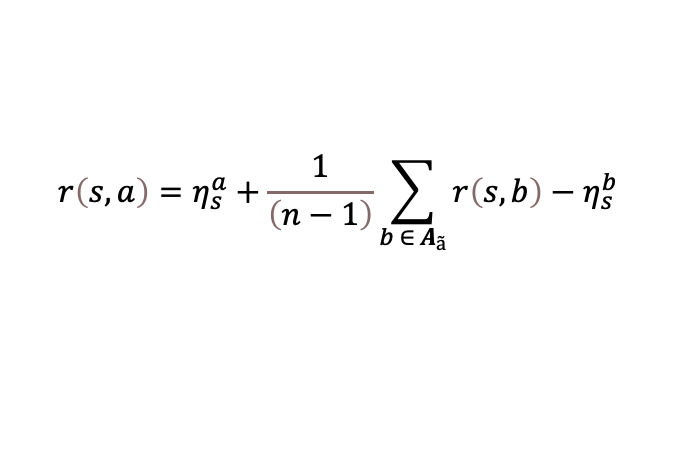
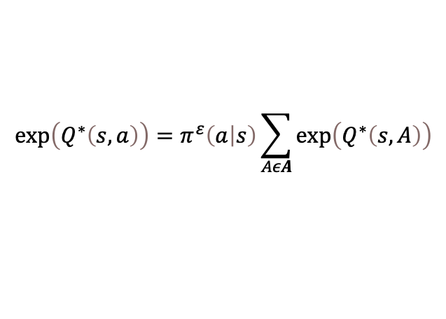
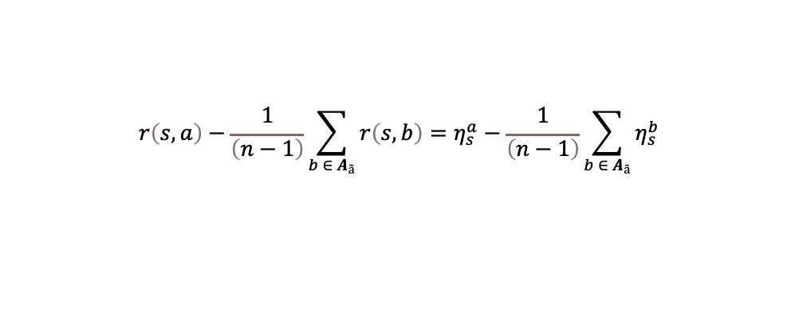
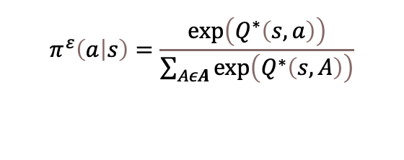

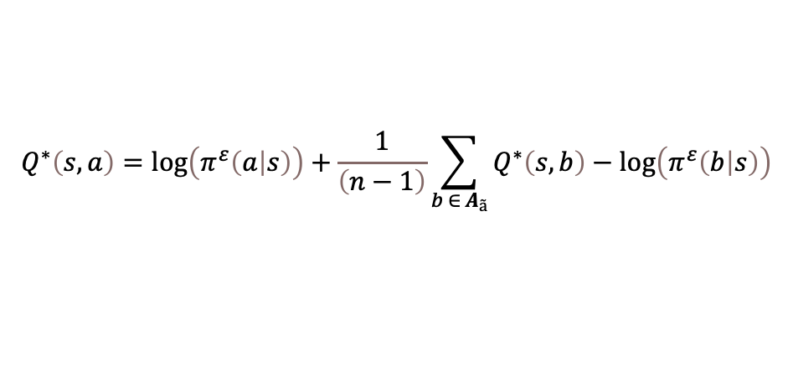
3. Methodology and algorithms
3.2 Inverse action value iteration – IAVI
$$π^{ε}\left(a | s\right)=\frac{\exp\left(Q^{∗}\left(s,a\right)\right)}{\sum_{AεA}{\exp\left(Q^{∗}\left(s,A\right)\right)}}$$
$$η_{s}^{a}:=\log\left(π^{ε}\left(a | s\right)\right)−γ\max_{a′}{E_{s^{′}\sim M\left(s , a , s′\right)}Q^{∗}\left(s^{′},a^{′}\right) }$$
$$η_{s}^{b}:=\log\left(π^{ε}\left(b | s\right)\right)−γ\max_{b′}{E_{s^{′}\sim M\left(s , b , s′\right)}Q^{∗}\left(s^{′},b^{′}\right) }$$
$${\exp\left(Q^{∗}\left(s,a\right)\right)=π}^{ε}\left(a | s\right)\sum_{AεA}{\exp\left(Q^{∗}\left(s,A\right)\right)}$$
$$r\left(s,a\right)=η_{s}^{a}+\frac{1}{\left(n−1\right)}\sum_{b ∈ A_{ã}}{r\left(s,b\right)−η_{s}^{b}}$$
$$\exp\left(Q^{∗}\left(s,a\right)\right)=\frac{π^{ε}\left(a | s\right)}{π^{ε}\left(b | s\right)}\exp\left(Q^{∗}\left(s | b\right)\right)$$
$$r\left(s,a\right)−\frac{1}{\left(n−1\right)}\sum_{b ∈ A_{ã}}{r\left(s,b\right)}=η_{s}^{a}−\frac{1}{\left(n−1\right)}\sum_{b ∈ A_{ã}}{η_{s}^{b}}$$
$$Q^{∗}\left(s,a\right)=\log\left(π^{ε}\left(a | s\right)\right)+Q^{∗}\left(s,b\right)−\log\left(π^{ε}\left(b | s\right)\right)$$
$$Q^{∗}\left(s,a\right)=\log\left(π^{ε}\left(a | s\right)\right)+\frac{1}{\left(n−1\right)}\sum_{b ∈ A_{ã}}{Q^{∗}\left(s,b\right)−\log\left(π^{ε}\left(b | s\right)\right)}$$

Slide 10
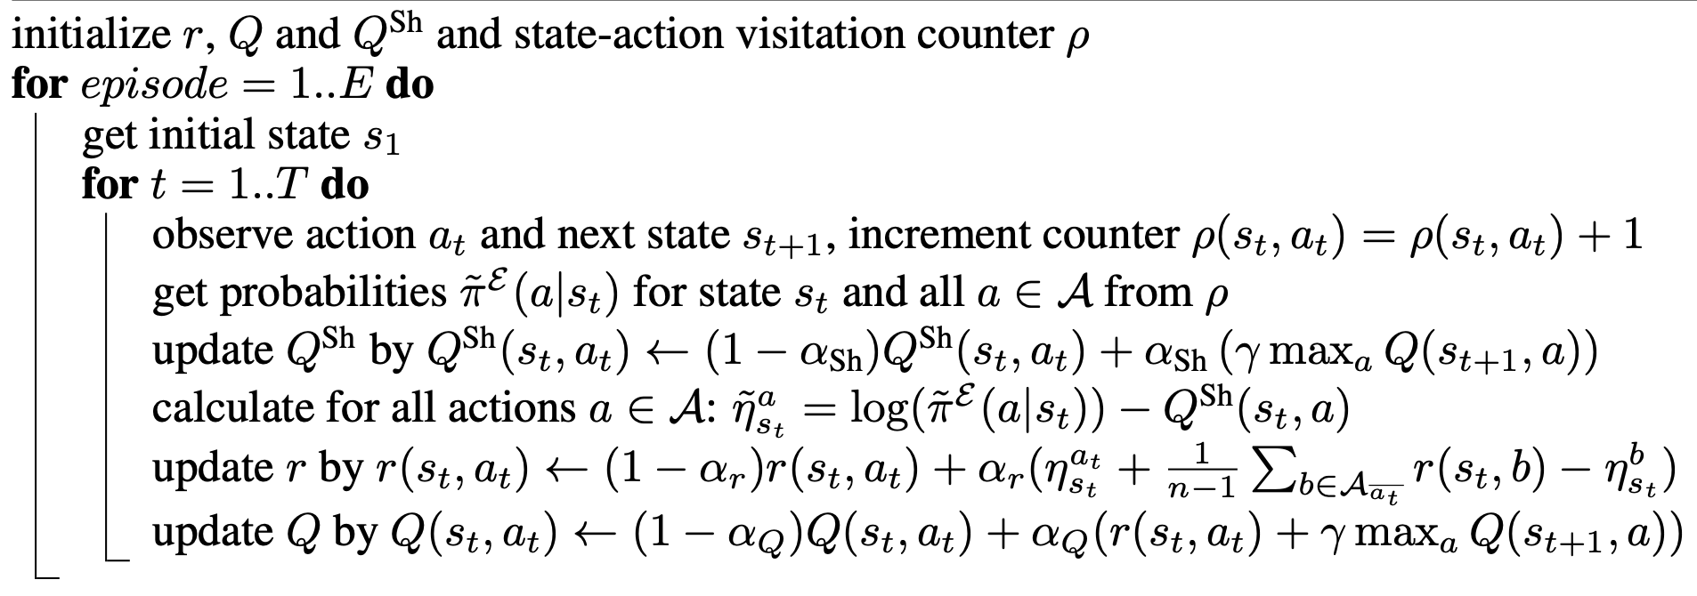
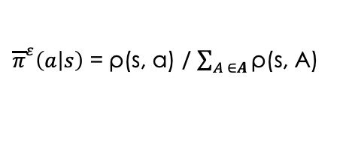

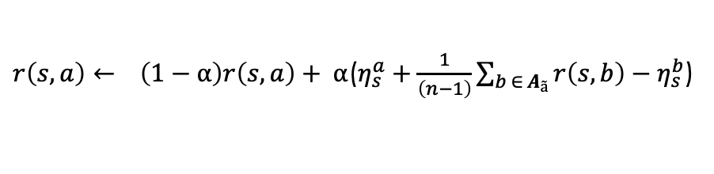

3. Methodology and algorithms
3.3 Tabular Inverse Q-learning – Model-free
To relax the assumption of an existing transition model and action probabilities, they have extended the Inverse Action-value Iteration to a sampling-based algorithm. They have used shifted Q-functions to avoid the need of a model.
${\overline{π}}^{ε}\left(a | s\right)$ = ρ(s, a) / $\sum_{A ∈A}{\text{ρ}\text{(}\text{s}\text{, }\text{A}\text{)}}$
$r\left(s,a\right)← \left(1−α\right)r\left(s, a\right)+ α$($η_{s}^{a}+\frac{1}{\left(n−1\right)}\sum_{b ∈ A_{ã}}{r\left(s,b\right)−η_{s}^{b}}$)
$$Q^{sh}=γ\max_{b′}{E_{s^{′}\sim M\left(s , a , s′\right)}Q^{∗}\left(s^{′},a^{′}\right) }$$
$$η_{s}^{a}=log\left({\overline{π}}^{ε}\left(a | s\right)\right)−Q^{sh}(s,a)$$

Slide 11
4. The Experiment
They evaluate the algorithms on the Objectworld benchmark and show a significant speedup compared to existing methods.
They evaluated the algorithm using Expected Value Difference (EVD).
They also apply the Deep Constrained Inverse Q-learning algorithm to the task of learning autonomous lane-changes in a simulator and achieving competent driving after training on 30 minutes of demonstrations.
In this assignment, we will evaluate the IQL and IAVI on the Objectworld environment under the following settings
grid_size = 32
n_objects = 50
n_colours = 2
wind = 0.3
discount = 0.99
trajectory_length = 8

Slide 12
4. The Experiment
4.1 The Objectworld environment
The Objectworld environment is an N × N map, where an agent can choose between going up, down, left, or right or staying in place per time step.
Stochastic transitions take the agent in a random direction with 30% chance. Objects are randomly put on the grid with certain inner and outer colors from a set of C colors.
Let’s say we have two colors. Then there will be 4 types of objects in the environment.
Inner color of Color 0
Outer color of Color 0
Inner color of Color 1
Outer color of Color 1
In this experiment, we are only considering the outer color, which means we only have two types of objects.

Slide 13
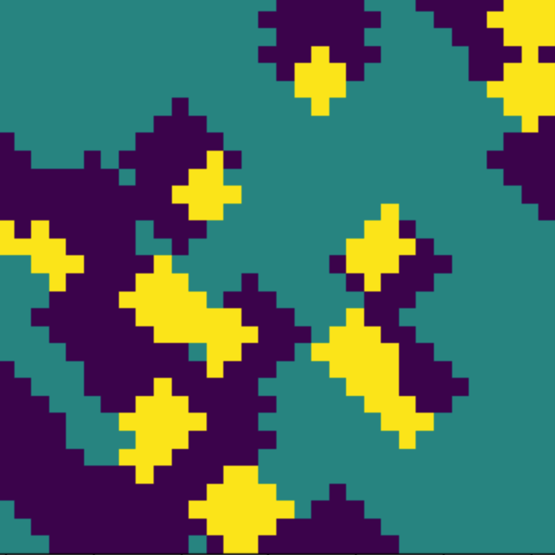
4. The Experiment
4.1 The Objectworld environment
Let’s say the agent position is (x, y) and, the number of colors is two.
Then the environment will check for at least 1 outer color 0 object within the distance of 3
And the environment will check for at least 1 outer color 1 object within the distance of 2
If there are objects of both colors, the reward is 1. If there are only objects of color 0, the reward is -1. Otherwise, the reward is 0.
Yellow: +1
Green: 0
Violet: -1
Figure 4: Reward heatmap of the environment

Slide 14
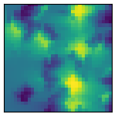
4. The Experiment
4.2 The Expert policy for collect demonstrations
The expert policy is already implemented using Q-learning in the object world environment.
That policy has been used to generate demonstrations.
Generated demonstrations have been used to train IAVI and tabular inverse Q-learning, which is an extended version of IAVI
Figure 4: Expert’s Value heatmap- Ground truth

Slide 15
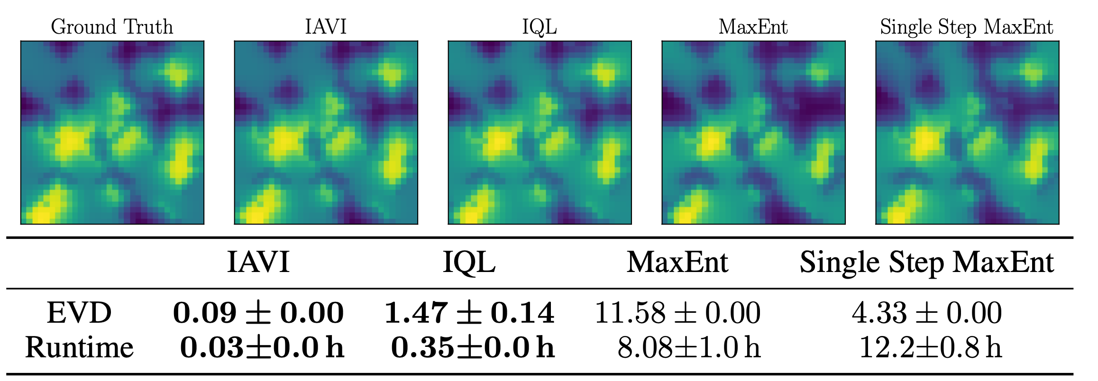
5. Results
5.1 Their implementation
Figure 5: Value heatmaps of different algorithms
AVI matches the ground truth distribution almost exactly with an EVD of 0.09 while IQL shows a low mean EVD of 1.47 and the MaxEnt IRL methods 11.58 and 4.33, respectively.
Additionally, IAVI and IQL have tremendously lower runtimes than MaxEnt IRL, with 1.77 min and 21.06 min compared to 8.08 h.

Slide 16
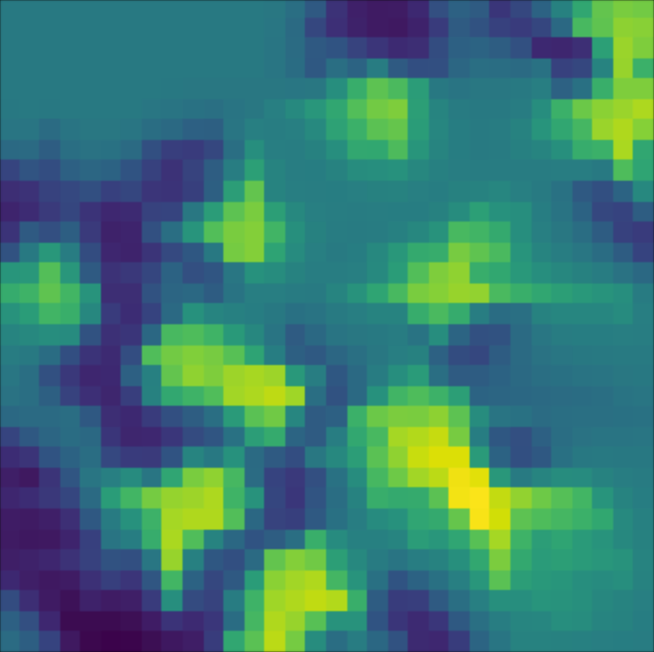
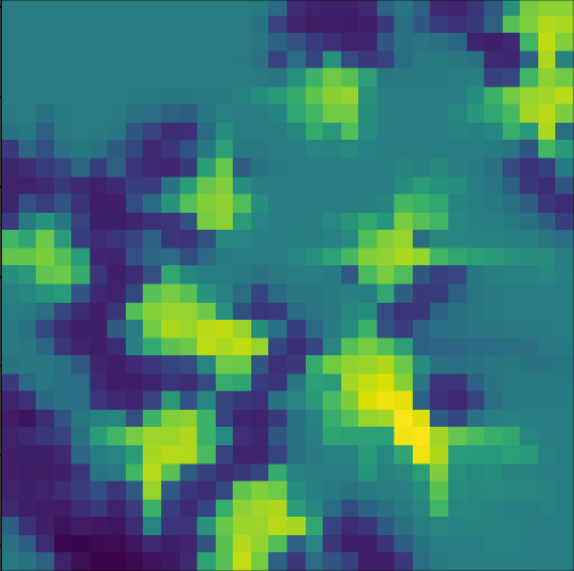
5. Results
5.1 My Implementation
Ground truth
IAVI
 | IAVI | IQL
EVD | 0.1 | To be implemented
Runtime | 3 min (512 demontrations) | To be implemented
Please note that correct results can be obtained after finishing the code

Slide 17
6. Discussion
To be added after the code implementation is finished

Slide 18
Thank you..!

