Slide 1
Effective Java
Third edition by Joshua Bloch

Slide 2
Chapter 1: About The Book
Designed to help use of java programming language more effectively
Memory Management, Performance , Effectively use Collections, Exception handling etc.
Consist of eleven chapters and well organized each with broad explanations
The book is not for beginners but for experienced with Design patterns, Collections, Reflections, OOP etc…

Slide 3
Chapter 2: Creating and Destroying Objects
When and how to create objects
When and how to avoid creating them
How they are destroyed/cleanup

Slide 4
Chapter 2 Contd. Item 1: Static factory method instead of constructors
Providing a public constructor is the traditional way to create instance of a class
Constructors do not describe the object going to be returned. But the factory methods having meaningful names to describe the object returned.
new ArrayList(int) -> ArrayList.withSize(int)
new BigInteger(int, Random) -> BigInteger.prime(int, Random)
new Boolean(boolean) -> Boolen.valueOf(boolean)
Collections.synchronizedCollection(originalCollection)
Collections.unmodifiableList(originalList)
Constructor creates a new object each time its invoked
What happens when “new” key word is used - Memory allocations in JVM
Objects Caching – Boolean Cache, Integer Cache
Constructors can’t return any sub type its return type
A class having two constructors whose parameter list differ only the order, is a bad idea
We can’t provide several implantation using same parameter sequence to different constructors

Slide 5
Chapter 1 Contd. Item 2: Use Builder Pattern when constructor with many parameters
Static factories and constructors having a limitation: They do not scale well to large numbers of optional parameters
new Person(fName, lName, description, age, title, skingColor, hairColor, weight, height, etc.)
Solutions:
1. Telescoping constructor pattern - does not scale well!
A class has multiple constructors, where each constructor calls a more specific constructor in the hierarchy, which has more parameters than itself, providing default values for the extra parameters. The next constructor does the same until there is no left.
Does not scale very well – when adding new parameter, you have to add new constructors to the chain
Hard to read when having more constructor parameters
2. JavaBeans pattern – Scalable into some level
Create the object using a parameter-less constructor and then setting only fields which you want using mutators (setter methods)
Easy to implement and change
Easy to read - setters are named and you know which fields are assigned which value instantly
Easy to scale - Adding more and more parameters is still easy
Cannot create immutable objects, their state can be changed using setters anytime after they are constructed

Slide 6
Chapter 1 Contd. Item 2 Contd.
Solutions:
3. Preferred way is Builder Pattern - combines the safety of the telescoping constructor pattern with the readability of the JavaBeans pattern
Create complex objects using simple objects step by step approach
Client code more easy to read and write.
Its Immutable

Slide 7
Chapter 1 Contd. Item 3: Enforce the singleton property with a private constructor or an enum type
There are two common ways to implement singletons
Singleton with public static final field
Singleton with static factory method
Both have disadvantages
Client can invoke the private constructor reflectively – Reflection Attack
Serialization Injection
Most preferred way is using Enums
Enums automatically supports serialization hence do not need to implement Serializable interface
Enums can’t call Enum’s constructors explicitly so it is not possible to create new instances using Reflection
JVM handles the creation and invocation of Enum constructors internally
Its even prevent Serialization Injection automatically

Slide 8
Chapter 1 Contd. Item 4: Enforce noninstantiability with a private constructor
You may want to create a class which is having only static fields and static methods
Such classes are known as utility classes and were not designed to be instantiated
However even if you are not providing explicit constructors for above utility classes, the compiler provides a public parameter less default constructor. And its leading to creates objects
Making a class abstract does not work for noninstantiability since the class can be sub classed and the sub class instantiated
So, providing private explicit constructor is very good solution noninstantiability for particular class

Slide 9
Item 5: Prefer dependency injection to hardwiring resources

Slide 10
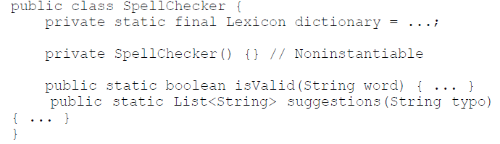
Many classes depend on one or more underlying resources
Examples
SpellChecker <--- depends on ---- Dictionary
Car <--- depends on ---- Engine
NotifyPerson <--- depends on ---- Email Service
Inappropriate Uses of such dependent classes
As static utility

Slide 11
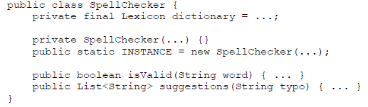
2. As singleton
Neither of these approaches is satisfactory
They assume that there is only one dictionary worth using
Inflexible & untestable

Slide 12
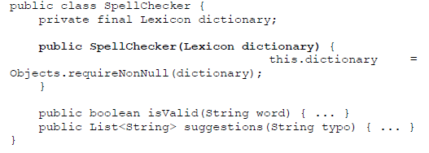
Implementation with dependency injection
http://www.javacreed.com/why-should-we-use-dependency-injection/
Pros
Dependency injection works with an arbitrary number of resources and arbitrary dependency graphs.
It preserves immutability, so multiple clients can share dependent objects
Dependency injection is equally applicable to constructors, static factories and builders.
A useful variant of the pattern is to pass a resource factory to the constructor

Slide 13
Cons
It can clutter up large projects, which typically contain thousands of dependencies.
-- This clutter can be all but eliminated by using a dependency injection framework, such as Dagger, Guice or Spring.

Slide 14
Item 5 : Summary
Static utility classes and singletons are inappropriate for classes whose behavior is parameterized by an underlying resource.
Instead, pass the resources, or factories to create them, into the constructor (or static factory or builder). This practice, known as dependency injection, will greatly enhance the flexibility, reusability, and testability of a class.

Slide 15
Item 6: Avoid creating unnecessary objects

Slide 16
Case 1
String s = new String(“ABC”);
The statement creates a new String instance each time it is executed, and none of those object creations is necessary
String s = “ABC”;
This version uses a single String instance, rather than creating a new one each time it is executed. Furthermore, it is guaranteed that the object will be reused by any other code running in the same virtual machine that happens to contain the same string literal

Slide 17
Case 2
static boolean isRomanNumeral(String s) {
return s.matches("^(?=.)M*(C[MD]|D?C{0,3})"+
"(X[CL]|L?X{0,3})(I[XV]|V?I{0,3})$");
}
String matches : internally creates a Pattern instance for the regular expression and uses it only once, after which it becomes eligible for garbage collection. Creating a Pattern instance is expensive because it requires compiling the regular expression into a finite state machine.
public class RomanNumerals {
private static final Pattern ROMAN = Pattern.compile("^(?=.)M*(C[MD]|D?C{0,3})"
+ "(X[CL]|L?X{0,3})(I[XV]|V?I{0,3})$");
static boolean isRomanNumeral(String s) {
return ROMAN.matcher(s).matches();
}
}

Slide 18
Case 3
Can you spot the object creation ?
private static long sum() {
Long sum = 0L;
for (long i = 0; i <= Integer.MAX_VALUE; i++) {
sum += i;
}
return sum;
}

Slide 19
Case 3
Can you spot the object creation ?
private static long sum() {
Long sum = 0L;
for (long i = 0; i <= Integer.MAX_VALUE; i++) {
sum += i;
}
return sum;
}
The variable sum is declared as a Long instead of a long, which means that the program constructs about 2 to the power 31 unnecessary Long instances (roughly one for each time the long i is added to the Long sum).
prefer primitives to boxed primitives, and watch out for unintentional autoboxing.

Slide 20
Item 6 : Summary
Reuse objects can be both faster and more stylish.
String.matches is the easiest way to check if a string matches a regular expression, it’s not suitable for repeated use in performance-critical situations.
prefer primitives to boxed primitives, and watch out for unintentional autoboxing.
-- The counterpoint to this item is Item 50 on defensive copying. The present item says, “Don’t create a new object when you should reuse an existing one,” while Item 50 says, “Don’t reuse an existing object when you should create a new one.”

Slide 21
Chapter 1 Contd. Item 7: Eliminate obsolete object references
When an Object eligible for garbage collected
When there is no any references for particular object
The ways of making objects eligible for GC
Nullifying the reference
Reassigning the reference variable
Objects created inside methods
Island of Isolation
What is an Obsolete reference
Unused objects which still having references

Slide 22
Chapter 1 Contd. Item 8: Avoid finalizers and cleaners
Finalizers are unpredictable, often dangerous, and generally unnecessary
Cleaners are less dangerous than finalizers, but still unpredictable, slow, and generally unnecessary
Never do anything time-critical in a finalizer or cleaner
Never depend on a finalizer or cleaner to update persistent state
There is a severe performance penalty for using finalizers and cleaners
Finalizers have a serious security problem: they open your class up to finalizer attacks
Throwing an exception from a constructor should be sufficient to prevent an object from coming into existence; in the presence of finalizers, it is not

Slide 23
Chapter 1 Contd. Item 9: Prefer try-with-resources to try-finally
try-finally - No longer the best way to close resources!
try-finally is ugly when used with more than one resource!
try-with-resources - the the best way to close resources
try-with-resources with a catch clause

