Slide 1

CLOUD ARCHITECTURE · DEVSECOPS · MICROSERVICES
NutriAI Health Portal
Enterprise Cloud Architecture & DevSecOps Implementation
Microservices Flexibility
Automated Infrastructure as Code
Zero-Trust Cloud Security
FastAPI · React · Azure Kubernetes Service · PostgreSQL · Azure OpenAI
Notes:
Welcome everyone. Today we are presenting the architecture, deployment, and security posture of the NutriAI Health Portal. We will walk through how we bridged enterprise microservices with a robust, automated Azure infrastructure using Terraform, adhering strictly to Zero-Trust security principles.

Slide 2




THE APPLICATION
Decoupled Microservices Ecosystem
React Frontend
(Nginx SPA)
API Gateway
Auth
Document
Diet
Health
Profile
Admin
Notification
Redis Caching Layer — integrated caching to accelerate response times for vitals and metrics queries across all seven backend services.
React frontend served as a single-page application via Nginx
Backend logic segregated across 7 distinct FastAPI microservices
API Gateway consolidates routing to backend containers seamlessly
02

Slide 3
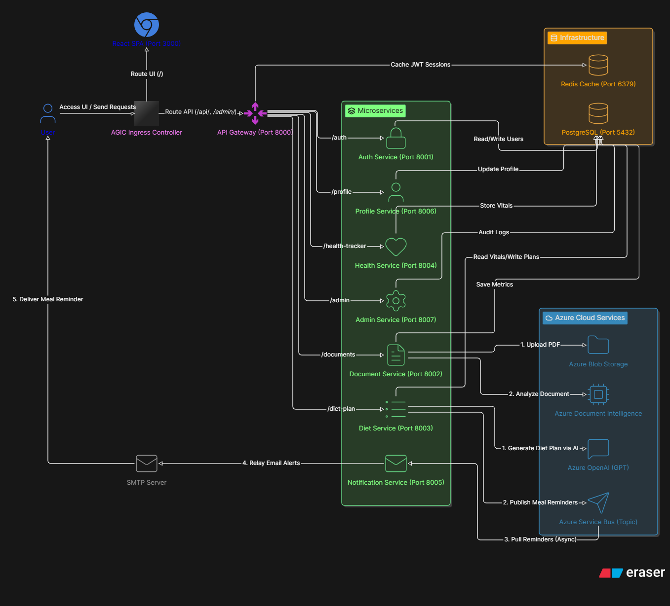
Application Architecture

Slide 4






THE APPLICATION
Event-Driven Data & AI Integrations
PDF Upload
Document
Intelligence
PostgreSQL
Azure OpenAI
Service Bus
SMTP Email
Blob Storage
OCR Parsing
Vitals Stored
Diet Plan
Topic Queue
Notification
OCR Integration: Document service uploads report PDFs to Azure Blob Storage and invokes Azure Document Intelligence to parse laboratory vitals.
AI Diet Engine: Diet service feeds vitals and preferences to Azure OpenAI to generate personalized meal plans.
Asynchronous Reminders: Diet plans trigger events queued in Azure Service Bus topics, consumed by the Notification service for SMTP emails.
03

Slide 5
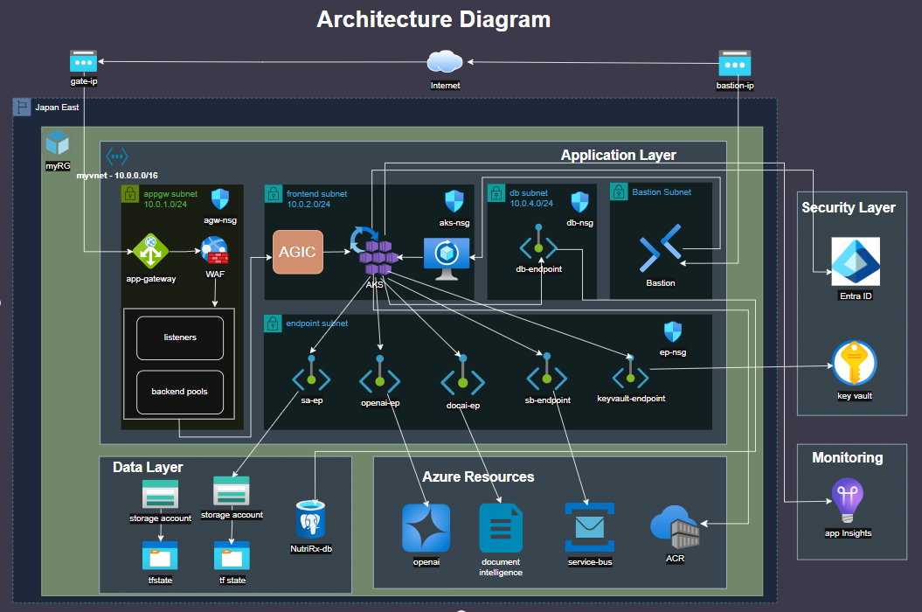

Slide 6




AZURE CLOUD ARCHITECTURE
Regional Compute & Traffic Routing
Virtual Network — Central India
Edge Traffic Flow
Internet
AKS Subnet
AppGW Subnet
Private Endpoint Subnet
Application Gateway
Azure CNI · v1.30+
AGIC Ingress
PaaS isolation
AGIC Ingress Controller
Pods (AKS Subnet)
Database Subnet
Bastion Subnet
Delegated
Secure admin
Primary region: Central India
AOAI availability: East US 2 / South India
04

Slide 7

AZURE CLOUD ARCHITECTURE
Managed Data Systems & Integration Services
PostgreSQL Flexible Server
Redis Cache
Azure Storage Account
Service Bus Premium
Fully managed relational database for application states, profiles, and transactional data.
Low-latency caching layer storing session info and vitals summaries.
Secured blob storage for container configurations and raw medical documents.
Messaging queue with topics and subscriptions for reliable, decoupled communication.
Design principle: fully managed Azure PaaS services minimize administrative overhead while each tier — relational, cache, blob, and messaging — scales independently behind private connectivity.
05

Slide 8
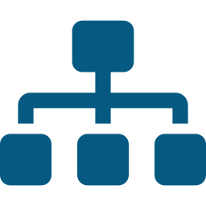



TERRAFORM INFRASTRUCTURE AS CODE
Modular Infrastructure as Code
Project Structure
Directory Structure: Clean separation of root variables and environment-specific parameters from reusable module blocks.
main.tf
variables.tf
terraform.tfvars
backend.tf (remote state + locking)
modules/
├─ database
├─ keyvault
├─ storage
├─ integration
├─ container_registry
└─ entra_id
Custom Modules: Local modules group related Azure resources — Key Vault, Database, Storage, and Integrations.
State Management: State files locked and managed remotely in a dedicated Azure Storage Container for team collaboration.
Configurability: Fully parameterized modules enable swift multi-environment spins — Dev, Staging, Prod.
06

Slide 9



SECURITY POSTURE & HARDENING
Zero-Trust Private Networking
Public Internet
(Blocked)
✕
Key Vault
Storage
Service Bus
Cognitive Services
Private Endpoints + Private DNS Zones route all traffic inside the VNet
Private Endpoints: Configured for Key Vault, Storage, Service Bus, and Cognitive Services — no traffic over the public internet.
Private DNS Zones: Dynamic name resolution inside the VNet, mapping private links directly to subnets.
Database Isolation: PostgreSQL Flexible Server deployed in a delegated subnet, with public access disabled.
Bastion & Isolated VM: Build VM has zero public IPs; administration restricted via secure Azure Bastion.
08

Slide 10


SECURITY POSTURE & HARDENING
RBAC & Identity-Centric Access
Entra ID
App Registration
AKS Kubelet
Deployer
Secrets User
Secrets Officer
read-only
read/write
Key Vault
Entra ID Integration: OAuth 2.0 app registration handles token issuance and user identity authentication.
Azure RBAC Enforcement: RBAC roles replace access keys — e.g. Key Vault Secrets Officer and Secrets User.
Least Privilege Access: AKS Kubelet identity gets read-only Secrets User; the deployer gets write permissions.
Secure ACR Attachments: AKS is natively linked to ACR, automatically establishing secure container pull permissions.
09

Slide 11



CONCLUSION & KEY TAKEAWAYS
Architectural Summary & Next Steps
Build
Secure
Scale
Monitor
Turnkey Infrastructure: Fully automated deployment from scratch with a single terraform apply.
Resiliency & Scale: Decoupled microservices on AKS ready for autoscaling.
Uncompromised Security: Network isolation combined with role-based access management.
Next Steps: Implement CI/CD pipelines in GitHub Actions and configure advanced Grafana monitoring dashboards.
10

