Slide 1
Oracle SQL

Slide 2










Iconic Representations.......
Coffee Break
Can you Solve?
FAQ
Test your Memory
Objective
Queries
Demo
Recap
Need more Info
Brainstorm

Slide 3
Objectives
SQL
Data Definition Language(DDL)
CREATE ALTER DROP TRUNCATE
Data Manipulation Language(DML)
INSERT UPDATE DELETE MERGE

Slide 4
Data Control Language

Slide 5
Data Control Language
DCL:
Creating User Statement
creating a new user account name as Trainer and password as syntel123.
CREATE USER Trainer
IDENTIFIED BY Syntel123;
ALTER USER Trainer IDENTIFIED BY Password123;

Slide 6
Data Control Language
DCL:
Provide SELECT, INSERT, UPDATE, DELETE privileges on training. Employee table
to username(Trainer)
.
Provide ALL privileges on training. Employee table to username(Trainer)
GRANT SELECT, INSERT, UPDATE, DELETE ON training.employees TO Trainer;
GRANT ALL ON training.departments TO Trainer;

Slide 7
Data Control Language
DCL:
Revoke SELECT, INSERT, UPDATE, DELETE privileges on training. Employee table
to username(Trainer)
.
Revoke ALL privileges on training. Employee table to username(Trainer)
REVOKE SELECT, INSERT, UPDATE, DELETE ON training.employees FROM Trainer;
REVOKE ALL ON training.departments FROM Trainer;

Slide 8
Data Definition Language

Slide 9
Data Definition Language
DDL:
Data Definition Language
Used to define , modify or drop the database objects like tables , views, sequences, synonyms, etc..
Some Statements are:
CREATE : Creates the database object
ALTER : Modify the object
DROP : Delete the object

Slide 10
Create Table
DDL:
CREATE TABLE:
Used to create a table to hold the data
Integrity constraints are used to ensure accuracy and consistency of data in the table
Constraints can be defined at
Column Level : Specified immediately after the column definition.
Table Level : Specified after all the columns are defined.
CREATE TABLE [schema.]table (
column datatype [DEFAULT expr]
[column constraints[,…]] [,column datatype [,…]] )
[ table constraint [,…]] [ table ref constraint [,…]]

Slide 11
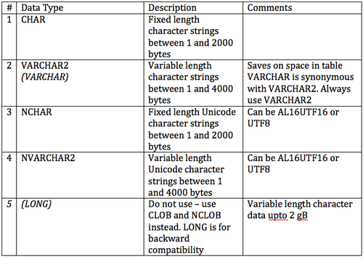
Data types in Oracle

Slide 12
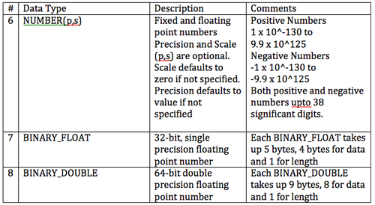
Data types in Oracle

Slide 13
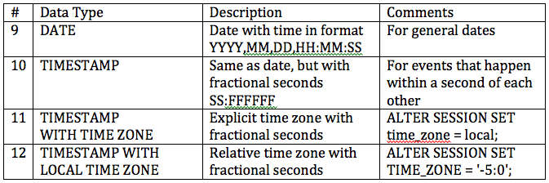
Data types in Oracle

Slide 14
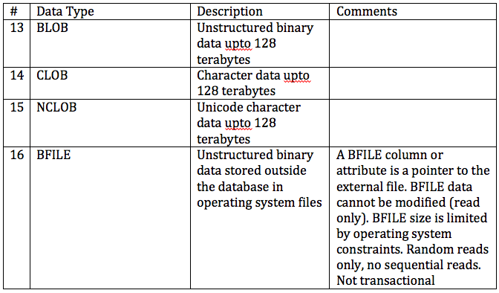
Data types in Oracle

Slide 15
Creating Table
DDL:
CREATE TABLE:
Example:
CREATE TABLE products ( product_id NUMBER(10), product_name VARCHAR2(100), product_cost NUMBER);

Slide 16
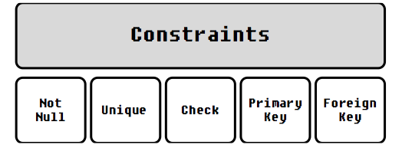
Constraints
DDL:
CREATE TABLE:
Constraints
Defined as the rules to preserve the data integrity in the application.
These rules are imposed on a column of a database table, so as to define the basic behavioral layer of a column of the table and check the sanctity of the data flowing into it.
The data which violates the rule, fails to pass the constraint layer and oracle raises a predefined exception.
They can be defined when a table is first created via the CREATE TABLE statement, or after the table is already created.
The key milestones achieved by the usage of constraints are:
Validate NULL property of the data
Validate uniqueness of the data
Validate referential integrity of the data

Slide 17
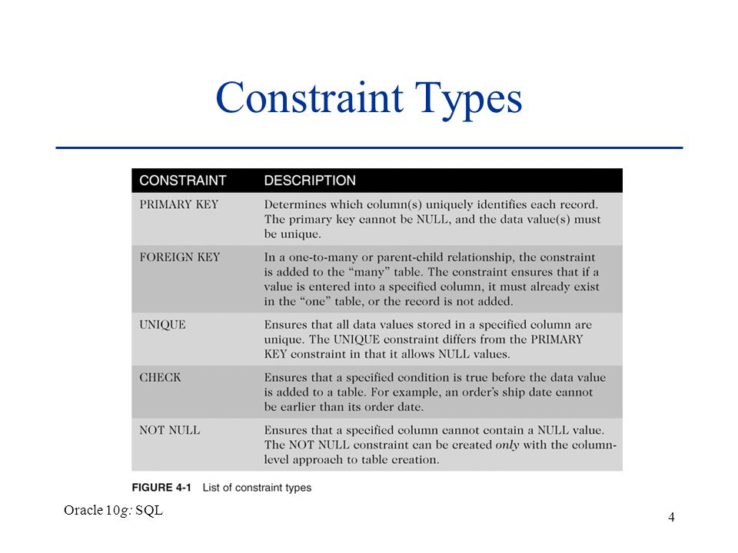
Type of Constraints

Slide 18
Constraints Definitions
Null:
‘Not Null’ constraint can be defined only at the column level.
If any NULL values are encountered during insertion: ‘ORA-01400: cannot insert NULL into [Column description]’.
NOT NULL constraint is also active during update operation: ‘ORA-10407: cannot update [Column description] to NULL’.
Unique:
It prevents duplication of the column data, but interestingly allows NULLs. It allows multiple NULLs during creation as well as modification of the column data.
Can also be defined at Table-level as well

Slide 19
DDL:
CREATE TABLE:
Example: NOT NULL
Note :
CREATE TABLE products ( product_id NUMBER(5), product_name TEXT NOT NULL cost numeric );

Slide 20
DDL:
CREATE TABLE:
Example: UNIQUE
CREATE TABLE products ( product_id NUMBER(5), product_name TEXT UNIQUE, cost numeric );
CREATE TABLE products ( product_id NUMBER(5), product_name TEXT , cost numeric,
CONSTRAINT UN_NAME UNIQUE(product_name));
);

Slide 21
DDL:
CREATE TABLE:
Example: PRIMARY KEY
It is referred to as the hybrid evolution of NOT NULL and UNIQUE
The declaration can be either made at Column level, Table level or using ALTER TABLE command.
Unlike other constraints, there can be one and only one Primary Key in a table. It can be either a single column or a composite primary key.
Composite primary keys can accommodate maximum of 32 columns.
Similar to UNIQUE key, a unique b-tree index is always created whenever a primary key is created, with the same name as that of primary key constraint.
CREATE TABLE products ( product_id NUMBER(5) PRIMARY KEY, product_name TEXT UNIQUE, cost numeric );

Slide 22
DDL:
CREATE TABLE:
Example: FOREIGN KEY
Two tables can be connected through a column, where one table acts as Parent table while the other one is the child table.
The key column value set in the child table is always the subset of key column value set in the parent table, thus establishing the Parent Child relationship and obeys the referential integrity of data.
The key column in child table is known as Foreign Key i.e. its data references an ‘external or foreign’ set of values.
CREATE TABLE Sales ( sales_id NUMBER(4) PRIMARY KEY, product_id NUMBER(5)
REFERENCES Product(product_id),
quantity INT CHECK(quantity >0),
order_date DATE );

Slide 23
DDL:
CREATE TABLE:
Example: FOREIGN KEY
Oracle prevents the deletion of a Parent record, if its corresponding child exists in the child table.
This can be solved by adding the CASCADE clause with the constraint :
ON DELETE CASCADE : This will remove the record from child table, if that value of foreign key is deleted from the main table.
and ON DELETE SET NULL : This will set all the values in that record of child table as NULL, for which the value of foreign key is deleted from the main table.
CREATE TABLE Sales ( sales_id NUMBER(4) PRIMARY KEY, product_id NUMBER(5),
quantity INT CHECK(quantity >0),
order_date DATE,
CONSTRAINT FK_PRODUCT FOREIGN KEY (product_id) REFERENCES Product(product_id) ON DELETE CASCADE );

Slide 24


DDL:
CREATE TABLE:
Example: FOREIGN KEY
Guidelines for establishing Relationship
The key column in the Parent table must be a Primary Key.
Multiple Child key columns can refer single Parent key column.
Though the Parent table key column is a Primary Key (which does not allows NULLs), foreign key can accommodate NULL values.
Oracle prevents the deletion of a Parent record, if its corresponding child exists in the child table. If the constraint is enforced with ON DELETE CASCADE option, then the child record would also be deleted. If the constraint is enforced with ON DELETE SET NULL option, then the child record would not be deleted, but their key column value would be set to NULL
Oracle prevents the creation of a Child record, for which value of key column does not exists in the Parent table.

Slide 25
DDL:
CREATE TABLE: Creating a Table From an Existing Table
Example:
The new Table Emp_New will be created with the data populated from HR.Employees.
Although the table structure and data is copied the constraints are not copied.
CREATE TABLE AS (SELECT Query);
CREATE TABLE Emp_New AS (
SELECT * from HR.Employees
);

Slide 26
DDL:
CREATE TABLE: Creating a Table with the same structure as an existing Table.
The structure of a table can be copied by giving in a WHERE condition that evaluates to false
CREATE TABLE Emp_New AS (
SELECT * from HR.Employees where 1=2
);

Slide 27
DDL:
ALTER TABLE:
It is used for alteration of table structures. There are various uses of alter command, such as,
To add a column to existing table
To rename any existing column
To change data type of any column or to modify its size.
alter is also used to drop a column
Rename a Table

Slide 28
DDL:
ALTER TABLE: Columns
Add Column to an Existing Table
Syntax:
Example:
Adding multiple columns
ALTER TABLE table_name ADD (column_1 column-definition, column_2 column-definition, ... column_n column_definition);
ALTER TABLE Products ADD price NUMBER(4) NOT NULL
ALTER TABLE supplier ADD (
supplier_name varchar2(50),
city varchar2(45));

Slide 29
DDL:
ALTER TABLE: Columns
Modifying an Existing Column
Syntax:
Example:
Altering the size of the column
Altering multiple columns
ALTER TABLE table_name MODIFY column_name column-definition[, column_2 column-definition, ... column_n column_definition]);
ALTER TABLE supplier
MODIFY supplier_name varchar2(70) not null;
ALTER TABLE supplier MODIFY (
city varchar2(75) NOT NULL,
supplier_name(75)) NOT NULL;

Slide 30
DDL:
ALTER TABLE: Columns
Dropping an Existing Column
Syntax:
Example:
ALTER TABLE table_name DROP COLUMN column_name
ALTER TABLE supplier DROP COLUMN supplier_name;

Slide 31

DDL:
ALTER TABLE:
Renaming a Column
Starting in Oracle 9i Release 2, you can now rename a column.
Syntax:
Example:
ALTER TABLE table_name
RENAME old_column TO new_column_name
ALTER TABLE supplier RENAME COLUMN city TO supplier_city;

Slide 32
DDL:
ALTER TABLE: Constraints
Enable / Disable a Constraint
Syntax:
Example:
ALTER TABLE table_name
ENABLE/DISABLE constraint ConstraintName;
ALTER TABLE Sales
DISABLE CONSTRAINT FK_PRODUCT

Slide 33
DDL:
ALTER TABLE: Constraints
Add /Drop Constraints
Example:
ALTER TABLE table_name
ADD/DROP CONSTRAINT ConstraintName
ALTER TABLE Sales
DROP CONSTRAINT FK_PRODUCT

Slide 34
DDL:
ALTER TABLE: Table
Rename a Table
Example:
Note : If you change the object's name any reference to the old name will be affected. You have to manually change the old name to the new name in every reference.
RENAME old_table_name TO New_Table_name
RENAME TABLE Suppliers TO vendors

Slide 35
DDL:
DROP TABLE:
Used to delete one or more table structure which is no longer in use.
When a table is dropped, all the tables' rows, indexes and privileges will also be removed.
CASCADE Constraints :
Deletes all foreign keys that reference the table to be dropped, then drops the table.
PURGE :
As of Oracle 10g, when a table is dropped it is moved into the recycle bin unless the PURGE modifier is used. If the PURGE modifier is used then the table is dropped completely from the database and is unrecoverable.
DROP TABLE table_name
DROP TABLE table_name CASCADE constraints;
DROP TABLE table_name PURGE;

Slide 36
DDL:
DROP TABLE: Retrieving the Table Back
With Oracle 10g, the table once dropped, cannot be queried or acted upon and is moved from schema to Oracle Recycle bin.
We can see the contents of user’s recycle bin:
Table can be retrieved back from the recyclebin using FLASHBACK utility as:
To drop the table entirely and release the space, use “PURGE” clause.
Unless you purge them, Oracle will leave objects in the recyclebin until the tablespace runs out of space, or until you hit your user quota on the tablespace.
At that point, Oracle purges the objects one at a time, starting with the ones dropped the longest time ago, until there is enough space for the current operation.
SELECT * FROM recyclebin;
FLASHBACK table table_name
TO BEFORE DROP;

Slide 37
DDL:
TRUNCATE :
Used to remove (delete) all rows from a table.
Also deallocates all of the space used by the removed rows
TRUNCATE TABLE table_name;

Slide 38
How do you force a DROP command to drop the parent table even when a child table is existing?
Answer: Using the CASCADE CONSTRAINTS Option with the DROP Command

Slide 39
Where the integrity constraints are stored in Data Dictionary ?
Answer: The integrity constraints are stored in USER_CONSTRAINTS.

Slide 40
Brainstorm

Slide 41
Queries

Slide 42
Oracle SQL
DML – Data Manipulation Language

Slide 43
Oracle SQL
DML:
Data Manipulation Language
Used to manipulate the data stored in the database.
Inserting Data
Updating Data
Deleting Data
Merging Data

Slide 44
Oracle SQL
DML:
INSERT :
Data can be inserted into the table using INSERT Statement
Example:
If data is inserted into all the columns of the table the column_name can be skipped
INSERT INTO table_name (column-1, column-2, ... column-n) VALUES (value-1, value-2, ... value-n);
INSERT INTO suppliers (supplier_id, supplier_name,supplier_city,phone) VALUES(‘S01’,’UPS’,’Columbia’,’0441-782-7892’);
INSERT INTO suppliers VALUES(‘S01’,’UPS’,’Columbia’,’0441-782-7892’);

Slide 45
Oracle SQL
DML:
INSERT : INSERT ALL
INSERT ALL can be used for inserting multiple rows at a time
Applicable only to Oracle10g and above
Example:
INSERT ALL
INTO table_name (column-1, ..) VALUES (value-1... )
INTO table_name (column-1, ..) VALUES (value-1... )
INSERT ALL
INTO Supplier (supplier_name) VALUES (‘A')
INTO Supplier (supplier_name) VALUES (‘B')
INTO Supplier (supplier_name) VALUES (‘C')
SELECT * FROM dual;

Slide 46
Oracle SQL
DML:
INSERT :
We can also use sub-selects in an INSERT Statement
Example:
INSERT INTO table_name (column-1, column-2, ... column-n)
SELECT column1,column2 FROM table_name …..
INSERT INTO suppliers (supplier_id, supplier_name) SELECT account_no, name
FROM customers WHERE city = 'Newark';

Slide 47
Oracle SQL
DML:
UPDATE :
Used to modify the existing data in the table.
Example:
If the WHERE Clause is ignored it will update all the rows in the table.
Example : Updating Multiple Columns
UPDATE table_name
SET column-1= value-1[, column-2 = value-2, ... column-n) [WHERE …..]
UPDATE suppliers
SET name = ‘Samsung' WHERE name = ‘Apple’;
UPDATE suppliers
SET name = ‘Nokia', product = ‘Nokia 910'
WHERE name = ‘Samsung';

Slide 48
Oracle SQL
DML:
UPDATE :
Example: Update records in one table based on values in another table.
UPDATE suppliers
SET supplier_name = (SELECT customers.name
FROM customers
WHERE customers.customer_id = suppliers.supplier_id)
WHERE EXISTS
(SELECT customers.name
FROM customers
WHERE customers.customer_id = suppliers.supplier_id);

Slide 49
Oracle SQL
DML:
UPDATE :
Example: Update based on a query returning multiple values
UPDATE suppliers
SET (supplier_name,city) = (SELECT customers.name,city
FROM customers
WHERE customers.customer_id = suppliers.supplier_id)
WHERE supplier_id=10;

Slide 50
Oracle SQL
DML:
DELETE :
Used to delete the data in the table
DELETE Statement by default deletes all the data from the table unless specified using a WHERE clause
DELETE
FROM table_name
[WHERE …..]

Slide 51
Oracle SQL
DML:
MERGE :
The MERGE statement was introduced in Oracle 9i to conditionally insert or update data in a single atomic statement, depending on the existence of a record.
The MERGE statement reduces table scans and can perform the operation in parallel if required.
Syntax:
MERGE into <target table>
USING <souce table/view/result of subquery>
ON <match condition>
WHEN MATCHED THEN
<update clause>
<delete clause>
WHEN NOT MATCHED THEN
<insert clause>

Slide 52
Oracle SQL
DML:
MERGE :
Example:
MERGE INTO dept d
USING dept_online o
ON (d.deptno = o.deptno)
WHEN MATCHED THEN
UPDATE SET d.dname = o.dname, d.loc = o.loc
WHEN NOT MATCHED THEN
INSERT (d.deptno, d.dname, d.loc) VALUES (o.deptno, o.dname, o.loc);

Slide 53
Oracle SQL
DML:
MERGE :
With the release of 10g, Oracle has added many enhancements to MERGE statement
It can now UPDATE, DELETE and INSERT with separate conditions for each.
It also supports UPDATE-only or INSERT-only operations.
Deleting during the merge operation
Example: Oracle 10g : UPDATE- only
Similarly for INSERT-only operations.
MERGE INTO dept d
USING dept_online o
ON (d.deptno = o.deptno)
WHEN MATCHED THEN
UPDATE SET d.dname = o.dname, d.loc = o.loc

Slide 54
Oracle SQL
DML:
MERGE :
With Oracle 10g, we can now apply additional conditions to the UPDATE or INSERT operation within a MERGE.
This is extremely useful if we have different rules for when a record is updated or inserted but we do not wish to restrict the ON condition that joins source and target together.
Example: Oracle 10g : Conditional dml
MERGE INTO dept d
USING dept_online o
ON (d.deptno = o.deptno)
WHEN MATCHED THEN
UPDATE SET d.dname = o.dname, d.loc = o.loc
WHERE d.deptno IN (10,20,30)

Slide 55
Oracle SQL
DML:
MERGE :
With Oracle 10g, we can conditionally DELETE rows from the target dataset during an UPDATE operation.
The DELETE works against conditions on the target data, not the source.
The DELETE works only on rows that have been updated as a result of the MERGE. Any rows in the target table that are not touched by the MERGE are not deleted, even if they satisfy the DELETE criteria.
Example: Oracle 10g : Conditional dml
MERGE INTO emp e1
USING emp_load e2
ON (e2.empno = e1.empno)
WHEN MATCHED THEN
UPDATE SET e1.sal = e2.sal DELETE WHERE sal <= 0
WHEN NOT MATCHED THEN
INSERT (empno, ename, job, mgr, hiredate, sal, comm, deptno) VALUES (e2.empno, e2.ename, e2.job, e2.mgr, e2.hiredate, e2.sal, e2.comm, e2.deptno);

Slide 56
Brainstorm

Slide 57
Queries

Slide 58
Oracle SQL
TCL – Transaction Control Language

Slide 59
Oracle SQL
TCL:
Transaction Control Language
Properties of TCL
Commit
Rollback

Slide 60
Oracle SQL
Properties of TCL:
Atomicity: This property ensures that either all the operations of a transaction reflect in database or none.
Consistency: To preserve the consistency of database, the execution of transaction should take place in isolation (that means no other transaction should run concurrently when there is a transaction already running).
Isolation: For every pair of transactions, one transaction should start execution only when the other finished execution
Durability: Once a transaction completes successfully, the changes it has made into the database should be permanent even if there is a system failure. The recovery-management component of database systems ensures the durability of transaction.

Slide 61
Oracle SQL
TCL:
Commit :
Save changes permanently made on tables after query is executed successfully
Rollbackl:
undo the changes made on tables after query is execution getting failure
UPDATE suppliers
SET name = ‘Samsung' WHERE name = ‘Apple’;
Commit;
UPDATE suppliers
SET name = ‘Samsung' WHERE name = ‘Apple’;
rollback;

Slide 62
How is DELETE different from TRUNCATE?
Answer: Delete is a DML Operation. After performing a DELETE we need to COMMIT or ROLLBACK the transaction to make the change permanent or to undo it and this operation will cause all DELETE triggers on the table to fire.
TRUNCATE operation is a DDL Operation. It cannot be rolled back and no triggers will be fired. As far as performance is concerned TRUCATE is faster and doesn't use as much undo space as a DELETE.

Slide 63
Why is TRUNCATE faster than DELETE?
Answer: When you type DELETE. All the data get copied into the Rollback Tablespace first and then delete operation is performed. That’s how when you type ROLLBACK after deleting a table ,you can get back the data. All this process is time consuming.
Whereas when you type TRUNCATE, it removes data directly without copying it into the Rollback Tablespace and makes TRUNCATE a faster operation in comparison. Once you Truncate the data cannot be retrieved.

Slide 64
Recap
DDL Statements
Help in Defining and Modifying the database structure
CREATE TABLE:
Creates the Table and also help in providing in the different constraints to maintain the integrity of the data
ALTER TABLE:
Used to modify the existing data structure which includes adding a new column or constraint, dropping an existing column or constraint, enabling or disabling a constraint,etc…
DROP TABLE:
Dropping an existing data structure temporarily or permanently and also retrieving the data structure using the FLASHBACK utility of Oracle 10g.
TRUNCATE TABLE;
Used to remove all the data from the table.
DML Statements
Manipulate the data store in the tables
INSERT,UPDATE,DELETE and MERGER

