Slide 1
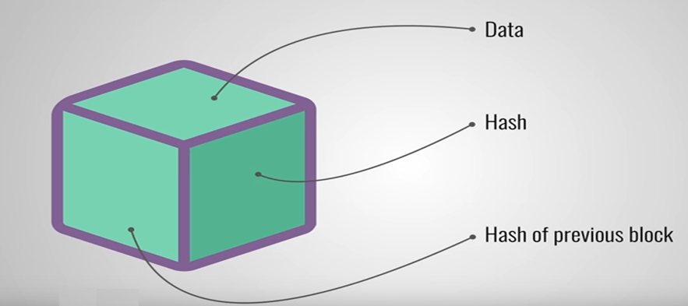
What is Blockchain
A blockchain is a decentralized, distributed and public/private digital ledger that is used to record transactions across many computers so that the record cannot be altered without the alteration of all subsequent blocks and the consensus of the network.

Slide 2
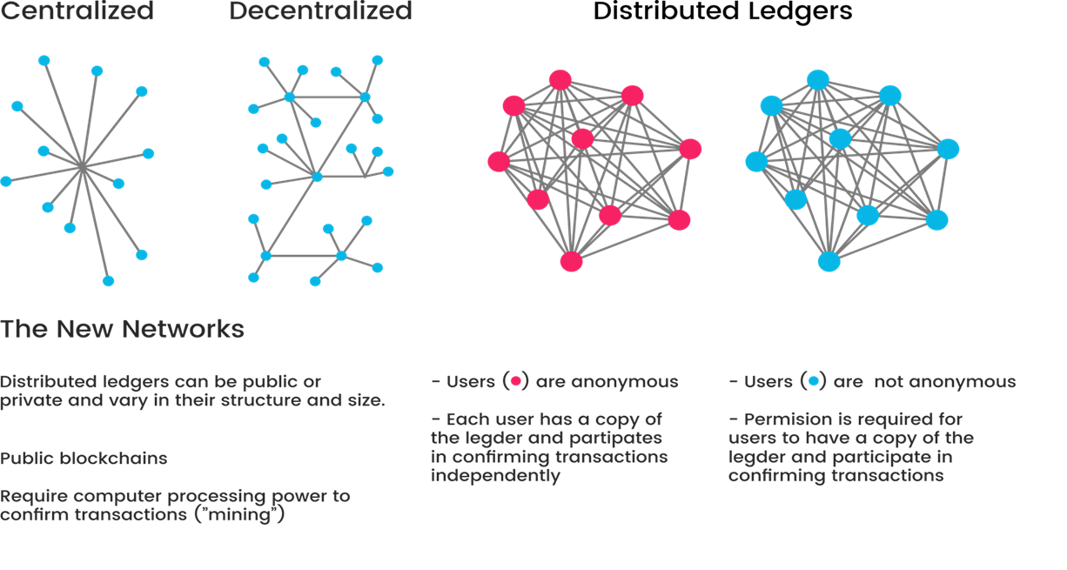

Slide 3
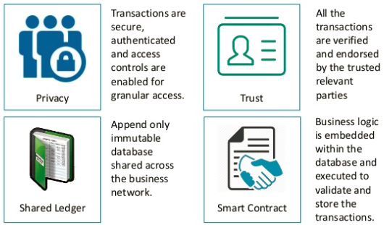
Business requirement.

Slide 4
What is hyper ledger fabric?
Hyperledger fabric is an open source collaborative effort created to advance cross-industry blockchain technologies. It is a global collaboration, hosted by The Linux Foundation, including leaders in finance, banking, IoT, supply chain, manufacturing and technology.

Slide 5
Thank you

