Slide 1
OPencv Advanced
opencv 進階應用
秦語萱

Slide 2
environment
Python
Python 3.7
opencv-contrib-python (3.4.2.17) cv2
Matplotlib 3.1.1, numpy
UI framework: pyqt5 (5.15.1)

Slide 3
environment
In Main.py but can’t execute
詳細project 連同 gui檔案（需要import與安裝上一頁環境參數）
在 https://github.com/chinyu1229/opencv_stereo

Slide 4
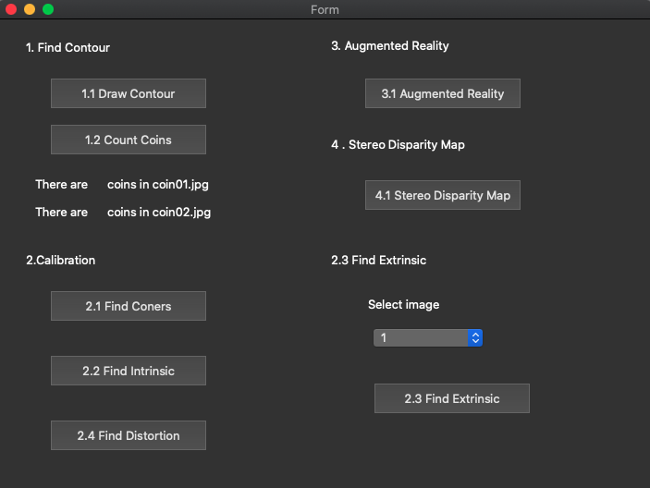
GUI & function
1. Find Contour
1.1 Draw Contour
1.2 Count Coins
2. Camera Calibration
2.1 Corner detection
2.2 Find the intrinsic matrix
2.3 Find the extrinsic matrix
2.4 Find the distortion matrix
3. Augmented Reality
4. Stereo Disparity Map
4.1 Compute disparity map
4.2 Calculate the depth

Slide 5
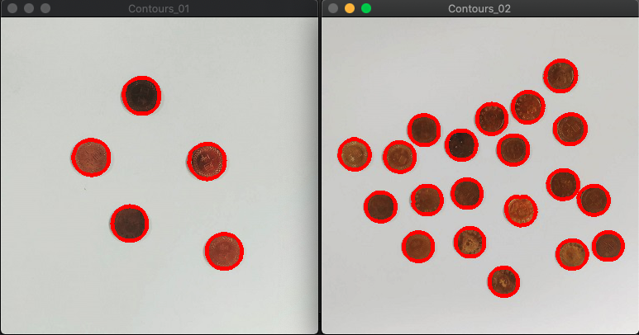
1.1 Find Contour – Draw Contour
Given: two color images
Draw Contour: Using OpenCV functions to find the contours of coins in two images.
step1: RGB -> Grayscale -> binary
step2: use Gaussian blur to remove the noise
step3: using edge detection functions( cv2.Canny() ) to get better results
step4: using cv2.findContours() & cv2.drawContours then show the results

Slide 6
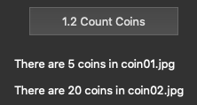
1.2 Find Contour – Count Coins
Given: two color images
Draw Contour: Using OpenCV functions to find how many coins in two images
step1: RGB -> Grayscale -> binary
step2: use Gaussian blur to remove the noise
step3: using edge detection functions( cv2.Canny() ) to get better results
step4: using cv2.findContours() which return value is num of coins

Slide 7
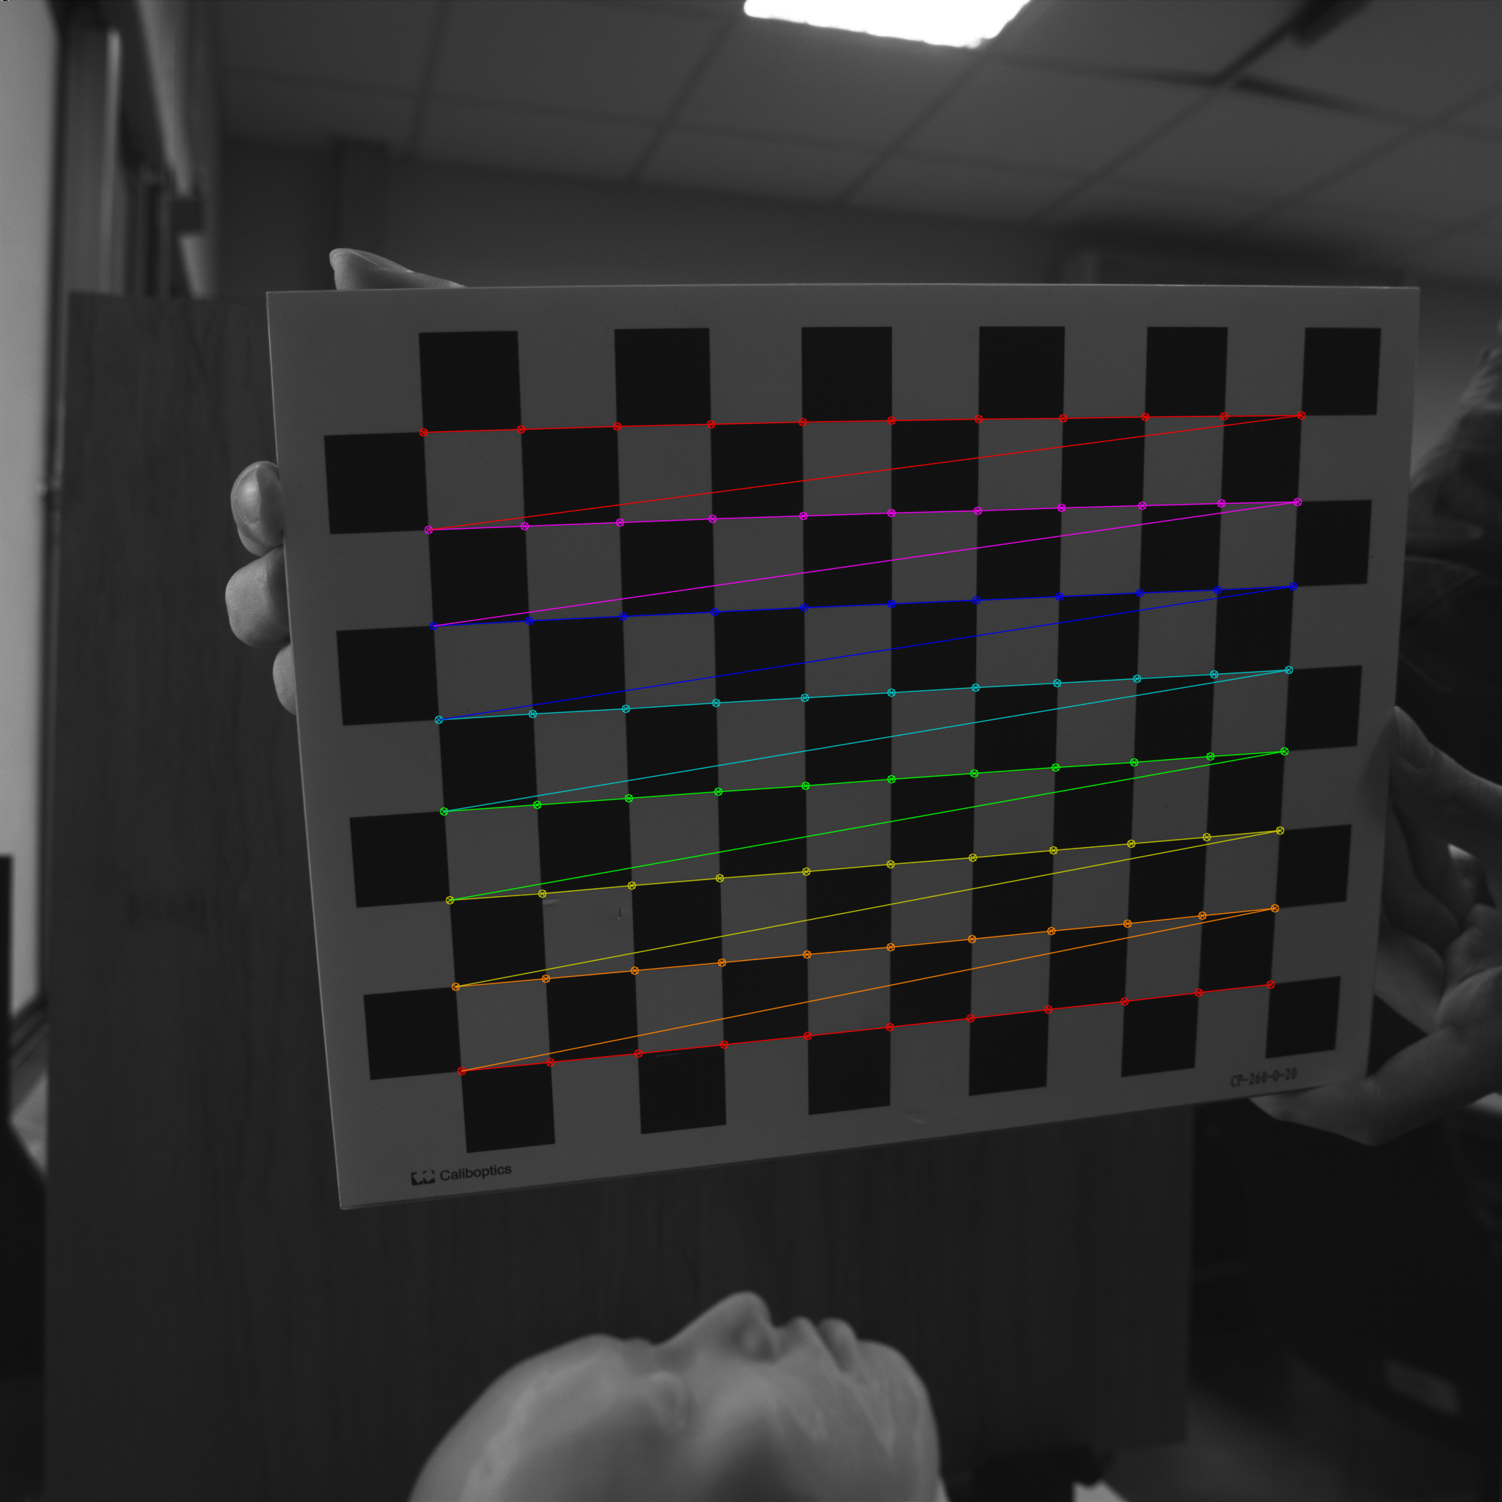
2.1 Corner Detection
Given : 15 images, 1.bmp ~ 15.bmp
Find and draw the corners on the chessboard for each image
step1 : using cv2.findChessboardCorners to find chessboard corners and return ‘ret’ value
step2 : using cv2.drawChessboardConers to show 1~15 images

Slide 8
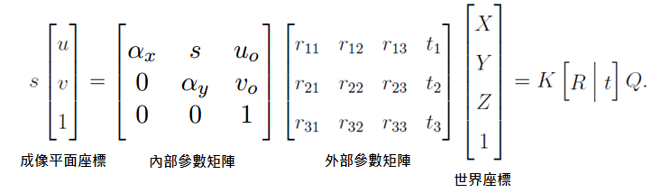
2.2 Find the Intrinsic Matrix
Camera Calibration (相機校正）是利用多個已知的世界座標 跟其對映的影像座標的點，來求該 Camera 的內部參數矩陣(Intrinsic Matrix) 及外部參數矩陣(Extrinsic Matrix)
理論基礎為：世界座標(3D)經過相機外部參數矩陣的作用 轉換成相機座標(3D)，而相機座標(3D) 再經過相機內部參數矩陣的投影作用轉換成影像座標(2D)。
根據針孔相機成像成理，假設 Q 點的世界座標為 (X, Y, Z)，而影像座標的座標為 (u, v)，可以得到以下相機矩陣關係：
Given : 15 images, 1.bmp ~ 15.bmp
Find the intrinsic matrix
cv2.calibrateCamera to print intrinsic matrix ( return value is mtx )

Slide 9
2.3 Find the extrinsic matrix
Given: intrinsic parameters, distortion coefficients, and the list of 15 images
Find the extrinsic matrix of the chessboard for each of the 15 images
step1 : cv2.calibrateCamera to find given parameters
step2 : use rotation matrix( return value is rvecs）& transformation matrix (return value is tvecs) to calculate the extrinsic matrix

Slide 10

2.4 Find the distortion matrix
Given: 15 images
Find the distortion matrix
cv2.calibrateCamera to print distortion matrix ( return value is dist )

Slide 11
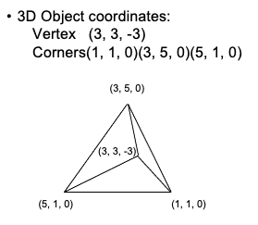
3. Augmented reality
Given: 15 images
1) Calibrate 5 images to get intrinsic, distortion and extrinsic parameters
2) Draw a “pyramid” on the chessboards images(1.bmp to 5.bmp)
3) Click the button to show the tetrahedron on the picture. Show each picture 0.5 seconds (total 5 images)
Set pyramid vetex then using cv2.drawContours() & cv2.line() to draw pyramids

Slide 12
4. stereo disparity Map
Given: a pair of images L.png & R.png
4.1 compute the disparity map/image based on Left and Right stereo images
4.2 Select a point on disparity map from 4.1, calculate the depth and show both the disparity value and the depth on the image
當採取兩個同一水平線上的攝像頭進行拍攝的時候，同一物體將在兩個攝像機內被拍攝到，在兩個攝像機內部，這個物體相對於攝像機中心點位置有不同的座標。left是該物體在左攝像機內相對位置，right是該物體在右攝像機內相對位置。
兩個攝像機相距S，焦距為f，物體P距離攝像機z，z也就是景深。當我們將兩幅影象重疊在一起的時候，左攝像機上P的投影和右攝像機上P的投影位置有一個距離|Xleft| |Xright|，這個距離稱為Disparity。
根據相似三角形可以得到z=sf/d，計算d的值的過程中需要對兩幅影象進行匹配，尋找到物體P在兩幅影象中的相對位置。在對影象進行匹配的過程中，需要用到cost computation，即通過尋找同一水平線上兩幅影象上的點的最小誤差來確定這兩個點是否是同一個物體所成的像。

Slide 13
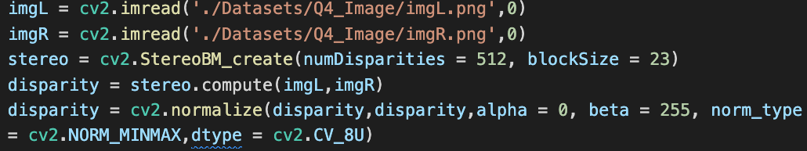
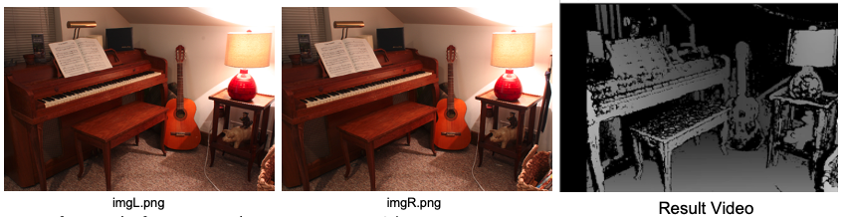
4. stereo disparity Map(cont.)
basic algorithm: calculate disparity
calculate depth using z = sf / d, s is given 178, f is given 2826

Slide 14
the end
THANK YOU!

