Slide 1
Title: Parch_and_Posey Database Exploratory Analysis
Name: Chioma Eboaju
BootCamp Name: CoreDataEngineers
Highlights: This presentation provides a comprehensive analysis of sales data from Parch and Posey, a leading provider of high-quality paper products. The analysis examines sales performance across various channels.

Slide 2
Objectives:
Bar Chart showing Sales by Paper Type
Bar Chart showing Top 5 Accounts by Sales
Pie Chart showing Sales by Region
Bar Chart showing Top Performing Sales Reps by Revenue
Bar Chart showing Web Event Engagement by Channel
Strategic Recommendations on the above charts

Slide 3
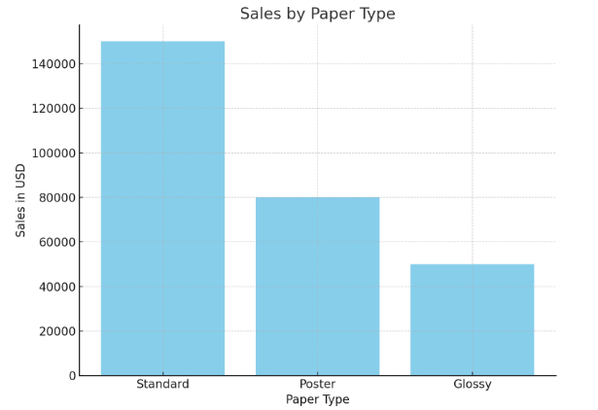
Sales by Paper Type: A bar chart showing that Standard paper is the highest seller, followed by Poster and Glossy.

Slide 4
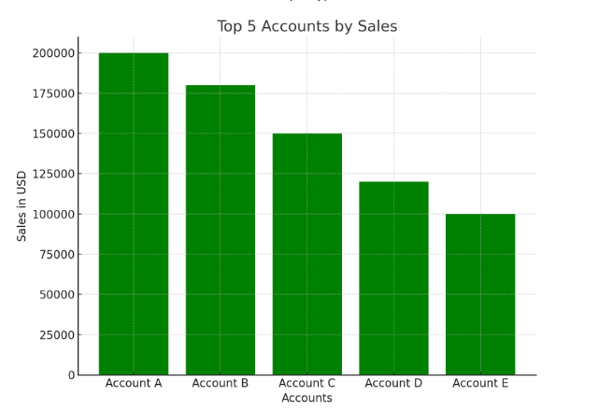
Top 5 Accounts by Sales: A bar chart showing the top 5 accounts by total sales, with Account A being the highest contributor.

Slide 5
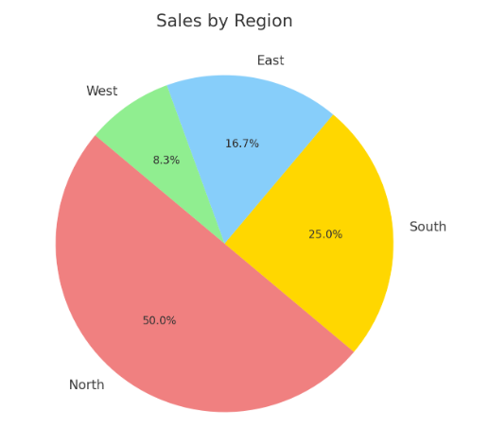
Sales by Region: A pie chart illustrating that the North region generates the largest portion of total sales.

Slide 6
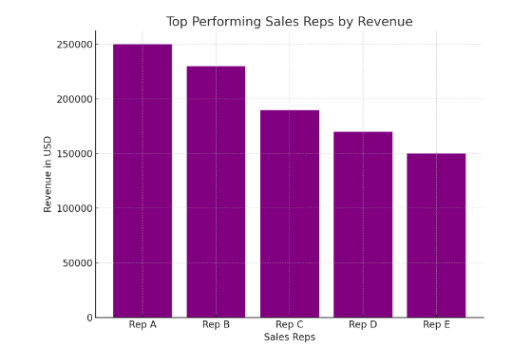
Top Performing Sales Reps by Revenue: A bar chart highlighting Rep A as the top performer in terms of revenue

Slide 7
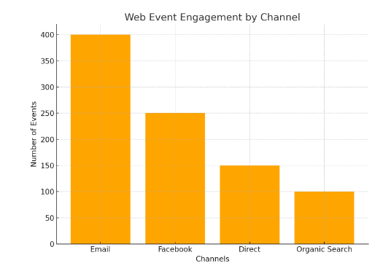
Web Event Engagement by Channel: A bar chart showing that Email is the most engaging channel, followed by Facebook.

Slide 8
Strategic Recommendations
Sales by Paper Type:
Insight: Standard paper is the highest-selling product, contributing significantly to total sales, while glossy paper lags behind.
Suggested Action: Focus on marketing campaigns that emphasize the benefits of glossy paper to boost sales. Consider bundling it with high-selling standard paper to increase sales.

Slide 9
Strategic Recommendations
Top 5 Accounts by Sales:
Insight: Account A is the top contributor, followed closely by Accounts B and C. These few accounts generate a substantial portion of revenue.
Suggested Action: Strengthen relationships with these key accounts through loyalty programs or personalized offers. Consider diversifying the customer base to reduce dependency on a small number of accounts.

Slide 10
Strategic Recommendations
Sales by Region:
Insight: The North region generates 50% of total sales, while the West region underperforms with just 10% of the total.
Suggested Action: Increase sales efforts in the underperforming West region by deploying more sales reps or offering region-specific promotions. Investigate why the North is thriving and replicate successful strategies in other regions.

Slide 11
Strategic Recommendations
Top Performing Sales Reps by Revenue:
Insight: Rep A is the top performer, generating the highest revenue. The performance of Rep B and C is also commendable.
Suggested Action: Recognize and incentivize top-performing sales reps to maintain high performance. Offer additional training or support to lower-performing reps, or redistribute responsibilities for better performance balance.

Slide 12
Strategic Recommendations
Web Event Engagement by Channel:
Insight: Email is the most engaging channel, followed by Facebook. Organic search and direct visits are much lower in engagement.
Suggested Action: Double down on email marketing efforts and improve the targeting of campaigns. Experiment with increasing organic search visibility through better SEO or content marketing.

