Slide 1

HOSPITAL DATABASE MANAGEMENT SYSTEM (HDMS)
by
Chioma Juliet Uche

Slide 2

AIM
PROJECT OVERVIEW
To design, develop and implement a robust database to efficiently streamline hospital operations.
Objectives
To design a relational database for all patient-related information.
To retrieve and analyse data from multiple tables using Join and subqueries.
To automate routine tasks using advanced SQL features like triggers, views, events, stored function and procedure.
SCOPE
Patient management
Appointment scheduling.
Billing and payments
Room allocation

Slide 3
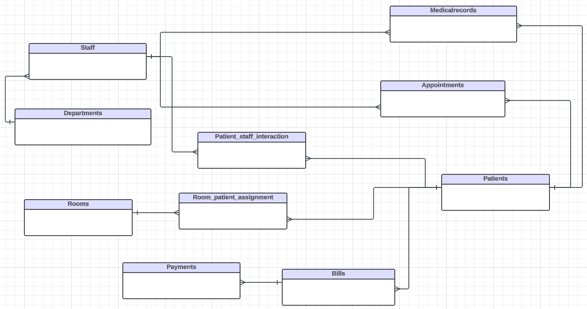
DATABASE MODELLING
Conceptual SCHEMA
This database design consists of 10 entities:
Patients
Staffs
Medical records
Appointments
Departments
Patient staff interaction
Rooms
Room patient assignment
Bills
Payments
RELATIONSHIPS
One-to-Many - (Patients and Medical Records, Patient and Staff, Patient and Bills)
Many-to-One - (Staff and Departments, appointments and Patients, Payment and Bills)

Slide 4
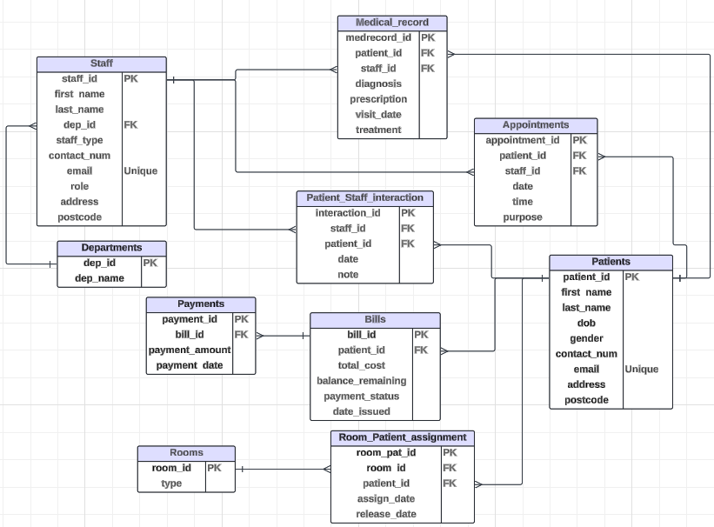
Logical SCHEMA
Added attributes
Added Primary key
Added Foreign key
Added Unique constraint on the email attribute in the staff and patient entities.

Slide 5
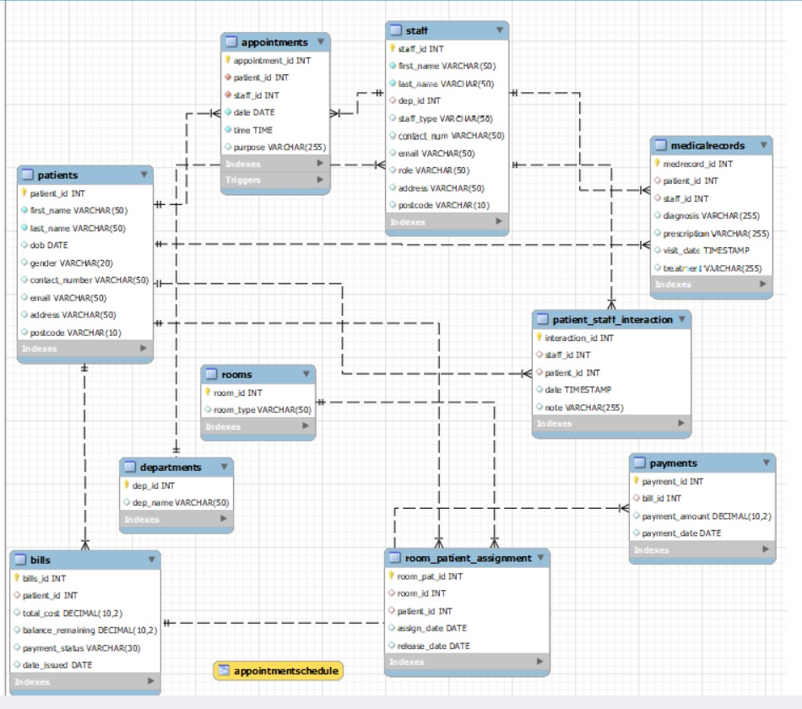
PHYSICAL SCHEMA
Created tables, specifying the data type and sizes of the attributes.
DBMS Features include:
Stored Procedures
Trigger
View
Event
Normalization was done up to the 3rd normal form.

Slide 6
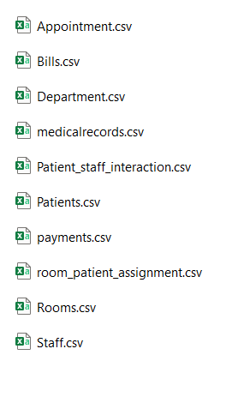
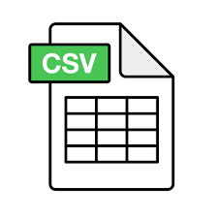
IMPORTING DATA INTO THE HOSPITAL MANAGEMENT DATABASE
A fictional dataset of 50 records was generated to simulate real-world data for initial testing purposes.
Data was saved in csv format.
Data was imported using MySQL database management tool.

Slide 7
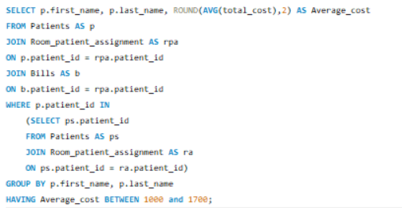
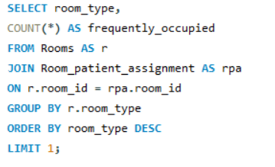
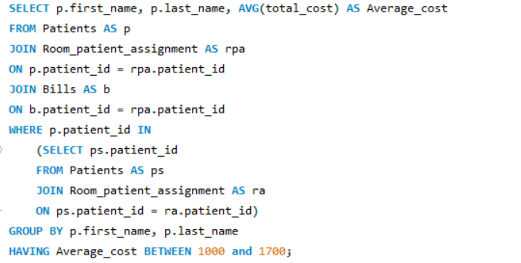
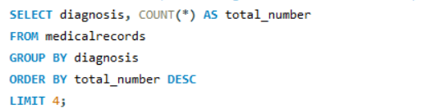
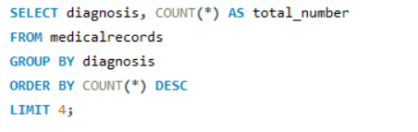
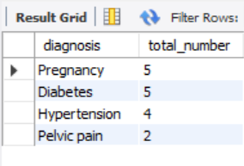
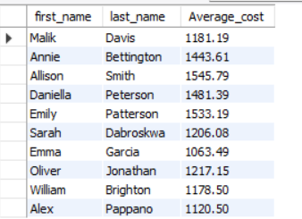
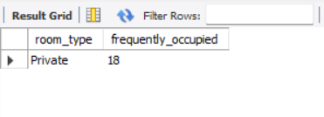
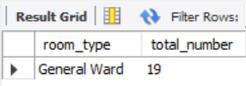
RETRIEVAL AND ANALYSIS OF DATA FROM THE DATABASE
What are the top four diagnoses treated in the hospital?
Which room type is frequently occupied?
What is the average cost of bills for patients who have occupied a room, with an average cost per patient between £1000 and £1700?

Slide 8
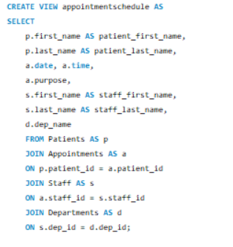
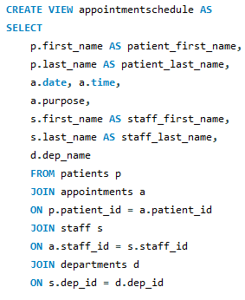
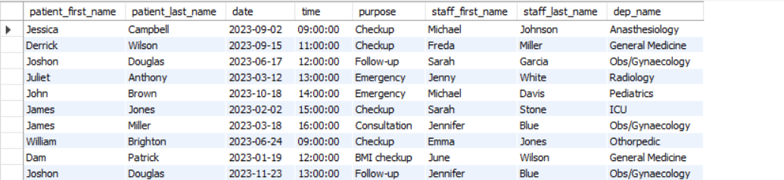
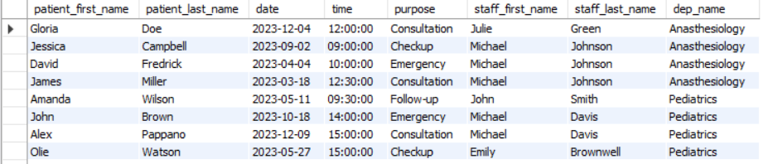
VIEWS
Created a virtual table from patients, appointments, departments, and staff tables named “appointmentschedule” for easy access to patients' appointment times and staff they are scheduled to see.
Syntax for creating view
Implementation

Slide 9
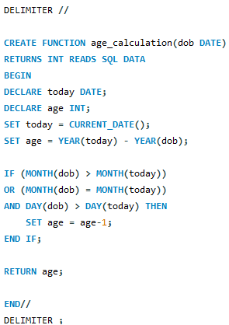

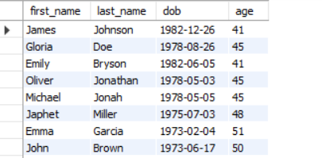
STORED FUNCTION
Created a stored function to calculate age of patients from their date of birth (dob) for further research like knowing the age that is prevalent to cancer and other diseases.
Syntax for creating the stored function
Implementation
Find the patients who are aged 40 and above.
Result

Slide 10

STORED PROCEDURE
Created a stored procedure named AddingPayment to automatically adjust and update payment status once any patient pays their bills.
To test the stored procedure, for example, call the AddingPayment procedure to add £100 to bill_id 7.

Slide 11
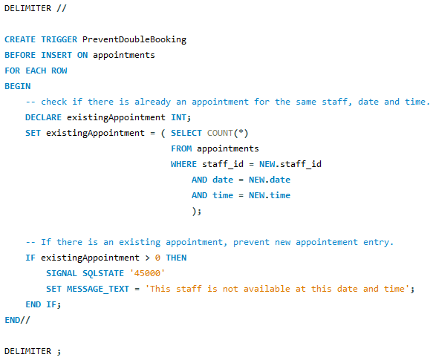
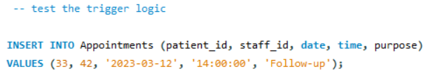
TRIGGER
Created triggers to prevent double appointments booking for patients
To test if the trigger set works, I tried to book for an appointment for a particular time slot with a staff that is already taken.
Syntax for creating the stored function
Implementation
Result
Error Code: 1644. This staff is not available at this date and time

Slide 12

CHALLENGES / LIMITATION
Generating a small dataset may not expose performance issues that could arise with real-world data volumes.
The effectiveness of the DBMS features (trigger, event, and stored function) has been validated only in limited scenarios.
The logic to handle room assignment is based on one patient per room. However, the DBMS does not account for multiple people staying a general type room.

Slide 13
CONCLUSION
Successfully designed and implemented a comprehensive Hospital management system to streamline hospital operation and enhance patient care.
Demonstrated the power of automation through stored procedure, triggers and events for efficient appointment scheduling, billing management and follow-up processes.
Recognized the need for expanding the dataset for more robust testing.
Thank you for your attention.

Slide 14

Q&A

