Slide 1

Cercetarea si dezvoltarea unui sistem inteligent.
Prezentarea finală.
Tema: Credit score classification.
Student: Chioroglo Alexandr,
Grupa: IA-213
Conducător: lect.univ. V.Alexei

Slide 2

Plan:
Problem statement
Brief description of tools, that were used to solve the problem
The results of preliminary exploratory data analysis
The variables used to predict risk category
Machine learning model
The risk category service scheme
Results and conclusions

Slide 3

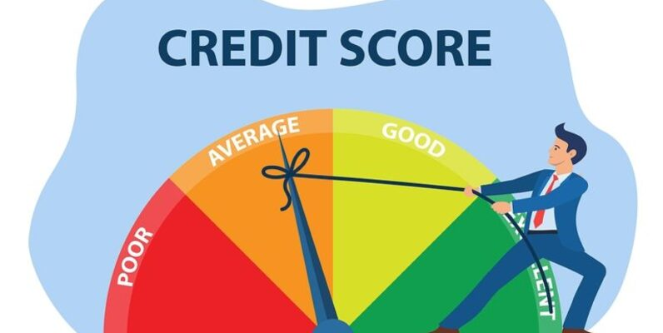
Problem statement:
You are working as a data scientist in a global finance company. Over the years, the company has collected basic bank details and gathered a certain amount of credit-related information. The management wants to build an intelligent system to segregate the people into credit score brackets to reduce the manual efforts.
Assignment:
Given a person’s credit-related information, build a machine learning model that can classify the credit score for the company internally and to sell the credit score predictions outside the company as pay-per-check service (Credit Bureau).

Slide 4

Brief description of tools
To perform data analysis, I’ve used such tools as:
R programming language and several modules for data analysis (dplyr), tools for plotting (highcharter,plotly), model creation (stats).
Python programming language as a platform for running Tensorflow machine learning library
For studying these libraries I’ve used Tensorflow wiki, R documentation from the links below:
https://dplyr.tidyverse.org/
https://www.rdocumentation.org/packages/stats/versions/3.6.2
https://www.rdocumentation.org/packages/stats/versions/3.6.2
https://scikit-learn.org/

Slide 5
Exploratory data analysis
Each record represents a monthly snapshot of a financial situation of certain client in this company. Data can be split in several categories:
Personal data (Age,Name,SSN,identifiers, occupation)
Financial data (Annual Income, salary,investment data)
Credit history data(Amount of loans, outstanding debts, credit load, interest rate,number of credit inquirements etc)
Personal data was practically eliminated, because for the most part they are not significant at the domain level (Name, SSN are metadata of a client that are used to define him). The age and occupation were variables that were taken in further analysis.
I decide to perform the chi-squared test for independence. The null hypothesis is that the two categorical variables are independent. If the p-value is less than a chosen significance level (e.g., 0.05), we may reject the null hypothesis and conclude that there is a significant association between 'Occupation' and 'Credit_Score.’. However, the Chi-Squared testing tells us that there is significant dependency, it can tell us nothing about causality. So after graphing I decided to relinquish this variable, because distribution of credit scores are practically the same. The statistical dependency does not mean causality and importance.

Slide 6
Exploratory data analysis
Due data analysis process were put several hypotheses:
Salary does not affect credit score and may not be taken into consideration
Occupation of a person does not affect credit score
Dataset contains array, explaining us the credit mix of a person and types of loans
Investments of lead affects credit score significantly.
After process of EDA some of these hypothesizes were rejected or approved:
Salary does actually affect credit score as the matter of possibility of a person to cover the debt since, but the growth and stability of salary tells us more than the actual value of salary, because Credit Score itself is made for predicting the stability of payment.
Occupation does not really affects credit score significantly (statistical and plot analysis)
Due to analysis of domain, credit mix itself represents the financial literacy of person, so we may not parse these string values to compute the same result due hard calculations and analysis

Slide 7
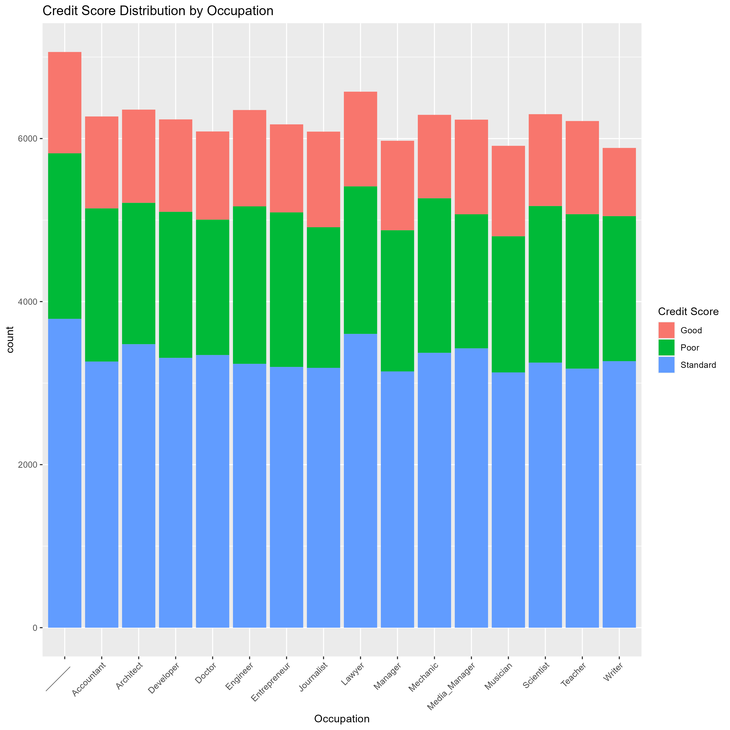

Slide 8
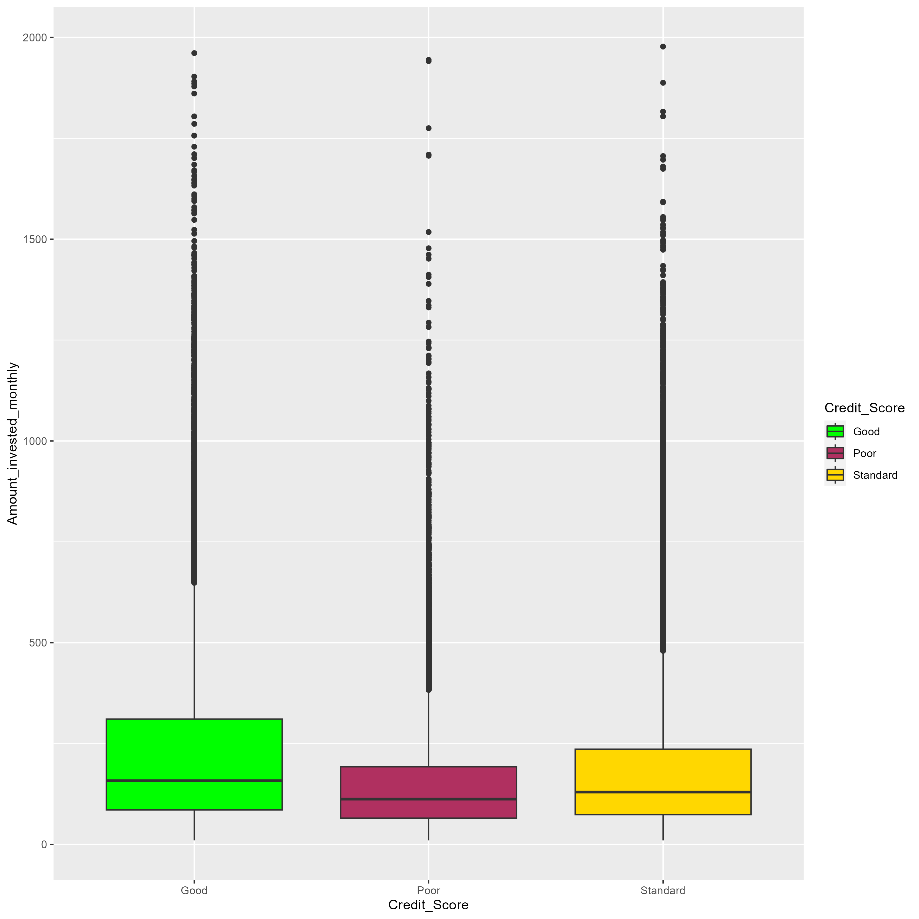
Amount invested monthly distribution over Credit Score Categories.
Example of insignificant variable for algorithm

Slide 9
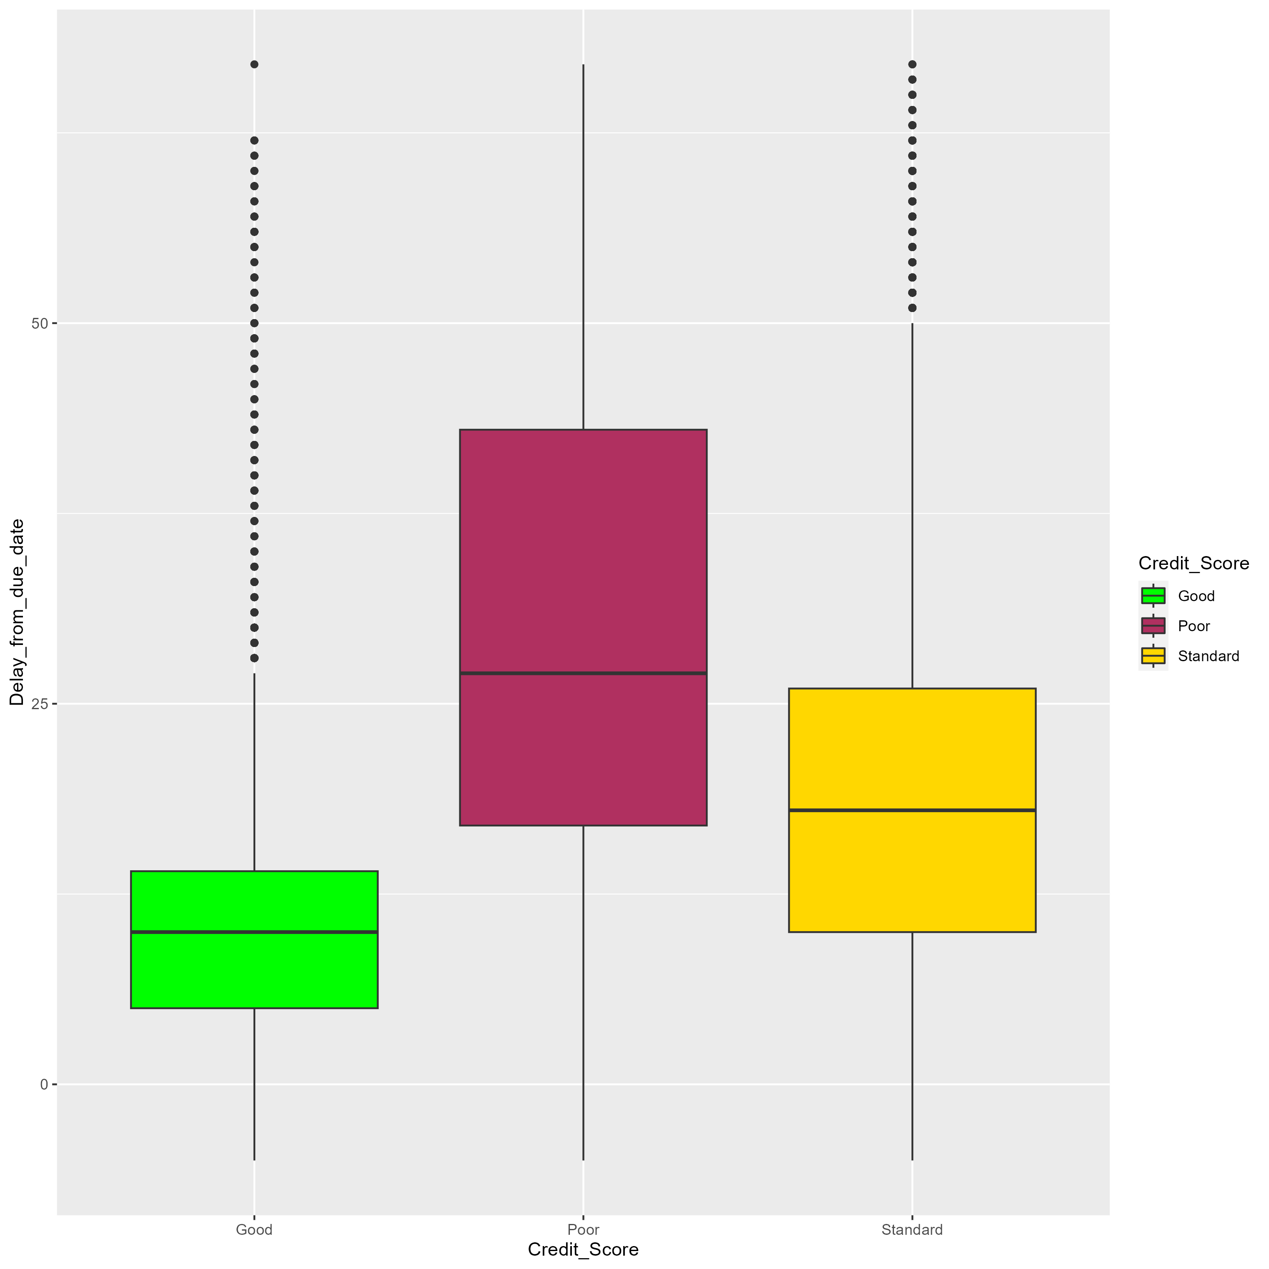
Maximum days past due (DPD) over Credit Score Categories.
Example of significant distribution clusters

Slide 10
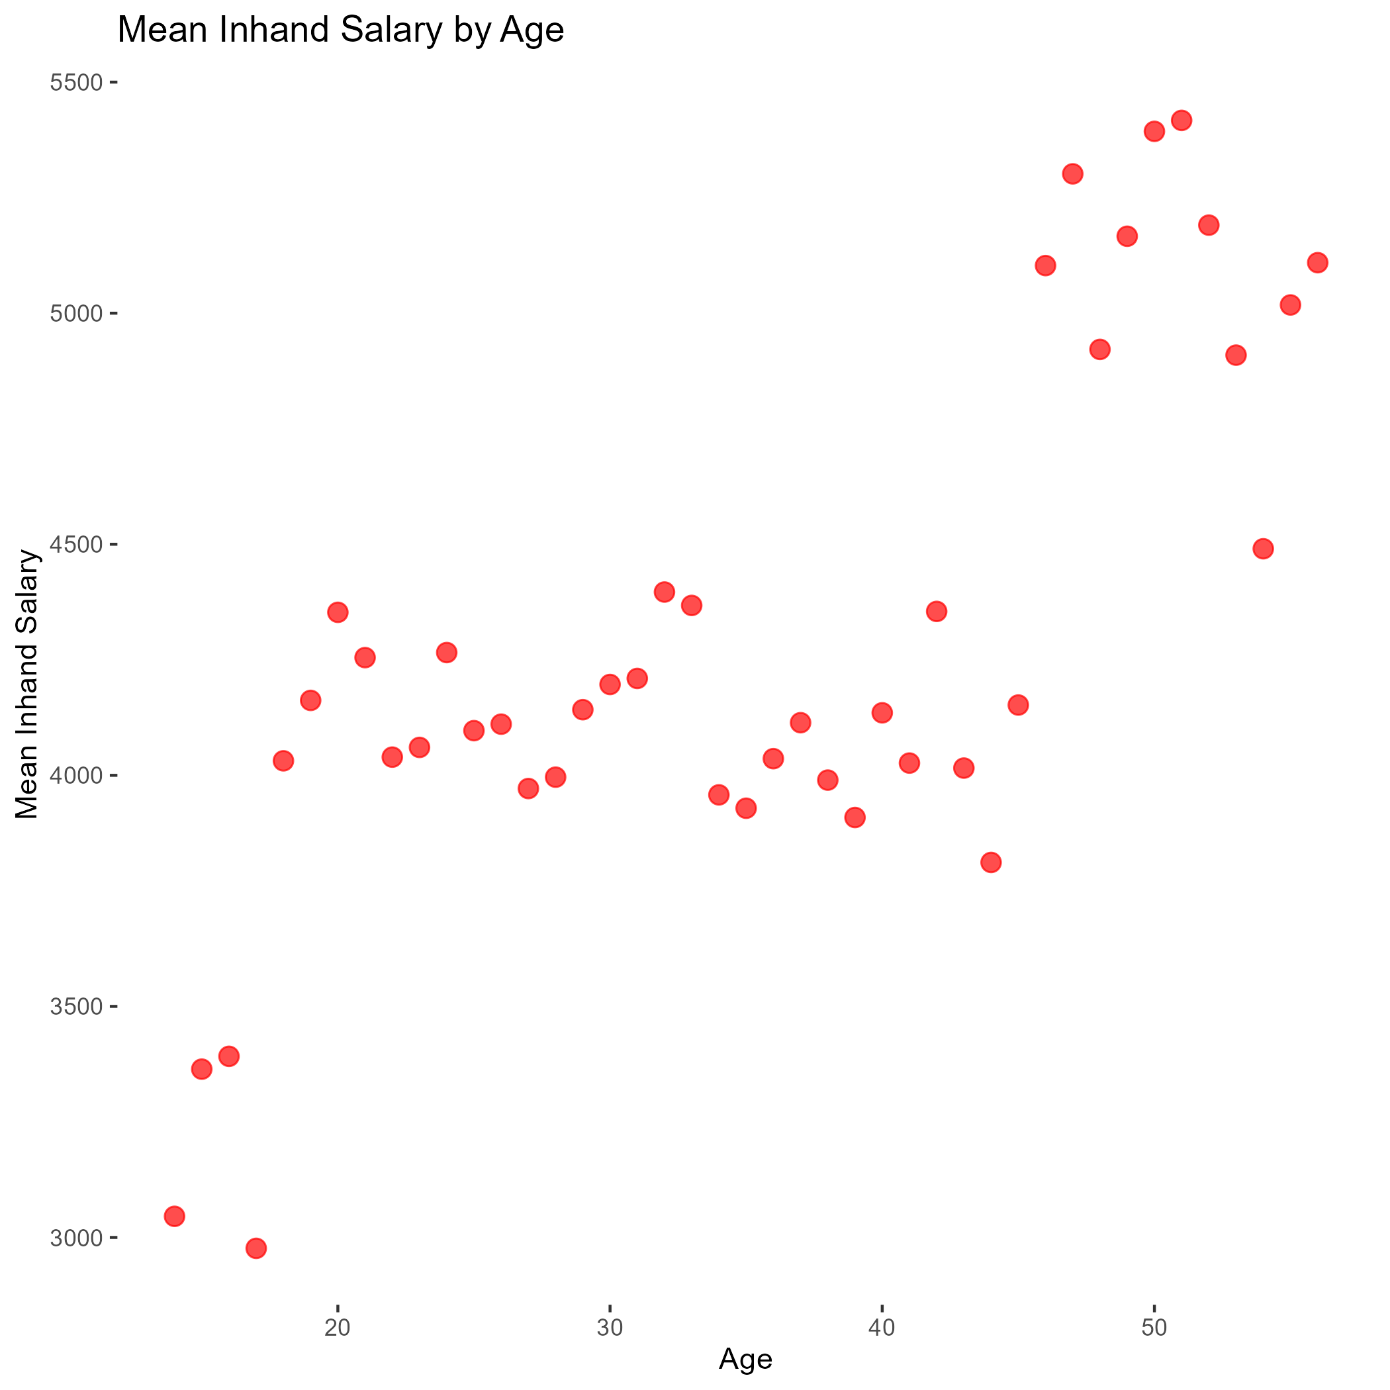

Slide 11
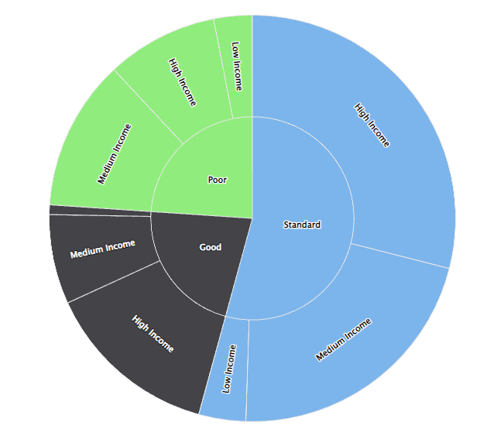
Hierarchical distribution of score categories and annual netto incomes (Sunburst)

Slide 12
Splitting categorical variables
There is such a stat, named (Payment_Behaviour). Labels for this variable are:
Low_spent_Small_value_payments
High_spent_Small_value_payments
Low_spent_Medium_value_payments
High_spent_Medium_value_payments
Low_spent_Large_value_payments
High_spent_Large_value_payments
Unknown
I’ve decided to split these in three different variables:
Payment_Behaviour_Is_Unknown(true/false flag)
Payment_Behaviour_Amount_Spent (low/high/unknown)
Payment_Behaviour_Value_Payments (small/medium/large/unknown)
Special value (-1) is used to indicate whether payment behaviour is unknown to separate such records in separate cluster

Slide 13
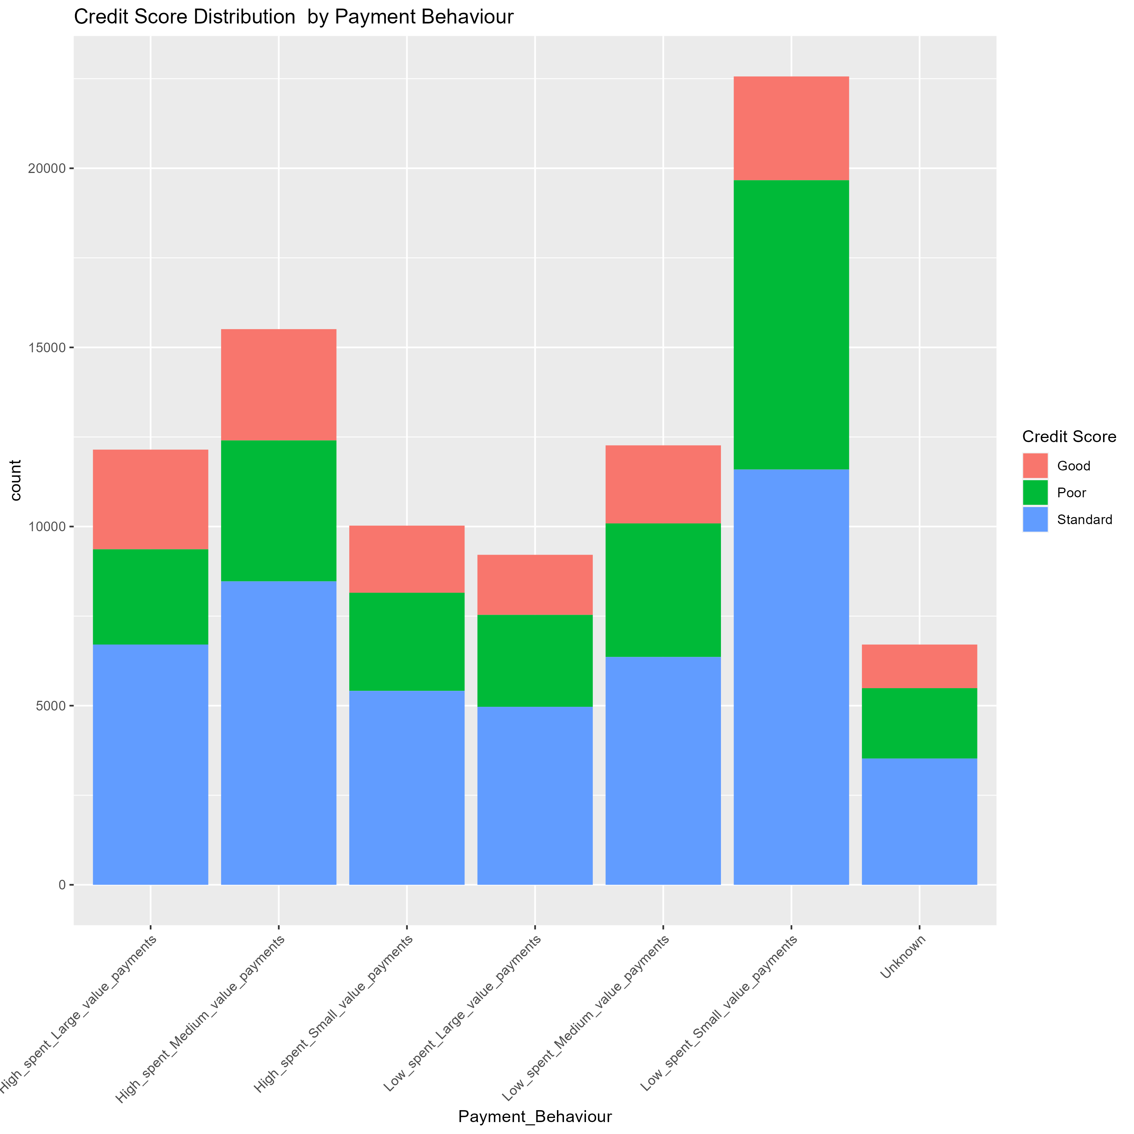

Slide 14
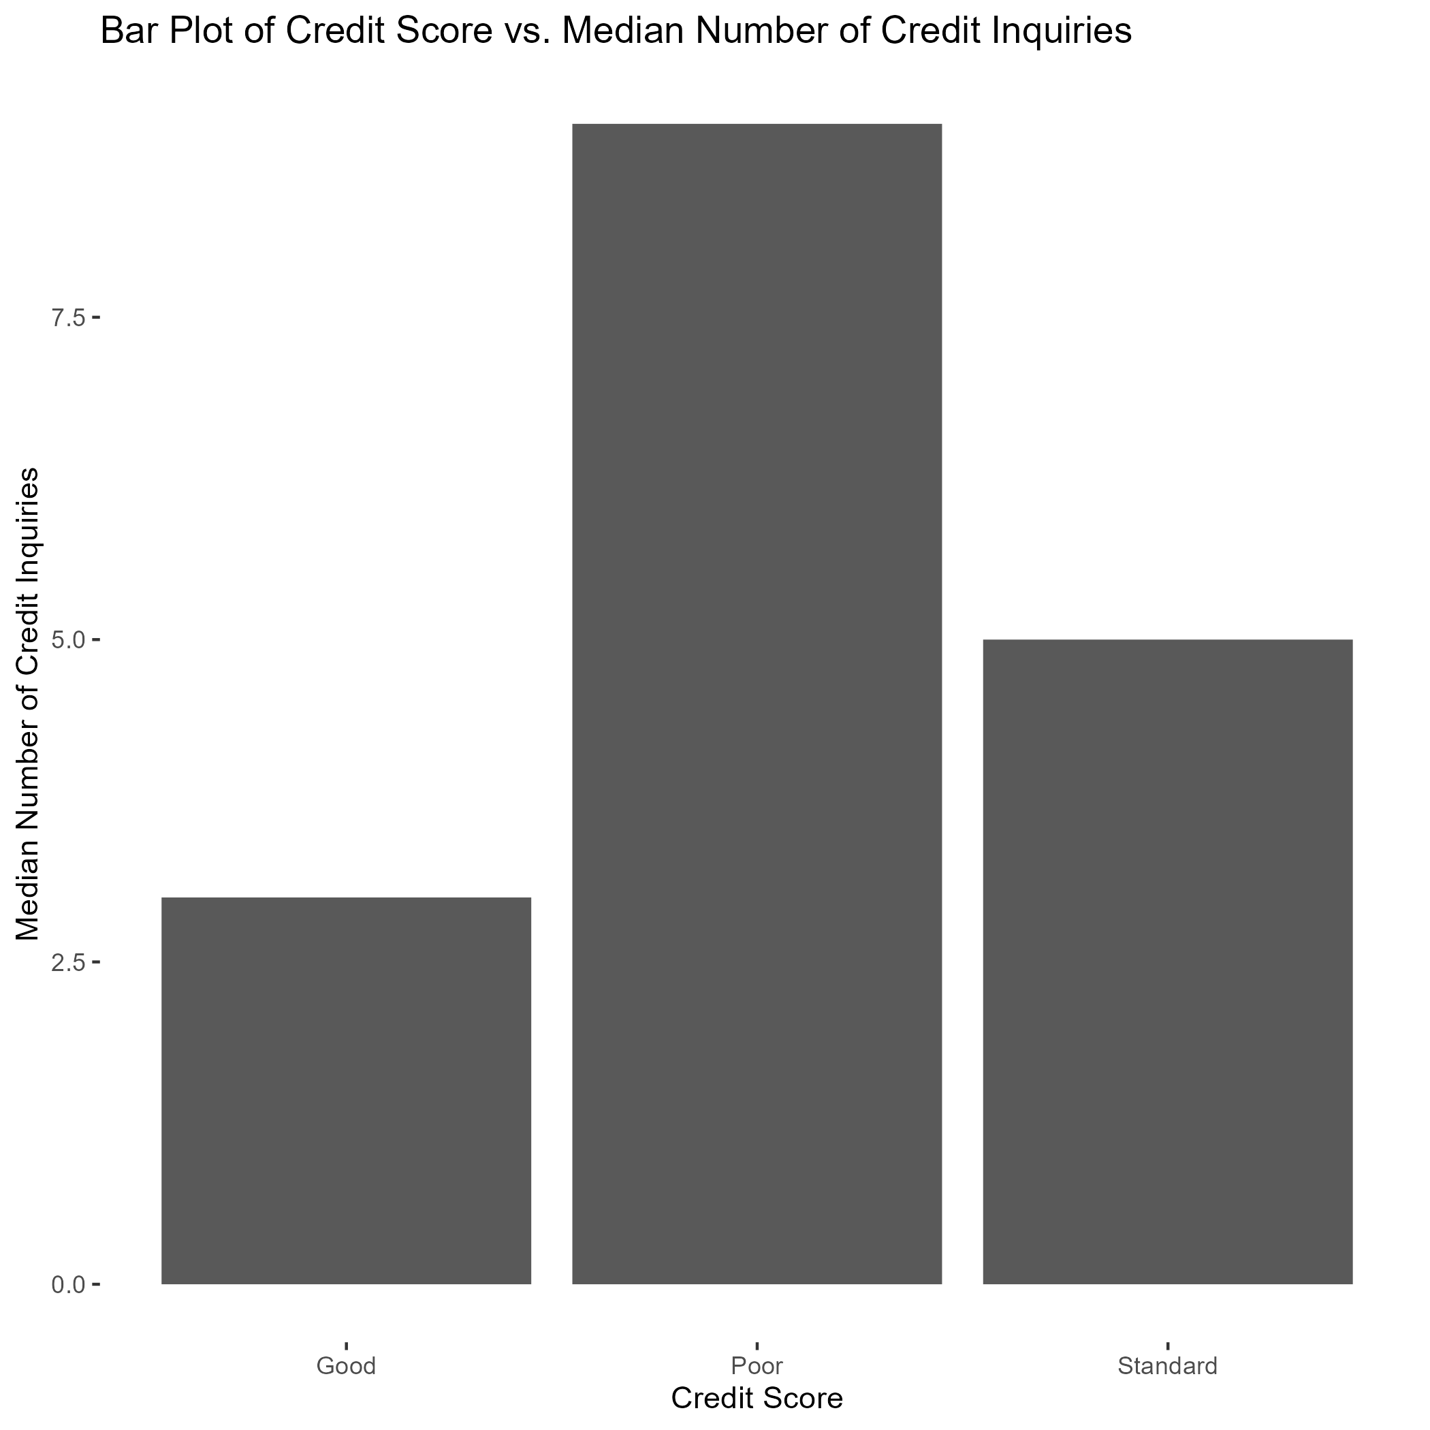

Slide 15
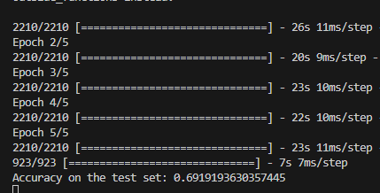
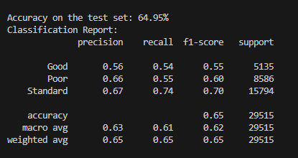
Picking machine learning model
There are two machine learning approaches, that I consider applicable to this case:
Logistic regression:
  Pretty usual for financial sphere as it represents clear formula with fixed coefficients, indicating probability of attribution
  logistic regression doesn't assume a linear relationship between the independent variables and the log-odds of the dependent variable. This allows it to capture non-linear relationships.
Neural network (Sequential, 5 epochs, 3 hidden layers)
Neural network:
Pro:
  Neural networks can capture non-linear relationships and complex patterns in financial data, which may be challenging for traditional linear models.
  Con:
  Neural networks often require large amounts of data for training, which may be a limitation in finance where high-quality labeled data is sometimes scarce.
Logistic regression

Slide 16
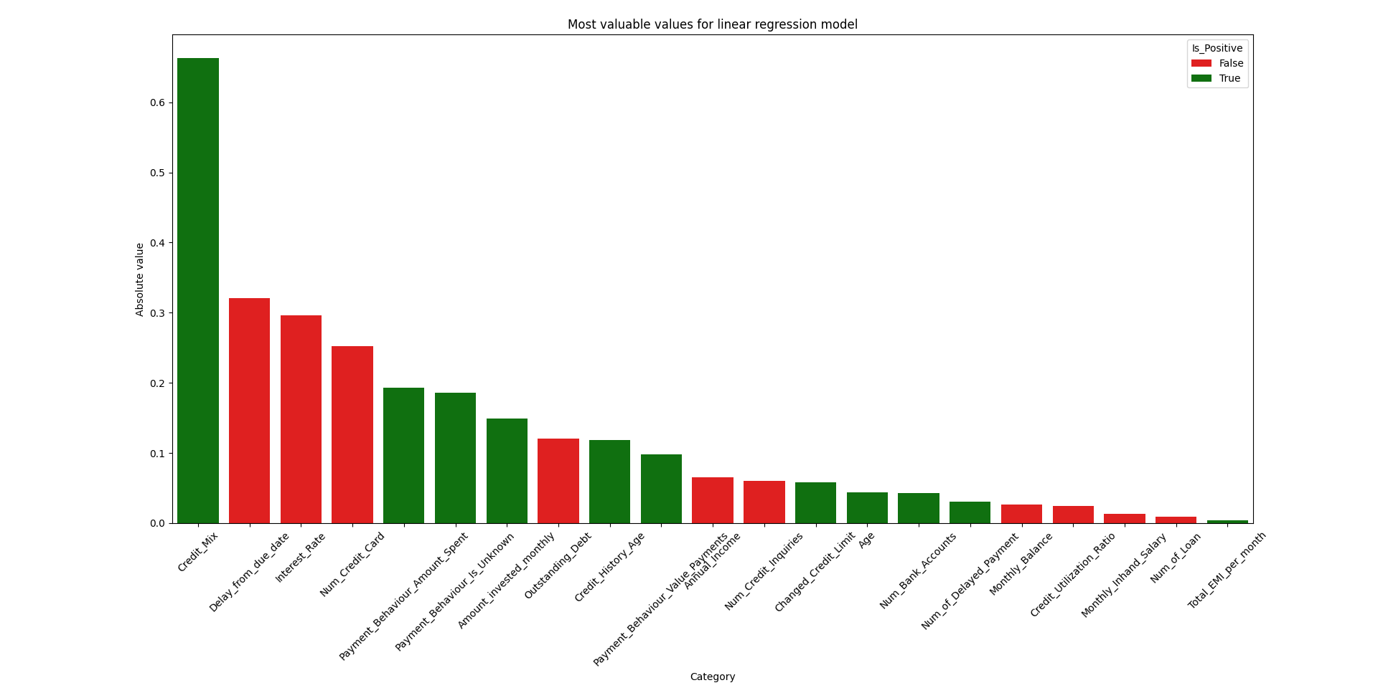

Slide 17
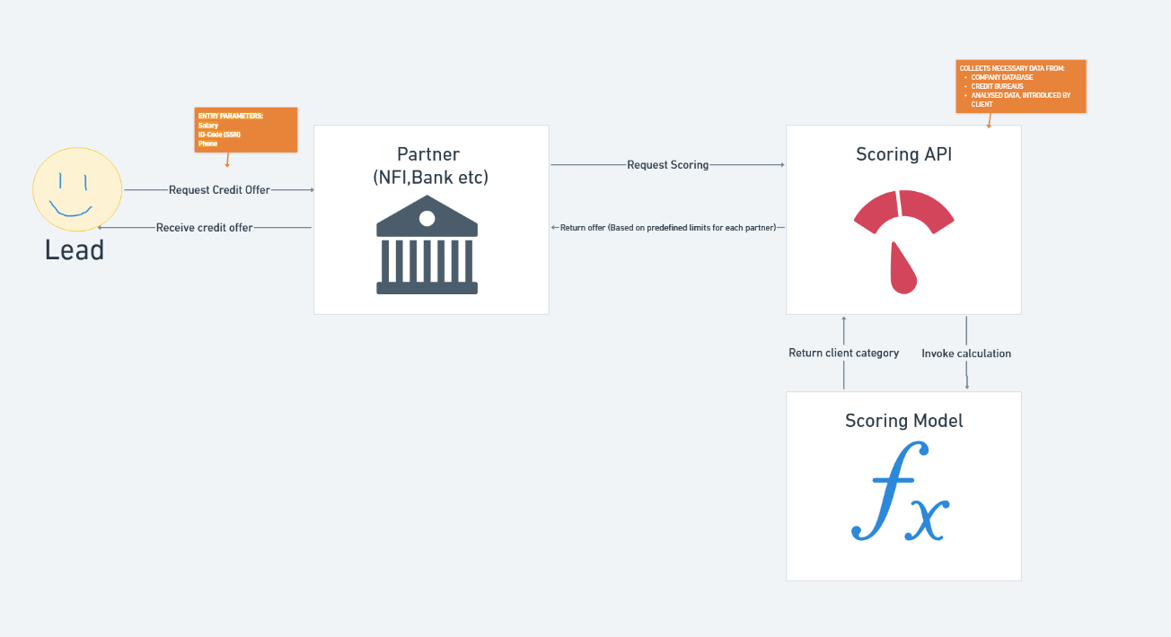

Slide 18
Conclusions

