Slide 1
Recommender of the literatures in the GEP datasets
Ni-Ting Chiou

Slide 2
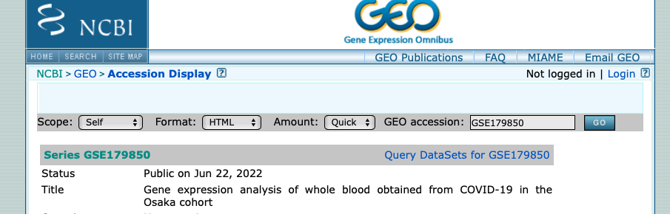

GEO is a database storing the sequencing data of the research paper

Slide 3
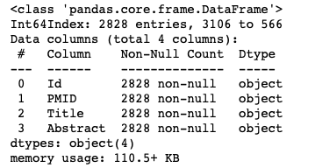
NLP of the abstract cited in the GEO database
Goal:
To recommend the datasets for reanalysis or comparison based on the abstract of the literatures associated with the datasets
Data:
GEO database API

Slide 4
Processing
Preprocessing:
Remove all backslash, parenthesis and hyphen
Tokenize the abstract into the named entities, followed by lemmatization, string stripping, lowercasing.
TfidfVectorizer
2828 documents with 2075 words
Topic Modeling:
kMeans clustering
NMF topic modeler

Slide 5
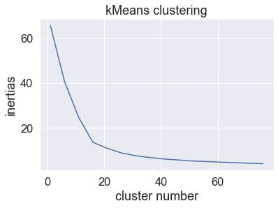
15 topics for kMeans clustering of 2828 documents with 2075 words

Slide 6
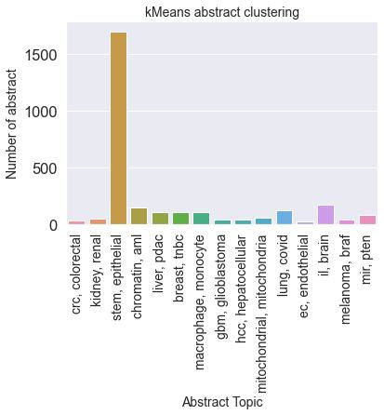
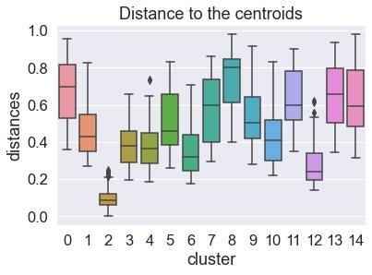
The literatures in the cluster 2 are not very similar to each other

Slide 7
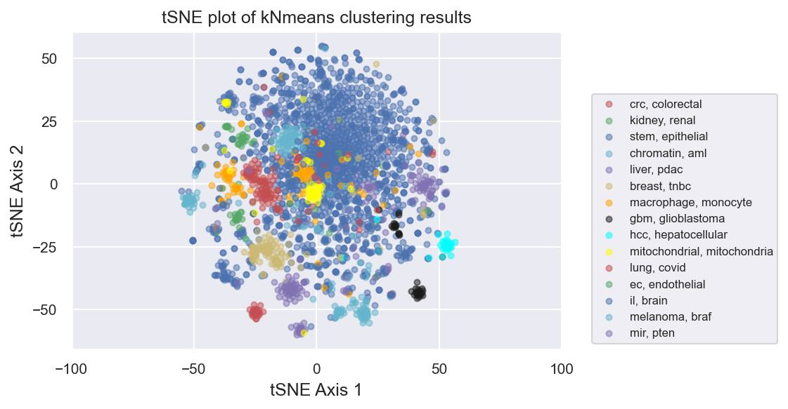
tSNE plot of doc_word matrix colored by kMeans clustering labels

Slide 8
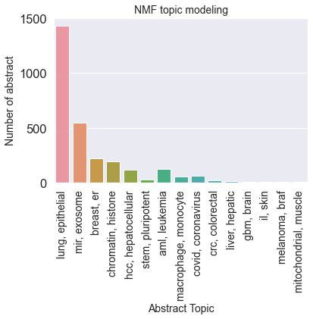
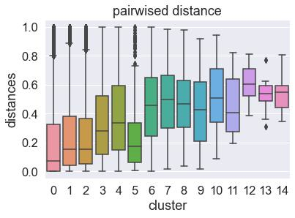
NMF topic modeling

Slide 9
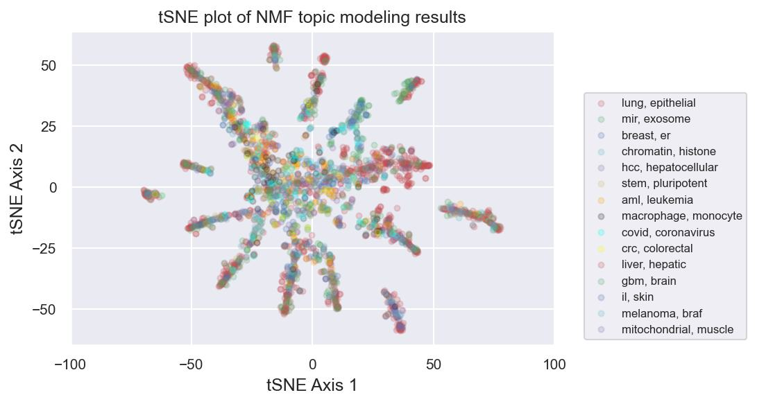
tSNE plot of doc_topic matrix colored by topic with highest score

Slide 10
Discussion
Most abstracts in the GEO database are very heterogeneous and they are not clustered very well.
kMeans seam to be a better topic modeling way for the heterogeneous datasets.

