Slide 1
Recommender of the literatures in the GEO (Gene Expression Omnibus) datasets
Ni-Ting Chiou

Slide 2
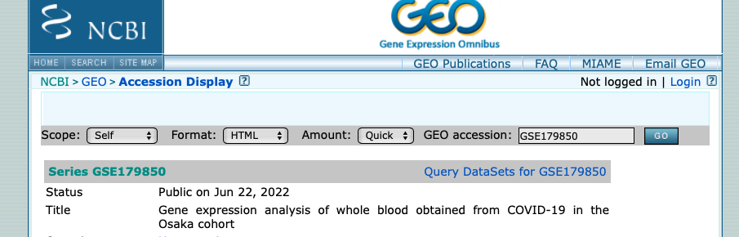
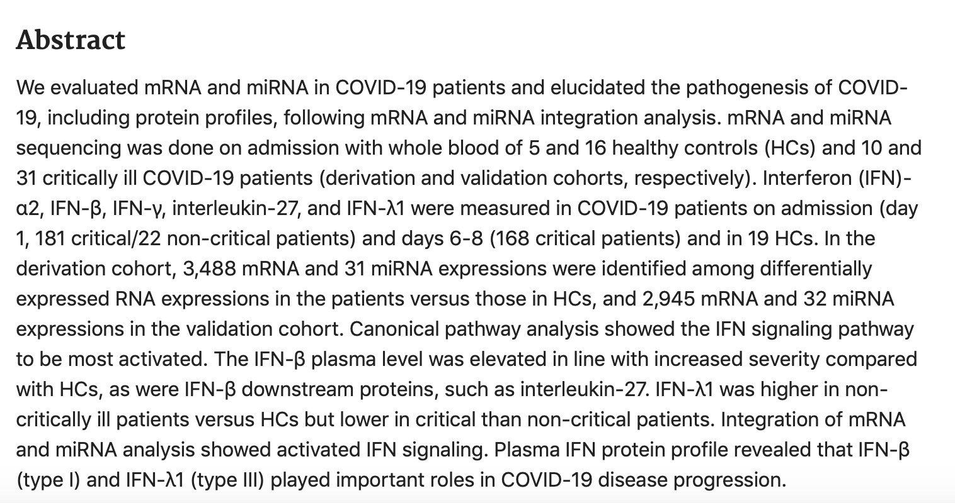

GEO is a database storing the sequencing data of the research paper

Slide 3
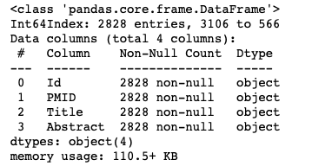
NLP of the abstract cited in the GEO database
Goal:
To recommend the datasets for reanalysis or comparison based on the abstract of the literatures associated with the datasets
Data:
GEO database API

Slide 4
Processing
Preprocessing:
Remove all backslash, parenthesis and hyphen
Tokenize the abstract into the named entities, followed by lemmatization, string stripping, lowercasing.
TfidfVectorizer
2828 documents with 2075 words
Unsupervised clustering of abstract:
(1) kMeans clustering
(2) NMF topic modeling →kMeans clustering

Slide 5
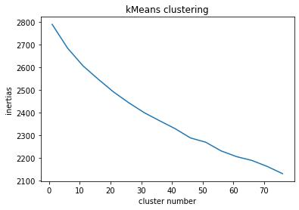
Inertias for kMeans clustering of 2828 documents with 2075 words vectorized by Tfidf vectorizer
No elbow !!!
Choose k =15 for clustering

Slide 6
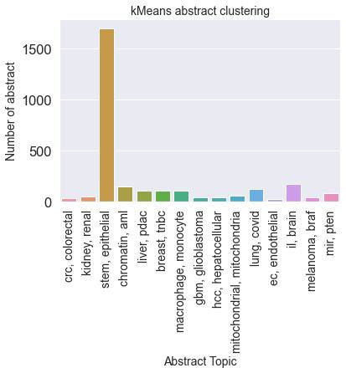
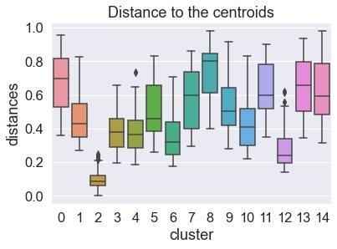
The distances in cluster 2 are ~5 fold lower than other clusters
Cluster 2

Slide 7
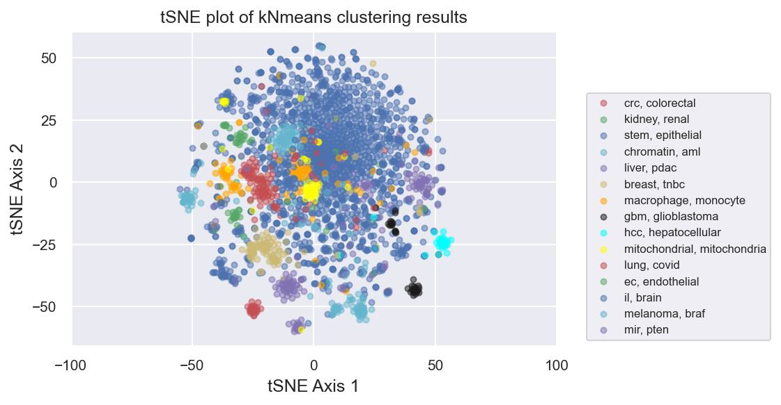
tSNE plot of doc_word matrix colored by kMeans clustering labels
Cluster 2

Slide 8
Processing
Preprocessing:
Remove all backslash, parenthesis and hyphen
Tokenize the abstract into the named entities, followed by lemmatization, string stripping, lowercasing.
TfidfVectorizer
2828 documents with 2075 words
Unsupervised clustering of abstract:
(1) kMeans clustering
(2) NMF topic modeling →kMeans clustering

Slide 9
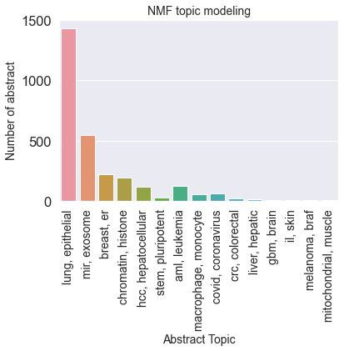
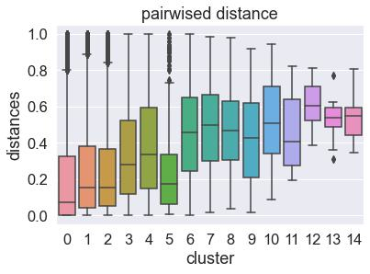
NMF topic modeling of 2828 documents with 2075 words vectorized by Tfidf vectorizer

Slide 10
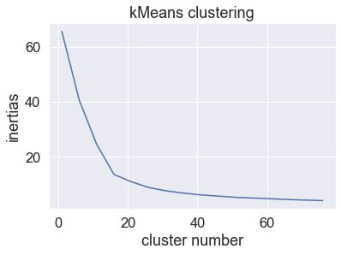
Inertias for kMeans clustering of 2828 documents with 15 topic modeled by NMF
Elbow !!!
K = 15

Slide 11
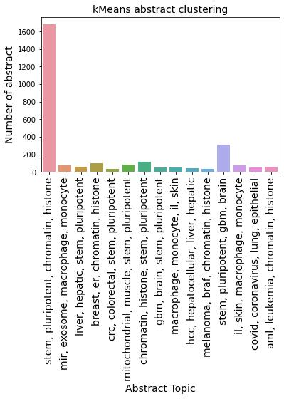
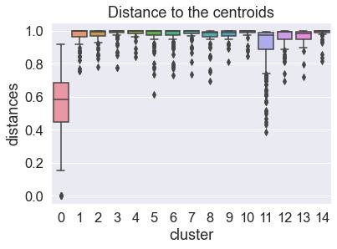
The distances in cluster 0 are ~2 fold lower than other clusters

Slide 12
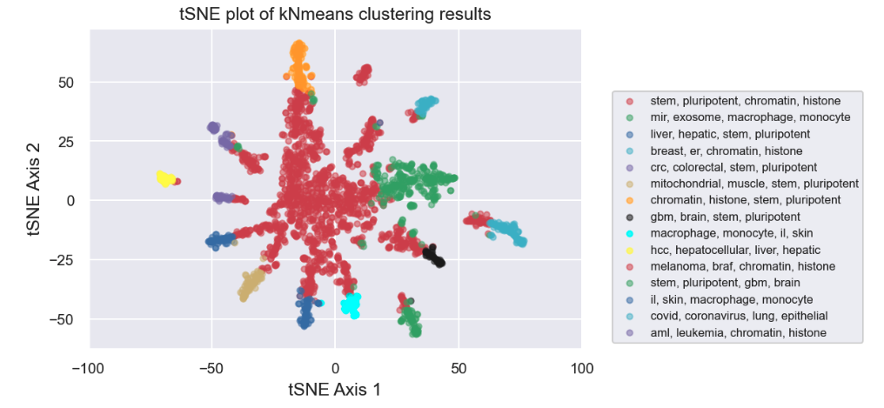
tSNE plot of doc_topic matrix colored by kMeans clustering labels

Slide 13
Discussion and future work
Most abstracts in the GEO database are very heterogeneous and they are not clustered very well without the dimensional reduction.
The abstracts in the same cluster will be furthered reviewed. The final goal is to combine gene expression data from similar biological conditions to identify drug targets or biomarkers.

