Slide 1
Query Database with SQL & R
Case Study: Lahman’s Baseball Database

Slide 2
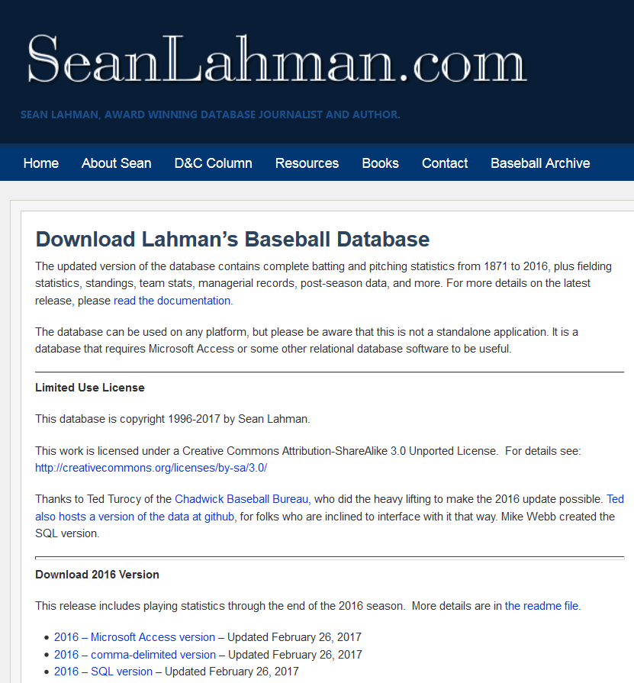

The database is comprised of the following main tables:
MASTER - Player names, DOB, and biographical info
Batting - batting statistics
Pitching - pitching statistics
Fielding - fielding statistics
Batting Table
playerID Player ID code
yearID Year
AB At Bats
R Runs
H Hits
2B Doubles
3B Triples
HR Homeruns
SO Strikeouts
…

Slide 3
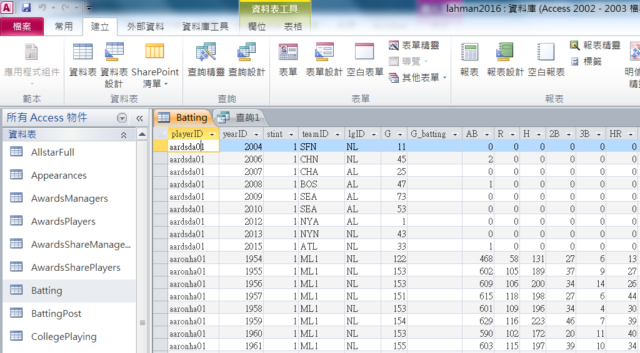
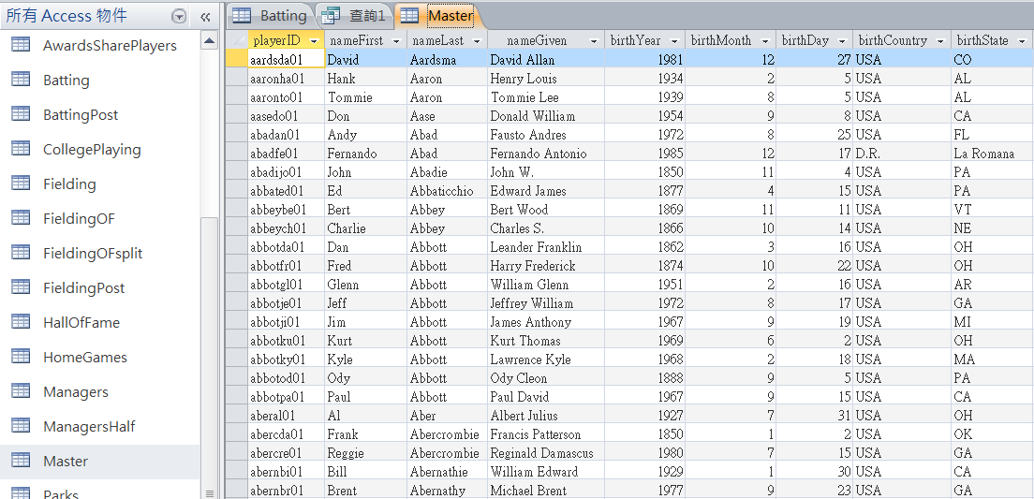

Slide 4
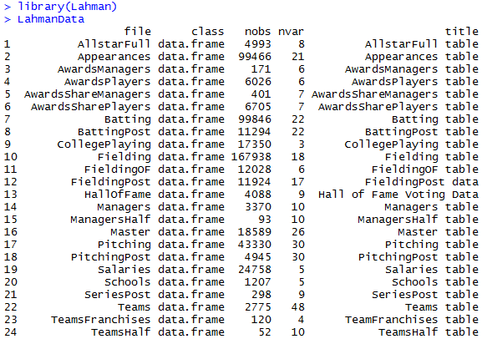
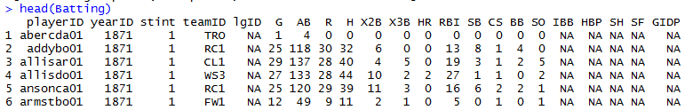
Lahman’s Baseball Database
Install Lahman’s Baseball Database
install.packages("Lahman")
Load Lahman’s Baseball Dataset
library(Lahman)
List Lahman’s Baseball Database
LahmanData
List Batting Database
head(Batting)

Slide 5
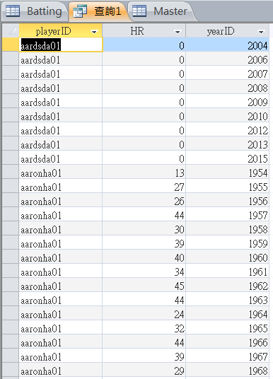
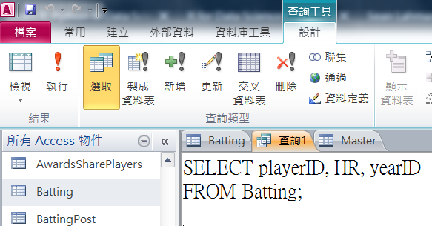
SQL – SELECT data FROM table
List player ID, homerun number and year ID from Batting table
SQL: SELECT playerID, HR, yearID FROM Batting;

Slide 6
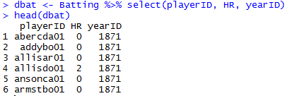
dplyr verbs: select
Load the dplyr package
library(dplyr)
Select date
SQL: SELECT playerID, HR, yearID FROM Batting;
dbat <- Batting %>% select(playerID, HR, yearID)
head(dbat)

Slide 7
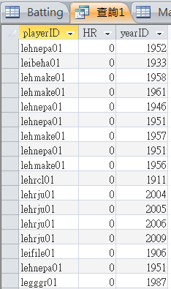
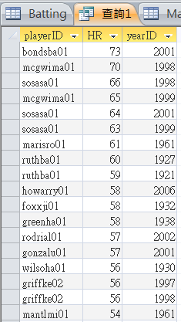
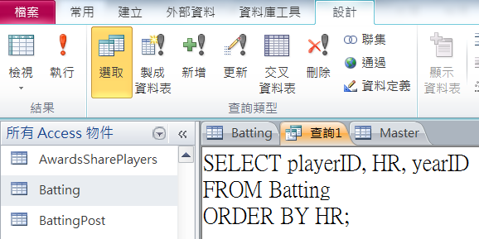
SQL – SELECT data FROM table ORDER BY
List player ID, homerun number and year ID from Batting table in order
SQL: SELECT playerID, HR, yearID FROM Batting ORDER BY HR DESC;

Slide 8
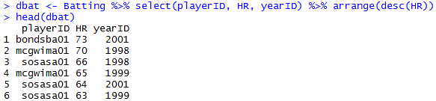
dplyr verbs: arrange
Select data and list by order
SQL: SELECT playerID, HR, yearID FROM Batting ORDER BY HR DESC;
dbat <- Batting %>% select(playerID, HR, yearID) %>% arrange(desc(HR))
head(dbat)

Slide 9
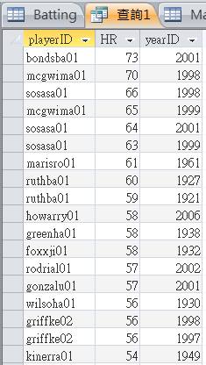
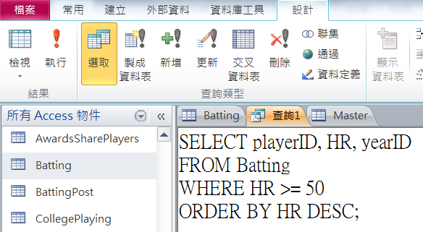
SQL – SELECT data FROM table WHERE
List player ID, homerun number and year ID from Batting table where the homerun (HR) number is over 50.
SQL: SELECT playerID, HR, yearID FROM Batting WHERE HR >= 50 ORDER BY HR DESC;

Slide 10
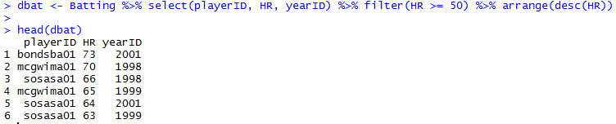
dplyr verbs: filter
List data by condition
SQL: SELECT playerID, HR, yearID FROM Batting WHERE HR >= 50 ORDER BY HR DESC;
dbat <- Batting %>% select(playerID, HR, yearID) %>% filter(HR >= 50) %>% arrange(desc(HR))

Slide 11
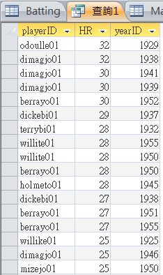
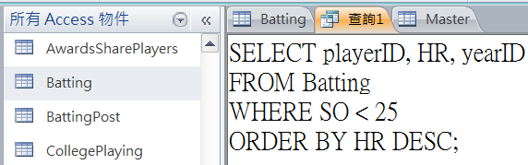
SQL – SELECT data FROM table WHERE (2)
List player ID, home-run (HR) number and year ID from Batting table where the strikeouts (SC) number is less 25.
SQL: SELECT playerID, HR, yearID FROM Batting WHERE SO < 25 ORDER BY HR DESC;

Slide 12
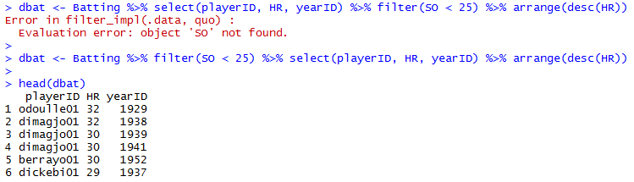
%>% execution order
dbat <- Batting %>% select(playerID, HR, yearID) %>% filter(SO < 25) %>% arrange(desc(HR))
dbat <- Batting %>% filter(SO < 25) %>% select(playerID, HR, yearID) %>% arrange(desc(HR))

Slide 13
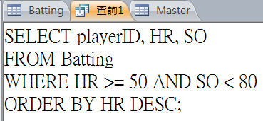
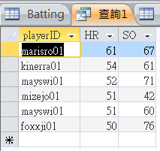
SQL – SELECT with condition AND
Select from Batting table where the strikeouts (SC) number is less 80 and home-run (HR) number is over 50.
SQL: SELECT playerID, HR, SO FROM Batting WHERE HR >= 50 AND SO < 80 ORDER BY HR DESC;

Slide 14
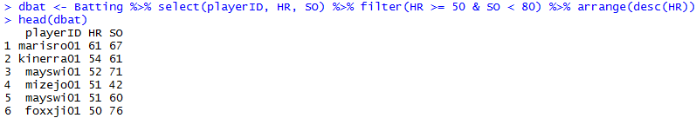
dplyr verbs: filter (with &)
List data by more condition
SQL: SELECT playerID, HR, SO FROM Batting WHERE HR >= 50 AND SO < 80 ORDER BY HR DESC;
dbat <- Batting %>% select(playerID, HR, SO) %>% filter(HR >= 50 & SO < 80) %>% arrange(desc(HR))

Slide 15
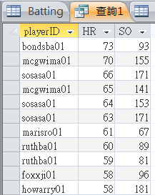
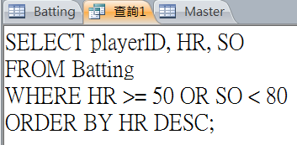
SQL – SELECT with condition OR
Select from Batting table where the strikeouts (SC) number is less 80 or home-run (HR) number is over 50.
SQL: SELECT playerID, HR, SO FROM Batting WHERE HR >= 50 OR SO < 80 ORDER BY HR DESC;

Slide 16
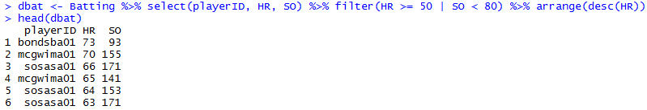
dplyr verbs: filter (with |)
List data by more condition
SQL: SELECT playerID, HR, SO FROM Batting WHERE HR >= 50 OR SO < 80 ORDER BY HR DESC;
dbat <- Batting %>% select(playerID, HR, SO) %>% filter(HR >= 50 | SO < 80) %>% arrange(desc(HR))

Slide 17
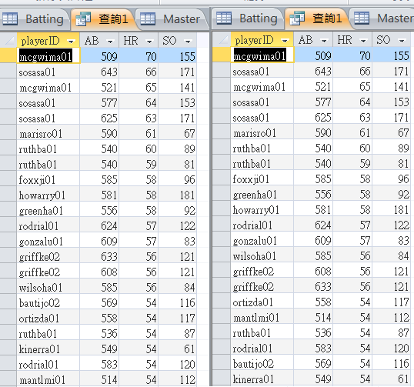
SQL – SELECT with more conditions
Select from Batting table where the at-bats (AB) is more than 500 and strikeouts (SC) number is less 80 or home-run (HR) number is over 50.
SQL: SELECT playerID, AB, HR, SO FROM Batting WHERE AB > 500 AND HR >= 50 OR SO < 80 ORDER BY HR DESC;
SQL: SELECT playerID, AB, HR, SO FROM Batting WHERE AB > 500 AND (HR >= 50 OR SO < 80) ORDER BY HR DESC;

Slide 18
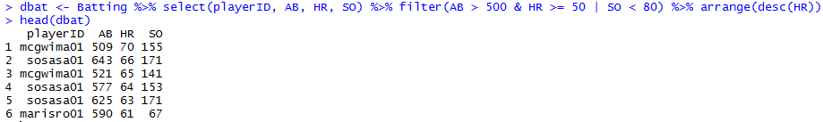
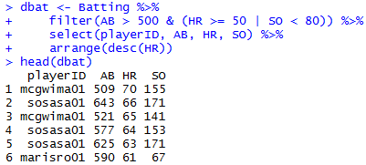
dplyr verbs: filter (more conditions)
List data by more condition
dbat <- Batting %>% select(playerID, AB, HR, SO) %>% filter(AB > 500 & HR >= 50 | SO < 80) %>% arrange(desc(HR))
dbat <- Batting %>% filter(AB > 500 & (HR >= 50 | SO < 80)) %>% select(playerID, AB, HR, SO) %>% arrange(desc(HR))

Slide 19
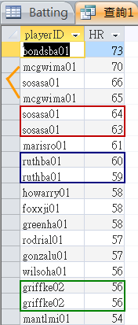
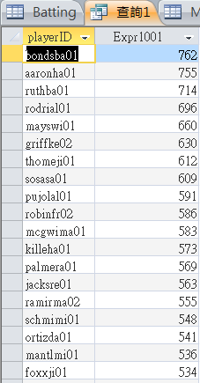
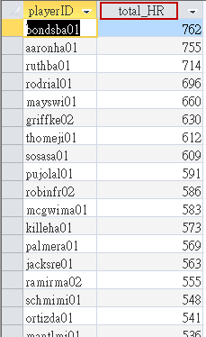
SQL – GROUP BY & sum()
Select from Batting table for each player’s total home-run (HR) number
SQL: SELECT playerID, HR FROM Batting ORDER BY HR DESC;
SQL: SELECT playerID, sum(HR) FROM Batting GROUP BY playerID ORDER BY sum(HR) DESC;
SQL: SELECT playerID, sum(HR) AS total_HR FROM Batting GROUP BY playerID ORDER BY sum(HR) DESC;

Slide 20
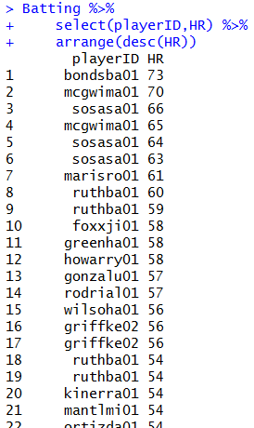
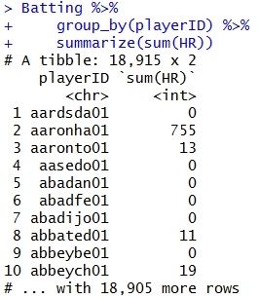
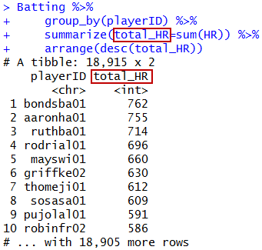
dplyr verbs: group_by & summarize
List home-run data by group of playerID
Batting %>% select(playerID,HR) %>% arrange(desc(HR))
Batting %>% group_by(playerID) %>% summarize(sum(HR))
Batting %>% group_by(playerID) %>% summarize(total_HR=sum(HR)) %>% arrange(desc(total_HR))

Slide 21
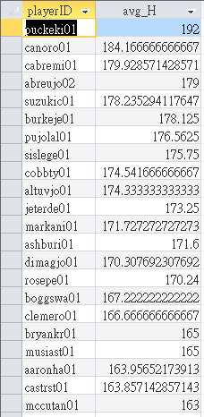
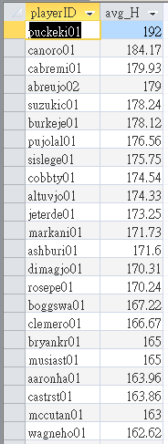
SQL – GROUP BY & avg(), round()
Select from Batting table for each player’s average hit (H) number
SQL: SELECT playerID, avg(H) AS avg_H FROM Batting GROUP BY playerID ORDER BY avg(H) DESC;
SQL: SELECT playerID, round(avg(H),2) AS avg_H FROM Batting GROUP BY playerID ORDER BY avg(H) DESC;

Slide 22
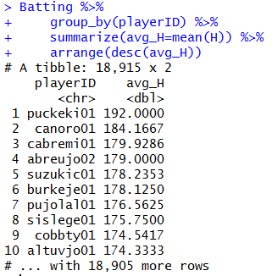
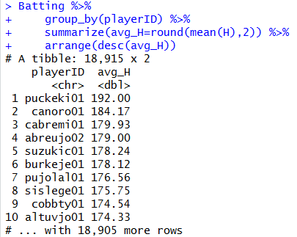
dplyr verbs: group_by & summarize
List average hit data by group of playerID
Batting %>% group_by(playerID) %>% summarize(avg_H=mean(H)) %>% arrange(desc(avg_H))
Batting %>% group_by(playerID) %>% summarize(avg_H=round(mean(H),2)) %>% arrange(desc(avg_H))

Slide 23
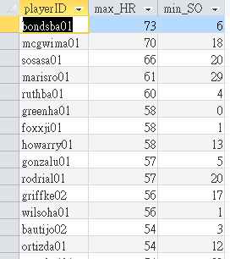
SQL – GROUP BY & max(), min()
Select from Batting table for each player’s max home-run (HR) and min strikeout (SO) number
SQL: SELECT playerID, max(HR) AS max_HR, min(SO) AS min_SO FROM Batting GROUP BY playerID ORDER BY max(HR) DESC;

Slide 24
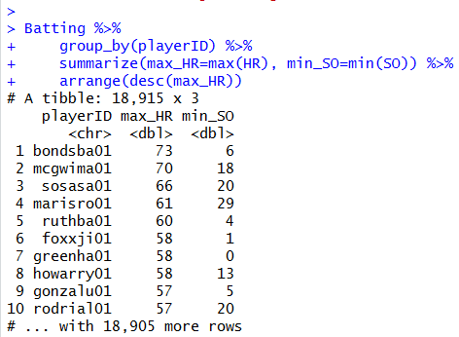
dplyr verbs: group_by & summarize (2)
List max home-run and min strikeout data by group of playerID
Batting %>% group_by(playerID) %>% summarize(max_HR=max(HR), min_SO=min(SO)) %>% arrange(desc(max_HR))

Slide 25
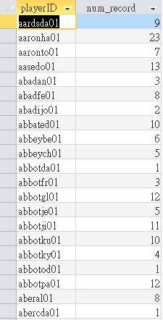
SQL – GROUP BY & count()
Count the number of records by playerID
SQL: SELECT playerID, count(*) AS num_record FROM Batting GROUP BY playerID

Slide 26
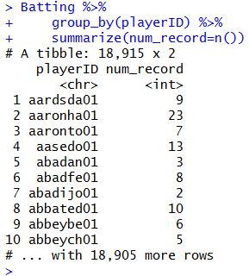
dplyr verbs: group_by & summarize (2)
Count the number of records by playerID
Batting %>% group_by(playerID) %>% summarize(num_record=n())

Slide 27
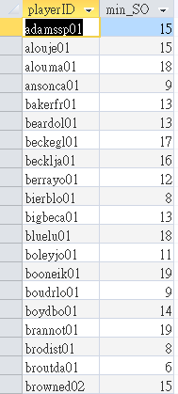
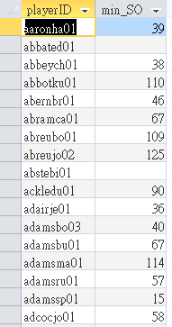
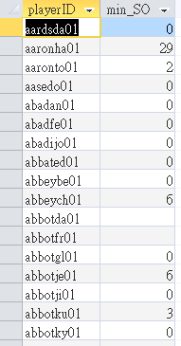
SQL – GROUP BY & WHERE & HAVING
List the playerID whos at-bats (AB) is more than 400 and min of strikeout (SO)
SQL: SELECT playerID, min(SO) AS min_SO FROM Batting GROUP BY playerID
SQL: SELECT playerID, min(SO) AS min_SO FROM Batting WHERE AB >= 400 GROUP BY playerID
SQL: SELECT playerID, min(SO) AS min_SO FROM Batting WHERE AB >= 400 GROUP BY playerID HAVING min(SO) < 20
WHERE before GROUP BY,
HAVING after GROUP BY.

Slide 28
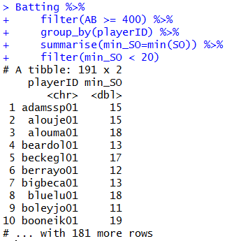
dplyr verbs: filter, group_by & summarize
List the playerID whose at-bats (AB) is more than 400 and min of strikeout (SO)
SQL: SELECT playerID, min(SO) AS min_SO FROM Batting WHERE AB >= 400 GROUP BY playerID HAVING min(SO) < 20
Batting %>% filter(AB >= 400) %>% group_by(playerID) %>% summarize(min_SO=min(SO)) %>% filter(min_SO < 20)

Slide 29
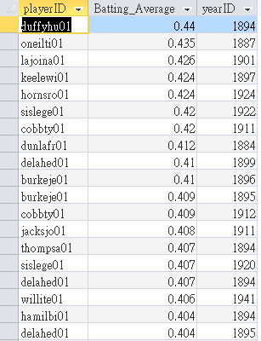
SQL – GROUP BY & WHERE & HAVING
Show batting average (H/AB) for playerID whose at-bats (AB) is more than 400
SQL: SELECT playerID, round(H/AB,3) AS Batting_Average, yearID FROM Batting WHERE AB >= 400 ORDER BY H/AB

Slide 30
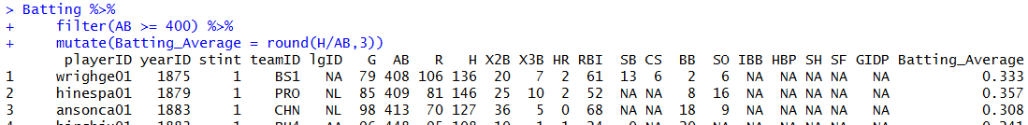
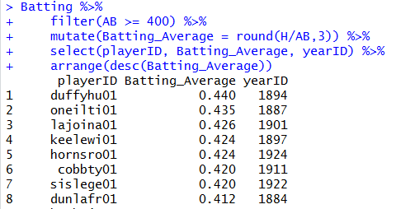
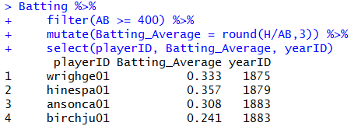
dplyr verbs: filter, mutate, select & arrange
Show batting average (H/AB) for playerID whos at-bats (AB) is more than 400
Batting %>% filter(AB >= 400) %>% mutate(Batting_Average = round(H/AB, 3)) %>% select(playerID, Batting_Average, yearID) %>% arrange(desc(Batting_Average)

Slide 31
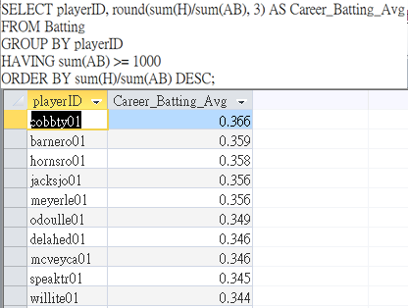


SQL – GROUP BY & HAVING
Show career batting average (H/AB) for playerID whose total at-bats is over 1000
SQL: SELECT playerID, round(sum(H)/sum(AB),3) AS Batting_Average, yearID FROM Batting GROUP BY playerID HAVING sum(AB) >= 1000 ORDER BY sum(H)/sum(AB) DESC;

Slide 32



dplyr verbs: group_by, summarize, filter & mutate
Show career batting average (H/AB) for playerID whose total at-bats (AB) is over 1000
Batting %>% group_by(playerID) %>% summarize(career_H = sum(H), career_AB = sum(AB)) %>% filter(career_AB > 1000) %>% mutate(career_BA = round(career_H/career_AB,3)) %>% select(playerID,career_BA)

Slide 33


SQL – INNER JOIN
Inner join two tables
SQL: SELECT * FROM Batting INNER JOIN Master ON Batting.playerID = Master.playerID WHERE Batting.playerID = "aardsda01" OR Master.playerID = "abbotda01";

Slide 34

dplyr verbs: inner_join & filter
Inner join two tables
Batting %>% filter(playerID == "aardsda01" | playerID == "aaronha01")
inner_join(Batting, Master, by=c("playerID", "playerID")) %>% filter(playerID == "aardsda01" | playerID == "aaronha01")
bdat <- Batting %>% filter(playerID == "aardsda01" | playerID == "aaronha01") inner_join(bdat, Master, by=c("playerID", "playerID"))

Slide 35

SQL – Query with INNER JOIN
Show player’s HR
SQL: SELECT playerID, teamID, yearID, HR FROM Batting;
Show player’s name (in Master table) and his HR record (in Batting table)
SQL: SELECT Batting.playerID, nameFirst, nameLast, teamID, yearID, HR FROM Batting INNER JOIN Master ON Batting.playerID=Master.playerID

Slide 36

dplyr verbs: inner_join & select
Show player’s name (in Master table) and his HR record (in Batting table)
bdat <- Batting %>% select(playerID, teamID, yearID, HR) bdat2 <- inner_join(bdat, Master, by=c("playerID")) %>% select(playerID, nameFirst, nameLast, teamID, yearID, HR)

Slide 37
SQL – Query with more INNER JOIN
Show ruthba01’s HR record
SQL: SELECT playerID, teamID, yearID, HR FROM Batting WHERE playerID=“ruthba01”;
Show ruthba01’s team name (in Teams table) and his HR record (in Batting table)
SQL: SELECT playerID, Teams.name, Batting.yearID, Batting.HR FROM Batting INNER JOIN Teams ON Batting.teamID=Teams.teamID WHERE playerID=“ruthba01”;
SQL: SELECT playerID, Teams.name, Batting.yearID, Batting.HR FROM Batting INNER JOIN Teams ON Batting.teamID=Teams.teamID AND Batting.yearID=Teams.yearID WHERE playerID=“ruthba01”;

Slide 38




Slide 39
dplyr verbs: inner_join & filter & select
Show ruthba01’s team ID and his HR record (in Batting table)
bdat <- Batting %>% filter(playerID==“ruthba01”) %>% select(playerID, teamID, yearID, HR)
Join Batting and Team talbes
… bdat2 <- inner_join(bdat, Teams, by=c(“teamID“, “yearID”))
Show ruthba01’s team name (in Teams table) and his HR record (in Batting table)
… bdat3 <- inner_join(bdat, Teams, by=c(“teamID“, “yearID”)) %>% select(playerID, name, yearID, HomeRun=HR.x)

Slide 40




Slide 41
SQL – JOIN three tables
Show ruthba01’s name (in Master table) HR record (in Batting table)
SQL: SELECT nameFirst, nameLast, teamID, yearID, HR FROM Batting INNER JOIN Master ON Batting.playerID=Master.playerID WHERE Batting.playerID=“ruthba01”;
Show ruthba01’s name (in Master table), team name (in Teams table) and his HR record (in Batting table)
SQL: SELECT nameFirst, nameLast, name, Batting.yearID, Batting.HR FROM (Batting INNER JOIN Master ON Batting.playerID=Master.playerID) INNER JOIN Teams ON Batting.teamID=Teams.teamID AND Batting.yearID=Teams.yearID WHERE Batting.playerID=“ruthba01”;

Slide 42



Slide 43
dplyr verbs: inner_join & filter & select
Show ruthba01’s team ID and his HR record (in Batting table)
bdat <- Batting %>% filter(playerID==“ruthba01”) %>% select(playerID, teamID, yearID, HR)
Show ruthba01’s name (in Master table), team ID and his HR record (in Batting table)
... bdat2 <- inner_join(bdat, Master, by=c(“playerID”)) %>% select(nameFirst, nameLast, teamID, yearID, HR)
Show ruthba01’s name (in Master table), team name (in Teams table) and his HR record (in Batting table)
... bdat3 <- inner_join(bdat, Teams, by=c(“teamID“, “yearID”)) %>% select(nameFirst, nameLast, TeanName=teamID, yearID, HomeRun=HR.x)

Slide 44



Slide 45
SQL – GROUP BY and JOIN
Group by playerID from Batting table for each player’s total home-run (HR) number
SQL: SELECT playerID, sum(HR) FROM Batting GROUP BY playerID ORDER BY sum(HR) DESC;
Show player’s name (in Master table), and their total (group by and sum) HR record (in Batting table)
SQL: SELECT first(nameFirst), first(nameLast), sum(HR) FROM Batting INNER JOIN Master ON Batting.playerID=Master.playerID GROUP BY Batting.playerID;

Slide 46



Slide 47
dplyr verbs: group_by, summarize & inner_join
List home-run data by group of playerID
bdat <- Batting %>% group_by(playerID) %>% summarize(total_HR=sum(HR)) %>% arrange(desc(total_HR))
Show player’s name (in Master table) and his HR record (in Batting table) – summarize then join
... bdat2 <- inner_join(bdat, Master, by=c(“playerID”)) %>% select(nameFirst, nameLast, yearID, total_HR)
Inner join Batting and Master table directly, then summarize them
bdat <- inner_join(Batting, Master, by=c(“playerID”)) %>% group_by(playerID) %>% summarize(FirstName=nameFirst[1], LastName=nameLast[1],total_HR=sum(HR)) %>% select(FirstName, LastName, total_HR)

Slide 48



Slide 49
Problem 1 – SQL
Generate the list of all the players who played for a team whose park was Petco Park. Limit the list to players in the Batting Table.
SQL: SELECT playerID, Batting.teamID, Batting.yearID, park FROM Batting INNER JOIN Teams ON Batting.teamID=Teams.teamID AND Batting.yearID=Teams.yearID WHERE park=“Petco Park”;
Each such player should be listed with his first name and last name, and no player should be listed more than once.
SQL: SELECT first(nameFirst), first(nameLast) FROM (Batting INNER JOIN Teams ON Batting.teamID=Teams.teamID AND Batting.yearID=Teams.yearID) INNER JOIN Master ON Batting.playerID=Master.playerID WHERE park=“Petco Park” GROUP BY Batting.playerID;

Slide 50



Slide 51
Pronlem 1 – dplyr
List team ID whose park is Petco Park
bdat <- Teams %>% filter(park==(“Petco Park”) %>% select(teamID, yearID)
Get player ID (in Batting table) which the team ID is SDN (whose park is Petco Park)
bdat2 <- Batting %>% filter(teamID==“SDN”, yearID>=2004, yearID<=2013) %>% select(playerID)
Inner join the result of player ID (in bdat2) and Master table, then summarize them
bdat3 <- inner_join(bdat2, Master, by=c(“playerID”)) %>% group_by(playerID) %>% summarize(FirstName=nameFirst[1], LastName=nameLast[1]) %>% select(FirstName, LastName)

Slide 52



Slide 53
Problem 2 – SQL
List all the players who averaged more than one million dollars per year in salary (in Salaries table).
SQL: SELECT playerID, avg(salary) FROM Salaries GROUP BY playerID HAVING avg(salary) > 1000000;
List all the players named “Bob” (in Master table) only.
SQL: SELECT first(nameFirst), first(nameLast), avg(salary) FROM Salaries INNER JOIN Master ON Salaries.playerID=Master.playerID WHERE nameFirst=“Bob” GROUP BY Salaries.playerID HAVING avg(salary) > 1000000;

Slide 54


Pronlem 2 – dplyr
List all the players who averaged more than one million dollars per year in salary (in Salaries table)
bdat <- Salaries %>% group_by(playerID) %>% summarize(avg_salary=mean(salary)) %>% filter(avg_salary>1000000)
List all the players named “Bob” (in Master table) only.
... bdat2 <- inner_join(bdat, Master, by=c(“playerID”)) %>% filter(nameFirst==“Bob”) %>% select(FirstName, LastName)

Slide 55
Problem 2 – SQL
List all the players who averaged more than one million dollars per year in salary (in Salaries table).
SQL: SELECT playerID, avg(salary) FROM Salaries GROUP BY playerID HAVING avg(salary) > 1000000;
List all the players named “Bob” (in Master table) only.
SQL: SELECT first(nameFirst), first(nameLast), avg(salary) FROM Salaries INNER JOIN Master ON Salaries.playerID=Master.playerID WHERE nameFirst=“Bob” GROUP BY Salaries.playerID HAVING avg(salary) > 1000000;

