Slide 1
R – Data Virtualization
ggplot2

Slide 2
ggplot2
Install & load the ggplot2 package
install.packages("ggplot2")
library(ggplot2)
Show datasets
iris
cars
economics

Slide 3
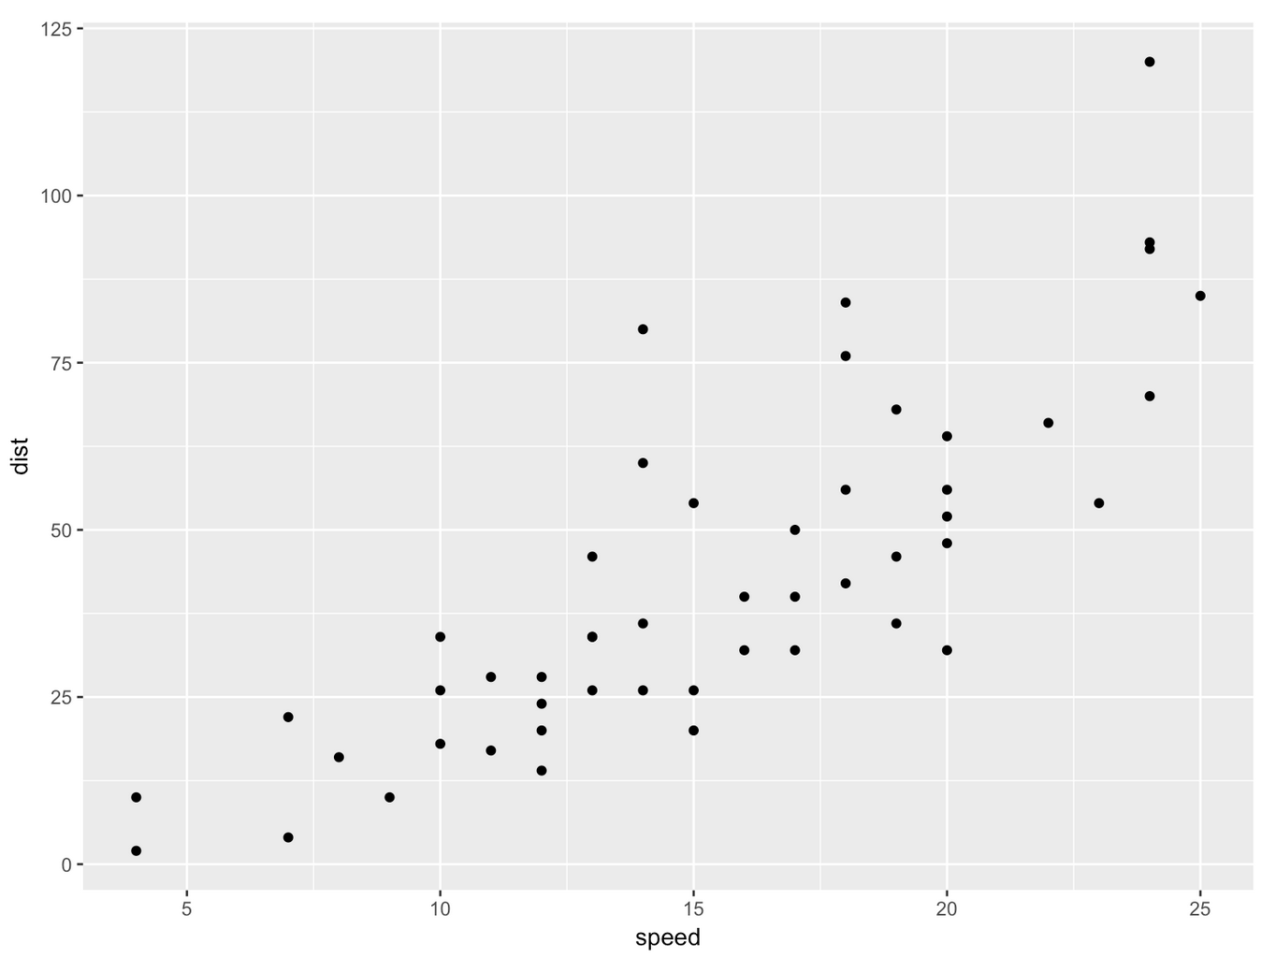
geom_point
ggplot(cars, aes(x = speed, y = dist)) + geom_point()

Slide 4
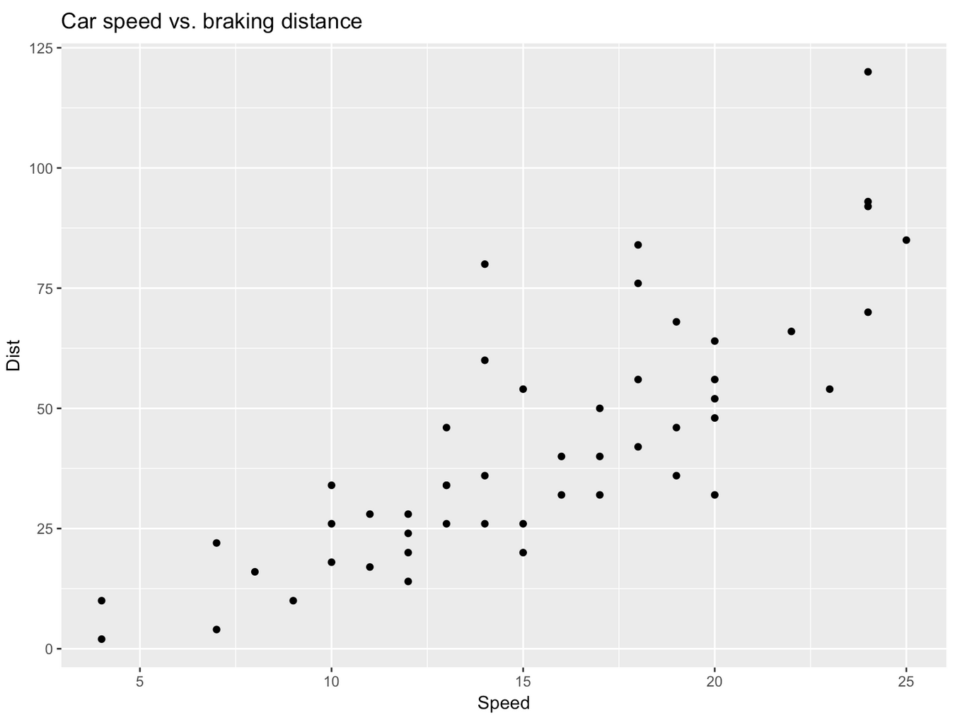
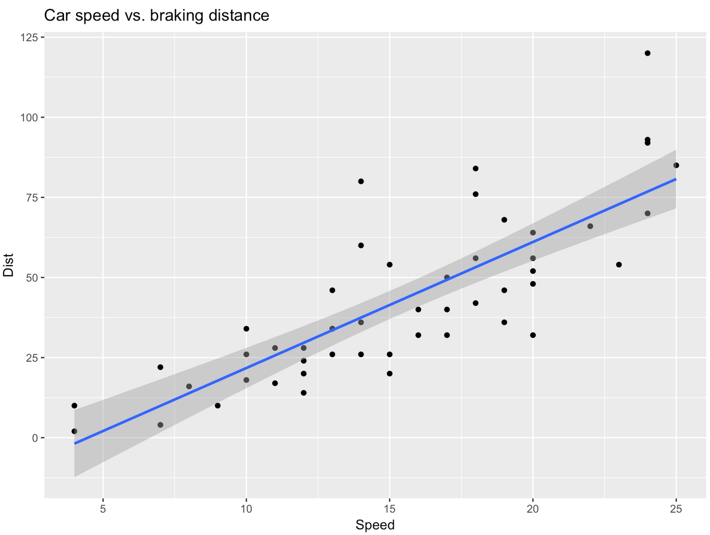
geom_point, ggtitle, xlab, ylab, geom_smooth
ggplot(cars, aes(x = speed, y = dist)) + geom_point() + ggtitle("Car speed vs. braking distance") + xlab("Speed") + ylab("Dist")
+ geom_smooth(method = "lm")

Slide 5
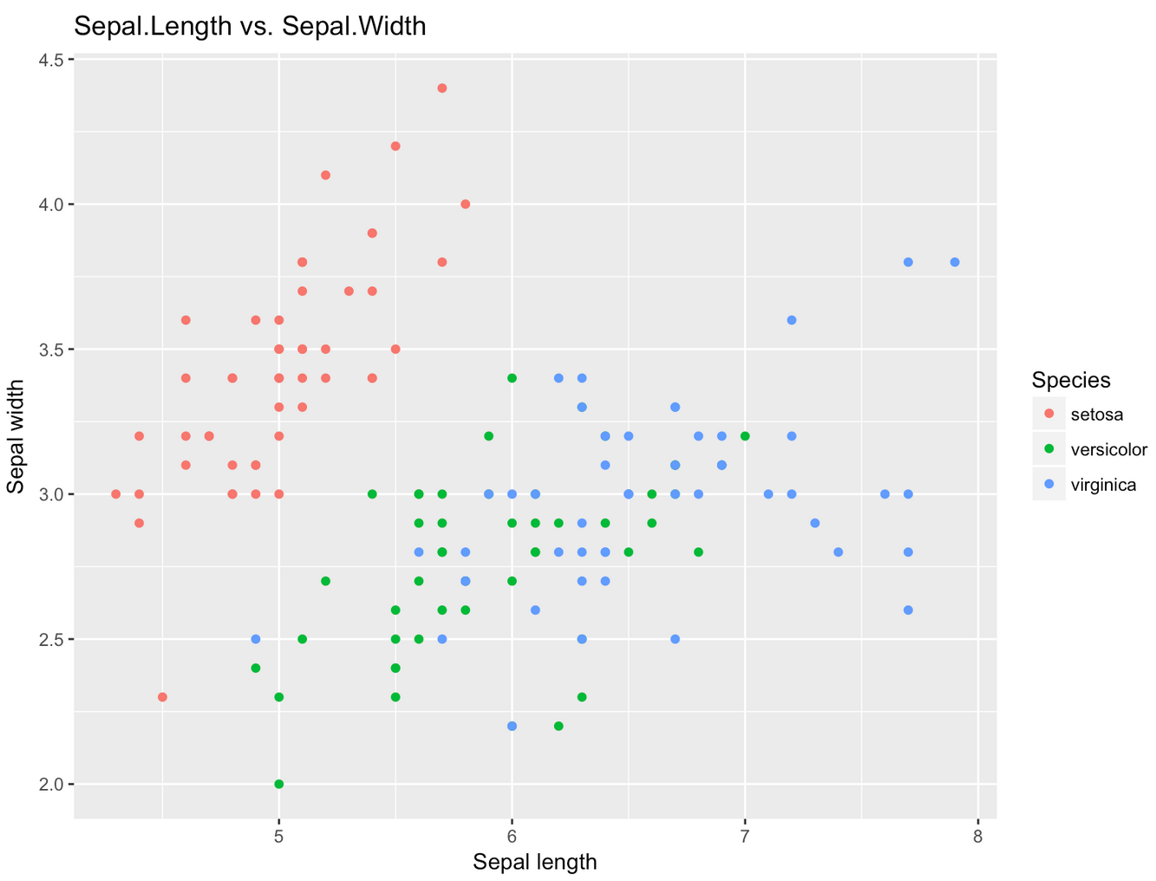
color
ggplot(iris, aes(x = Sepal.Length, y = Sepal.Width, color = Species)) + geom_point() + ggtitle("Sepal.Length vs. Sepal.Width") + xlab("Sepal length") + ylab("Sepal width")

Slide 6
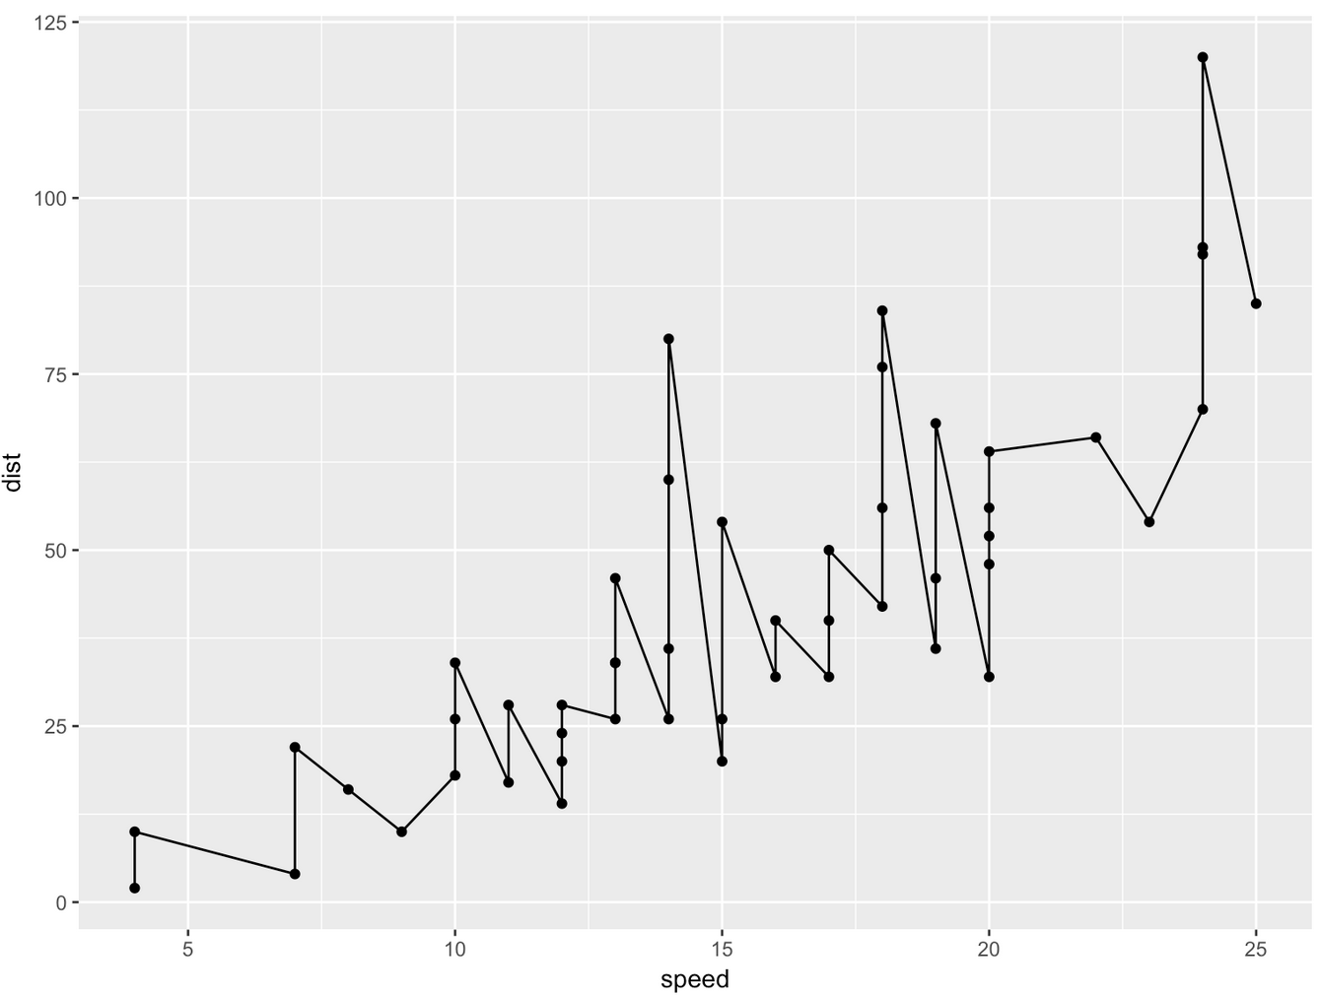
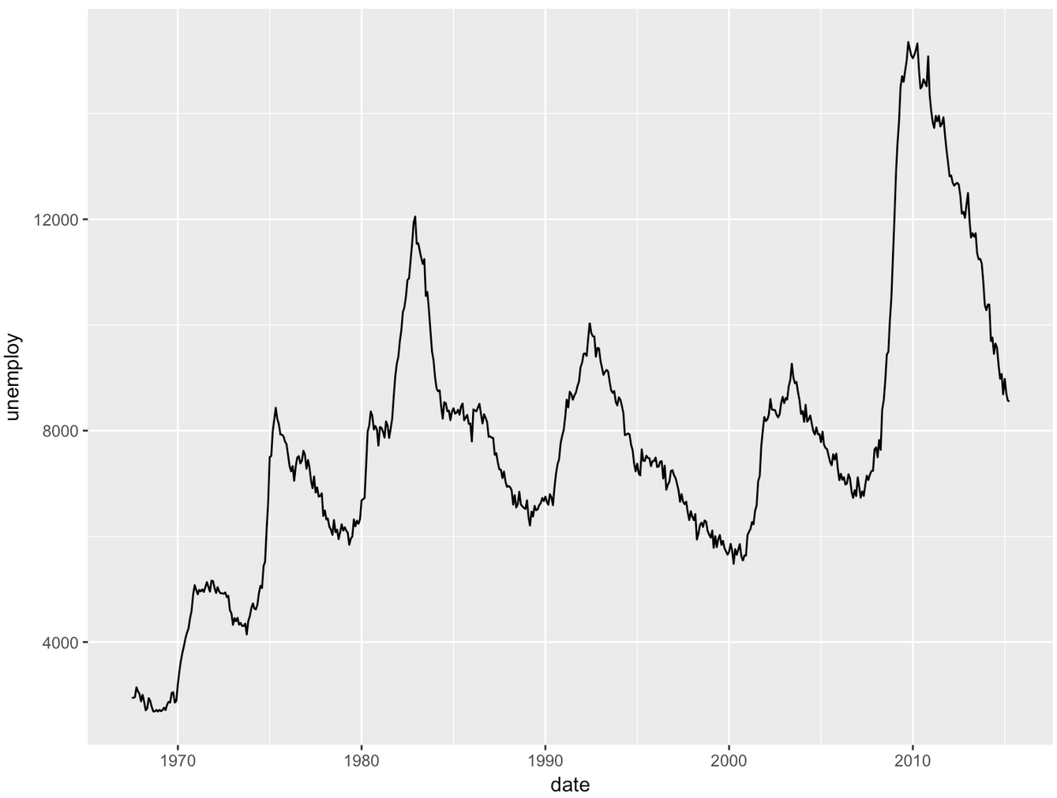
geom_line
ggplot(cars, aes(x = speed, y = dist)) + geom_point() + geom_line()
ggplot(economics, aes(x = date, y = unemploy)) + geom_line()

Slide 7
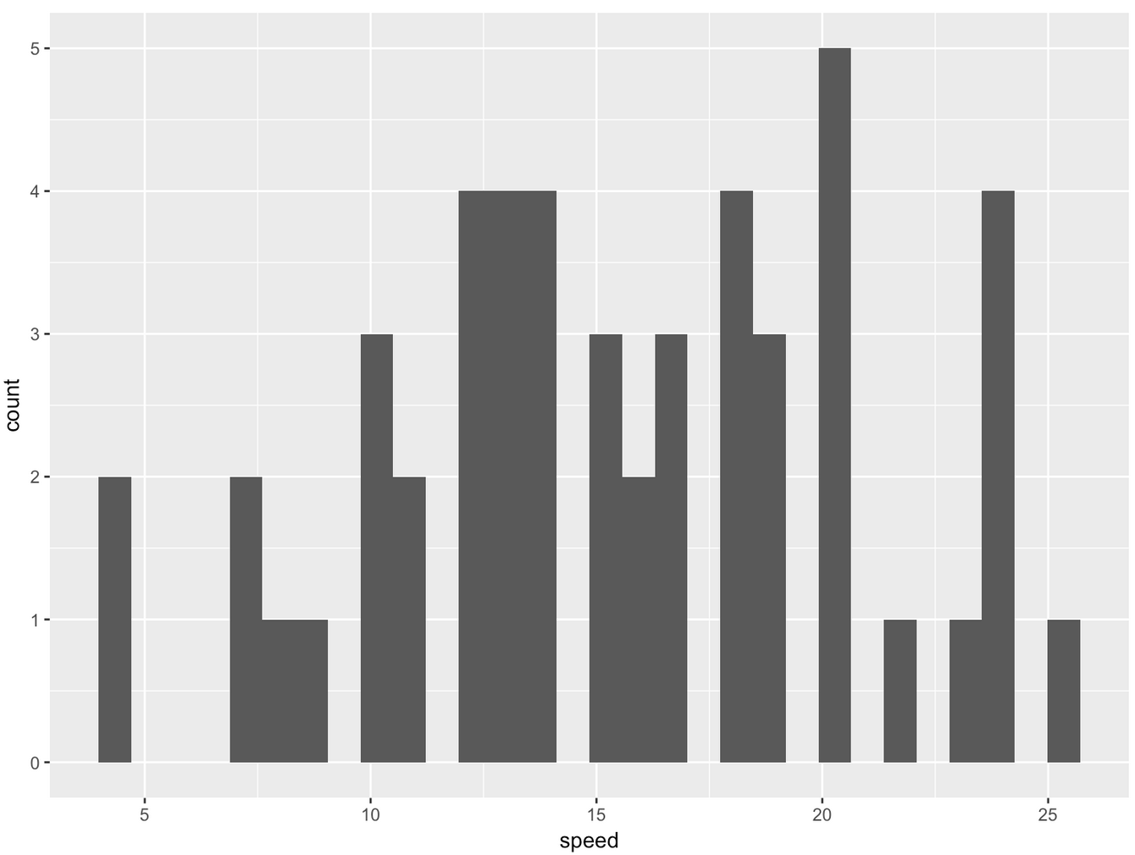
geom_histogram
ggplot(cars, aes(x = speed)) + geom_histogram()

Slide 8
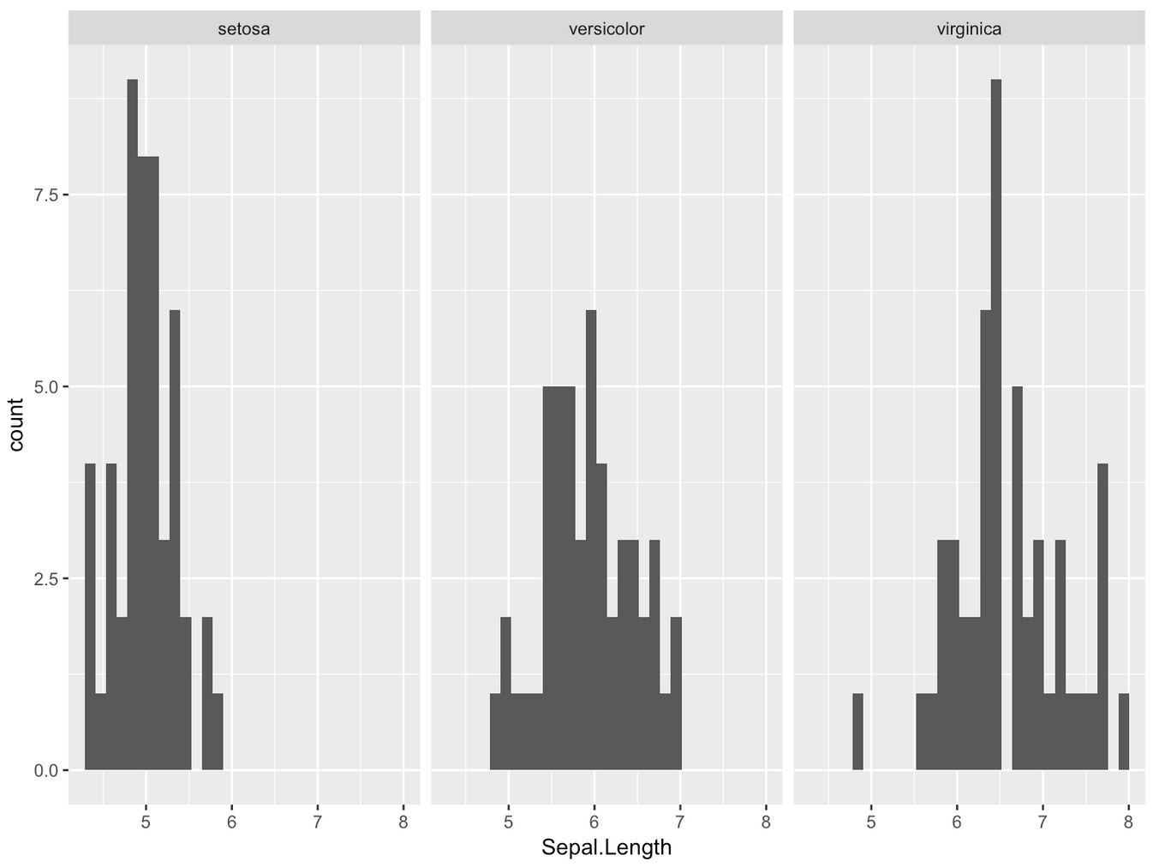
facet_warp
ggplot(iris, aes(x = Sepal.Length)) + geom_histogram() + facet_wrap(~ Species)

Slide 9
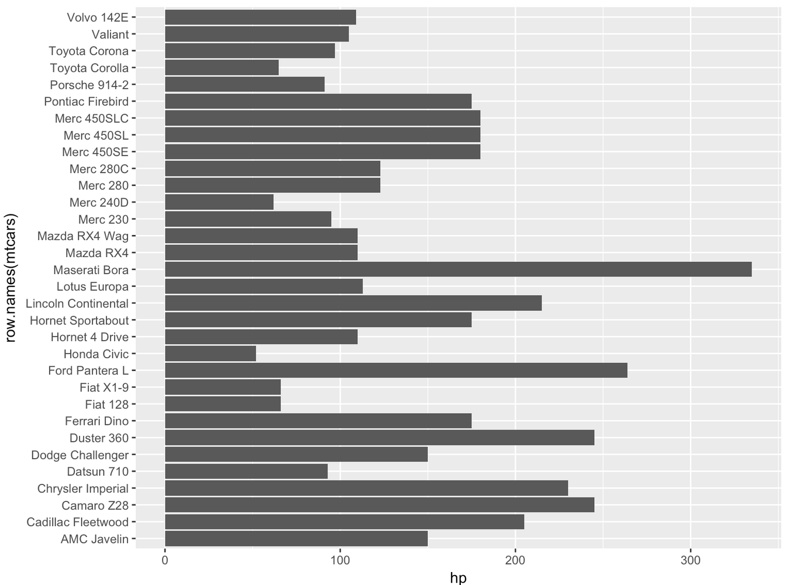
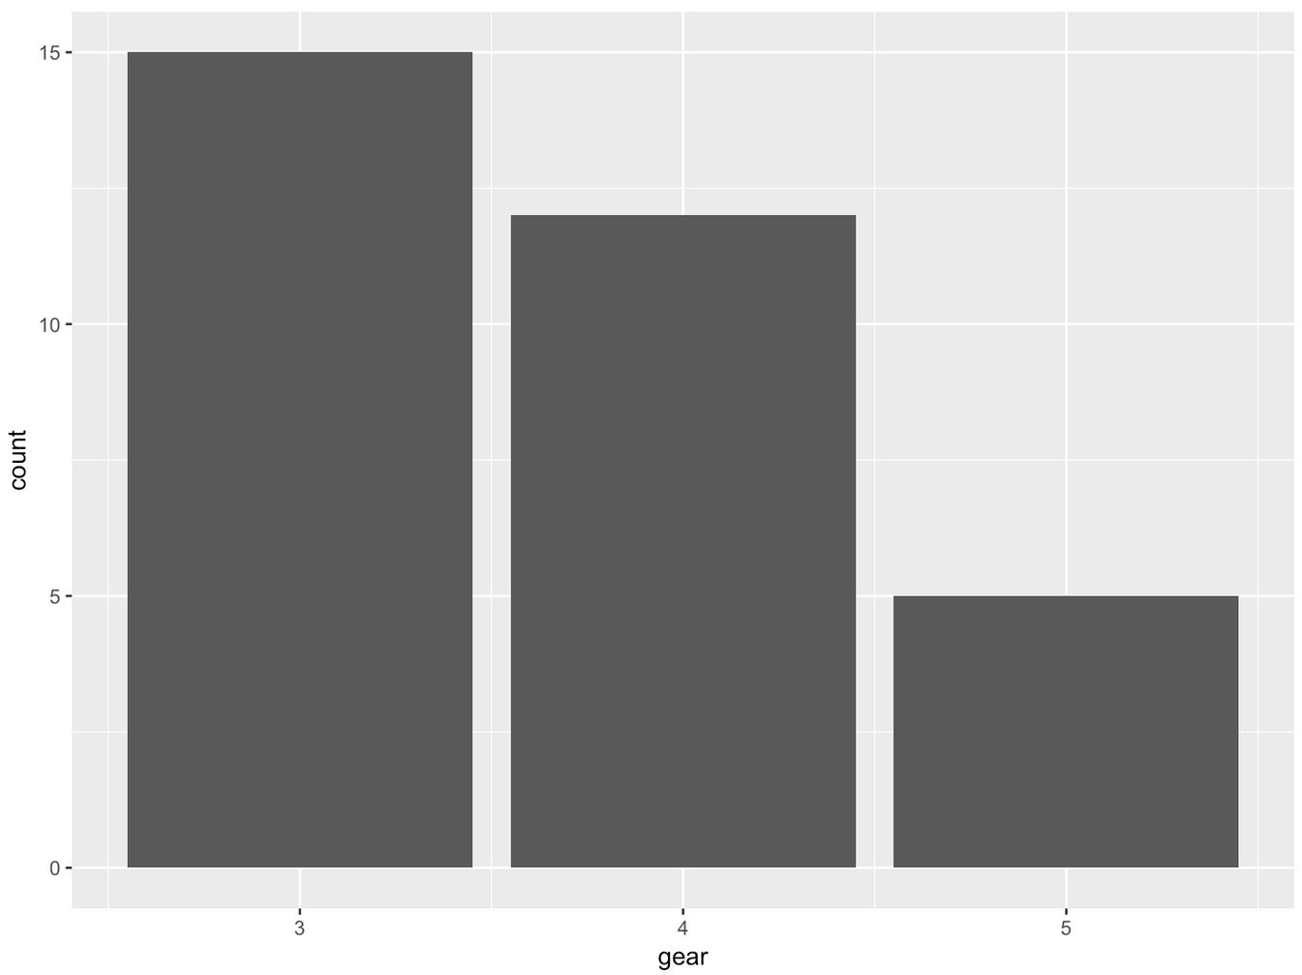
geom_bar, coord_flip
ggplot(mtcars, aes(gear)) + geom_bar()
ggplot(mtcars, aes(x = row.names(mtcars), y = hp)) + geom_bar(stat = "identity") + coord_flip()

Slide 10
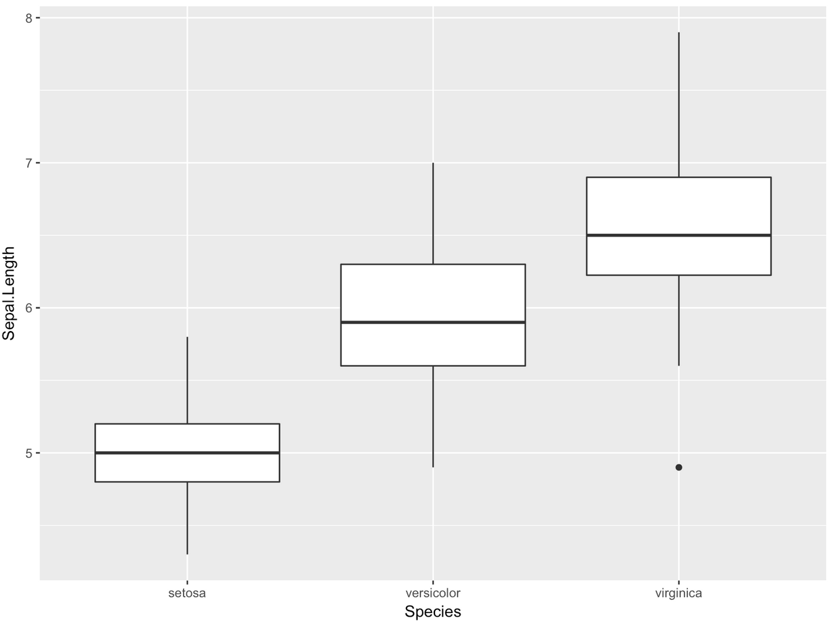
geom_boxplot
ggplot(iris, aes(x = Species, y = Sepal.Length)) + geom_boxplot()

