Slide 1
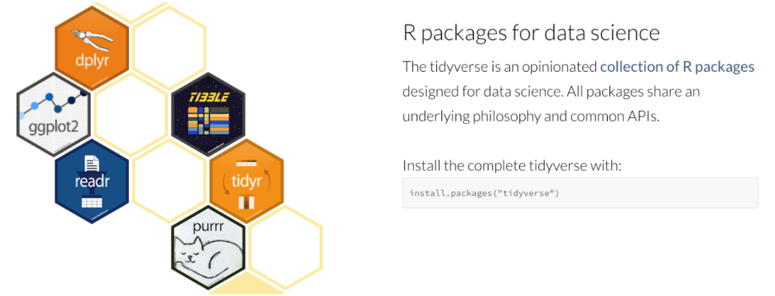
Tidyverse - 學習 R 語言的起點

Slide 2
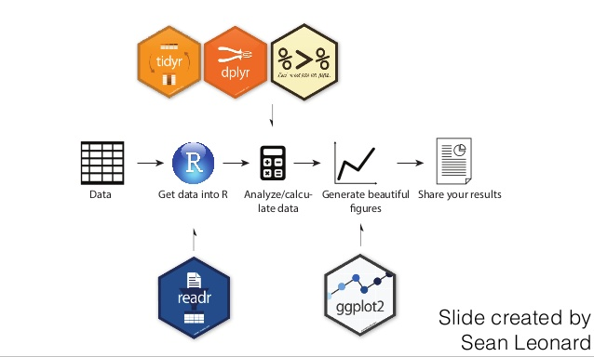
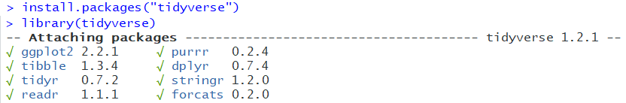
Tidyverse 成員
視覺化文法的王者 ggplot2
資料處理的利器 dplyr
長寬表格轉換的專家 tidyr
資料載入的 readr
消弭迴圈的加速器 purrr
強化資料框的 tibble

Slide 3
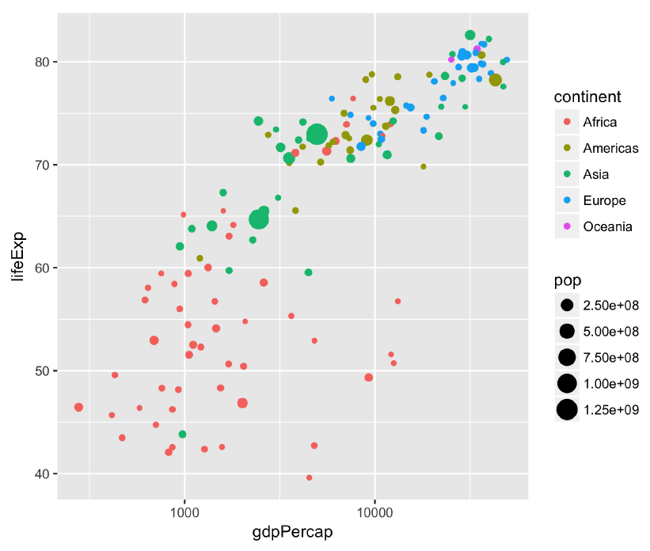
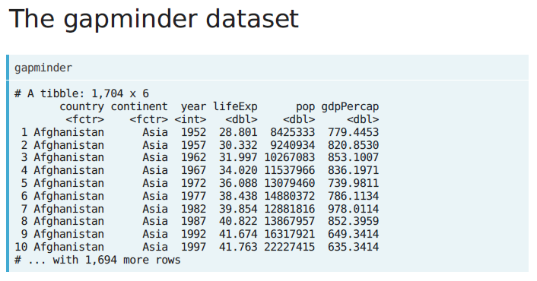
The gapminder dataset
install.packages("gapminder") library(gapminder)
library(dplyr)
dim(gapminder) gapminder
1704 data sets.
6 variables: country、continent、year、lifeExp、pop & gdpPercap

Slide 4
library(dplyr)
dplyr is a powerful R-package to transform and summarize tabular data with rows and columns.
dplyr verbs | Description
select() | select columns
filter() | filter rows
arrange() | re-order or arrange rows
mutate() | create new columns
summarize() | summarize values
group_by() | allows for group operations in the “split-apply-combine” concept

Slide 5
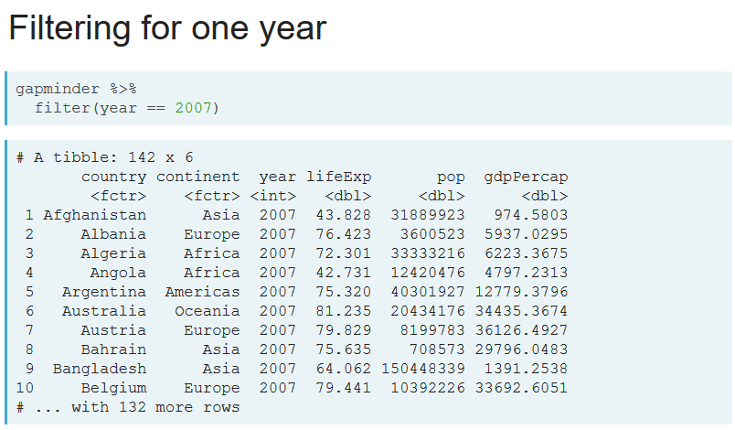
filter()

Slide 6
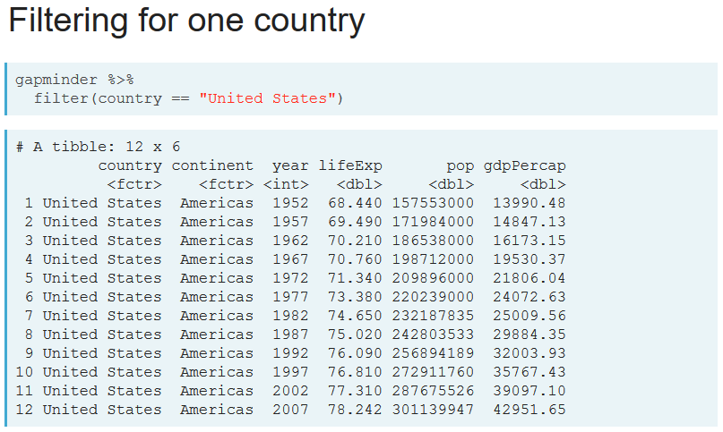
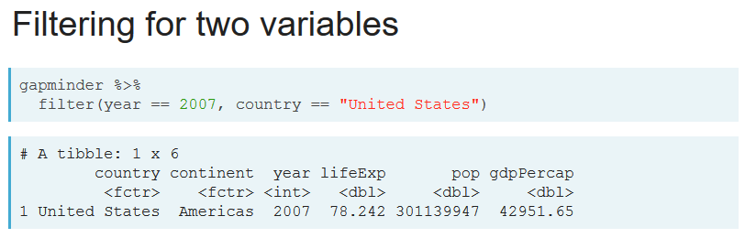

Slide 7
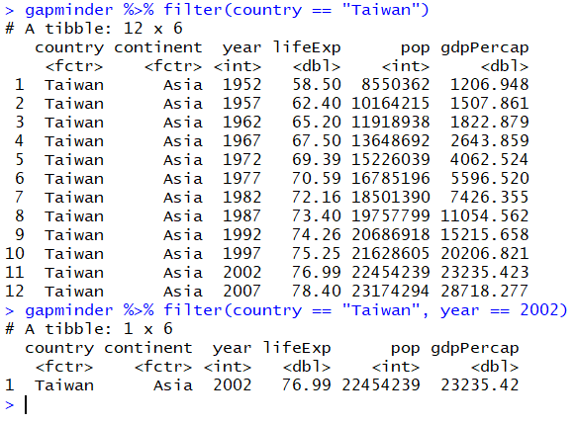
Let's practice - filter()
Filter the gapminder data to retrieve only the observation from Taiwan in year 2007.

Slide 8
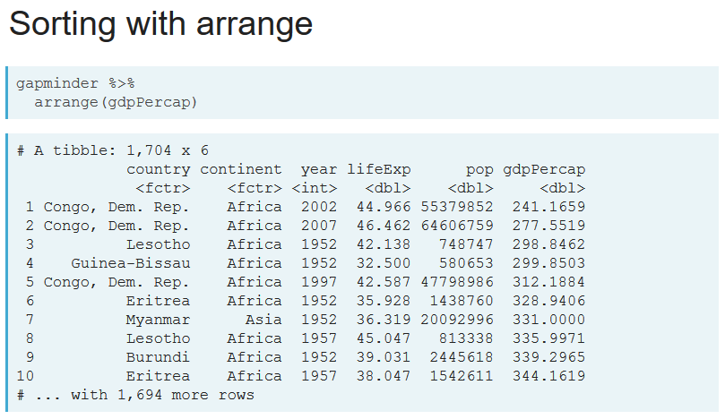
arrange()

Slide 9
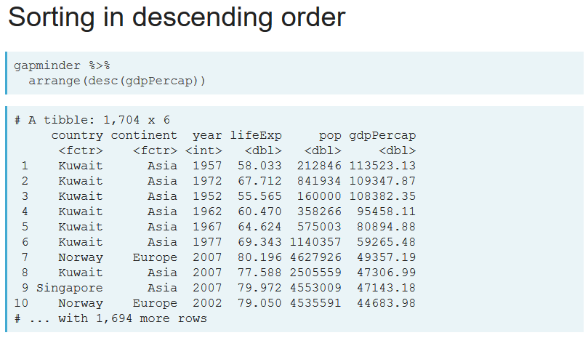

Slide 10
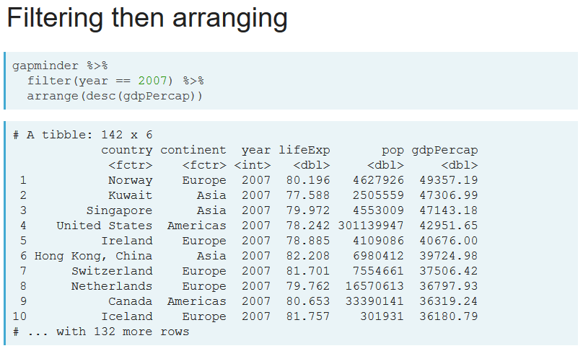

Slide 11
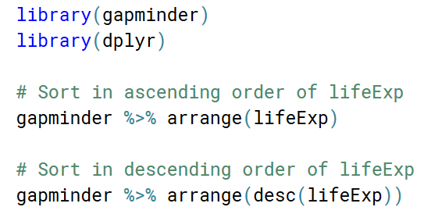
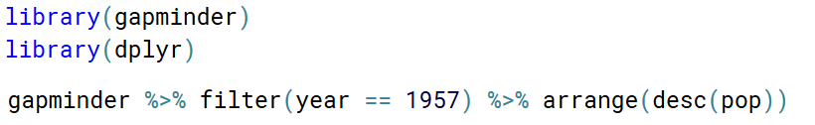
Let's practice - arrange()
Sort the gapminder dataset in ascending order of life expectancy (lifeExp).
Sort the gapminder dataset in descending order of life expectancy (lifeExp).
Filter for the year 1957, then arrange in descending order of population

Slide 12
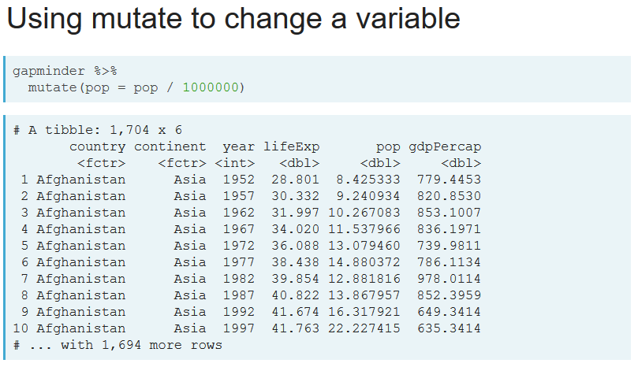
mutate()

Slide 13
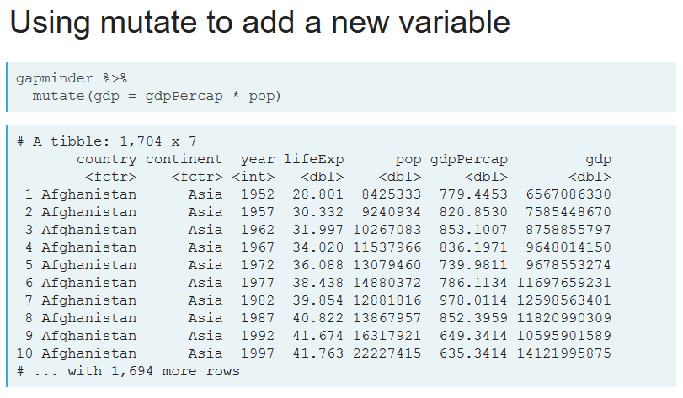

Slide 14
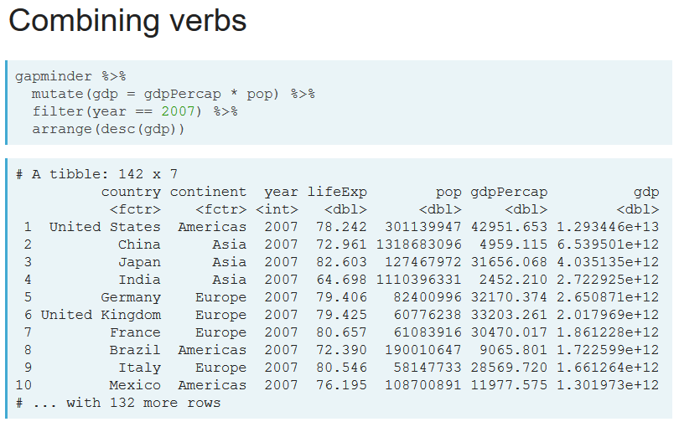

Slide 15
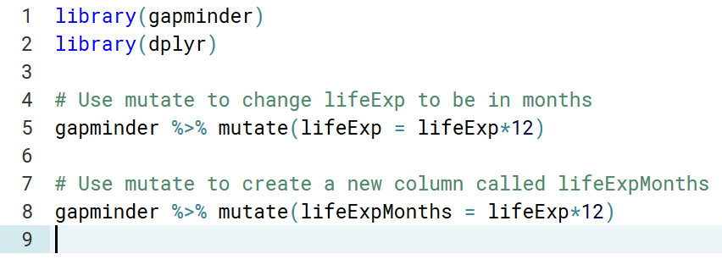
Let's practice - mutate()
Use mutate to change lifeExp to be in months
Use mutate to create a new colume called lifeExpMonths

Slide 16
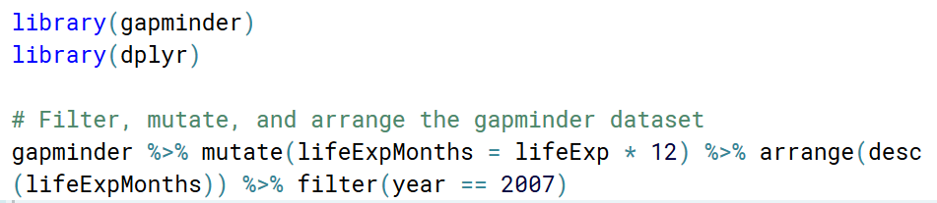
Let's practice – filter(), mutate(), and arrange()
To find the countries with the highest life expectancy, in months, in the year 2007.
filter() for observations from the year 2007
mutate() to create a column lifeExpMonths, calculated as 12 * lifeExp
arrange() in descending order of that new column

Slide 17
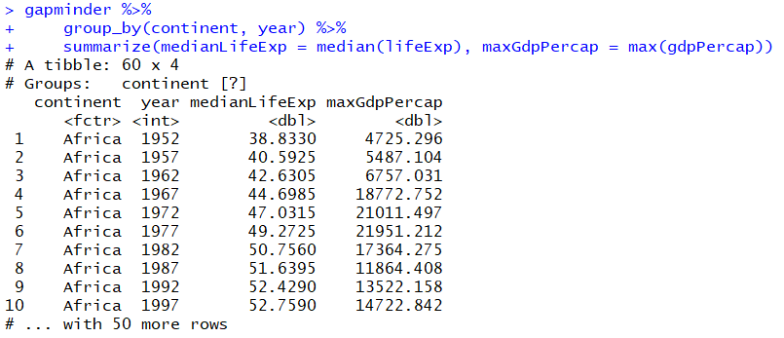
group_by() & summarize()

Slide 18
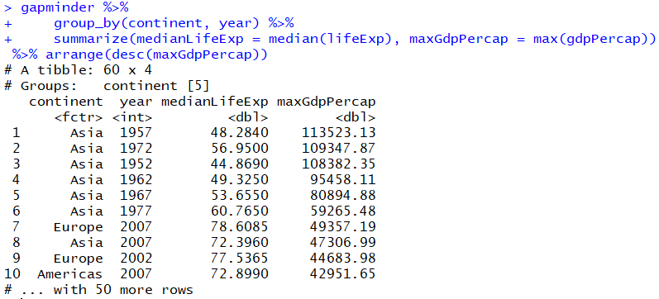
group_by(), summarize() & arrange()

Slide 19
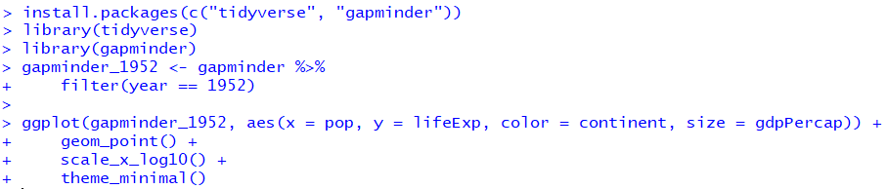
ggplot2
ggplot2
geom_point
scale_x_log10
theme_minimal

Slide 20
