Slide 1
儲存技術的趨勢

Slide 2
網路儲存產業與職場經驗分享
資料儲存與備份技術
工作類型與知識管理
相關技術與研究

Slide 3
資料儲存是資訊技術的基礎
資料完整性
資料備份是已備不時之需
企業運作不間斷

Slide 4
Data Availability
備份 (以備不時之需)
Backup / Restore / Recovery
分身 (隨時取而代之)
Mirror
Replication / DR / HA
其他備份的策略
CDP / Snapshot
Storage Virtualization

Slide 5
Backup / Restore / Recovery
完整備份: 完全備份
增量備份: 僅備份上次備份後的異動
差異備份: 僅備份上次完全備份後的差異
備份的資料量
還原的時間
Monday | Tuesday | Wednesday | Thursday | Friday | Saturday | Sunday

Slide 6
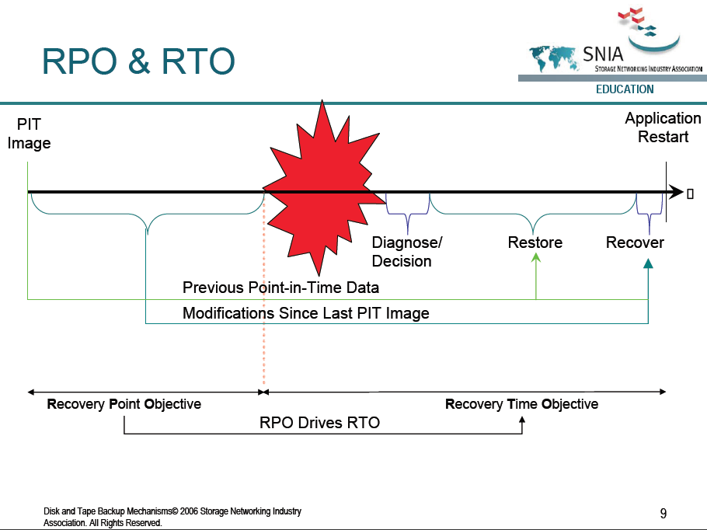
評估指標: RTO & RPO
RPO(Recovery point objective)
能承受的資料損失
RTO(Recovery time objective)
能承受的停機時間

Slide 7
Mirror / Replication / DR / HA
同步更新，隨時有一模一樣的分身
Mirror
遠端備份，分散地理風險
Replication / Disaster Recovery
副元首，靜靜的伺機取而代之
High Available / Failover

Slide 8

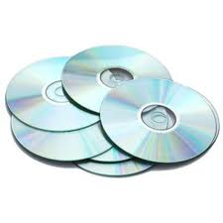
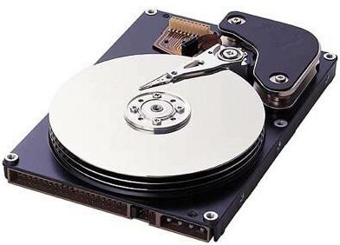
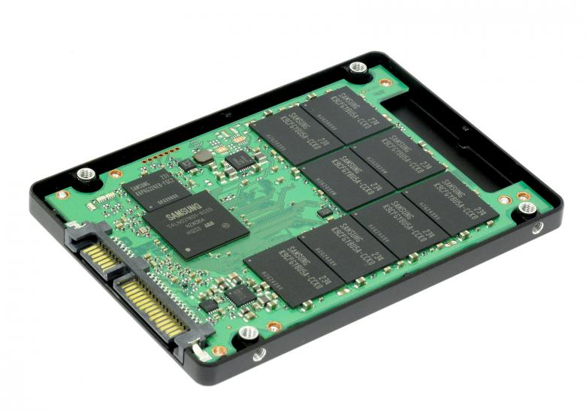
儲存媒體的演進就是管理方法的演進

Slide 9

分散式儲存
儲存設備是主機系統的周邊
自己管自己 – 無法集中管理
使用不平均 – 容易造成浪費

Slide 10
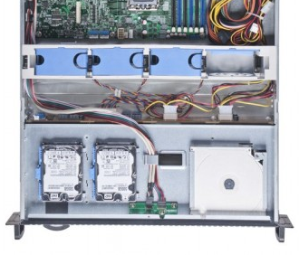
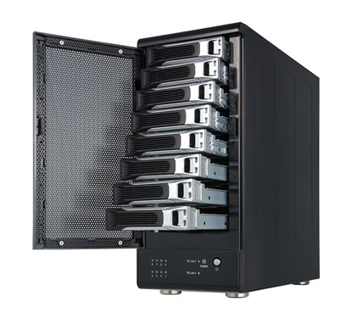
DAS (Direct Attached Storage)
內建硬碟 -> 外接儲存系統
磁碟陣列 ( Disk Array )
最基本的儲存虛擬化

Slide 11
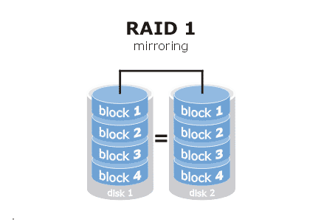
RAID (Redundant Array of Independent Disks)
Mirror

Slide 12
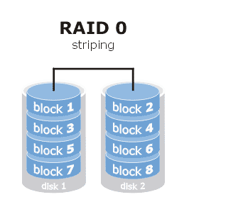
RAID (Redundant Array of Independent Disks)
Striping

Slide 13
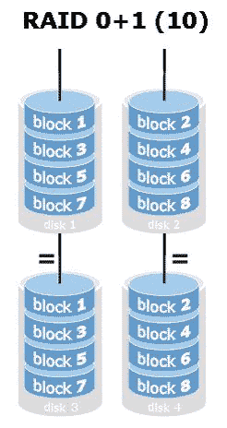
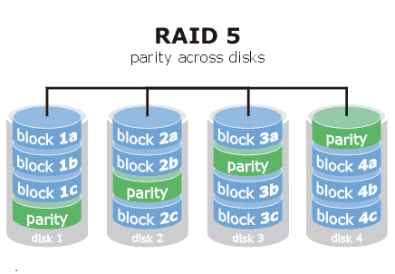
RAID (Redundant Array of Independent Disks)
RAID 5, 6, 1+0

Slide 14
集中式儲存管理
NAS ( Network Attached Storage )
SAN ( Storage Area Network)
FC/SAN
IP/SAN
Storage + Networking

Slide 15
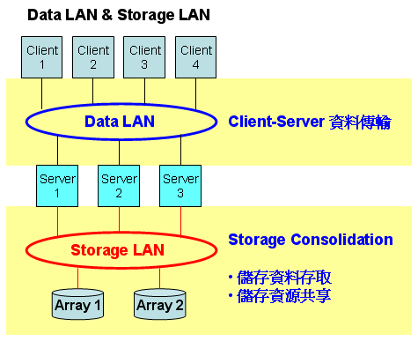
Storage Consolidation
http://www.netpro.com.tw/?FID=23&CID=95&category=1

Slide 16
NAS (Network Attached Storage)
NAS
NFS/CIFS
Client
LAN
NAS

Slide 17
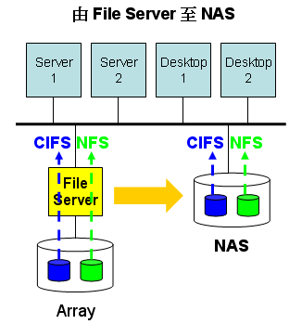
NAS (Network Attached Storage)
File Server
SAMBA
UNIX – NFS ( Network File System )
Windows – CIFS ( Common Internet File System )
Serverless – NAS
Disk Array 內建NFS與CIFS

Slide 18
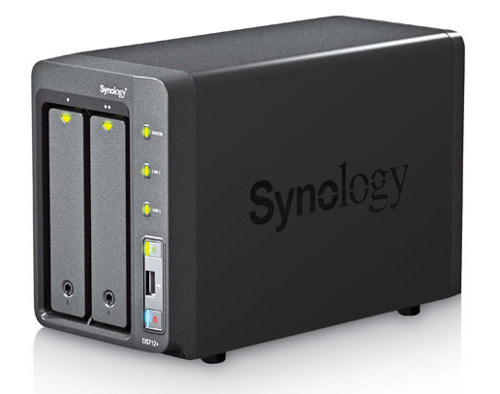
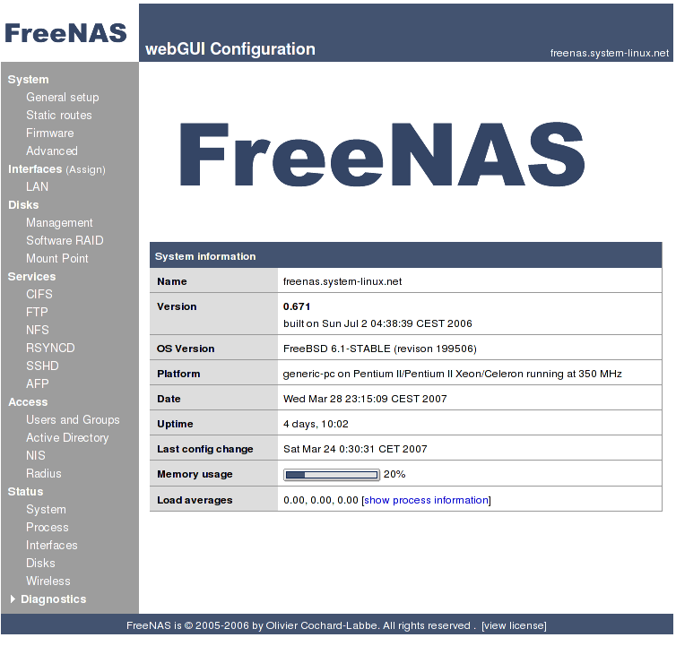
NAS (Network Attached Storage)
Media Center
只支援檔案型態資料

Slide 19
SAN (Storage Area Network)
SAN
Server
Server

Slide 20
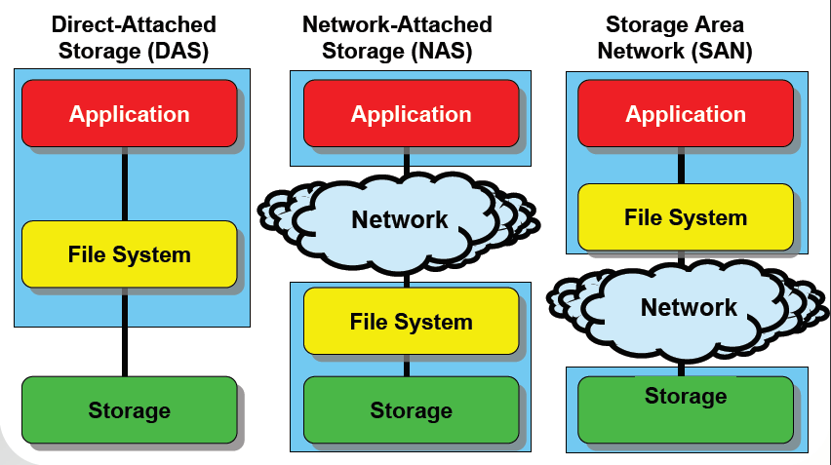
比較

Slide 21
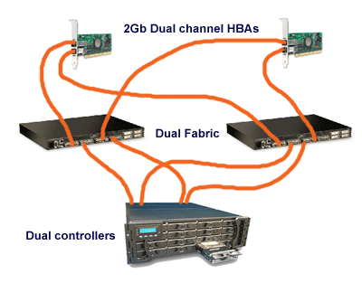
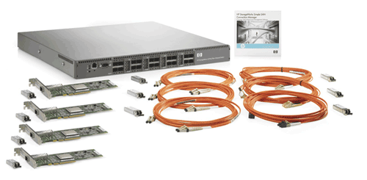
FC/SAN
Fiber Channel
FC switch
HBA

Slide 22
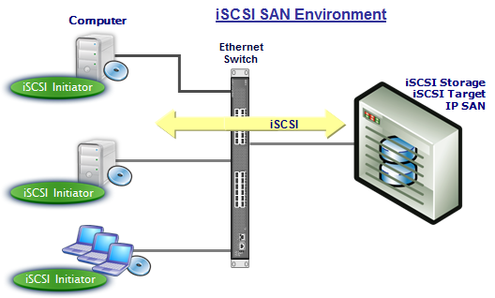
IP/SAN
iSCSI
Initiator
Target

Slide 23
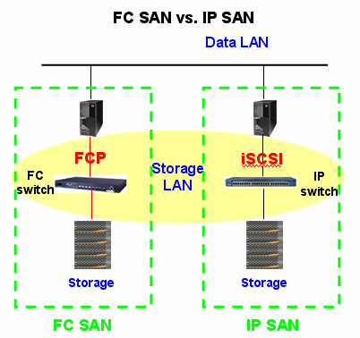
FC/SAN vs. IP/SAN
架構相似
不同通訊協定
組成元件不同
建置成本
管理成本
效能

Slide 24
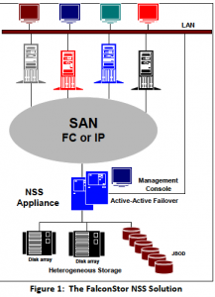
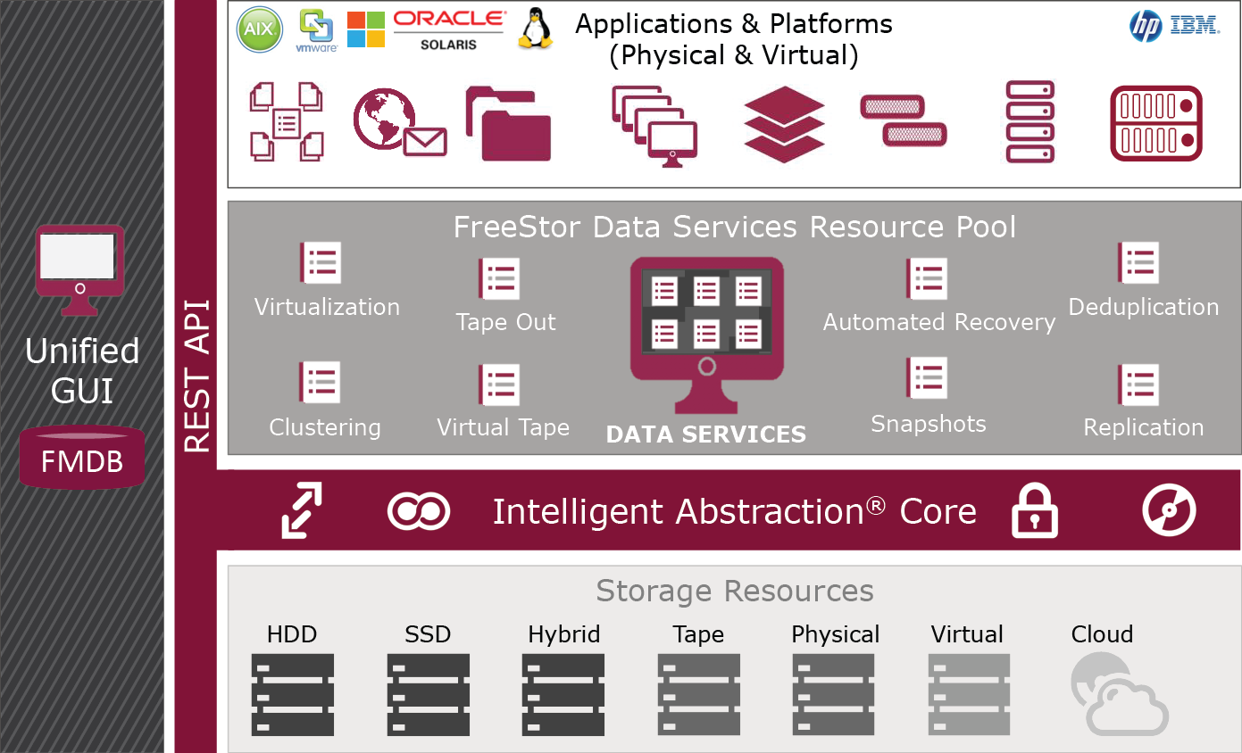
Storage Gateway

Slide 25
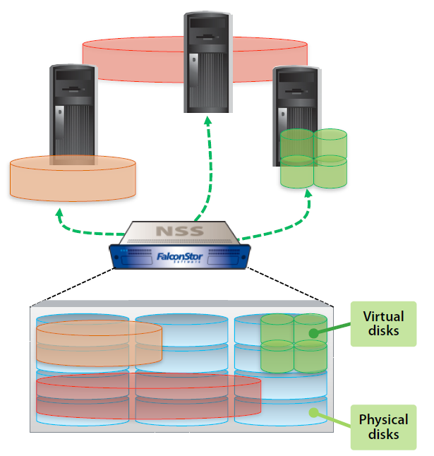
儲存虛擬化
Storage Virtualization
LVM
VTL
Thin Provision
彈性空間管理
Storage Pool
混合storage
In-band vs. Out-band

Slide 26
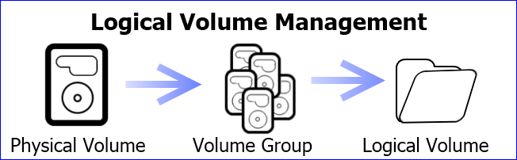
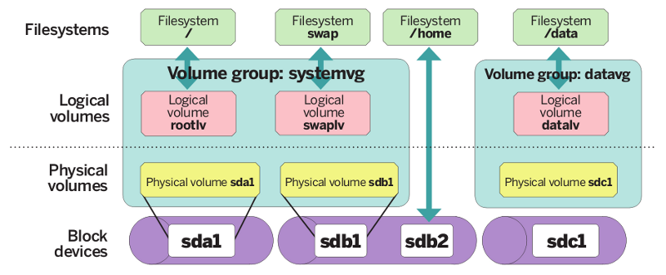
LVM (Logical Volume Management)

Slide 27
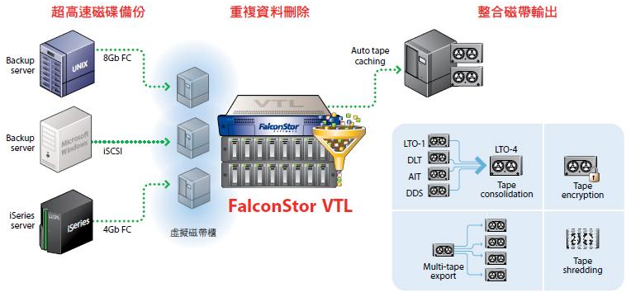
VTL (Virtual Tape Library)
De-dupe vs. Compress
Block level vs. File level

Slide 28
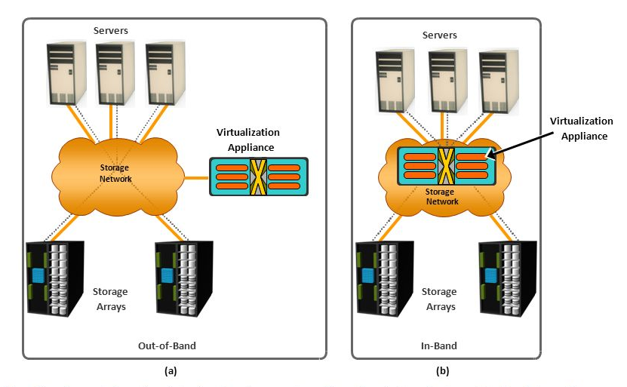
Out-of-Band & In-Band
虛擬化的設定存在資料路徑上與否

Slide 29
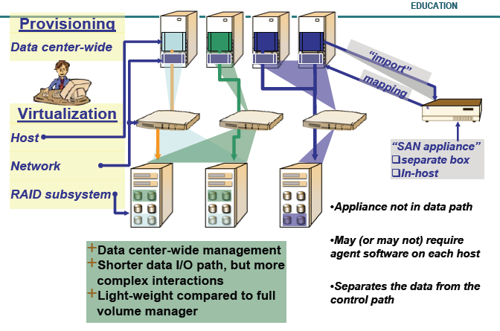
Out-of-Band

Slide 30
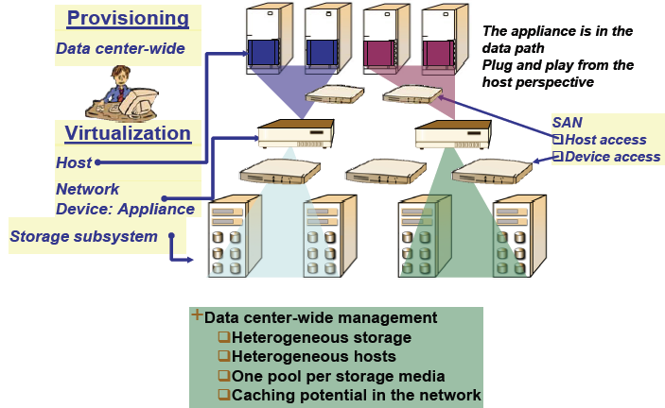
In-Band

Slide 31
Out-of-Band vs. In-Band
Data與control是否在同一條path上
架構簡易程度
由appliance接手，server無須而外控制軟體
Mapping與認證機制較複雜
效能最佳化
同一條path較易最佳化
擴充彈性
增減storage只須更新mapping內容

Slide 32
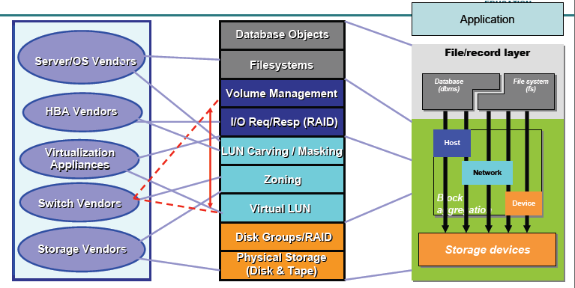
儲存技術分佈

Slide 33
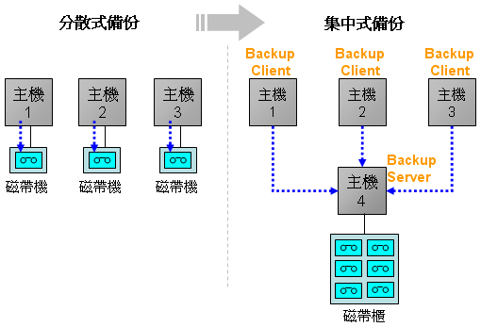
資料備份
單機備份 – 分散式
集中是備份 – Client / Server
http://www.netpro.com.tw/?FID=23&CID=107&category=1

Slide 34
備份架構
Backup server
執行backup/restore的動作
設定週期性的backup動作
設定要backup哪些檔案…
Backup device
儲存備份的資料 (硬碟或磁帶)
Metadata (in the backup server)
紀錄備份動作的相關資訊: log, time, range, type…
Application server / backup client (with agent)
應用伺服器: 需要備份的對象
Storage node
提供資料運算與儲存的空間(硬碟)
資料路徑

Slide 35
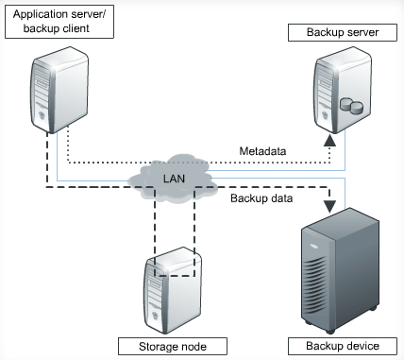
LAN-based Backup

Slide 36
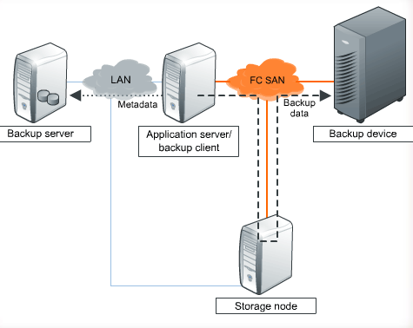
SAN-based Backup

Slide 37
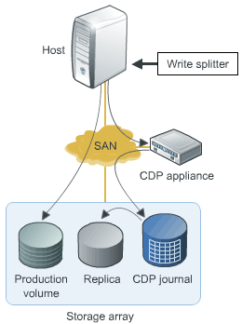
CDP, Continuous Data Protection
Write splitter.
Agent, duplicate data.
CDP appliance.
Manages replication.
CDP Journal.
Data changes.
Local replication.
Sync the production volume and replica.

Slide 38
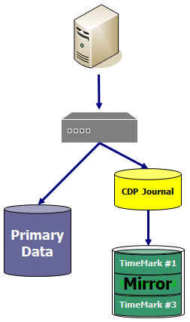
CDP: Continuous Data Protection
保留所有更動
CDP Journal
Snapshot
point-in-time image
TimeMark
Virtualized snapshot for recovery
In-band / Side-band
Mirror

Slide 39
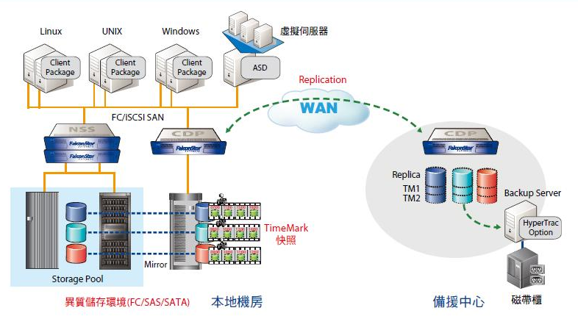
CDP 架構

Slide 40
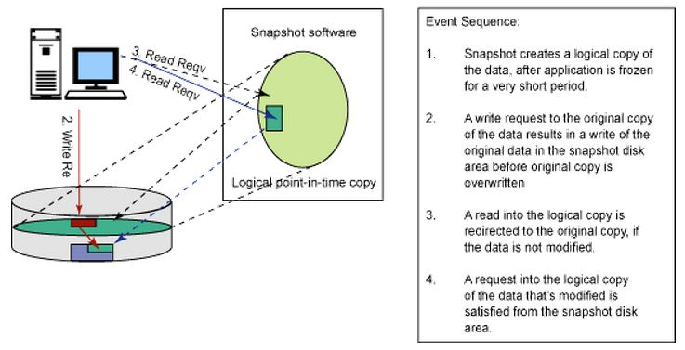
Snapshot
Copy-on-write

Slide 41
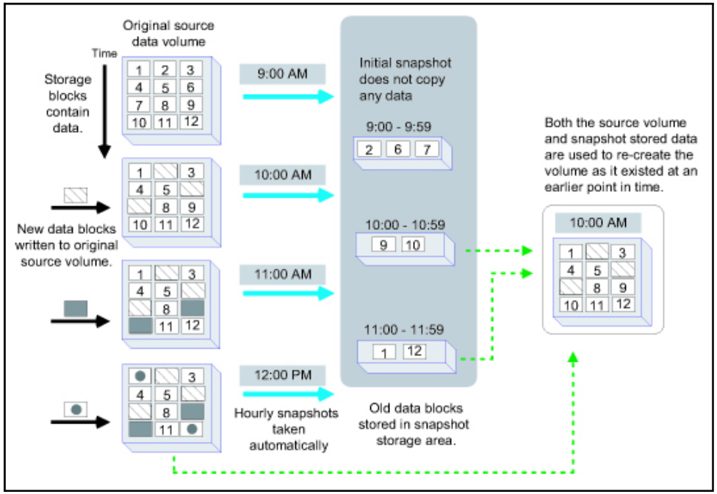
Snapshot

Slide 42
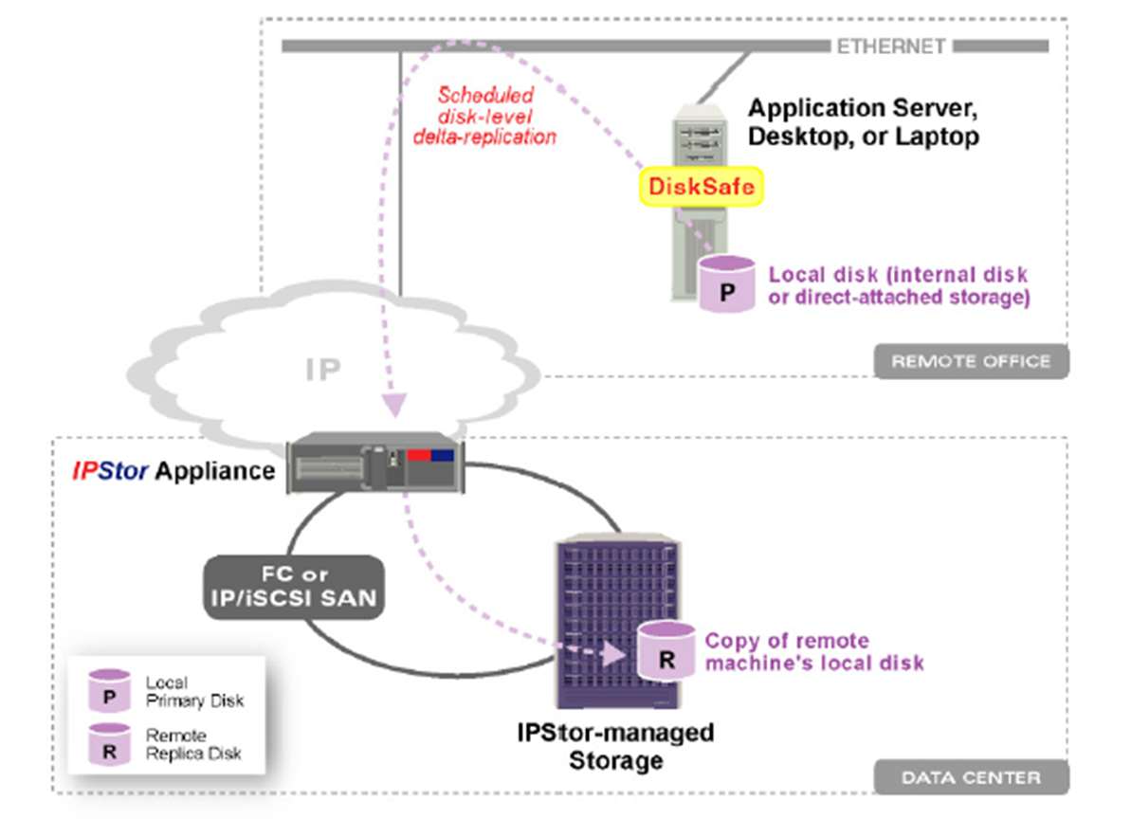
Side-band: Host-based

Slide 43


Local Data Protection and Recovery
Snapshots agents are triggered to create consistent recovery points
Application Data integrity check points
TimeView
TimeView provides a Point-in-Time view of a previous version of a vDev
The resource is available almost immediately
Minimal storage allocation is required only to temporarily store writes sent to the TimeView*
TimeMark Copy
A full-size copy of the vDev as it existed at the time of the snapshot used. Because a full and complete copy id being made, the TM Copy vDev is available at the end of the copy process
Once mounted, the TimeMark Copy vDev is a totally independent vDev
Rollback
Use a selected snapshot to completely revert the primary vDev to its state at the date and time of the snapshot
Requires vDev dismount until rollback is complete
vDev is available to be mounted again at the end of the process
SAN Disk Manager
Snapshot Agent
File System Agent
Host based applications
Message Recovery
HyperTrac
Application Server
TimeMark Copy
(Cloning)
TimeView
(PiT View)
DB
LOG
DB
LOG
I/O Transactions
Independent Image
Temporary Image
Rollback
TimeMark (Snapshot)
8:00AM
DB
LOG
DB
LOG
SRA
SRA
DB
LOG
Snapshot Resource Area
9:00AM
vDev's
10:00AM
DB
LOG
COFW
Preserved Images

Slide 44

Replication
Standby Application Server
Application Server
3 - TimeMark protects data in the Replica Resource in case replication is interrupted before the stable image is completely transferred
1 - When a replication is triggered a temporary TimeMark is created on the both Primary & Replica Disks and then an internal TimeView is created
Promote
2 -Frozen Data is read from the internal TimeView according to U-Map and differences are sequentially transferred to the replica
DB
LOG
Internal TimeView
Target Site NSS
DB'
LOG'
vDev
DB
LOG
Replica Disk
Snapshot Area
Replication Snapshot
Rollback if
Replication fails
10:00AM
DB
LOG
Available only is TimeMark is enabled on replica
8:00AM
DB
LOG
Preserved Image
DB
LOG
9:00AM
Primary NSS
DB
LOG
10:00AM
Preserved Images

Slide 45
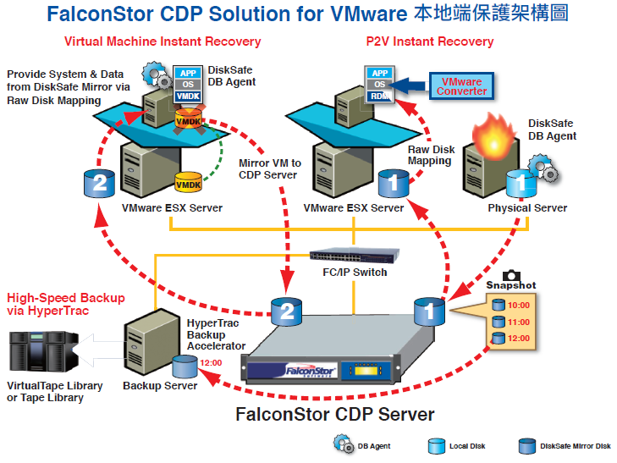
Disaster Recovery in VMware Environments

Slide 46
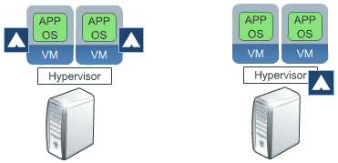
VM Backup
Backup agent runs on each VM.
Backup agent runs on hypervisor.

Slide 47
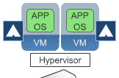
VM Backup, agent runs on each VM
每一部VM都要安裝agent.
就像是在傳統實體機器上的備份環境.
Dedupe VM上的資料
無法備份VM file: BIOS, configuration…

Slide 48
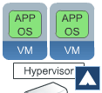
VM Backup, agent runs on hypervisor
Agent只需安裝在hypervisor server上.
不是備份整部 hypervisor server.
對hypervisor而言, VM就只是一堆檔案.
Dedupe可以發揮最大功效, 當VM間的差異不大時.

Slide 49
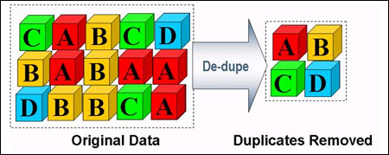
Dedupe: Data de-duplication
比對原始資料
建立索引
刪除共有部分，僅保留索引與差異
Dedupe
Block level
Compress
File level

Slide 50
Deduplication
File-level deduplication (single-instance repository)
如果檔案的差異不大, 即無法dedupe, 無法節省很多空間.
Sub-file deduplication
Fixed-length block
Variable-length segment
Dedupe Types: source or target-based
Bandwidth, server loading, backup loading…

Slide 51
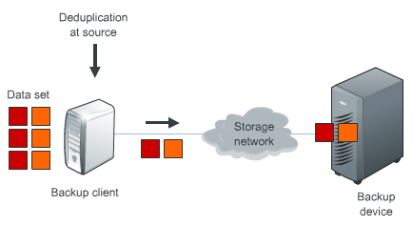
Source-based Dedupe

Slide 52
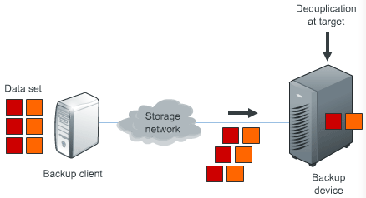
Target-based Dedupe

Slide 53


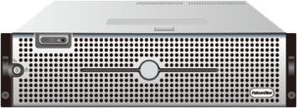
Failover
Application Server
Application Server
Application Server
Application Server
Disk1
Disk2
Disk1
Disk2
Heartbeat
Disk1
Stdb2
Disk2
Stdb1
Disk2
Disk1
SCI ( Storage Cluster Interlink)
P1
P2
P1
P2
Shared Storage
Shared Storage

Slide 54
Tech Engineers
Systematical thinking
Tech & product knowledge
Team work
RD
Programming / Debug
Improve performance
QA
Test Cases / Automation
Heterogeneous test environments
Support
Communication
Storage Architect

Slide 55
RD activities
Research and development.
Document specification.
Code review.
Testable code.
Event logs.
Debug messages.
Bug fix.
Tools: IDE / GCC / GDB / Git

Slide 56
QA activities
Review and reproduce incoming bug reports.
Verify bugs that RD fixed.
Setup test environment and test new builds.
Define test cases.
Automatic regression tests.
Report defects.
Analyze defect report to provide quality level (defect find and fix rates), also make recommendations for improve product quality.

Slide 57
Support activities
Follow up customer’s issue.
Investigate customer’s issue and reproduce it if needed.
Escalate issue if suspect the issue is a bug.
Skill: Second foreign language.

Slide 58
Fundamental Courses
Operating System
System Programming
Computer Networking
Programming Languages
C/C++, Java, Scripts
Object Oriented Analysis and Design

Slide 59
Interesting Topics
System administrator
Linux
Windows
Cluster
Virtualization
VMWare
Hyper-V
Programming
Driver, Networking, REST API, ZeroMQ, JSON,…
OpenStack

Slide 60
Resources
Sourceforge (sourceforge.net)
Github (github.com)
Stack overflow (stackoverflow.com)

