Slide 1
儲存系統中的網路技術

Slide 2
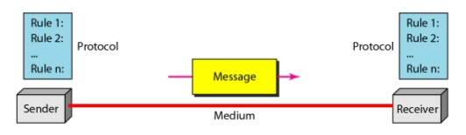
資料通訊要素
Message (data, information)
Sender
Receiver
Medium
Protocol

Slide 3
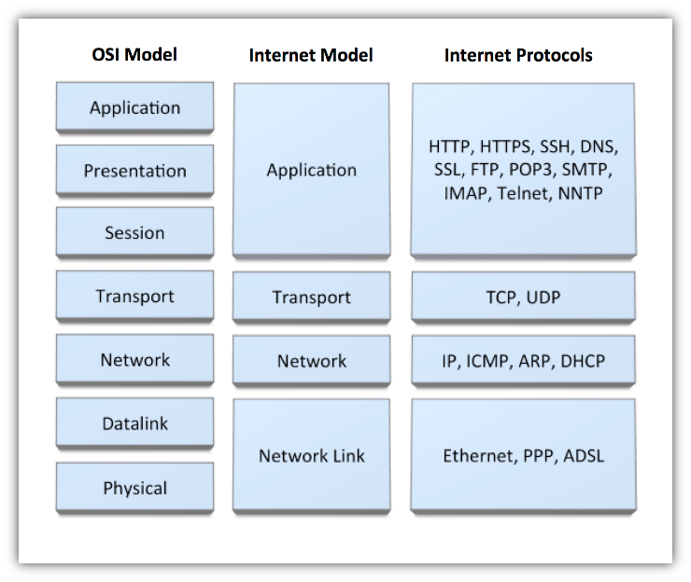
Protocol Model

Slide 4
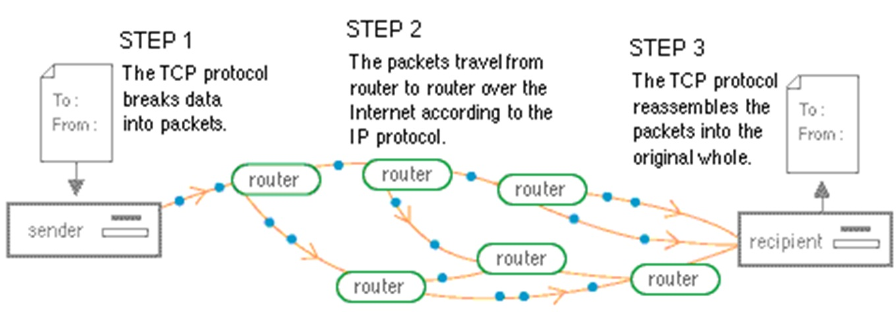
How TCP/IP Work
TCP – 導遊
IP – 司機

Slide 5
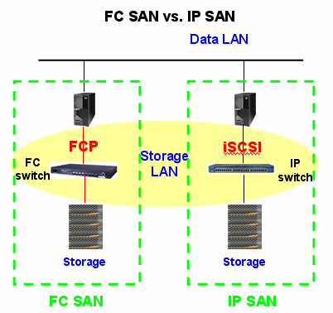
Storage Area Network
FC/SAN
IP/SAN

Slide 6
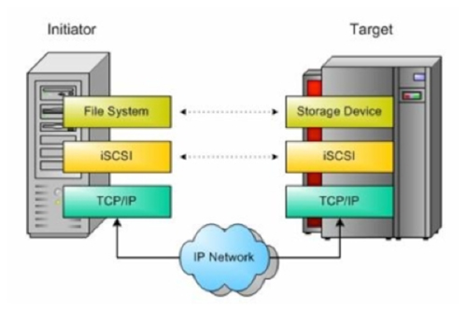
Initiator & Target

Slide 7
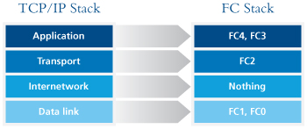
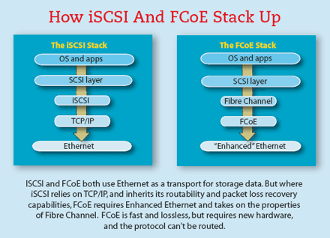
Fibre Channel Protocol

Slide 8
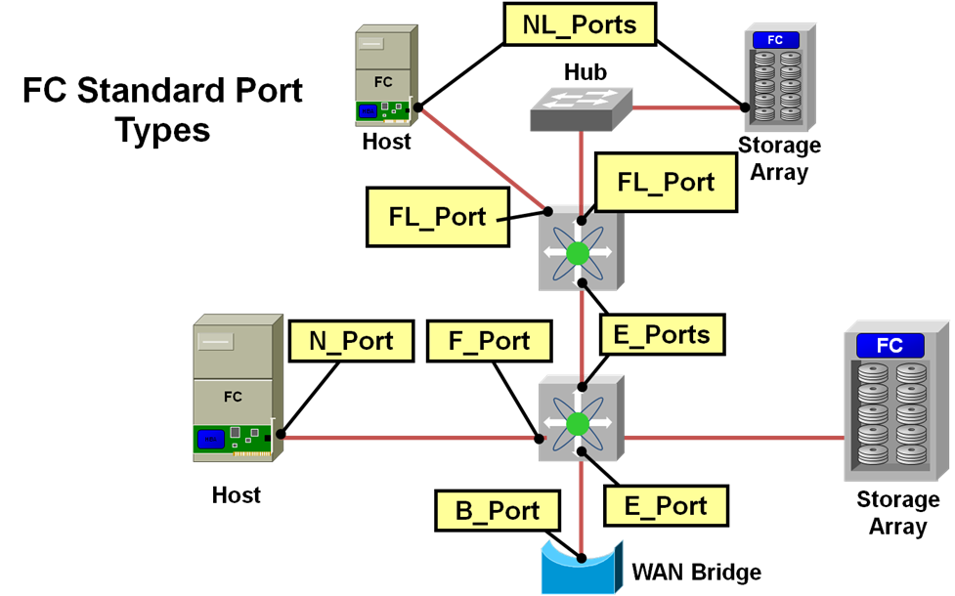
FC Port Types
N_Port
F_Port
E_Port

