Slide 1
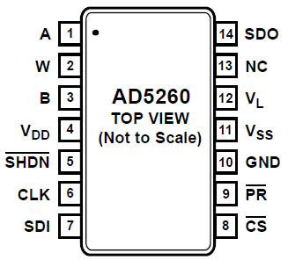
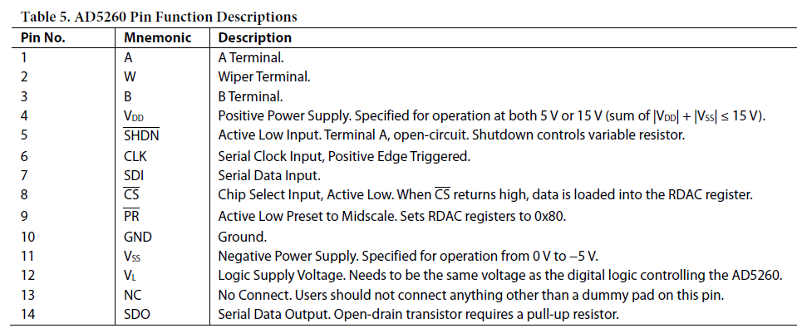
Wiring for Arduino (5V Logic, 5V Output)
Input (5V)
NC
Output
NC
Gnd
5V
5V
Gnd
5V
Gnd
SPI CLK
5V
SPI SDI
SPI CS

Slide 2
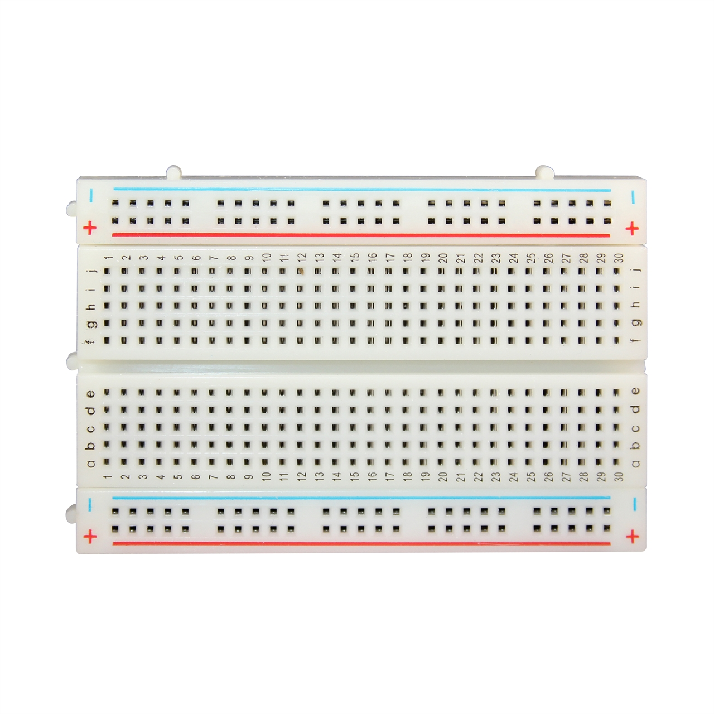
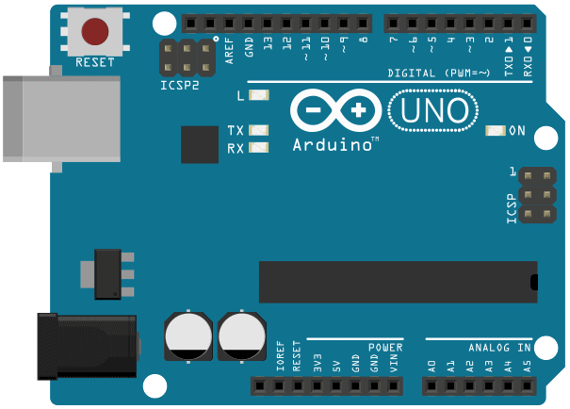
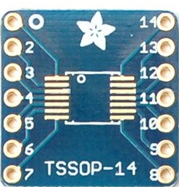
Trial of DigiPot Via Arduino UNO
Output (0-5V)
13
11
10
AD
5260

Slide 3
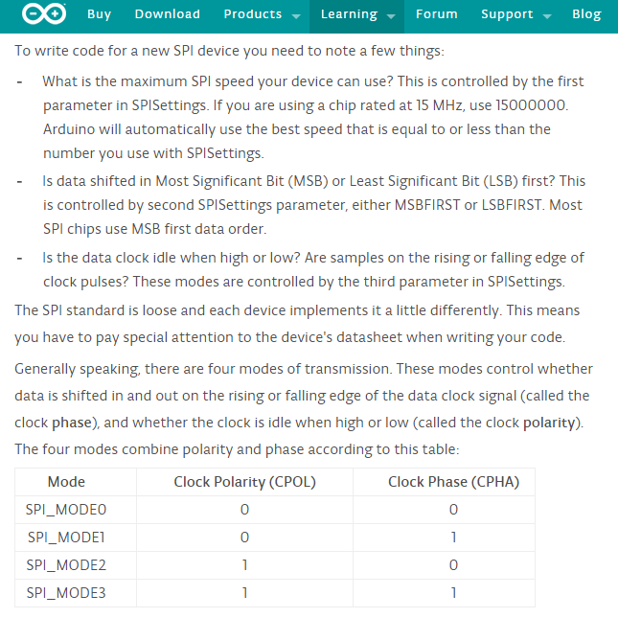
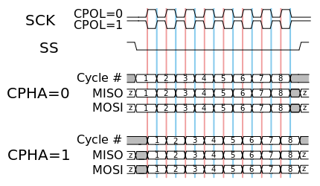
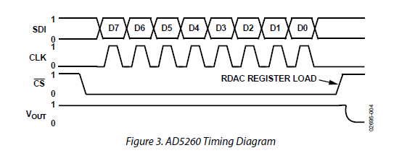
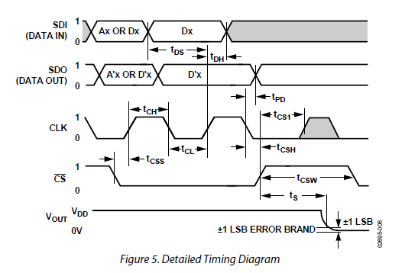
https://www.arduino.cc/en/Reference/SPI
https://en.wikipedia.org/wiki/Serial_Peripheral_Interface_Bus
AD5260:
SPI up to 20MHz (?)
MSB First
CLK Idle low. (CPOL=0?)
CLK is positive edge (CPHA=0?)
So SPI_MODE0

Slide 4
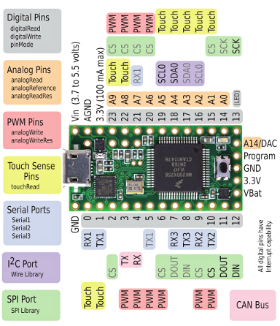
Trial of Digipot using Teensy 3.1
Output (0-5V)
AD
5260

