Slide 1
Combine
Publisher, Subscription and Subscriber – Under the hood

Slide 2
Learning Curve is steep
Publishers
Subject
Subscribers
Operators
Properties Wrappers
ObservableObject
SwiftUI
And so on …

Slide 3
Fundamental Components
Publisher
Subscriber
Subscription

Slide 4
Publisher & Subscriber
Publisher
Subscriber
Publisher
Publisher
emit
Subscriber
receive
value
finish
failure
Publisher
Subscriber

Slide 5
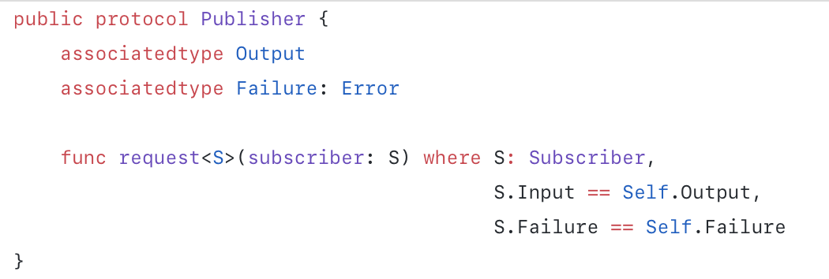
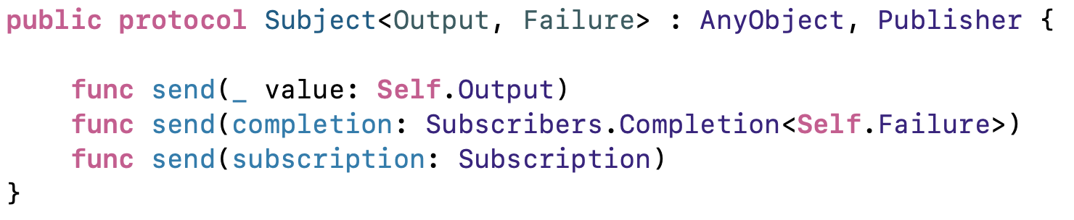
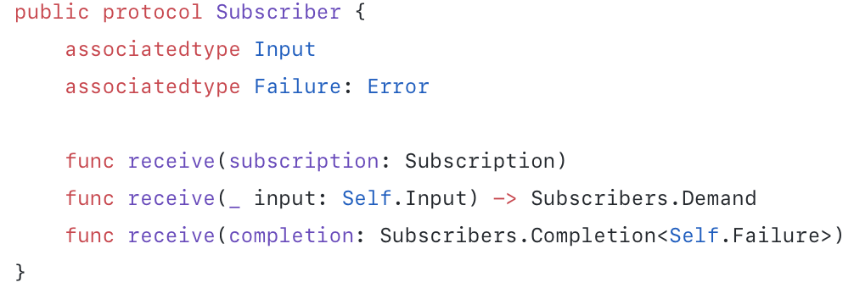
Publisher & Subscriber

Slide 6
Subscription
Publisher
Subscription
Subscriber
demand
seller
buyer
Ask to subscribe
Business contract
Agree, send back subscription
Request Max Demand
Send values
Send values
Send More Demand
Send Finish or Failure
Send Finish or Failure
x
x
Terminate

Slide 7
Implement
Create our own Publisher, Subscription, and Subscriber

Slide 8
Publisher & Subscriber anywhere
Anything can become Publisher
Anything can subscribe
UIKit.UIView example (data is backgroundColor)
Send backgroundColor
Send back backgroundColor
UIView B
UIView A
subscriber
publisher

Slide 9
Next Topics
MVVM-C with SwiftUI ?
Future & Promise under the hood

