Slide 1
Race Condition

Slide 2
What is race condition?
Why do we need to avoid race condition?
How to avoid race condition in Swift?

Slide 3



What is race condition?
Multiple threads access and alter the same resources at the same time
BankAccount
(100euros)
50 euros
70 euros
120 euros
-20 euros

Slide 4
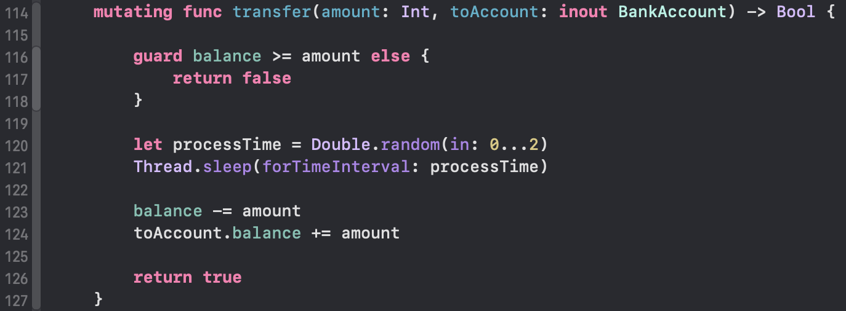
How does it happen in code?

Slide 5
Why do we need to avoid race condition?
Hard to detect
Unpredictable result
Extremly difficult to fix

Slide 6
How to avoid race condition in Swift?
Write unit tests to detect
Use Lock
Use Serial Queue
Use Concurrent Queue with dispatch barrier
Use Semaphore
Use Actor

Slide 7
Example:
Implement BankAccount (transfer money)

Slide 8
Unit Test
2 transactions at the same time (husband & wife)
Expected: Only one transaction is successful

Slide 9
Lock
Lock the critical section in our code
Only 1 thread access this critical code at a time.

Slide 10
Semaphore
Number of threads can access to a particular section of code.

Slide 11
Serial Queue
Guarantee the code is executed sequentially.

Slide 12
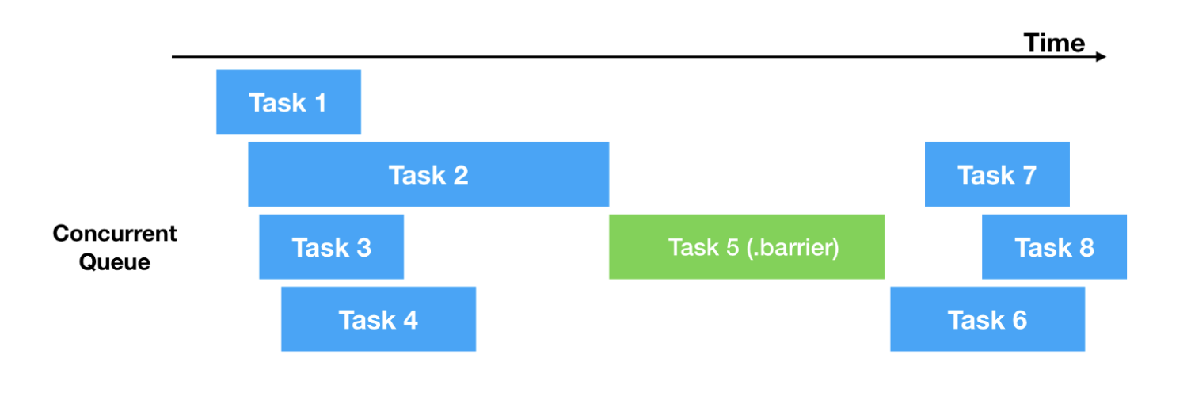
Concurrent Queue with barrier
time1
time2
time3

Slide 13
Actor
Swift 5.5
Limit the access to its properties.

