Slide 1
Modularization
INGBEEnrollment, INGBEItsme

Slide 2
Modularization
Cons:
Launch time
Debug
Pros:
Reuse
Work is organizable
Maintainable
Testable
Build time
App
Feature 1
Feature 2
Feature 3
Feature 4

Slide 3
Enrollment & Itsme
BEInvestmentApp
BEOneApp
BEEnrollment
Itsme

Slide 4
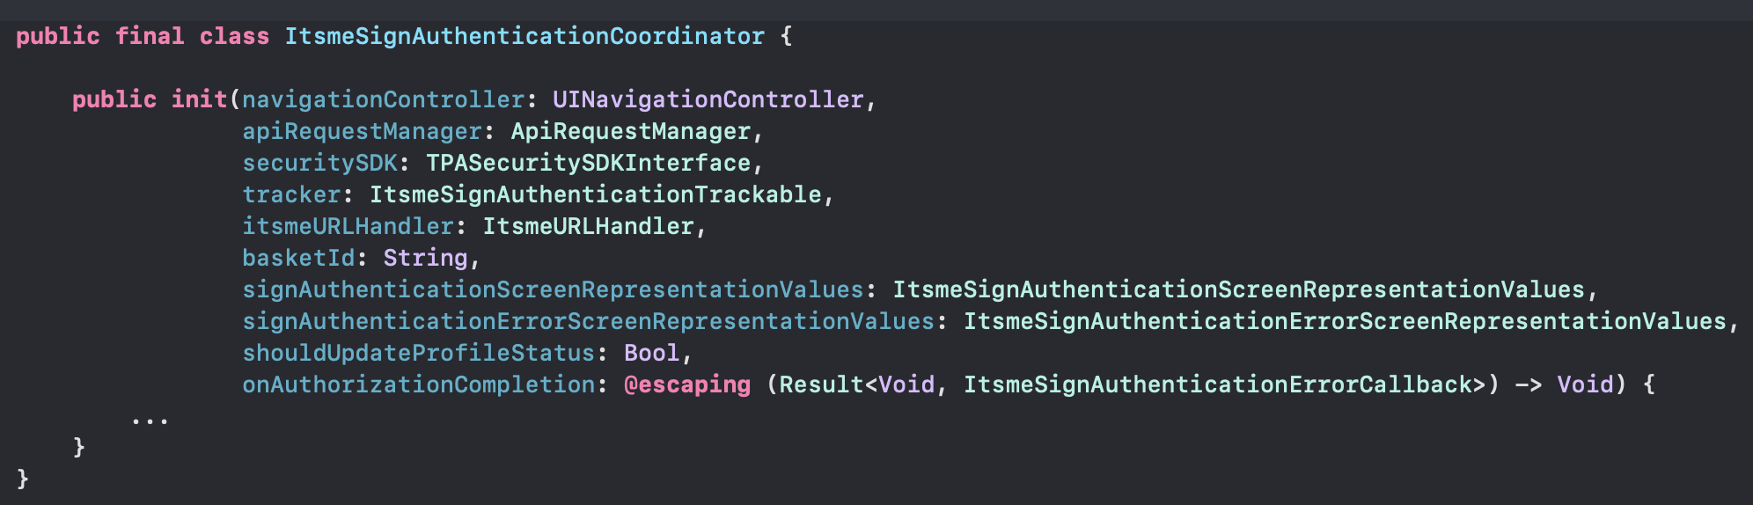
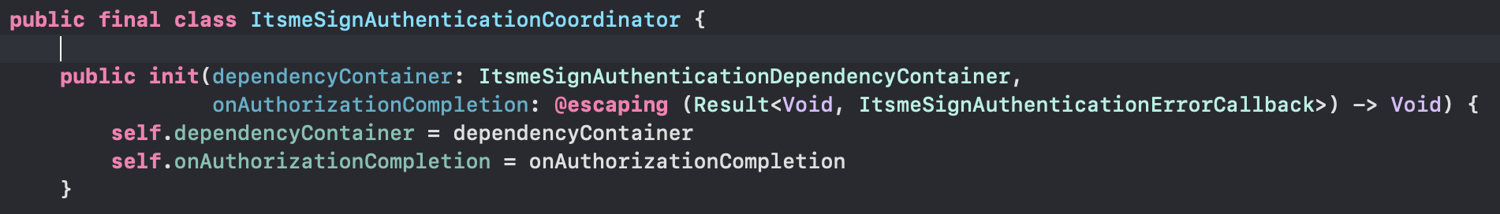
Components
Client
Delegate vs Completion
delegate1
delegate2
APIs
completion
Short, consise
delegate3
Not expose unnecessary things
Module
documentation
DependencyContainer
Dependency1
Dependency N
……
Dependency1
Dependency N
……

Slide 5
Unit Test
Unit Tests
Single Responsibility
APIs
naming
Module
func test_functionName_givenInput_shouldReturnOutput() {
func test_authenticate_givenExpiredLoginStatus_shouldReturnTimedoutError() {

Slide 6
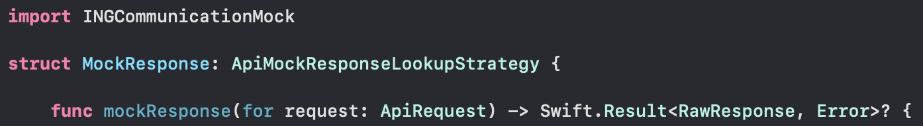
Mock framework
Unit Tests
APIs
INGCommunicationMock
Module
Mock Framework
Client
Unit Tests
Showcase App
UI Tests

Slide 7
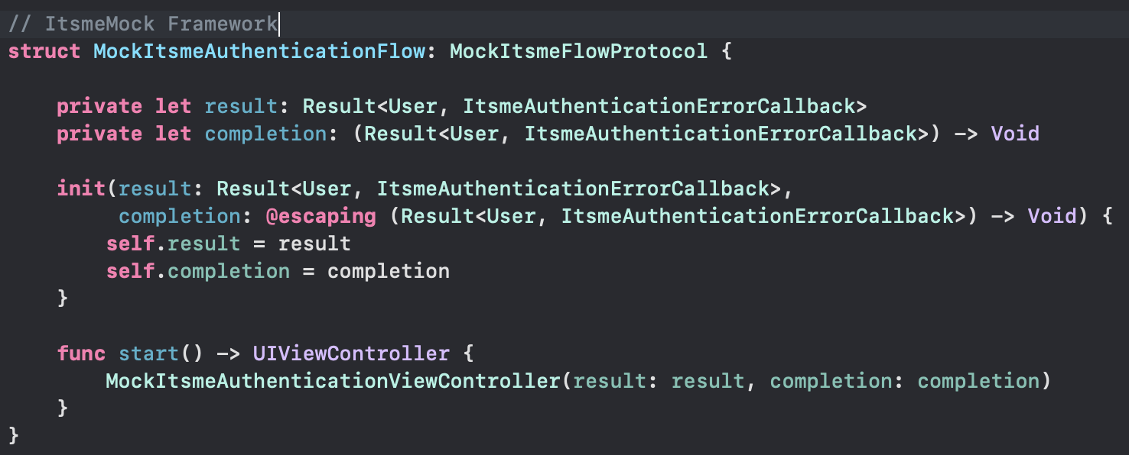
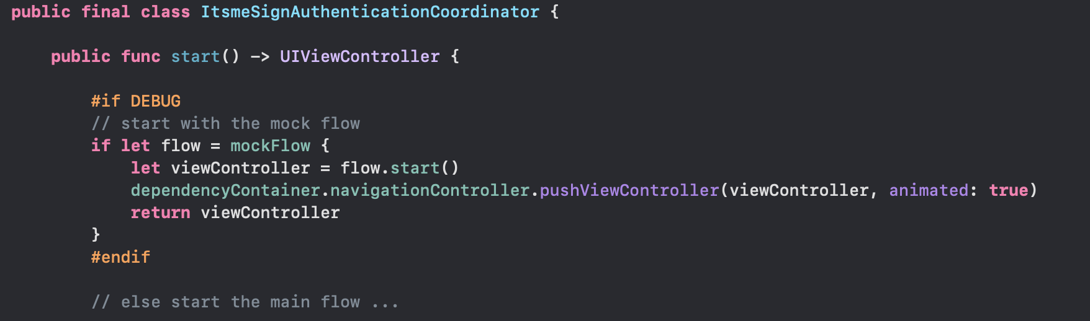
Implement ItsmeMock framework
Start
Main Flow
Itsme Coordinator
Mock Flow ?
NO
Exit
Start
Mock Flow
YES

Slide 8
Showcase App
Unit Tests
APIs
Module
Showcase App
Mock Framework

Slide 9
BEEnrollment Showcase App
Identification Flow
Choose Authentication
Card & Card Reader
Enter Challenge
Sms Otp flow
Signing Flow
…
…
the navigation logic mostly relies on the result of the network api
If all the network apis succeed, we will have happy flow
If some network apis fail, we will have unhappy flows with different error screens.
Should cover all cases
DEMO …

Slide 10
UI Tests
Unit Tests
Showcase App
Target to Showcase App
Single Responsibility
APIs
Module
func test_givenInput_shouldReturnOutput() {
func test_givenAllServicesSuccessful_shouldAuthenticateSuccessfully() {
func test_givenItsmeLoginStatusFailed_withCancelledError_shouldShowGenericError() {
Mock Framework
UITest

Slide 11
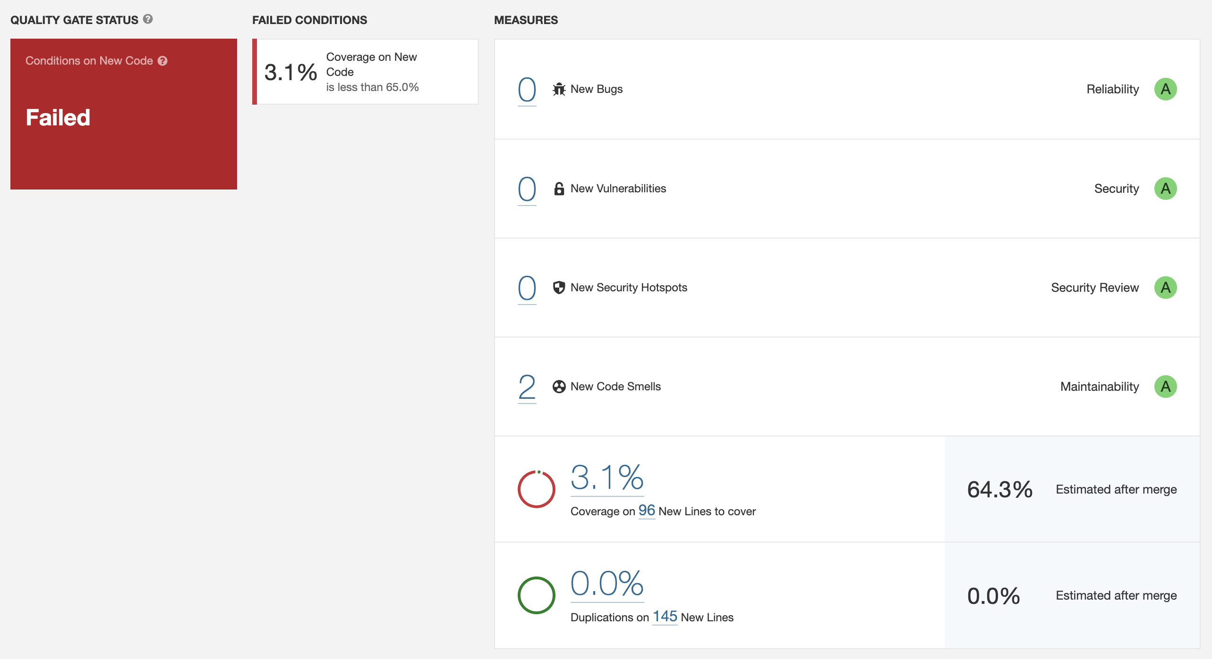
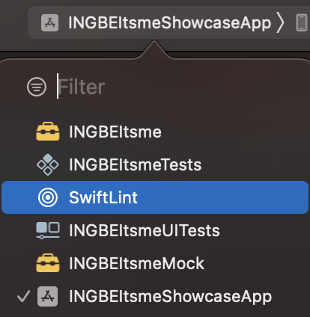
Code Quality Check
SwiftLint
Use a separate target
Unit Tests
Showcase App
APIs
Module
Qualify Check
SonarQube
Check the quality before
asking our colleague to review a PR
Mock Framework
UITest
Checkmarx

Slide 12
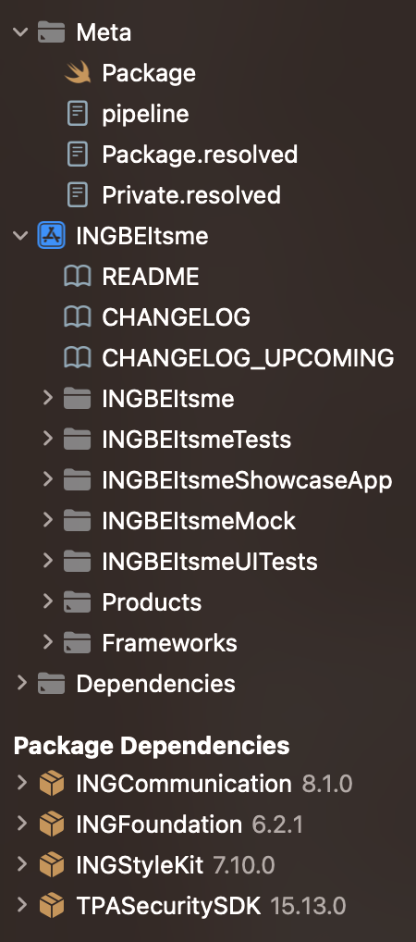
Script to create a ready built module
Unit Tests
Showcase App
APIs
Module
Module Creation Script
Demo
Mock Framework
UITest
Qualify Check
Clone Sample Module
Rename
Build
Fetch& Resolve Dependencies
Push to Repo

Slide 13
Thank you!

