Slide 1

Software Development Life Cycle

Slide 2
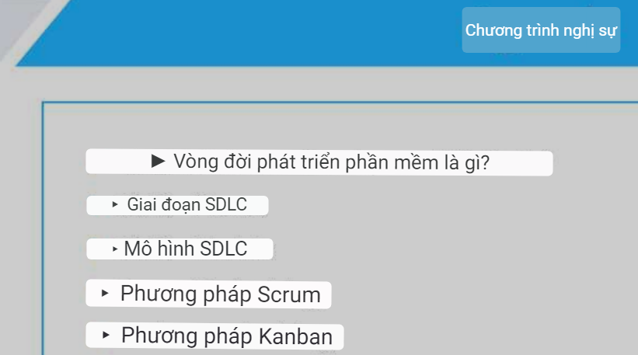
Agenda
What is Software Development Life Cycle?
SDLC – Phases
SDLC – Models
Scrum Methodology
Kanban Methodology

Slide 3
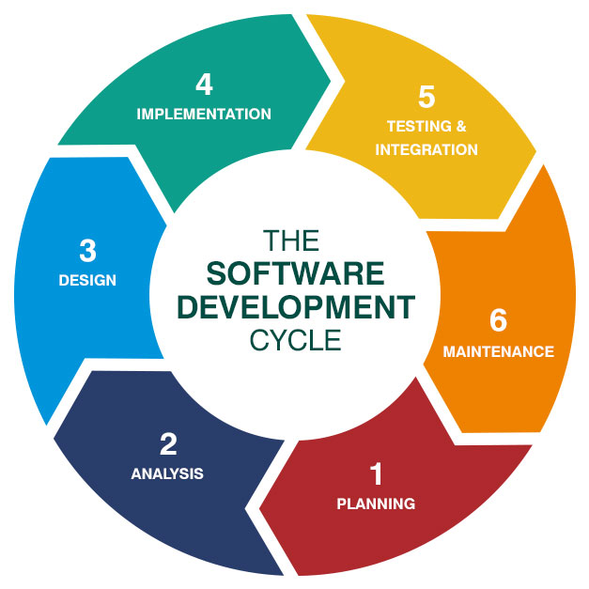
What is Software Development Life Cycle?
SDLC, Software Development Life Cycle is a process used by software industry to design, develop and test high quality software. The SDLC aims to produce a high quality software that meets or exceeds customer expectations, reaches completion within times and cost estimates.
There are following six phases in every Software development life cycle model:
Requirement gathering and analysis
Design
Implementation or coding
Testing
Deployment
Maintenance
Thực hiện
Hội nhập
Vòng đời phát triển phần mềm

Slide 4
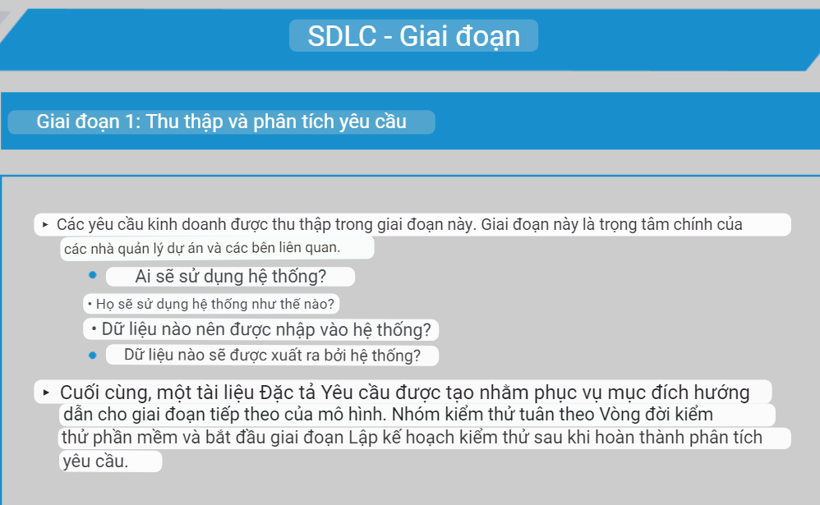
SDLC – Phases
Phase 1: Requirement gathering and analysis
Business requirements are gathered in this phase. This phase is the main focus of the project managers and stake holders.
Who is going to use the system?
How will they use the system?
What data should be input into the system?
What data should be output by the system?
Finally, a Requirement Specification document is created which serves the purpose of guideline for the next phase of the model. The testing team follows the Software Testing Life Cycle and starts the Test Planning phase after the requirements analysis is completed.

Slide 5
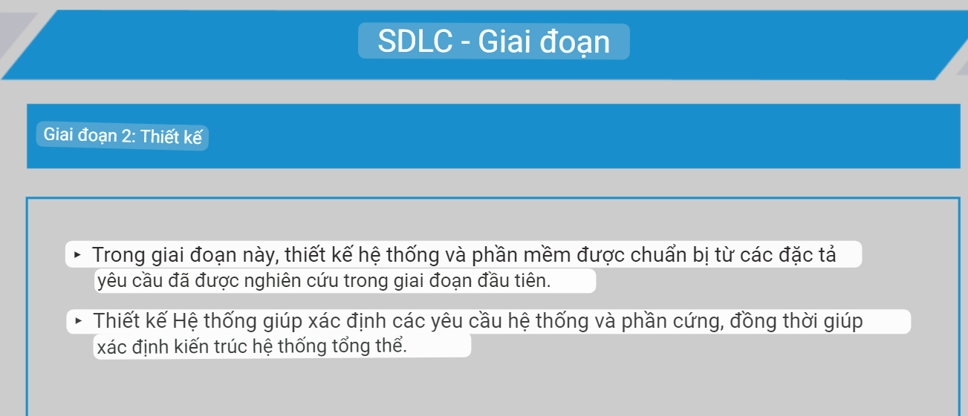
SDLC - Phases
Phase 2: Design
In this phase the system and software design is prepared from the requirement specifications which were studied in the first phase.
System Design helps in specifying hardware and system requirements and also helps in defining overall system architecture.

Slide 6
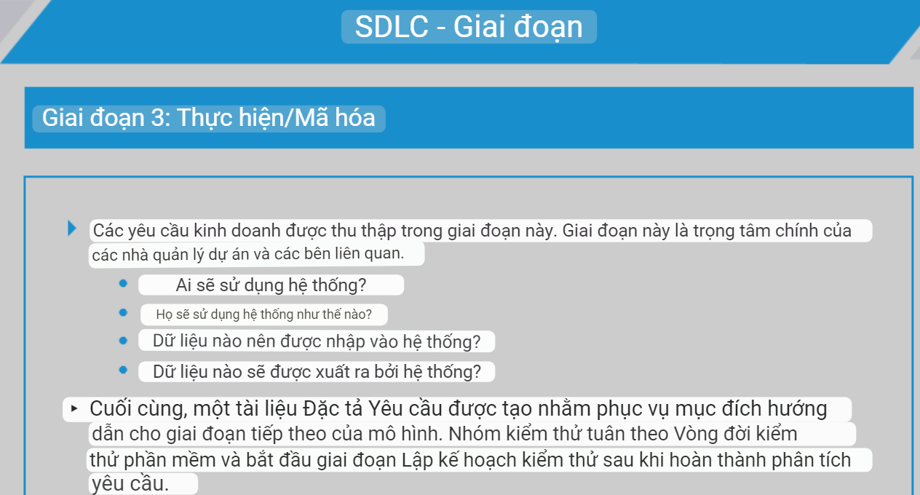
SDLC - Phases
Phase 3: Implementation / Coding
Business requirements are gathered in this phase. This phase is the main focus of the project managers and stake holders.
Who is going to use the system?
How will they use the system?
What data should be input into the system?
What data should be output by the system?
Finally, a Requirement Specification document is created which serves the purpose of guideline for the next phase of the model. The testing team follows the Software Testing Life Cycle and starts the Test Planning phase after the requirements analysis is completed.

Slide 7
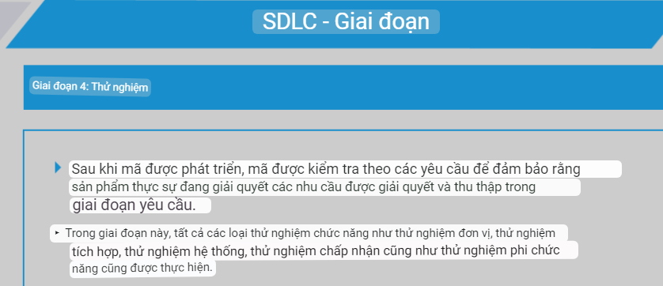
SDLC - Phases
Phase 4: Testing
After the code is developed it is tested against the requirements to make sure that the product is actually solving the needs addressed and gathered during the requirements phase.
During this phase all types of functional testing like unit testing, integration testing, system testing, acceptance testing are done as well as non-functional testing are also done.

Slide 8
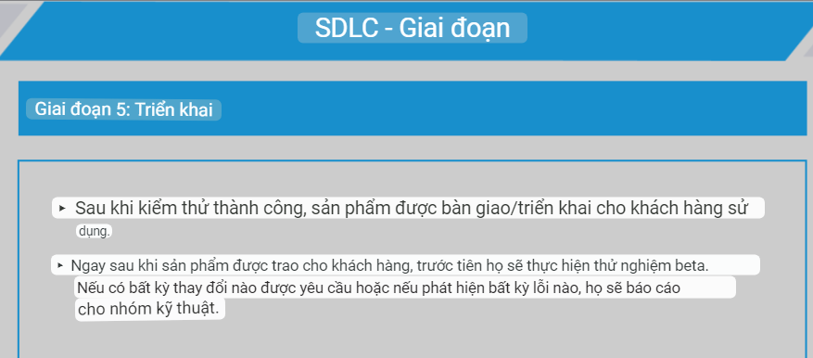
SDLC - Phases
Phase 5: Deployment
After successful testing the product is delivered / deployed to the customer for their use.
As soon as the product is given to the customers they will first do the beta testing. If any changes are required or if any bugs are caught, then they will report it to the engineering team.

Slide 9
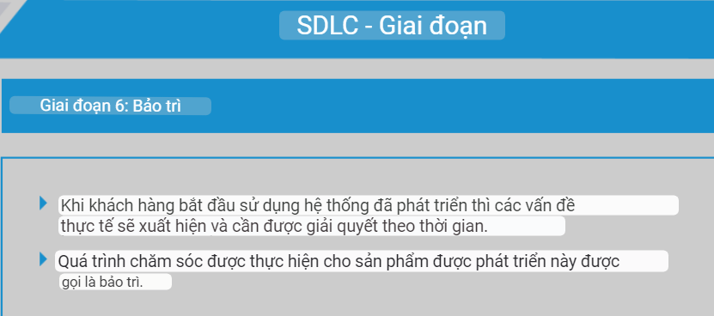
SDLC - Phases
Phase 6: Maintenance
Once when the customers starts using the developed system then the actual problems comes up and needs to be solved from time to time.
This process where the care is taken for the developed product is known as maintenance.

Slide 10
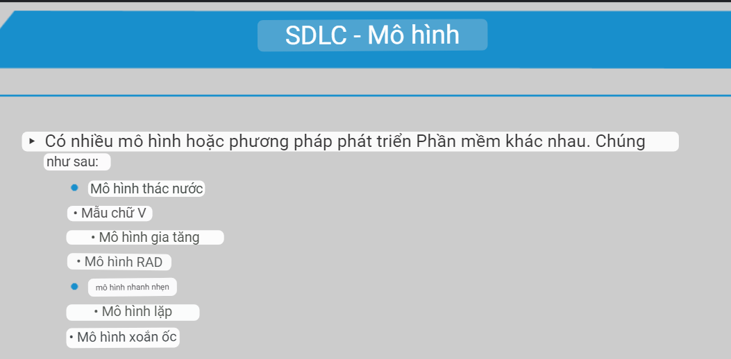
SDLC - Models
There are various Software development models or methodologies. They are as follows:
Waterfall model
V model
Incremental model
RAD model
Agile model
Iterative model
Spiral model

Slide 11
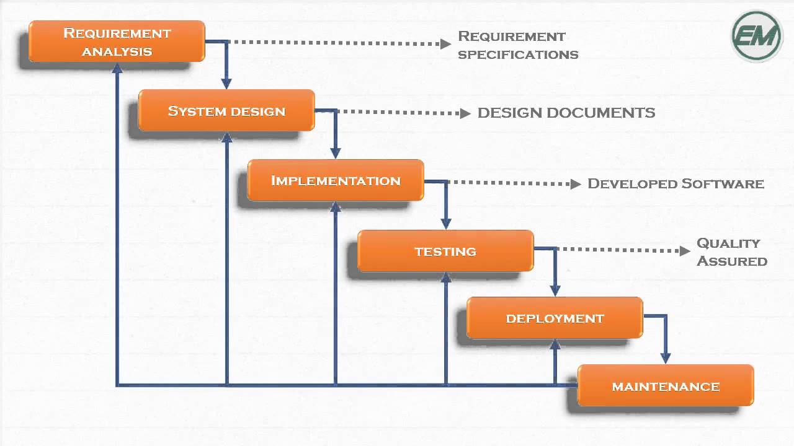
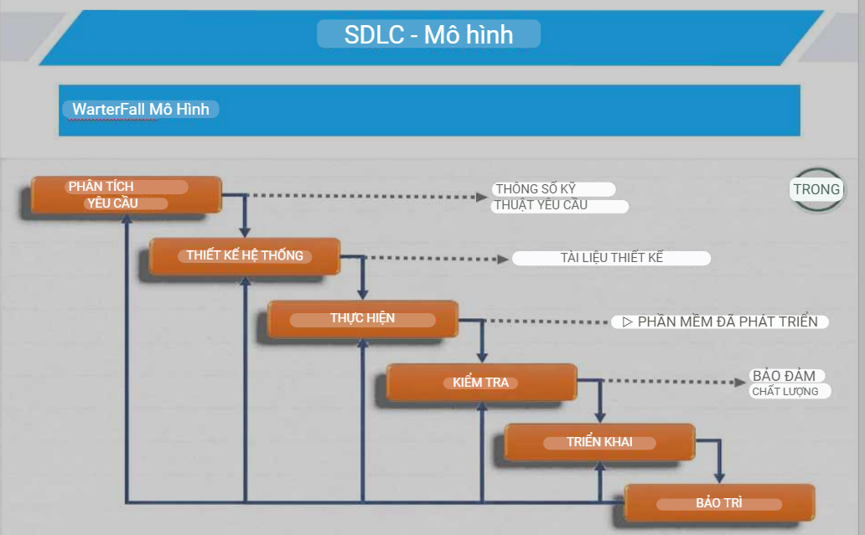
SDLC - Models
WarterFall Model
The Waterfall Model was first Process Model to be introduced. It is also referred to as a linear-sequential life cycle model.
In a waterfall model, each phase must be completed fully before the next phase can begin.

Slide 12
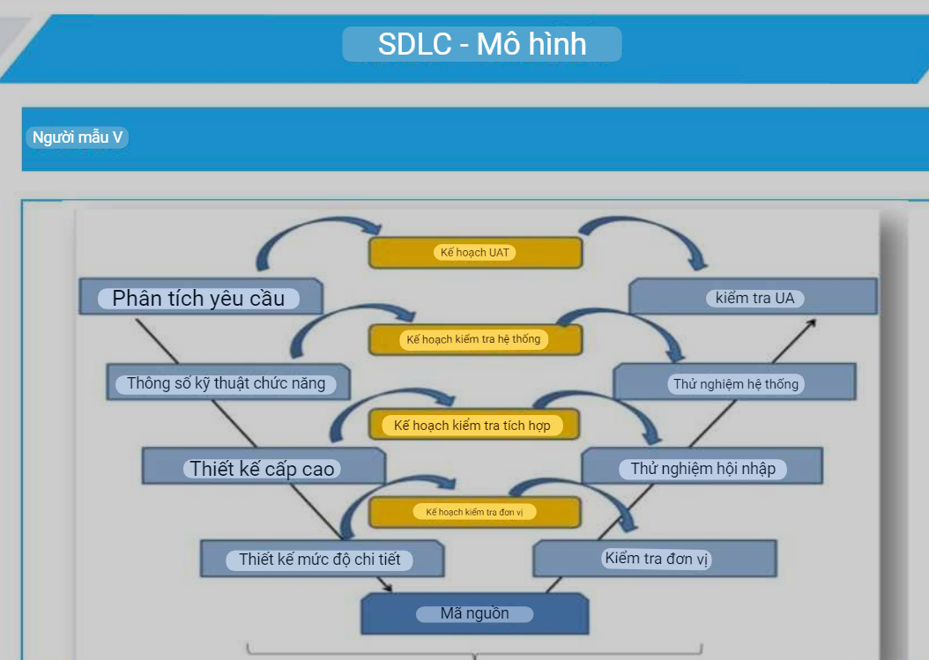
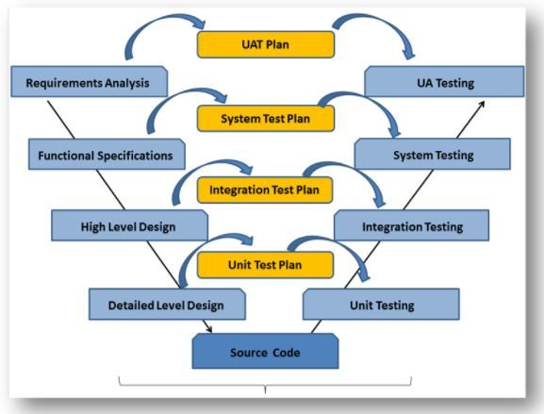
SDLC - Models
V-Model
V- model means Verification and Validation model. Just like the waterfall model, the V-Shaped life cycle is a sequential path of execution of processes. Each phase must be completed before the next phase begins.

Slide 13
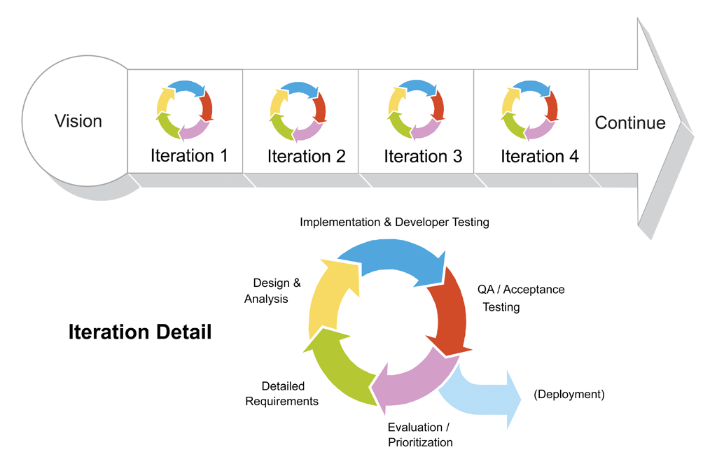
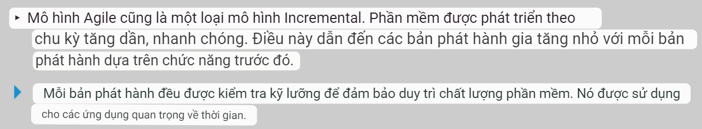
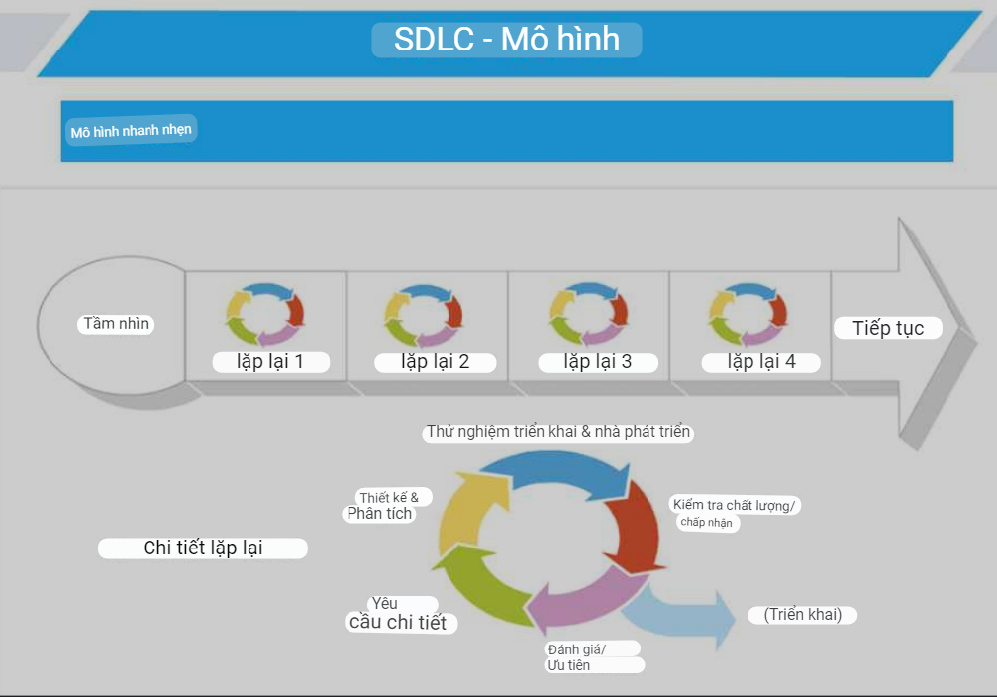
SDLC - Models
Agile Model
Agile model is also a type of Incremental model. Software is developed in incremental, rapid cycles. This results in small incremental releases with each release building on previous functionality.
Each release is thoroughly tested to ensure software quality is maintained. It is used for time critical applications.

Slide 14
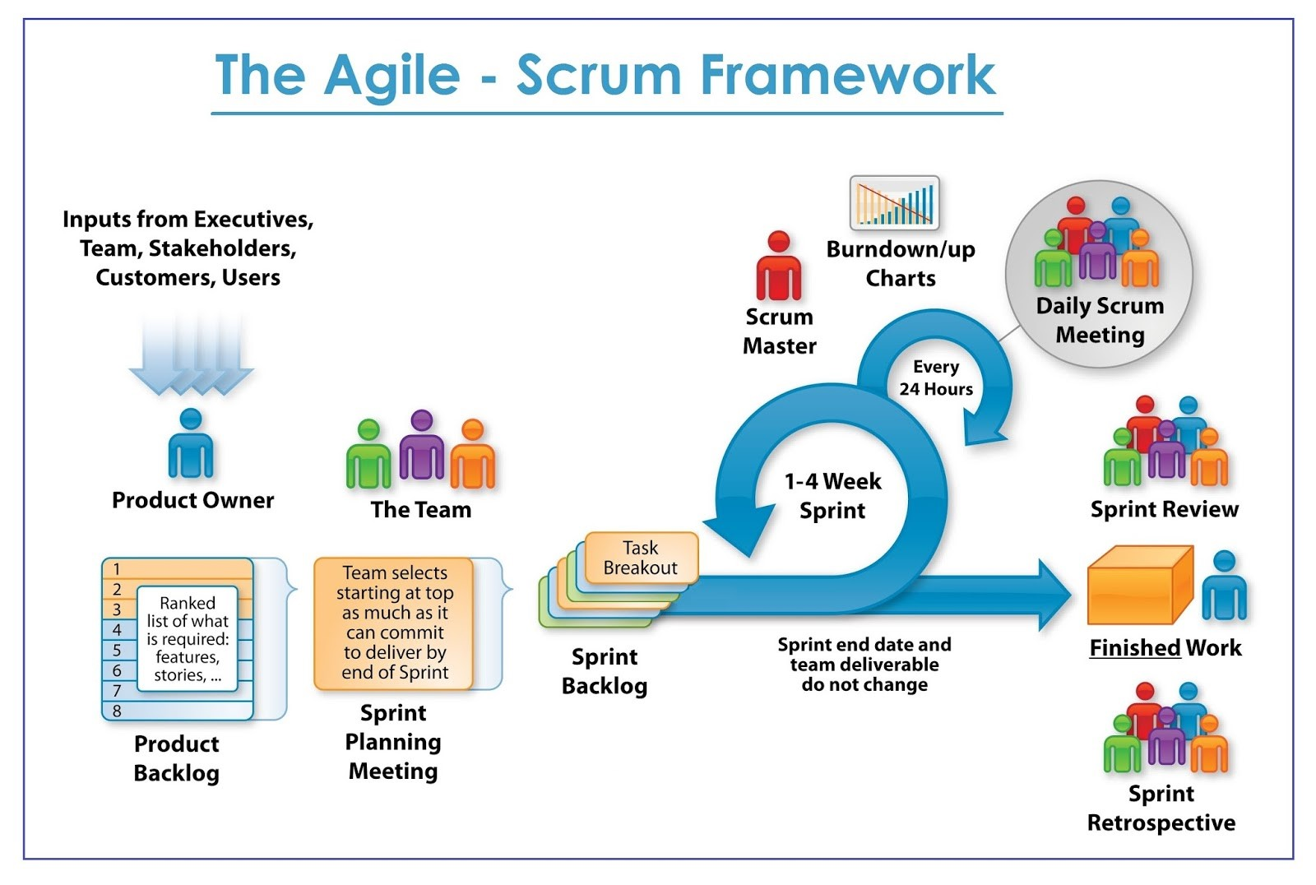
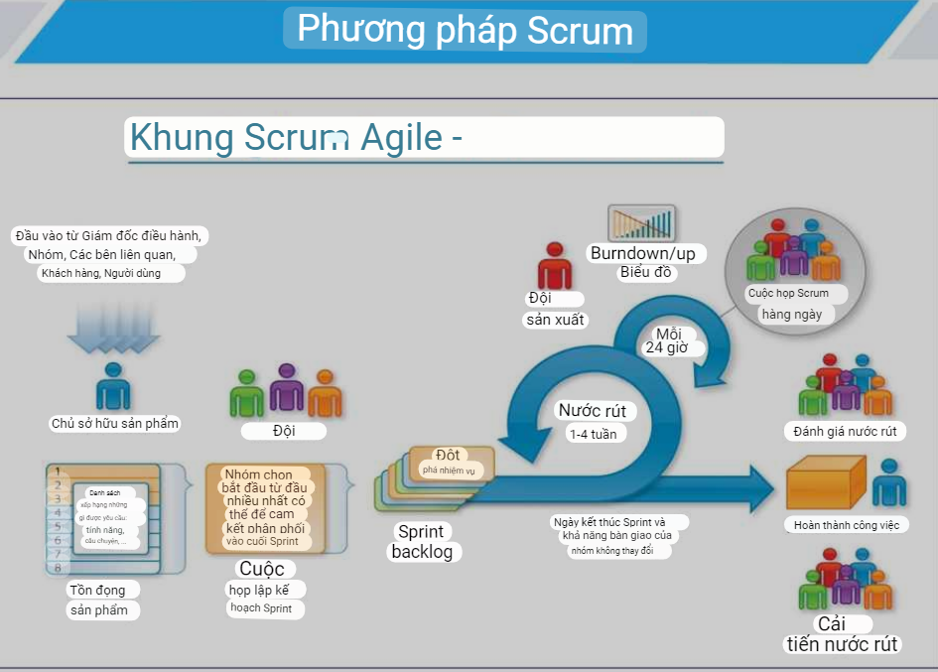
Scrum Methodology
What is Scrum?
Scrum Roles
Scrum is an agile way to manage a project, usually software development. Agile software development with Scrum is often perceived as a methodology; but rather than viewing Scrum as methodology, think of it as a framework for managing a process.
In the Scrum world, instead of providing complete, detailed descriptions of how everything is to be done on a project, much of it is left up to the Scrum software development team. This is because the team will know best how to solve the problem they are presented.
Product Owner: The Product Owner should be a person with vision, authority, and availability. The Product Owner is responsible for continuously communicating the vision and priorities to the development team.
Scrum Master: The Scrum Master acts as a facilitator for the Product Owner and the team. The Scrum Master works to remove any impediments that are obstructing the team from achieving its sprint goals.
Team: The development team is responsible for self organizing to complete work.

Slide 15
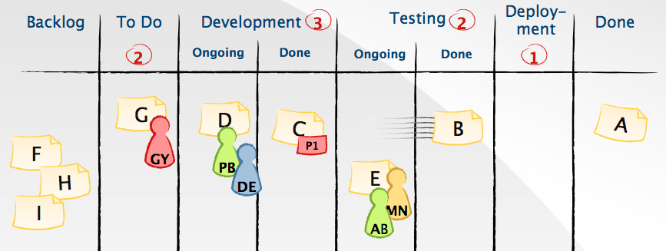
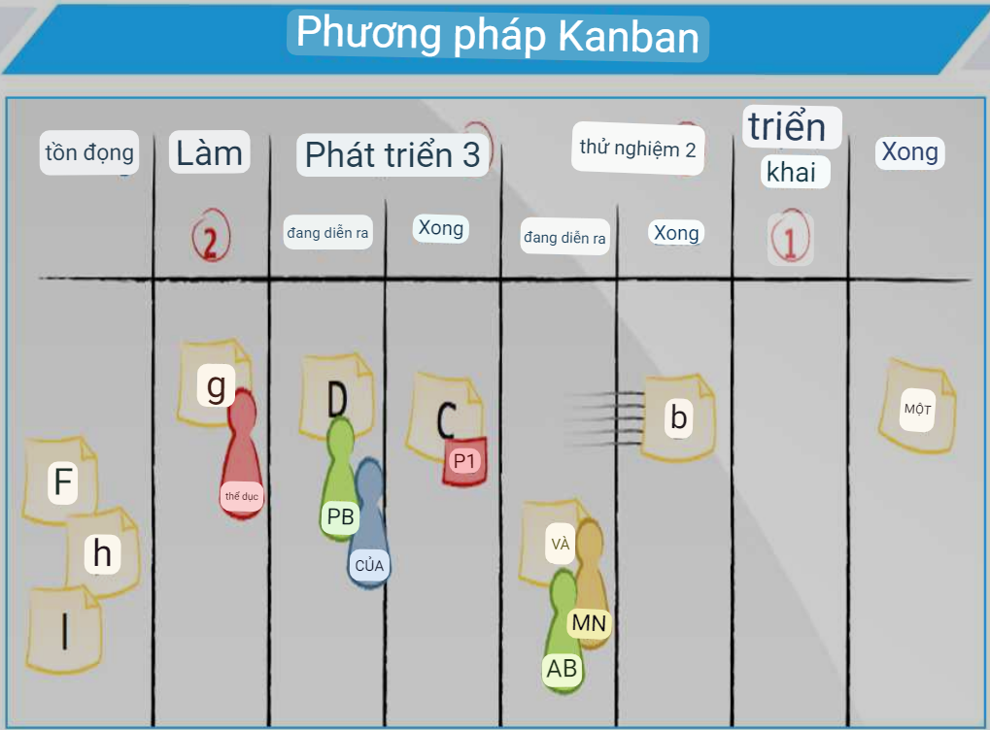
Kanban Methodology
What is Kanban?
Kanban principles
Kanban was inspired by the Toyota Production System and Lean Manufacturing. In the 1940s, Toyota improved its engineering process by modeling it after how supermarkets stock shelves.
Kanban is a method for managing the creation of products with an emphasis on continual delivery while not overburdening the development team. Like Scrum, Kanban is a process designed to help teams work together more effectively.
Visualize what you do today (workflow): seeing all the items in context of each other can be very informative.
Limit the amount of work in progress (WIP): this helps balance the flow-based approach so teams don't start and commit to too much work at once.
Enhance flow: when something is finished, the next highest thing from the backlog is pulled into play.

Slide 16
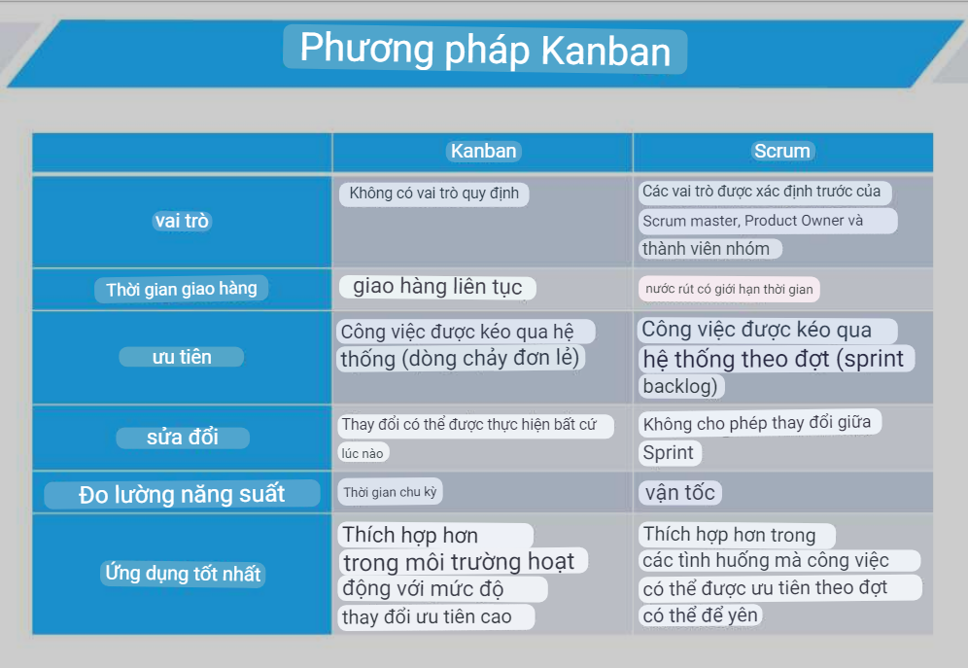
Kanban Methodology
 | Kanban | Scrum
Roles | No prescribed roles | Pre-defined roles of Scrum master, Product owner and team member
Delivery Timelines | Continuous Delivery | Timeboxed sprints
Prioritization | Work is pulled through the system (single piece flow) | Work is pulled through the system in batches (the sprint backlog)
Modifications | Changes can be made at any time | No changes allowed mid-sprint
Measurement of Productivity | Cycle time | Velocity
Best Applications | More appropriate in operational environments with a high degree of variability in priority | More appropriate in situations where work can be prioritized in batches that can be left alone

Slide 17
Reference Link
http://tryqa.com/what-are-the-software-development-life-cycle-sdlc-phases/
https://www.mountaingoatsoftware.com/agile/scrum
http://scrummethodology.com/
https://www.versionone.com/what-is-Kanban/
https://leankit.com/learn/kanban/kanban-vs-scrum/

Slide 18
THANK YOU!

