Slide 1
How To:
Dispatching Instructions
Please note: Displayed screen shots in this How To guide may change and look different as enhancements are made to the DOSD tool but the process and steps to request a part should remain the same.

Slide 2
How To: Process Flow and Steps
Log On to DOSD web site
Select Dispatches
Select Create Dispatches
Input Service Tag
Add Problem Description & Troubleshooting Performed
Add Primary Contact Information
If requesting On-site Technician
Alternate Contact Information needed
Ship to Address Tab
Provide address for part delivery
Parts Tab
Select warranty replacement part / parts needed
Apply Button
Submit Request Button in the middle of the screen when done

Slide 3
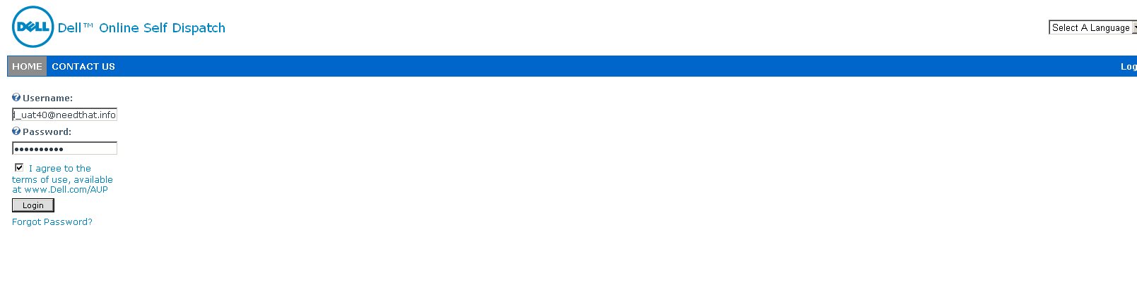
Logon to the main DOSD web site with your User Name and Password

Slide 4
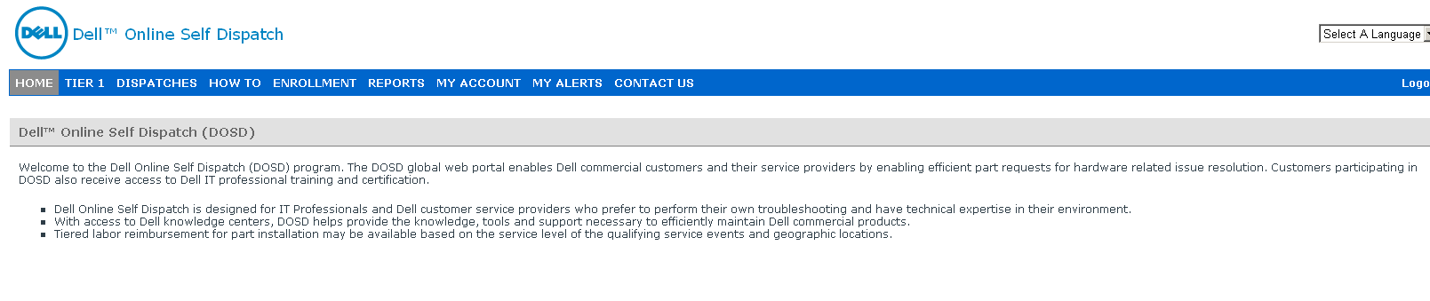
Main DOSD web site with function tabs at the top of the page

Slide 5
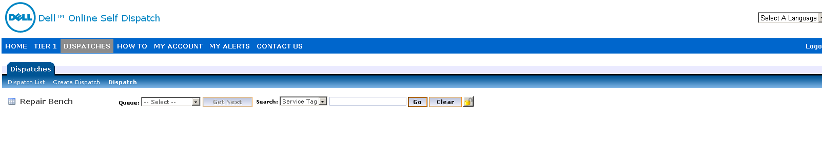
Select Dispatches and then Create Dispatch

Slide 6
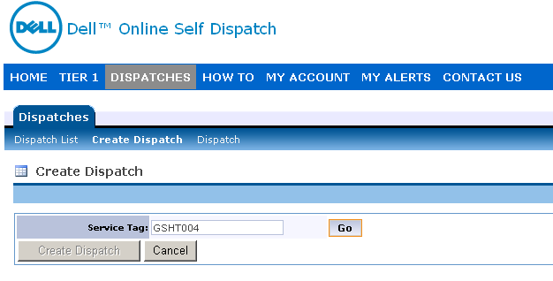
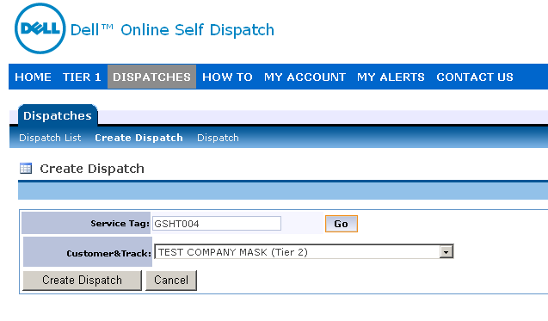
Enter Service tag of system and press go

Slide 7
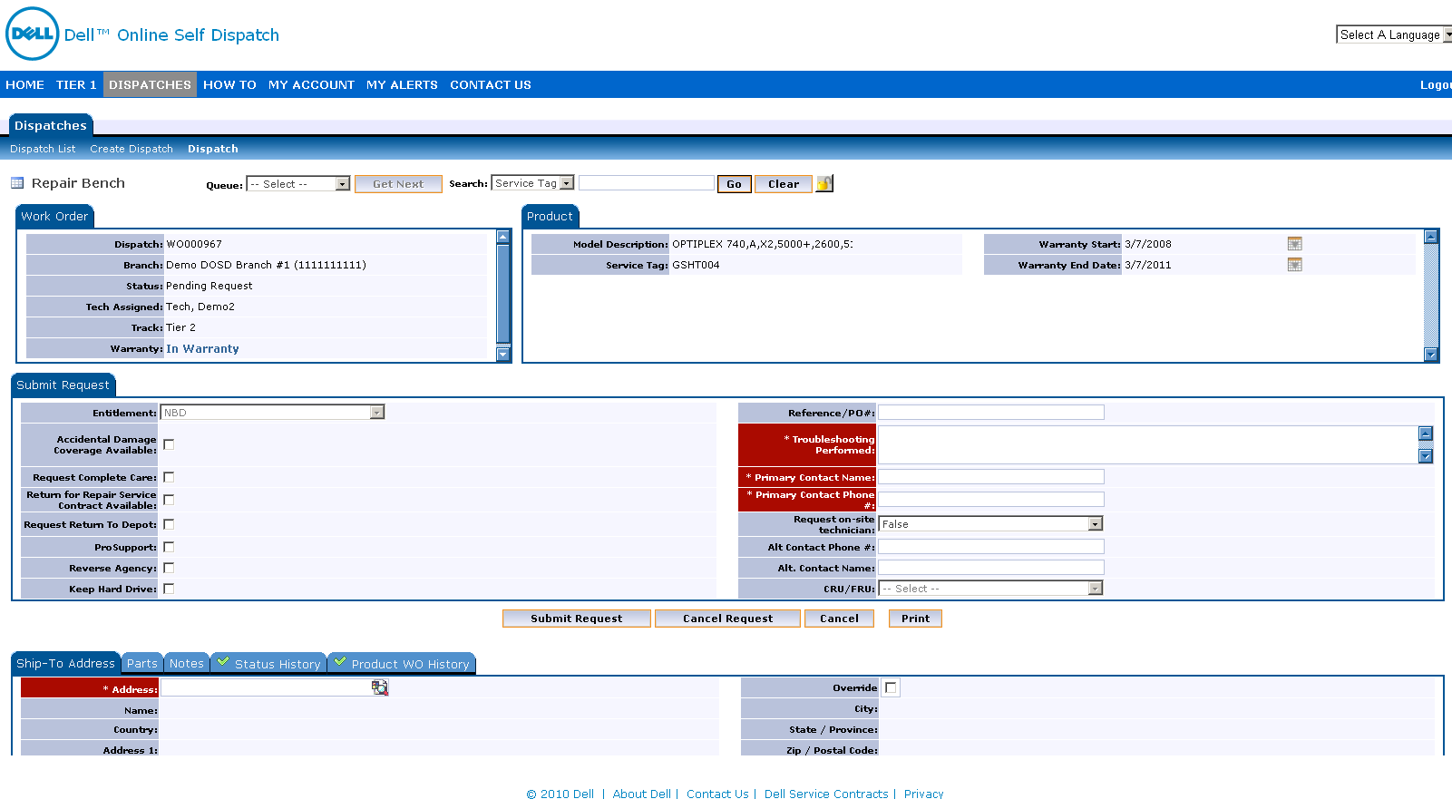
New Dispatch Request Page

Slide 8
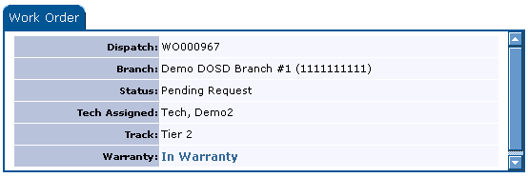
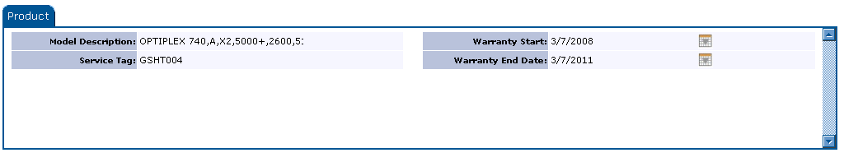
Section Breakdown: Work Order# and Product System Information
Section shows Work Order #
Warranty Status
System Information

Slide 9
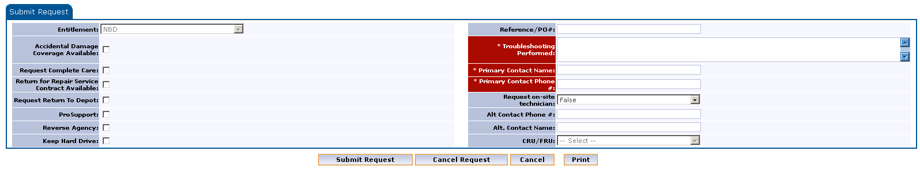

Submit Dispatch Section
Provide Problem Description & Troubleshooting Performed.
Contact Information.
If this is a Complete Care repair check off box.
If you need a Dell Onsite tech select “True” and provide alternate contact information.

Slide 10
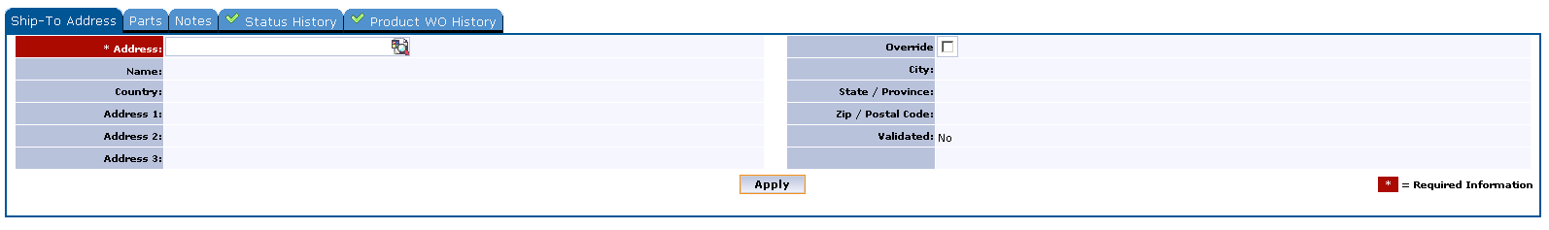
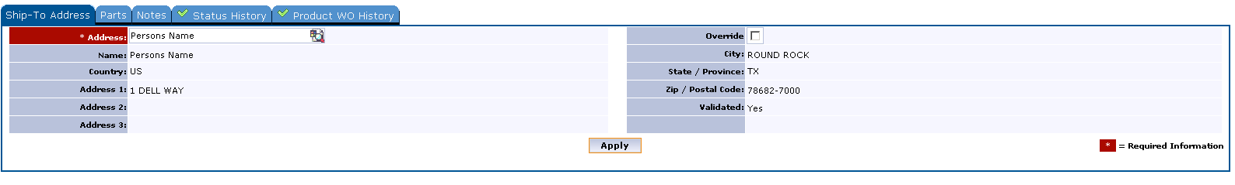
Ship To Address Information
Select the “Ship To Address” tab at the bottom of the screen.
If you have a preloaded address set up you can select that address from the drop down search button.
If you need to add a new address, check the “Override” box
Add your address and click “Apply”.

Slide 11
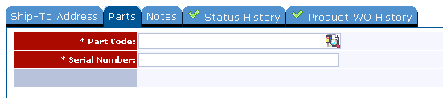
“Parts” selection tab
There are (2) ways to select the part you need:
“ Add Part”
If you know your part number, you can select this choice and add the part you need.
“Parts List”
This feature will allow you to search by a listing of parts.

Slide 12
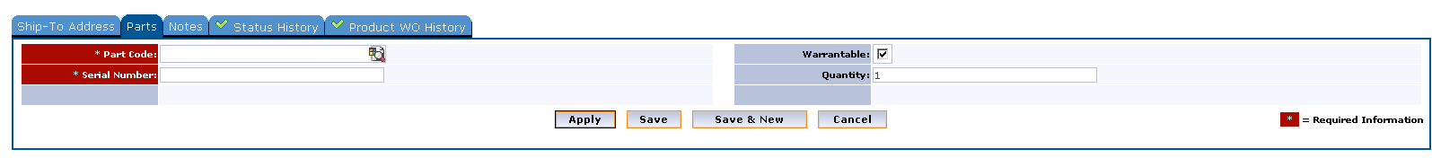
“Add Part” button screen
Add part number .
Add serial number if part has a PPID number such as a notebook battery or monitor.
Press “Apply” to add part to request.

Slide 13
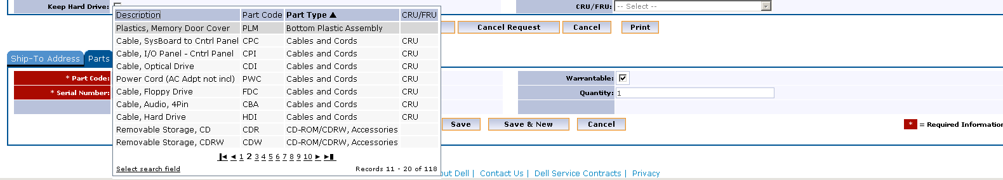
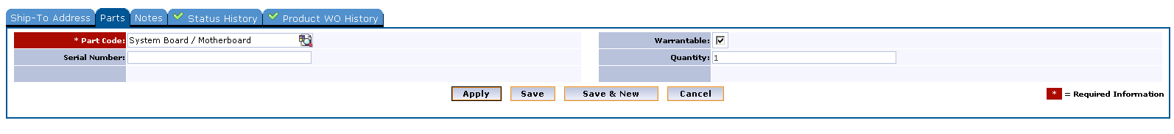
“Parts List” button screen
Page will display a listing of parts by a number of views: Part Type, Part Number, Part Description.

Slide 14
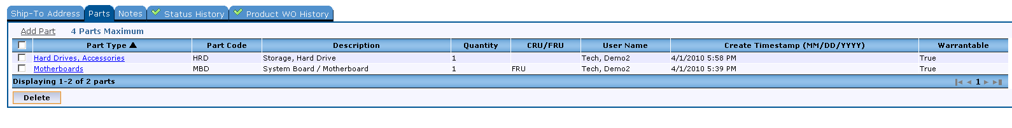
Adding parts and checking ‘Apply”
Example of how multiple parts can be requested by selecting each part and then pressing “Apply” to each item.

Slide 15
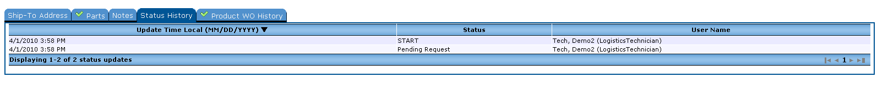
Status History will show the request status

Slide 16
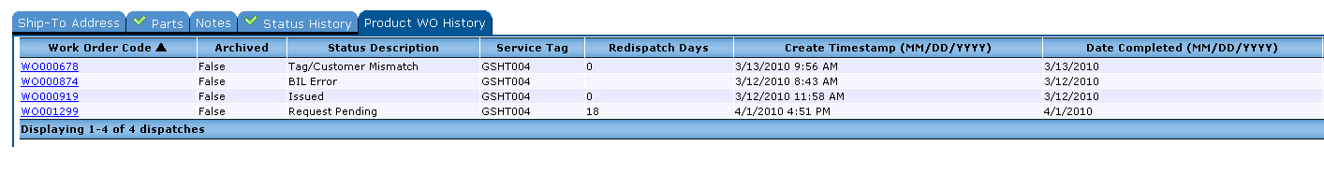
Product WO History Tab

Slide 17
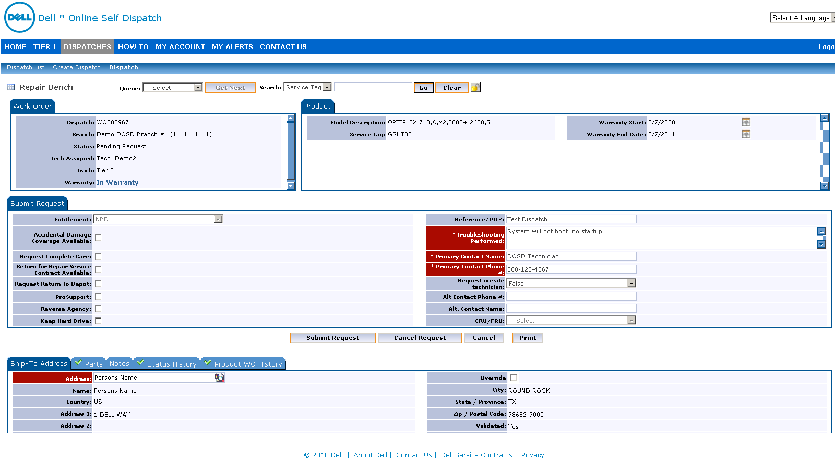
When ready to “Submit Request”
Problem Description and Troubleshooting Performed notes added.
Primary Contact Information provided.
Ship-To Address information provided.
Part or Parts needed selected.
Press “Submit Request” in the middle of the page.

Slide 18
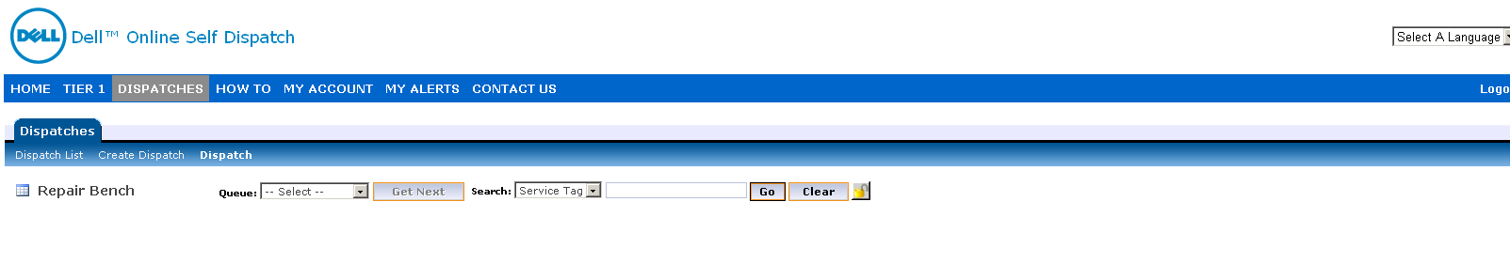
“Submit Request” button is pressed
The system will bring you back to Dispatch page where you can submit another Service Tag to request another part by selecting “Create Dispatch”.

Slide 19
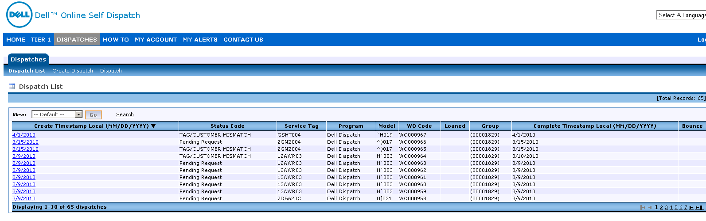
Clicking on “Dispatch List” will show the status of requests submitted
You can customize the viewing columns by selecting “Customize View”.
The “Search” button will allow you to find a specific order submitted.

Slide 20
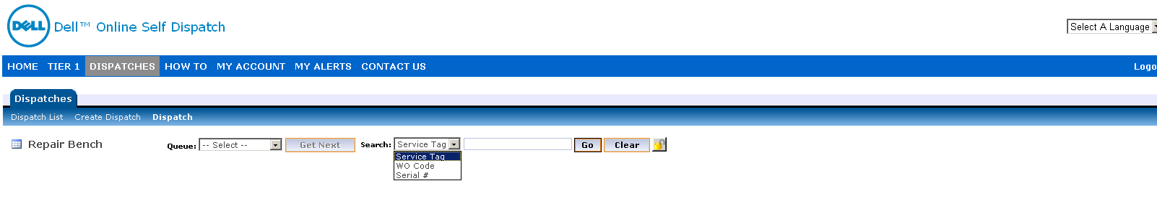
You can also search by the following for orders submitted

Slide 21
If you have questions:
For any Enrollment or Certification issues, send a e-mail to the DOSD_ADMIN@Dell.com
For any Parts Dispatch issues, send a e-mail to the DOSD_Support@Dell.com
For any other type of questions, refer to the “Contact Us” tab at the top of the main DOSD web site.

