Slide 1
DSU Procurement Card Program
Crystal Beach, CMPA; Accounts Payable/Procurement Coordinator
Grace Ballard, CMPA; Accounts Payable Analyst
JB Willingham, Accounts Payable/Inventory Clerk

Slide 2
What is the DSU Procurement Card and what are the benefits?
MS Code of 1972 Section 7-7-23, the State Fiscal Officer established a general rule to allow state agencies to make certain purchases without first issuing a purchase order.
Designed to decrease administrative costs by streamlining the purchasing process
Provides flexibility in purchasing process
Allows faster payment to vendors and fewer checks written by agencies
Acts as a purchase order and obligates the university for payment

Slide 3
Procurement Cards
Additional Benefits
Procurement card transactions do not require a requisition or PO at the time of purchase, but must still be approved by the Department Head prior to completing a purchase.
Faster delivery of goods and faster payments to vendors
Nearly universally accepted, some vendors no longer accept PO’s
All transactions are compiled and paid monthly on a single direct-pay(paper) requisition (reduced paper and processing time)
Procurement card transactions save an average of $60/transaction in administrative costs for the university

Slide 4
Procurement Cards
Procurement cards are approved and available for use for all commodity purchases that are $5,000 or less and are NOT considered equipment, including state contract items.
ALL departments are encouraged to secure a minimum of one card for departmental use (contact Crystal Beach or Grace Ballard for application and setup) You will now be required to attend a training session before being allowed to apply and receive a P-card.
All departments with a procurement card are STRONGLY encouraged to use it
The cardholder is personally liable for ANY purchase made that is not in compliance

Slide 5
Program Rules
Department chair approval is required prior to any purchases being made
ALL procurement card purchases must have sufficient funds in the budget to pay for the transaction. Purchasing items without verifying sufficient funds is deemed as fraud and will be reported to the Vice President of Finance & Administration
Statements must be reviewed, submitted and received in Procurement Office along with a payment requisition(s) within one week of receiving your statement. All discrepancies with the statement must be documented. This is time sensitive information that needs to be in our office by the requested date. If issues arise for the same card holders each month, we may be required to suspend your card for 3 months.
Statements that are not received on time/due date will be paid from the department’s primary fund budget. TIMELINESS IS VERY IMPORTANT

Slide 6
Program Rules(cont.)
Card limits are set by department chairs. The single-transaction limit cannot exceed $5,000.00.
Orders cannot be split to allow procurement card usage
No MS vendor can charge sales tax to the card. If sales tax is charged, you must obtain a written credit from the vendor. Be sure to advise all vendors that the card is tax-exempt prior to completing the purchase. Call the vendor if necessary to inform of the tax exemption.
Problems with the card are to be reported to the Procurement Office immediately. Please reach out to Grace Ballard for assistance at 4007.

Slide 7
Allowable Purchases
Office supplies-state contract items purchased from state contract vendors as well as those not on state contract.
Printing
Clothes & Dry goods
Certain expenses related to contractual services can be charged to procurement card such as postage, advertising, dues, subscriptions and registrations.

Slide 8
Allowable Purchases(cont)
Food for business meetings
May be purchased from restaurants, grocery stores or any location that food is sold-Card will sometimes deny at restaurants considered to be “clubs/entertainment” known for selling alcohol. Must serve a legitimate business purpose and include an agenda and food form.
NO alcohol may be purchased
Itemized/detailed invoice/receipt MUST be included with the statement when reconciling. A receipt only showing the charge amount is NOT acceptable.
Any gratuity over 20% requires written justification
More than one person must be present
A list of attendees must be attached (the following form may be used)

Slide 9
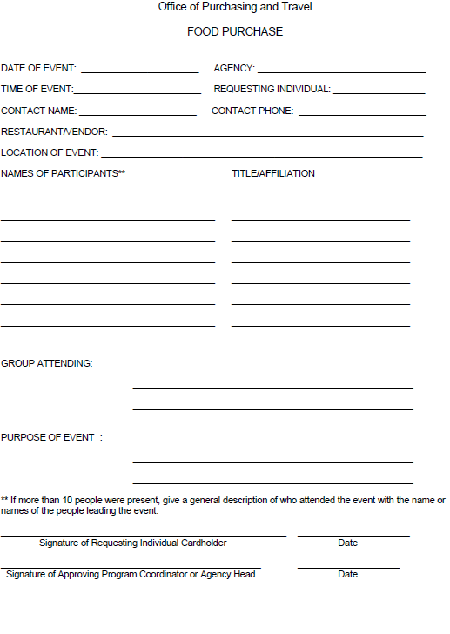
Food Form
Please complete the form to its entirety and be sure all needed signatures are at the bottom before submitting to Procurement at reconciliation time.
The food form can be found here:
http://www.deltastate.edu/PDFFiles/procurement/UMB-food-purchase-form.Aug2019.pdf

Slide 10
Prohibited Purchases
Equipment
Travel related expenses
Contractual services- card is not set up to be 1099 reportable to an individual, partnership or LLC-Partnership.
Cash advances
Items for personal use
Alcoholic beverages
Items on back order
MS state sales tax
Entertainment
Gifts for employees or students- NO GIFTS, NO GIFT CARDS, ETC- DOESN’T MATTER WHERE THE MONEY COMES FROM (foundation can not pay this and excuse this error). STRICTLY PROHIBITED ON THE P-CARD. The Auditor is looking at the charge itself, not which fund/org/acct its being paid from.

Slide 11
Equipment
Equipment of any value MAY NOT be purchased with the Procurement card
The University is responsible for keeping a listing of all property that has a value of $1,000 or more. It is hard to keep track of equipment (items that require a DSU sticker) if it is purchased on the procurement card. NO equipment is to be purchased, regardless of the dollar amount.
The following is considered equipment and may NOT be purchased:
Weapons
Two-Way Radio
Lawn maintenance equipment
Cell phones
Air compressors
Welding machines
Generators
Motorized Vehicles
TV’s greater than $250.00
Camera and Camera Equipment
Computer and computer equipment greater than $250.00

Slide 12
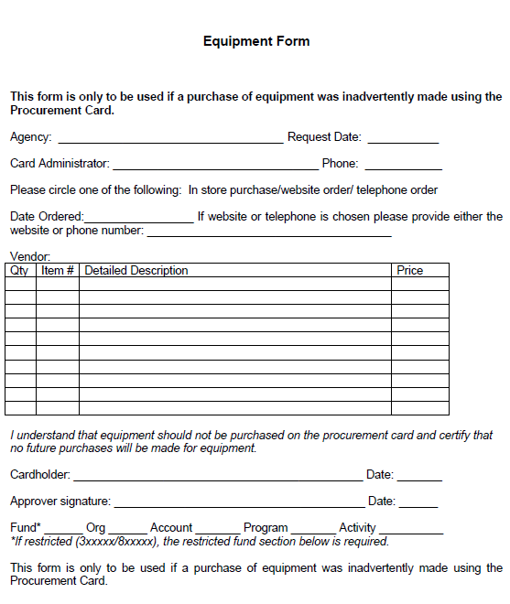
Equipment Form
If equipment is purchased with the Procurement card, the cardholder must attach the Equipment Form to the monthly statement. Repeated violation of this policy will result in cancelation of cardholder privileges.
The Equipment form can be found on here:
http://www.deltastate.edu/PDFFiles/procurement/UMB-Equipment-Form.pdf

Slide 13
Split Purchases
Split purchases are defined as splitting one purchase totaling more than $5,000.00 into several purchases to circumvent the $5,000.00 limit. Purchases over $5,000 must be on a purchase order and require two written quotes.
Split purchases are NOT ALLOWED

Slide 14
Sales Tax
Before using your Procurement card, make sure the vendor knows you are exempt from sales tax.
If sales tax is charged, obtain a credit from the vendor.
If sales tax is charged and a credit is not received, the cardholder will be responsible for reimbursing to Delta State the total amount of sales tax applied to the UMB card.

Slide 15
Gift Cards/Give-A-Ways
No gift cards or give-a-ways allowed.
STRICTLY PROHIBITED.
IF GIFTS ARE PURCHASED, THE CARD WILL BE SUSPENDED FOR UP TO 3 MONTHS. IT IS IRRELEVANT WHICH FUND/ORG/ACCT YOU PLAN TO PAY THE GIFTS FROM.
Complete a requisition/purchase order if you would like to purchase gifts. Plan accordingly!!

Slide 16
Other No No’s
Do not give your card to vendors in any instance that you have recurring monthly charges(shouldn’t have an Amazon Prime charge each month- nor any other recurring charges on a monthly basis.)
Do not give your card number to reserve a hotel room
Do not give your card number to a vendor to keep on file for future use
Do not send cash, change or a check to repay taxes or other issues to Procurement. We are NOT allowed to handle cash, change or checks. This should be handled by the cardholder at Student Business Services. Be sure to complete the deposit slip when taking money to SBS.
Reminders:
No equipment
No sales taxes
No split purchases
No personal use
No alcohol
No shipping to your home address- MUST come to DSU campus-Plan accordingly so there aren’t large shipping cost. If you wouldn’t pay for it with your own money, don’t spend DSU’s money. PLAN ACCORDINGLY.

Slide 17
Declined Transactions
Monthly spending limit exceeded
Requested when application is made
May be increased with department head approval
Single Transaction limit exceeded
There is a $5,000 single transaction limit on all Procurement cards- this cannot be changed
Incorrect expiration date or card number
Restricted Vendor
Blocked MCC code- These codes are designated by the State of MS to determine eligibility of items available for purchase.
If you have issues other than these listed, please contact Grace Ballard for assistance at 4007.

Slide 18
Statement Reconciliation
A filing system should be in place that can make reconciliation painless- Create a UMB folder, require all users to provide an invoice at the time the card is “swiped” and file in folder. This makes for an easy reconciliation for the limited amount of time you will have to provide reconciled paperwork and all supporting documents to Procurement. Also, if you require the user to provide an invoice at the time of purchase, there will be no scrambling around to find needed invoices in a hurry. If a folder is there, all you should have to do is pull it and match invoices with your statement to create the requisition.
Please be aware that the statements come at the beginning of the month. Although unforeseen circumstances arise, the due date remains the same. This is why UMB filing is so important. If you know you are not going to be on campus, you are still responsible for turning all paperwork in on time. If something comes up and you can’t come to campus, someone in your office should have access to this information and should be easily able to match the invoices to the statement and get it turned in on time in case of your absence.

Slide 19
Statement Reconciliation (con’t)
Everyone should be set up to receive statements via e-mail. If you are not, please do so now.
You should receive the statement within the first three workings days of the month from customerservice@commercialcardcenter.com
The subject line will be: Your Online Statement is Now Available
Sign in with your user name and password. If you have not set up this information, there is a place for you to enter your card number and it will take you through the steps to do so. Please document all login info including the PIN created.

Slide 20
Statement Reconciliation (con’t)
Once you receive your statement, attach a completed requisition with ALL invoices in the order in which they appear on the statement and send to the Procurement office. Our office staff will notify you of the due date it should be in Procurement by (policy states one day after statement is delivered. We do try to give a few more days). It is imperative to get this information in on time as the Procurement office has its own approval process and review that takes quite a bit of time. If you aren’t on time with your statement, we are late on payment. Late payments are unacceptable and can flag our account as a whole to be suspended.
A completed requisition includes signatures and totals equal total purchases. PLEASE review this before submitting. Make sure no taxes have been applied.
For auditing purposes, small receipts should be taped individually to an 8 ½ x 11 sheet of paper. DO NOT submit loose receipts as they tend to get stuck to things or get lost altogether.
Attach any necessary document of verification.
Invoices must be submitted; not carts, not preparing to ship, etc.. Recurring errors could cause your department card to be suspended for up to 3 months.

Slide 21
Filing Order
Statement
Audit checklist
Sign-Out form
Requisition with the purchases listed in order from the statement and all necessary signatures
Detailed receipts placed in order of the statement
*If a food form is required, please place that behind the receipt the food was purchased on.
We should be able to follow the statement and transaction receipts in order when reconciling.

Slide 22
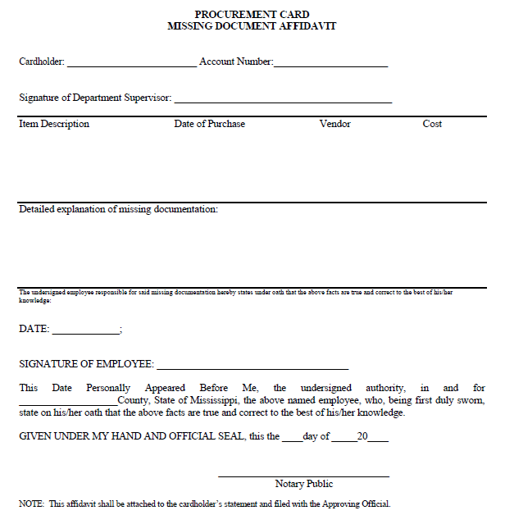
Missing Document Affidavit
If you are missing any receipts or documentation, a Missing Document Affidavit Form must be completed. It has to be completed and notarized by the Notary Public. Include this form in place of the receipt in the statement lineup(put where the charge is on the statement).
The form can be found here:
http://www.deltastate.edu/PDFFiles/procurement/UMB-Missing-Document-Affidavit-Form.pdf

Slide 23
Disputed Transactions
Be sure to contact the Procurement office if fraudulent charges/activity is noticed on your card. A dispute form will be provided if you are disputing any transactions shown on your statement. Your card will be closed and a new card will be issued. They come to Procurement office in about 7-10 days after they are closed.
If the bank notifies the cardholder or program coordinator of fraudulent activity, the card will be closed and reissued at that time.
Do not dispute personal charges made on accident. Simply contact Procurement and we will let you know what fund/org/acct you should deposit money into with Student Business Services. DO NOT provide cash, change or a check to Procurement for payment. We are NOT ALLOWED to handle money in this office.

Slide 24
Audit
We will be audited by the Office of the State Auditor. Some things they will look for are:
Sales tax
Equipment
Travel related expenses
Split purchases
Signatures on submitted reconciled requisitions, food forms, etc.
Itemized receipts
Agendas/flyers for events(must include date and time on the agenda/flyer)
If the auditor reveals multiple errors during the audit, he/she can determine that the university is not in compliance with policies and procedures which will cause cards to be suspended for an undetermined amount of time. It is very important to review all information submitted and verify that accurate paperwork and supporting documents are attached as well.

Slide 25
User Agreement Please read the following, print and sign, then return to the Procurement Office. The following minimum requirements for use of UMB card are as follows:
Assures any purchase made using the card adheres to all applicable purchasing procedures as set forth in Section 31-7-1, MS Code of 1972 Annotated.
Assure that the items purchased are required for a bona fide government purpose
Assure that the prices paid are fair and reasonable (no expedited shipping cost---plan accordingly for timely deliveries)
Notify merchant/vendor that the purchase is being made in the name of a government entity which is tax exempt.
Assure that a list of items purchased is reviewed/confirmed in writing by the cardholder(requisition with all necessary signatures)
Assure all items are delivered/received (no back order items)
Assure that state contract items are purchased only from state contract vendors at or below state contract price
Assure that purchases are within the limits set by DSU and the State of MS, and funds are available in your budget.
Assure no cash advances are made with card
Assure users are aware that he/she will be personally liable for any purchase that is made which is not in compliance with these procedures; continued abuse will result in card suspension/termination
Assures that no purchases are made for travel purposes
The cardholder shall review all charges to assure accuracy, complete applicable dispute documents, reconcile the statement with detailed receipts and order logs, and approve and sign the statement requisition.
Forward the statement and necessary documentation to Procurement. This should be done within one day after receipt of the statement per policy.
Review and approve/deny charges on statement before submitting to Procurement.
Maintain proper filing with invoices, receipts, etc.
I, ____________________________, have read and understand the user agreement for the UMB Procurement card on _______________.

