Slide 1
Does learning to count involve a semantic induction? Kathryn Davidson, Kortney Eng, David Barner

Slide 2
CP Knowers
Previous studies have reported qualitative differences
between subset-knowers and CP-knowers in a constellation
of different tasks that test knowledge of numerals beyond
four. CP-knowers, but not subset-knowers, can
successfully give sets of 5 or more objects when asked,
and can identify sets of 5 or more in a forced choice task
(Condry & Spelke, 2008; Le Corre, Van de Walle, Brannon,
& Carey, 2006; Wynn, 1990, 1992, etc.). When a set beyond
the child’s counting range has an item removed and replaced
with a different item, CP-knowers understand that
it retains its cardinality and thus that the same number
word applies (Lipton & Spelke, 2005). Finally, when a large
set is labeled (e.g., as five) and one item is added, CP-knowers
are more likely than subset-knowers to respond correctly
when asked if there are now six or seven objects
(Sarnecka & Gelman, 2004; Sarnecka & Carey, 2008).
Although these tasks place varying processing demands
on children, they all test the understanding of how to label
sets with number words.

Slide 3
Sarnecka and Carey (2008)
Under this view, when children become CP-knowers
they do not merely learn another blind procedure – e.g.,
that the last word in a count is the ‘‘right’’ response to a request
like ‘‘how many?’’ Instead, becoming a CP-knower
involves making an observation about the semantic relation
between numerals, and thus learning why counting
generates correct responses. This view is clearly articulated
by Sarnecka and Carey (2008):
‘‘The cardinal principle is often informally described as
stating that the last numeral used in counting tells how
many things are in the whole set. If we interpret this literally,
then the cardinal principle is a procedural rule
about counting and answering the question ‘how
many.’ . . .Alternatively, the cardinal principle can be
viewed as something more profound – a principle stating
that a numeral’s cardinal meaning is determined by
its ordinal position in the list. This means, for example,
that the fifth numeral in any count list – spoken or written,
in any language – must mean five. And the third
numeral must mean three, and the ninety-eighth
numeral must mean 98, and so on. If so, then knowing
the cardinal principle means having some implicit
knowledge of the successor function – some understanding
that the cardinality for each numeral is generated
by adding one to the cardinality for the previous
numeral.’’ (p. 665)

Slide 4
Tasks
Give-a-Number
Child is ‘CP knower’ if s/he can ‘give N’ correctly 2/3 times for 5,6,7 & 8
Fast dots task
1 sec display, ‘say how many dots’
More task
Which box has more stickers, the one with N or the one with M?
Unit task
Place N in box; place one or two more in box; ask child whether there are now N+1 or N+2.
Counting task
‘Count as high as you can’

Slide 5
Results
Kids were 3;4 – 5;3
all but 7/98 were ‘CP-knowers’
7 others excluded for other reasons, leaving 84 CP-knowers
Counting: Range 9-100; median 29
Divided into 3 groups: 9-19, 20-29; 30+
Fast Dots:
Mappers (61): had slopes > .3
Non-Mappers (23): -.26 < slope < .26

Slide 6
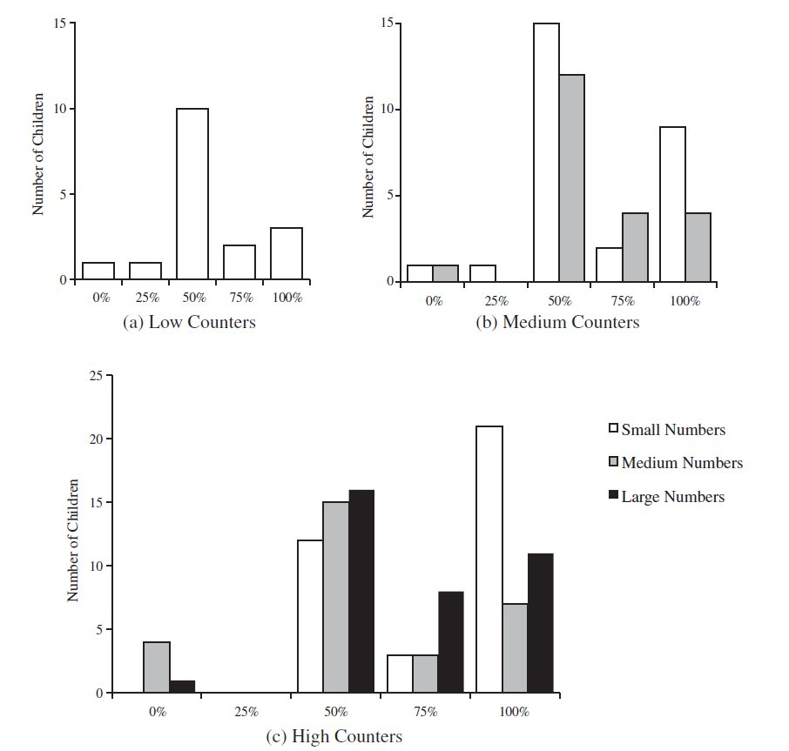
Units Task

Slide 7
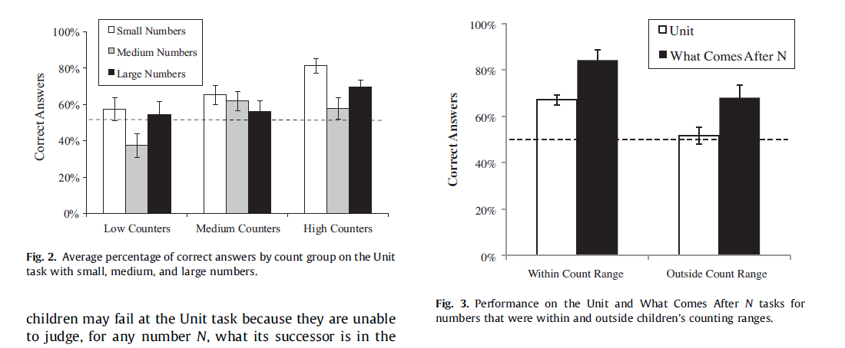

Slide 8
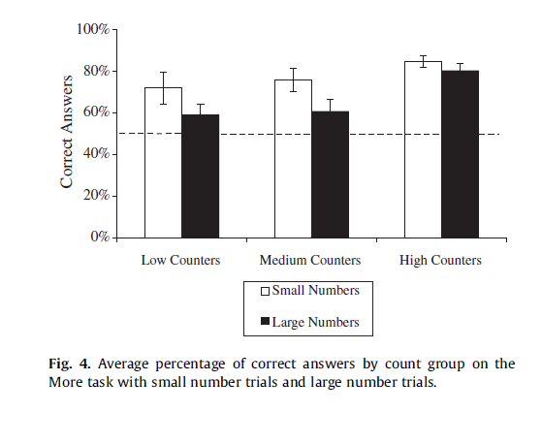
MORE Task

Slide 9
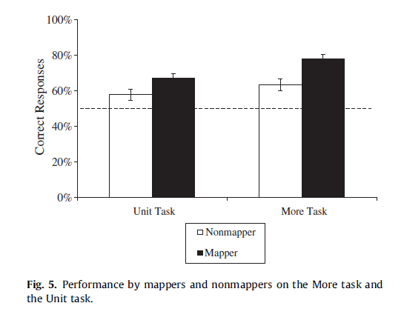
Mappers vs non-Mappers

