Slide 1
Emergent Functions of Simple Systems
J. L. McClelland
Stanford University

Slide 2
Topics
Emergent probabilistic optimization in neural networks
Relationship between competence/rational approaches and mechanistic (including connectionist) approaches
Some models that bring connectionist and probabilistic approaches into proximal contact

Slide 3
Connectionist Units Calculate Posteriors based on Priors and Evidence
Given
  A unit representing hypothesis h_{i}, with binary inputs indexed by j representing the state of information about various elements of evidence e, where for all j p(e_{j}) is conditionally independent given h_{i}
  A bias on the unit equal to log(prior_{i}/(1-prior_{i}))
  Weights to the unit from each input equal to log(p(e_{j}|h_{i})/(1-log(p(e_{j}|not h_{i}))
If
  the output of the unit is computed from the logistic function
  a = 1/[1+exp( bias_{i} + Σ_{j} a_{j} w_{ij})]
Then
  a = p(h_{i}|e)

Slide 4
Further Points
A collection of connectionist units representing mutually exclusive alternative hypotheses can assign the posterior probability to each in a similar way, using the softmax activation function (where net_{i} = bias_{i} + Σ_{j} a_{j} w_{ij})
a_{i} = exp(γnet_{i})/Σ_{i’} exp(γnet_{i’})
If γ = 1, this consitutes probability matching.
As γ increases, more and more of the activation goes to the most likely alternative(s).
Selecting the h_{i} largest a_{i} corresponds to choosing the alternative with the largest posterior probability.

Slide 5
Emergent Outcomes from Local Computations
(Hopfield, ’82, Hinton & Sejnowski, ’83)
If wij = wji and if you update units in a network one at a time, setting
ai = 1 if neti >0, ai = 0 otherwise
The net will settle to a state s which is a local maximum in a measure Rumelhart et al (1986) called G
  G(s) = Si<j wij aiaj + Si ai(biasi + exti)
If each unit sets its activation to 1 with probability logistic(gneti) then
p(s) = exp(gG(s))/Ss’(exp(gG(s’))
This allows probability matching (g = 1) or maximization (g->infinity), and that can be achieved via simulated annealing (gradual increase in g)

Slide 6
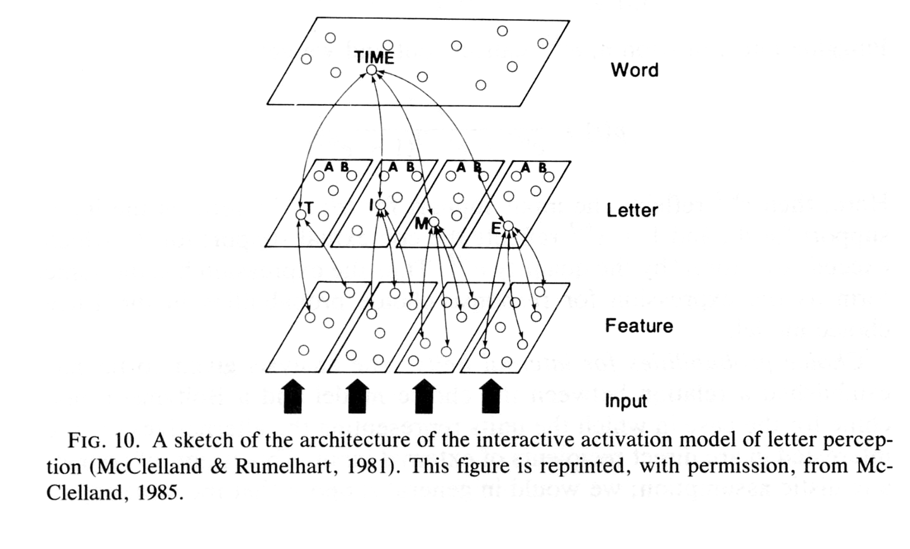
A Tweaked Connectionist Model (McClelland & Rumelhart, 1981) that is Also a Graphical Model
Each pool of units in the IA model is equivalent to a Dirichlet variable (c.f. Dean, 2005).
This is enforced if we use softmax and set one of the a_{i} in each pool to 1 with probability:
p_{j} = e^{net}j/Σ_{j’}e^{net}j’
Weight arrays linking the variables are equivalent of the ‘edges’ encoding conditional relationships between states of these different variables.
Biases at word level encode prior p(w).
Weights are bi-directional, but encode generative constraints (p(l|w), p(f|l)).
At equilibrium with g = 1, network’s probability of being in state s equals p(s|I)

Slide 7
But that’s not the true PDP approach to Perception/Cognition/etc…
We want to learn how to represent the world and constraints among its constituents from experience, using (to the fullest extent possible) a domain-general approach.
In this context, the prototypical connectionist learning rules correspond to probability maximization or matching
Back Propagation Algorithm:
    Treats output units (or n-way pools) as conditionally independent given Input
    Maximizes
    p(oi|I)
I o

Slide 8
Overcoming the independence assumption
The Boltzmann Machine algorithm learns to match probabilities of entire output states given current Input.
That is, it minimizes
- Integral(o) p(o|I) log(p(o|I)/q(o|I)) do
Here: p(o|I) is sampled from the environment
q(o|I) is the network’s estimate of p(o|I)
obtained by Gibbs sampling
The algorithm is beautifully simple and local:
Dwij = e (ai+aj+ - ai-aj-)
This is slow and generalizes poorly in completely unconstrained Boltzmann machines.

Slide 9
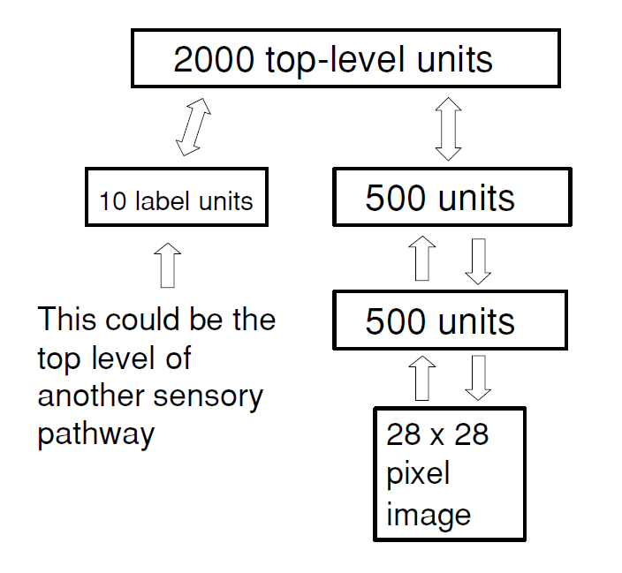
But things have gotten much better recently…
Hinton’s deep belief networks are fully distributed learned connectionist models that use a restricted form of the Boltzmann machine (no intra-layer connections) and learn state-of-the-art models very fast (e.g. handwritten digit recognition).
Generic constraints (sparsity, locality) turn out to allow such networks to learn very efficiently and generalize very well in demanding task contexts (c.f. Olshausen, Lewicki, le Cun, Bengio, Ng, and others).
Hinton, Osindero, and Teh (2006). A fast learning algorithm for deep belief networks. Neural Computation, 18, 1527-54.

Slide 10
Topics
Emergent probabilistic optimization in neural networks
Relationship between competence/rational approaches and mechanistic (including connectionist) approaches
Some models that bring connectionist and probabilistic approaches into proximal contact

Slide 11
Relationship between rational approaches and mechanistic approaches
Characterizing what’s optimal is always a great thing to do
Optimization is of course relative to a set of constraints
  Time
  Memory
  Processing speed
The lesson of Voltaire’s Candide.
The question of whether people do behave optimally in any particular situation is an empirical question
The question of why and how people can/do behave rationally in some situations and not so rationally in others is a matter of theory.

Slide 12
Two perspectives
People are rational.
They seek to derive explicit internal models of the structure of the world.
  Optimal structure type
  Optimal structure within each type
Resource limits and implementational constraints are unknown, and should be ignored in determining what is rational.
But inference is hard, and prior domain-specific constraints are therefore essential.
People emerged through an optimization process, so they are likely to approximate rationality within limits.
Implicit internal models characterize natural/intuitive intelligence; human cultures seek explicit models of the structure of the world; science and scientists engage in this search.
Culture/School teaches us to think explicitly, we do so under some circumstances. Most connectionist models do not directly address this kind of thinking.
Human behavior won’t be understood without considering the constraints it operates under.
  Figuring out what is optimal sans constraints is always a good thing.
  Such an effort should not presuppose individual human intent to derive and explicit model of the structure of the world.
Inference is hard, and explicit models help, but domain-general mechanisms (which may be partially pre-structured where evolution has had a long time to work its magic) shaped by generic constraints deserve the fullest possible exploration.
In some cases such models may closely approximate what might be the optimal explicit model.
  But that model might only be an approximation and the domain-specific constraints might not be necessary.

Slide 13
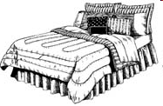

It is important to figure out when we rely on explicit vs. implicit cognition
Box appears…
Then one or two objects appear
Then a dot may or may not appear
RT condition: Respond as fast as possible when dot appears
Prediction condition: Predict whether a dot will appear, get feedback after prediction.
Outcomes follow ‘Causal Powers’ model with 10% noise.
Half of participants are instructed in Causal Powers model, half not.
All events listed to the right occur several times, interleaved.
All participants learn explicit relations.
Only Instructed Prediction subjects show Blocking and Screening.
AB+,A+
CD+,C-
EF+
GH-,G-
fillers

Slide 14
Topics
Emergent probabilistic optimization in neural networks
Relationship between competence/rational approaches and mechanistic (including connectionist) approaches
Some models that bring connectionist and probabilistic approaches into proximal contact

Slide 15
Some models that bring connectionist and probabilistic approaches into proximal contact
Graphical IA model
Leaky Competing Accumulator Model (LCAM, Usher and McClelland, 2001, and the large family of related decision making models).
Models of Unsupervised Category Learning:
  Competitive Learning, OME, TOME
Subjective Likelihood Model of Recognition Memory (SLiM, McClelland and Chappell, 1998; c.f. REM, Steyvers and Shiffrin, 1997).

Slide 16
Some Phenomena in Cognitive Science – Are they all Emergents?
Categories, prototypes, rules
Lexical entries
Grammatical and semantic structures
Cognitive modules for words and faces
Attention, working memory
Choices and decisions
Memories for specific episodes or events
Deep dyslexia
Category-specific deficits
Deficits in the hierarchical organization of behavior
Appearance/disappearance of behaviors in development
Object permanence
Stage transitions
Sensitive periods
Language structure and language change

Slide 17
Some Phenomena in Cognitive Science – Are they all Emergents?
Categories, prototypes, rules
Lexical entries
Grammatical and semantic structures
Cognitive modules for words and faces
Attention, working memory
Choices and decisions
Memories for specific episodes or event
Deep dyslexia
Category-specific deficits
Deficits in the hierarchical organization of behavior
Appearance/disappearance of behaviors in development
Object permanence
Stage transitions
Sensitive periods
Language structure and language change

Slide 18
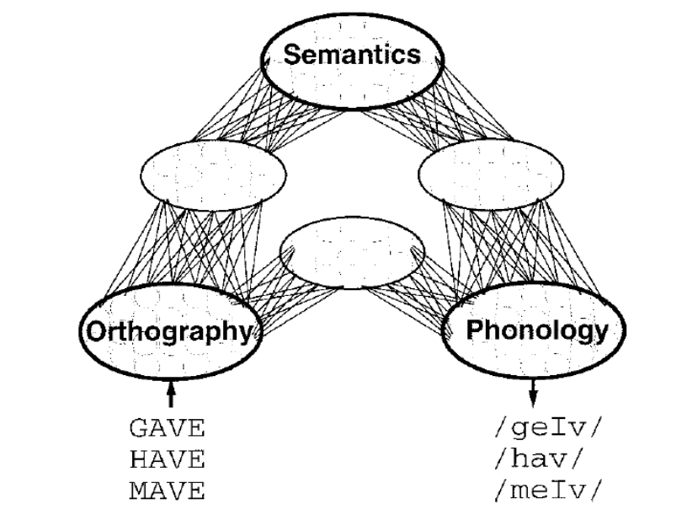
Example:
PDP models of reading can…
Read regular words, exception words, and nonwords without rules or lexical entries.
Match data showing graded sensitivity to consistency and frequency in response choices and reaction times.
Account for detailed aspects of deficits including
  Graded effects of damage
  Co-occurrence of semantic and visual errors in deep dyslexia
  Regularization errors in surface dyslexia
  Correlation of semantic impairment and surface dyslexia
  Patterns of individual differences in these correlations
Sem: APRICOT “peach”
Vis: FLASK “flash”
Reg: CAFE “caif”

Slide 19
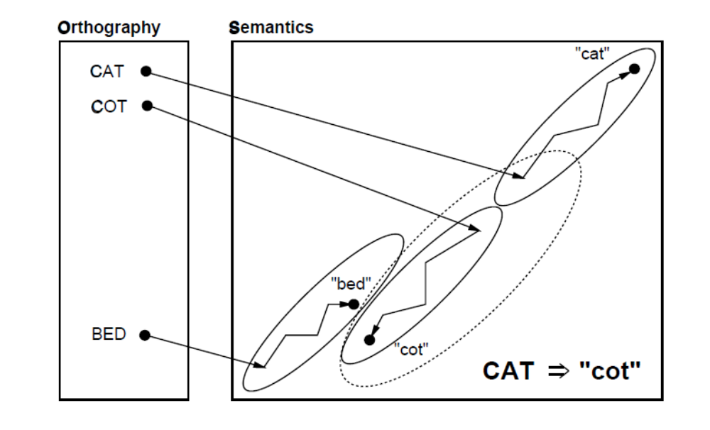
Basis of Visual Errors in Deep Dyslexia

Slide 20
Some Phenomena in Cognitive Science – Are they all Emergents?
Categories, prototypes, rules
Lexical entries
Grammatical and semantic structures
Cognitive modules for words and faces
Attention, working memory
Choices and decisions
Memories for specific episodes or event
Deep dyslexia
Category-specific deficits
Deficits in the hierarchical organization of behavior
Appearance/disappearance of behaviors in development
Object permanence
Stage transitions
Sensitive periods
Language structure and language change

Slide 21
Object Permanence and The A not B Error
(Thelen et al, BBS, 2001; Munakata et al, Psych Rev, 1997; Munakata, Devel Sci, 1998)
Do young children lack ‘The Principle of Object Permanence’?
Or have they not yet acquired the ability to sustain a tendency to respond to an object that is no longer visible?
What underlies the striking A-not-B error?
  Failure of knowledge or competing response tendencies?
Basic object permanence behaviors and the A-not-B error are both highly sensitive to task details – ages at which these effects can occur are easily manipulated.
In emergentist accounts, these effects emerge from gradually-developing abilities that must be strong enough to withstand delays and other impediments and to compete with other forces favoring alternative response tendencies.

Slide 22
Why Does Emergence Matter?
Because it explains phenomena in terms of their substrate without reducing them to it.
Because it explains how phenomena arise without the need for a blueprint or plan.
Because an emergent account allows us to see more clearly how the phenomenon is more graded, approximate, and context sensitive than would otherwise be apparent.
Because the phenomenon is contingent on the details of what it emerges from, explaining when it does and does not occur.
Because the explanation may not require the postulation of something that itself remains to be explained.
  Gravity
  Preformation
  Universal Grammar

Slide 23
How well do we understand emergence?
Only to a very limited extent –
  More work is clearly necessary!

Slide 24
What can be done to increase our understanding?
Increase awareness of emergent phenomena in other domains of science and foster an understanding of their mechanistic basis
Increase acceptance of and reliance on computational models as vehicles for explaining observed cognitive, developmental and linguistic phenomena
Work harder on making the explanations for the emergent properties of models more clear
Increase emphasis on understanding underlying mechanisms and processes

Slide 25
Credits and Bibliography
Braitenberg. Vehicles
Rumelhart et al. Parallel-Distributed Processing.
Elman, Bates, Johnson, Karmiloff-Smith, Parisi and Plunkett. Rethinking Innateness
Thelen and Smith. A Dynamic Systems Approach to the Development of Cognition and Action
MacWhinney. The Emergence of Language.

