Slide 1

Reinforcement Learning: Computational Roles for Dopamine, Striatum, and Hippocampus
1:00-1:05 Welcome to the symposium (Jay McClelland)
1:05-1:30 Introduction and overview (Sam McClure)
1:30-2:20 From bees to comp’l psychiatry (Read Montague)
2:20-3:10 Learning latent structure (Yael Niv)
3:10-3:30 Coffee break
3:30-4:20 Linking context and reward (Gary Aston-Jones)
4:20-5:00 Panel and audience discussion
5:00-6:00 Wine and Cheese Reception
February 29, 2012 • Stanford University

Slide 2

Sam McClure Department of Psychology, Stanford
Behavioral studies, functional and structural imaging, and computational modeling to explore the neural basis of reward-related decision making.
Widely known for his work on choice between immediate and delayed rewards, and for the view that multiple brain systems contribute when we make such decisions.

Slide 3
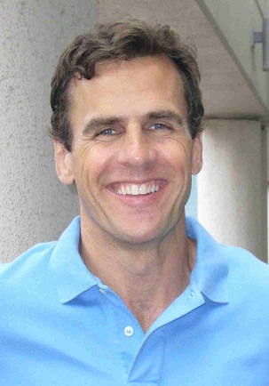
P. Read Montague, PhD Virginia Tech & University College London
Pioneered work relating dopamine to reinforcement learning algorithms
Remains at the forefront of using neuroscience to develop computational model of decision-making.

Slide 4

Yael Niv, Ph. D. Neuroscience and Psychology, Princeton
Combines optimal statistics analysis and reinforcement learning with measures of brain function to develop models of the neuroscience of learning and decision-making.
Yael has explored how anticipated value is translated into effort, how goals are managed in the human brain, and how the hippocampus facilitates reward learning.

Slide 5

Gary Aston-Jones, PhD Medical University of South Carolina
Gary’s foundational research has led to new theories for the role of the locus coeruleus and norepinephrine in attention and behavioral control.
His recent work has uncovered a circuit critical for motivated behavior, linking the hippocampus to the dopaminergic midbrain.

