Slide 1
PET Criteria for Response Assessment After Completion of Therapy for Aggressive NHL and HL
Definition of a positive PET scan (Visual assessment is adequate, SUV is not necessary)
General definition of a positive (abnormal) PET finding using visual assessment: focal or diffuse FDG uptake above background in a location incompatible with normal anatomy/physiology
Cheson et al. J Clin Oncol 2007; 25:579-86; Juweid et al. J Clin Oncol 2007; 25:571-8

Slide 2
Exceptions:
  Negative PET: mild and diffusely increased uptake ≤ mediastinal blood pool (BP) within residual masses ≥ 2 cm in diameter regardless of location
  Positive PET: diffuse or focal uptake > mediastinal BP for lesion ≥ 2 cm in diameter
  Positive PET: any increased uptake above surrounding background in lymph nodes or nodal masses < 2 cm (including normal sized LNs) by CT
Cheson et al. J Clin Oncol 2007; 25:579-86; Juweid et al. J Clin Oncol 2007; 25:571-8

Slide 3
Positive PET: new lung nodules ≥ 1.5 cm by CT with no evidence of pulmonary lymphoma before therapy if their uptake > mediastinal BP
Negative PET: new lung nodules regardless of their size or uptake in patients without established pulmonary lymphoma at baseline who responded completely at all known disease sites – infectious/inflammatory
New lesions < 1.5 cm: PET is unreliable for assessment of these lesions and residual lymphoma cannot be excluded with no FDG uptake
Juweid et al. J Clin Oncol 2007; 25:571-8
Notes:
Pulmonary nodules < 1.5, the uptake is unreliable.

Slide 4
Residual hepatic or splenic lesions > 1.5 cm on CT
  Positive, if the uptake is ≥ liver or spleen
  Negative, if the uptake is < liver or spleen
Residual hepatic/splenic lesions < 1.5 cm
  Positive, if their uptake is > liver or spleen
  Negative PET, if their uptake is ≤ liver or spleen
Positive PET: diffusely increased splenic uptake > normal liver (unless there was recent cytokine therapy)
Juweid et al. J Clin Oncol 2007; 25:571-8

Slide 5
Positive PET: increased (multi)focal bone (marrow) uptake
Negative PET: diffusely increased BM uptake, even if > liver uptake is usually due to post-therapy marrow hyperplasia
BM biopsy remains the standard procedure for assessment of BM (negative PET does not exclude mild or moderate BM involvement)
Juweid et al. J Clin Oncol 2007; 25:571-8

Slide 6
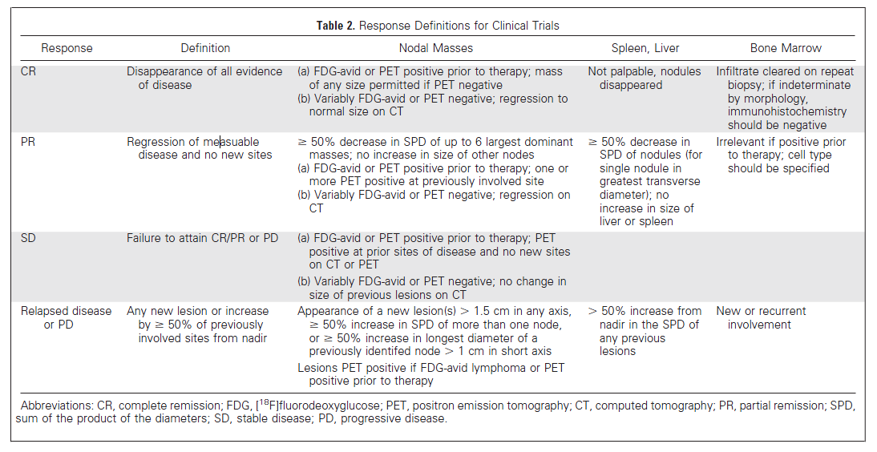
Response Definition for Clinical Trials
Cheson et al. J Clin Oncol 2007; 25:579-86

