Slide 1

Introducing BDC: Canada’s bank for entrepreneurs
March 2020
Barb Stegemann
Founder and CEO
7 Virtues
Notes:
Good day everyone,
My name is XXX and I am YYY at the Business Development Bank of Canada, known as BDC.
I am delighted to give you a brief overview of BDC.
Hopefully, after I’m finished, you will have an even better understanding of BDC’s services and offering.

Slide 2




BDC is the only bank devoted exclusively to entrepreneurs
Notes:
We are the bank of entrepreneurs. In fact, BDC is the only Canadian bank devoted exclusively to entrepreneurs. We complement the role played by private-sector financial institutions. We’re profitable, operating at no cost to the Canadian taxpayer, and has a sole shareholder, the Government of Canada.
We’re proud to be the first financial institution in Canada to receive the Beneficial Corporation (B Corp) certification — and the 100th Canadian company to join the B Corp community.
B Corps are businesses that act in ways that benefit society as a whole rather than focusing solely on making profits. The certification is granted by a non-profit organization called B Lab and is similar to Fair Trade certification for coffee and LEED certification for green buildings. To be certified, companies must meet high standards of purpose, social and environmental performance, transparency and accountability. Compared to traditional companies, B Corps are recognized for creating greater economic opportunity, strengthening local communities and preserving the environment.

Slide 3

big part of Canada
Small and medium-sized businesses are a
99
.8%
97
1
0
.9%
.9%
.2%
of Canadian companies
are SMEs
1-99
Employees
100-499
Employees
500+
Employees
SOURCE: Key Small Business Statistics, January 2019, Innovation, Science and Economic Development Canada
Notes:
Small businesses—those with fewer than 100 employees—account for 97.% of all Canadian companies, while the mediums (100-499 employees) account for 1.8%.
So, 99.8% of all Canadian companies are small and medium-sized businesses.

Slide 4

Behind every small business, there’s an entrepreneur with a dream.
Notes:
Entrepreneurs are the engine of our economy. They build businesses, create jobs and make a difference in their communities — every single day.
At BDC, we pride ourselves on understanding these bold, innovative thinkers and their businesses.

Slide 5
Canadian entrepreneurs face
significant challenges
Difficulty scaling up
Sluggish productivity
Slow digital adoption
Limited market
development
Only 1.7%
of Canadian companies have more than 100 employees
30% less productivity
for Canadian firms versus U.S. firms and gap is widening.
Only 19%
of Canadian firms are digitally advanced
Only 14%
of Canadian SMEs are exporters
Source: Statistic Canada, Centre for Living Studies, BDC studies and calculations
Notes:
We help entrepreneurs tackle the host of challenges they face in starting and growing their business.
Challenges include troubles scaling up, productivity that lags behind U.S. firms, slow innovation and tech adoption, and limited global market development.

Slide 6


We help entrepreneurs succeed
Flexible financing
  Business loans
  tailored to the entrepreneur
Advisory services
  Expert advice for a better, more profitable business
Smart
capital
  Access to specialized investment solutions
Notes:
We support entrepreneurs in all industries and all across Canada with financing, capital and advisory services.

Slide 7
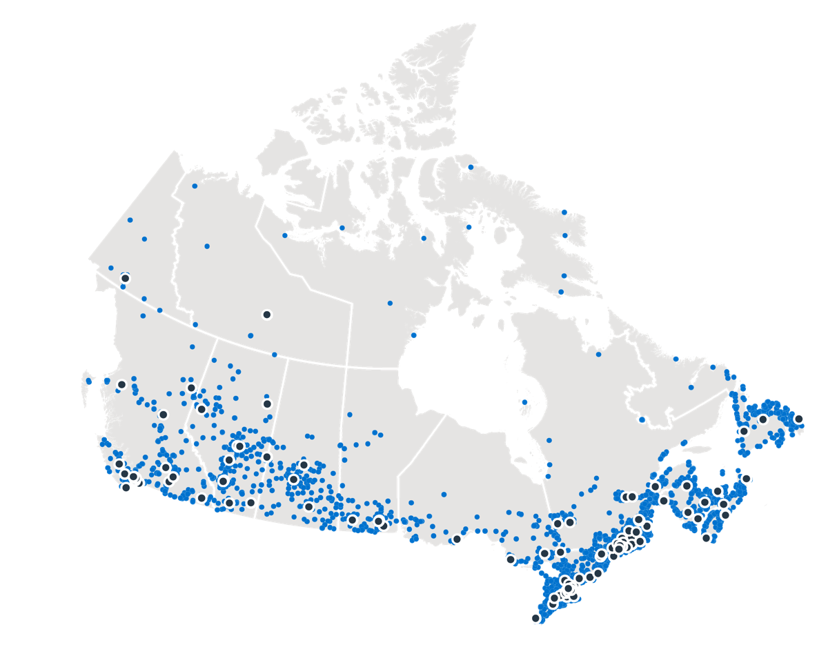
We have the reach to support businesses virtually anywhere in Canada.
60,000
entrepreneurs
123
BDC business centres
2,300
BDC employees
94%
Client satisfaction
BDC Business Centres BDC Clients
Notes:
To give you an idea of BDC’s reach—we have more than 2,300 employees and close to 123 business centres across the country.
As Canada’s development bank, we need to be where entrepreneurs are and provide them with the financing and advisory services they need, when they need it. Thanks to our national presence, we are able to reach entrepreneurs in each region of Canada.
We work with 60,000 entrepreneurs across the country.
We have $35 billion in capital committed to small and medium-sized businesses.
The entrepreneurs we work with are happy with our services; our client satisfaction rate is 94%.

Slide 8

Our services meet the full range of entrepreneur needs
Financing
Capital
Advisory services
Notes:
Here you have an overview of how our business is structured.
In a nutshell, BDC offers Canadian entrepreneurs:
Financing – term loans
Capital
And advisory services
Our business loans represent over 90% of our portfolio.
BDC also offers indirect financing—a specialized form of financing for finance and leasing companies.
Through our investments arm—BDC Capital—we also offer a full spectrum of specialized risk capital, including venture capital, as well as growth and business transition capital.
We also offer a full range of non-financial services to entrepreneurs. All these are regrouped under our Advisory Services business unit.

Slide 9








We work with entrepreneurs in all industries
A snapshot of our financing portfolio
(as at March 31, 2019)
manufacturing
25%
tourism
12%
service industries
13%
wholesale and
retail trade
15%
construction
8%
resources
8%
commercial properties
5%
other
14%
Notes:
Here’s an overview of how our financing portfolio is structured.

Slide 10
When the market falters, we step up
BDC is a key support for entrepreneurs
during tough financial times:
  After 9/11, when business credit fell off
  When the Great Recession hit in 2008
  When oil prices collapsed in 2016
18%
35%
21%
  BDC credit
  portfolio growth
  BDC credit
  portfolio growth
  BDC credit
  portfolio growth
Notes:
An important part of BDC’s mandate is to identify and fill market gaps and deficiencies.
In terms of structural deficiencies, BDC assists companies in higher-risk segments such as small businesses, start-ups, young entrepreneurs, exporters, innovators and knowledge-based firms, as well as businesses in cyclical sectors. These types of firms have trouble accessing financing because:
They may be inexperienced.
They have no financial track record.
They have little to pledge as security, or simply because of their location in a remote or under-serviced region.
Cyclical deficiencies are more temporary. They are experienced by all businesses when the economic cycle enters a downturn. When available credit goes down, BDC lending goes up.
Three examples—U.S. Recession, Global Credit Crunch and the oil price collapse.
BDC acted as a “shock absorber” for entrepreneurs in moments of crisis.

Slide 11
Financing
  Our services

Slide 12
Our financing solutions
We are a patient, flexible lender.
Access working capital
Start a business
Buy a business
Invest in technology
Invest in real estate
Transfer a business
Purchase equipment
Export to new markets
Notes:
In terms of financing, BDC offers entrepreneurs access to working capital, the means to purchase equipment, and more.
For larger, more complex loans, BDC’s Corporate Financing experts offer customized solutions.

Slide 13

What makes us different
BDC offers entrepreneurs:
Longer repayment periods
  Repayment schedules matched
  to your cash flow cycle
  Higher risk tolerance
  Terms and conditions that don’t change without due cause
  Personal assets are not taken
  as collateral for a loan
  BDC
  is a patient, flexible lender
Notes:
What makes BDC different? We are a patient, flexible lender offering:
Longer repayment periods
Repayment schedules matched to the SME’s cash flow cycle
Higher risk tolerance
Terms and conditions that don’t change without due cause
Personal assets are not taken as collateral for a loan

Slide 14
Entrepreneurs can get up to
$100,000 online in five business days or less.
Small projects. Big ambitions.
www.bdc.ca/oce_smallloan
Notes:
Entrepreneurs who need smaller loans can apply online for up to $100,000.
There are no application fees and the application is done 100% online.

Slide 15
Advisory Services
  Our services
Notes:
As a development bank, we go beyond financing to give entrepreneurs practical advice to help them run a better, more profitable business. Because We know that entrepreneurs need more than money to succeed.
We’ve been offering advisory services for more than 30 years.
Our national network of consultants and highly experienced specialists can help entrepreneurs scale up their businesses, be more productive, innovate and globalize.
Our experienced advisors gain a deep understanding of their entrepreneur client’s business to help them address the inevitable challenges that come from growth, no matter how daunting they seem.
We accompany clients throughout the mandate, offering objective and practical advice on a wide range of subjects to help them build a strong, successful company.
Our solutions are designed to equip entrepreneurs with the knowledge and know-how to manage every function of their company with confidence.

Slide 16
Our goal
Increase sales
Improve productivity
Optimize technology
Provide top-notch advice to help you overcome your challenges and
run a stronger business
Manage your business
Find new markets
Address specific needs
Notes:
BDC advisory services help entrepreneurs work smarter.
Our goal is to help you adopt and incorporate best practices to meet your business challenges and to remain competitive.
First, we want to accelerate your growth.
We work on increasing your sales by focusing on sales and marketing (both traditional and digital), as well as innovation (product development).
Secondly, we want your business to be more agile and more efficient. We can help you improve your operations by streamlining processes, implementing lean manufacturing and selecting the right equipment and technology for your business.
We also help you build organizational capabilities to manage your business effectively. We offer advisory services in areas such as strategic planning, financial management, organizational design and HR management.
We work on finding new markets to keep your business growing, including international expansion.
Finally, we can also help you address more specific needs such as accelerating growth or becoming certified.

Slide 17
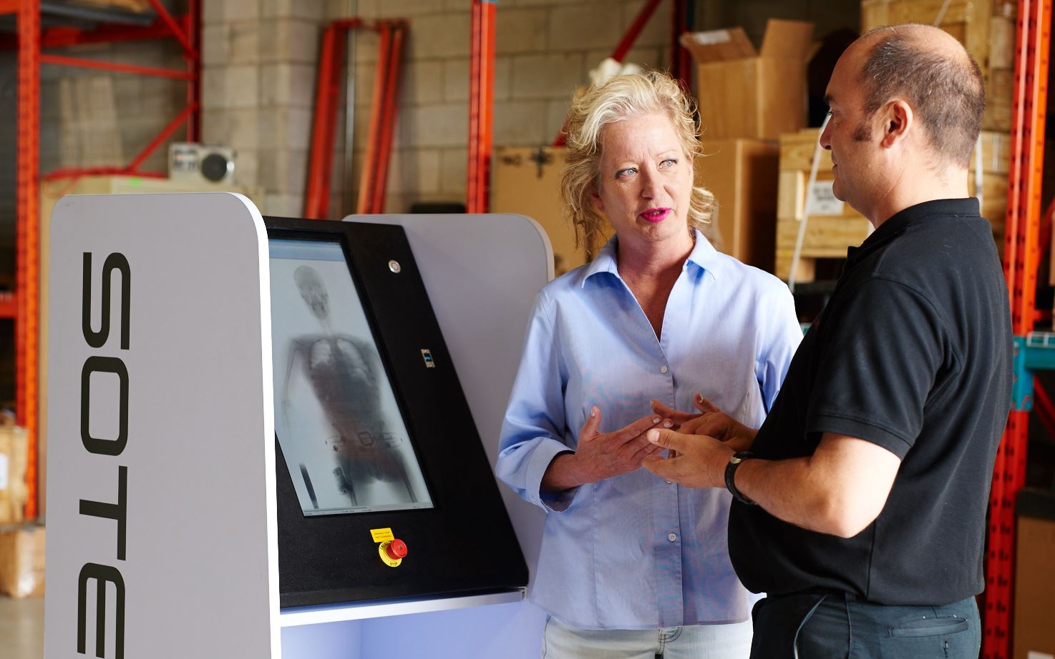
Colleen Rodi
  Owner
  Visiontec Systems
Notes:
Here’s one of the entrepreneurs BDC Advisory Services have helped.
Her name is Colleen Rodi. She’s the owner of Visiontec Systems, an integrator of security systems in Mississauga Ontario.
A few years ago, Colleen’s company was growing so fast that it was squeezing cash flow at her business.
With her line of credit was stretched to the limit, Colleen withdrew money from her RRSP to fund her business.
That’s when Colleen came to see us. A BDC financial management consultant helped her find the breathing room she needed to make much-needed improvements to the management of her business’s finances.
The result was a better handle on the company finances, which helped her grow her business in a sustainable way.

Slide 18

Growth Driver Program
Helping ambitious, mid-sized firms
grow faster
Notes:
Our Growth Driver Program is tailormade for ambitious mid-sized firms with a track record of rapid growth.
The firm works directly with seasoned leader with experience overcoming challenges associated with a growing business. At the same time, an extensive network of peers, analysts and resources supports the firm.
The ultimate goal of the program is to help the firm identify and develop the skills needed to advance to the next level. We help CEOs articulate their growth strategy, develop an action plan and then implement it.

Slide 19
9
10
out of
BDC clients say we have
a positive impact
on their business*
Notes:
With our insight and advice, clients develop greater capacity for growth, profitability and innovation, and strengthen their competitive edge.
In fact, 9 out of 10 of our advisory clients say we have a positive impact on their business.
Let’s look at some of the main challenges entrepreneurs just like you face daily and how we assist.

Slide 20
Capital
  Our services
Notes:
BDC Capital—which is a subsidiary of BDC—offers the full spectrum of specialized financing including venture capital, and growth and business transition capital.

Slide 21
With BDC, entrepreneurs can access capital tailored to their needs...
Growth &
Transition Capital
Venture
Capital
Growth
Equity
Notes:
Our investment arm plays a prominent role in fostering a healthy, vibrant Canadian innovation ecosystem through its three divisions:
Growth & Transition Capital—which is basically customized financing for established or high-growth companies that don’t have enough tangible assets to qualify for term loans and that are looking to finance a new project or business transition.
Venture Capital—where we invest in innovative companies.
And Growth Equity—where we make minority equity investments into mid-market growth companies looking to grow exponentially.

Slide 22
Growth & Transition Capital
A full range of financing options for entrepreneurs
What we do
Financing from $250,000
to $35M – mezzanine, cash flow
and quasi-equity financing
Who we do it for
Established or high-growth companies with insufficient tangible assets to pledge for security and a desire to limit dilution of ownership
  Projects we can provide financing for
Working
capital
Transferring
a business
Buying
a business
Notes:
BDC’s Growth & Transition Capital group offers a full range of financing options such as mezzanine, cash flow and quasi-equity financing solutions on flexible terms to both mid-market and high-revenue Canadian companies—loan amounts typically range from $250,000 to $35 million.
We have more than 600 clients and $1B in portfolio.
These solutions allow businesses to raise capital when they have insufficient tangible assets to pledge for security and don’t want to dilute ownership.
The key benefits of BDC’s Growth & Transition Capital financing solutions are:
Security is subordinated to secured lenders
Limits dilution of ownership and offers an affordable alternative to equity financing
Personal assets are not taken as collateral

Slide 23
Growth Equity
A long-term partnership to accelerate business growth
What we do
Dedicated, patient investors helping entrepreneurs grow and maintain control of their business
Minority equity investments from $2M to $25M
Who we do it for
Mid-market businesses looking
to become leaders in their industry and who want to grow while reducing financial risks
  Benefits of partnering with BDC
Maintain control of your business
Get the liquidity you need to grow
Access future rounds of capital
Notes:
For entrepreneurs managing mid-market growth businesses looking to grow, but that still want to maintain control of their companies, our Growth Equity team provides minority equity investments from $2M to $25M. We can participate, lead or be the sole partner in the transaction.
Our non-controlling interest ensures that the entrepreneur maintains control of the company.
One example of a company in which BDC Capital’s growth equity team has taken a minority equity position is Montreal-based Budge Studios, a world leading applications developer and publisher of children’s apps for smartphones and tablets.
BDC Capital’s $3 million equity investment allowed Budge to further its expansion plans through key initiatives such as evolving their current platforms and expanding their catalogue of applications.

Slide 24
Venture Capital
For early-stage companies looking to transform
innovative ideas into successful businesses
What we do
Direct investing
Investing in other funds
and co-investing
Support for Canada’s venture
capital ecosystem
Who we do it for
Innovative entrepreneurs looking
to build businesses
$2B⁺
capital under management
800
investee
companies
Notes:
On the VC front, BDC Capital invests in technology-based Canadian companies that offer unique products or services, addressing promising global markets
We are involved at every stage of the companies’ development cycles, from seed through expansion, and our investment period averages 7 to 10 years. It is high-risk investing.
BDC works with promising entrepreneurs, angel investors and other venture capital funds to invest in outstanding Canadian businesses through:
Direct investing
Investing in other venture capital funds
Support for Canada’s venture capital ecosystem
We have more than $2 billion capital under management and 800 investee companies.

Slide 25

BDC’S Aerospace strategy

Slide 26
BDC’s aerospace strategy - since 2012
Make Canadian entrepreneurs the most competitive in the world
BDC’s goal for aerospace
Tier-up Canada’s aerospace entrepreneurs to win more, bigger, and profitable international contracts
Grow Canada’s share of the global aerospace market
BDC’s strategy to achieve
Capitalize on BDC’s national footprint to deliver sector expertise that elevates entrepreneurs’ strategic focus and accompanies them through execution
Increase access to capital and advice
Accelerate growth, innovation & productivity
Strengthen the entrepreneurial ecosystem
Patient, flexible Capital
  Exposure to market trends, transition success stories, connections with strategic firms
Sector-specialized delivery of advisory services on business transition
Patient, flexible Capital
Exposure to market trends, connections for innovation, acquisition, international expansion
Sector-specialized delivery of advisory services, e.g.:
  International expansion
  Innovation
  M&A, etc.
For the Ecosystem:
SME-specific market research, success stories and market trend analyses
Collaboration across Canada, to promote the Canadian brand, reduce innovation risk, share learnings and leading practices, etc.
Strategic Activities in Support of BDC Corporate Strategy

Slide 27
BDC offers the right mix of industry knowledge and understanding of entrepreneurs needs
We have a national team dedicated to aerospace entrepreneurs
Our clients coast to coast provide us with a unique perspective on trends, pain points and opportunities
We follow the industry’s major developments and provide the capital and advice you need to face them
We have a financing solutions specific to the unique needs of the sector, the aerospace development cost loan for NRC linked to new contracts (including FAIs)

Slide 28
Helping all Canadian entrepreneurs make their dreams come true
Notes:
As Canada’s development bank, we want to grow the country’s entrepreneurial community and ensure we have a greater impact on more business owners.

Slide 29
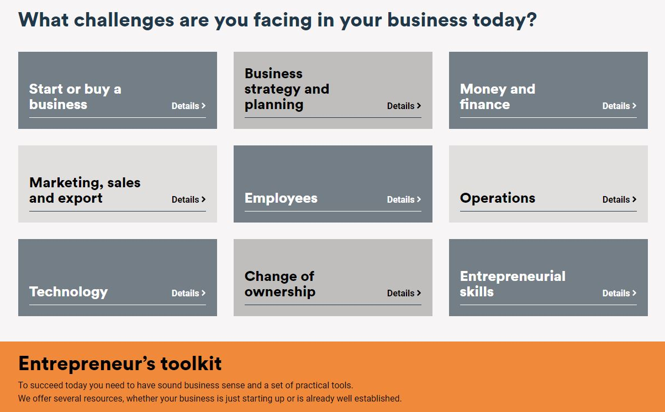
Free business advice
on bdc.ca
Notes:
We also support entrepreneurs in other indirect but powerful ways.
Our website, BDC.ca, offers a variety of free advice to entrepreneurs in the form of templates, articles, tools, eBooks and blogs.

Slide 30
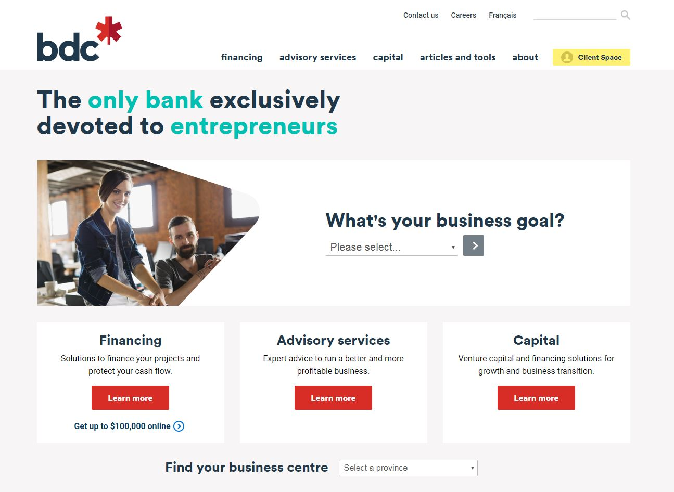
7.5M
visits on BDC.ca
1,000⁺
articles, videos and tools on
a variety of business topics
Notes:
BDC.ca attracted 5.6 million visits last year — an increase of 33% from the previous year.
This reflects our continuous efforts to offer high-quality, useful and inspiring content to help entrepreneurs address the challenges they face.
You can find more than 1,000 articles, videos and tools on BDC.ca about a variety of business topics.

Slide 31

Insightful knowledge on issues affecting entrepreneurs
  Expand Online: Strategies to boost sales, profits and exports
      (July 2019)
  Buying a Business:
  A Winning Strategy for Purchasing Another Company in Canada
  (April 2019)
  Labour Shortage: Here to stay
  (September 2018)
Notes:
As part of our mission to help create and develop Canadian businesses, BDC has an active research and market intelligence department that regularly produces surveys and reports that offer insights into the Canadian SME sector.

Slide 32

We are the bank of entrepreneurs
1
We’re the only bank devoted exclusively to entrepreneurs
We know their markets and understand their needs
We’re there at every stage
of their business journey
2
3
Notes:
To sum up:
We’re the only bank devoted exclusively to entrepreneurs
We know their markets and understand their needs
We’re there at every stage of their business journey

Slide 33
What we don’t do
4
Term deposits
1
5
Guaranteed investment certificates
Lines of credit
2
6
Grants
Non-commercial loans or residential loans
3
7
Interest-free loans
Bank accounts
and credit cards
Notes:
Here’s a list of what BDC does not provide: term deposits, grants, interest-free loans, bank accounts, non-commercial loans or residential loans.
Every dollar in our portfolio is used to support Canadian entrepreneurs.

Slide 34









60,000
Canadian entrepreneurs
stories
Notes:
We have 60,000 Canadian entrepreneurs that we were able to help and 60,000 excellent stories to tell.
Our job is to help entrepreneurs overcome the challenges they face, one entrepreneur at a time.

Slide 35
What BDC clients are saying about…
Our financing services:
Our advisory services:
Having a bank that’s on my side and looking out for my best interest makes life a whole lot easier. I would still be where I was without the help of BDC.
Leslie J. (John) Baxter
President, Coady’s Fishing
Our growth and transition
capital services:
The turnaround from the BDC team was very impressive. They fast-tracked our plant design, which we really appreciated. Our employees felt engaged in the whole process, which improved morale, and our sales are up!
Cory Brightwell
CEO, Woodwork+Pub
“BDC really gets what entrepreneurship is all about. BDC genuinely believed in us and that buyout allowed us to
triple our revenue,”
Nathan Sheaff
CEO, Sciemetric

Slide 36
Thank you.
Frédéric Loiselle
Director, Aerospace and Aviation solutions
514-283-3864
frederic.loiselle@bdc.ca
Notes:
To find out more about how BDC’s financing, investments and advisory services can take your company to the next level, go to bdc.ca or give us a call.
Thank you for your attention!

