Slide 1
TRADE COMMISSIONER SERVICE 101
March 11, 2020
Brad Havixbeck
Trade Commissioner

Slide 2
Section 1. | The Trade Commissioner Service
Section 2. | The Role of Regional Offices
Section 3. | CanExport 101
Section 4. | SME Federal Growth Journey

Slide 3
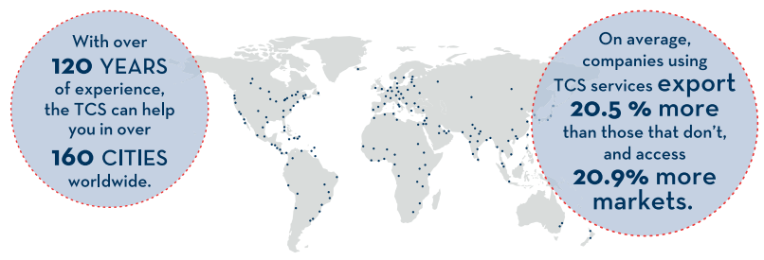
WHAT IS THE TCS?
The TCS provides Canadian companies with practical advice on foreign markets and on-the-ground intelligence to help them make better, more timely and cost-effective decisions in order to achieve their goals abroad.

Slide 4
The TCS Helps Canadian Businesses:
4 Key Services
Gain Business Insight
We provide key market insight and practical business advice.
Find New Opportunities
We open the door to business opportunities globally.
Expand to Global Markets
We can help your business navigate the complexities of global markets.
Connect with Key Contacts
We help businesses find qualified contacts
Reduce Risks
We can help reduce risks and avoid costly mistakes.
Resolve Business ProBLEMS
We can help resolve problems in foreign markets.

Slide 5
TCS client definition:
TCS Clients can be:
Small, medium or large organizations;
Foreign subsidiaries of companies registered or incorporated in Canada;
Qualified clients that are represented by consultants, distributors, agents, and students.
“Really value his sector experience and commercial knowledge.”
- TCS Client (anonymous)*
To Qualify as a TCS client, companies or organizations must have:
Demonstrated capacity for and commitment to internationalization
Meaningful economic ties to Canada
Potential to contribute significantly to Canada’s economic growth
“Has a passion for client service.”
- TCS Client (anonymous)*
89% of TCS Clients are SMEs**
TCS clients are happy with our services:
91.6% satisfaction rate**
*Feedback from client survey 2018 – Key Account Management Program
** TCS Client Survey 2018

Slide 6
TCS Services:
Client Services
Programs
Multi-Partner Initiatives
Funding Programs
Preparation for International Markets
Market Potential Assessment
Qualified Contacts
Troubleshooting
Canadian Technology Accelerator (CTA)
Global Mentorship Program
Business Women in International Trade
Trade Missions
Signature Events
Accelerated Growth Service (AGS)
Clean Growth Hub
Superclusters
CanExport SMEs
CanExport Innovation
CanExport Associations

Slide 7





Key programs:
Canadian technology accelerator
The TCS provides:
Intensive support from dedicated Trade Commissioner and mentorship from industry leaders and partners.
Support in accessing financial resources, engaging strategic partners, and refining business models for global opportunities
Access to office space and resources within shared co-working start up and tech ecosystems.
London
New York
Berlin
Boston/Cambridge
Tokyo
San Francisco/Silicon Valley
Hong Kong
Taipei
Delhi
Mexico City
Singapore
Results
547 Alumni Companies
$626M Capital Raised
$230M Revenue Generated
2,429 Jobs Created
Operating in seven global technology hubs, the CTAs help Canadian technology companies scale and grow. Target industries include: DigitalTech, Life Sciences, and CleanTech.

Slide 8
Key programs:
business women in international trade (BWIT)
Program provides targeted support and services to export-ready and women-owned businesses including export advice and qualified contacts, to matching them with commercial opportunities beyond Canada’s borders.
Women-owned businesses must be at least 51% owned, managed and controlled by one or more women.
Women focused trade missions to foreign markets where delegates have unique access to corporations that want to buy specifically from women.
Advice related to accessing supplier diversity programs of major corporations that source the products and services from women-owned certified businesses.
Referrals to other service providers within the Canadian entrepreneurship ecosystem.
Results
14 women-led trade missions since 2015
FY 2019-2020: 21 projects valued at approx. $160,000 were approved
New for 2019-2020: Inclusion of an Indigenous Fund under the BWIT ITSF Fund

Slide 9
The TCS Delivers results:
TCS clients earn 19.8% more in value*
TCS clients export to 24.8% more markets*
TCS clients export to 11.2% more product varieties*
Every dollar spent by the TCS results in 26$ in increased exports
*Compared to non-clients
Source: Office of the Chief Economist, Global Affairs Canada, 2018

Slide 10
TCS offers services around the world: number of clients served in FY 2018
EUROPE
Client Satisfaction: 90.5%
ASIA PACIFIC
Client Satisfaction: 92.1%
3,456
UNITED STATES & MEXICO
Client Satisfaction: 92.5%
4,248
3,229
1,323
MIDDLE EAST & NORTH AFRICA
Client Satisfaction: 90%
779
SUB-SAHARAN AFRICA
Client Satisfaction: 92.8%
2,006
LATIN AMERICA & THE CARRIBEAN
Client Satisfaction: 91.8%

Slide 11
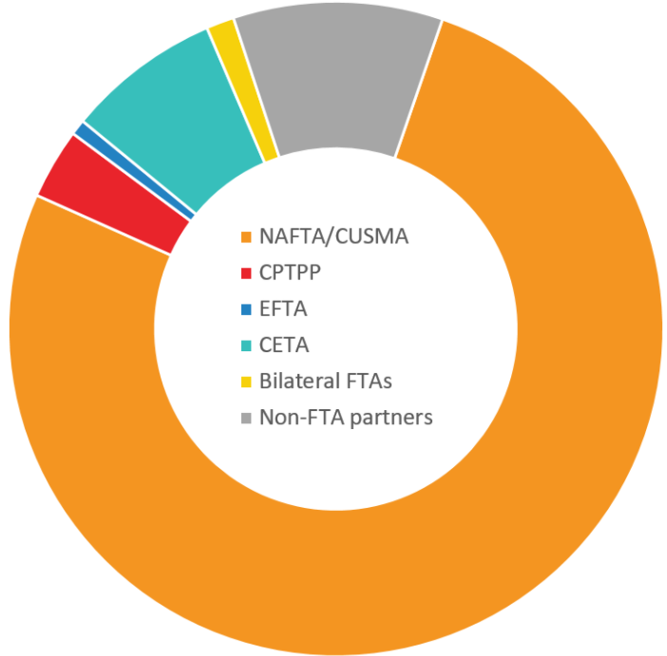

CANADA’S FREE TRADE AGREEMENTS (FTA)
Canada's total exports in 2018
Source: Trade Data Online
1%
10%
8%
1%
14 FTAs
3%
NAFTA/CUSMA
51 countries
CPTPP*
EFTA
CETA
Bilateral FTAs
Non-FTA partners
1.5 billion customers
76%
*Includes non-ratified members, and excludes Mexico
Notes:
Canada’s Free Trade Agreements are there to diversify export markets, generate more wealth and getting more Canadians involved in international trade.
Competitive advantage
They provide lower tariffs, protection for investors, transparency, standards & cooperation
14 FTAs
We count 14 FTAs currently in force, this includes over 51 countries.
1.5B customers
Canada’s FTAs open up preferential access to 1.5 billion consumers across the world, our country resembles a global trading hub.
EFTA --- Switzerland, Lichtenstein, Iceland, Norway
Four countries yet to ratify TPP
Brunei, Chile, Malaysia, Peru

Slide 12
Section 1. | The Trade Commissioner Service
Section 2. | The Role of Regional Offices
Section 3. | CanExport 101
Section 4. | SME Federal Growth Journey

Slide 13
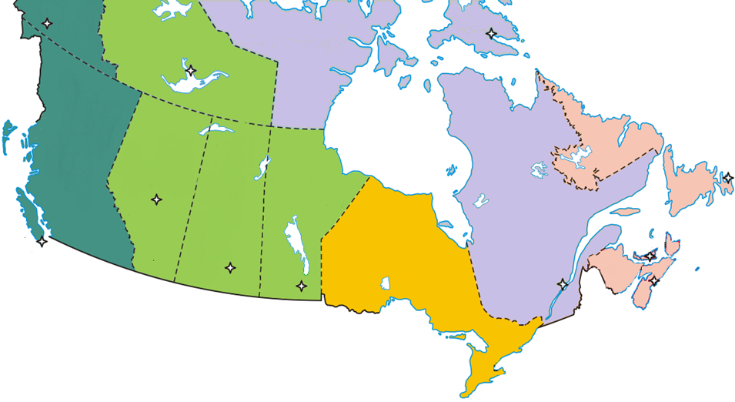


The Regional Office network
Yukon
Regional Office Hub
Northwest Territories
Nunavut
Satellite Officer(s)
Alignment with Partners
Newfoundland & Labrador
British Columbia
Alberta
St. John’s
Edmonton
Québec
Digital Transformation
Saskatchewan
Manitoba
VANCOUVER
Saskatoon
Charlottetown
Victoria
Regina
PEI
CALGARY
Winnipeg
Ontario
Moncton
Québec City
MONTREAL
HALIFAX
New Brunswick
Nova Scotia
Pacific Region (ROPAC)
TORONTO
Ottawa
Alberta & NWT Region (ROANT)
Manitoba & Saskatchewan Region (ROMSK)
Kitchener
Ontario Region (ROONT)
Updated August, 2019
Québec & Nunavut Region (ROQUE)
London
Atlantic Region (ROATL)

Slide 14
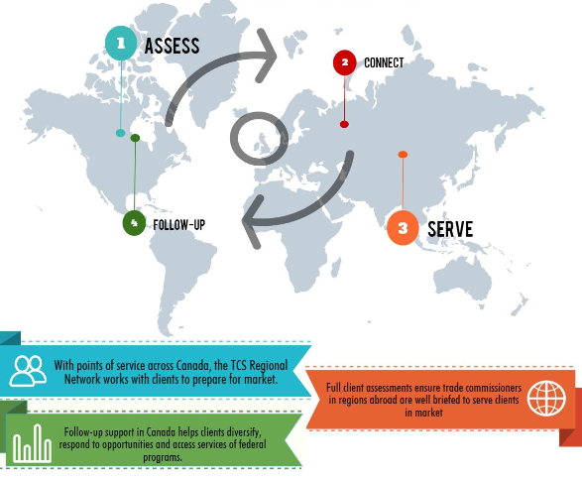
The Role of the regional office
TCS Regional Network, part of Global Affairs Canada’s Regional Trade Operations and Intergovernmental Relations Bureau (BSD), is a critical component of the Department’s global trade network working to support the success of the Trade Diversification Strategy. The Regional Network is the domestic arm of the Trade Commissioner Service consisting of six Regional Office Hubs plus an expanded network of Client Service Satellites (trade commissioners co-located with partners).
The mandate is to:
Engage with high-potential clients in proactive sectors and provide customized and sustained service;
Support high-impact and aligned domestic outreach by Minister’s, select HOMs and Global Affairs Canada senior-level executives.
Digital Transformation

Slide 15
Section 1. | The Trade Commissioner Service
Section 2. | The Role of Regional Offices
Section 3. | CanExport 101
Section 4. | SME Federal Growth Journey

Slide 16
CanExport – SMEs Guidelines:
Basic eligibility for companies (<500 FTE, revenue of $100K-$100M)
Choice of 7 activity categories in up to 5 international markets
Project value of $20K*-$100K
*Submitting a project <20K is allowed only when a project is limited to participation in a trade mission organized by GAC for groups under-represented in international trade
New Guidelines
Covers all sectors, including agriculture and agri-food
Increased funding amounts
Equal amounts for contributions and grants
Broader definition for “new market”
More guidance on eligible/ineligible expenses
Sales below $100K or 10% of total sales (domestic + international)
in past fiscal year (or 12 months for monthly or quarterly filers).
USA now divided into 4 sub-national markets; as well as Brazil, India and China.
Funding amounts
↑ Cost-sharing to 75:25 with stacking limit
$15K-$75K per project ($99,999 per year; $200K for related companies)
Cap of $50K on consultants’ fees
Notes:
Basic eligibility has not changed: we did not touch the basic eligibility requirements for companies. So if a company was not eligible before the new guidelines, they will not be eligible under the new guidelines.
We haven’t added any new category of activities (travel, participation in trade fairs, adaptation and creation of marketing material, interpretation, IP protection, consultant work).
We have maintained a limit of 5 target markets.
The project value limits are the same: from a minimum of $20K to $100K.
Here’s what has changed about the program.
We started covering the agriculture and agri-food sector on August 22.
The most profound change is that the cost sharing went from 50% to 75%. This means that companies are receiving 50% more than they would have had under the old guidelines. For a $20K project, SMEs will now be getting 15K instead of $10K. That’s for every recipient.
There are many reasons why we wanted to do the change but the principal one was that we wanted to harmonize with the other pillars, which all have a 75/25 cost sharing.
Another significant change is that the maximum limits for grants and contributions will now be the same.
Under the old guidelines, the maximum for grants was $30K. So projects of over $60K were not considered for grants – that will no longer be the case under the new guidelines: each project can potentially be grantable. It doesn’t mean that every single project will be a grant. We will still do a risk analysis based on the company profile and their performance in previous CanExport projects. If a company performed well and didn’t lapse too much of their funds the last time around, they are more likely to receive a grant. We will no longer be constrained by the value of the project or the size of the company.
We are much more generous on our definition of a new market. I’ll go over it in more details on the next slide.
The new CanExport guide is much more user-friendly and clearer for users.
One of the biggest challenges we’re faced with here is that the average CanExport recipient lapses 30% of their funds. So for every $10K that we give them, they only spend $7K. Last year, the lapsing was 38%.
Part of the problem that we saw was that our guidelines were unclear, ambiguous, misleading, hard to find. So when it came time for companies to submit claims, many were surprised when many of the expenses that they submitted were rejected. We wanted to address that disconnect by being clearer about the types of expenses that are eligible and not eligible from the get go.
Our definition of a new market is now more generous:
Below $100K in sales; OR
Below 10% of TOTAL sales.
For multiple target markets, as long as each of the target market satisfies these requirements, they’re good to go.
We wanted to change market eligibility to take into account accidental sales.
By popular demand, the US market is now segmented into 4 subnational markets: northeast, Midwest, south, west.
We will now fund 75% of the project, just like the other pillars of the TISP.
Our project size limits remain the same ($20K-$100K) so the funding limits will be $15K-$75K.
We have put a hard cap of $50K in funding for each project so theoretically, a company could do a project that is purely consultant fees.

Slide 17
CanExport - SMEs
CanExport SMEs is a Cost-sharing program to help small and medium sized businesses registered in Canada diversify their exports to new markets.
Funding of $10,000-$75,000 per project (for a maximum of $99,999 per year); average funding amount is $30,000.
Simple, intuitive online application process that is open year-round.
Decisions rendered in 25 business days.
All economic sectors will be covered since the transfer of the Agri-Marketing program from AAFC on August 22nd.
1,800+ projects approved
1500+ recipients
125+ new markets targeted
44% of projects result in new exports within 1 year
$376M+ in new exports
Average Recipient:
  30 employees
  $5.8M in annual revenue
Average Funding = $30K (before new guidelines)

Slide 18
Section 1. | The Trade Commissioner Service
Section 2. | The Role of Regional Offices
Section 3. | CanExport 101
Section 4. | SME Federal Growth Journey

Slide 19



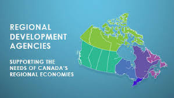



SME Federal Growth Support journey:
from Domestic to international expansion
PRODUCT DEVELOPMENT
BUSINESS ADVICE
& FUNDING
SCALE-UP &
EXPORT PREP
EXPORT FINANCING
INTERNATIONAL
EXPANSION
Export
financing
Canada Commercial Corporation
(CCC)
Strategic Innovation Fund (SIF)
Innovation Supercluster
Clean Growth Hub
AAFC - Business Support & AgriMarketing
> 10
Trade Commissioner Service
(TCS)
Export
Development Canada
(EDC)
NRC-Industrial Assistance Program (IRAP)
NRCan Tech Development & Transfer
Business
Development
Canada
(BDC)
Company Size ($ Million)
1-10
Regional
Development Agencies
(RDAs)
< 1
Product Development
Technology Adaptation
Tech Demonstration
Commercialization
Foreign Market Entry
International Expansion
Notes:
domestic

Slide 20
Contact
  Brad Havixbeck
  Trade Commissioner
  204-583-5124
  Brad.havixbeck@international.gc.ca
20

