Slide 1
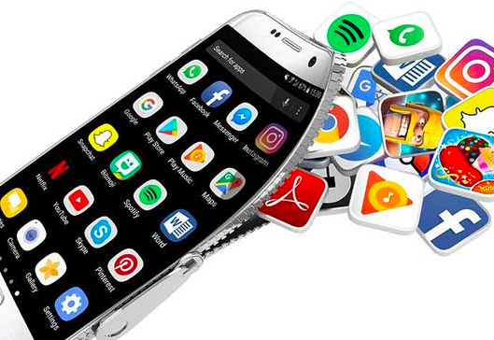
App Trader
A mobile app broker

Slide 2

Founded December 2020 -
Covid Opportunity
Idea:
Let developers focus on development; we’ll take on the marketing and accounting related to in-app purchases

Slide 3


App Trader Business Model
Partnership with app developers
Developers create the apps
Developers keep all money when users purchase the app
Developers keep 1/2 of the money from in-app purchases
App Trader purchases rights to the app from developers
App Trader markets the app
App Trader keeps 1/2 of the money from in-app purchases

Slide 4
What our research has shown
App Trader pays for rights to broker the app. A fair market price starts at $10,000 and is equal to $10,000 or 10,000 times the price of the app (in the app store) – whichever is greater.
Apps earn an average of $5000 per month from in-app advertising and in-app purchases. This is the number you’ll use to evaluate income.
App Trader will spend $1000/month to market an app. If the app is available in both the Apple App Store and the Google Play Store, we only pay $1000/month to market both versions. For this reason, we prefer to work with apps that are available in both stores.
Apps come and go. You can estimate the lifespan of an app by looking at its star rating. The number of years an app is available begins at 1 for an app with a rating of 0 and increases one year for every half point increase in rating.

Slide 5
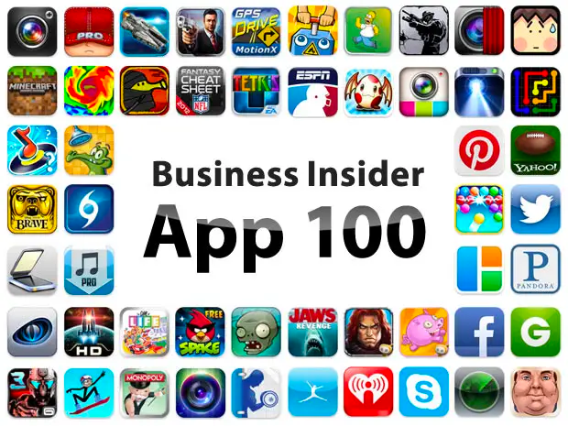
What we want from you, our analytics consultants
General recommendation on what types of apps to focus our attention on:
Genre
Content Rating
Price Range
Make a recommendation of 10 apps to buy next week and market for a Black Friday debut event on November 26, 2021.
Black
Friday
Event

