Slide 1
NYC Transit Hub
PROJECT PROPOSAL & WORKING PROTOTYPE
Real-time subway status, arrivals, station accessibility and personal alerts for New York City, built on MTA open data.
1
4
7
A
F
Q
October 2026
Notes:
NYC Transit Hub is a web app that puts the four things a subway rider checks into one place: is my line running, when is the next train, is the elevator working, and tell me if something changes. It is built and runs today on sample data, and switches to live MTA feeds when deployed.

Slide 2
Before leaving home, a rider answers four questions in four places
THE PROBLEM
?
?
?
?
Is my line running?
When is the next train?
Is the elevator working?
Will I hear if it changes?
Service alerts are long and written per incident, not per line.
Countdown clocks are on the platform, after you have paid the fare.
Outages sit in a separate list that most trip apps never show.
Riders want alerts for their own lines, in their own language.
Notes:
Each of these answers exists in MTA data today, but a rider has to stitch them together. For riders who use a wheelchair, a stroller or luggage, the elevator question decides whether the trip works at all.

Slide 3






Six features, one screen
THE PRODUCT
Service status dashboard
Interactive map
Accessibility
Every line at a glance: good, change, delays or suspended.
Lines and stations; tap one for live arrivals by direction.
Current and planned elevator and escalator outages.
Favorites and alerts
Six languages
User accounts
Star lines and stations; get notified when status changes.
English, Spanish, Chinese, Russian, Bengali, Korean.
Firebase sign-in; favorites sync across devices.
Notes:
These are the six features from the brief, all implemented in the prototype. The next slides show each one.

Slide 4
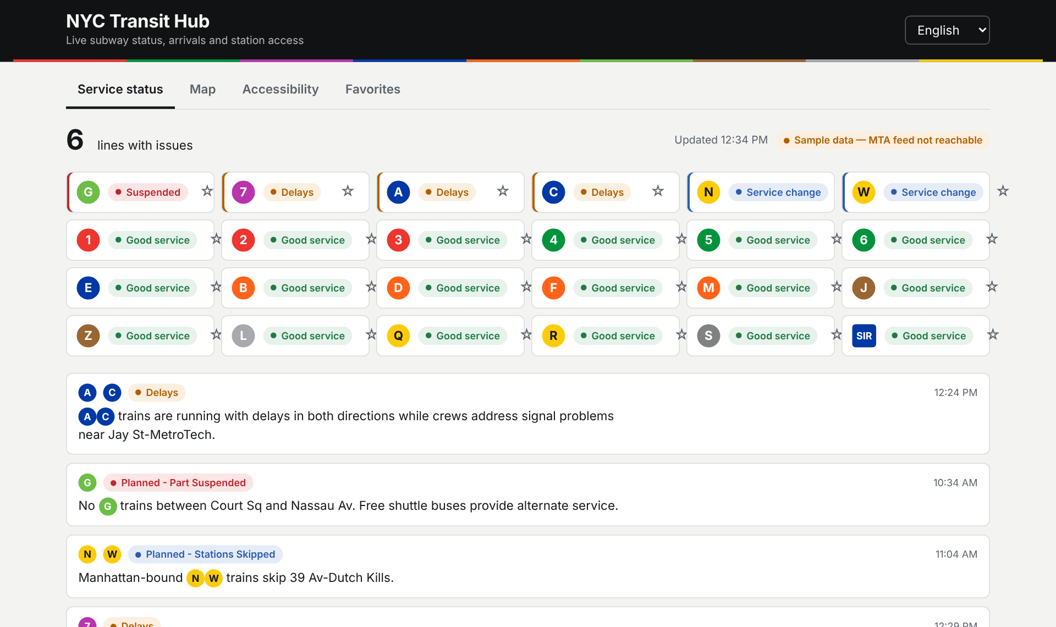
One status per line, worst alert wins
SERVICE STATUS
The server reads the MTA alerts feed, drops alerts outside their active period, and rolls the rest up by route.
Suspended — no service on part of the line
Delays — trains running slowly
Service change — reroutes, skipped stops
Good service
Notes:
Sorting puts problem lines first. Alert text marks routes as bracketed letters, like [A], which the app renders as line bullets. The screenshot is the prototype running on sample data.

Slide 5
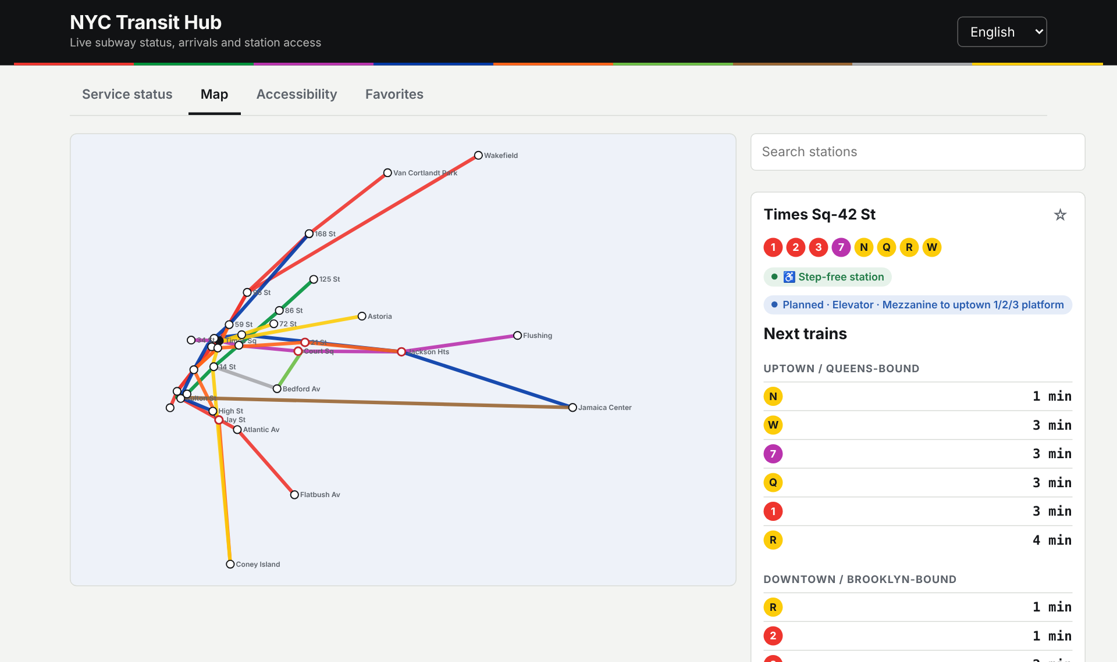
Tap a station, see the next trains
MAP & ARRIVALS
Leaflet map with lines and every station complex
Search by name; panel shows lines, step-free access and outages
Arrivals decoded from GTFS-realtime, split uptown and downtown
Notes:
A station like Times Sq is several GTFS stops, one per line group. The app merges them into one panel and requests each group's feed, so the 1/2/3, 7 and N/Q/R/W arrivals appear together. In the offline demo the map is a schematic drawn from the same coordinates.

Slide 6
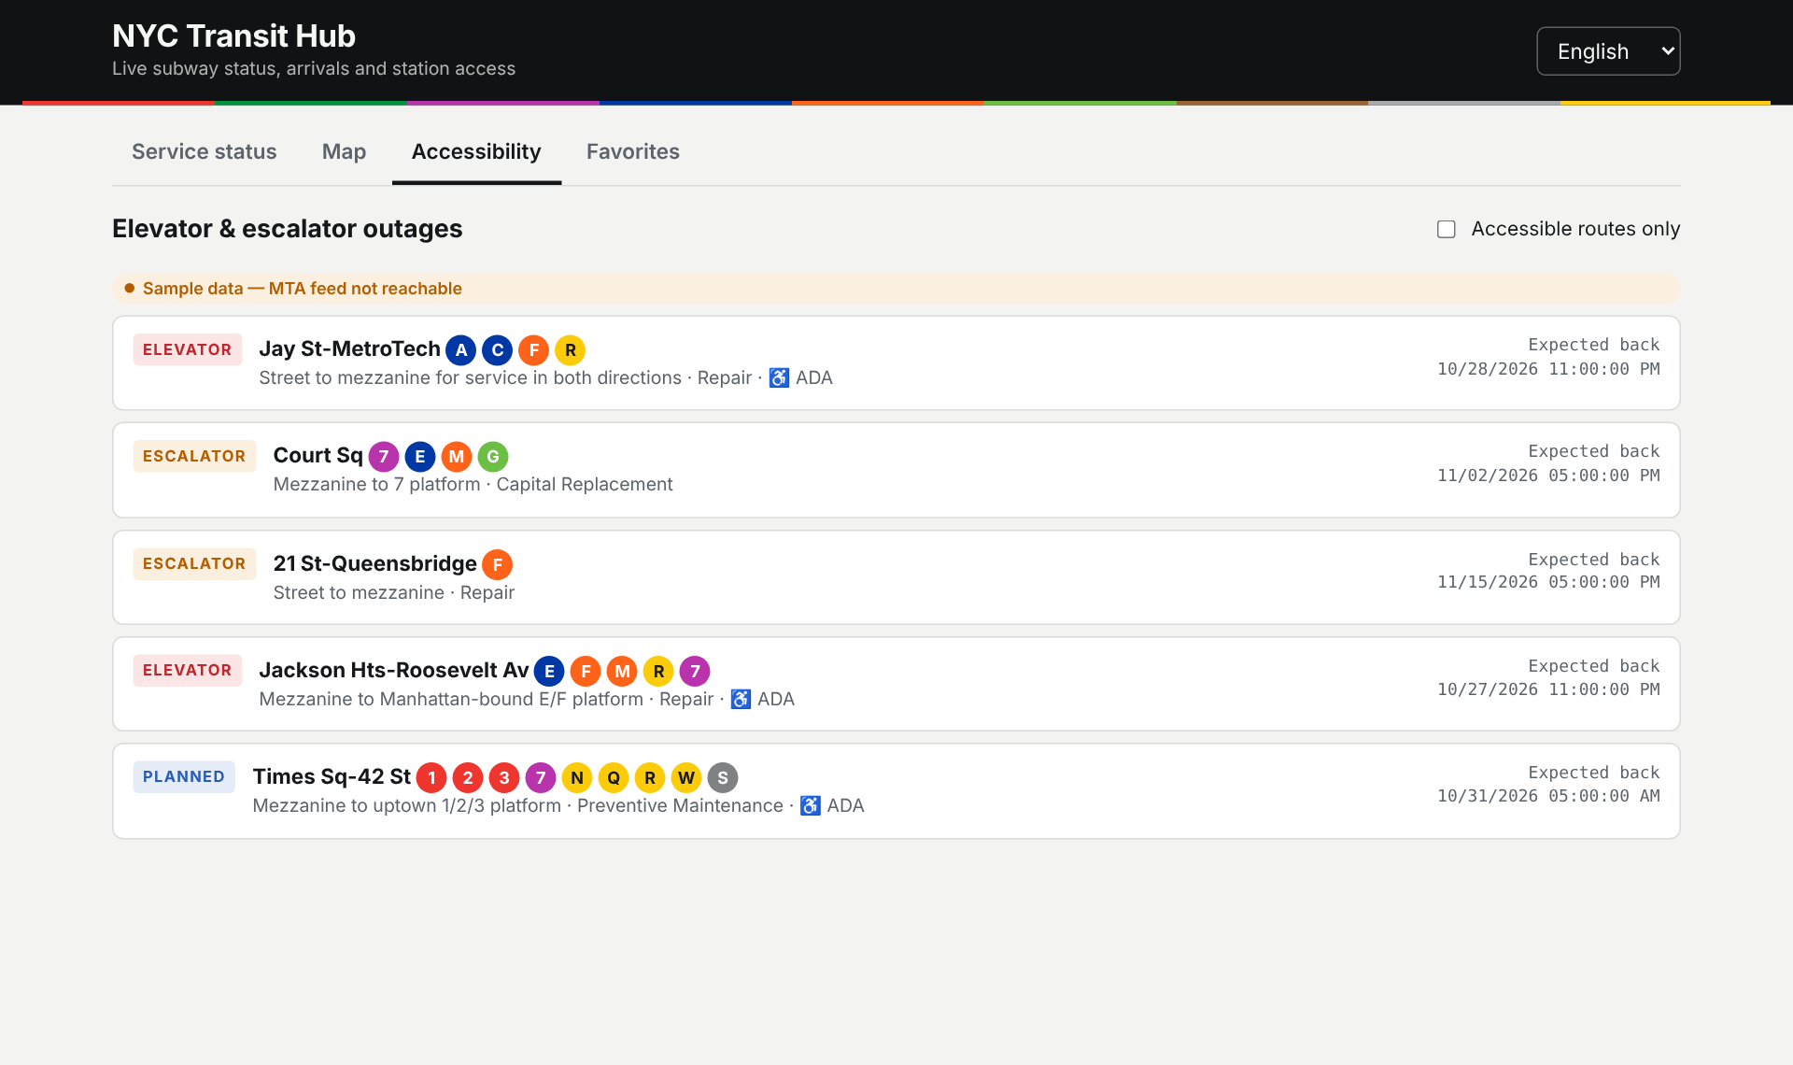
Know the elevator is out before you go
ACCESSIBILITY
Current and planned outages from the MTA elevator and escalator feeds
Filter to equipment on accessible (ADA) routes
Expected return time for each outage
Affected stations are outlined in red on the map
Notes:
The outage feed needs no API key. The roadmap adds a trip planner that routes around stations with an elevator out.

Slide 7
Your lines, your language, on every device
PERSONAL & MULTILINGUAL
Favorites & alerts
Firebase accounts
Six languages
Star any line or station. With alerts on, the app checks status every 60 seconds and sends a browser notification when a saved line changes.
Email/password or Google sign-in. Favorites live in Firestore at users/{uid}; security rules let each user touch only their own record.
English, Español, 中文, Русский, বাংলা, 한국어. The choice is also sent to the server so MTA alert text comes back translated where the feed has it.
Signed out, favorites are kept in the browser and merged into the account on first sign-in.
Notes:
Language defaults to the browser's setting. Adding a language is one block of strings in i18n.js.

Slide 8


A thin server turns MTA feeds into small JSON
ARCHITECTURE
MTA feeds
Browser
Node API
8 subway GTFS-realtime feeds
HTML + JS modules, Leaflet map, i18n, notifications
/api
Express, protobuf decode, 30-second cache, sample-data fallback
HTTPS
Subway alerts (JSON)
Elevator & escalator status
Bus Time SIRI (key)
The MTA feeds are protobuf and send no CORS headers, so the browser can’t read them directly. One cached upstream call per feed serves every user, and responses are labelled live or sample.
Firebase
Auth + Firestore favorites
Notes:
Request flow: the browser calls /api/status, /api/arrivals or /api/accessibility. The server fetches the matching MTA feed if its cache is older than 30 seconds, decodes it with gtfs-realtime-bindings, reshapes it with pure functions in transform.js, and returns JSON. Accounts never touch the server: the browser talks to Firebase directly.

Slide 9
Everything except buses runs without an API key
MTA DATA
Feed | Format | Key | Powers
Subway realtime (8 feeds) | GTFS-RT protobuf | None | Next-train arrivals
Subway alerts | GTFS-RT JSON | None | Status dashboard, alerts
Elevators & escalators | JSON | None | Accessibility view, map flags
Static subway GTFS | CSV in zip | None | Station list and coordinates
Bus Time SIRI | JSON | Free key | Bus arrivals API
Sources: api.mta.info, bustime.mta.info developer docs. Use is subject to the MTA Data Feed Agreement.
Notes:
Subway feeds are grouped by line division: 1-7 and shuttle, ACE, BDFM, G, JZ, L, NQRW and the Staten Island Railway. Bus keys are free from register.developer.obanyc.com. MTA logos and route symbols need a separate license before a public launch.

Slide 10
Working prototype, tested and runnable offline
BUILD STATUS
Stack
Quality
Layer | Choice
Server | Node 18+, Express
Realtime | gtfs-realtime-bindings
Frontend | Plain JS modules
Map | Leaflet + OpenStreetMap
Accounts | Firebase Auth, Firestore
6 unit tests on the feed parsers, all passing
Falls back to labelled sample data if the MTA is unreachable
Input validation on every API route
Works at phone width, light and dark mode
Single-file offline demo built from the same code
Notes:
npm test runs the parser tests with Node's built-in test runner. npm run sample starts the whole app on sample data, which is how the screenshots in this deck were taken.

Slide 11
From prototype to public launch
ROADMAP
Now
Next
Later
Deploy with live feeds
Full station list from static GTFS
Connect a Firebase project
Push alerts with the app closed (FCM)
Live bus positions on the map
Real track shapes from GTFS
Step-free trip planner
LIRR and Metro-North
Installable PWA, offline cache
Notes:
Push alerts while the app is closed need a scheduled Cloud Function that diffs line status and sends Firebase Cloud Messages. The step-free planner routes around stations whose elevators are out.

Slide 12
Run it in three commands
npm install
npm run build:stations
npm start → localhost:3000
Or open the offline demo: the same app on sample data, no install needed.
Notes:
The source zip includes a README with Firebase setup, the API reference and the full list of MTA feeds.

