Slide 1

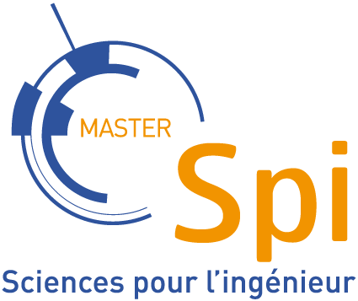
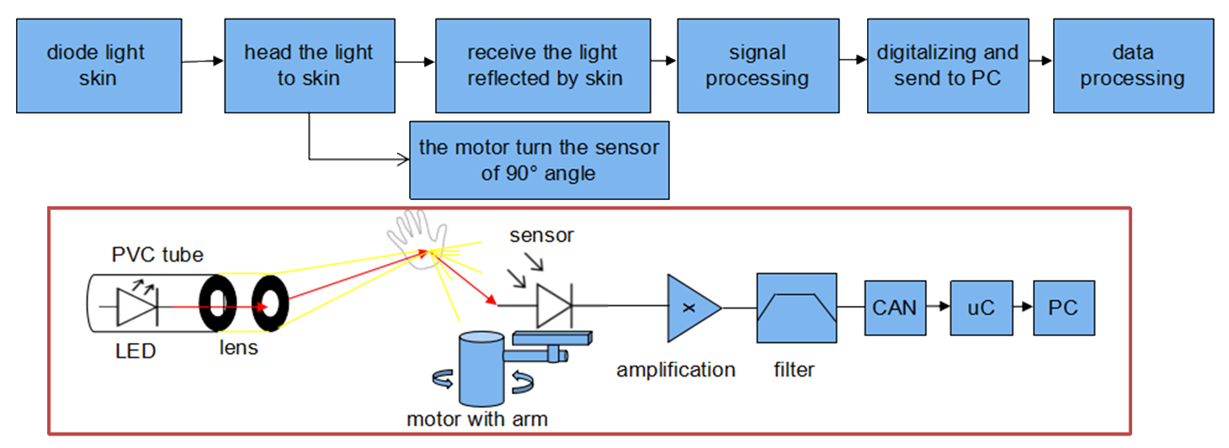
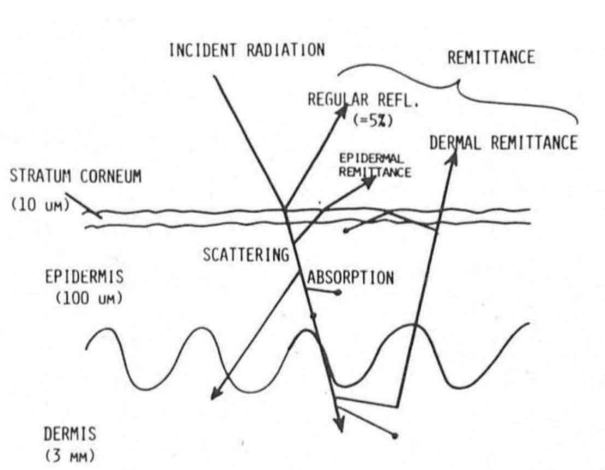
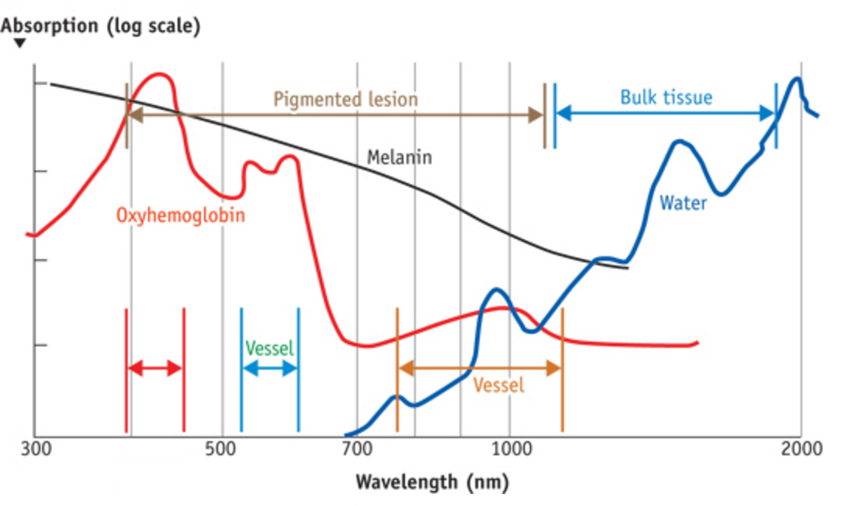
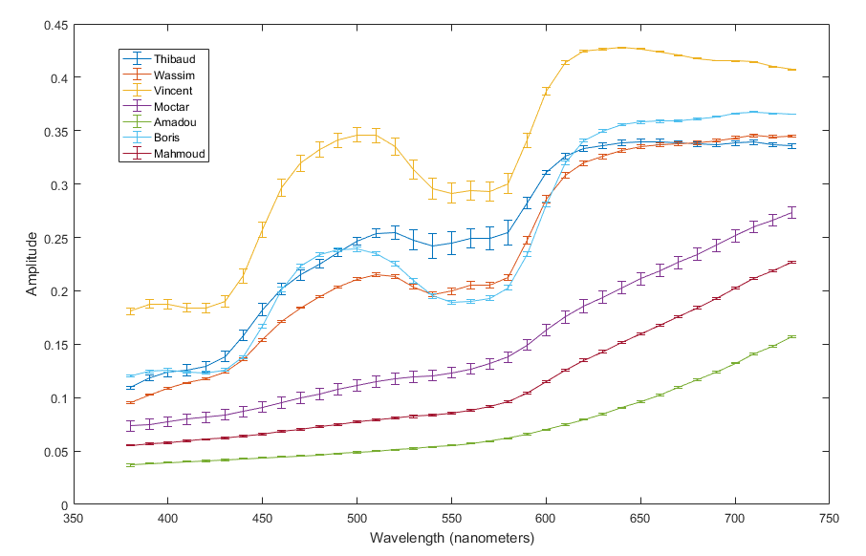
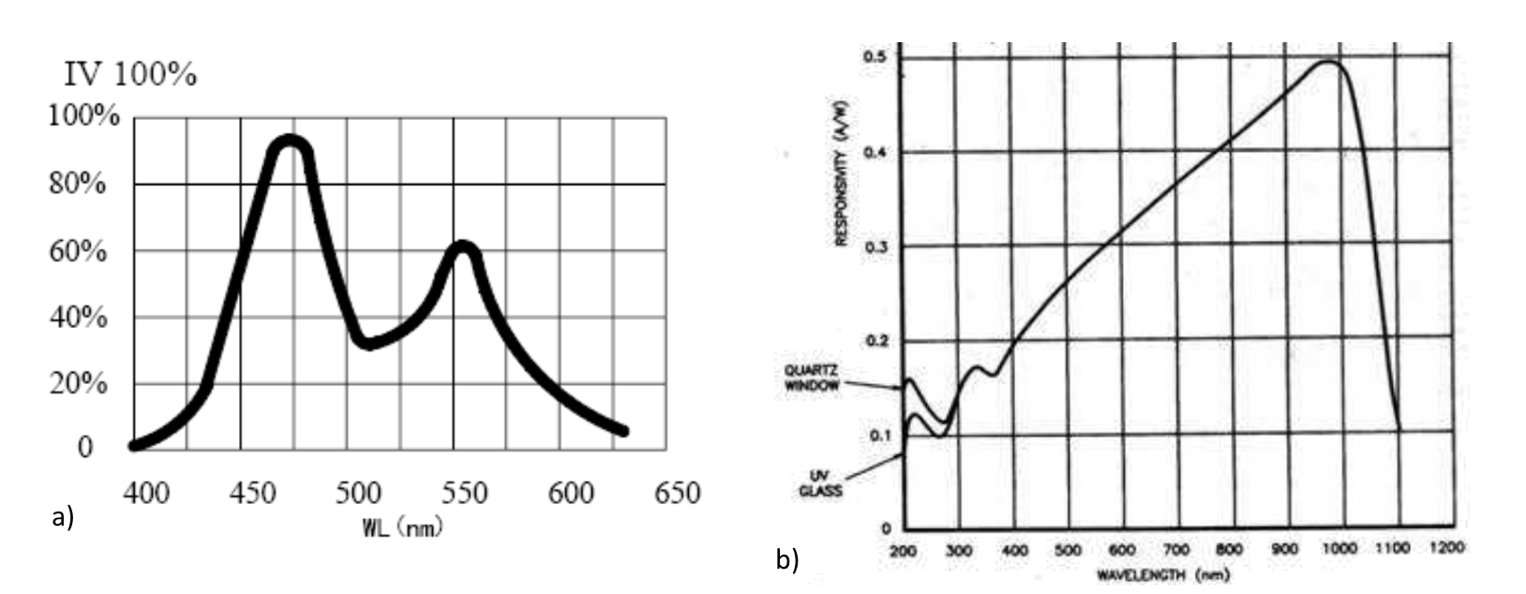
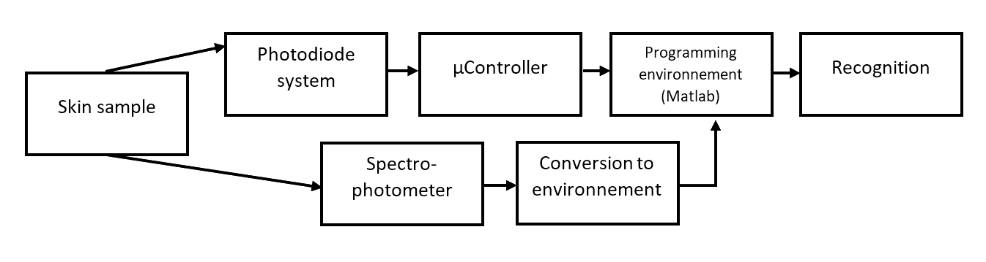
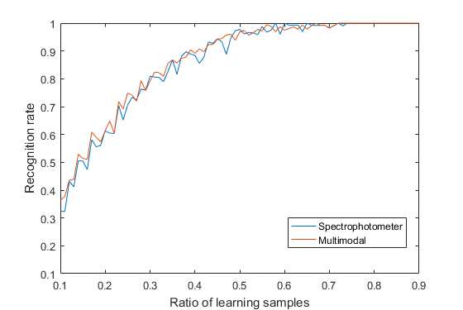
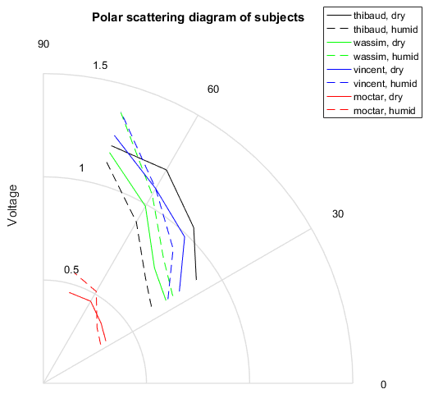
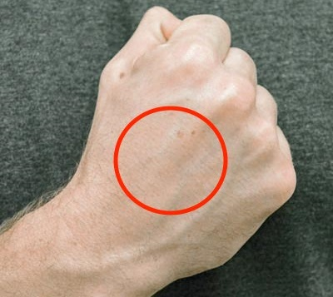
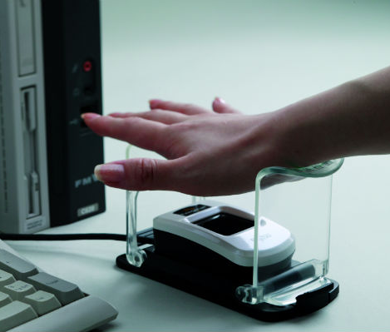
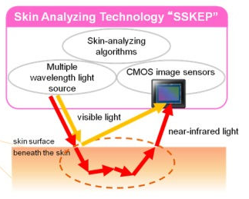
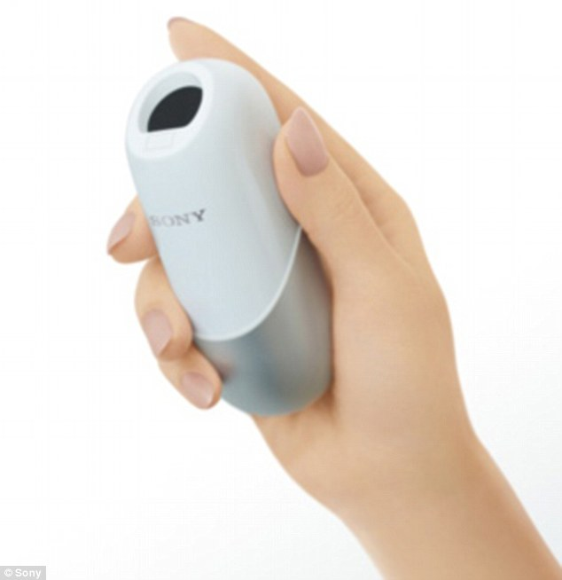
Caracterization study of the human skin
END OF MASTER PROJECT – MASTER OF ENGINEERING
Wassim Ourkiya, Vincent Maison, Kamel Loukkas, Sohan Lindor, Oumaima Krimech and Corentin Chan
Supervisor : Pr. Stéphane Holé (ESPCI), in charge of Sensor, Measurement and Instrumentation (CIMES) specialization
Skin – Light Interaction
Instrumentation
Identify skin chromophores with spectroscopy
Analysing scattering diagram, for each angle
(1) Schematic diagram of optical pathways in human skin
(2) Absorption coefficients of different chromophores
(3) Descriptive diagram and schematic of the system
Light isolated environnement
Skin sample is lighten up with a LED by converging light through lenses
Reflected light captured by the sensor (photodiode)
Stepper motor providing rotational movement, several angles during the measurement
Signal sampled by the microcontroller
Experimentation results
Integration of the absorption spectrum of the skin : ∫𝑆_{𝐸}∗𝑆_{𝑆}∗𝑆_{𝑅} 𝑑𝜆 ; 𝑆_{𝐸}, 𝑆_{𝑆}, and 𝑆_{𝑅} are respectively the spectrum of emission, diffusion and receiver
(4) Spectral response of the emitting (a, 5050 LED) and receiving (b, OSD 35-7X CQ) components
(5) Skin sample area used for each subject, as input of the acquisition system
Acquisition
Identify skin chromophores with spectroscopy
Analysing scattering diagram, for each angle
(4) Block-diagram of the recognition system
Discretization of the rotational movement
Convert photocurrent into data in a programming environnement
Measuring the absorption spectrum with a spectrophotometer
Vein segmentation can be done with a camera mounted on the motor
Multimodal recognition, biometric application
(5) Skin sample area used for each subject, as input of the acquisition system
(5) Skin sample area used for each subject, as input of the acquisition system
(5) Skin sample area used for each subject, as input of the acquisition system
Perspectives
Identify skin chromophores with spectroscopy
Analysing scattering diagram, for each angle
(5) Skin sample area used for each subject, as input of the acquisition system
(5) Skin sample area used for each subject, as input of the acquisition system
[23] Sharayanan, English: Depiction of Mie scattering on a spheric particle. The graph roughly displays scattering intensity per direction. From left to right : Rayleigh, intermediate and full Mie scattering. 2007.
[24] T. Vo-Dinh, Biomedical Photonics Handbook. CRC Press, 2003.
[23] Sharayanan, English: Depiction of Mie scattering on a spheric particle. The graph roughly displays scattering intensity per direction. From left to right : Rayleigh, intermediate and full Mie scattering. 2007.
[24] T. Vo-Dinh, Biomedical Photonics Handbook. CRC Press, 2003.
[25] G. Yu, K. Pakbaz, and A. J. Heeger, “Semiconducting polymer diodes: Large size, low cost photodetectors with excellent visible‐ultraviolet sensitivity,” Appl. Phys. Lett., vol. 64, no. 25, pp. 3422–3424, Jun. 1994.
[26] R. Korde and J. Geist, “Quantum efficiency stability of silicon photodiodes,” Appl. Opt., vol. 26, no. 24, pp. 5284–5290, Dec. 1987.

