Slide 1


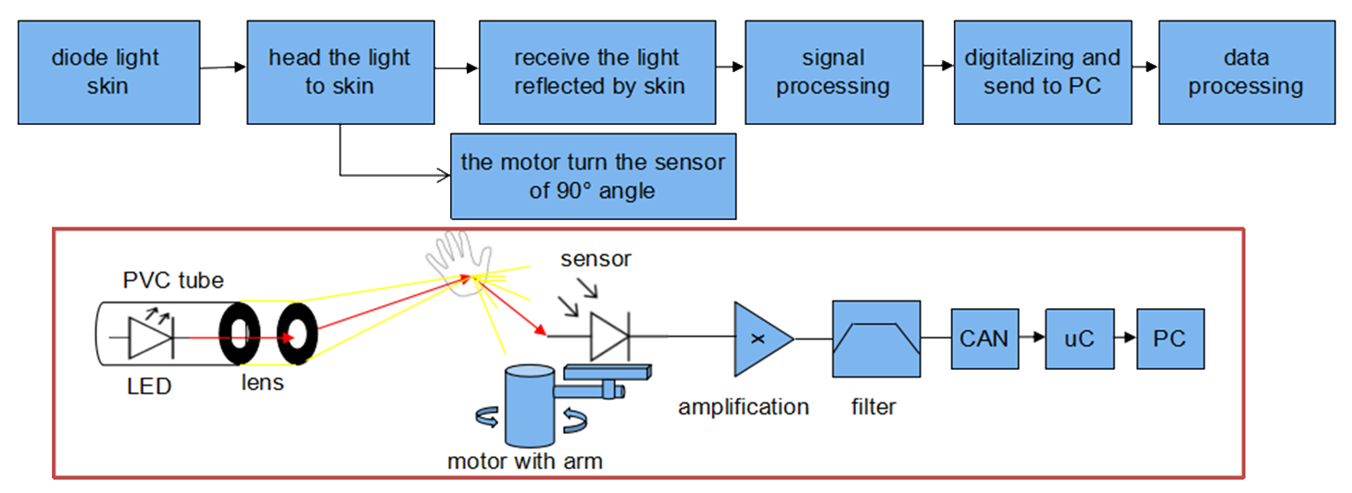
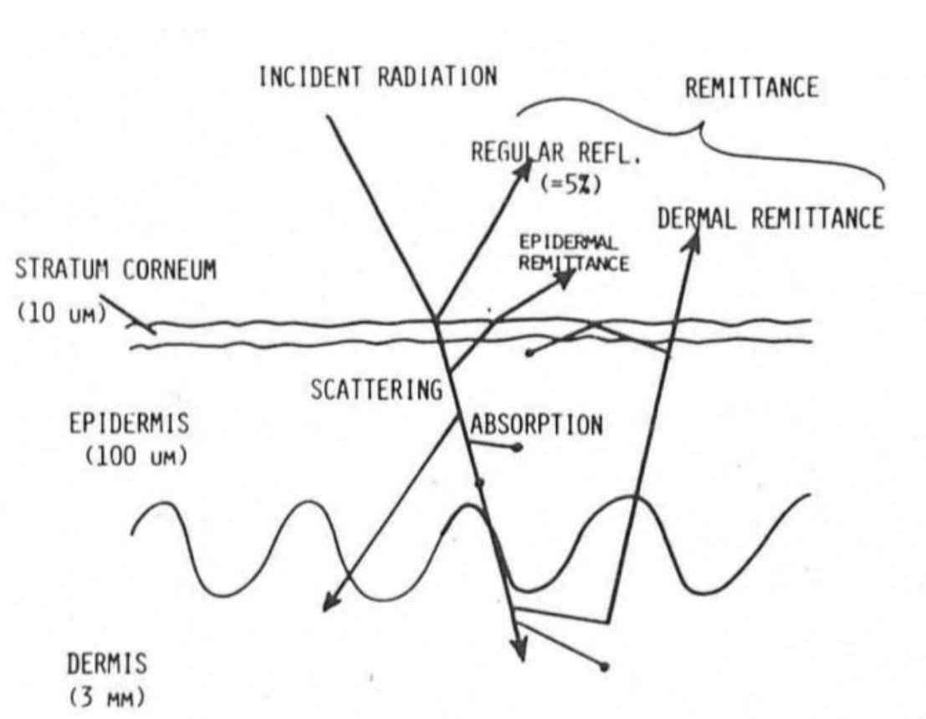
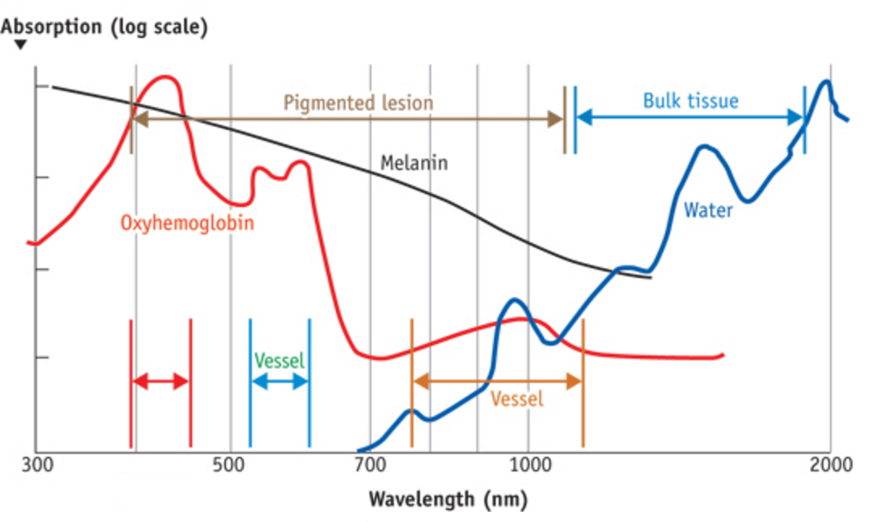
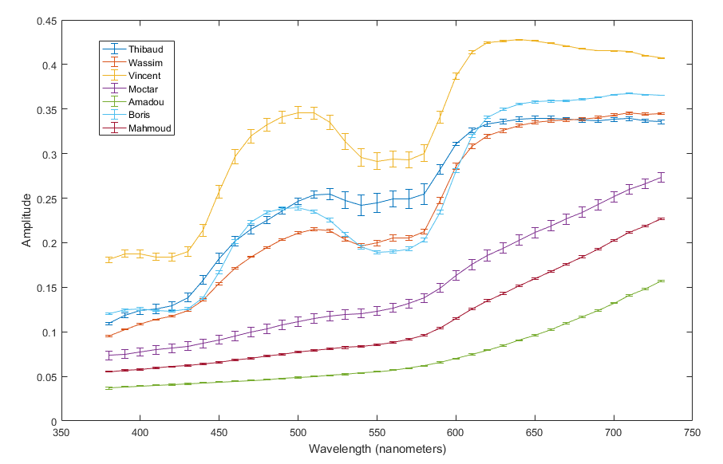
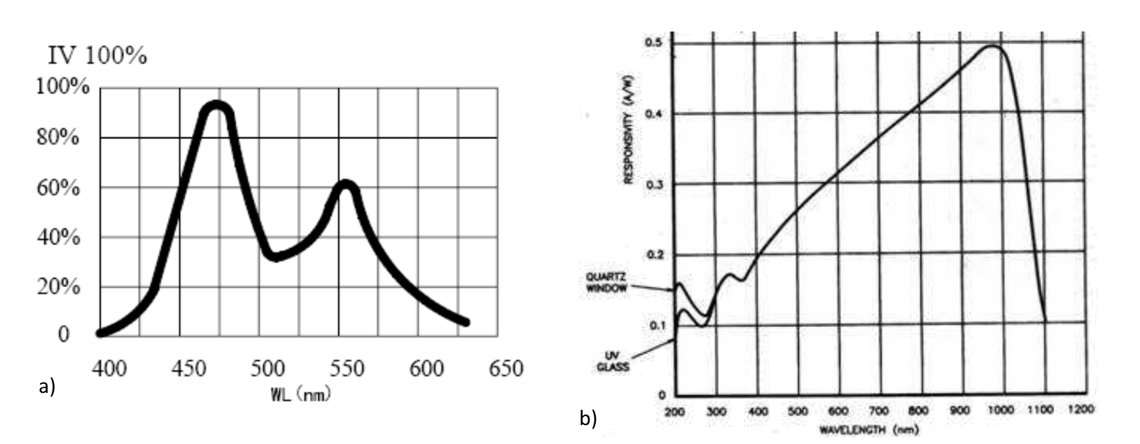
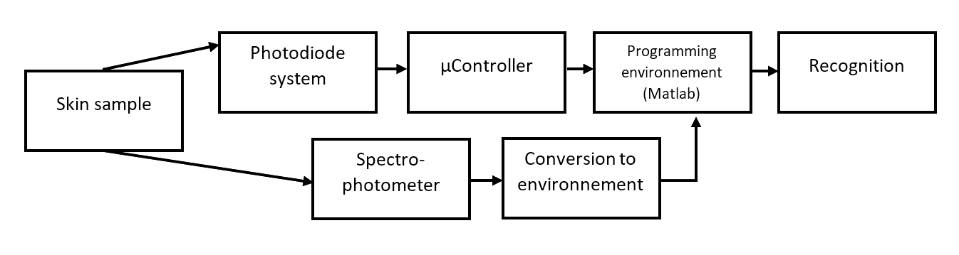
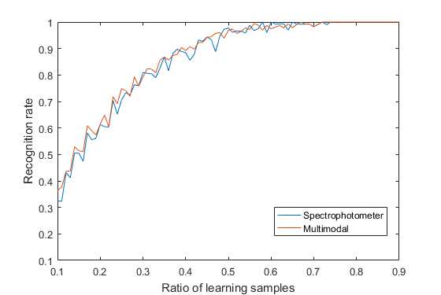
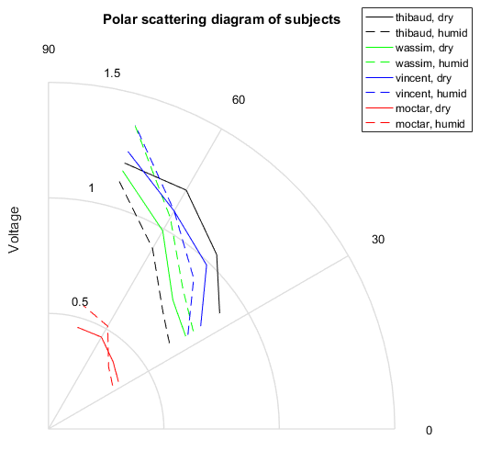
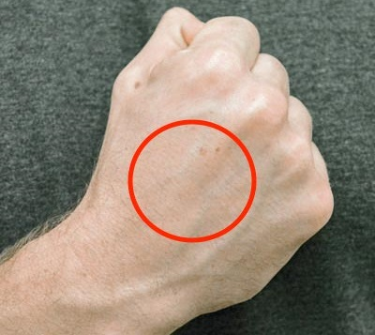

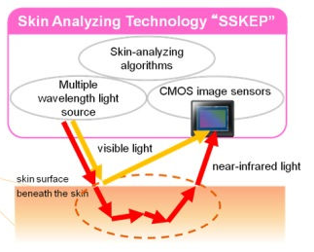
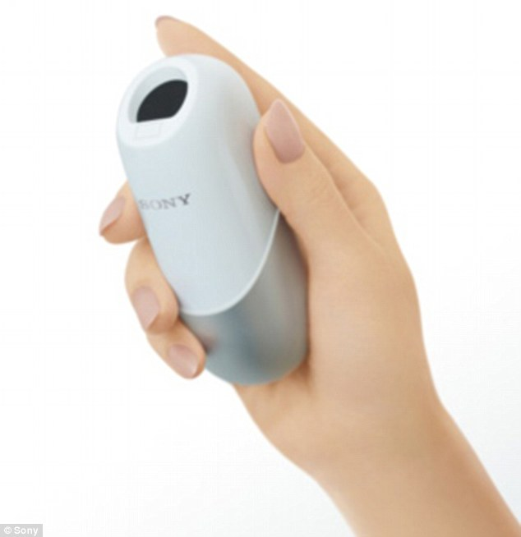
Caracterization study of the human skin
MASTER’S DEGREE FINAL PROJECT – MASTER OF ENGINEERING
Wassim Ourkiya, Vincent Maison, Kamel Loukkas, Sohan Lindor, Oumaima Krimech and Corentin Chan
Supervisor : Pr. Stéphane Holé (ESPCI), in charge of Sensor, Measurement and Instrumentation (CIMES) specialization
Skin – Light Interaction
Instrumentation
Identify skin chromophores with spectroscopy
Analysing scattering diagram, for each angle
(1) Schematic diagram of optical pathways in human skin
(2) Absorption coefficients of different chromophores
(3) Descriptive diagram and schematic of the system
Light isolated environnement
Skin sample is lighten up with a LED by converging light through lenses
Reflected light captured by the sensor (photodiode)
Stepper motor providing rotational movement, several angles during the measurement
Signal sampling by a micro controller
Experimentation results
Integration of the absorption spectrum of the skin :
∫𝑆_{𝐸}∗𝑆_{𝑆}∗𝑆_{𝑅} 𝑑𝜆 ; 𝑆_{𝐸}, 𝑆_{𝑆}, and 𝑆_{𝑅} are
respectively the spectrum of
emission, diffusion and receiver
(4) Spectral response of the emitting (a, 5050 LED) and receiving (b, OSD 35-7X CQ) components
(5) Spectrum of skin samples acquired from right back of hand of each seven subjects
Acquisition
7 healthy subjects in order to chromophores identification
4 subjects to test and compare dry and humid skin, via spectroscopy
Scattering diagram analysis for each angle
Extraction of error bars (input data for recognition tool)
Pattern recognition -> 100% accuracy
(4) Block-diagram of the recognition system
Discretization of the rotational movement
Conversion of photocurrent into data used in programming environnement
Measuring the absorption spectrum with a spectrophotometer
Vein segmentation through a camera mounted on the motor
Multimodal recognition, biometric application
(5) Skin sample area used for each subject, as input of the acquisition system
(6) Recognition rate for the two modalities of the recognition task.
(7) Polar scattering diagram of subjects
Perspectives
Improved system with a monochromator in order to have a great dimensionality as input of recognition data as well as higher accuracy for wide range of different data
Maximized signal-to-noise ratio by minimizing standard deviation.
Coupled system with a camera for a better clustering
Adaptation for different application in different fields of study such as medical, cosmetology, computer graphics as well as biometrics.
© Fujistu
© Sony
(5) Fujitsu PalmSecure Palm Vein, biometric authentication device
(5) Sony’s Smart Skin Evaluation Program, analyzing various elements of the skin
- R. R. Anderson and J. A. Parrish, “The Optics of Human Skin,” J. Invest. Dermatol., vol. 77, no. 1, pp. 13–19, Jul. 1981.
- K. S. Bersha, “Spectral imaging and analysis of human skin,” University of Eastern Finland, 2010.
- J. J. Riesz, The spectroscopic properties of melanin. University of Queensland, 2007.
- T. Vo-Dinh, Biomedical Photonics Handbook. CRC Press, 2003.
- L. Hode, Penetration of light into living tissue. 2012.
- J. K. Wagner, C. Jovel, H. L. Norton, E. J. Parra, and M. D. Shriver, “Comparing quantitative measures of erythema, pigmentation and skin response using reflectometry,” Pigment Cell Res., vol. 15, no. 5, pp. 379–384, Oct. 2002.

