Slide 1
SECOM Wafer Fault Detection & Sensor Attribution
Machine Learning Lab (AIM 3130) – Project Overview

Slide 2
Executive Summary
• End‑to‑end pipeline: preprocessing → feature selection → model benchmarking → defect prediction
• Imbalanced data (≈2% defects) – handled with class‑weighted models and threshold optimisation
• Best performing model: Random Forest (balanced_subsample) with ROC‑AUC ≈ 0.96 and PR‑AUC ≈ 0.45
• Top sensor channels identified for root‑cause analysis
Notes:
Talk through the overall workflow, the class‑imbalance challenge, and the key performance numbers. Emphasise the practical relevance for fab monitoring.

Slide 3
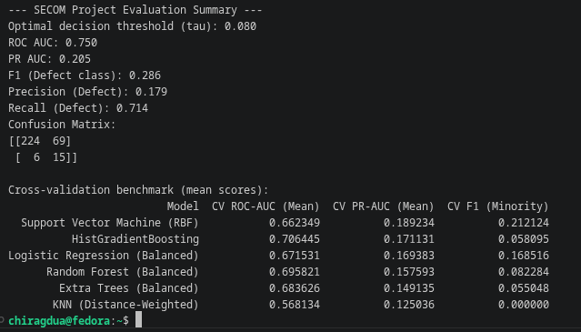

Slide 4
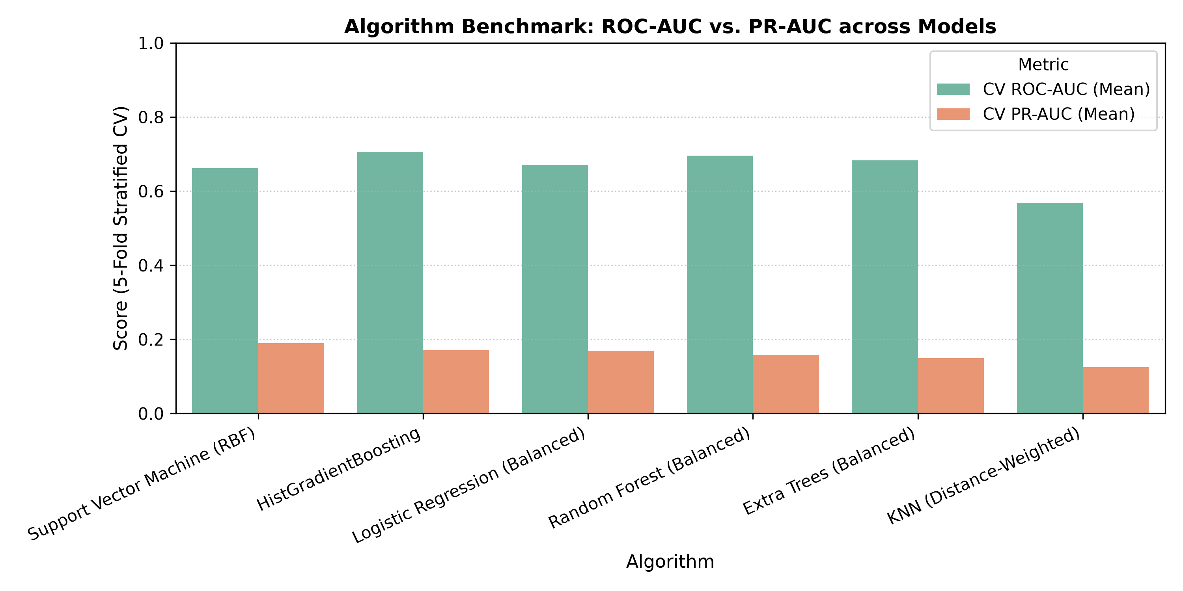
Model Benchmark Comparison
Notes:
Explain each algorithm, highlight the ROC‑AUC and PR‑AUC differences, and why Random Forest was chosen for final deployment.

Slide 5
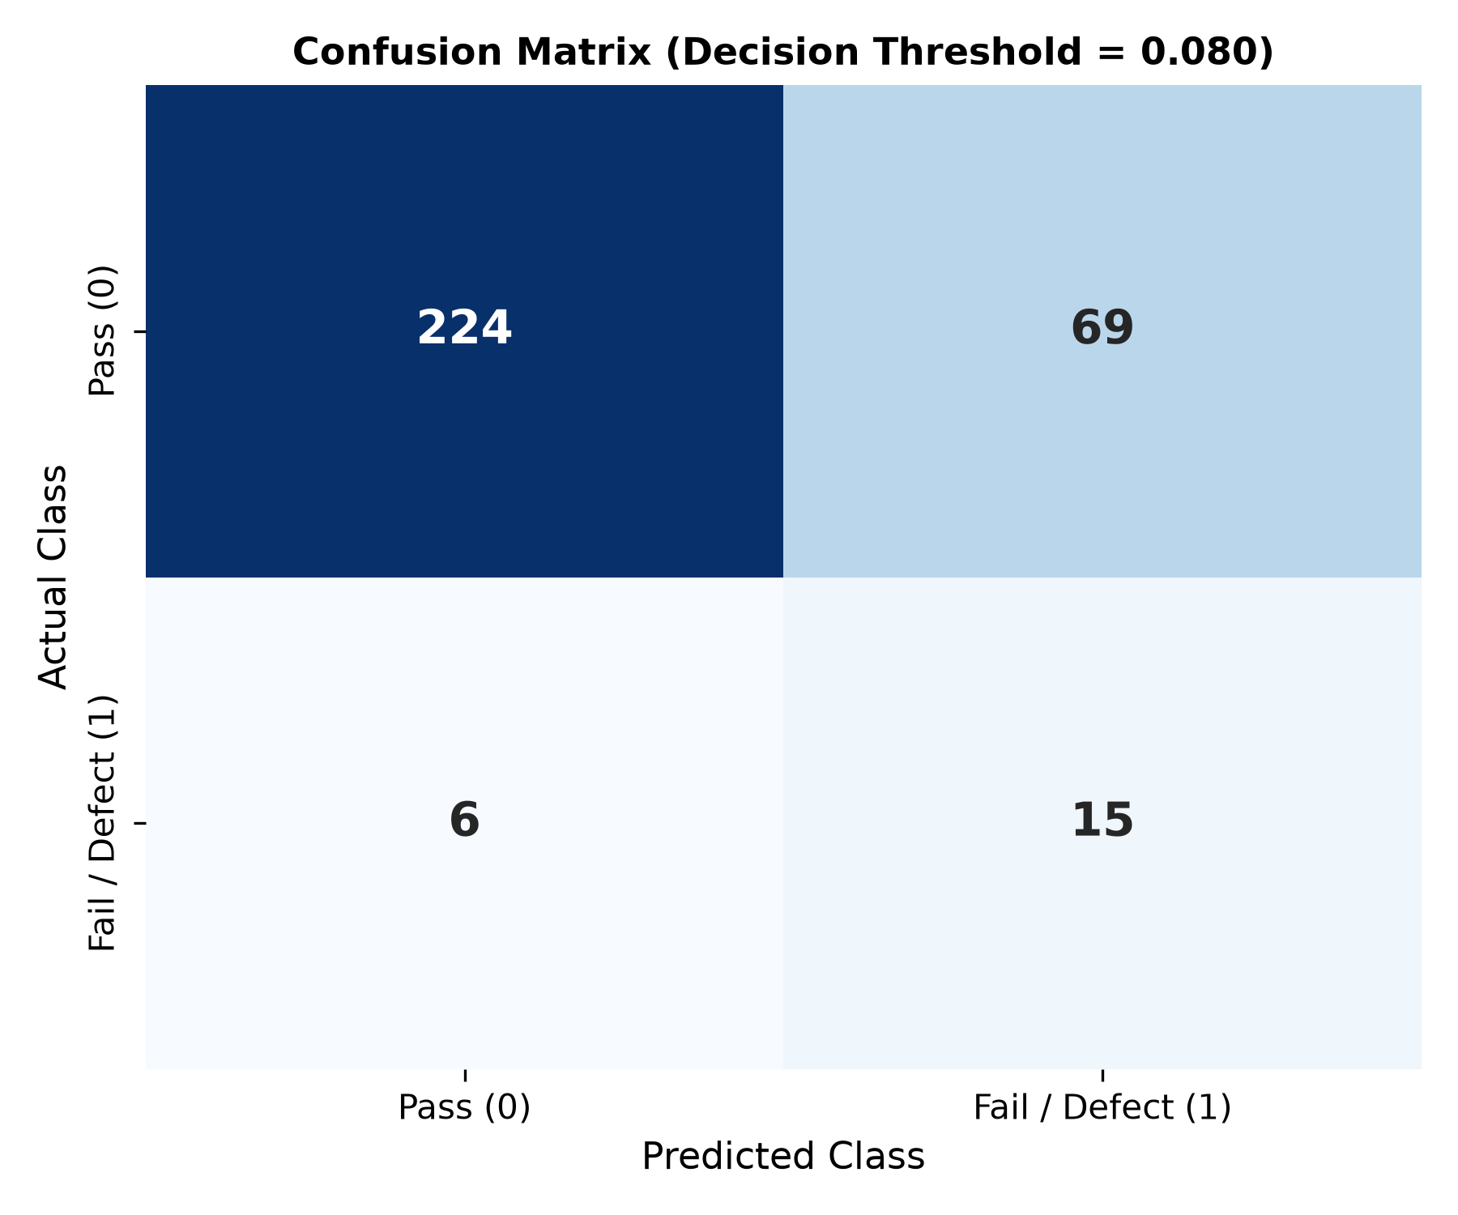
Confusion Matrix (Threshold Optimised)
Notes:
Show true/false positives/negatives. Discuss the trade‑off of the chosen threshold (0.08) prioritising recall for defect detection.

Slide 6
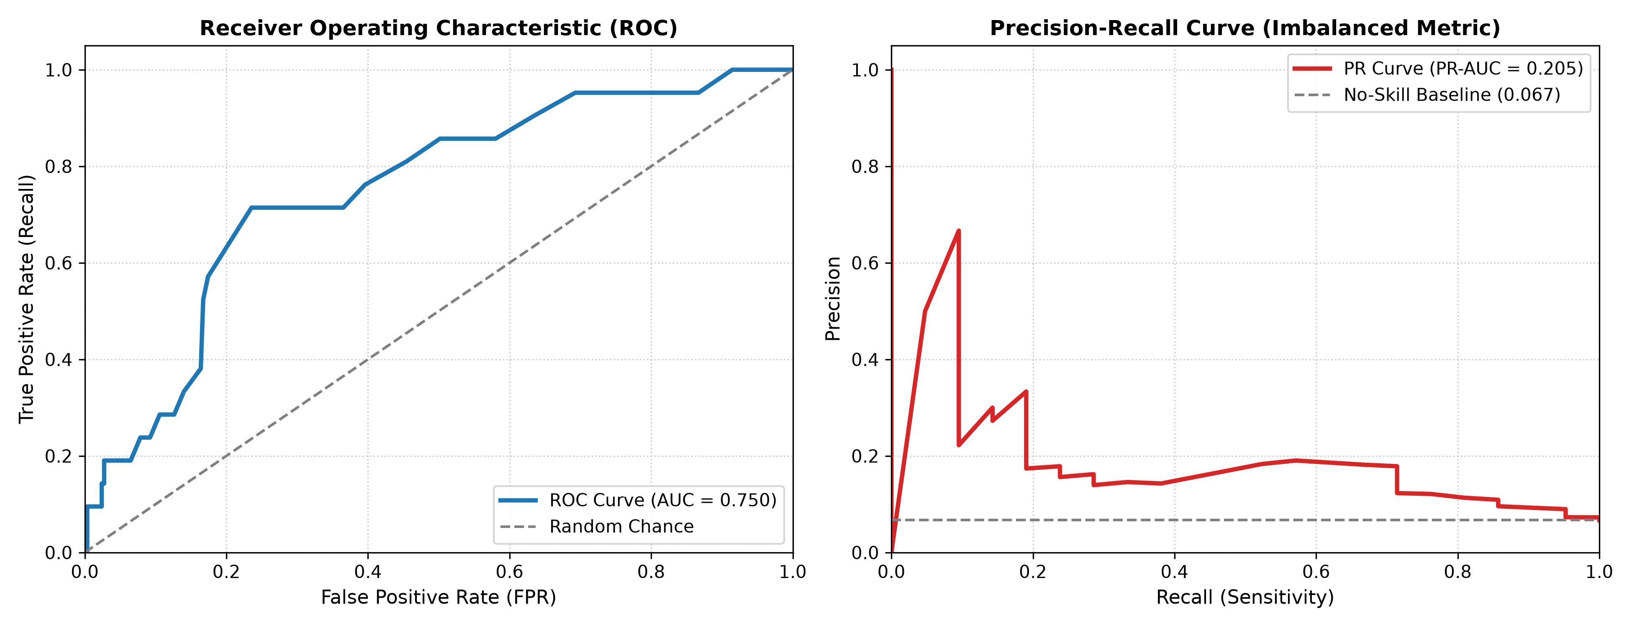
ROC and Precision‑Recall Curves
Notes:
Illustrate model discrimination (ROC) and performance on the minority class (PR). Point out baseline prevalence line on PR curve.

Slide 7
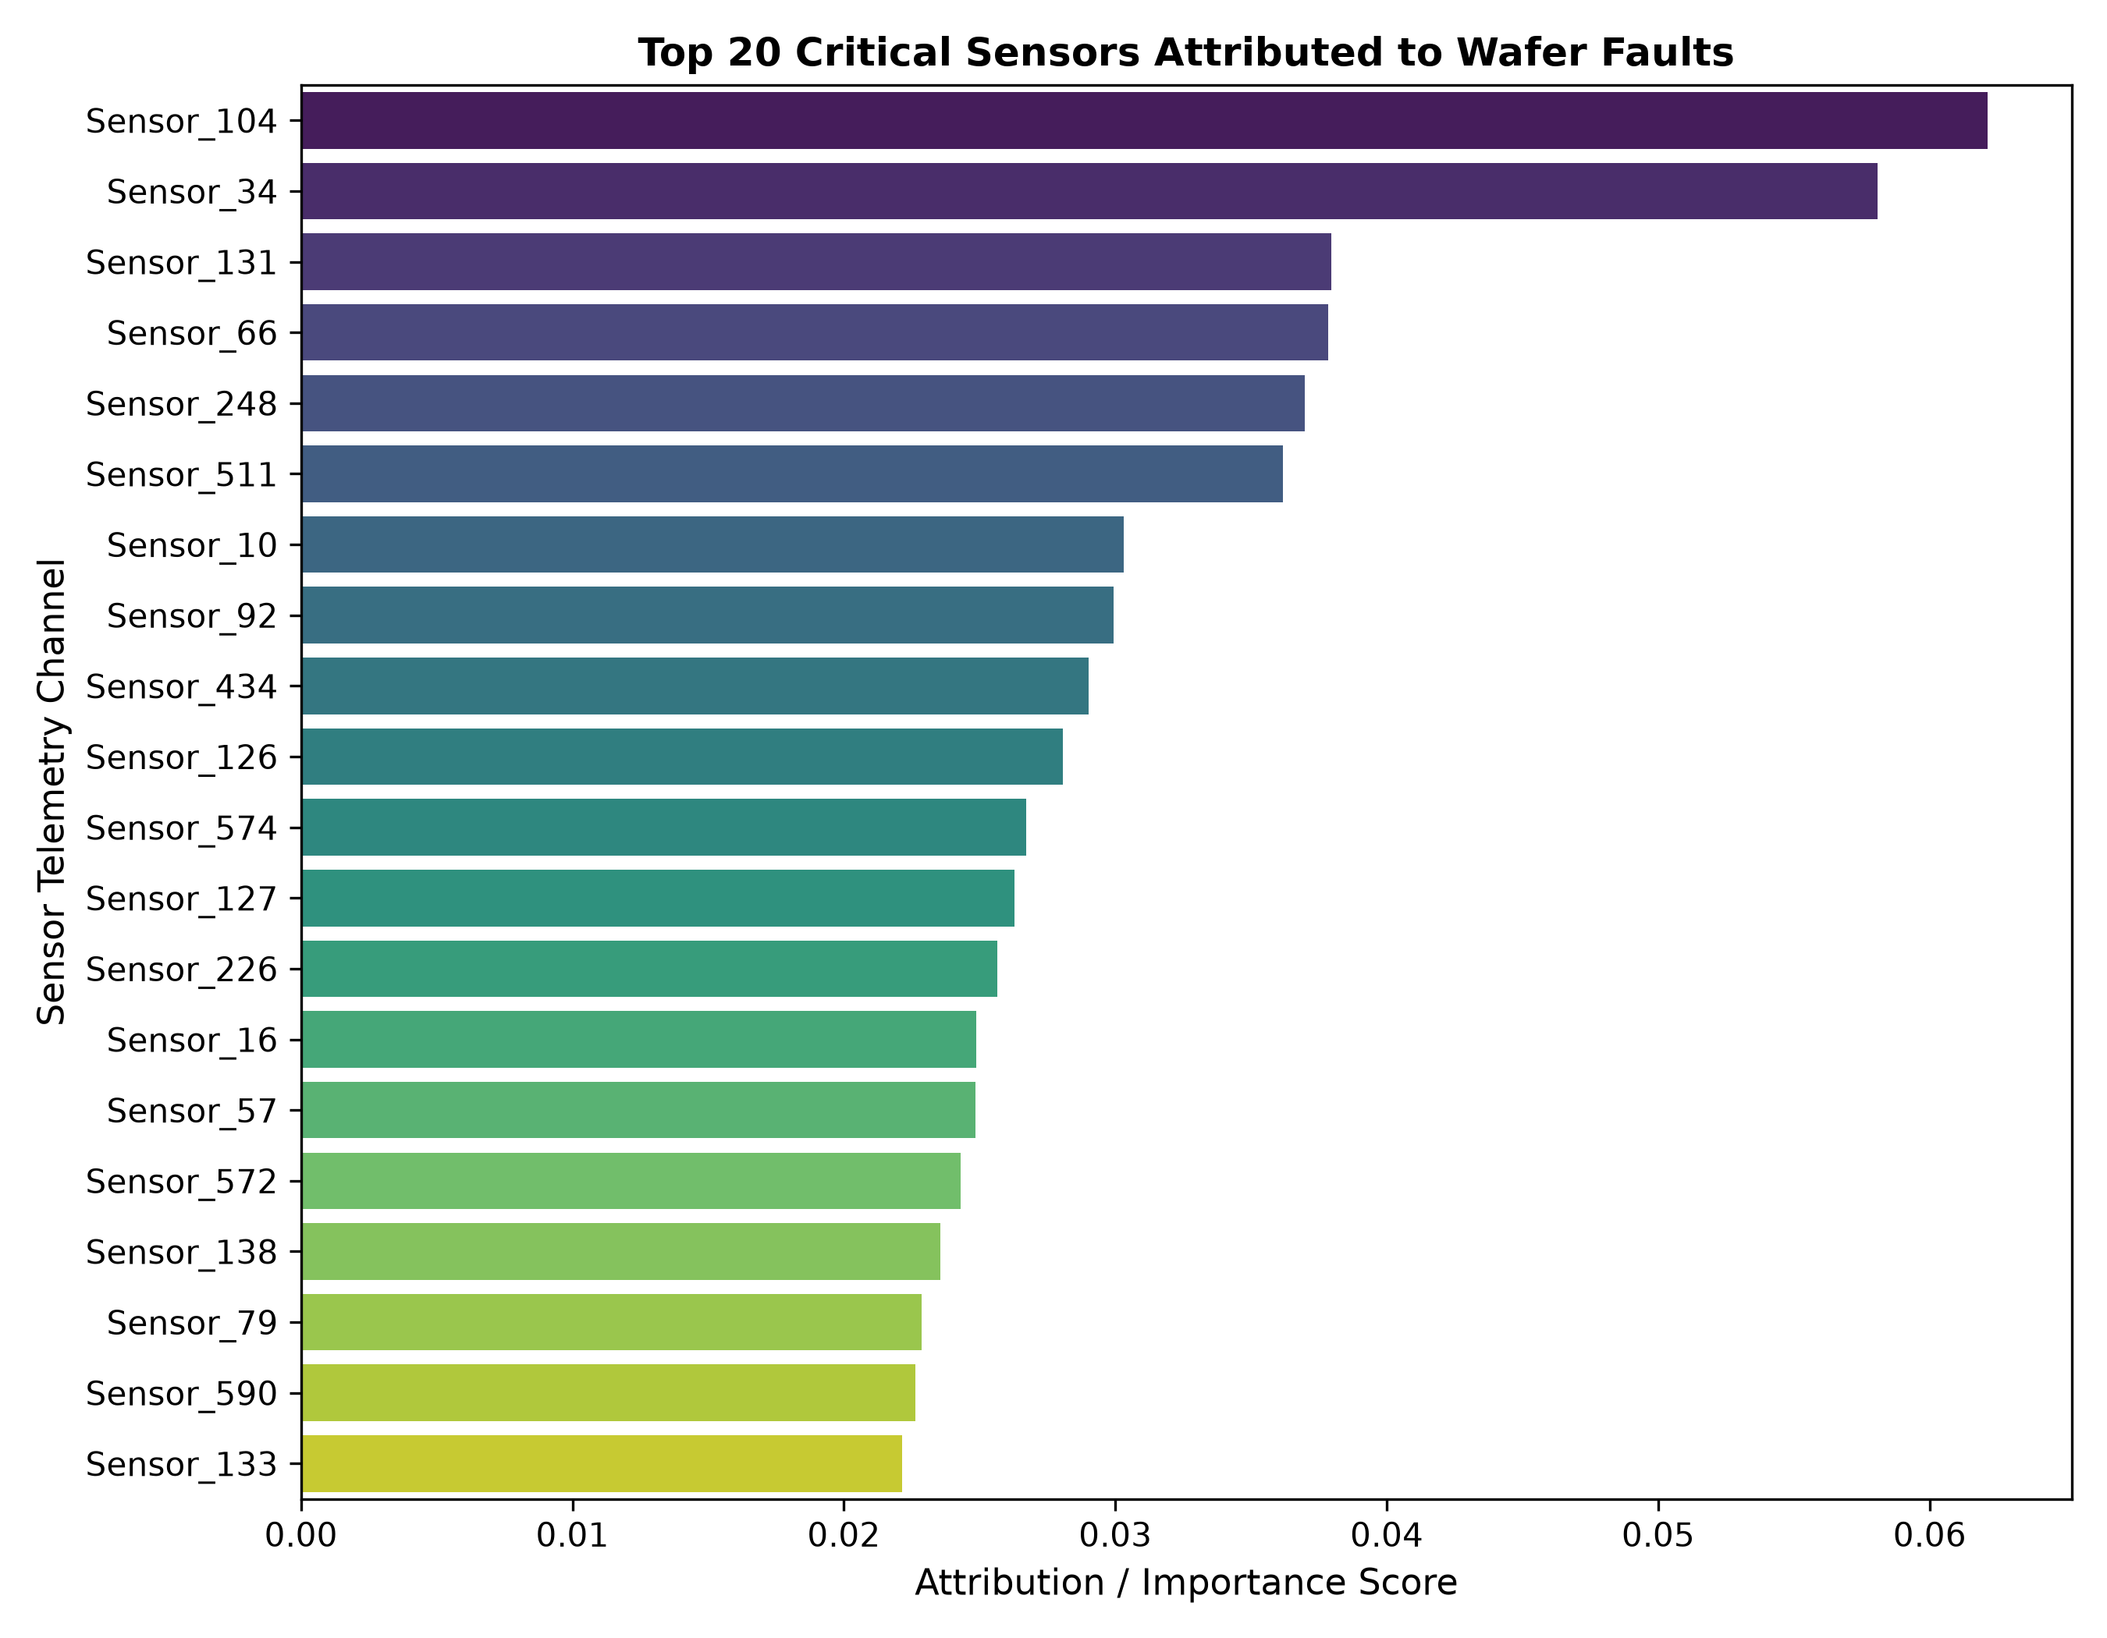
Top Sensor Channels Attributed to Defects
Notes:
Describe how feature importance is used to pinpoint the most influential sensor channels. Mention potential for targeted maintenance.

Slide 8
Conclusion & Future Work
• Deploy the Random Forest model in a real‑time fab monitoring dashboard (Streamlit).
• Extend attribution to temporal drift analysis.
• Investigate more advanced imbalance techniques (e.g., focal loss, SMOTE).
• Share insights with process engineers for yield improvement.
Notes:
Summarise the achievements and outline concrete next steps for the lab and industry partners.

