Slide 1
Identification and Classification of
Cross-outs in Handwritten Documents
D7047E — Advanced Deep Learning | Group 14
Suresh Balaraman · Nagarajan Ganesan · Chirag Gurumurthy Shameena Mohammed Nabeel · Lakshmi Shankar Paramasivan
Luleå University of Technology | May 2026

Slide 2
Problem & Objectives
Why cross-out detection matters
Cross-outs in handwritten documents obscure content and degrade automated recognition accuracy. This project develops a deep learning pipeline to detect and classify them.
1
Binary Classification — distinguish CLEAN vs CROSSED-OUT word images
2
Multi-class Classification — identify one of 7 cross-out styles (Single-Line, Double-Line, Diagonal, Cross, Wave, Zig-Zag, Scratch)
3
Generalisation Testing — evaluate on a custom hand-drawn dataset of 56 images
D7047E Advanced Deep Learning | Group 14 | LTU 2026 | L
Notes:
OVERVIEW
--------
We train neural networks to detect and classify cross-out marks on
handwritten word images. Two classification tasks:
Task 1 — Binary: Is the word crossed out or not? (2 classes)
Task 2 — Multi-class: Which cross-out style is it? (8 classes)
Task 3 — Custom-50: How well does the model work on real photos?

Slide 3
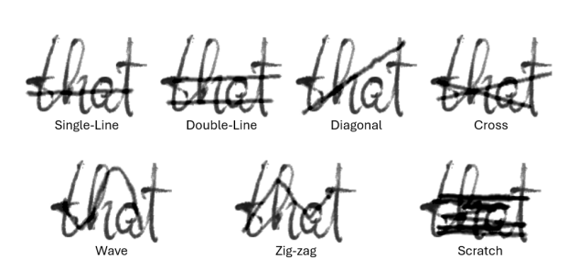
Dataset — IAM Handwriting Database
Synthetic cross-outs applied to real handwritten words
Data Splits - Given in the Dataset
Cross-out Styles
Split
Per Class
Total (8 classes)
Single-Line
Train ~63%
47,997
383,976
Double-Line
Val ~ 10%
7,559
60,472
Diagonal
Test ~27%
20,306
162,448
Cross
Wave
Zig-Zag
Scratch
⚡ Images ~68×136px (H×W) grayscale · Perfectly balanced splits · MIXED class used only for binary detection
D7047E Advanced Deep Learning | Group 14 | LTU 2026 | L
Notes:
DATASET (IAM Cross-out)
-----------------------
Source: IAM Handwriting Database with synthetic cross-outs added on top.
~48,000 word images per class, pre-split into train / val / test.
Image size: ~27x51 px, grayscale, black ink on white background.
8 categories:
CLEAN no cross-out (baseline)
SINGLE_LINE one horizontal line through the word
DOUBLE_LINE two parallel horizontal lines
DIAGONAL one diagonal line
CROSS two crossing lines forming an X
WAVE a wavy horizontal line
ZIG_ZAG zig-zag line
SCRATCH heavy scribbling covering the word
+ MIXED: randomly chosen style per image — used only in binary Task 1
(it is crossed-out, but not a classifiable style for Task 2)
The dataset is PAIRED: the exact same word image appears in every category
folder. e.g., "a01-000u-00-00.png" in CLEAN/ and in SINGLE_LINE/ is the
same word, with the cross-out drawn on top. This means every style was
applied to the same set of words — a controlled experiment.

Slide 4
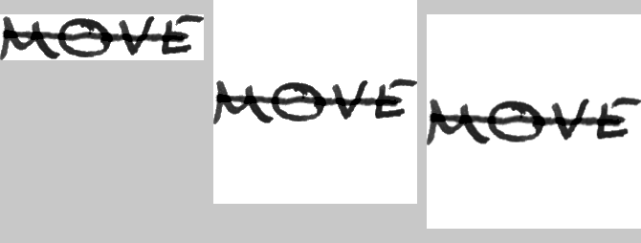
Pre-processing & Augmentation
Preserving cross-out geometry
Pre-processing (all splits)
Training Augmentation
①
Grayscale → 3-channel (RGB) for ImageNet compatibility
↻
RandomRotation ±5° — tilted paper/camera
②
PadToSquare — symmetric white padding, preserves aspect ratio
⇄
RandomAffine — 5% translation shift (simulate that the word not at the center)
③
Resize to 224×224
⬡
RandomPerspective (p=0.5) — angled capture
④
Normalize with ImageNet μ/σ
~
GaussianBlur σ∈[0.1,1.0] — camera blur , scan variations
◐
ColorJitter ±0.3 — lighting variation
IAM dataset are clean scans, these are done so that it generalizes well for custom data set
D7047E Advanced Deep Learning | Group 14 | LTU 2026 |L/C
Notes:
Every image goes through the same pipeline before the model sees it:
Step 1 — Grayscale to 3-channel
The images are grayscale (1 channel). Pretrained models (ResNet, etc.)
expect 3 channels (RGB). We duplicate the grayscale channel 3 times.
No colour information is added — it is still effectively grayscale.
Step 2 — PadToSquare (fill=255 white)
Word images are wide and short (~382x73 px). If we resize directly to
224x224 the word gets stretched and distorted, which would also distort
the cross-out geometry (a diagonal would no longer look diagonal).
Instead we pad the shorter side symmetrically with white pixels to make
it square first, then resize.
Step 3 — Resize to 224x224
Required input size for ResNet-50, EfficientNet-B0 and ViT-B/16.
Step 4 — ToTensor
Converts PIL image (0-255 integers) to a PyTorch float tensor (0.0-1.0).
Step 5 — Normalize with ImageNet statistics
Mean: [0.485, 0.456, 0.406]
Std: [0.229, 0.224, 0.225]
Pretrained models were trained with this normalization. Using the same
normalization keeps the input distribution consistent with what the
pretrained weights expect.
Training only (augmentation to improve generalization):
RandomRotation(±5°) — simulates slightly tilted paper or camera angle
RandomAffine(translate=5%) — slight position shift for positional robustness
Note: RandomHorizontalFlip is NOT used — flipping changes the visual meaning
of cross-out styles (e.g. a diagonal would mirror direction).
Val / test / custom-50: no augmentation — deterministic transforms only.

Slide 5
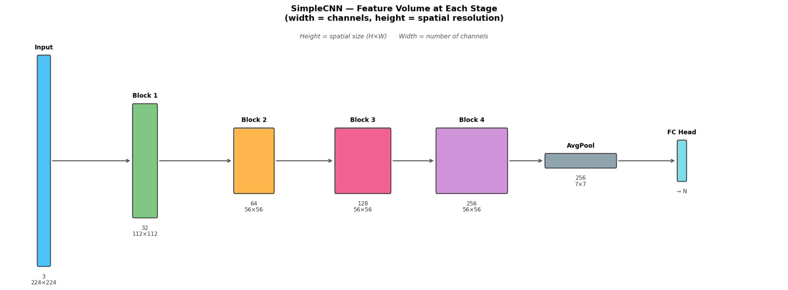
Task 1 — Binary Classification
CLEAN (0) vs CROSSED-OUT (1)
Architecture — SimpleCNN (selected model)
Block 1 (224→112): Conv(3→32)×2 + BatchNorm + ReLU + MaxPool
Block 2 (112→56): Conv(32→64)×2 + BatchNorm + ReLU + MaxPool
Block 3 (56×56): Conv(64→128) + Conv(128→128) + BatchNorm + ReLU [no pool]
Block 4 (56×56): Conv(128→256) + BatchNorm + ReLU + AdaptiveAvgPool(7×7)
Head: Flatten(12,544) → Linear(512) → Dropout(0.4) → Linear(128) → Dropout(0.3) → Linear(2)
Why SimpleCNN? ResNet-50 and ViT-B/16 also trialled — after 5–10 epochs SimpleCNN matched their validation accuracy while training significantly faster.
Results for CNN (selected)
0.9808
0.9908
0.9320
0.0587
Val Accuracy
IAM Test F1
Custom Dataset F1
Gen. Gap
D7047E Advanced Deep Learning | Group 14 | LTU 2026 |N/S
Notes:
cks 3–4 deliberately skip pooling to preserve spatial detail needed to distinguish fine-grained patterns like Wave vs Zig-Zag. BatchNorm after every conv stabilises training.
**Trainable parameters:** 7.07M
**What each component does:**
- **Conv2d** — a filter (small grid of learned numbers) slides across the image and computes a dot product at each position, detecting local patterns: edges, lines, curves. With 32 filters in layer 1, it learns 32 different pattern detectors simultaneously.
- **BatchNorm** — normalises activations after each layer, making training more stable and acting as regularisation.
- **ReLU** — sets all negative values to 0; introduces non-linearity (without it, stacking layers would be equivalent to a single linear transformation).
- **MaxPool** — takes the maximum value in each 2×2 region, halving the spatial size; makes features slightly position-invariant and reduces computation.
- **AdaptiveAvgPool** — resizes the feature map to a fixed output size regardless of input dimensions.
- **Dropout** — during training, randomly zeros a fraction of activations; forces the network not to rely on any single neuron (reduces overfitting).
Pre-trained on ImageNet. `layer4` (the final residual block) and the classification head are unfrozen:
```
Frozen: conv1 → layer1 → layer2 → layer3 [~17M params, fixed]
Unfrozen: layer4 [~8.4M params, fine-tuned]
New head: Linear(2048→512) → ReLU → Dropout(0.3) → Linear(512→8)
Pre-trained on ImageNet. `layer4` (the final residual block) and the classification head are unfrozen:
```
Frozen: conv1 → layer1 → layer2 → layer3 [~17M params, fixed]
Unfrozen: layer4 [~8.4M params, fine-tuned]
New head: Linear(2048→512) → ReLU → Dropout(0.3) → Linear(512→8)
```
**Residual connections** (what makes ResNet special):
```
Standard CNN: x → Conv → Conv → output
ResNet: x → Conv → Conv → output + x (skip connection)
```
The `+ x` (adding the input directly to the output) solves the vanishing gradient problem in very deep networks. Gradients can flow back through the skip connection without passing through all conv layers, enabling training of 50+ layer networks.
Unfreezing `layer4` lets the model adapt high-level features (shapes, stroke patterns) specific to cross-outs, while the frozen lower layers retain universal edge/texture detectors.
— Suresh– We have trialled the CNN, Resnet and VitB-16, and we can see from the training curves that CNN has slight edge and we have the test/trainign results for IAM and Custom data set

Slide 6
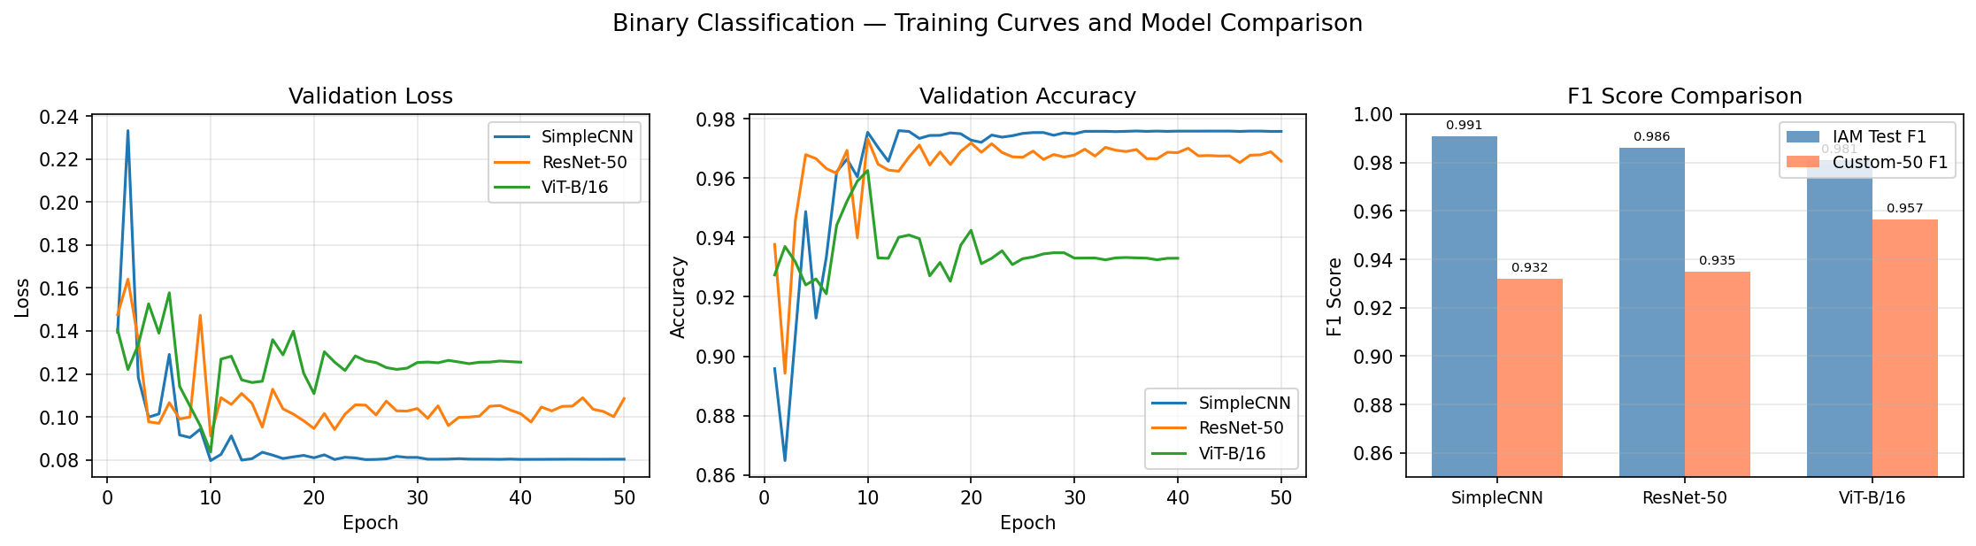
Task 1 — Training Dynamics
SimpleCNN converges within ~5 epochs
D7047E Advanced Deep Learning | Group 14 | LTU 2026 |S
Notes:
As, we see we tried CNN, Resnet and ViT, but after few epochs we could clearly see CNN in performing well and we wanted to pick it as we can to use the same model for the CNN multiclass, we can see teh F1-scores and VIT slightly performed better on the Custom dataset but not significantly, so we sticked to CNN.

Slide 7
Task 2 — Multi-class Classification
8 classes: CLEAN + 7 cross-out styles
SimpleCNN (candidate)
ResNet-50 (candidate)
Block 1 (224→112): Conv(3→32)×2 + BN + MaxPool
ImageNet pretrained | layer4 + fc head unfrozen
Block 2 (112→56): Conv(32→64)×2 + BN + MaxPool
Head: Linear(2048→512)→ReLU→Dropout(0.3)→Linear(512→8) LR = 4×10⁻⁴ | Batch = 256
Block 3 (56×56): Conv(64→128) + Conv(128→128) + BN
Block 4 (56×56): Conv(128→256) + BN + AdaptiveAvgPool(7×7)
IAM Test Results
Head: Linear(12544→512)→Drop(0.4)→Linear(128)→Drop(0.3)→Linear(8)
0.9025
0.9098
Test Accuracy
Macro-F1
0.8957
0.9042
0.9130
0.8947
Val Acc
Val Acc
Test Acc
Macro-F1
✓ Final model: SimpleCNN (F1=0.9130 vs ResNet-50 F1=0.9098)
D7047E Advanced Deep Learning | Group 14 | LTU 2026 | M
Notes:
Same as in SimpleCNN binary class, except for the linear classification layer which is 8 corresponding to our cross-out variants

Slide 8
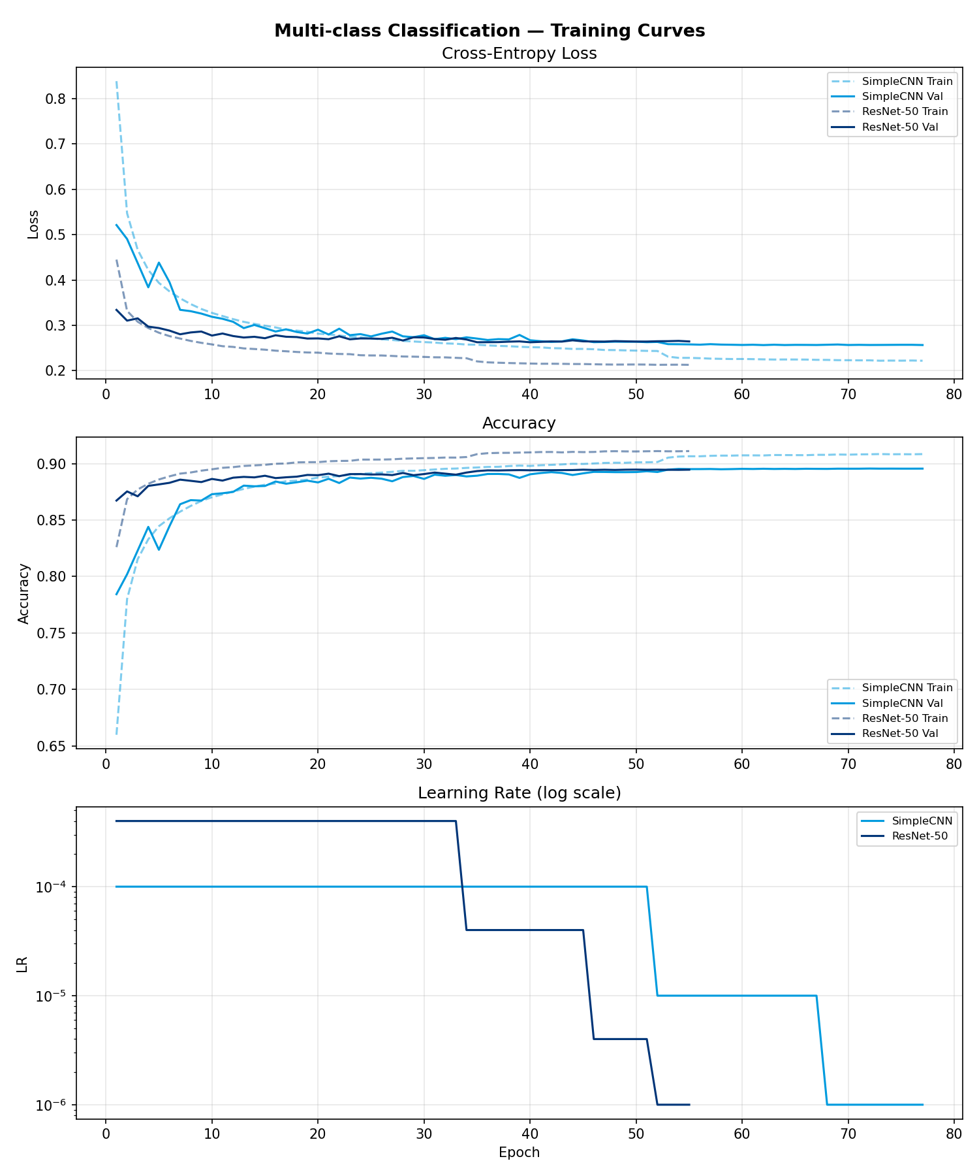
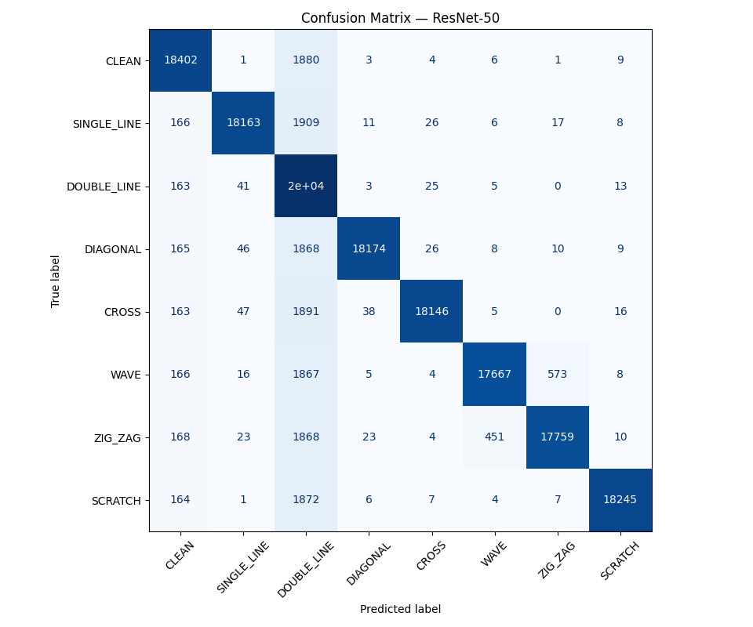
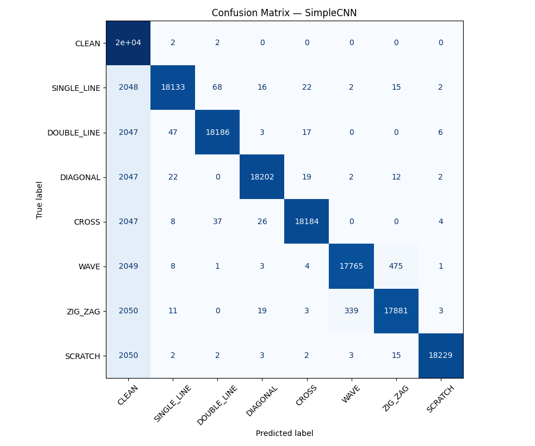
Task 2 — Confusion Matrices — ResNet-50 vs SimpleCNN (IAM Test)
ZIG_ZAG over-prediction is the dominant error
Key Observations
⚠
~9–10% of every class misclassified as ZIG_ZAG
〜
WAVE most confused (12.9% → ZIG_ZAG)
✓
ZIG_ZAG itself: 97.1% per-class accuracy
✓
SCRATCH: 89.8% per-class accuracy
D7047E Advanced Deep Learning | Group 14 | LTU 2026 | M
Notes:
Both CNN and ResNet val/accuracy training dynamics are similar, though resnet trained faster, but both were close in accuracy and didn’t improve past 90% margin. As we can see from Confusion Matrix Resnet confuses and defaults to Double line whereas CNN goes to Clean, this double line prediction for Resnet could be fact of its bias for double line features from the imagenet training weights. we prefer CNN though it has a slight edge, but we can improve the model possibly by trying out different dropout rate etc but we concluded at this point that due to the training length and for achieving fairly well accuracy

Slide 9
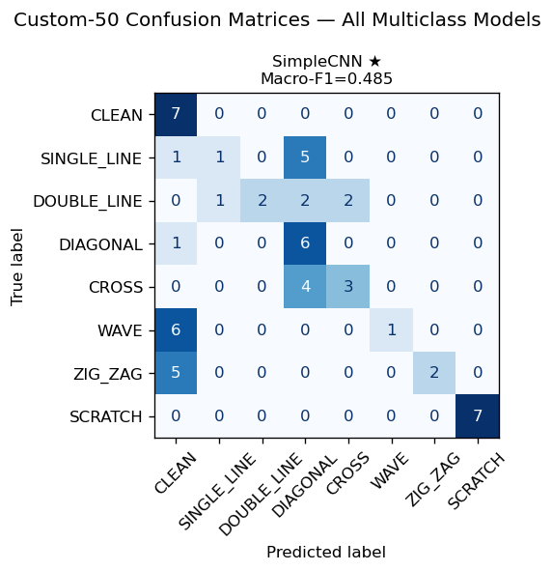
Custom Dataset Evaluation
Testing generalisation on real hand-drawn cross-outs
Dataset Construction
Binary — SimpleCNN Results
✍
56 hand-written word images (8 styles × 7 words)
IAM Test
Custom Dataset
F1 Score
0.9908
0.9320
📏
Word length: 4–7 letters (matches IAM distribution)
Gen. Gap
—
0.0587
🖊
Physical ink-on-paper cross-outs (all 8 classes represented)
Multi-class — Evaluation
SimpleCNN | Macro-F1 = 0.485 | Gen. Gap = 0.428
📷
Photographed — variable lighting, perspective & background noise
Failures: WAVE & ZIG_ZAG → CLEAN (faint strokes); SINGLE_LINE → DIAGONAL (natural angle). SCRATCH & CLEAN perfect (F1=1.0).
Domain Shift: IAM = clean digital scans · Custom Dataset = real photos with lighting variation, perspective & ink noise Binary gap of 0.059 is expected and acceptable. Augmentation (perspective, blur, jitter) partially mitigates this.
D7047E Advanced Deep Learning | Group 14 | LTU 2026 | C

Slide 10
Conclusions
✓ SimpleCNN — fast-converging binary detector (IAM F1 = 0.991, Custom Dataset F1 = 0.932)
✓ SimpleCNN — multi-class classifier (IAM F1 = 0.913, Custom Dataset F1 = 0.485, gap = 0.428)
⚠ ZIG_ZAG over-prediction: main error pattern — angular strokes visually ambiguous
⚠ Domain shift: binary gap = 0.059 (acceptable) · multiclass gap = 0.428 (significant)
→ Key finding: model learns synthetic geometry, not abstract crossout style — real-world generalisation requires augmented or real training data
Thank You
D7047E Advanced Deep Learning | Group 14 | Luleå University of Technology | May 2026 | N

