Slide 1

E₁
E₂

Slide 2
E₁
E₂
If output layer has linear activation function and hidden layer has tansigmoid , Write expression for E₂ and E₁
E₂ = (y_{d} - y), as f’(net)=1
E₁ = 0.5(1-v²)E₂ g

Slide 3
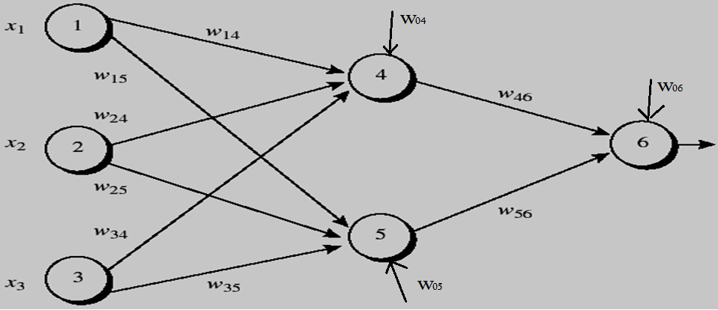
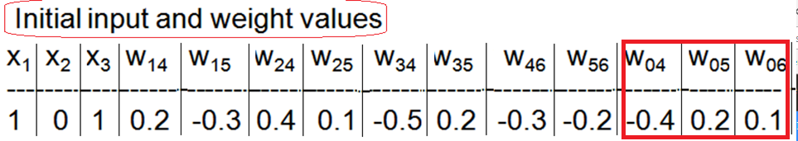
Note Bias inputs at node 4,5,6

Slide 4
learning rate η is 0.9 and the first training example is X=(1,0,1) whose class label is 1.
Logsigmoid is applied to hidden layer and output layer.
Phase1: Calculate outputs of node 4,5, 6

Slide 5
X = (1,0,1)
Calculate inputs( net₄ ,net₅ ) & outputs (O₄ , O₅ ) at nodes 4 &5
Calculate input ( net₆ ) and output at node 6 (O₆)

Slide 6
net₄ = w ₁₄ x₁ + w₂₄ x₂ + w₃₄ x₃ + w ₀₄ x 1
net₅ = w ₁₅ x₁ + w₂₅ x₂ + w₃₅ x₃ + w ₀₅ x 1
net ₆ = w ₄₆ O₄ + w₅₆ O₅ + w ₀₆ x 1

Slide 7
X = (1,0,1)
Node | Net input to node | Output of node
4 | net₄ =0.2+0-0.5-0.4=-0.7 | O₄ =1/(1+e^{0.7} )=0.332
5 | net₅ = -0.3+0+0.2+0.2=0.1 | O₅ =1/(1+e ^{-0.1})=0.525
6 | net₆ =(-0.3)(0.332) –(0.2)(0.525)+0.1=-0.105 | O₆ =1/(1+e ^{0.105})=0.474

Slide 8
Calculate error vectors at
output (E₂ = e₆ )and hidden layer (E₁ = e₄ , e₅ )

Slide 9
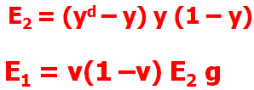
O₆ =0.474
O₅ =0.525
O₄ =0.332

Slide 10

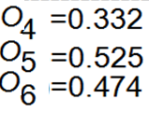
w₄₆ -0.3+(0.9)(0.1311)(0.332)= -0.261
w₅₆ -0.2+(0.9)(0.1311)(0.525)= -0.138
w₀₆ 0.1 + (0.9)(0.1311)(1) = 0.218

Slide 11
w₁₄ = 0.2 +(0.9)(-0.0087)(1) = 0.192
W₁₅= -0.3 +(0.9)(-0.0065)(1) = -0.306
W₂₄= 0.4+ (0.9)(-0.0087)(0) = 0.4
W₂₅= 0.1+ (0.9)(-0.0065)(0) = 0.1
w₃₄= -0.5+ (0.9)(-0.0087)(1) = -0.508
w₃₅= 0.2 + (0.9)(-0.0065)(1) = 0.194
w₀₅= 0.2 + (0.9)(-0.0065) (1) =0.194
w₀₄= -0.4 +(0.9)(-0.0087) (1)= -0.408

Slide 12
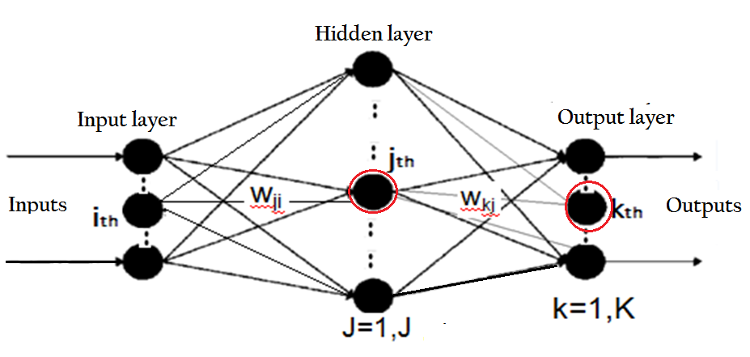
GENERAL BPA
3. Compute error for the pattern ‘p’ across all nodes at output layer .
Error component at k ^{th} output node for p^{th} pattern

Slide 13
4. Write expression for error component at
j^{th} hidden node for pattern p.

Slide 14
5. Update the connection-weight values to the output layer

Slide 15
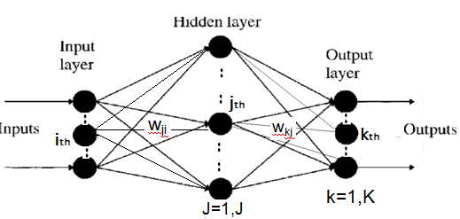
6. Update the connection-weight values from input to the hidden layer

Slide 16
Repeat steps 1 to 6 for all vector pairs in the training set; this is called an EPOCH.
Run as many epochs as required to reduce the network error E to fall below a Threshold ε:
Write Expression of SSE

Slide 17
Example : BPA
Two dimensional input data( Two features of fruits : Shape, Texture)
Output : Class 1(Banana) Class 2(Orange)
Pattern 1: 0.6, 0.1 target Class 1(Banana)
Pattern 2 : 0.2 , 0.3 target class 2 (Orange)

Slide 18
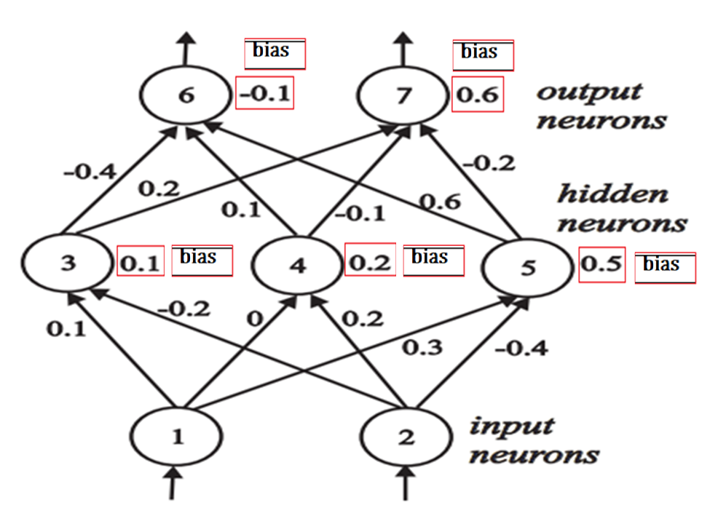

Slide 19
Banana( pattern1: I₁ = 0.6, I₂ =0.1) (d₆) = 1, (d₇ ) = 0
Orange( pattern2: I₁ = 0.2, I₂ =0.3) (d₆) = 0, (d₇ ) = 1
Do Forward Pass, Calculate inputs/outputs at node 3,4,5,6,7

Slide 20
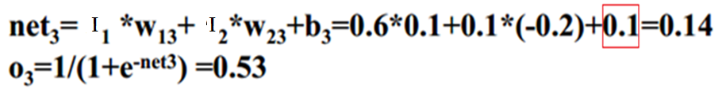
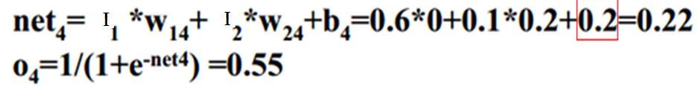
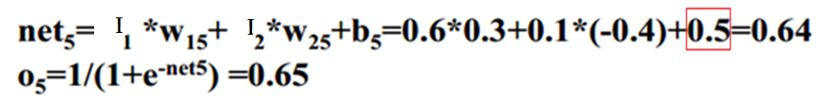
I₁ = 0.6, I₂ =0.1

Slide 21
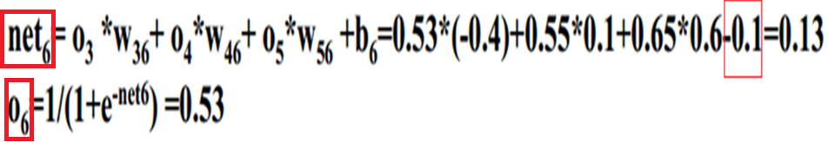
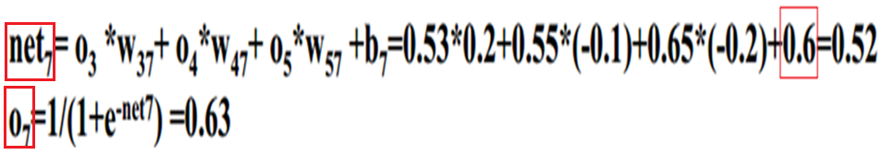
O₃ =0.53 O₄ =0.55 O₅ = 0.65

Slide 22
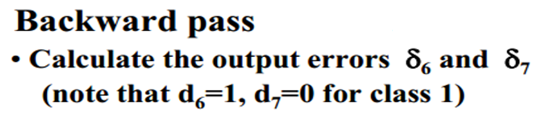
O₆ =0.53
O₇ =0.63

Slide 23
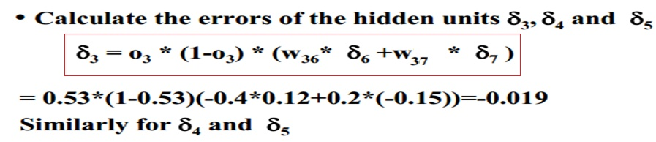
O₃ =0.53 O₄ =0.55 O₅ = 0.65

Slide 24
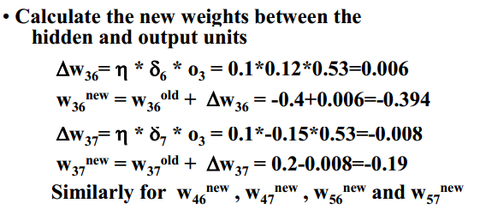
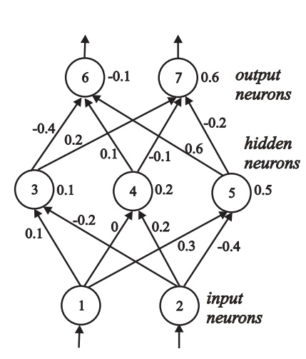
O₃ =0.53 O₄ =0.55 O₅ = 0.65

Slide 25
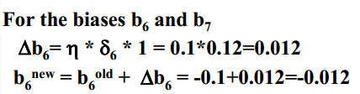

Slide 26
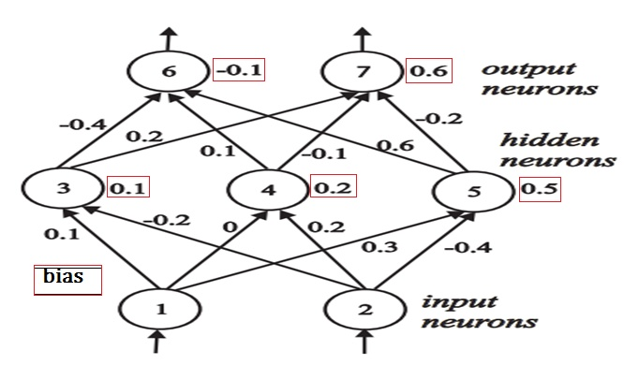
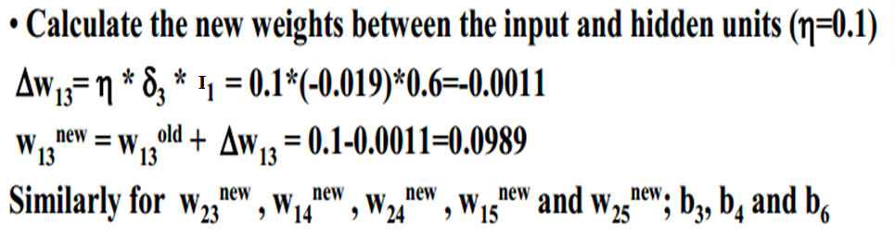
I₁ and I₂ are inputs:
0.6, 0.1

Slide 27
The order in which the training vectors are presented is important.
Randomizing is generally preferable
In Multilayers, it is accepted that more than two layers are rarely used

Slide 28
Two numbers X and Y are to be compared on the cross space [-2,2] x [-2,2]. Output of network is a 3 bit pattern corresponding to ( top node : X >Y, middle node : X<Y, bottom node : X = Y) taking value 0 if false and value 1 for true.
Use BPA algorithm for input pair ( X,Y) = ( -2, -1) for one epoch with neural architecture in which there is a single neuron in single hidden layer. Learning coefficient is 0.1, initial weights and biases at all hidden and output nodes are 0.5, activation function for all layers is logsigmoid.
(i) Draw the ANN network with weights, biases and inputs/outputs
(ii) Find Error vectors at output and hidden nodes and
(iii) Find new weights and biases.

Slide 29
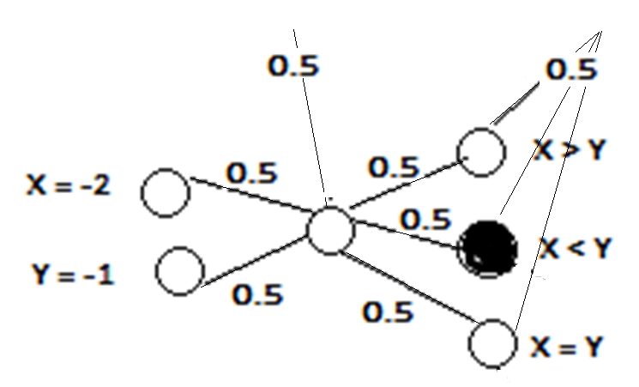
Desired outputs : starting from upper node [ 0 1 0 ]

Slide 30
Letter B
1 1 1 1 0
1 0 0 0 1
1 0 0 0 1
1 1 1 1 0
1 0 0 0 1
1 0 0 0 1
1 1 1 1 0
Pattern Recognition
For alphabets(A-Z) and numerals(0-9) are modeled using a 5x7 matrix
One hot shot output
INPUT NEURONS ??
7x5=35
Output Neurons??
PATTERNS : 36 (=26 alphabets + 10 numerals)
why not 6?
letterB =
[1 1 1 1 0 1 0 0 0 1 1 0 0 0 1 1 1 1 1 0 1 0 0 0 1 1 0 0 0 1 1 1 1 1 0 ]’

Slide 31
If the number of classes exceed 2, use one node for each class
Suppose 8 different classes. Though it is sufficient to use three output nodes to generate eight possible output vectors?
[ (0 0 0), (0 0 1), (0 1 0),(0 1 1), (1 0 0), (1 0 1), (1 10), (1 1 1)]
BUT, this requires training the network so that in some cases the outputs of multiple outermost layer nodes are simultaneously High.
Such a binary encoding scheme is feasible, but training such a network is more difficult than training the network with as many output nodes as the number of classes.

Slide 32
alphabet =
[letterA,letterB,letterC,letterD,letterE,letterF,….number5,number6,number7,number8,number9];
targets = eye(36);
% the eye function takes a number argument and returns an identity matrix of dimension equal to the number passed to it
% eg eye(4)
%ans =
% 1 0 0 0
% 0 1 0 0
% 0 0 1 0
% 0 0 0 1

Slide 33
March 15, 2019
To available data of Sales (in millions) vs years (2011 to 2015), linear regression equation is applied to find coefficients for best fit as a = 8.4, b =11.6.
sales = y= ax + b, x =year (0 to 4)
For year 2011, x = 2011 – 2011 = 0,
year 2012, x =1, Year 2013, x = 2, Year 2014,
x=3, Year 2015, x = 4
Neural network having one hidden layer with one node, is to be trained to predict the sales in present plus two next years, given the present year.

Slide 34
Activation function at hidden and output layers is logsig, ReLu respectively.
Learning rate is 0.1, momentum factor is 0.6.
All initial weights are 0.5 and there is bias only at hidden layer having value 0.5.
All datapresented to ANN is to be preprocessed to lie between 0-1.
Draw the network architecture
(b) Do one forward –backward pass for the year 2013.
©Calculate change in weights and biases after one iteration

Slide 35
year | Rep of year(x) | Normal year-input to NW | Sales=ax+b a=8.4 b=11.6 | Norm sales-output of NW
2011 | 0 | 0 | 11.6 | 0
2012 | 1 | 0.25 | 20.0 | 0.25
2013 | 2 | 0.5 | 28.4 | 0.5
2014 | 3 | 0.75 | 36.8 | 0.75
2015 | 4 | 1 | 45.2 | 1
Draw the architecture

Slide 36
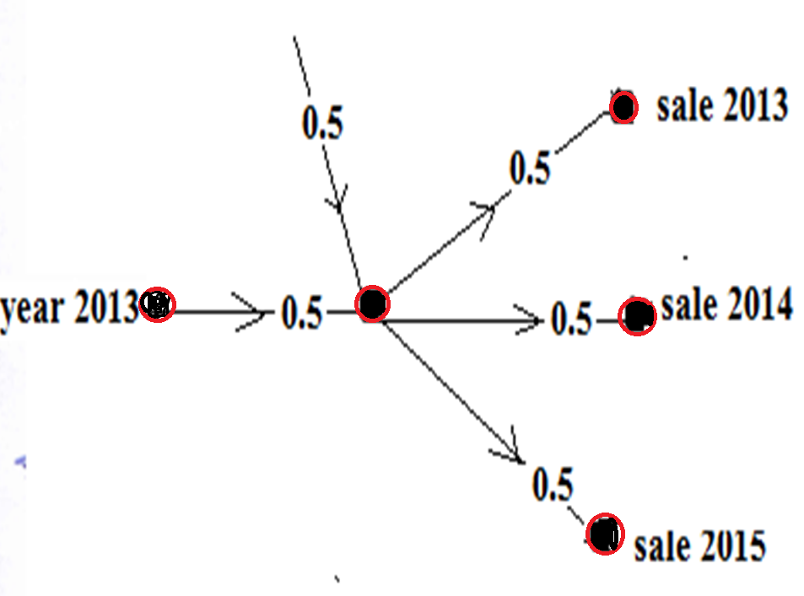

Slide 37
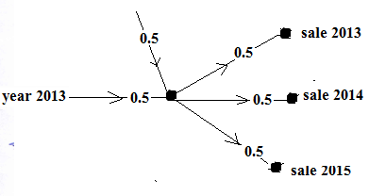
Feedforward
H_{in} = 0.5x0.5+0.5x1 = 0.75
H_{out} = 1/[(1+exp(-0.75)] = 0.679
O_{1-in} = O_{2-in} = O_{3-in} =0.5x0.679 = 0.3395
O_{1-out} = O_{2-out} = O_{3-out} = 0.3395
Error Vector at output
ReLu so f’(net)=1
0.5-0.3395=0.1605
0.75-0.3395= 0.4105
1.0-0.3395=0.6605
Error vector at Hidden Node
=0.697 (1-0.679)[0.5(0.1604+0.4105+0.6605)]=0.3141
Change in weights
ΔW_{H-O1} =(0.1)(0.1605)(0.679) =(0.01809)
ΔW_{H-O2} = (0.1)(0.4105)(0.679) =0.02787
ΔW_{H-O3} = (0.1) (0.6605) (0.679)=0.04484)
Δb =(0.1) (0.3141)(1) =0.03141
Δw_{year-H} =(0.1)(0.3141)(0.5)=0.0157

Slide 38
Compre- Dec 2017
Neural network is to be trained using BPA to identify the alphabet presented plus the next alphabet of word “THIS”.
Desired outputs: when T is presented, T at upper node and H at lower node; when H is presented, H at upper node and I at lower node; when I is presented, I at upper node and S at lower node, and when S is presented, S at upper node and zero(0) at lower node.
Input to network is binary representation of alphabets read row-wise from left to right in 3x3 matrix .Outputs of network are decimal equivalent of binary representations of alphabets inputted, divided by 2^{n}, where n =9.

Slide 39
Number of Inputs : 9
Number of Outputs : 2
Number of hidden nodes : 1
T = 111010 010 Decimal equivalent of T = 466, desired output = 466/512 =0.910
H = 101111101 Decimal equivalent of H = 381, desired output = 381/512 =0.744

Slide 40
MST Oct 2018
A single input feedforward neural network is to be trained to learn the unit step response of first order system in time domain described by equation [ 1- e^{-t/τ} ] for three different time constants (τ = 0.5s, 1s, and 2s ), from time t = 0 to 10 sec. There is one hidden layer having two nodes.
Draw the network architecture
How many input nodes?
How many output nodes?
Perform One forward and One backward pass for training the network at t=1 for response at three time constants (τ = 0.5s, 1s, and 2s ), and calculate change in weights.

Slide 41
[Learning rate is 0.2, weights between input and hidden layer is 0.4, between hidden and output layer is 0.2, no bias input. Activation function at the hidden layer is logsigmoid with slope of 2, and at the output layer is ReLu].
Truncate all values to 4 places after decimal.

Slide 42
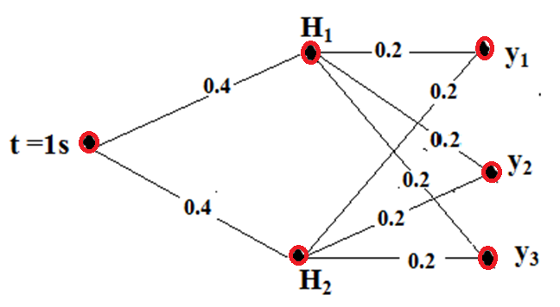
DRAW THE NETWORK ARCHITECTURE
CALCULATE DESIRED OUTPUTS

